Slide 2
What Jesus wants for me
Church of Christ at Medina
December 4th, 2022

Slide 3
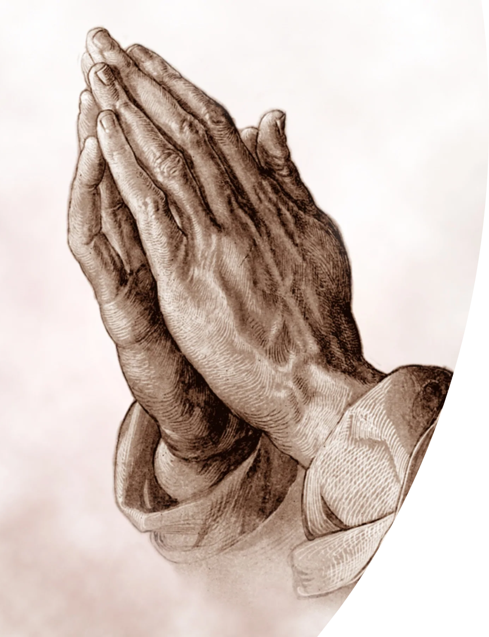
Jesus wants us to be kept.
Keep: protect, keep safe, watch over, guard
Jesus had been keeping the disciples through His perfect example and His teaching.
Jesus now asks the Father to keep His disciples. How does God accomplish this?
Providing protection from being overcome with temptation
Providing reminders (worship, Lord’s Supper, etc.)
Providing encouragement
Providing peace
Providing us His word
“I do not ask that you take them out of the world, but that you keep them from the evil one.”
John 17:15, ESV
References
1 Corinthians 10:13, 2 Thessalonians 3:3, Hebrews 10:24, Philippians 4:7, 1 Peter 1:5
What Jesus wants for me

Slide 4
Jesus wants us to have joy.
Jesus does not want our lives to be somber and depressed. He expresses His desire for us to have His joy.
Jesus found joy in this earthly life, but not because of circumstances. His joy was in doing the will of the Father.
We must learn to seek the will of the Father as the basis of our joy.
“…looking to Jesus, the founder and perfecter of our faith, who for the joy that was set before him endured the cross…”
Hebrews 12:2, ESV
References
John 17:13, Hebrews 5:8-9, Hebrews 12:1-2, Philippians 4:4, James 1:2-4
What Jesus wants for me

Slide 5
Jesus wants us to be sanctified.
Sanctification
Holy, set-apart, separation from evil
Dedication
How are we sanctified?
Through the precious blood of Jesus Christ.
¹³ For if the blood of goats and bulls, and the sprinkling of defiled persons with the ashes of a heifer, sanctify for the purification of the flesh, ¹⁴ how much more will the blood of Christ, who through the eternal Spirit offered himself without blemish to God, purify our conscience from dead works to serve the living God. (Hebrews 9:13-14)
We contact this blood through obedience to the truth of God!
“Sanctify them in the truth, your word is truth.”
John 17:17, ESV
References
Hebrews 9:11-28, John 17:19, Ephesians 1:7, 1 Peter 1:14-19, John 17:17
What Jesus wants for me

Slide 6
Jesus wants us to be one.
Unity among His disciples was (and is) very important to Jesus.
The basis and perfect example for oneness or unity is the relationship between the Father and the Son.
Jesus gave His glory to the disciples “that they may be one.” What is this glory?
It is different from the glory that Jesus had prior to His earthly life.
It is a glory that is based on fulfilling the will of the Father.
We share in this glory when we obey the truth that Jesus revealed.
“The glory that you have given me I have given to them, that they may be one even as we are one.”
John 17:22, ESV
References
Hebrews 2:9-10, John 1:14, 1 John 1:3, 2 Peter 1:4
What Jesus wants for me

Slide 7
Jesus wants us to be with Him!
As Jesus brings His prayer – list of things He wants for His followers – to a close, He verbalizes His desire for His followers to be with Him. How encouraging should this be to all of us?
When we obey His word, we enjoy a spiritual relationship with Him.
I believe this request of Jesus looks forward to the time when we will “see Him as He is.”
²⁴ Father, I desire that they also, whom you have given me, may be with me where I am, to see my glory that you have given me because you loved me before the foundation of the world.
John 17:24, ESV
References
Ephesians 2:4-7, 1 Peter 1:3-5
What Jesus wants for me

