Slide 2
Some Important Questions Jesus Asked
Church of Christ at Medina
November 13th, 2022

Slide 3
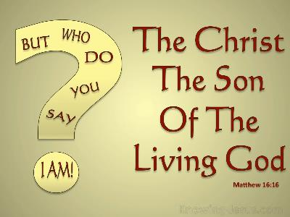
But who do you say that I am?
Jesus questioned the disciples regarding the reass a question that n why they still followed Him – Who do you say that I am?
This is a question that we must answer today…
Is He the Christ?
Is He the Son of God?
¹⁵ He said to them, “But who do you say that I am?”
Matthew 16:16, NASB
References
Matthew 16:13-20, Matthew 27:22, John 17:4, John 19:30, John 1:29, John 1:14, John 20:30-31

Slide 4
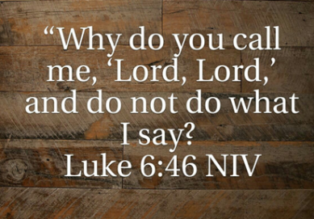
Why do you call me ‘Lord, Lord’?
Having discussed the fact that good fruit is produced only by good trees, Jesus presents the crowd with a pointed question – “Why do you call me ‘Lord, Lord’ and not do what I tell you?”
We cannot claim to be followers of Jesus and fail to actually obey Him.
“But be doers of the word, and not hearers only, deceiving yourselves.”
James 1:22
References
Luke 6:43-46, Genesis 1:11, James 1:22, Romans 2:13, Matthew 21:28-32,

Slide 5
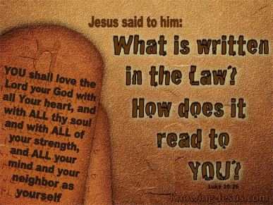
What is written in the Law?
Jesus responded to the lawyer’s question with a common teaching method – with a question of His own. “What is written in the Law? How do you read it?”
Jesus often asked the people of His time what the Law of Moses taught regarding matters. Why would He do this? It emphasized the need to know what God had already revealed to them.
What about us? Would Jesus ask us…What is written in My law? How does it read?
“Have you not read…”
Matthew 19:1-9
References
Luke 10:25-28, Matthew 17:1-5, Mark 2:23-28, Matt. 19:1-9, Mark 12:18-27, James 1:25, 2 Peter 1:3, Eph. 3:1-11, 2 Tim. 2:15, 1 Peter 2:1-2, 2 Pet. 3:18

Slide 6
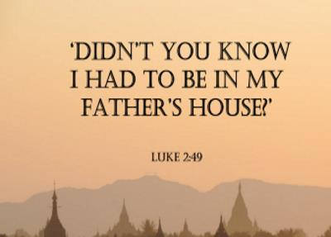
Didn’t you know I had to be in My Father’s house?
At a young age of 12, Jesus stayed in the city of Jerusalem and was found among the teachers in the temple. When found by His earthly parents who were very anxious about His absence, Jesus responded…”Why were you looking for me? Did you not know that I must be in My Father’s house?”
Does this describe our way of life? Are we found constantly in our “Father’s house” because of our need and desire to worship Him?
“God is spirit, and those who worship Him must worship in spirit and truth.”
John 4:24
References
Luke 2:41-52, John 4:24, Acts 20:7, 1 Cor. 16:1-2, Eph. 5:19, James 5:16, Heb. 10:24

