Slide 1
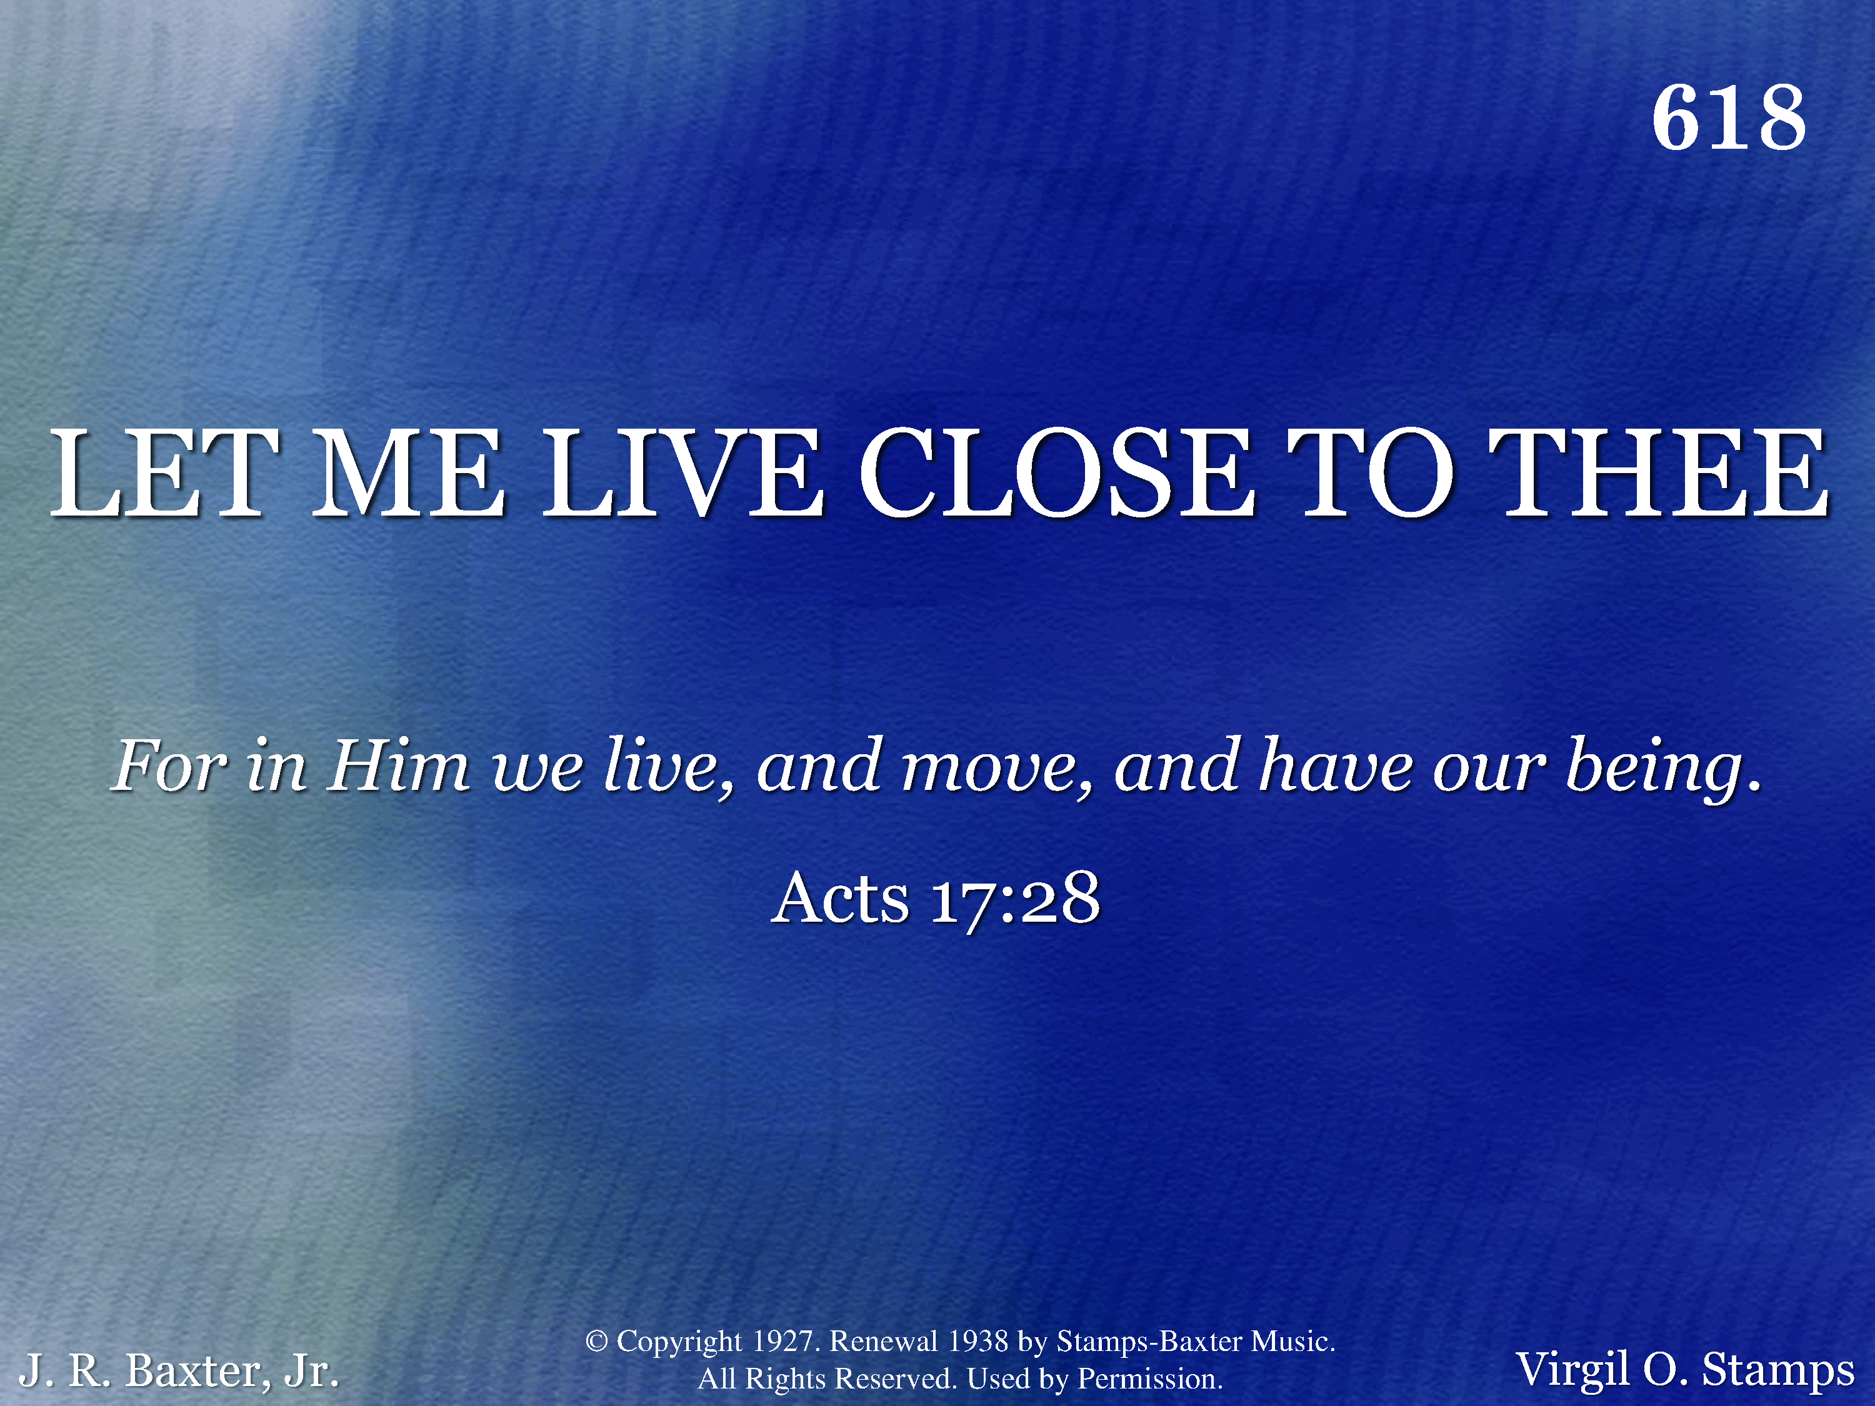
618 - Let Me Live Close To Thee - Title

Slide 2
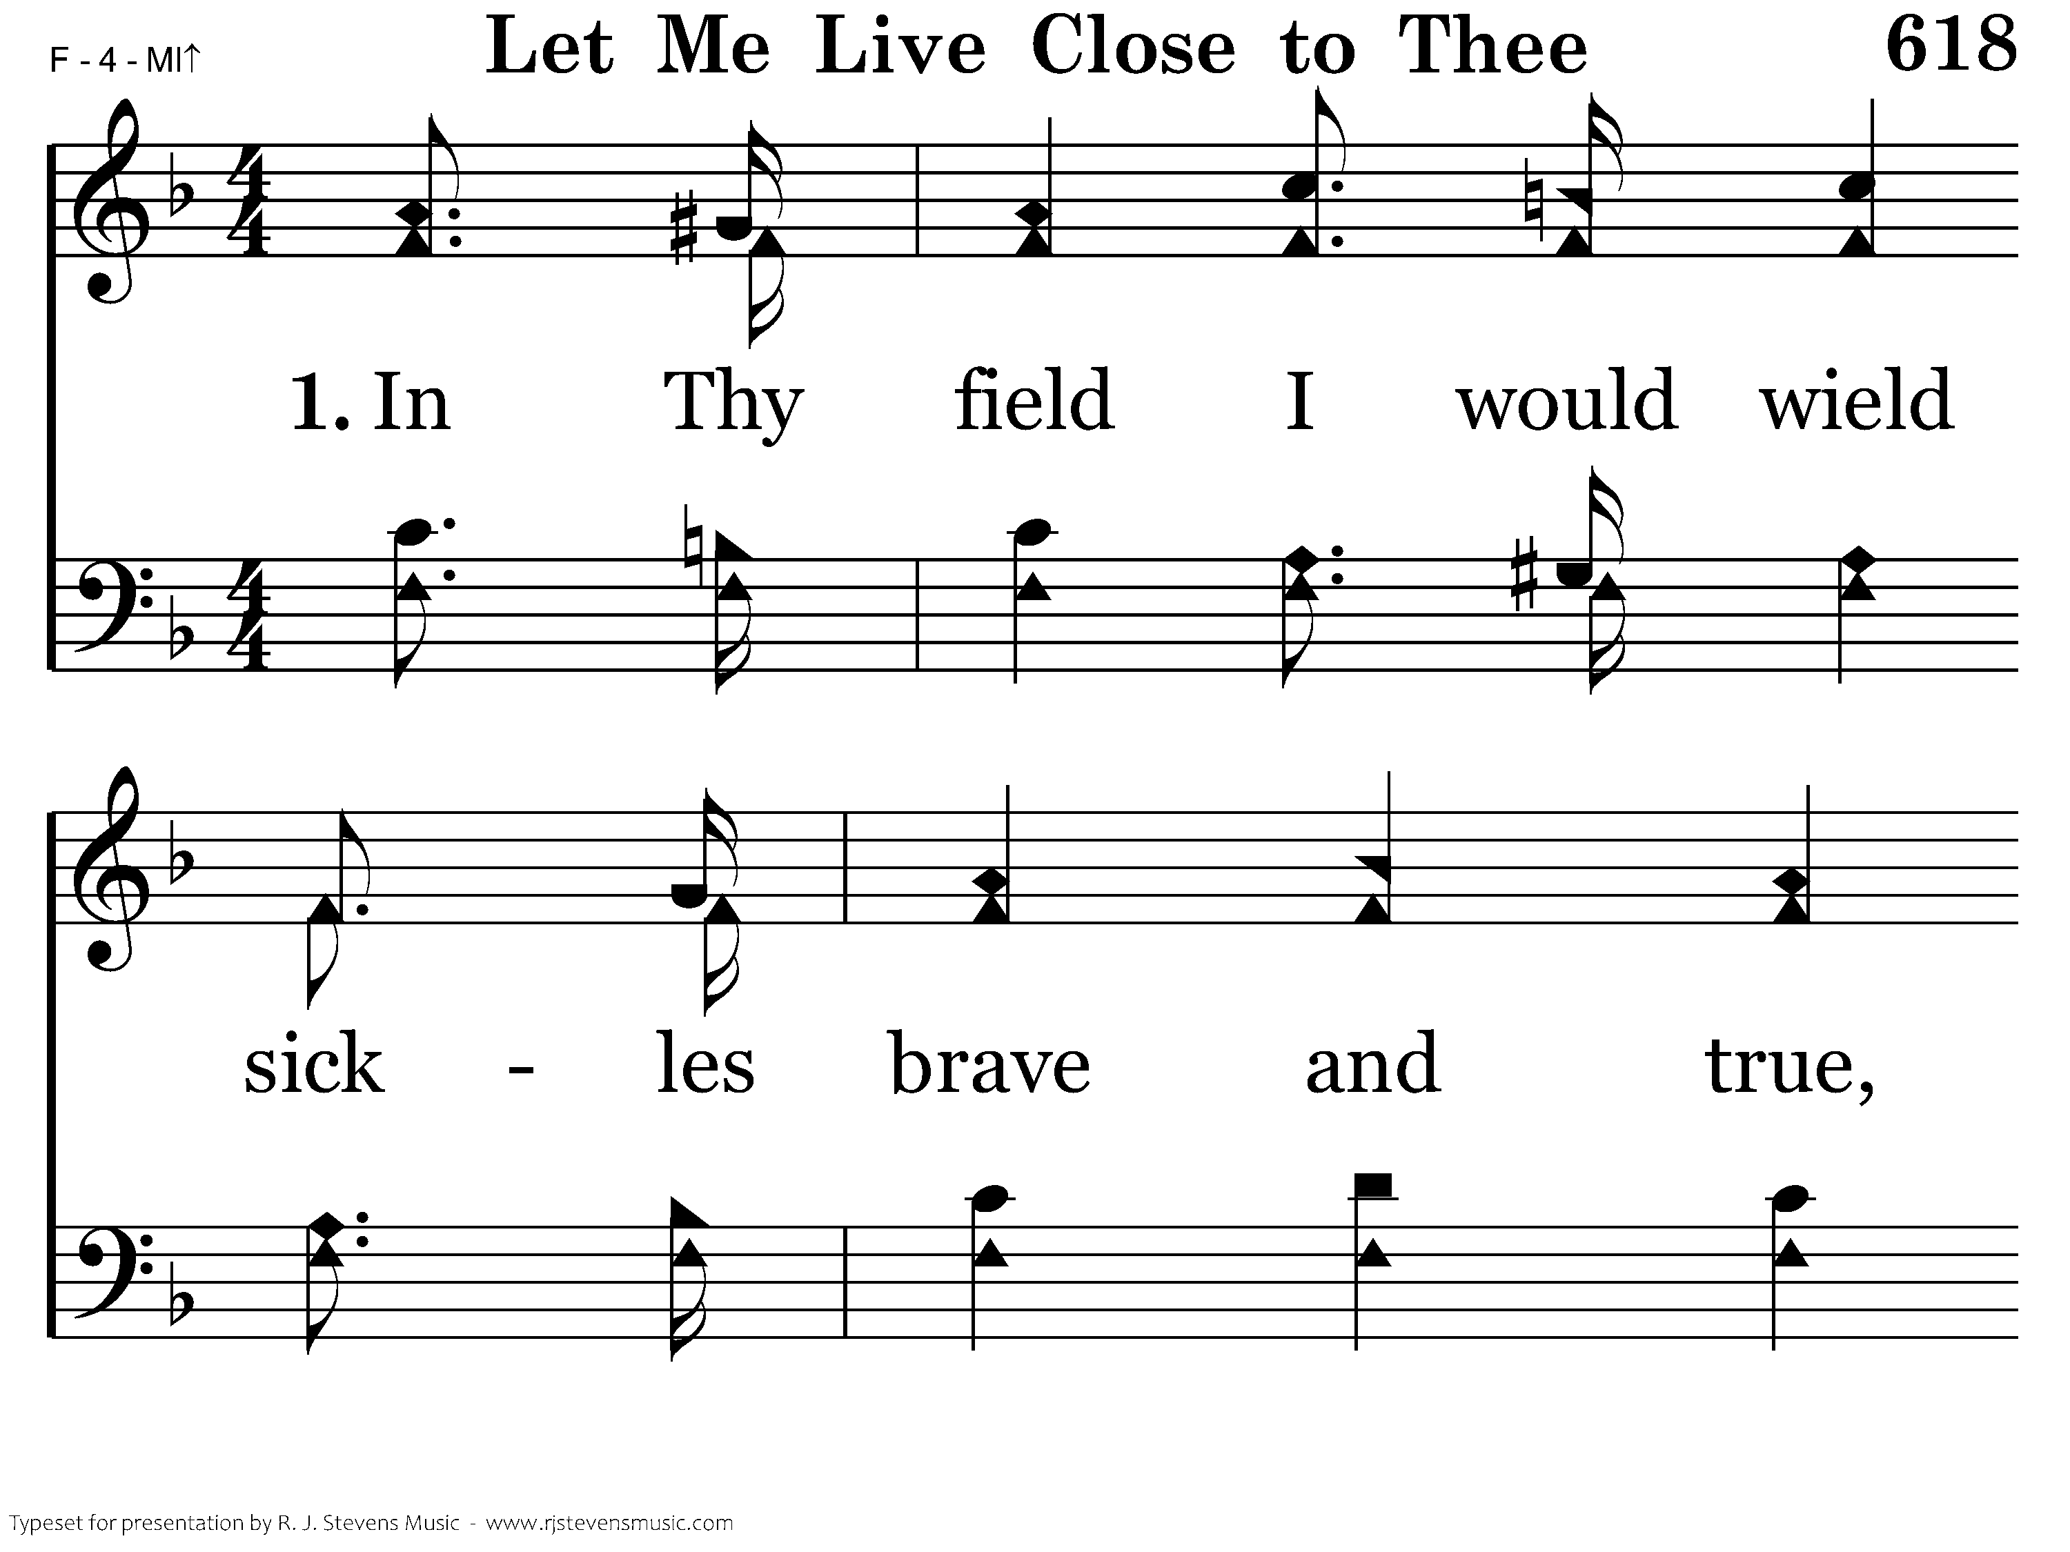
618 - Let Me Live Close To Thee - 1.1

Slide 3
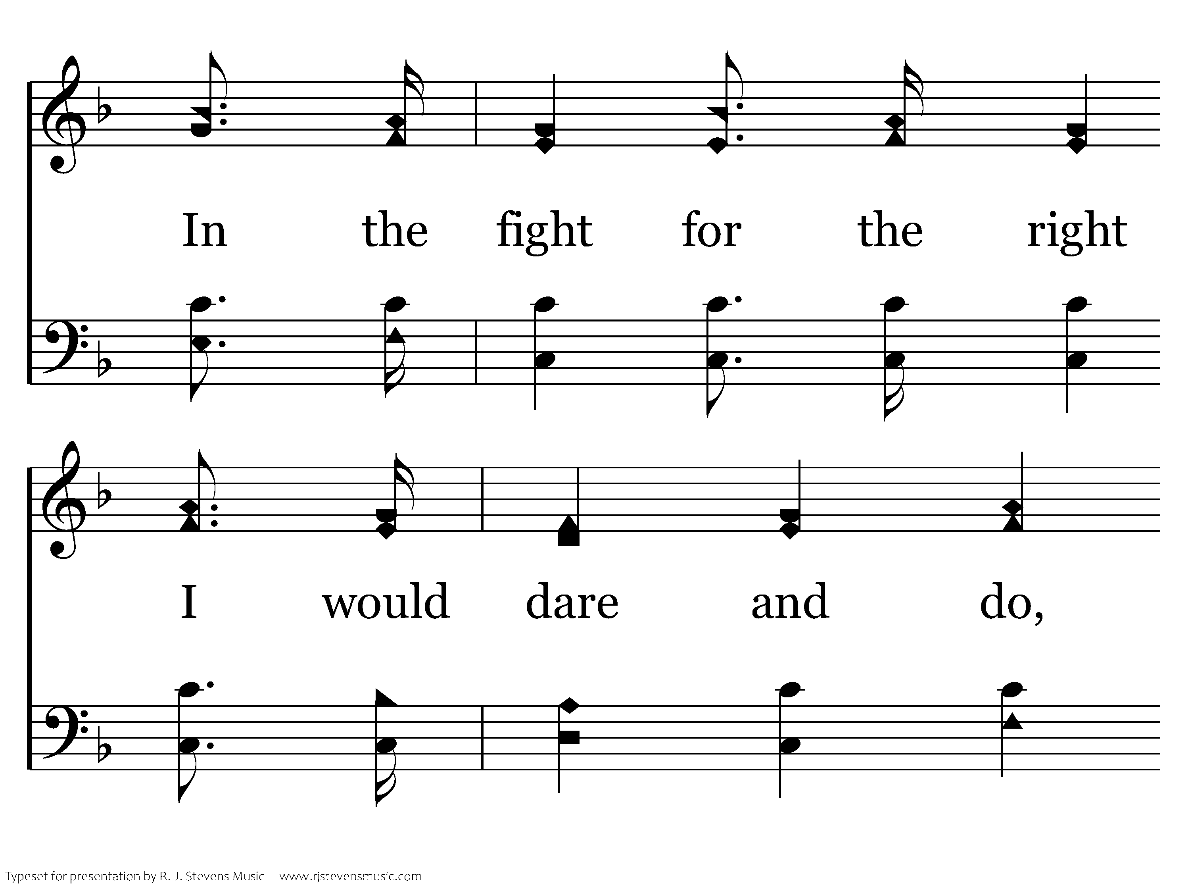
618 - Let Me Live Close To Thee - 1.2

Slide 4
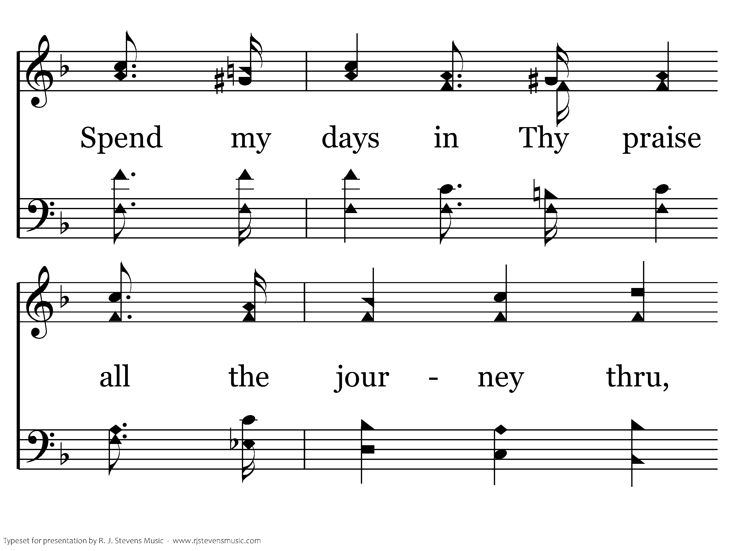
618 - Let Me Live Close To Thee - 1.3

Slide 5
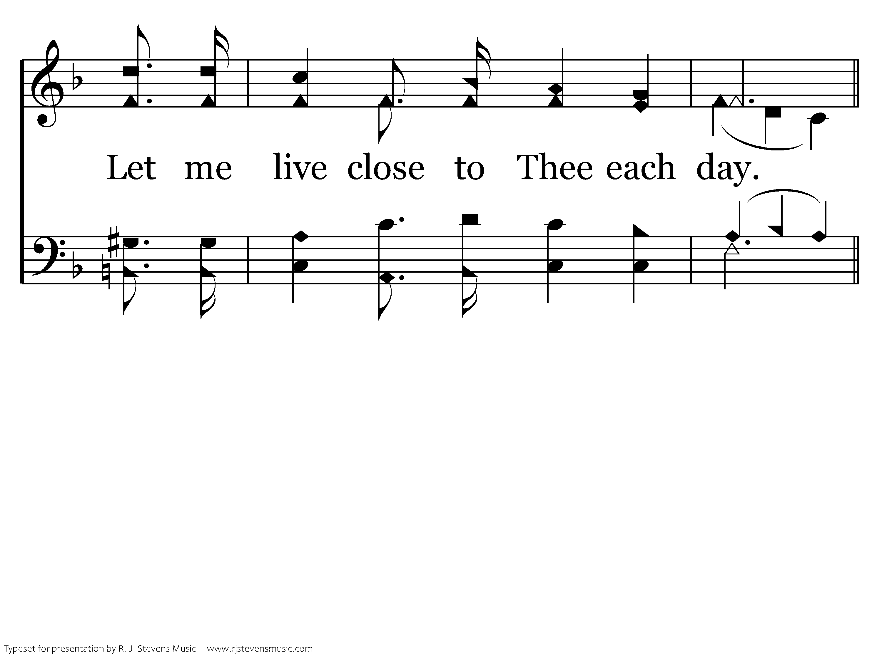
618 - Let Me Live Close To Thee - 1.4

Slide 6
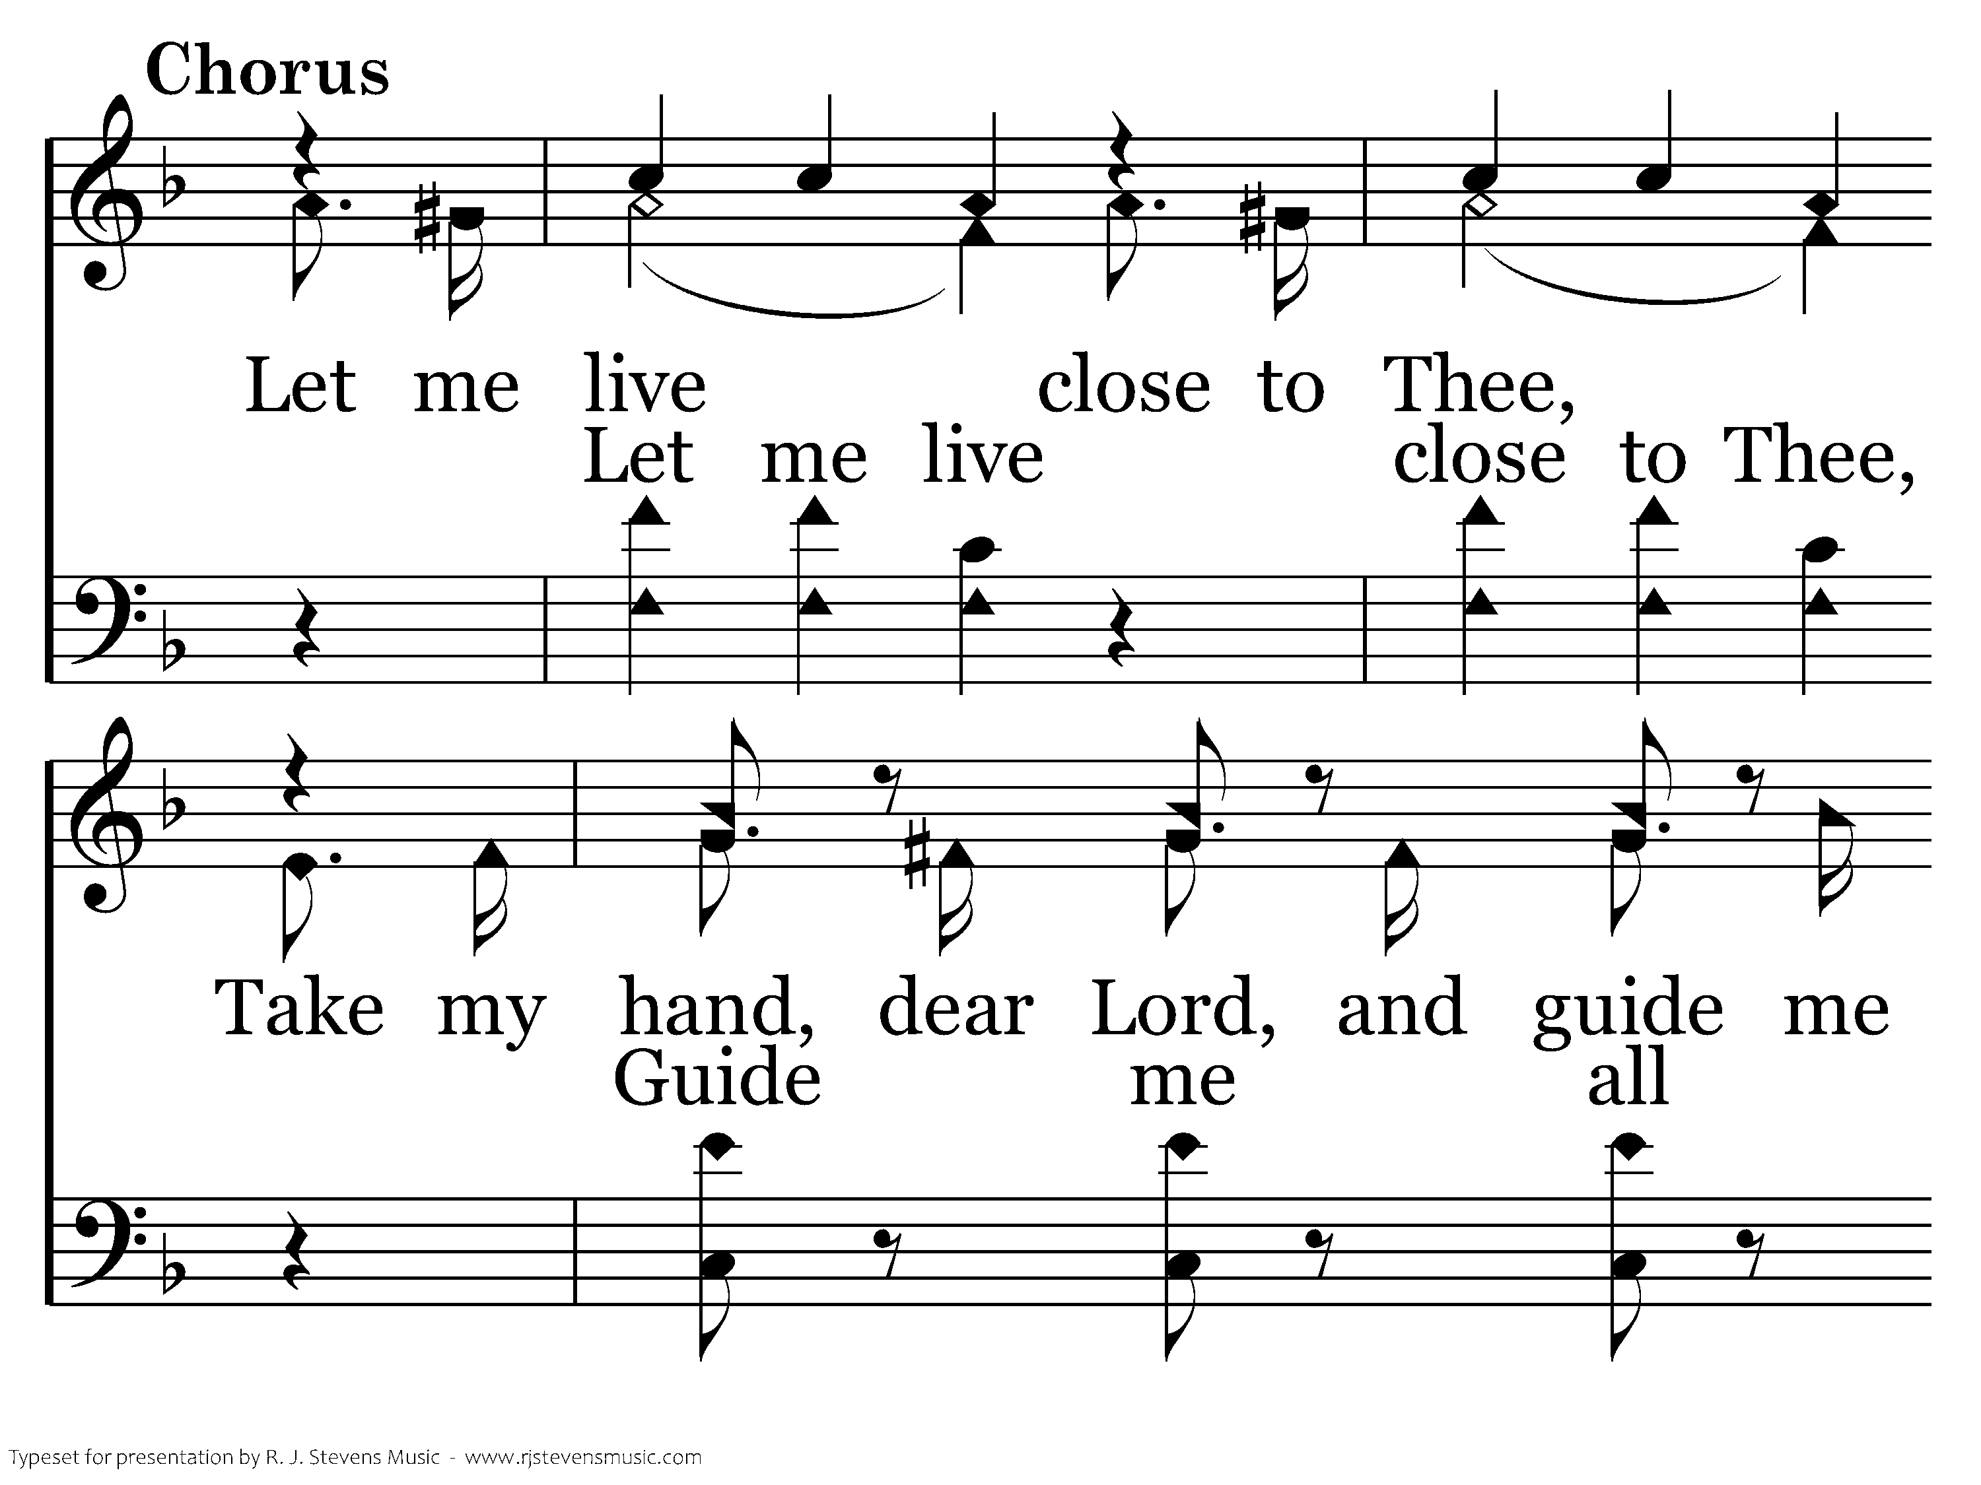
618 - Let Me Live Close To Thee - C.1

Slide 7
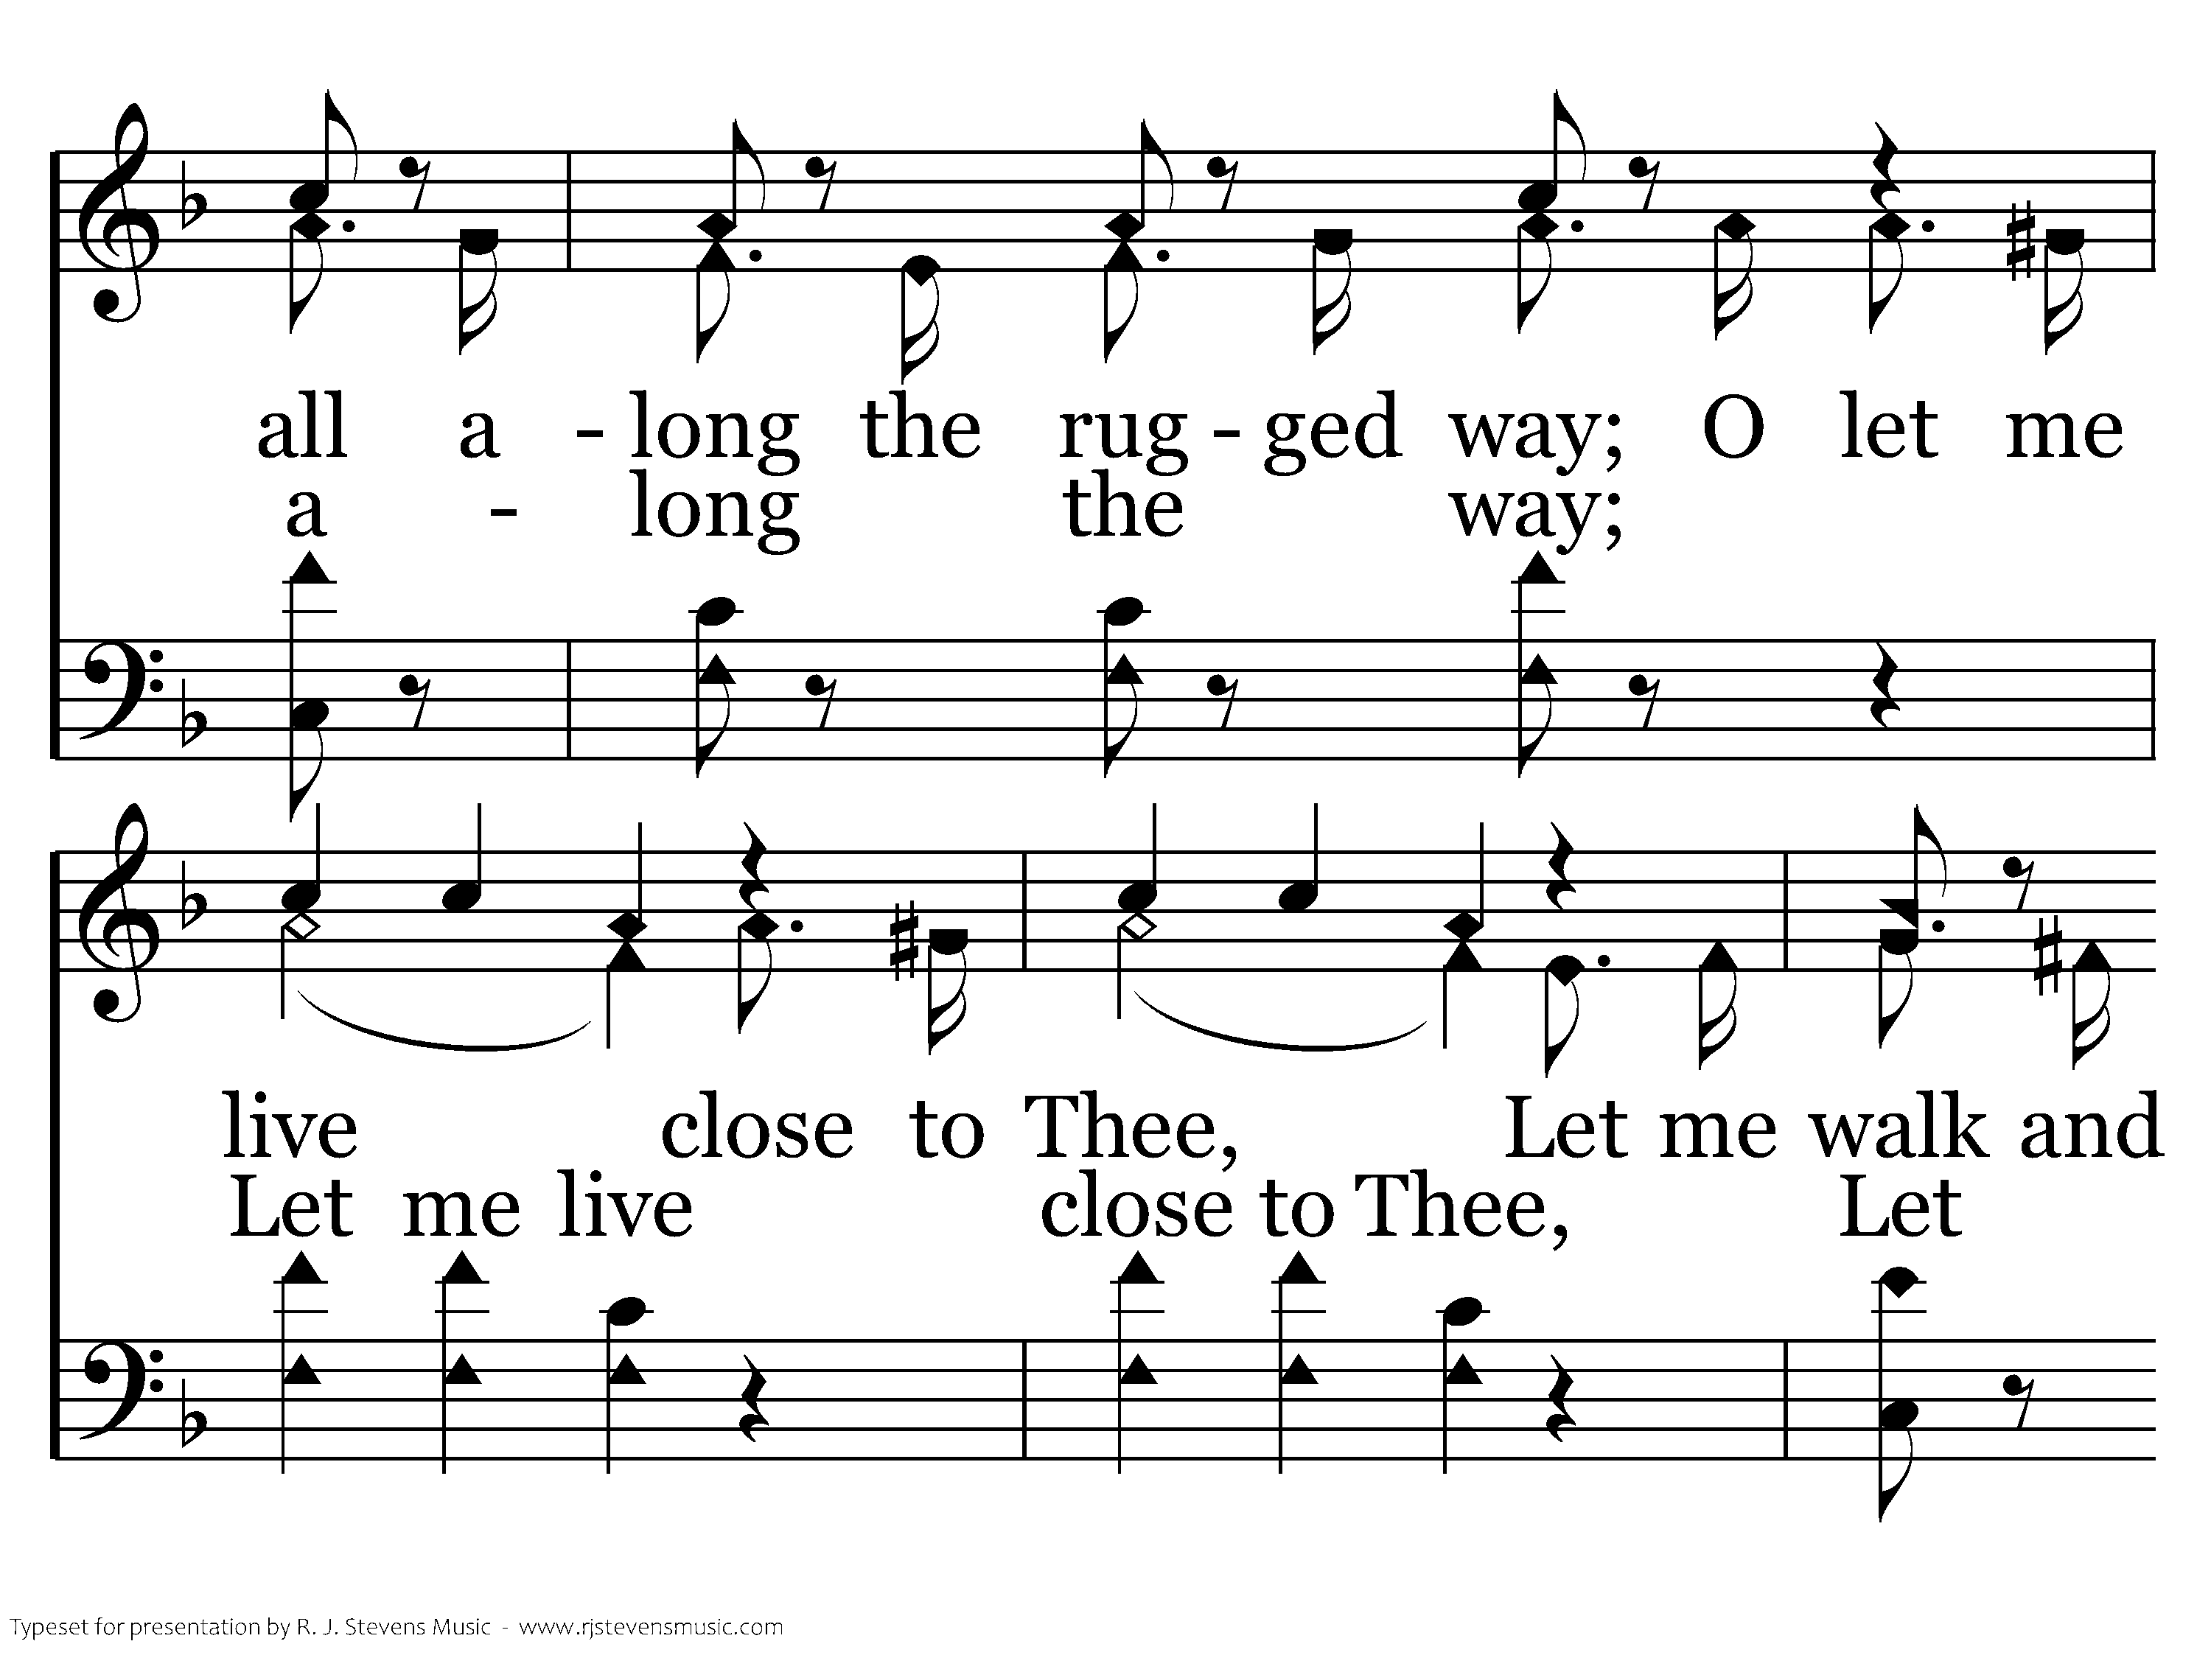
618 - Let Me Live Close To Thee - C.2

Slide 8
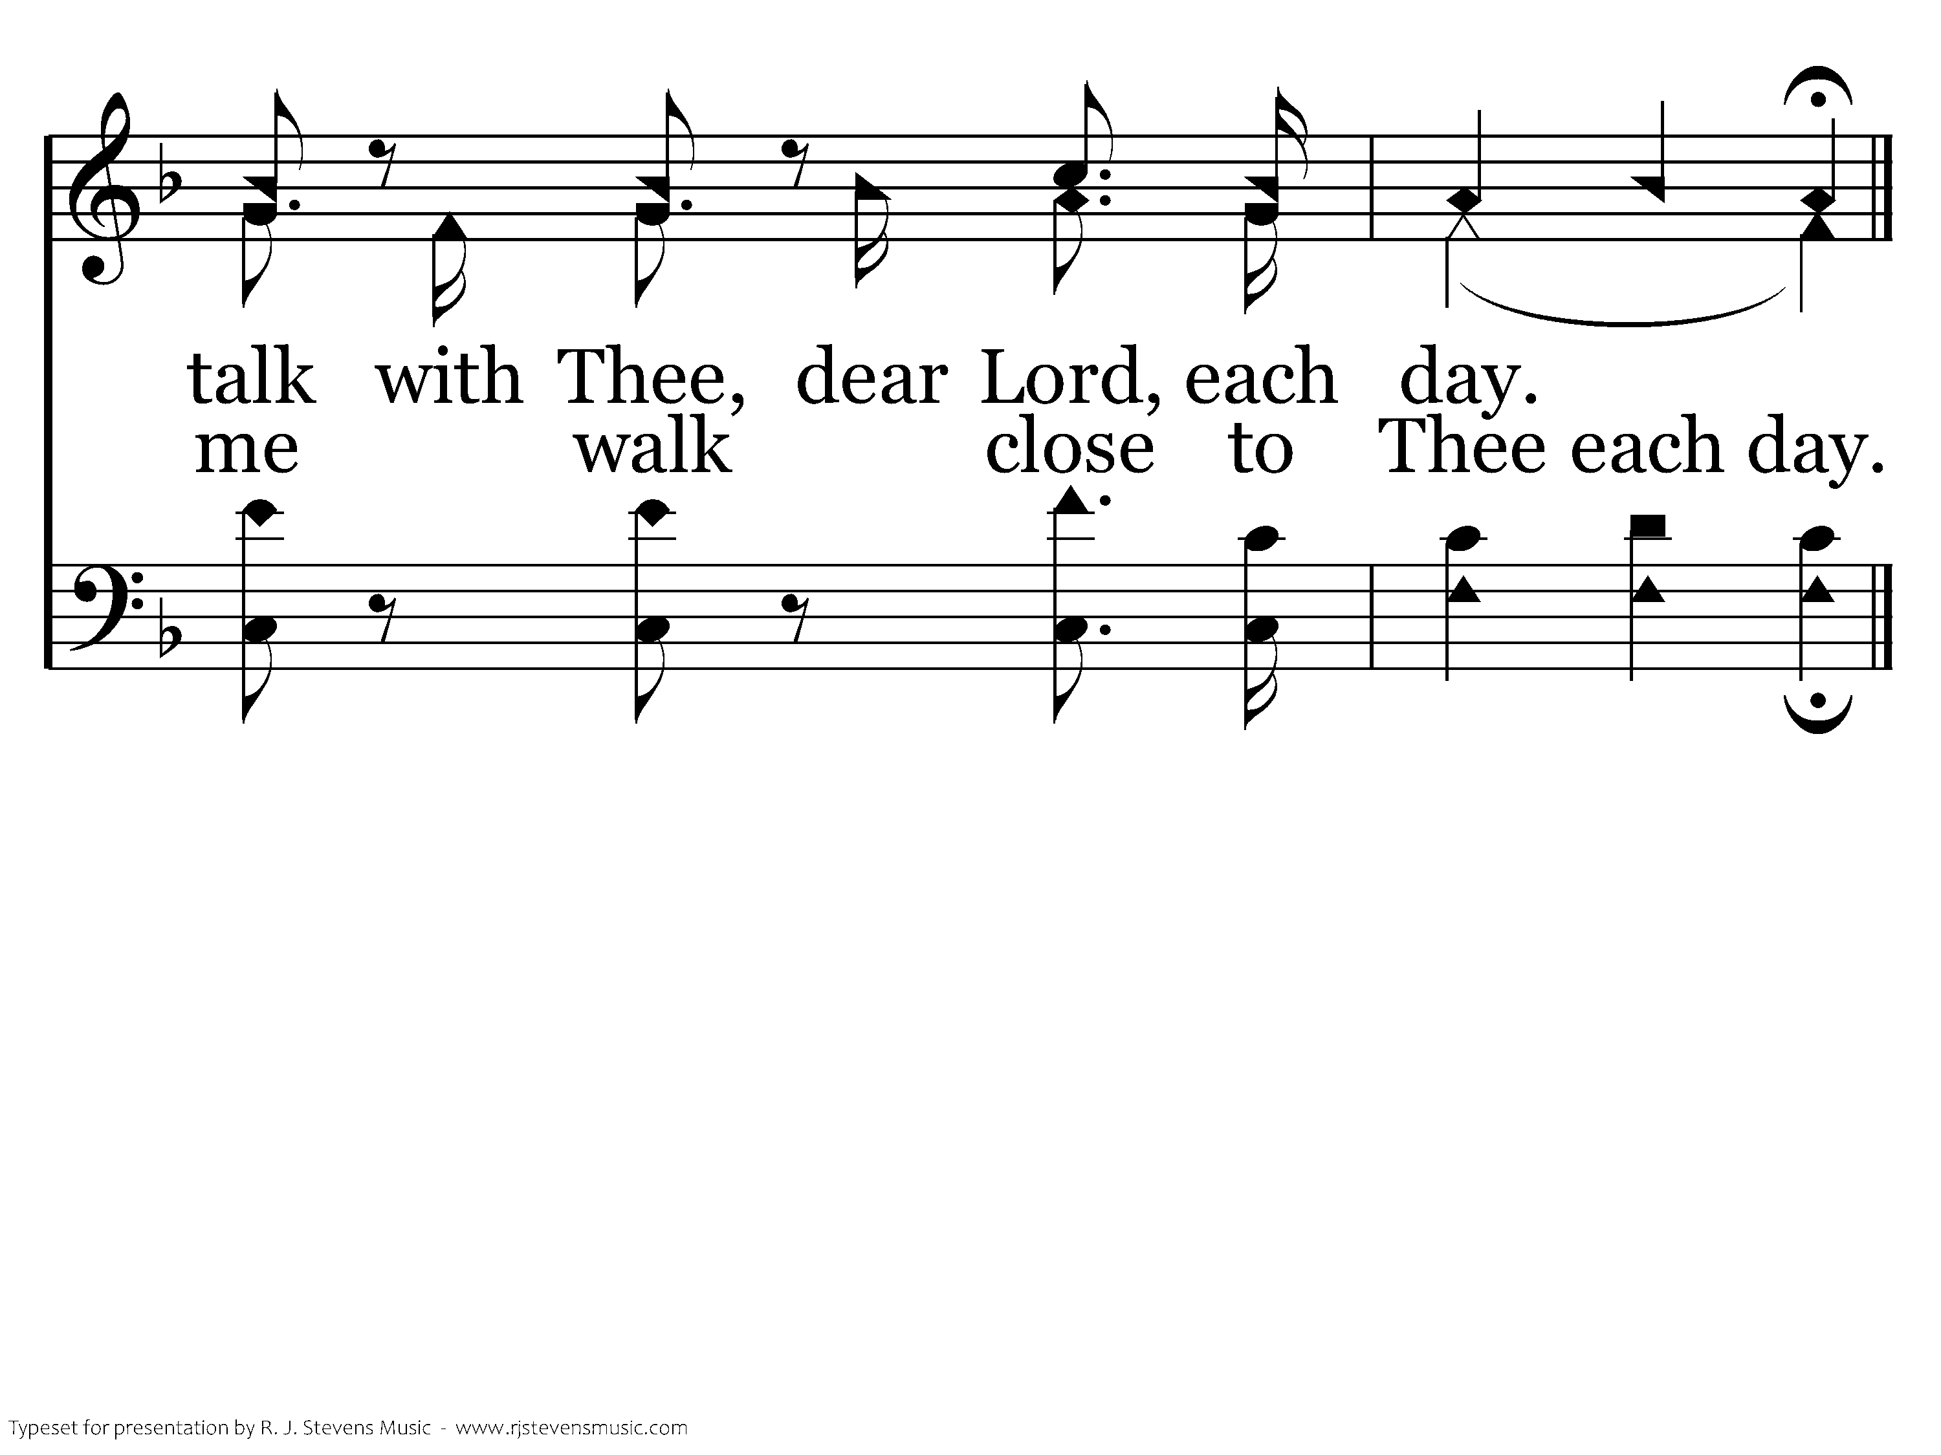
618 - Let Me Live Close To Thee - C.3
End of Verse 1

Slide 9
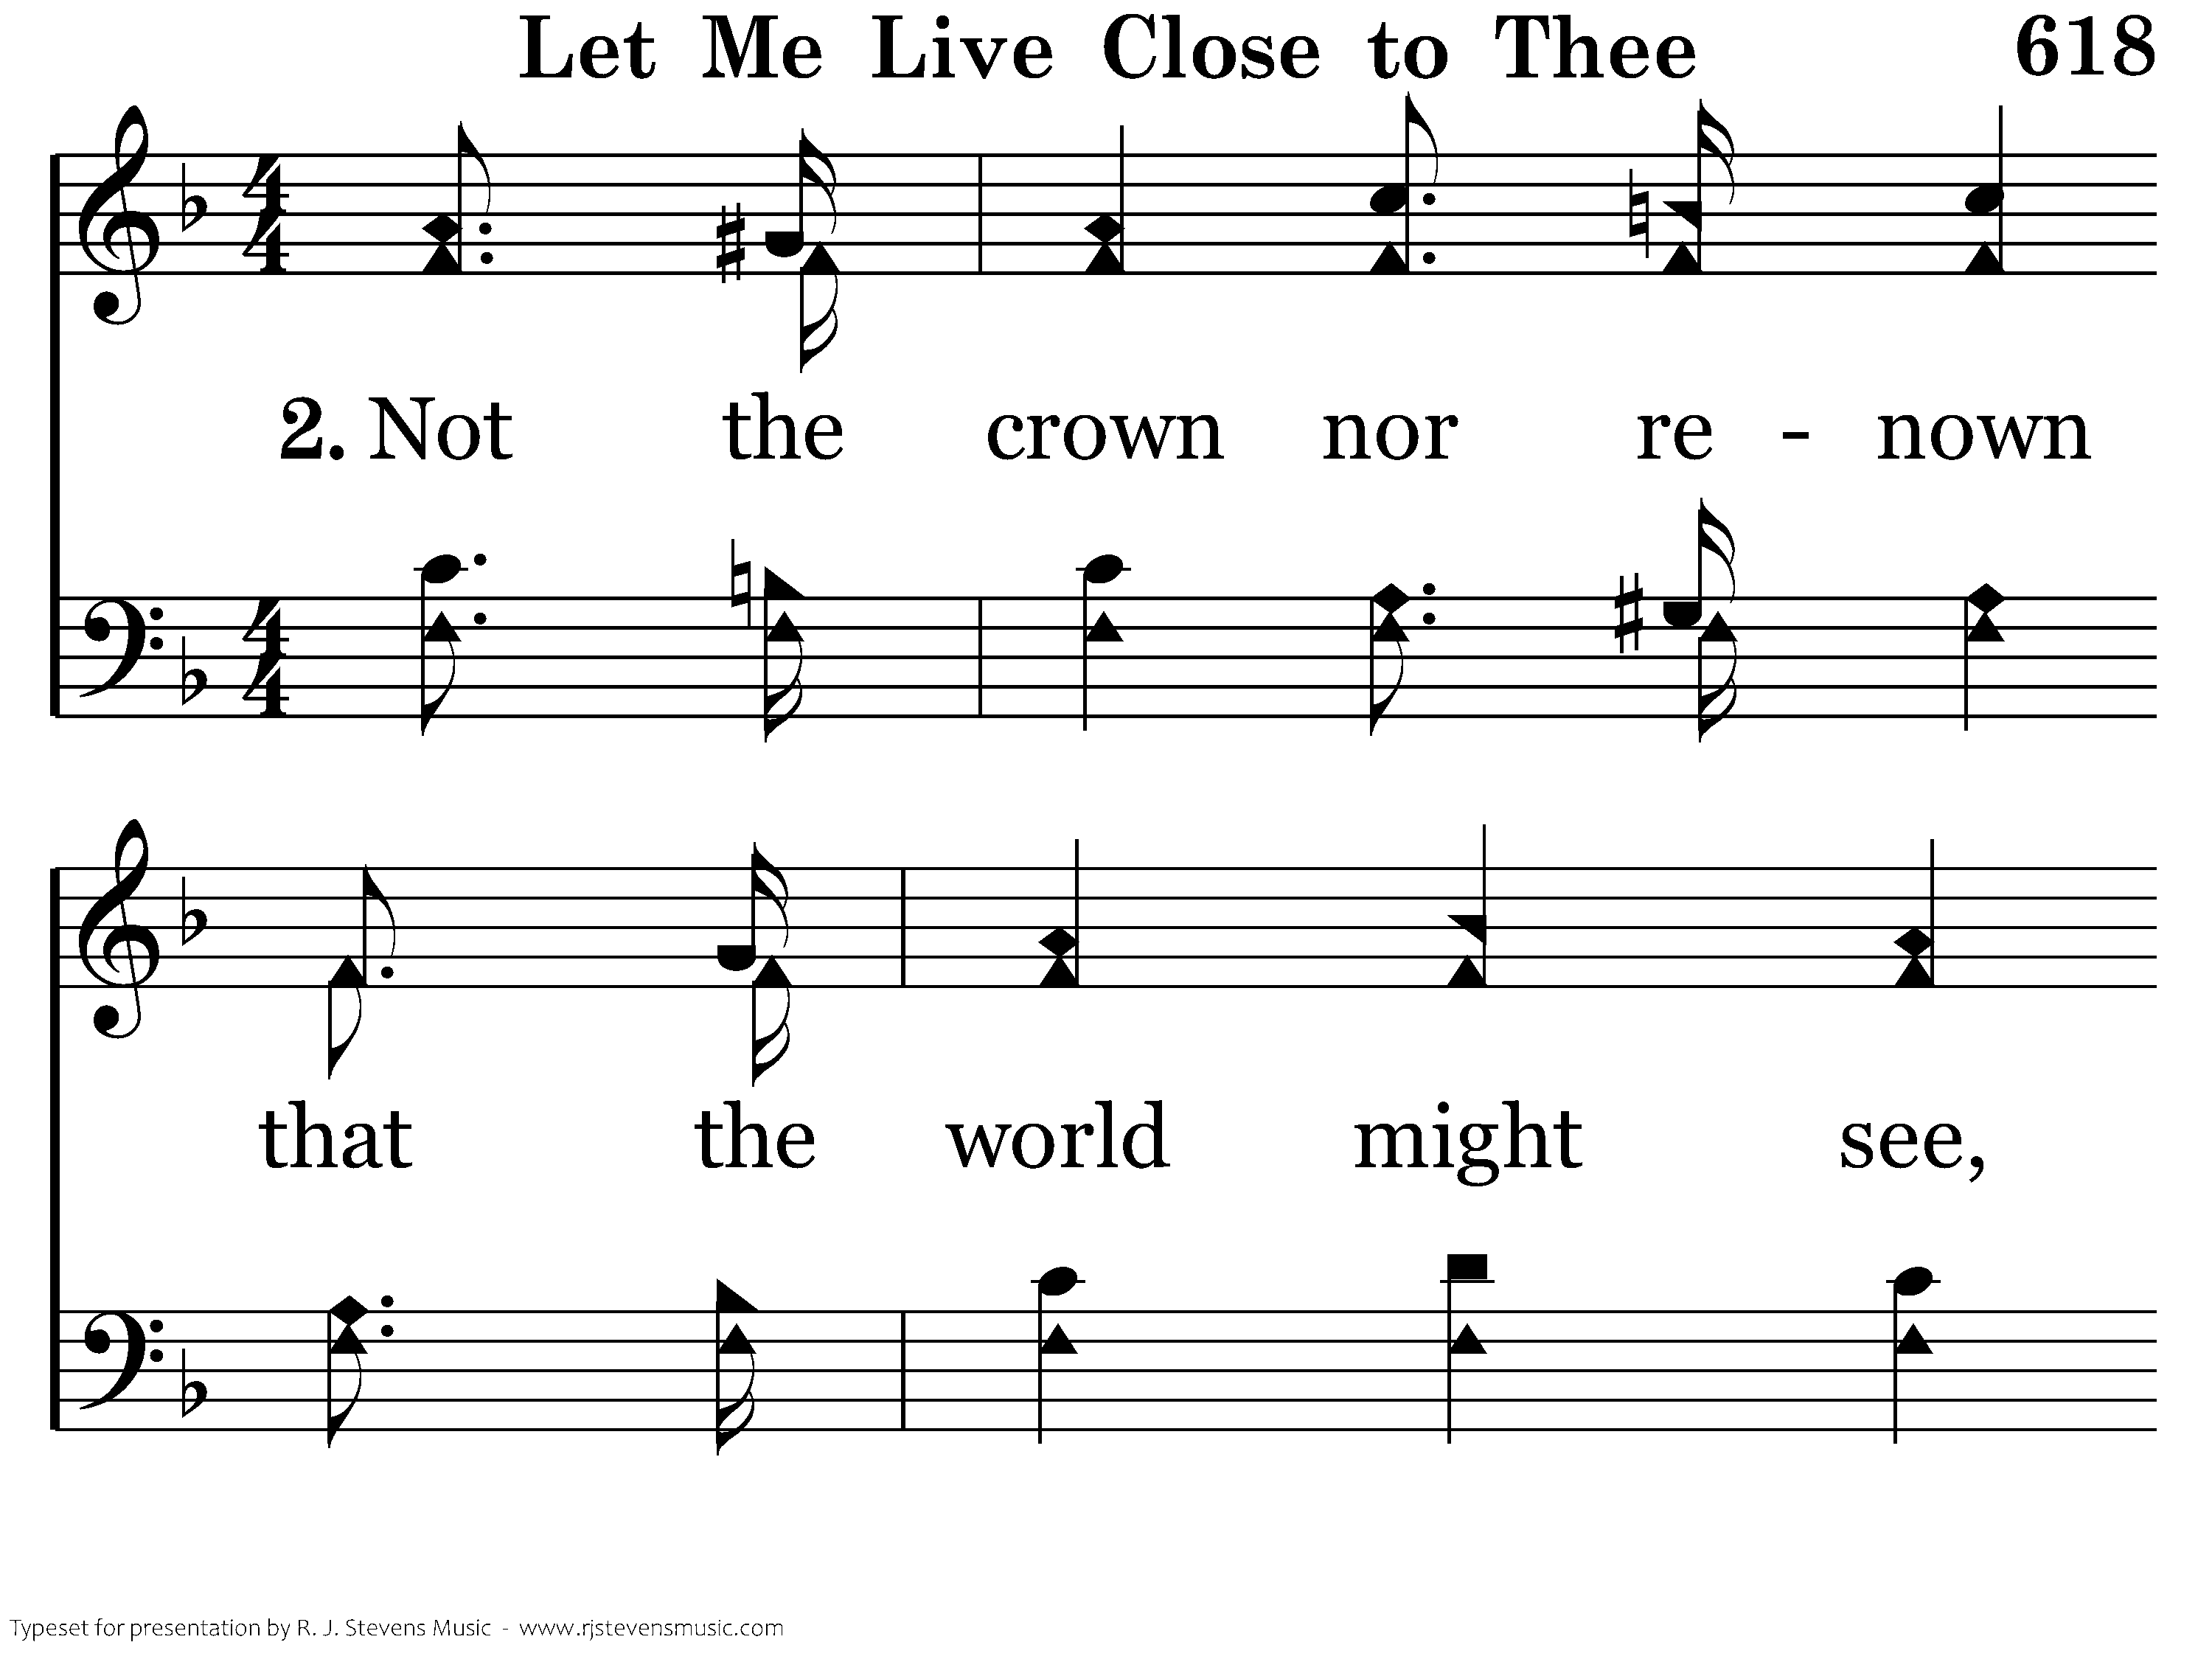
618 - Let Me Live Close To Thee - 2.1

Slide 10
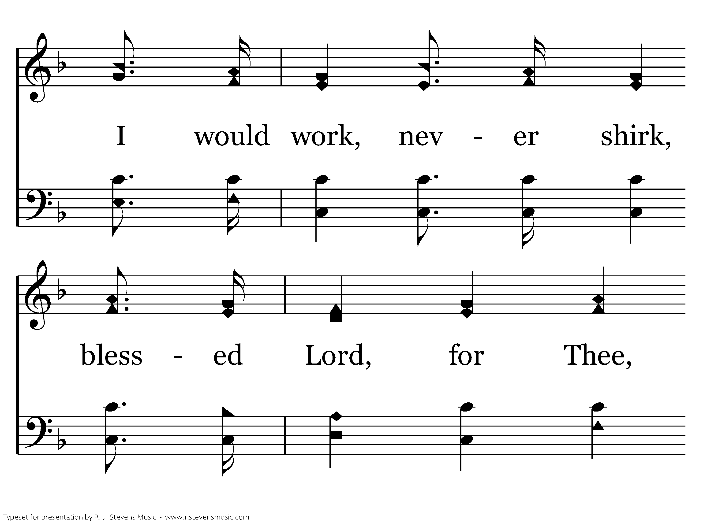
618 - Let Me Live Close To Thee - 2.2

Slide 11
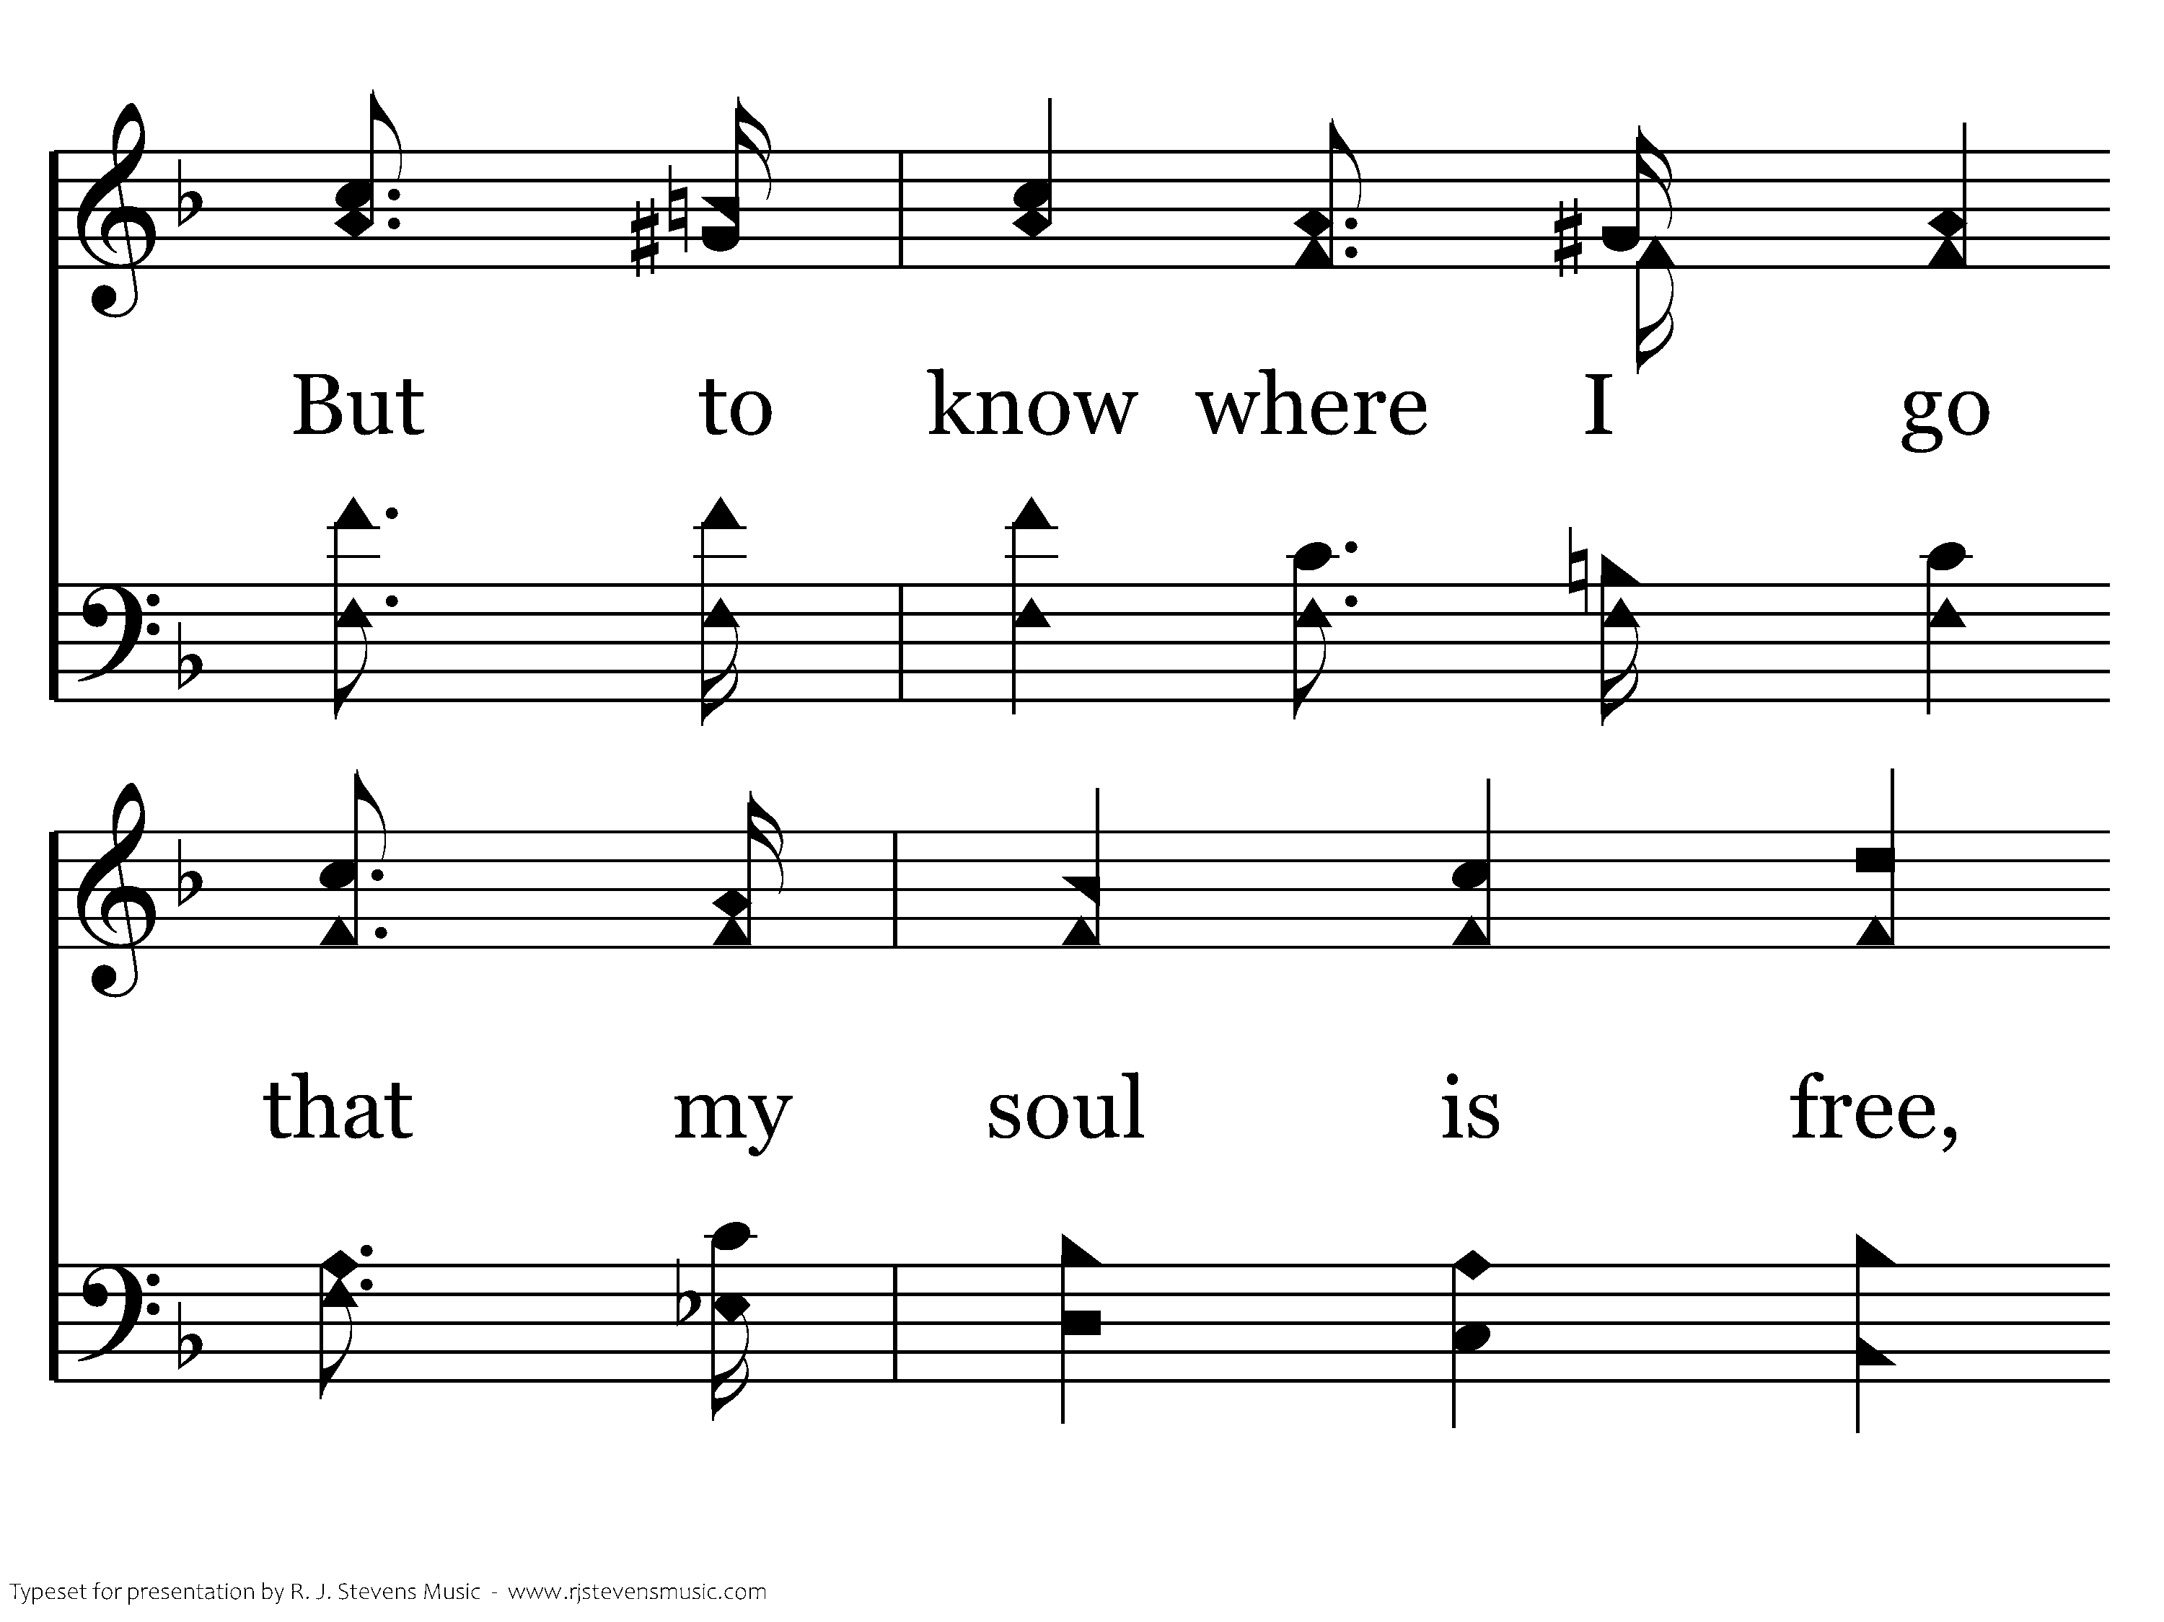
618 - Let Me Live Close To Thee - 2.3

Slide 12
618 - Let Me Live Close To Thee - 2.4

Slide 13
618 - Let Me Live Close To Thee - C.1

Slide 14
618 - Let Me Live Close To Thee - C.2

Slide 15
618 - Let Me Live Close To Thee - C.3
End of Verse 2

Slide 16
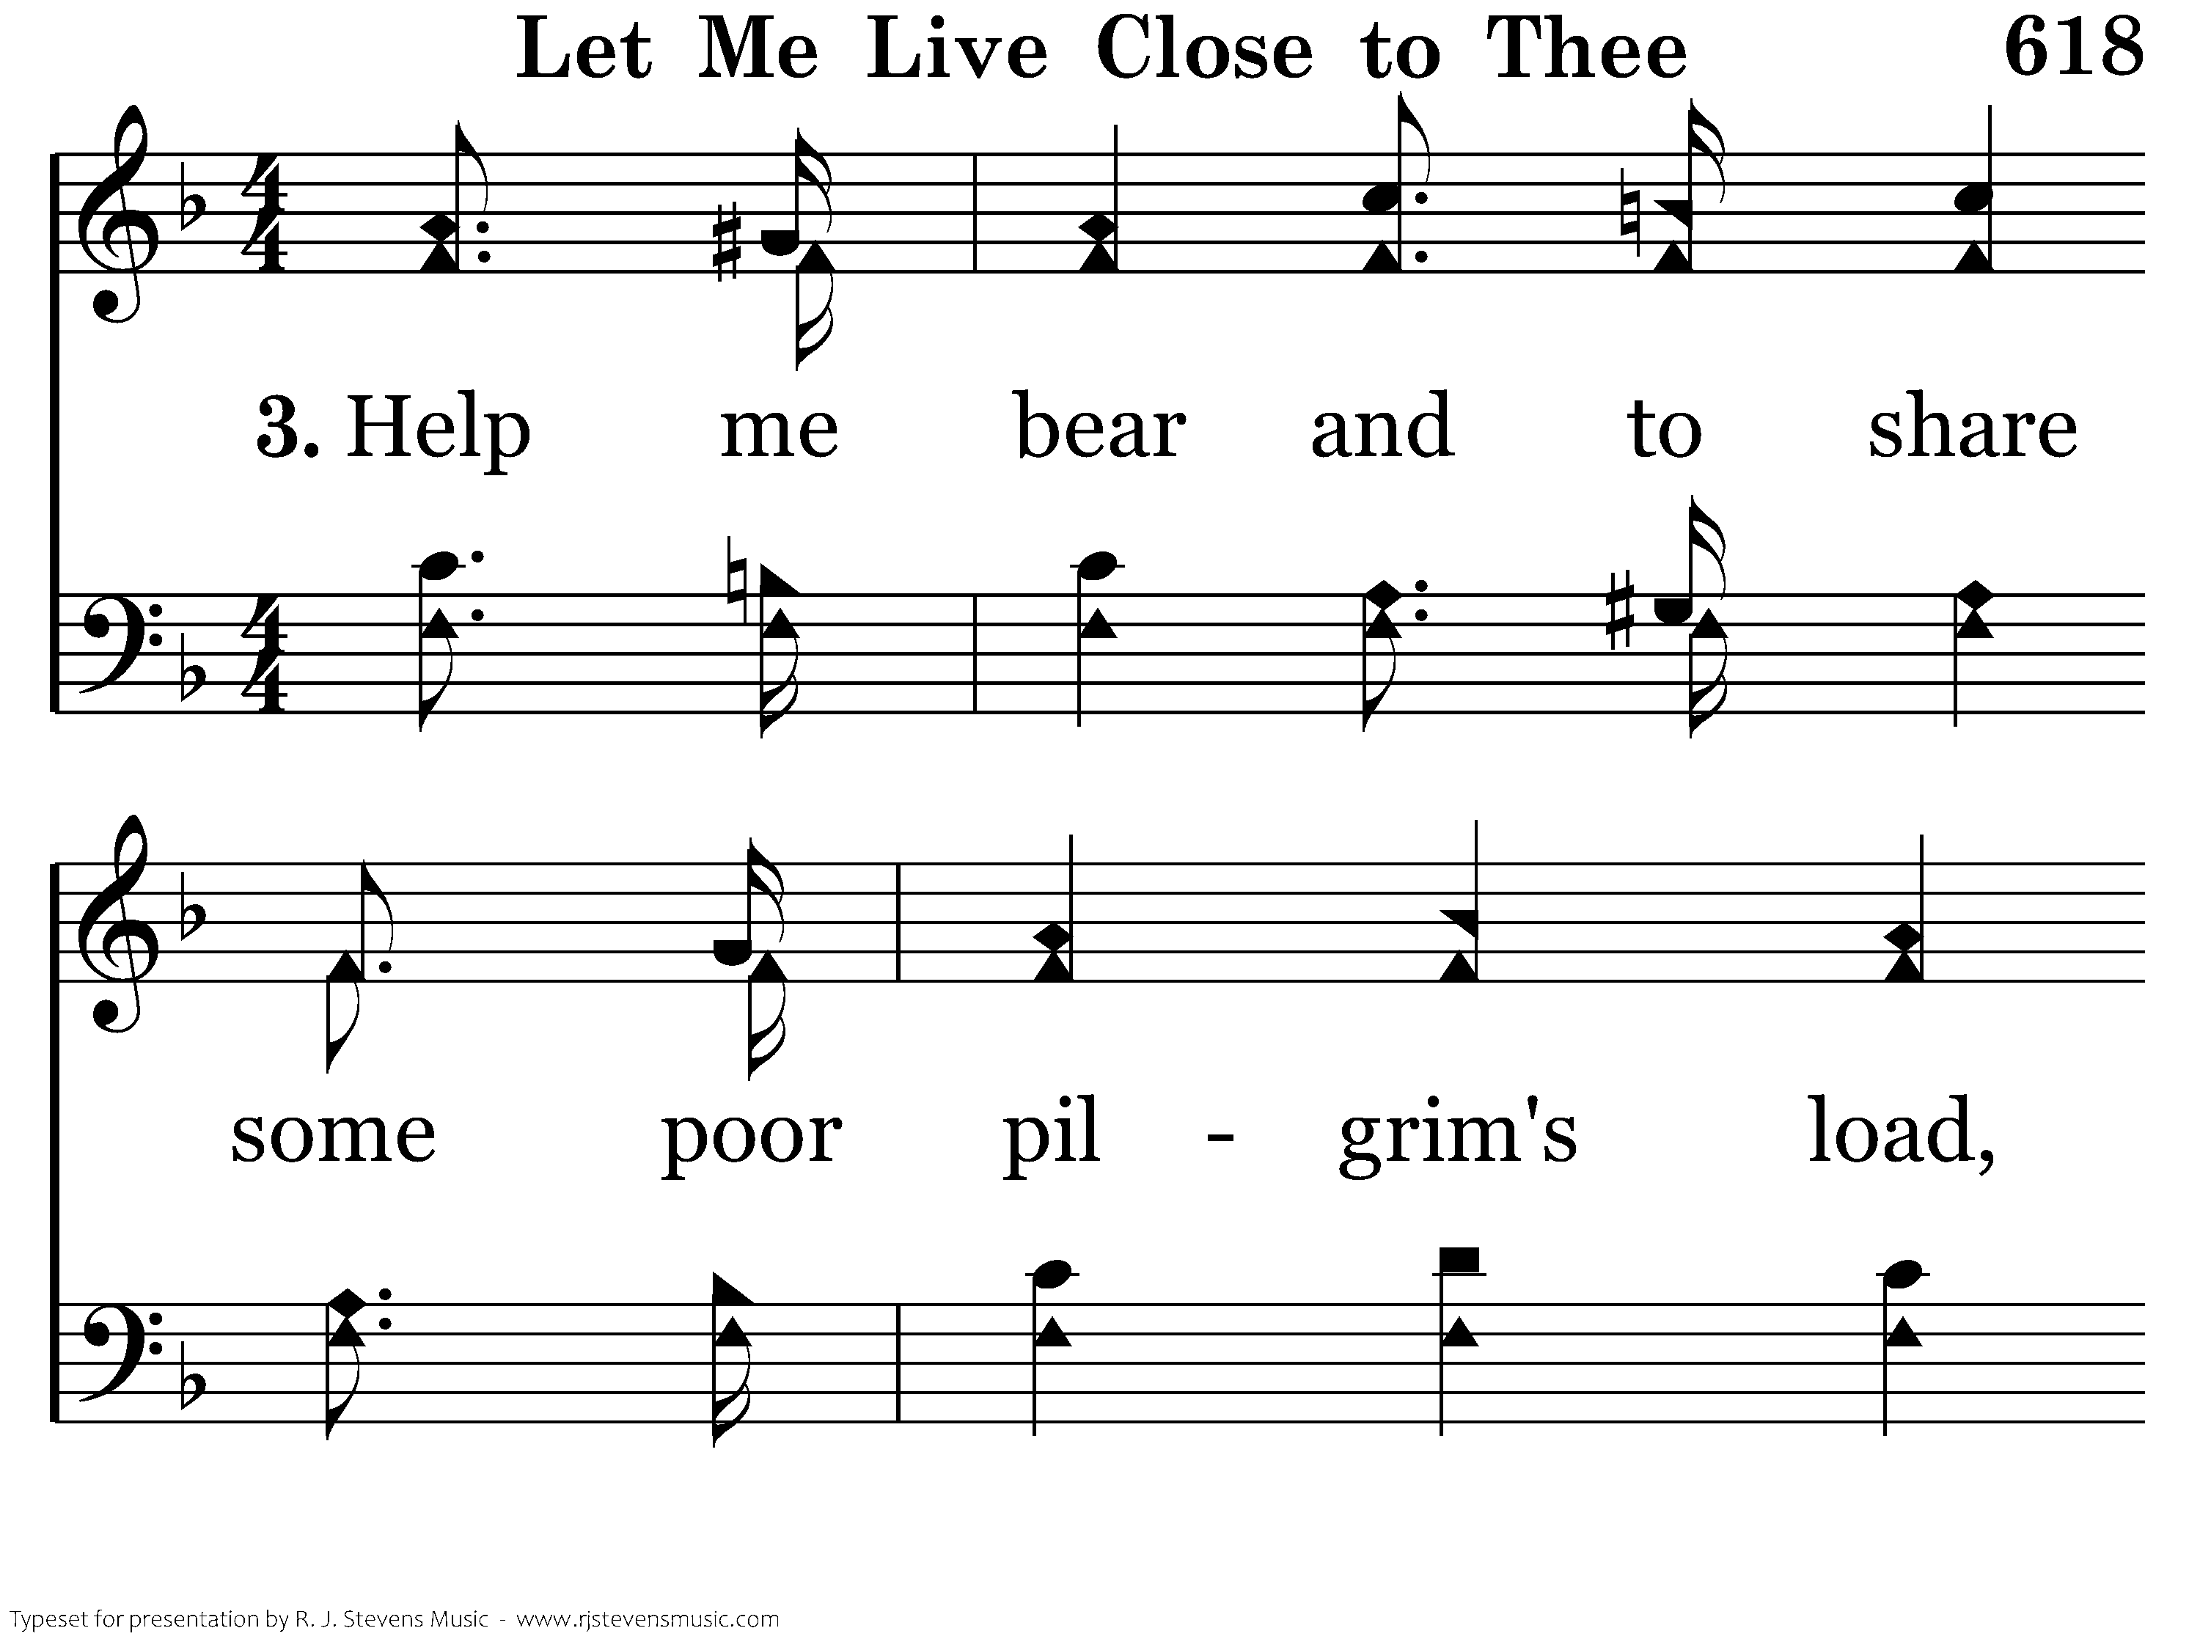
618 - Let Me Live Close To Thee - 3.1

Slide 17
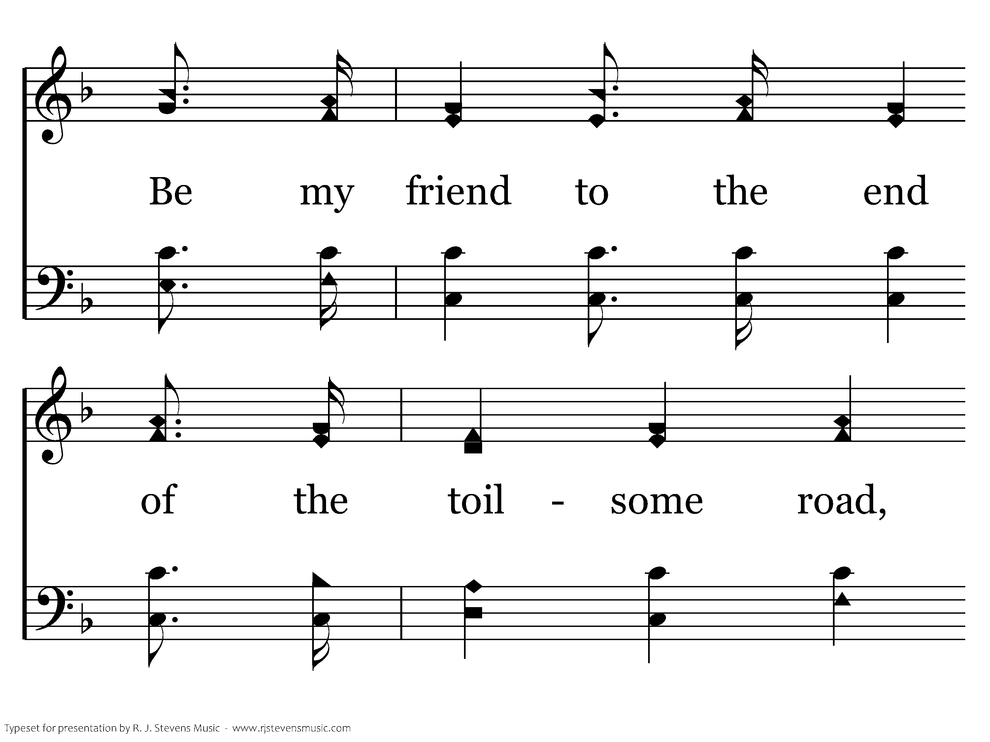
618 - Let Me Live Close To Thee - 3.2

Slide 18
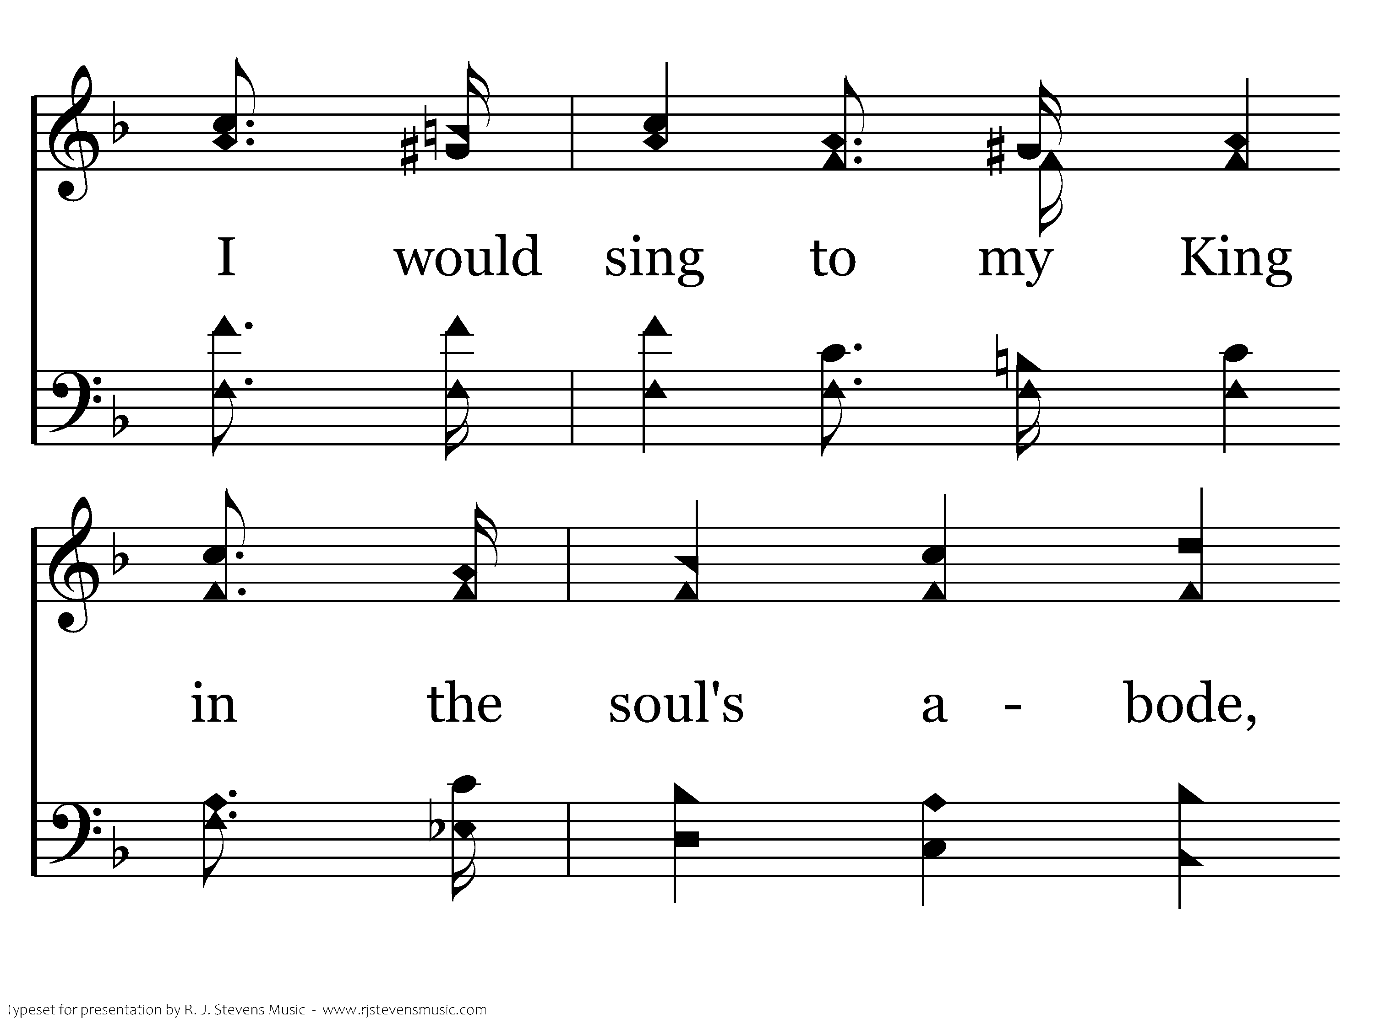
618 - Let Me Live Close To Thee - 3.3

Slide 19
618 - Let Me Live Close To Thee - 3.4

Slide 20
618 - Let Me Live Close To Thee - C.1

Slide 21
618 - Let Me Live Close To Thee - C.2

Slide 22
618 - Let Me Live Close To Thee - C.3
End of Song

Slide 23

374 - Ring Out The Message - Title

Slide 24
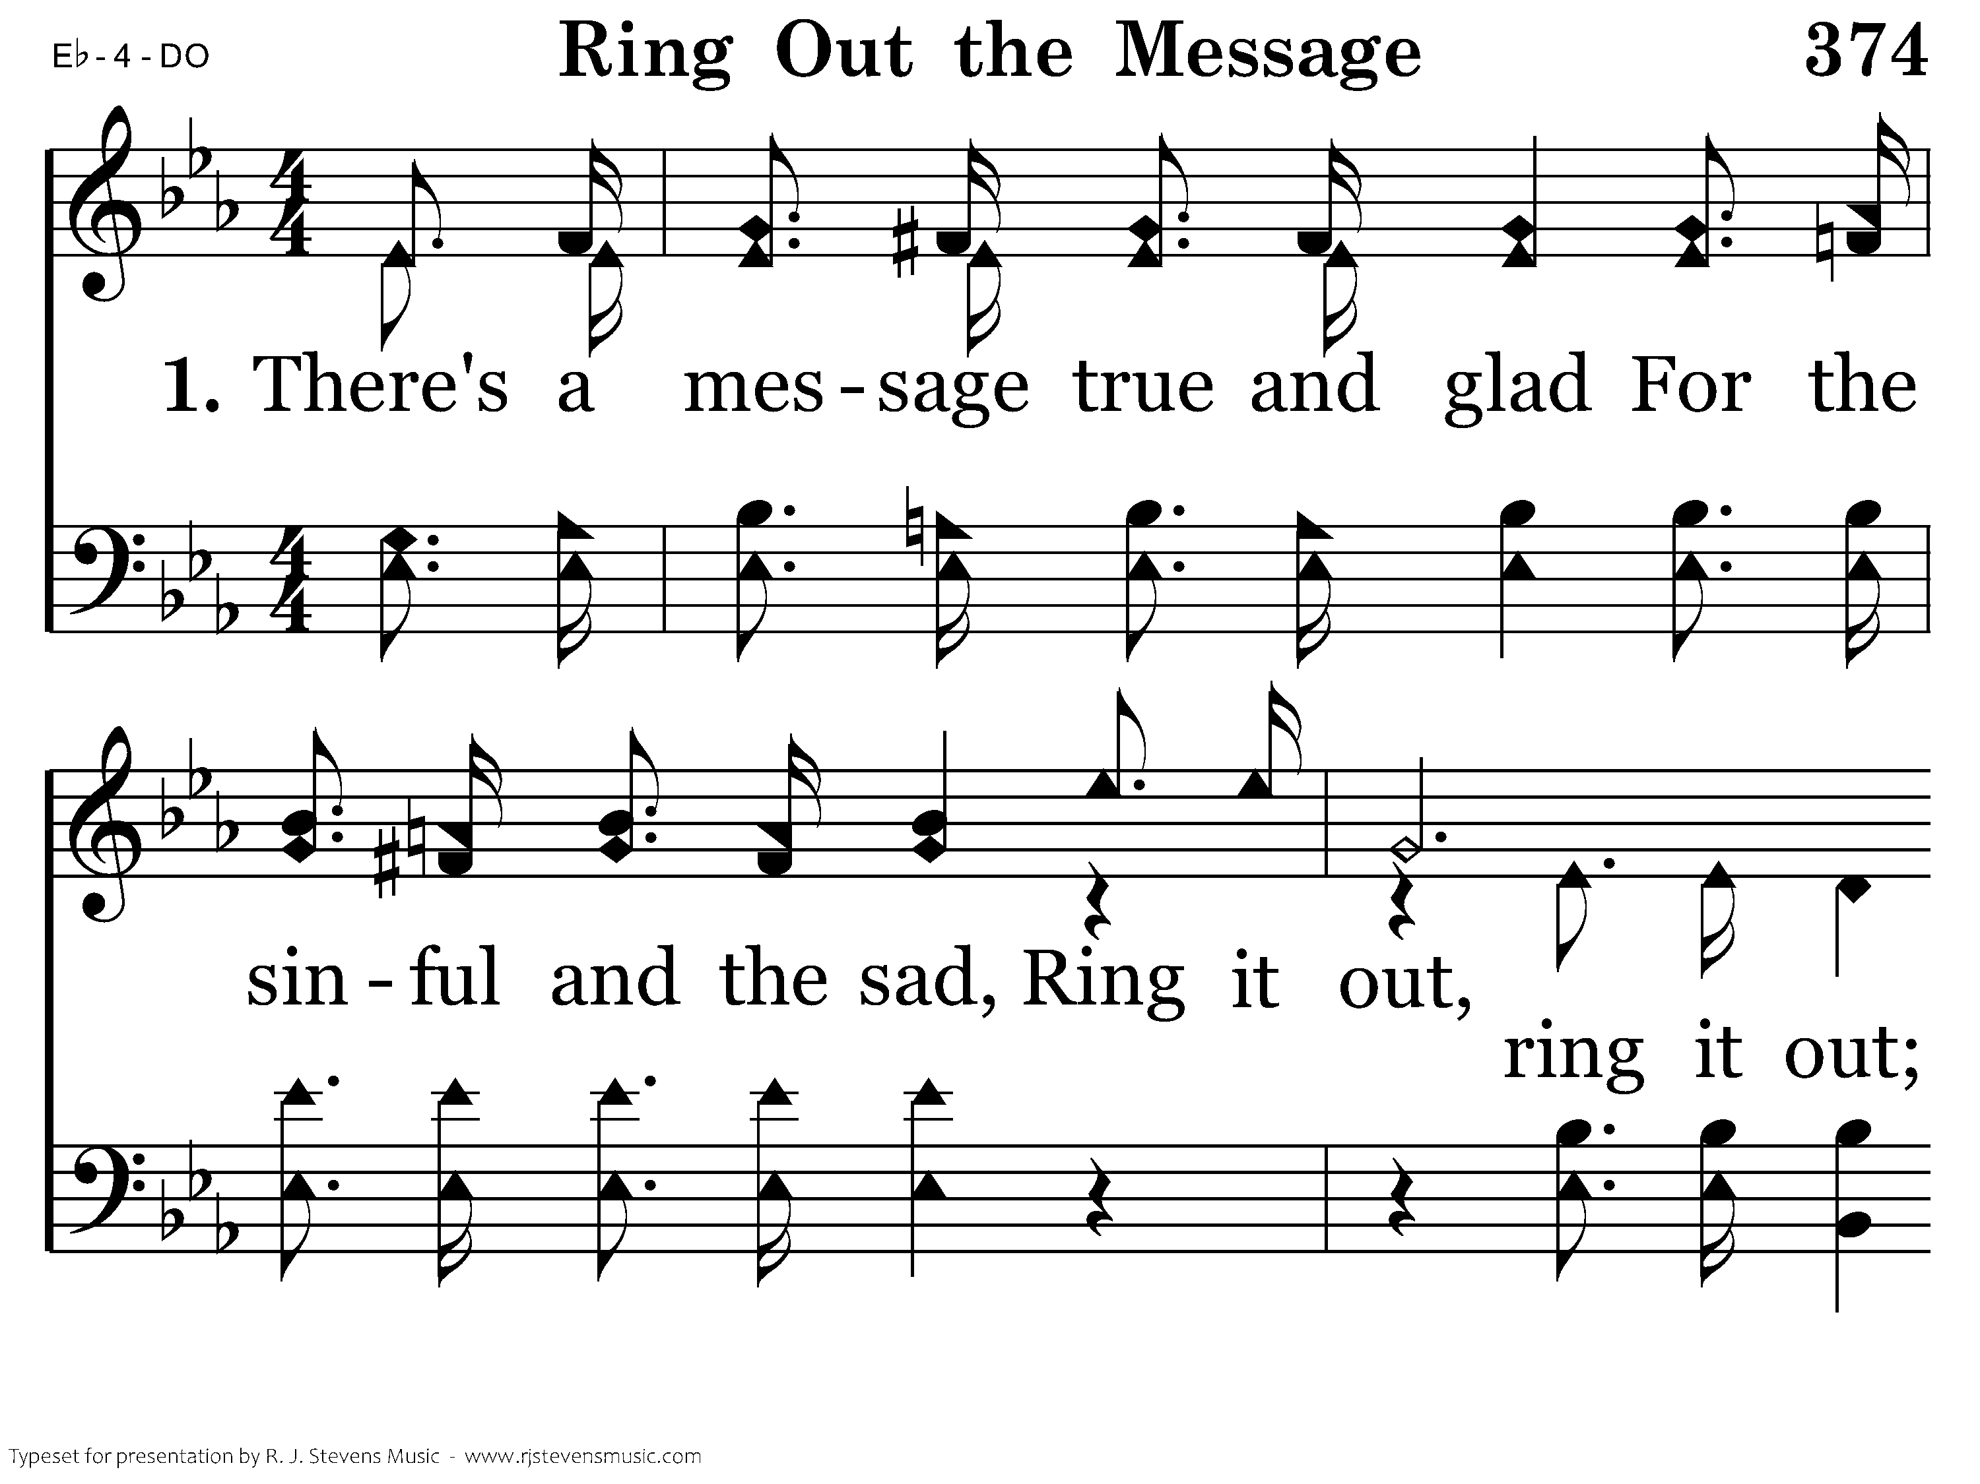
374 - Ring Out The Message - 1.1

Slide 25
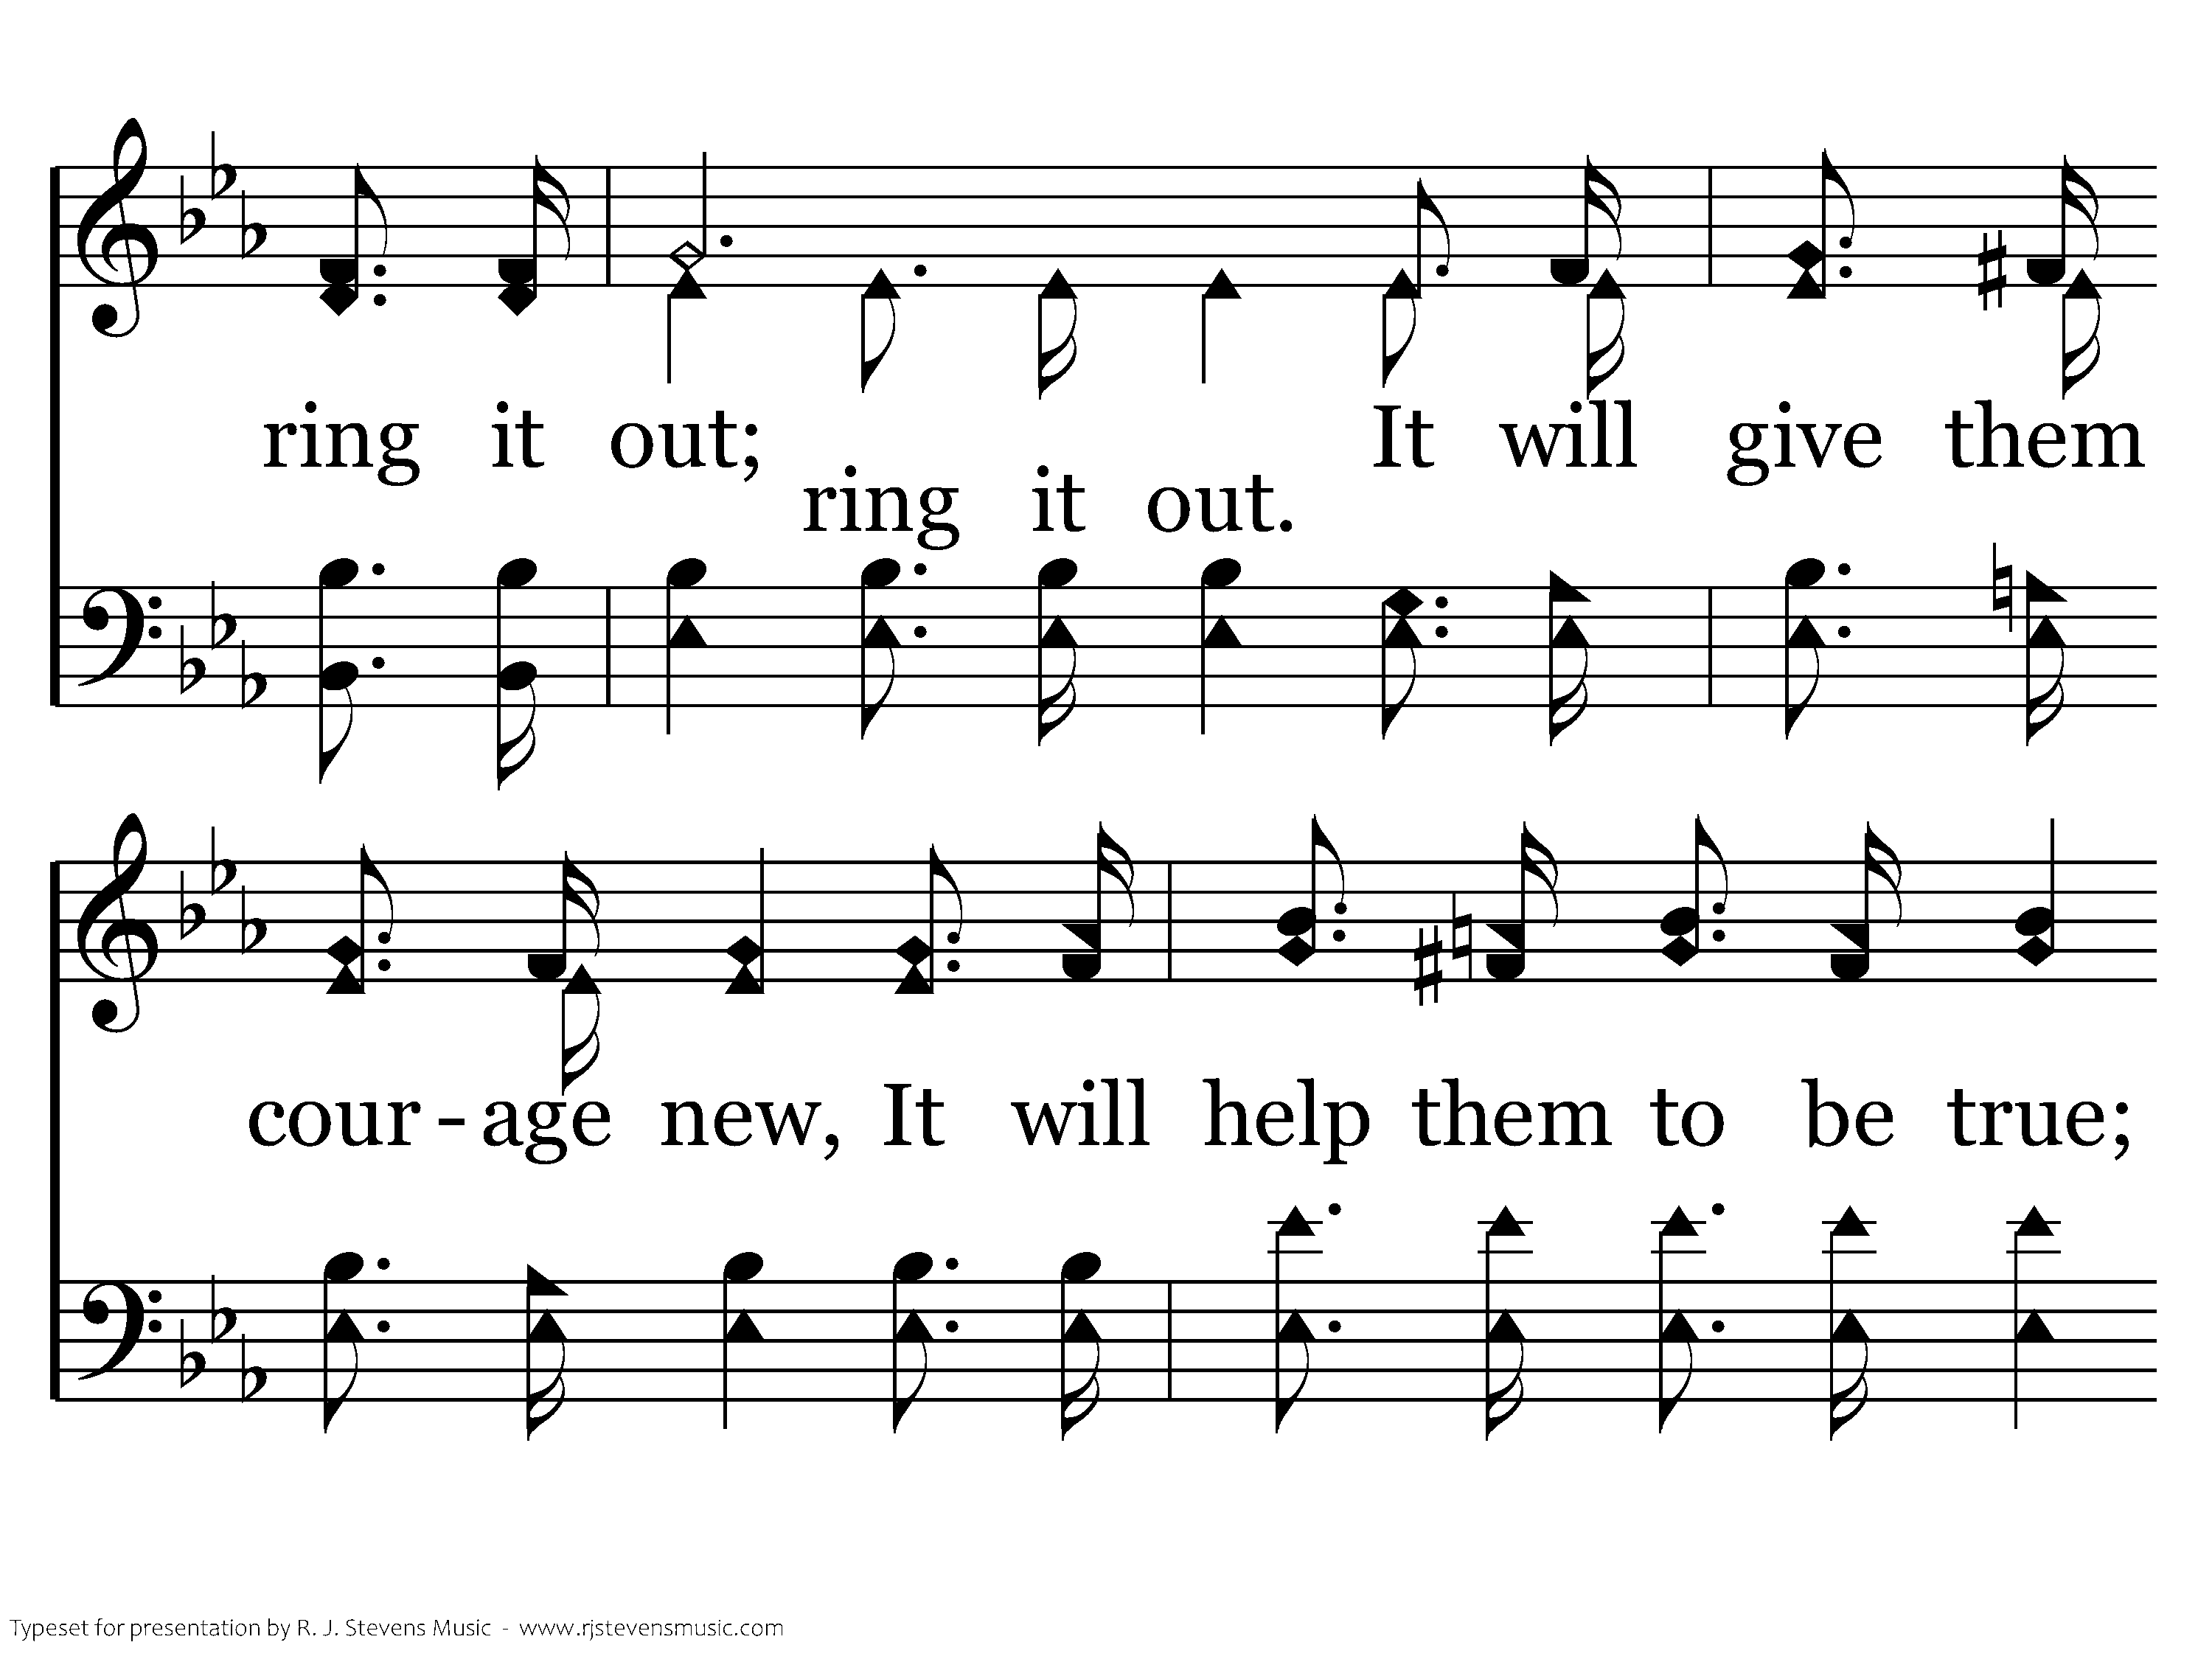
374 - Ring Out The Message - 1.2

Slide 26
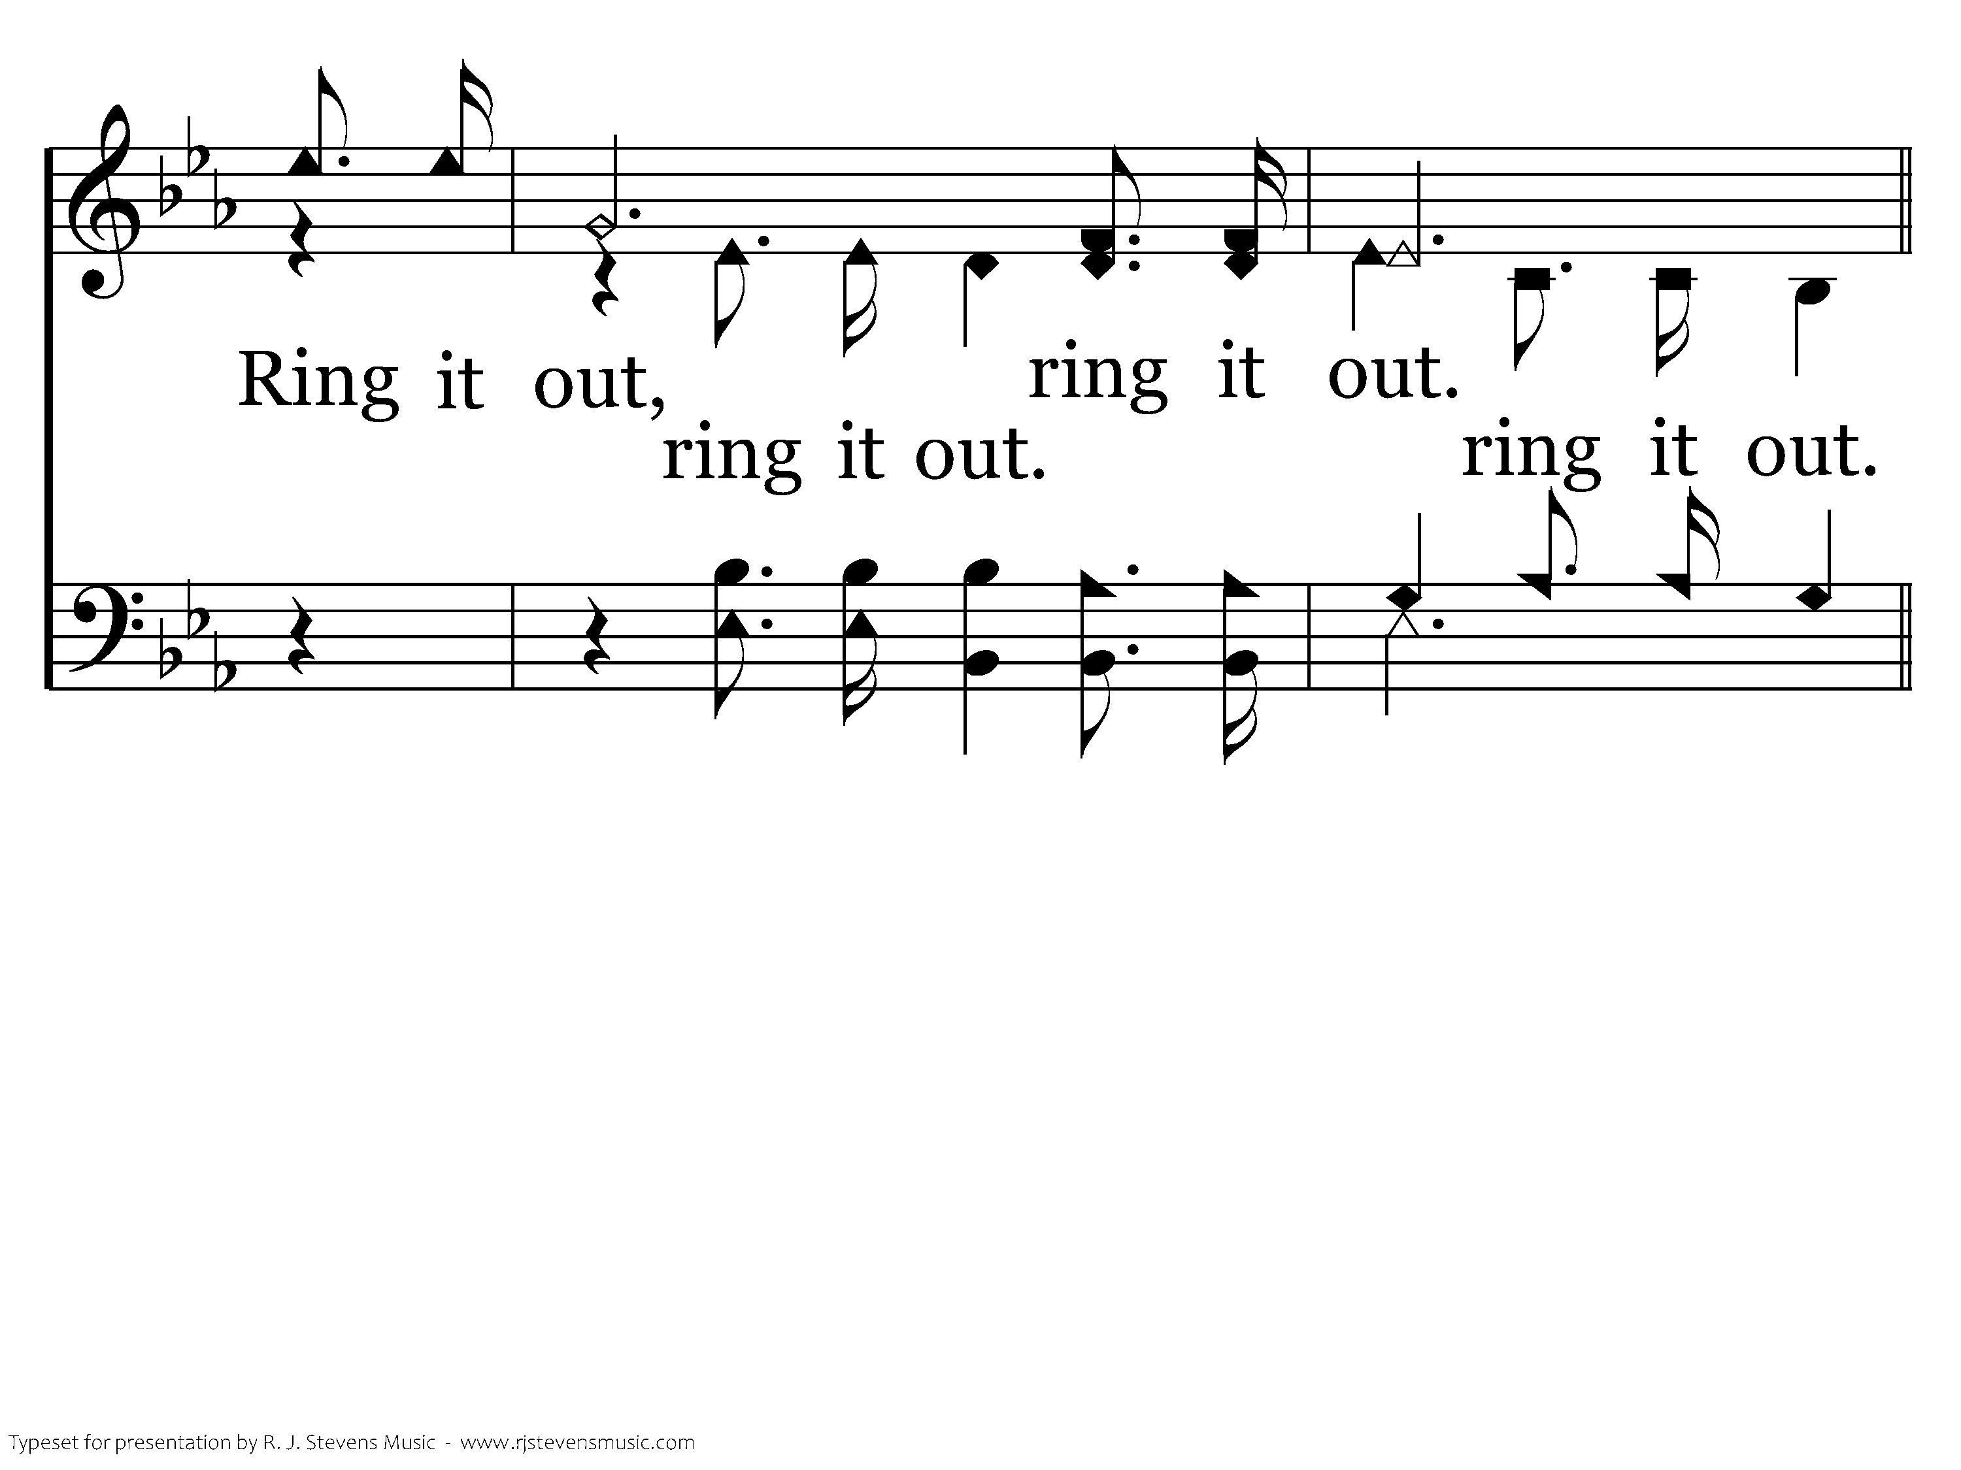
374 - Ring Out The Message - 1.3

Slide 27
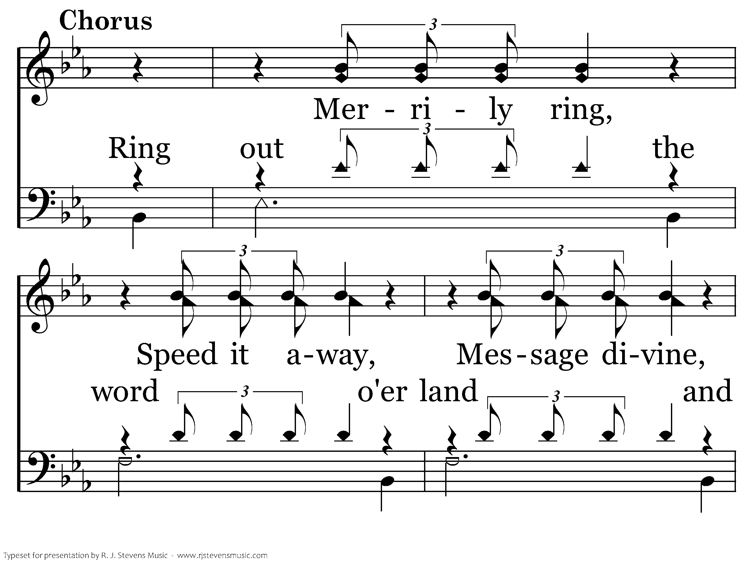
374 - Ring Out The Message - C.1

Slide 28
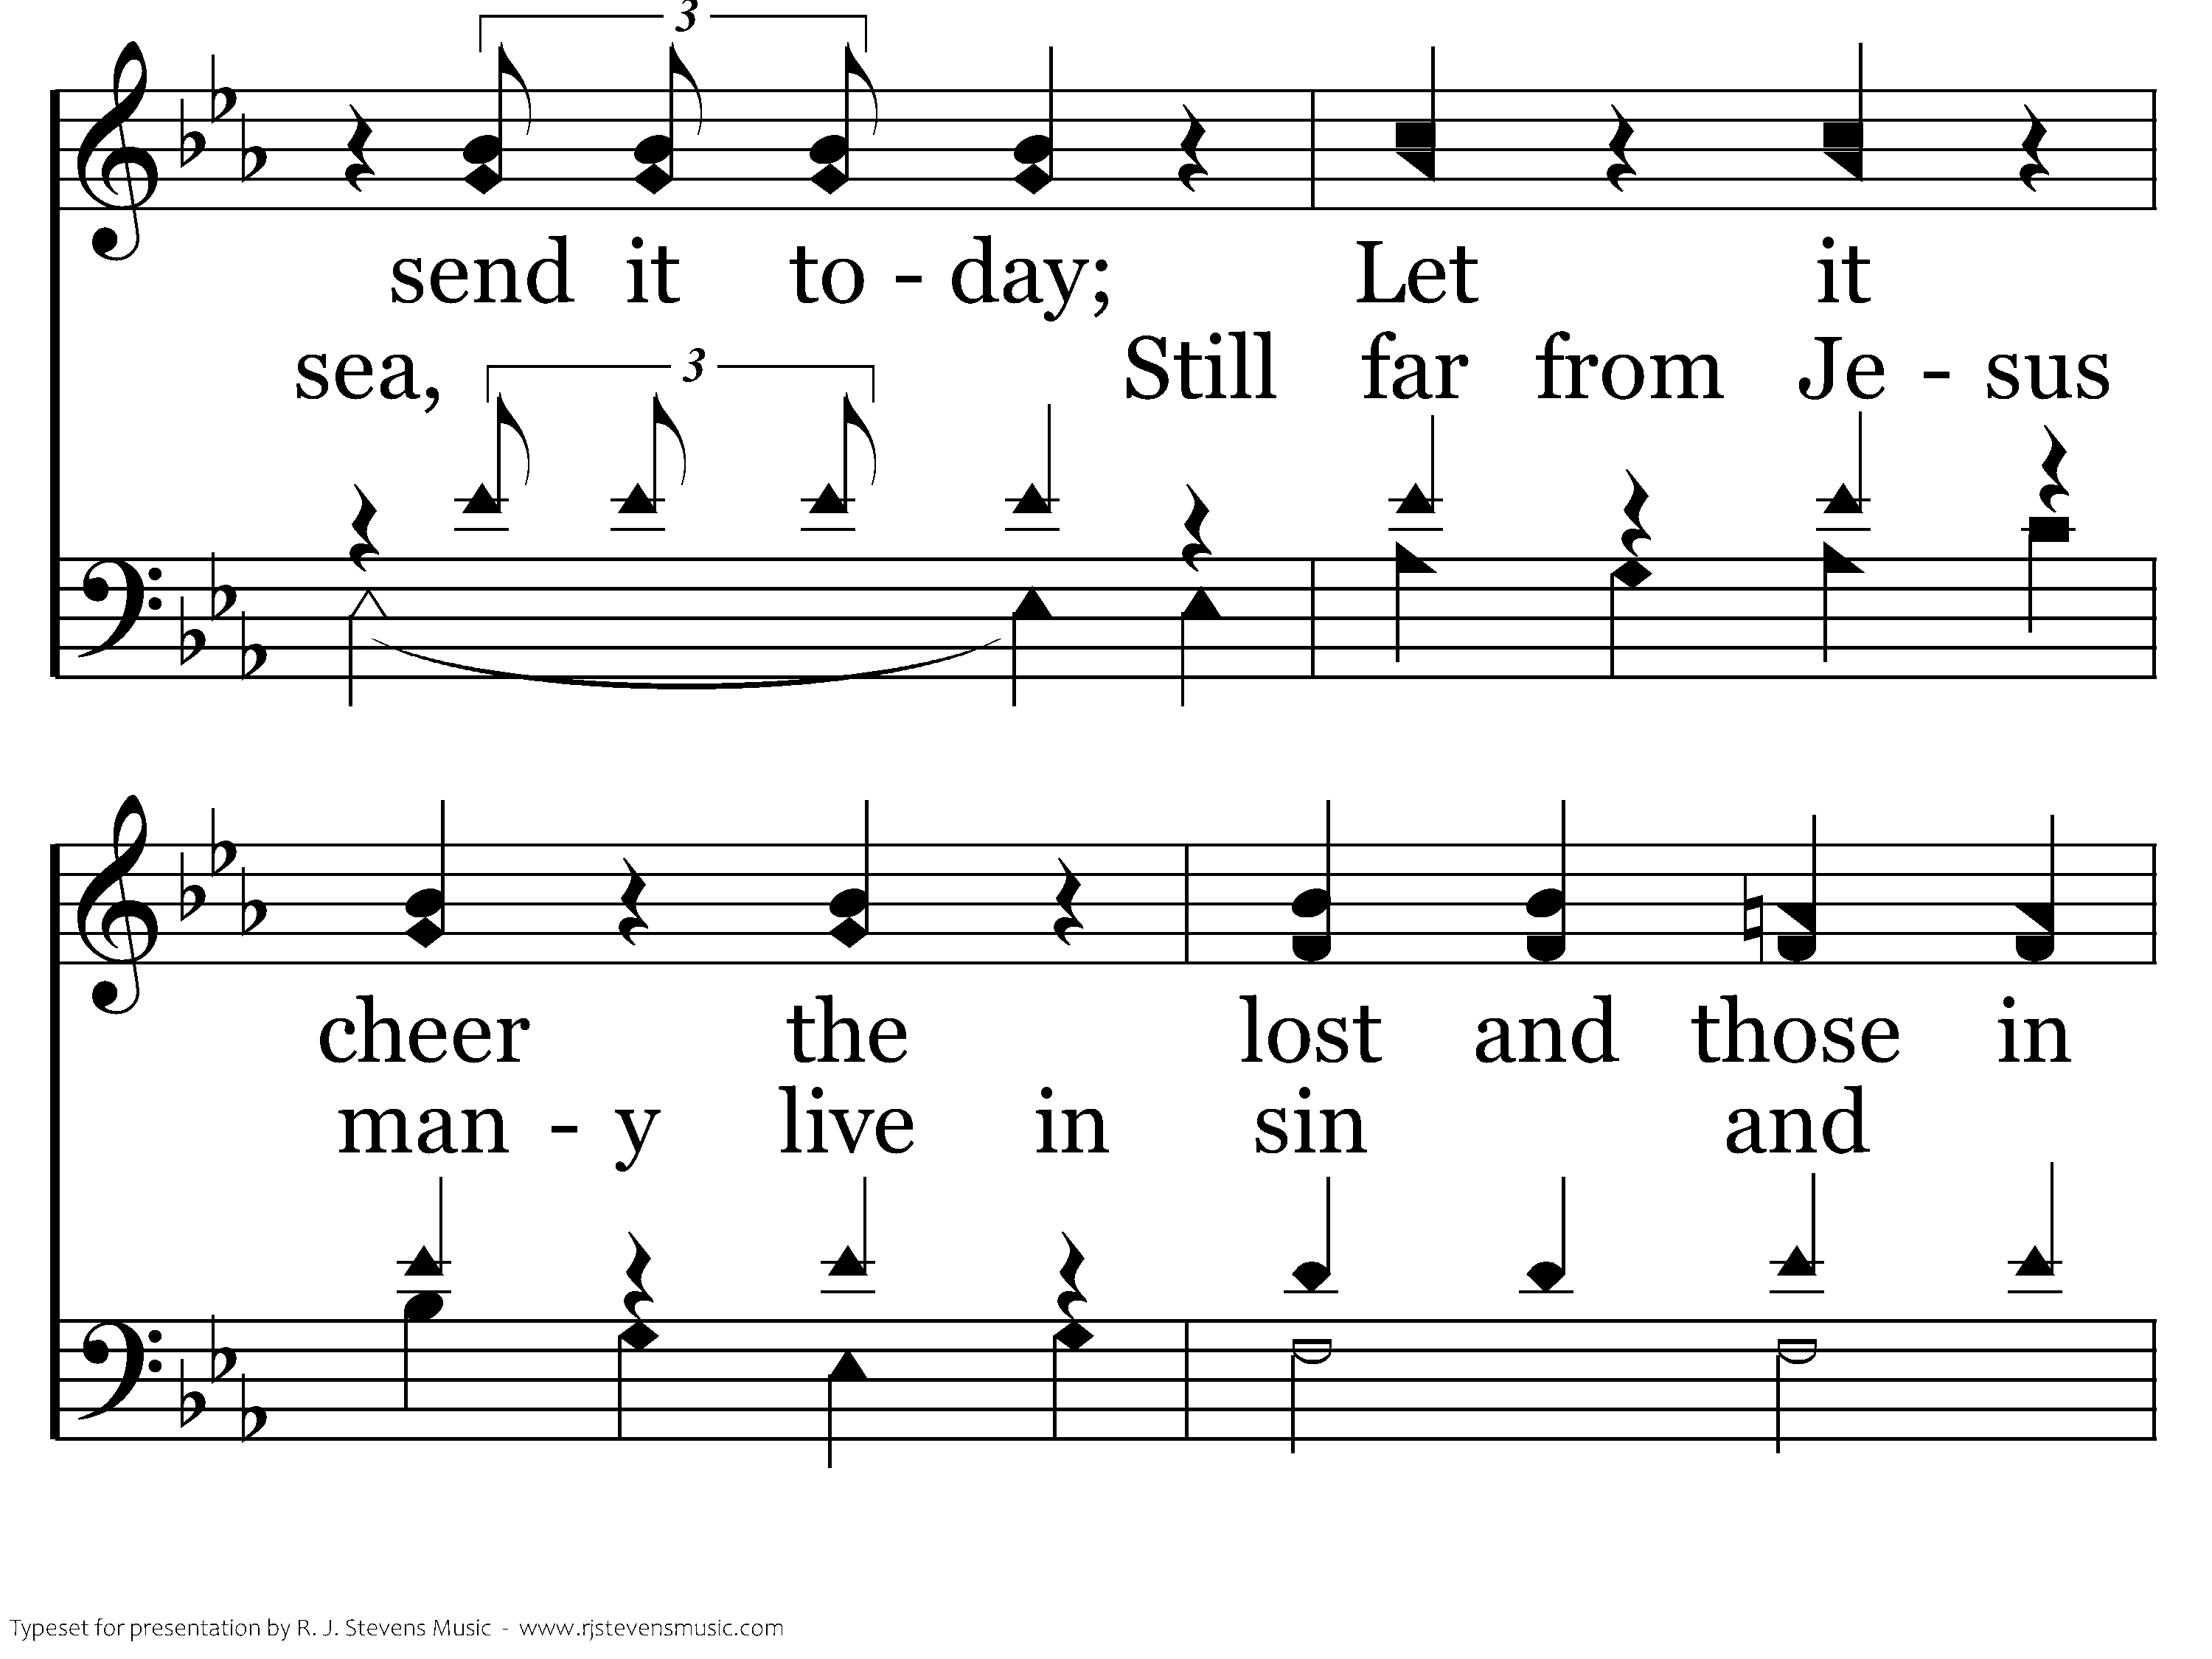
374 - Ring Out The Message - C.2

Slide 29
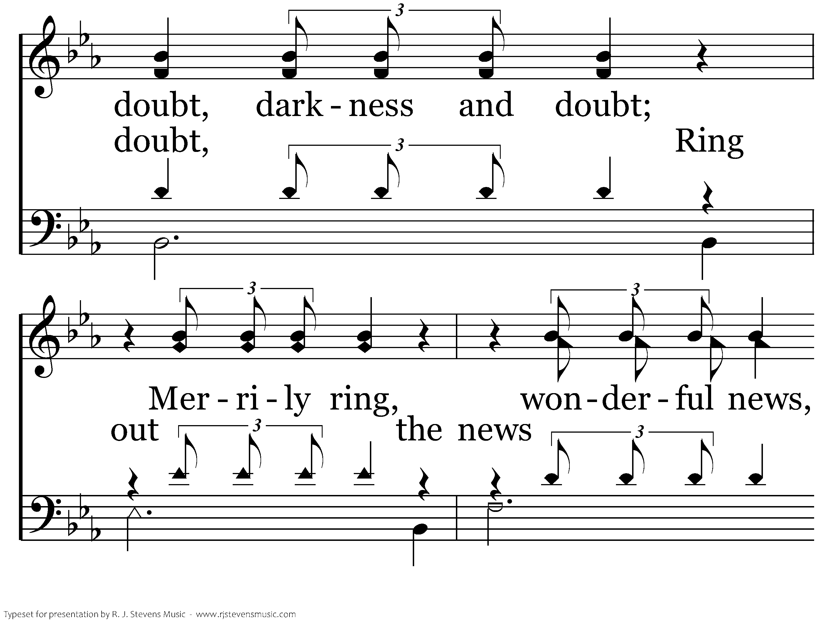
374 - Ring Out The Message - C.3

Slide 30
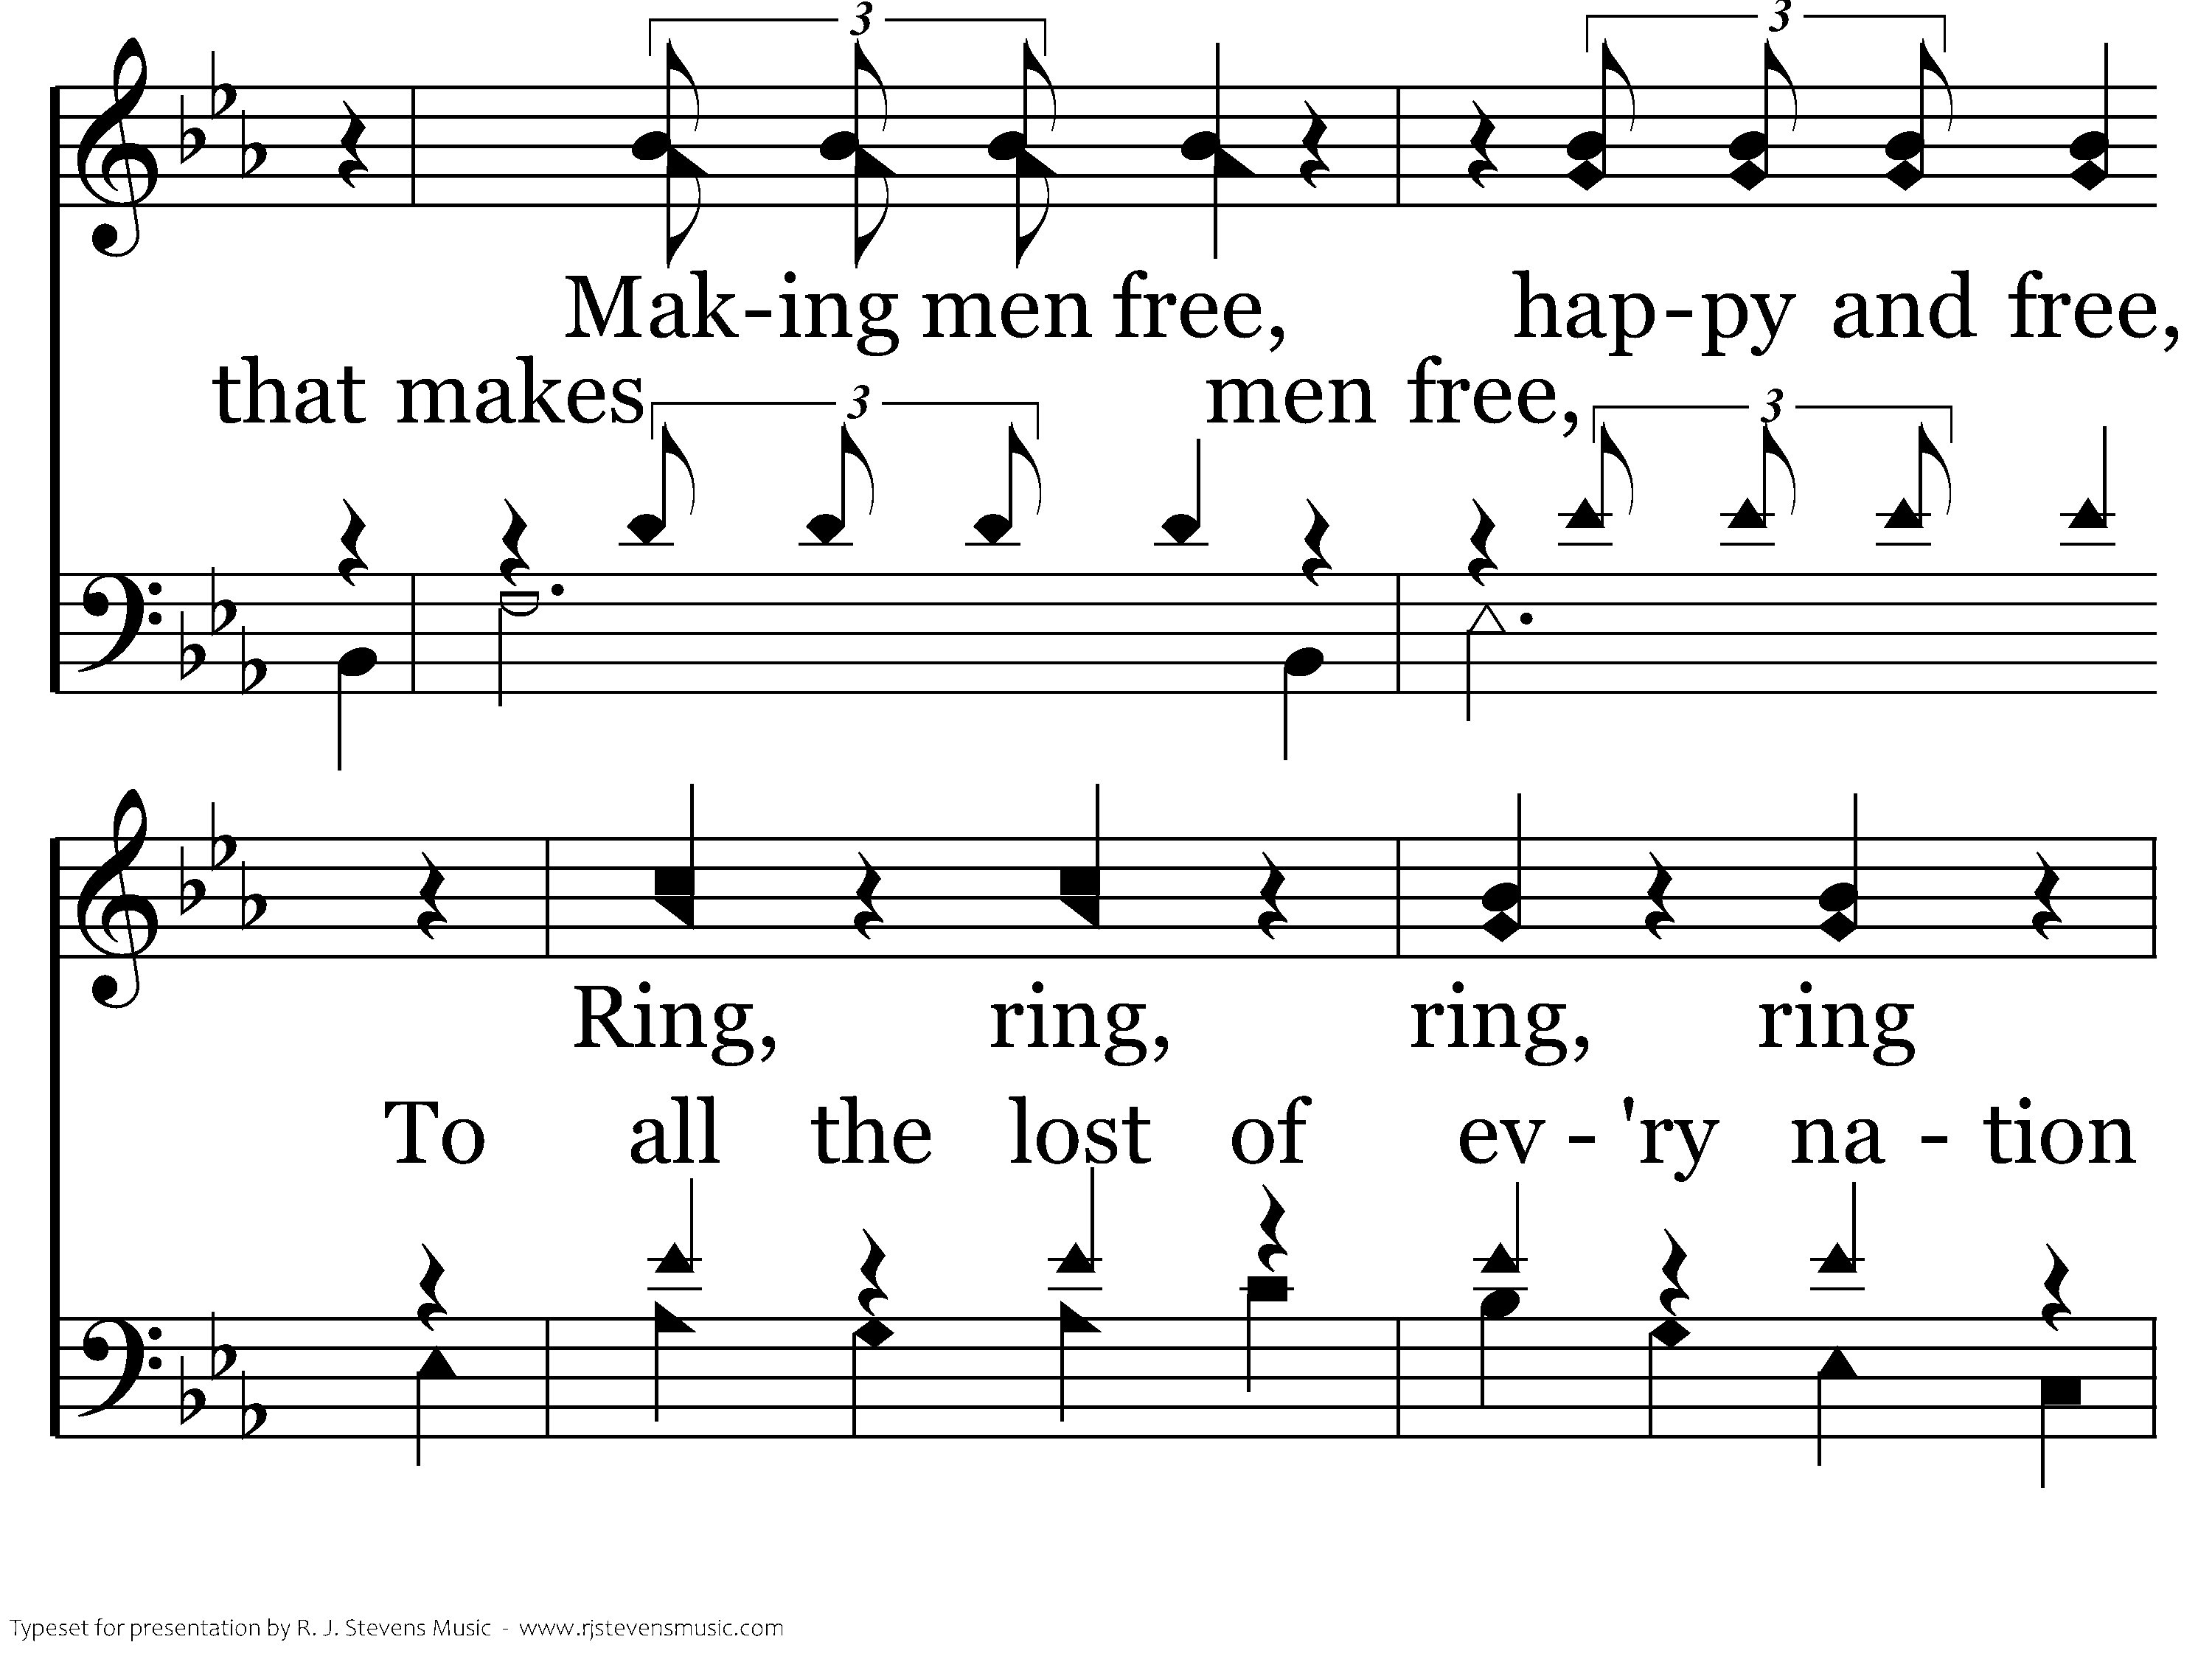
374 - Ring Out The Message - C.4

Slide 31
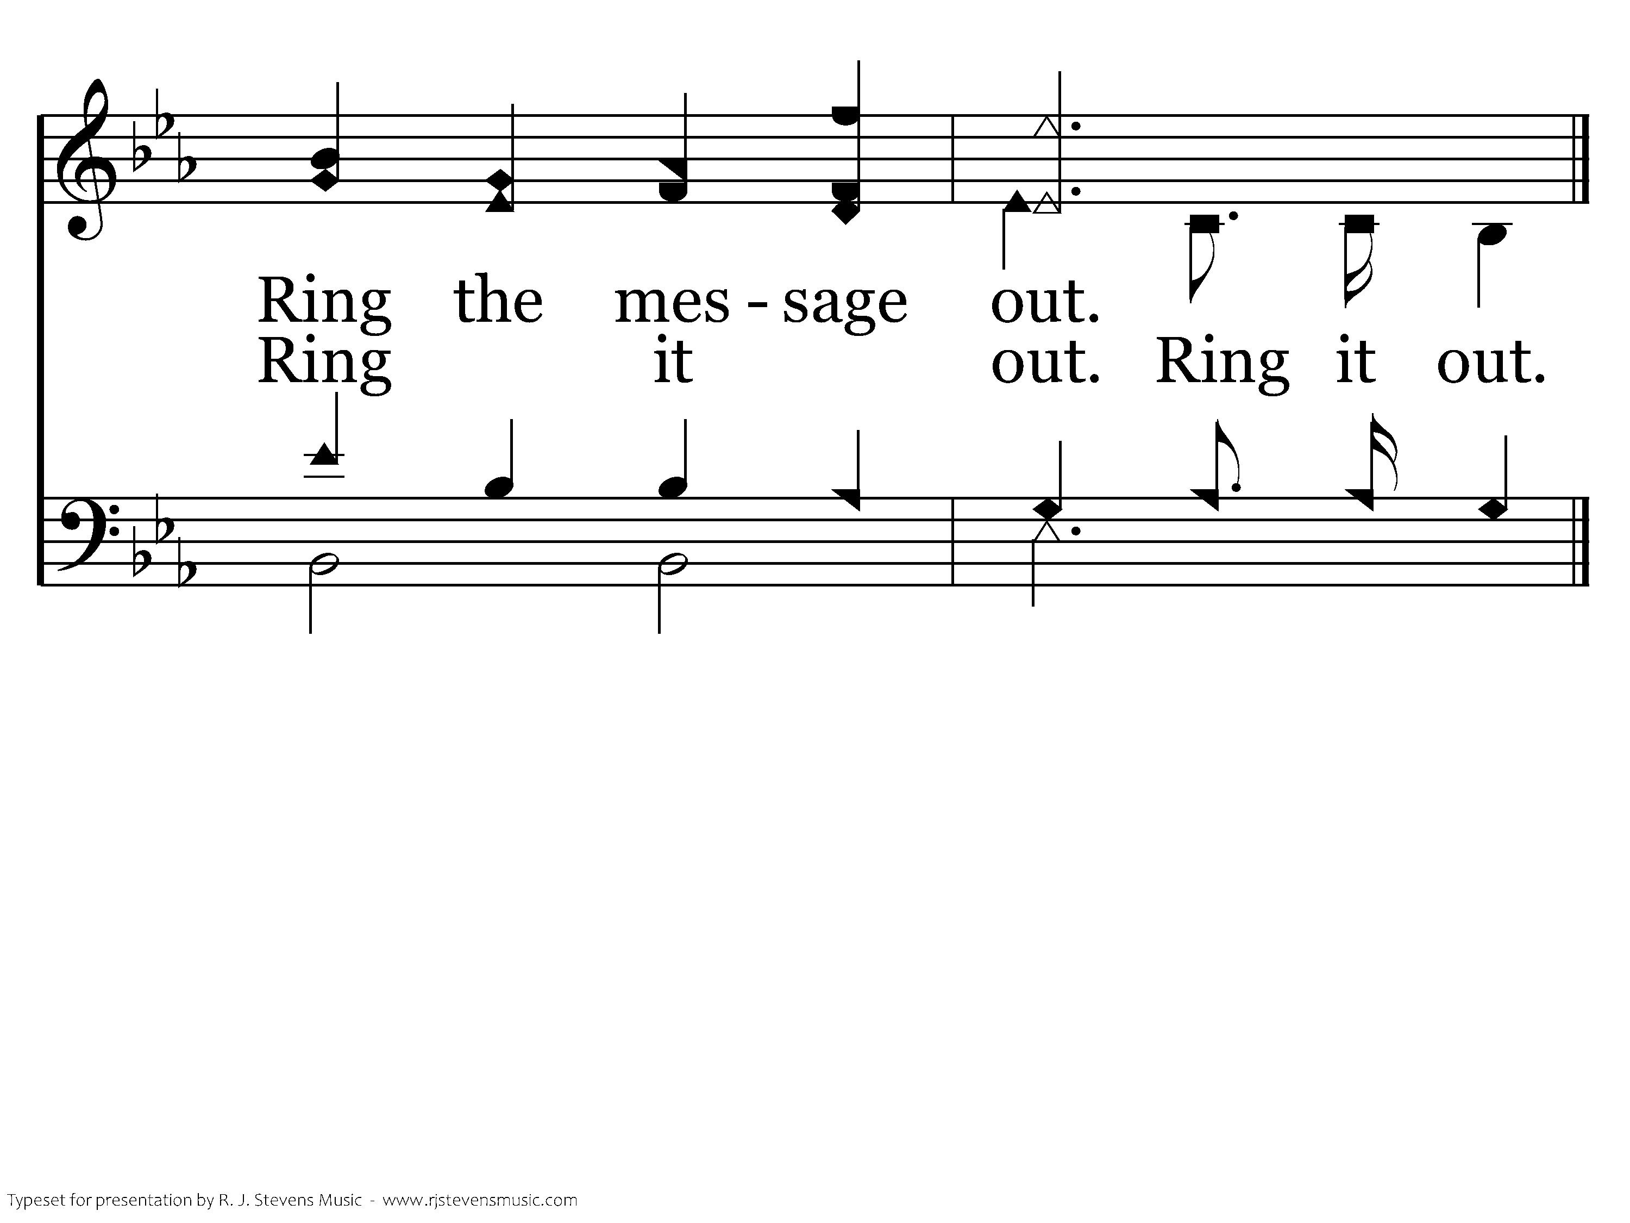
374 - Ring Out The Message - C.5
End of Verse 1

Slide 32
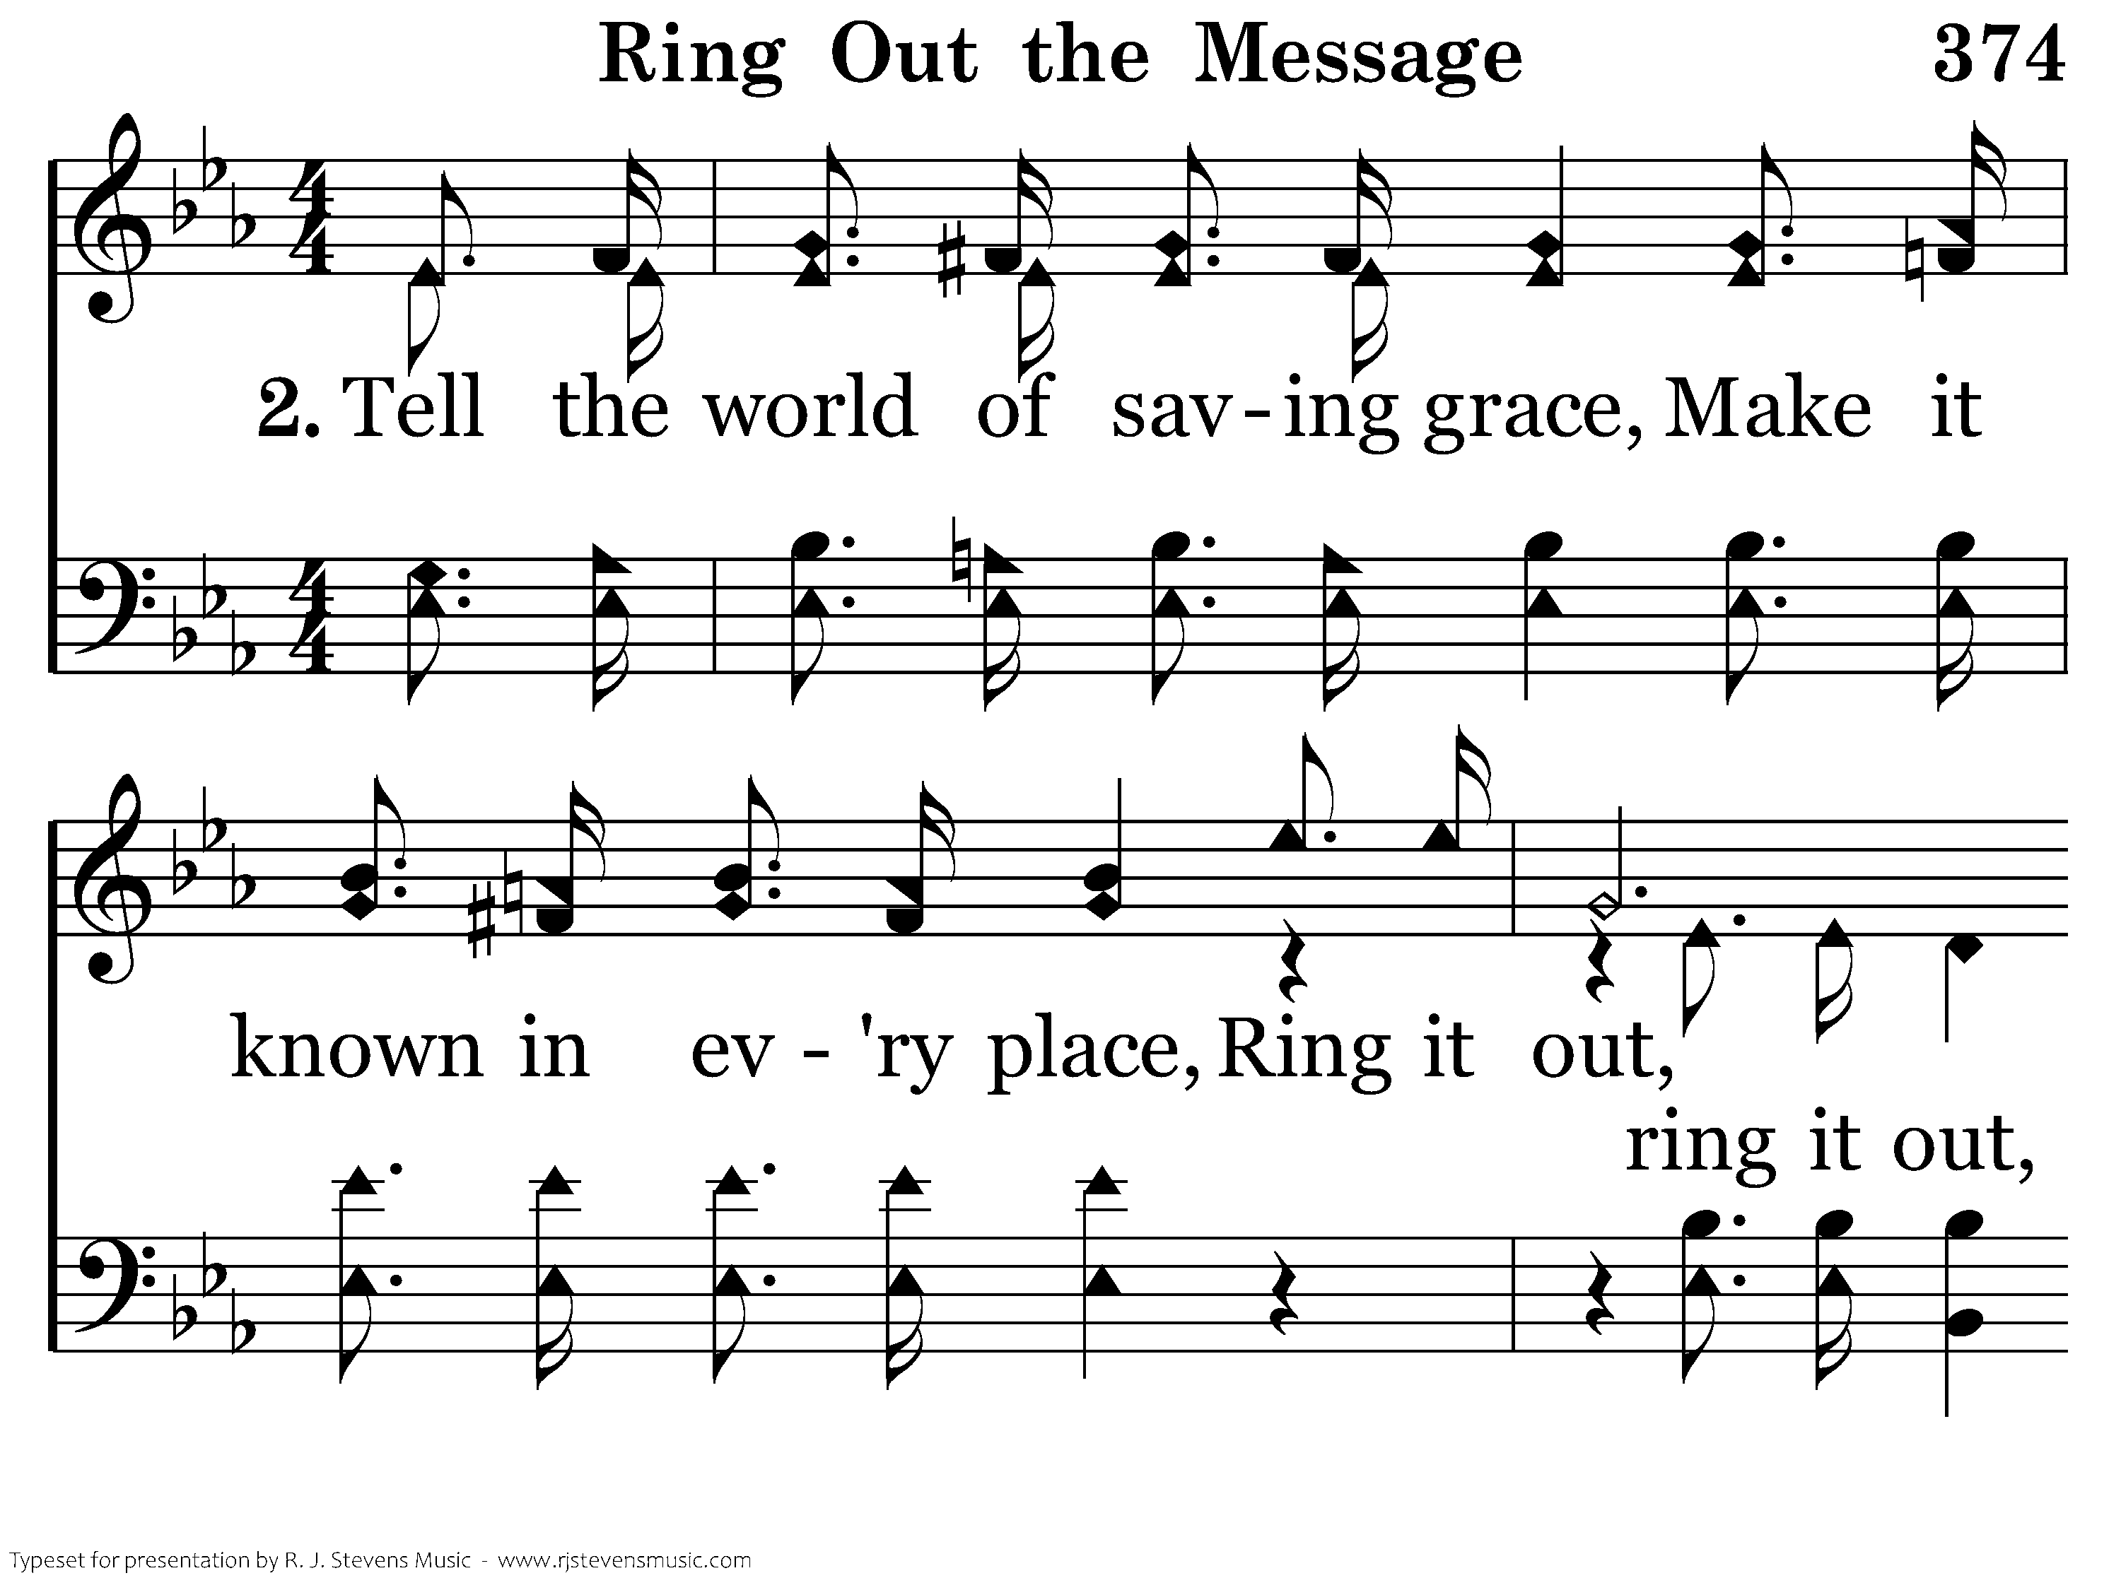
374 - Ring Out The Message - 2.1

Slide 33
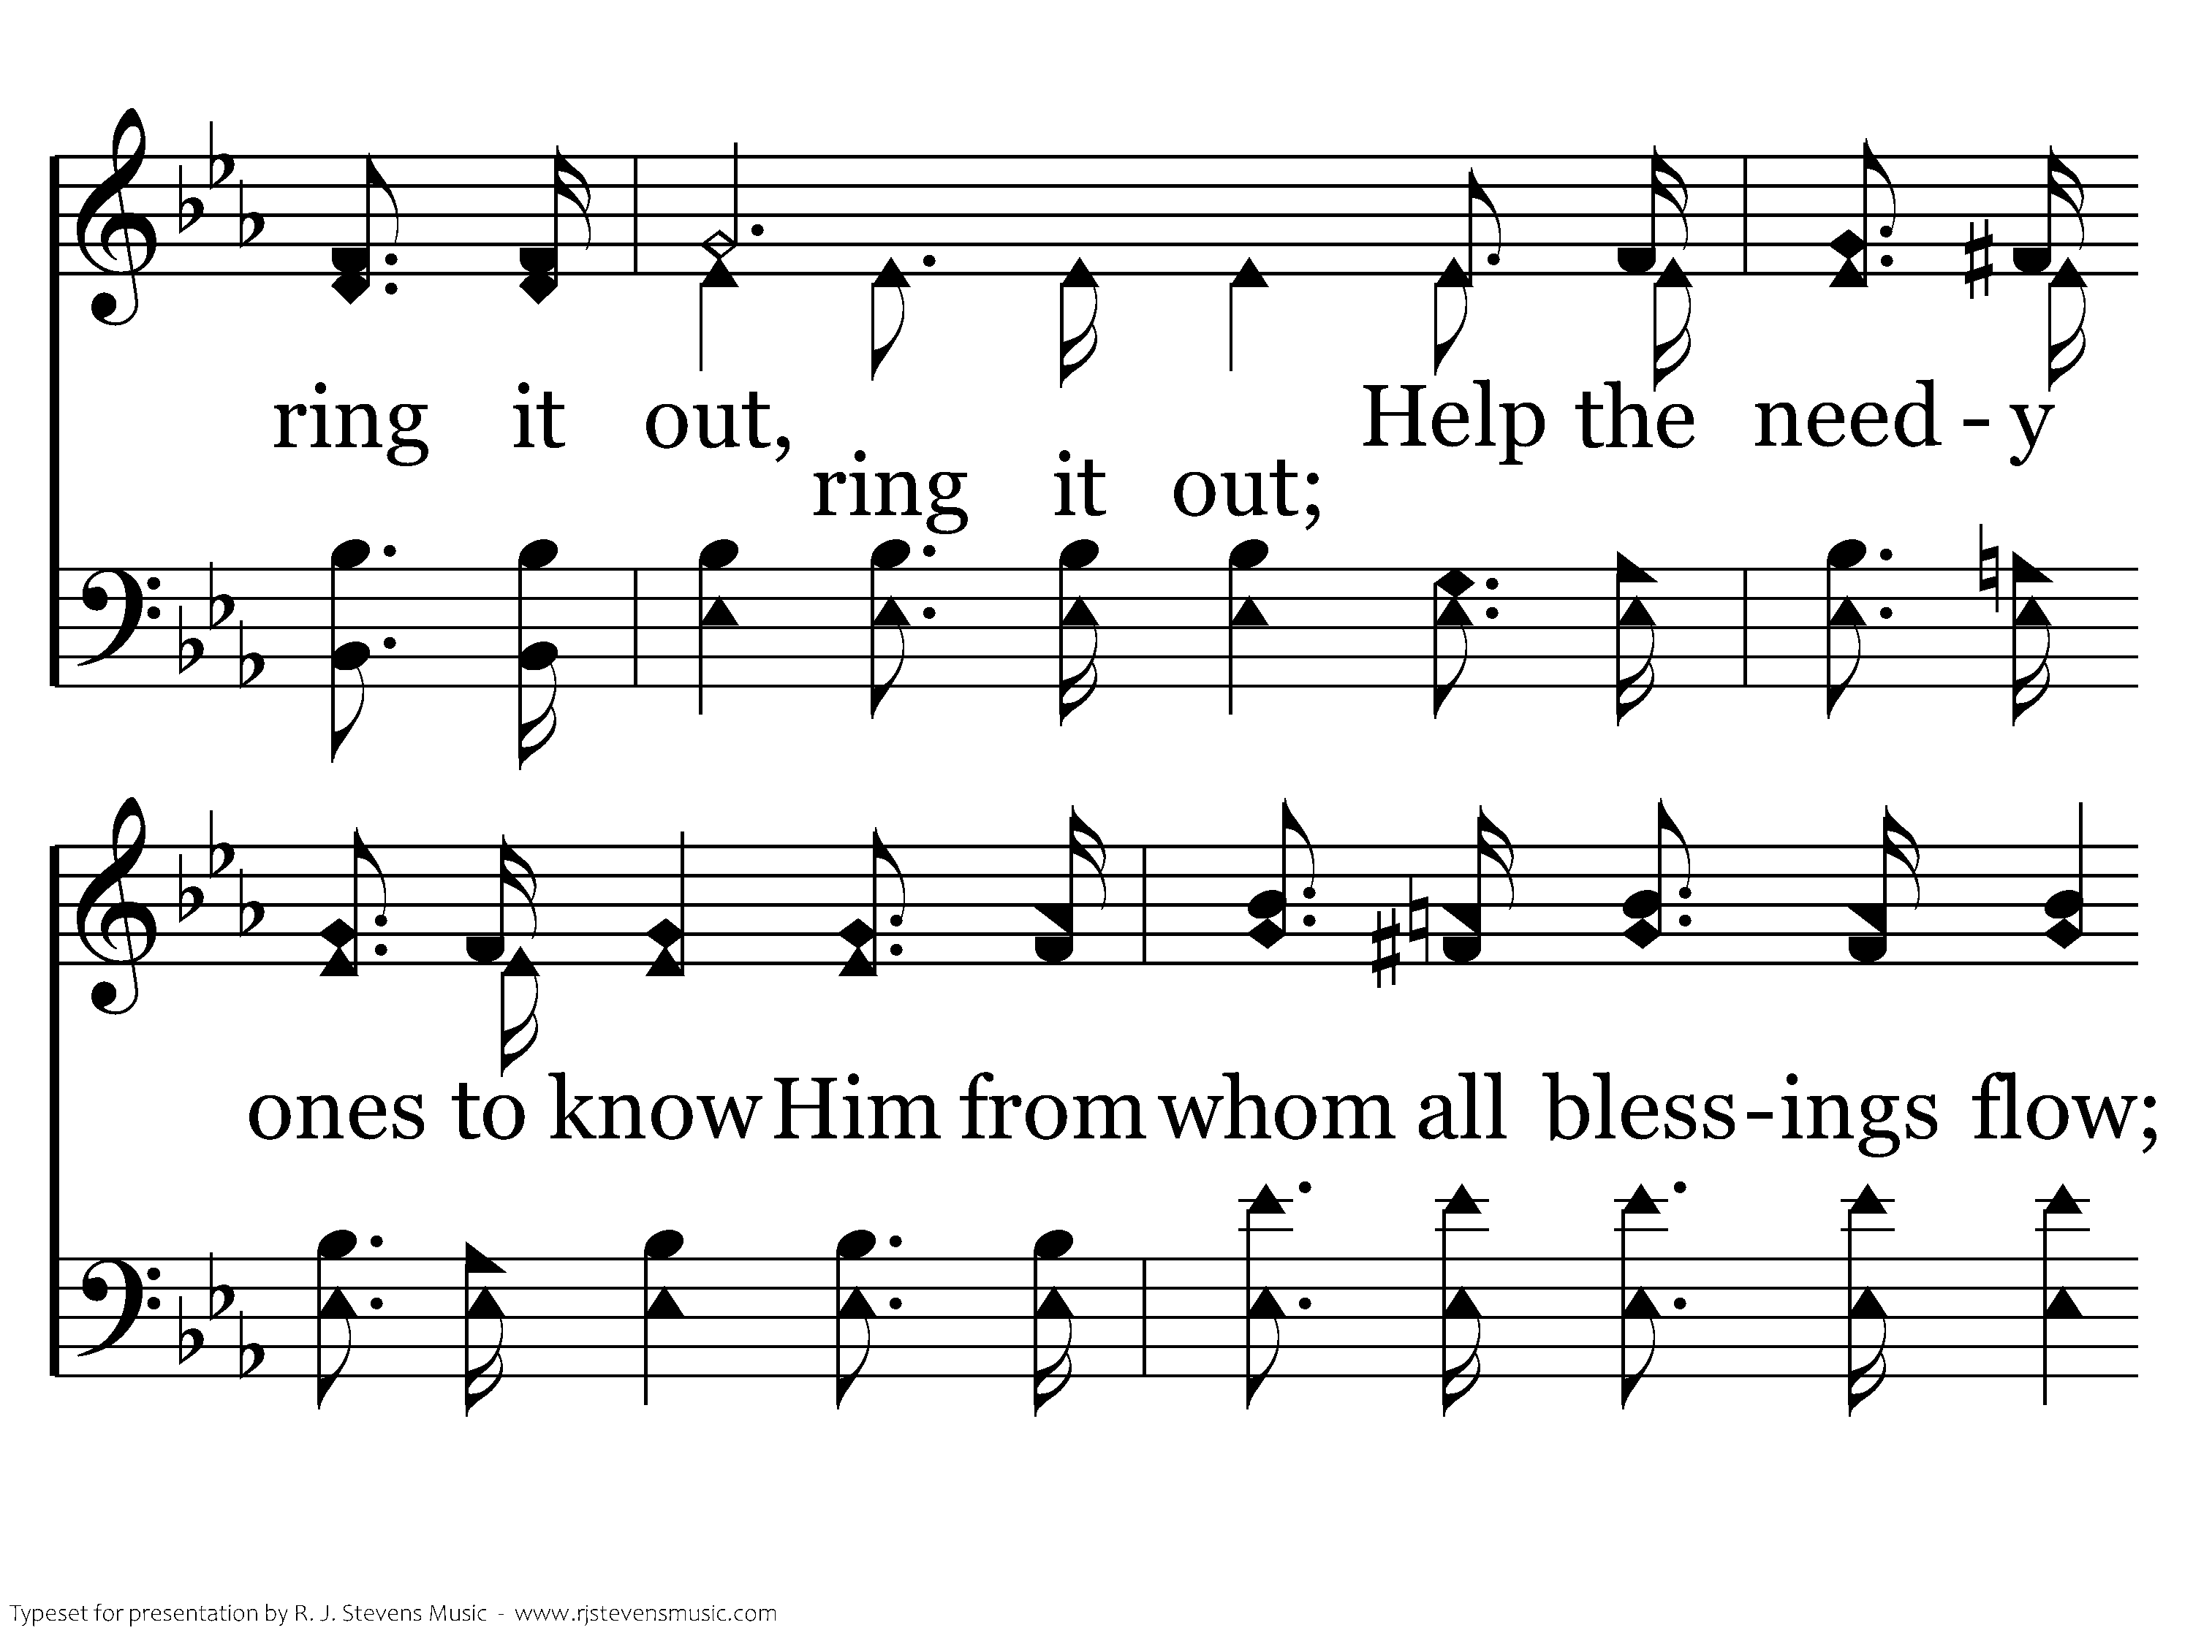
374 - Ring Out The Message - 2.2

Slide 34
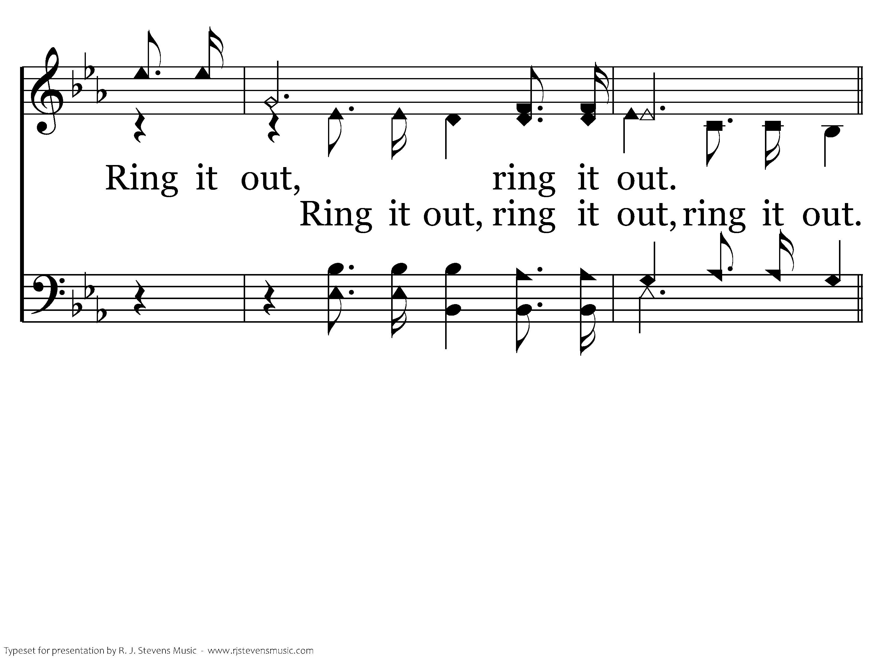
374 - Ring Out The Message - 2.3

Slide 35
374 - Ring Out The Message - C.1

Slide 36
374 - Ring Out The Message - C.2

Slide 37
374 - Ring Out The Message - C.3

Slide 38
374 - Ring Out The Message - C.4

Slide 39
374 - Ring Out The Message - C.5
End of Verse 2

Slide 40
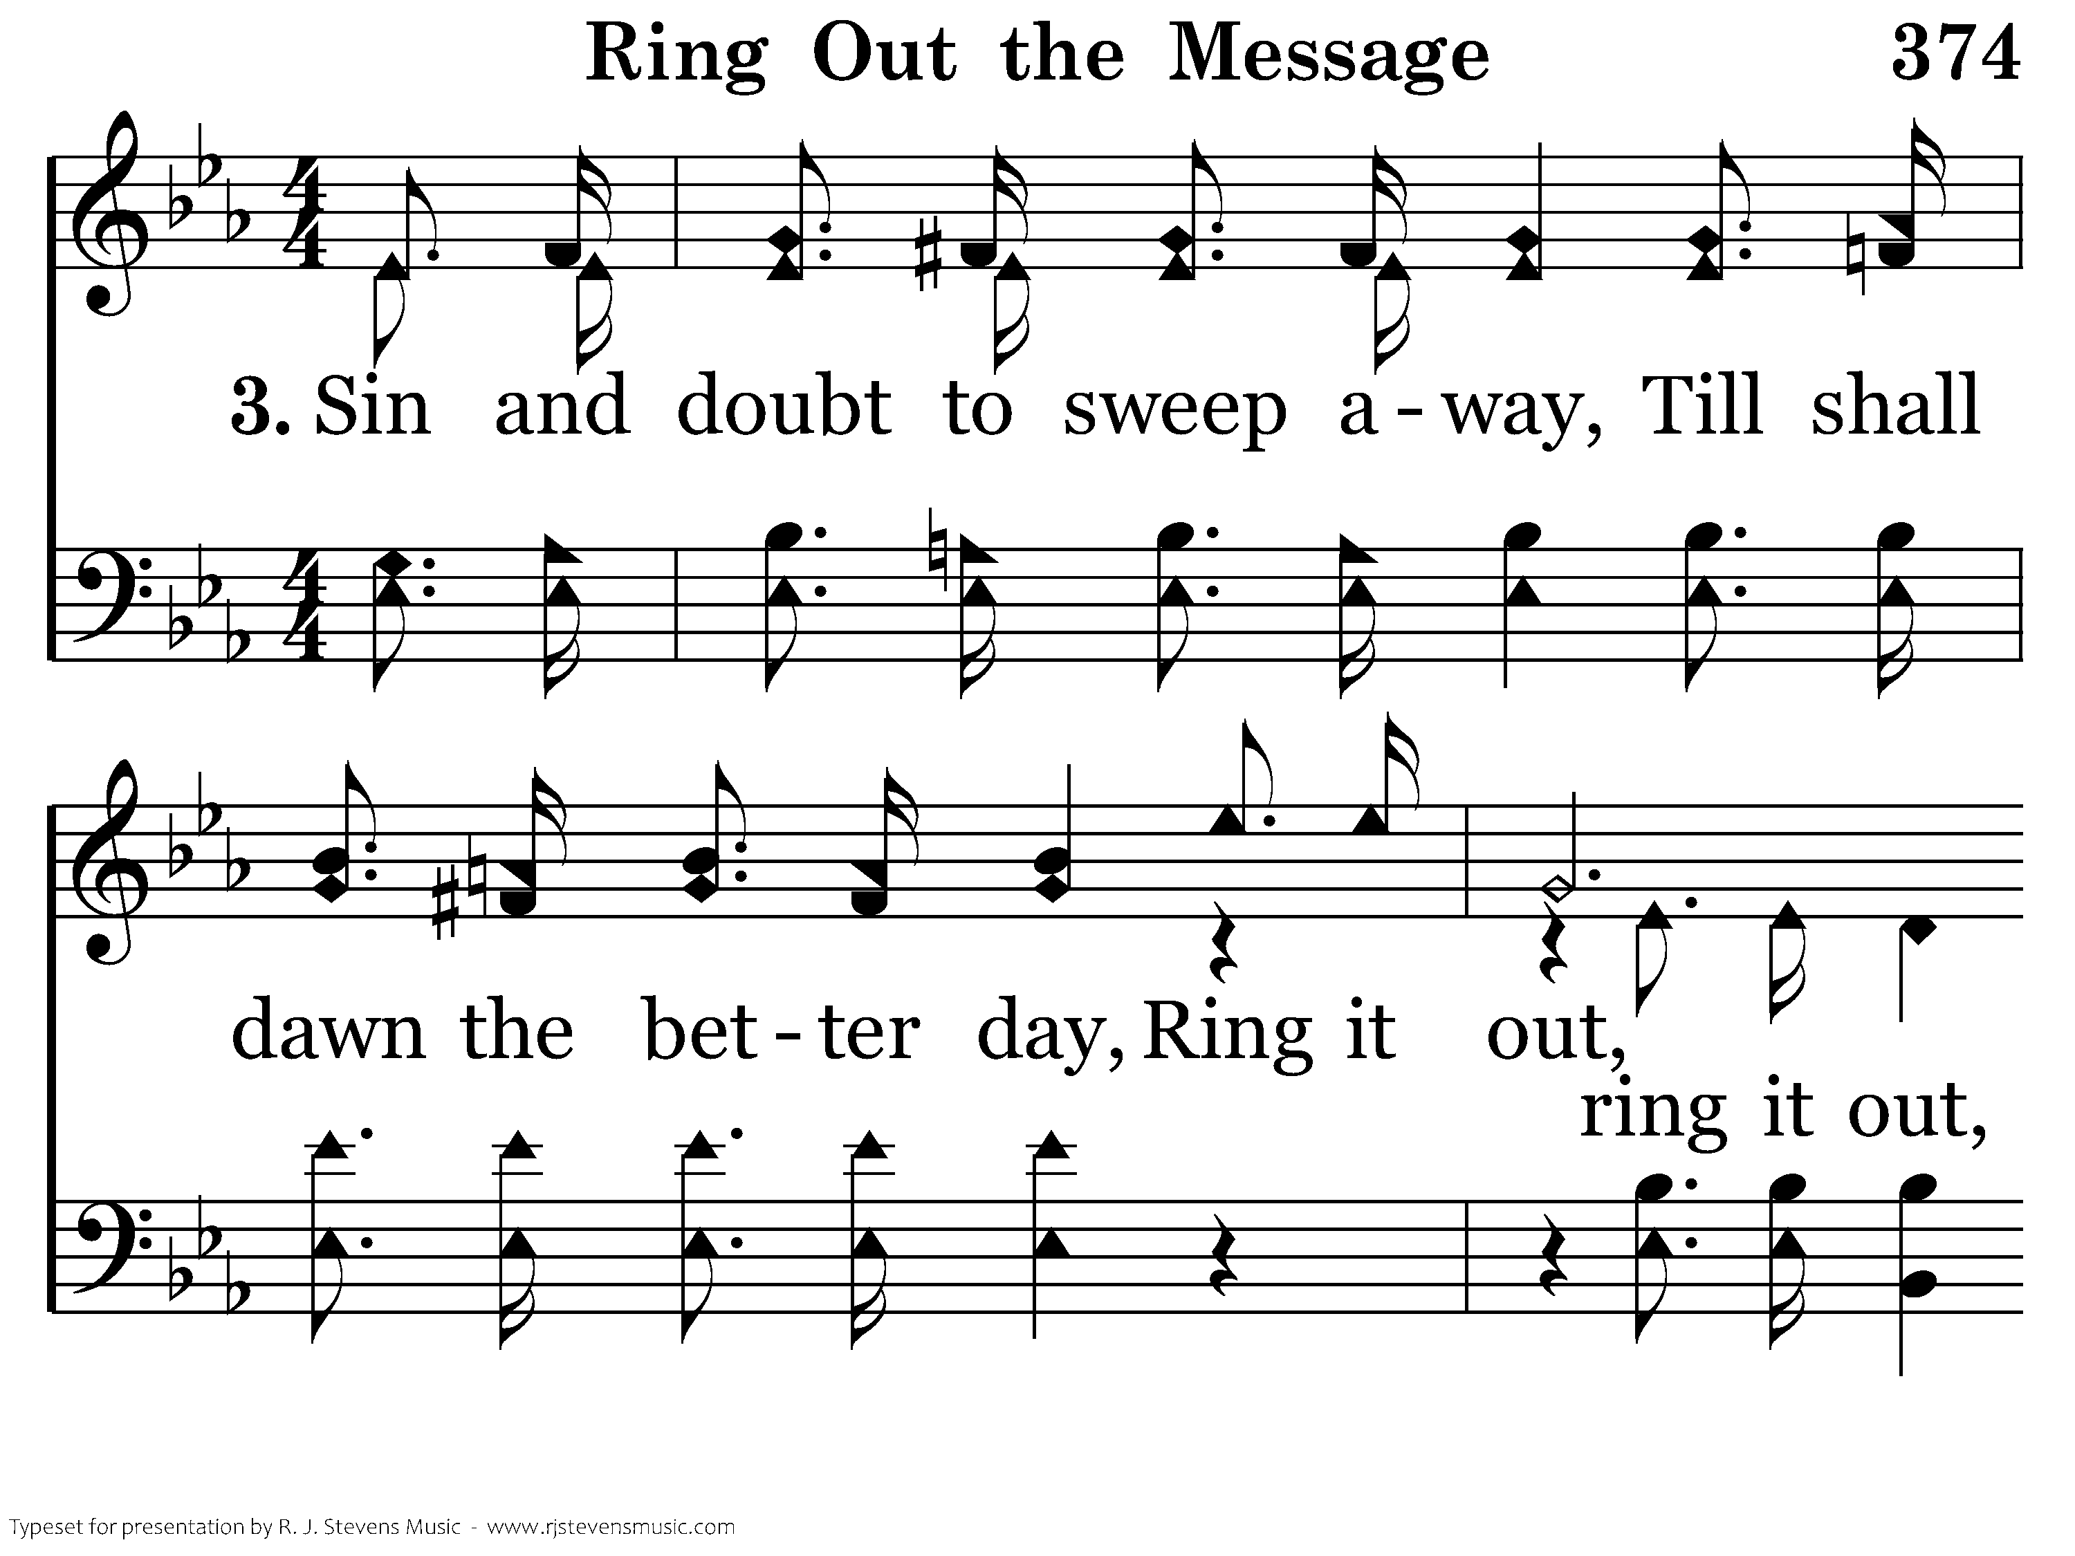
374 - Ring Out The Message - 3.1

Slide 41
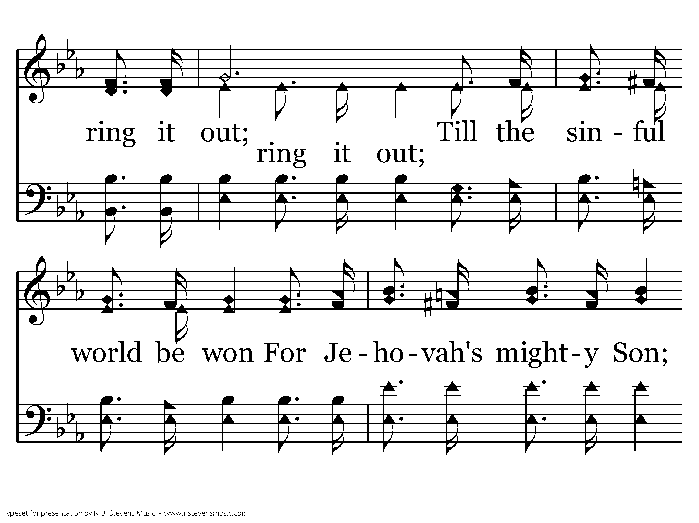
374 - Ring Out The Message - 3.2

Slide 42
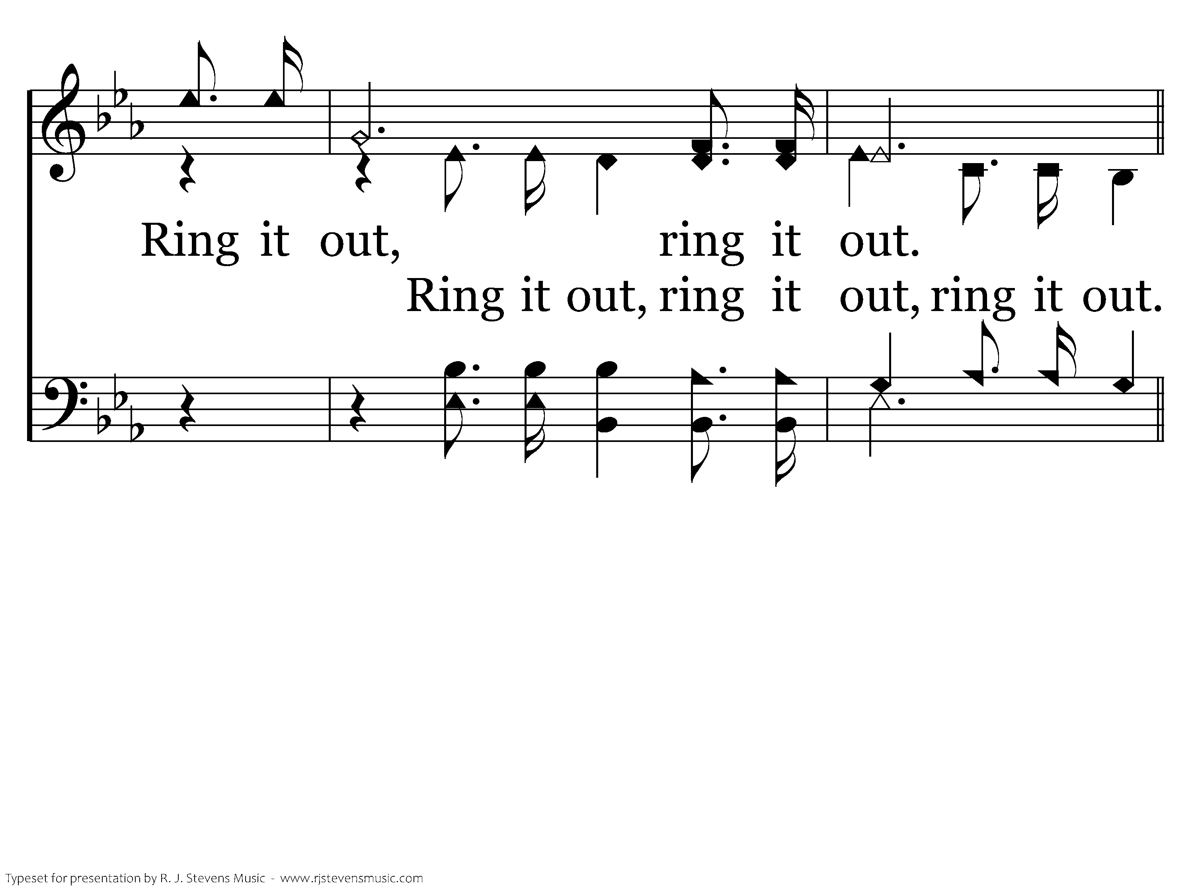
374 - Ring Out The Message - 3.3

Slide 43
374 - Ring Out The Message - C.1

Slide 44
374 - Ring Out The Message - C.2

Slide 45
374 - Ring Out The Message - C.3

Slide 46
374 - Ring Out The Message - C.4

Slide 47
374 - Ring Out The Message - C.5
End of Song

Slide 48

189 - When I Survey The Wondrous Cross - Title

Slide 49
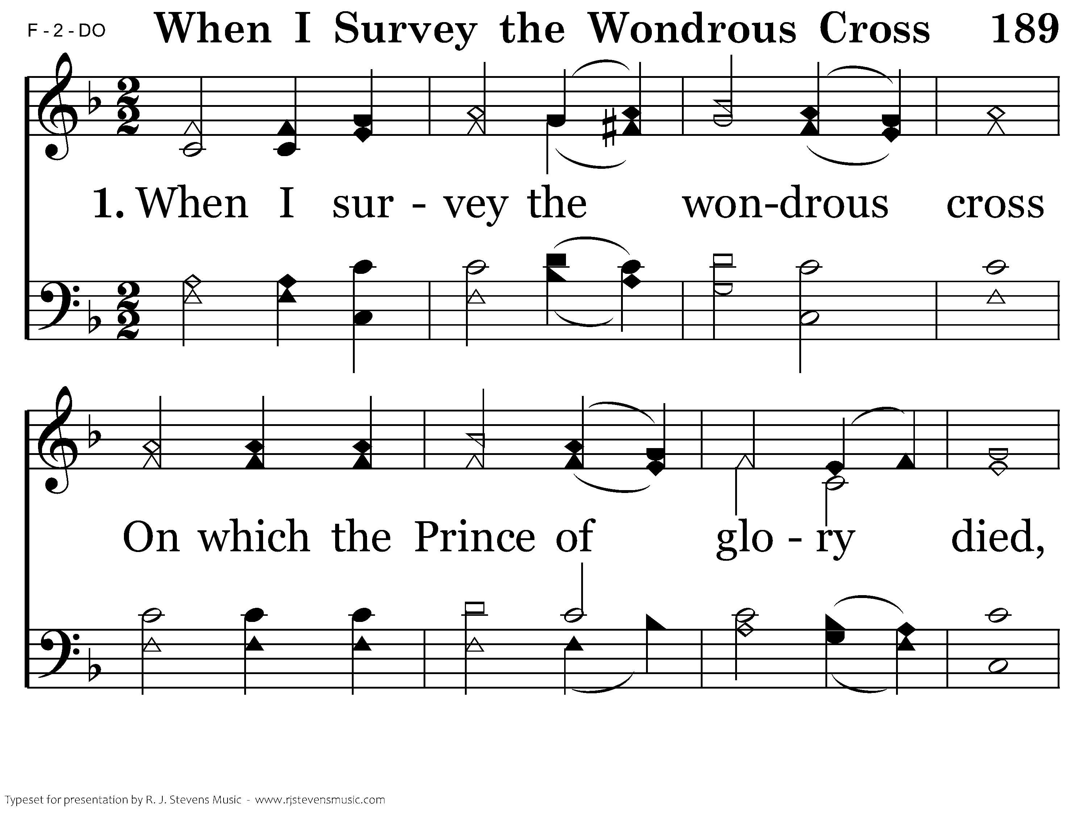
189 - When I Survey The Wondrous Cross - 1.1

Slide 50
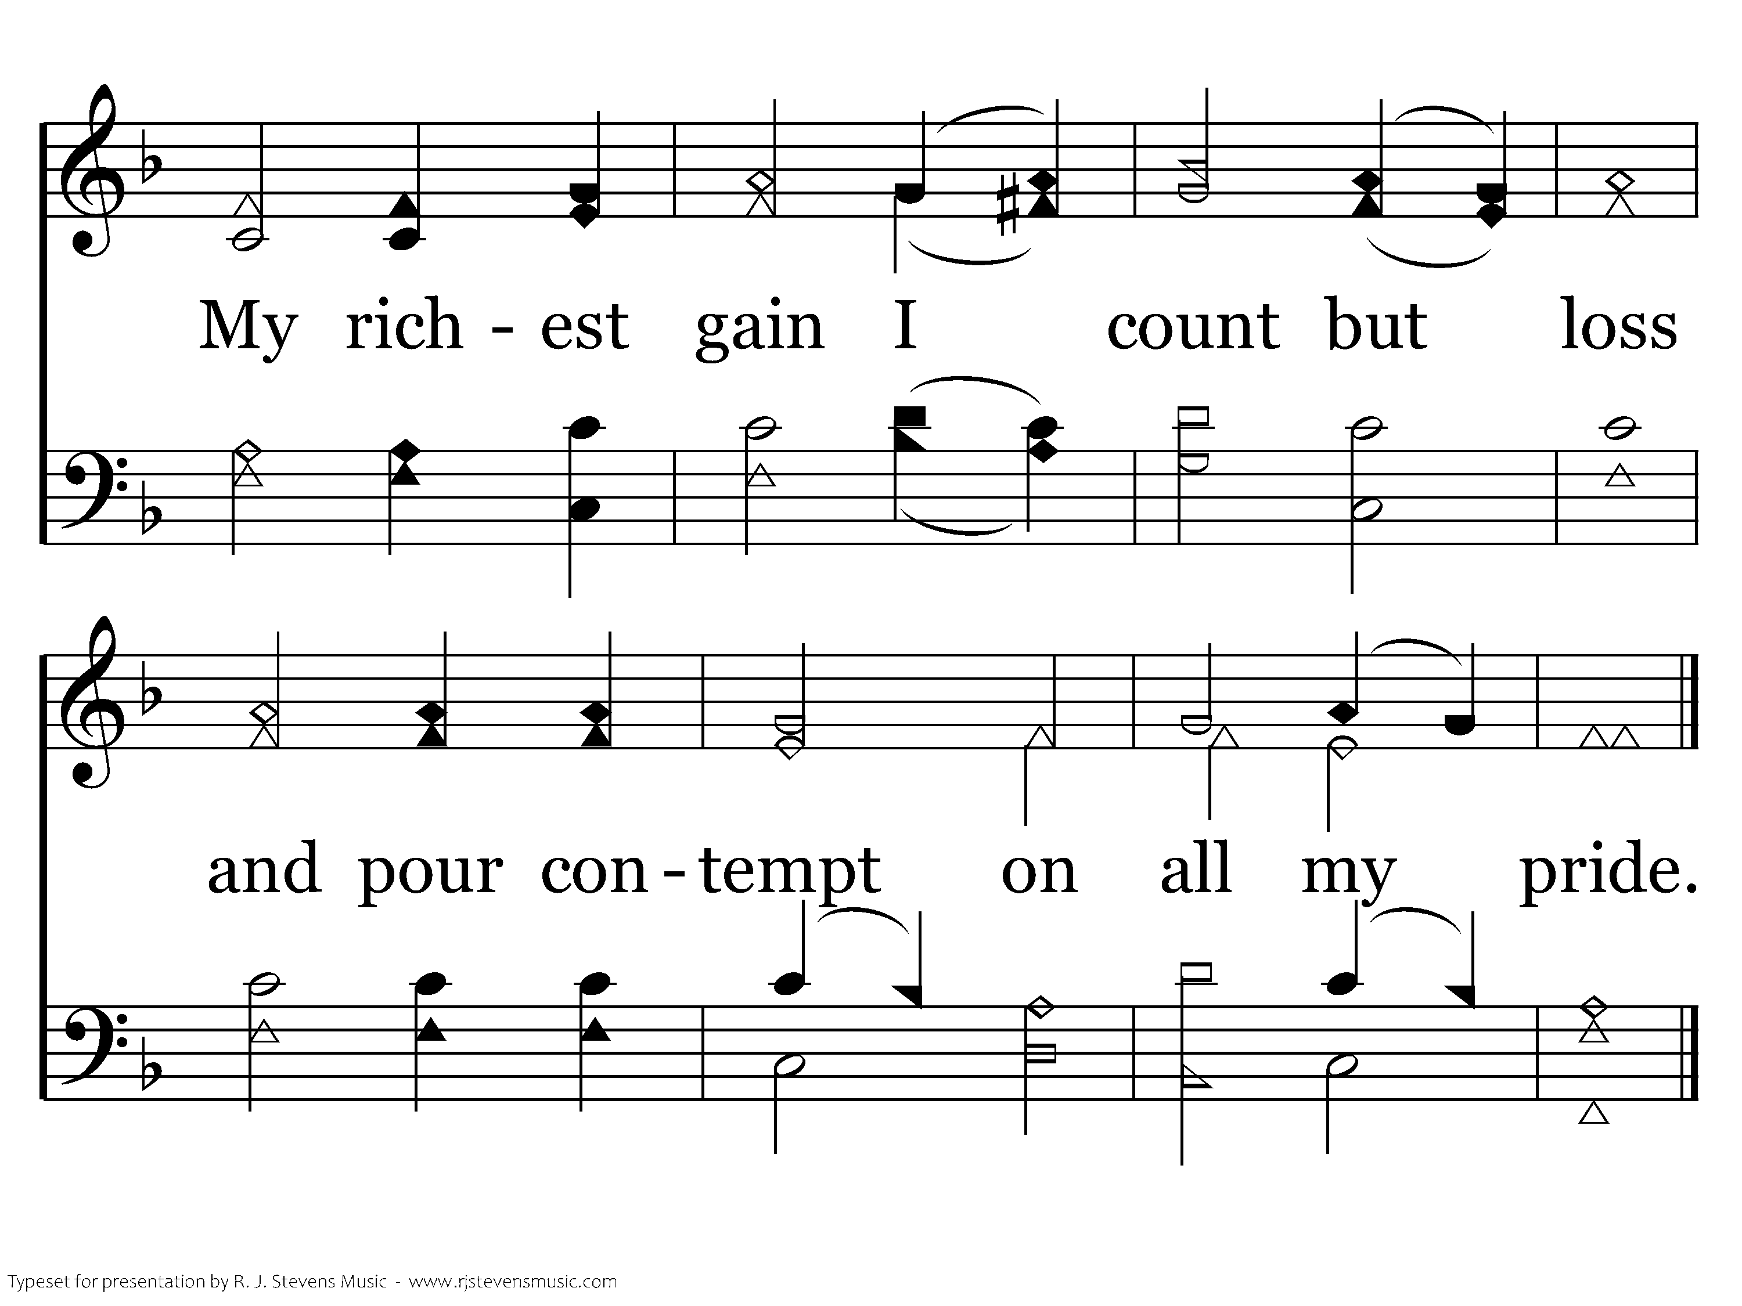
189 - When I Survey The Wondrous Cross - 1.2
End of Verse 1

Slide 51
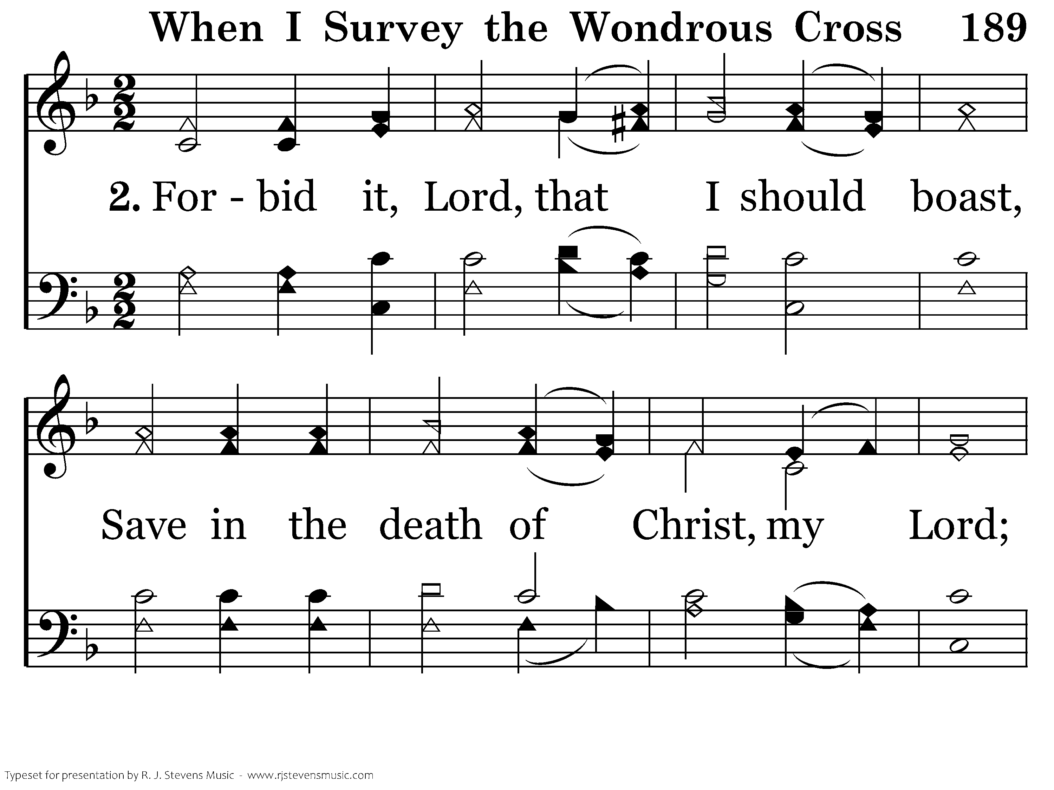
189 - When I Survey The Wondrous Cross - 2.1

Slide 52
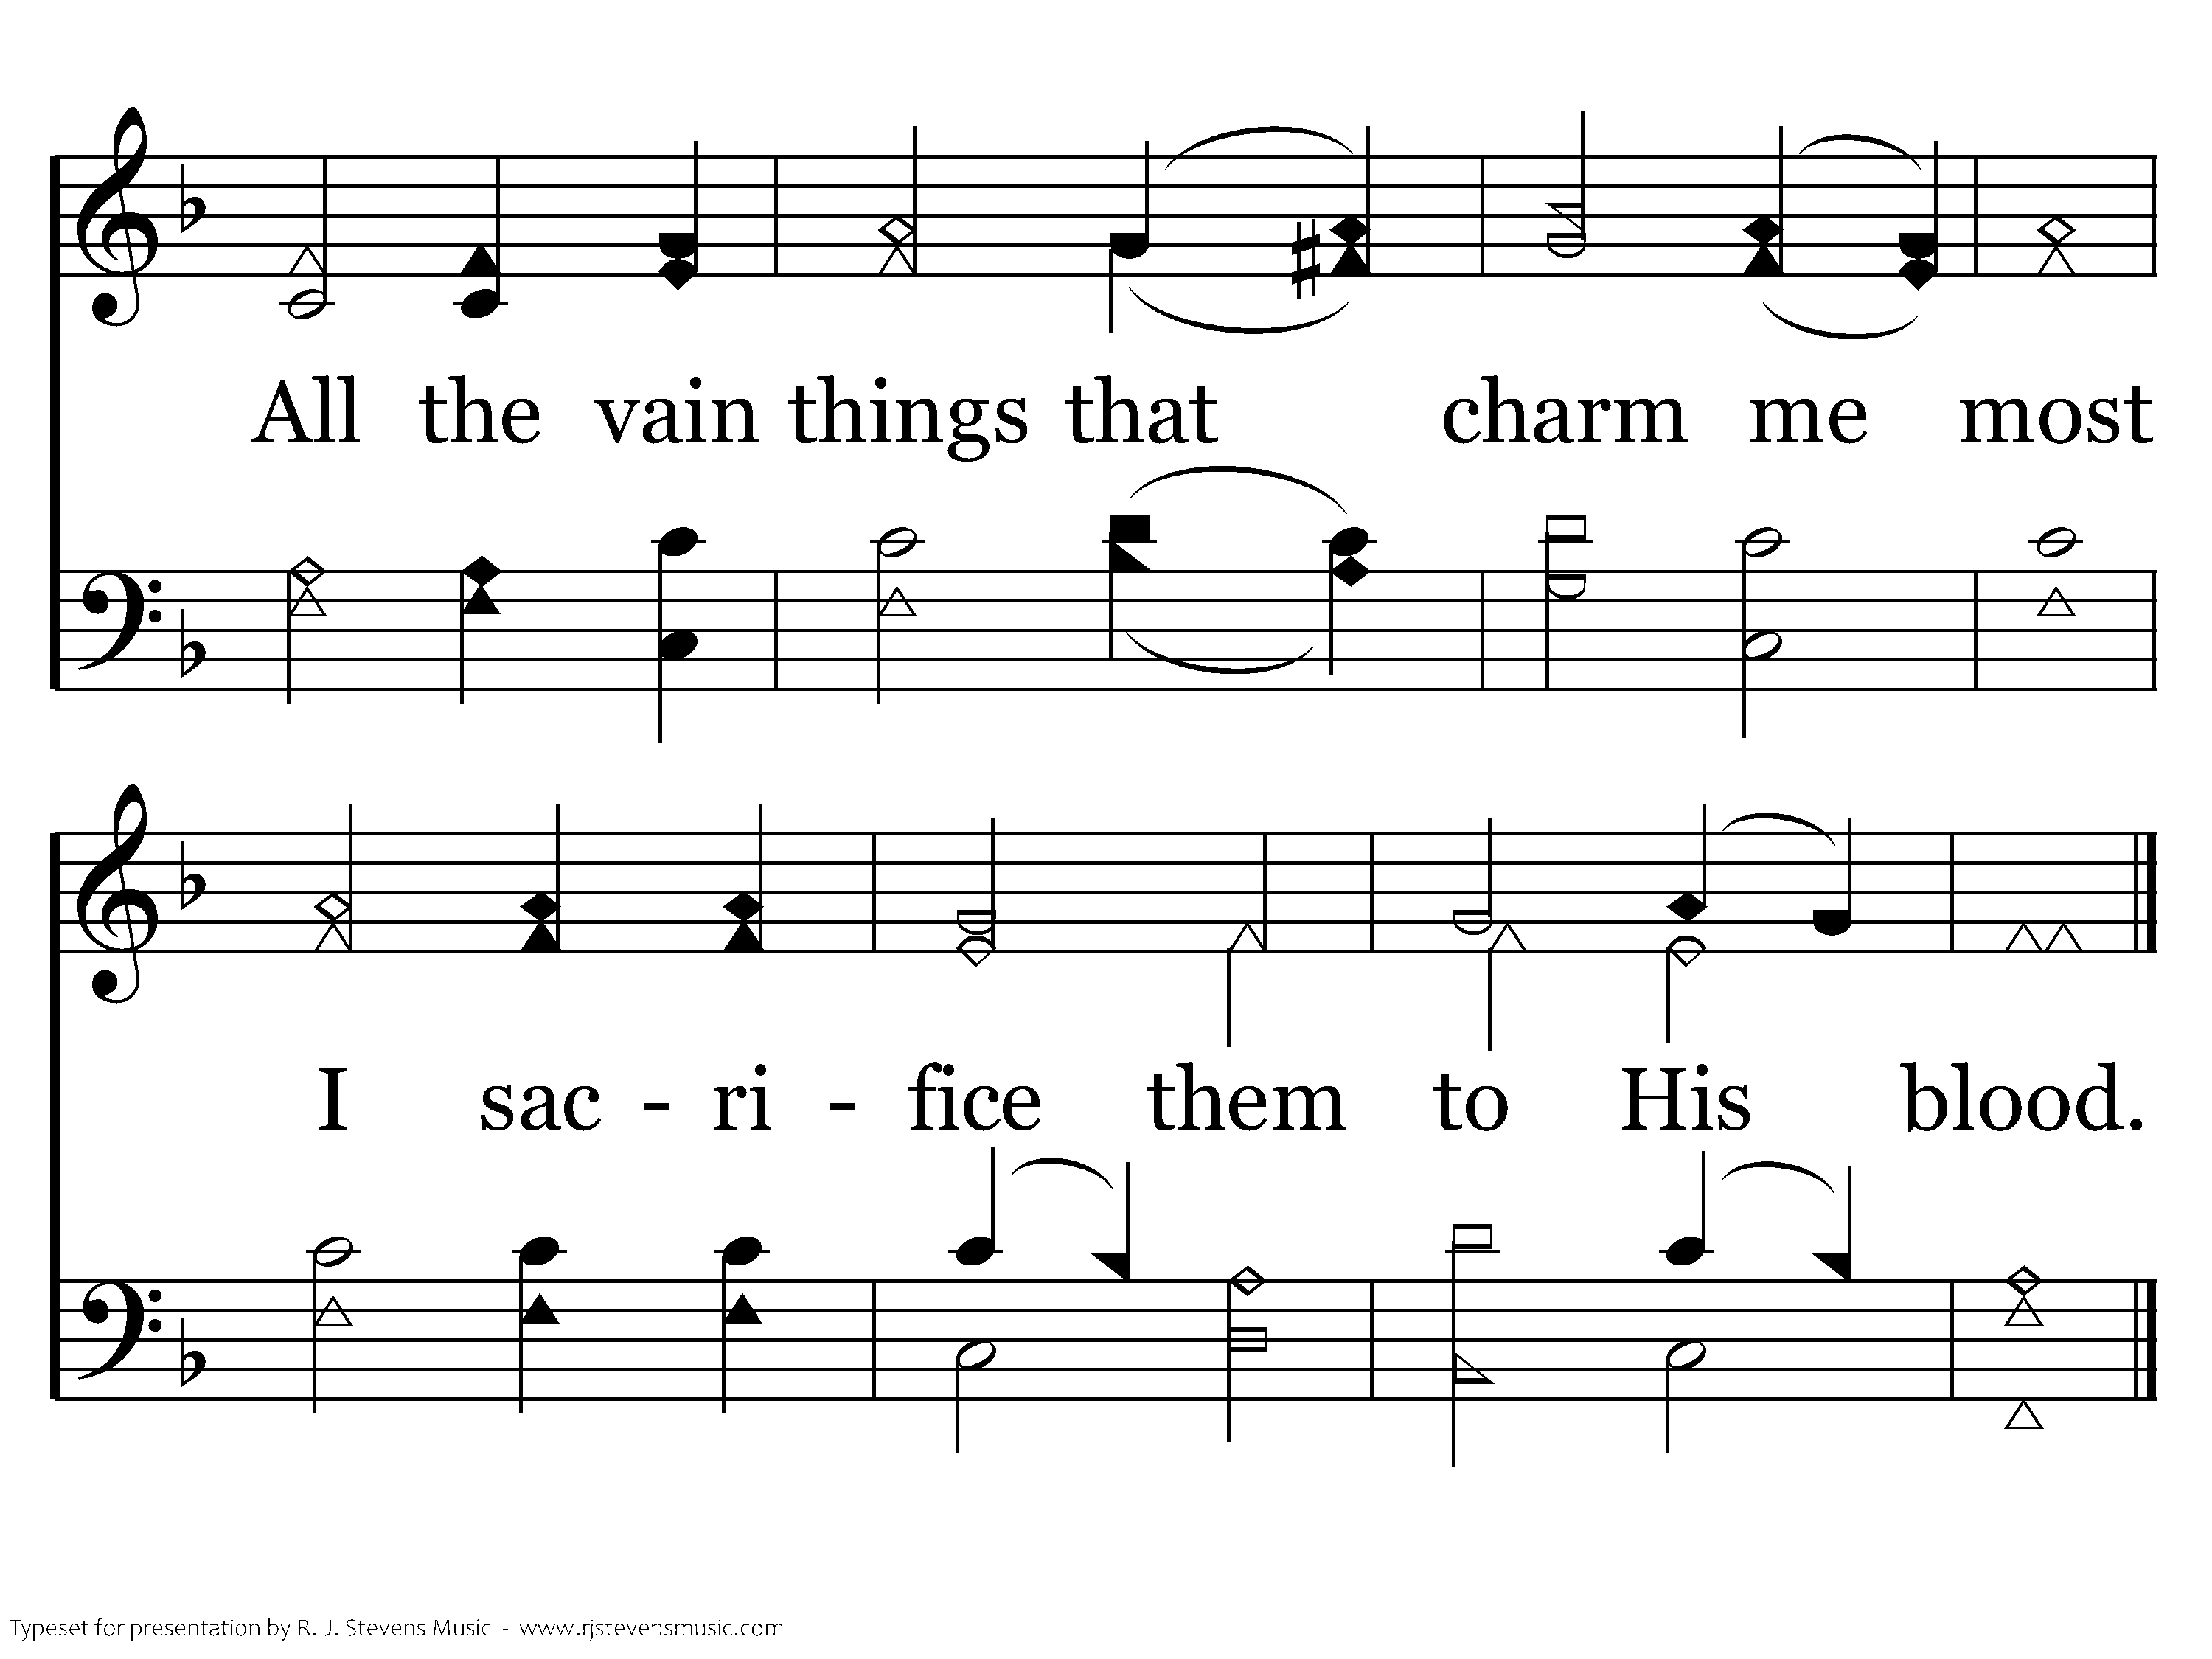
189 - When I Survey The Wondrous Cross - 2.2
End of Verse 2

Slide 53
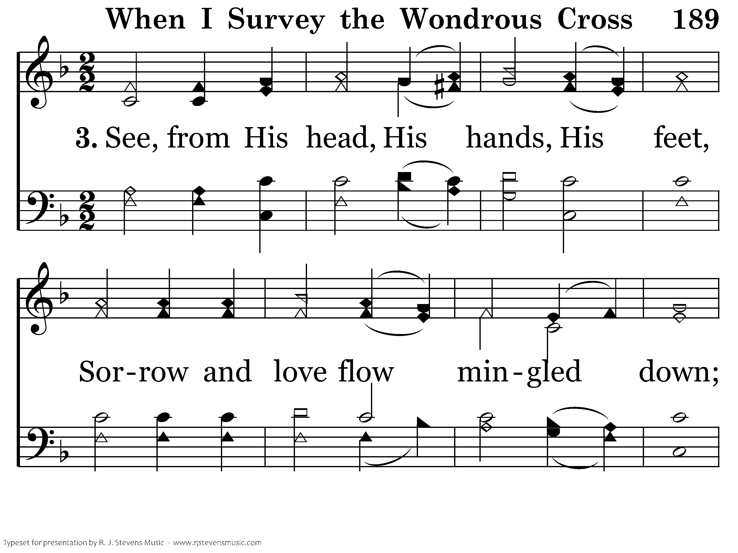
189 - When I Survey The Wondrous Cross - 3.1

Slide 54
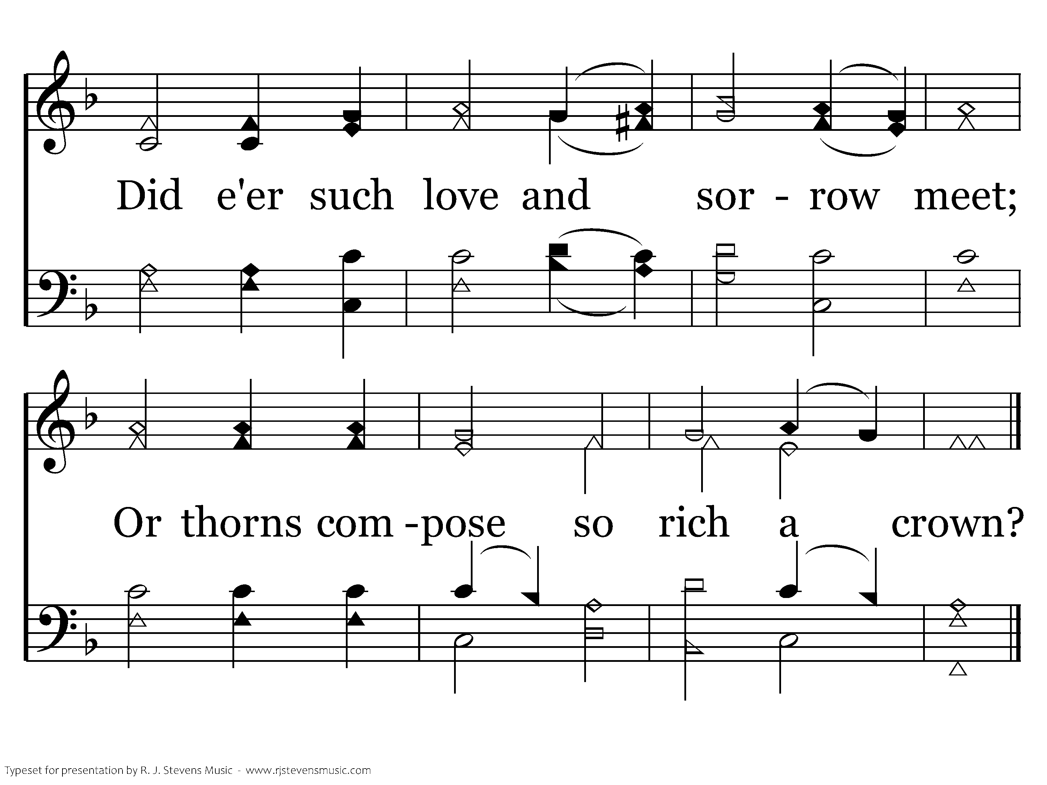
189 - When I Survey The Wondrous Cross - 3.2
End of Verse 3

Slide 55
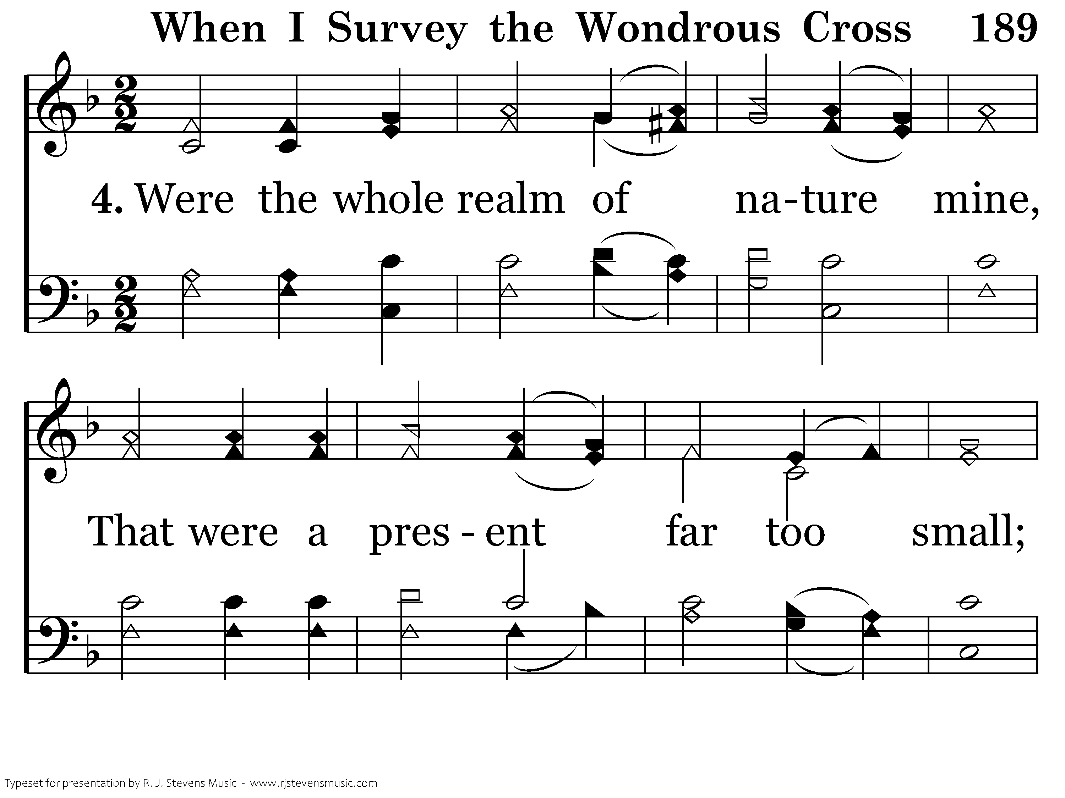
189 - When I Survey The Wondrous Cross - 4.1

Slide 56
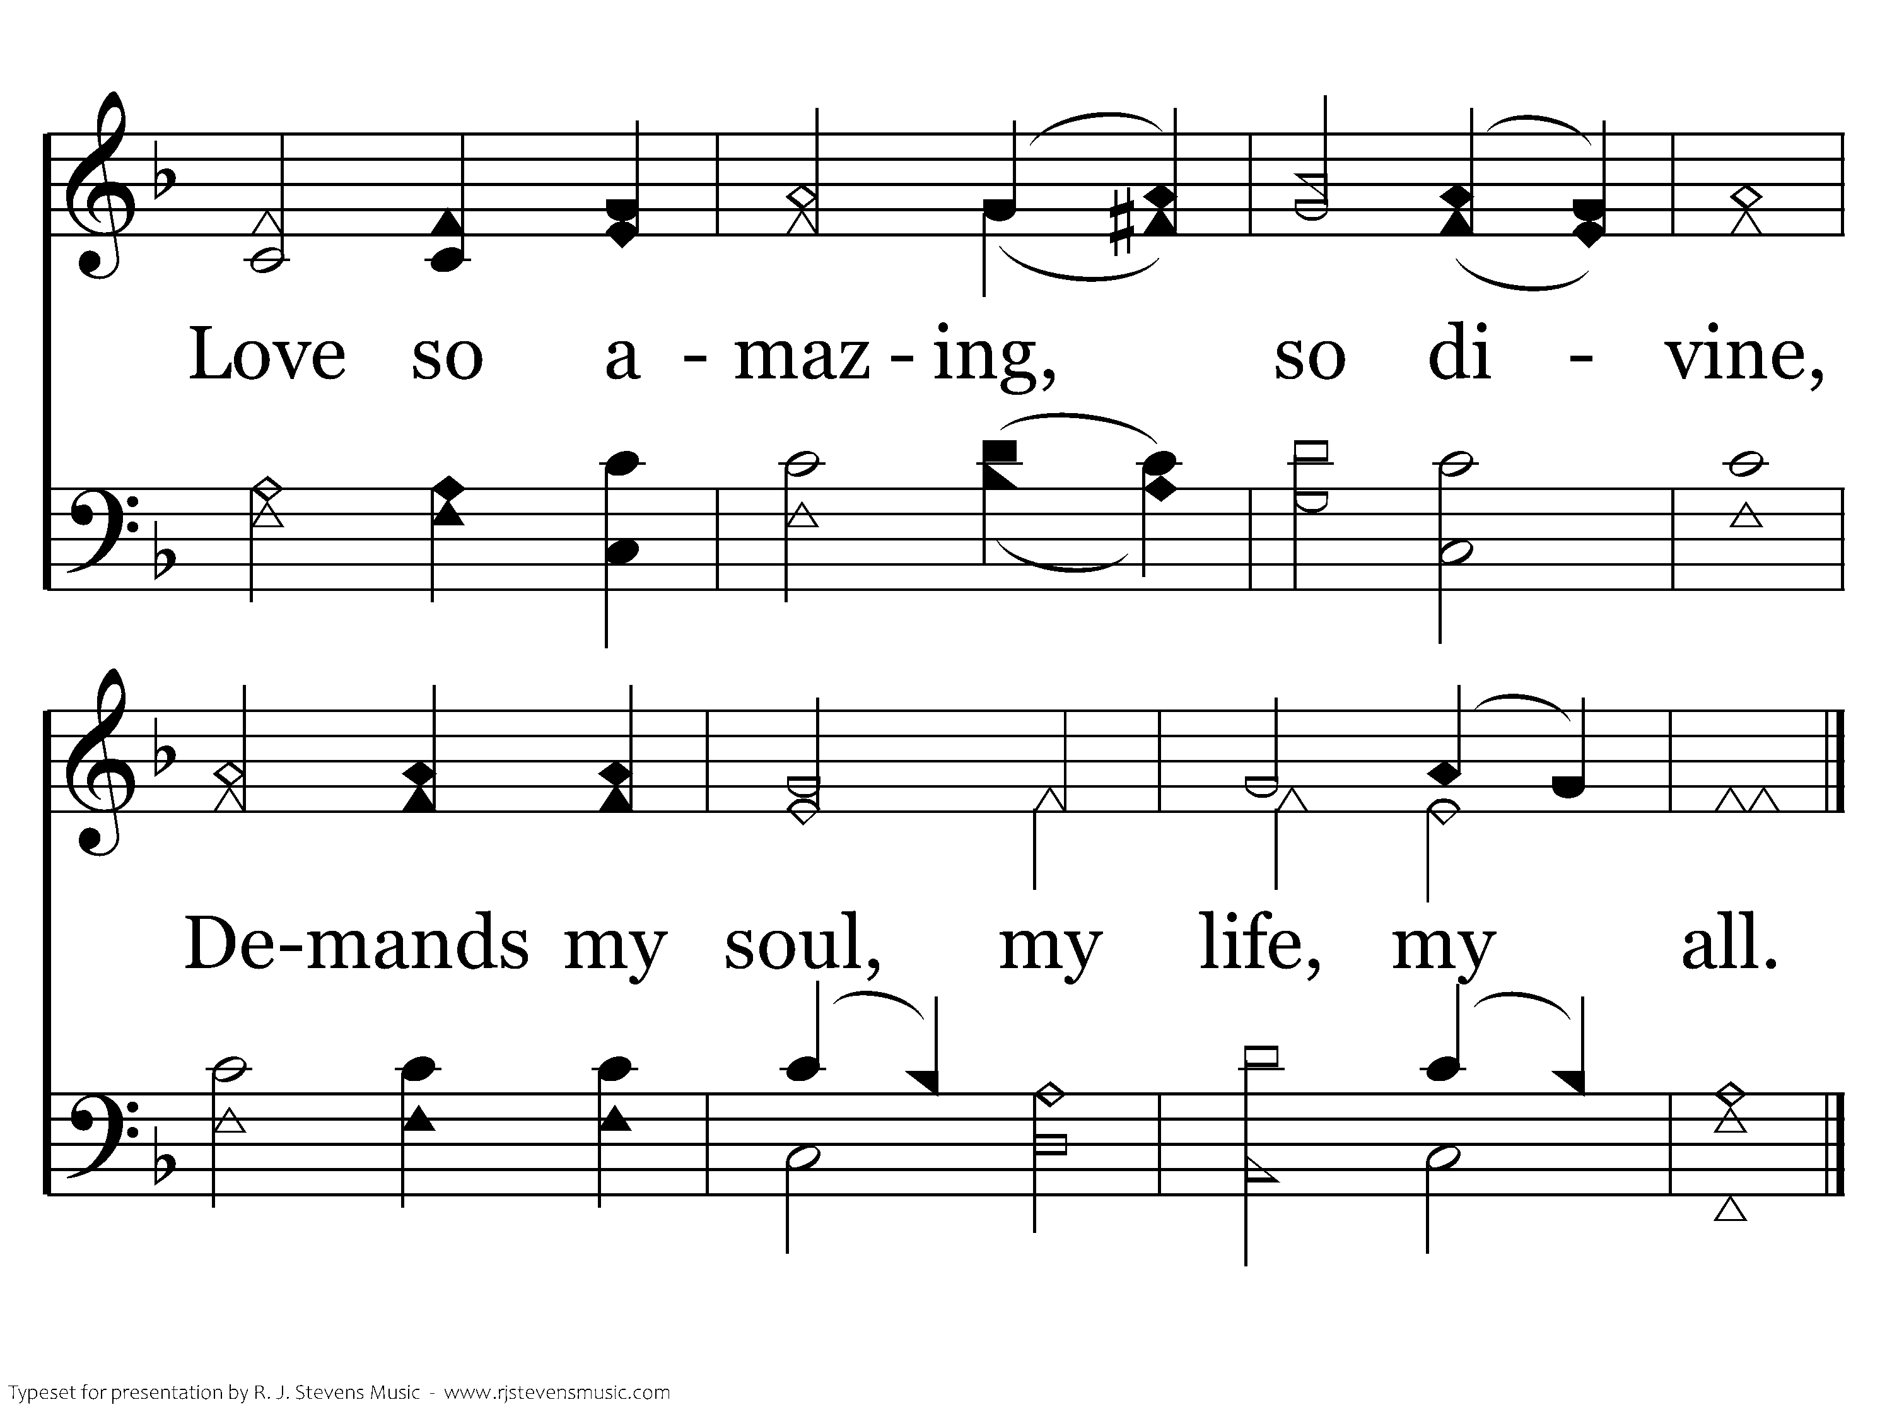
189 - When I Survey The Wondrous Cross - 4.2
End of Song

Slide 58

Peace When I Go Home?
“And Let the peace of Christ rule in your hearts, to which indeed you were called in one body. And be thankful. (Colossians 3:15, ESV)

Slide 59

Peace When I Go Home…
“Therefore, since we have been justified by faith, we have peace with God through our Lord Jesus Christ.” (Romans 5:1; ESV)
We are all going to our eternal home.
We will all face God after this life.
We need to be ready!
Ecc. 12:5; Num. 23:10; John 5:28,29; Job 14:14,15; Heb. 9:27; 2 Cor. 5:10; Matt. 25:31-46; Rev. 20:12-15; 2 Pet. 3:10-14; Matt. 22:42-44

Slide 60
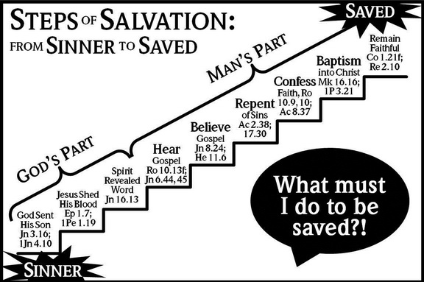

Slide 61

283 - There's A Great Day Coming - Title

Slide 62
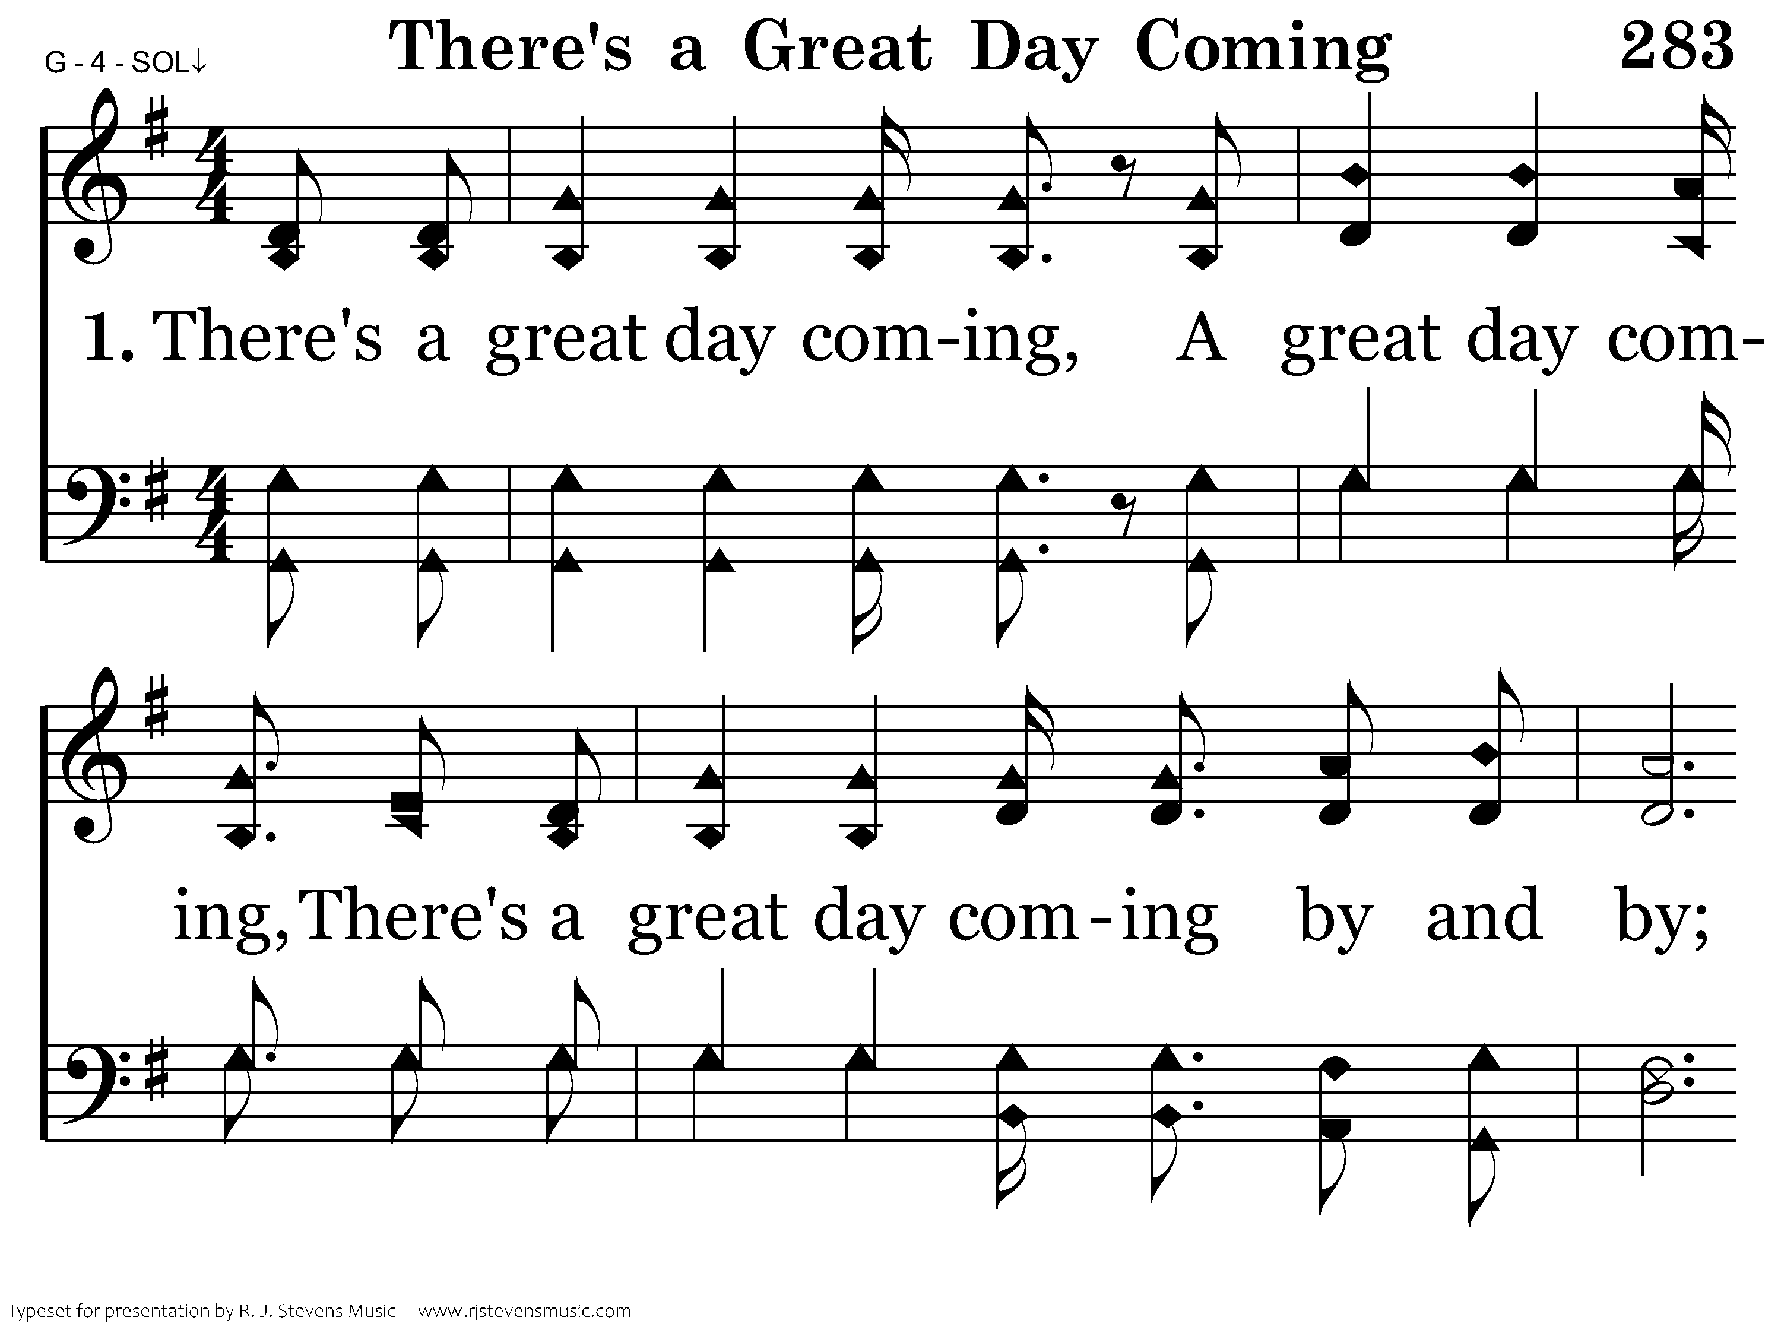
283 - There's A Great Day Coming - 1.1

Slide 63
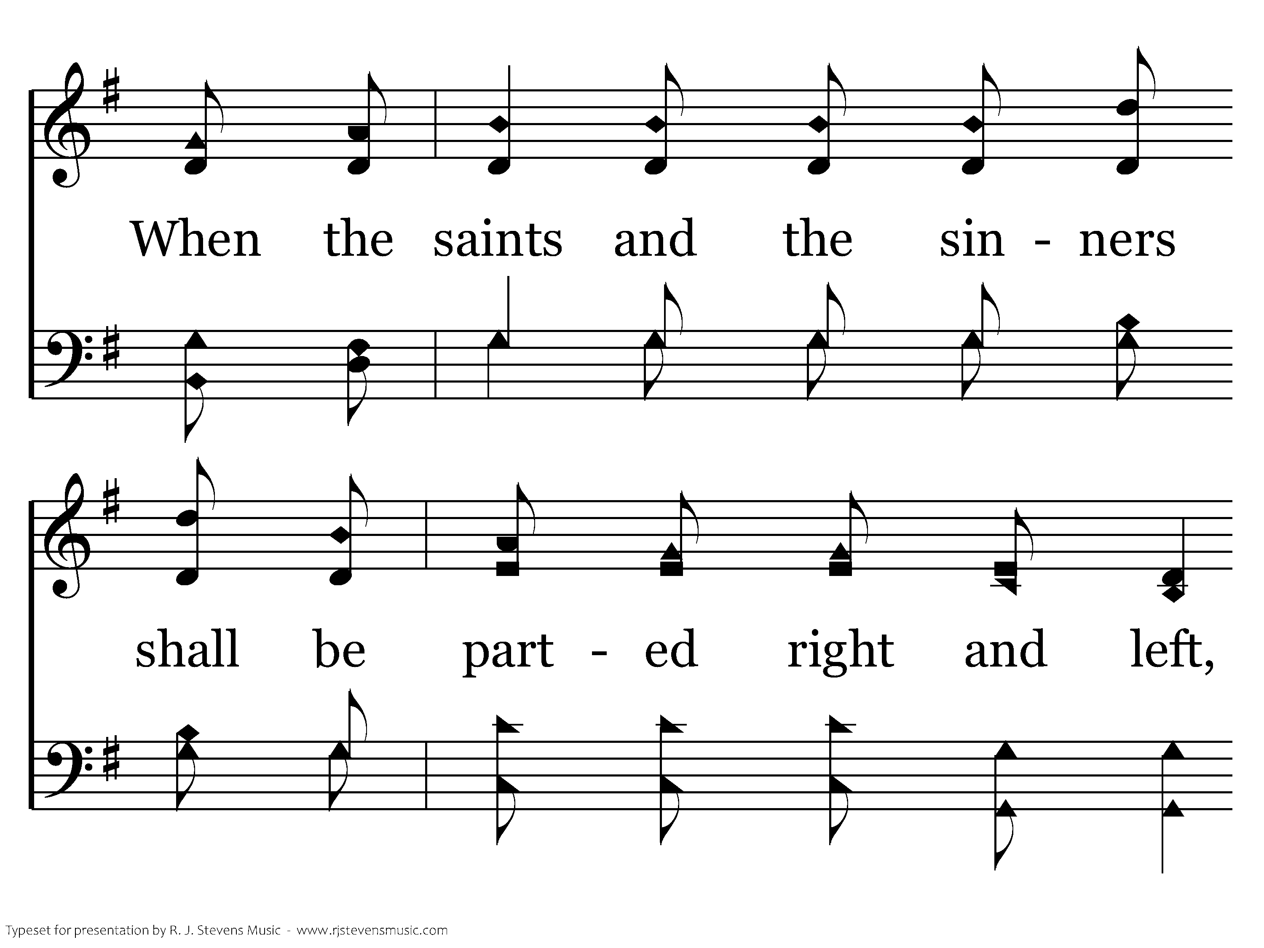
283 - There's A Great Day Coming - 1.2

Slide 64
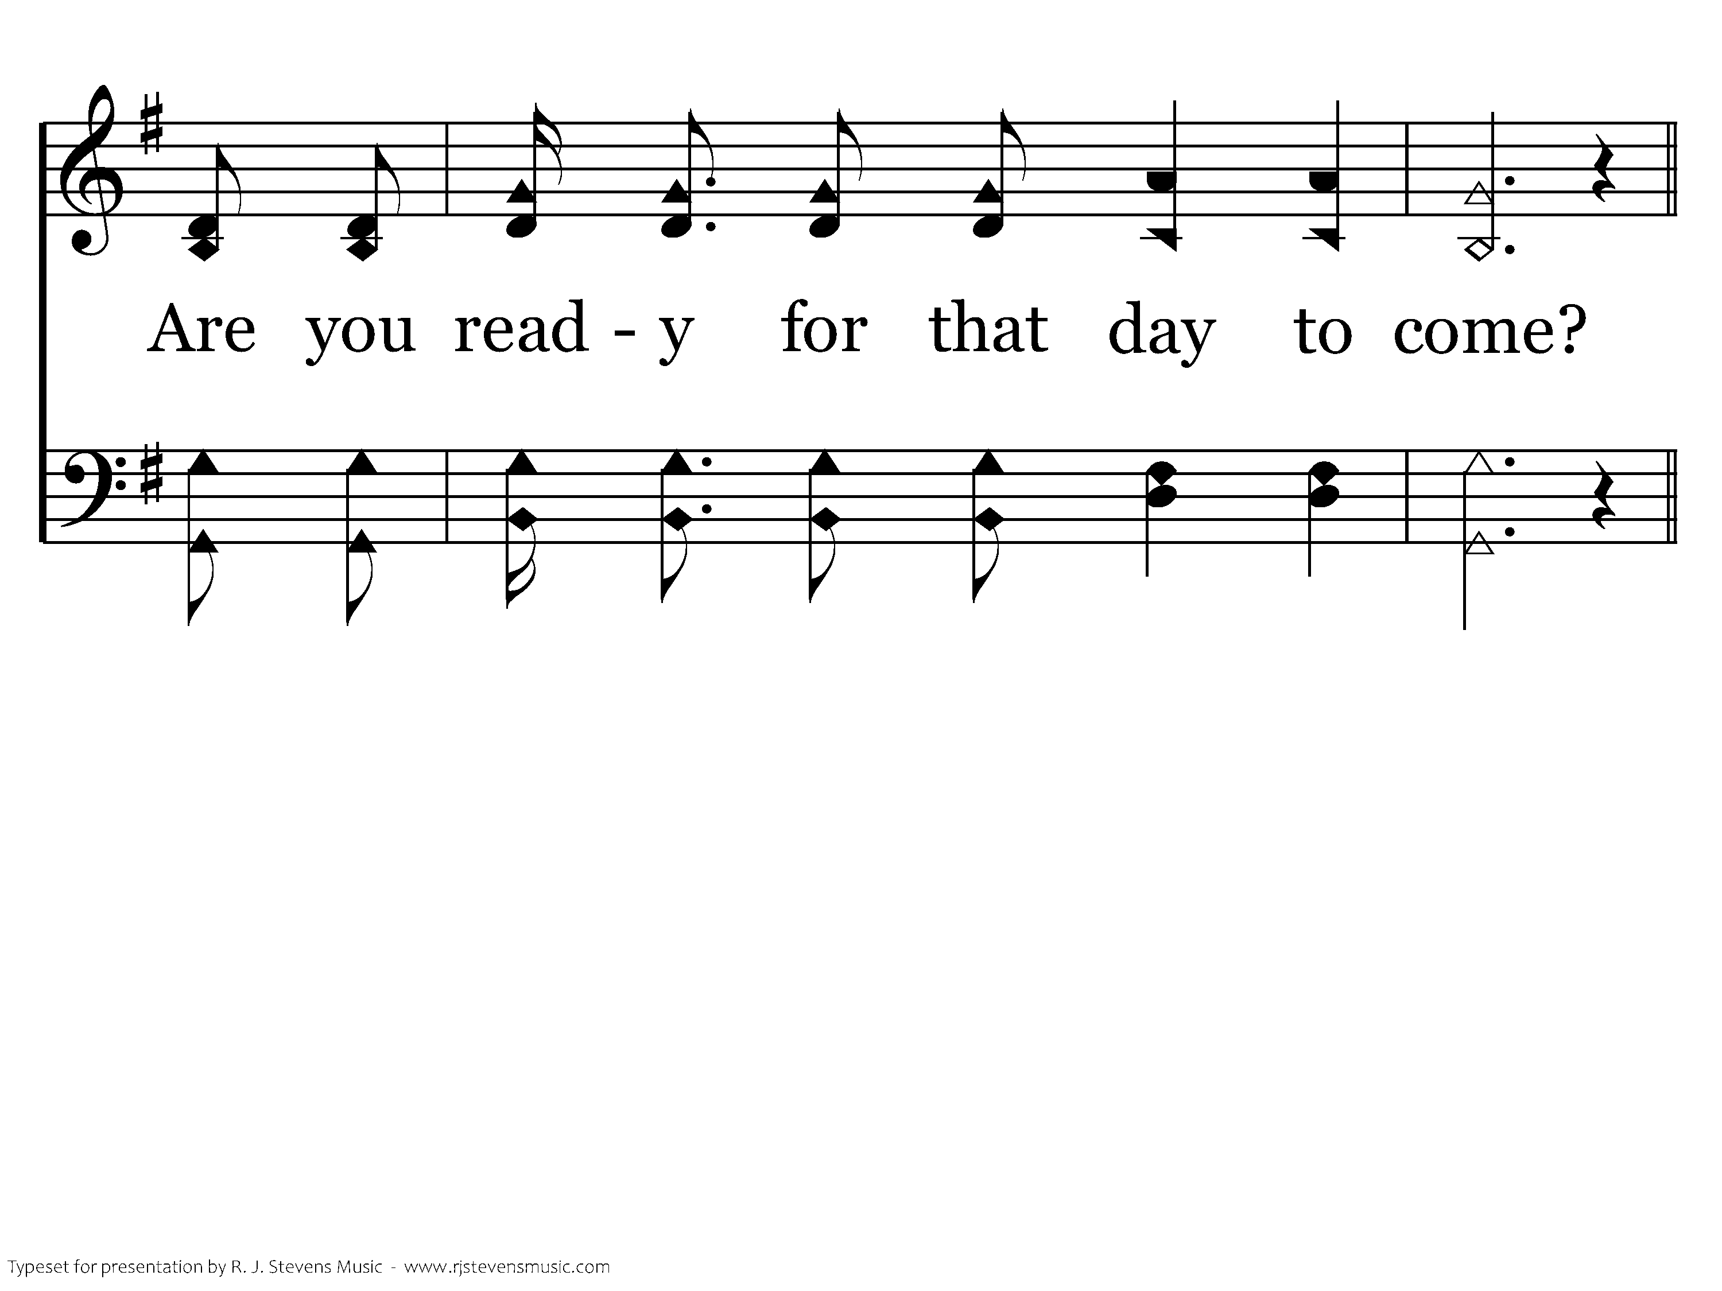
283 - There's A Great Day Coming - 1.3

Slide 65
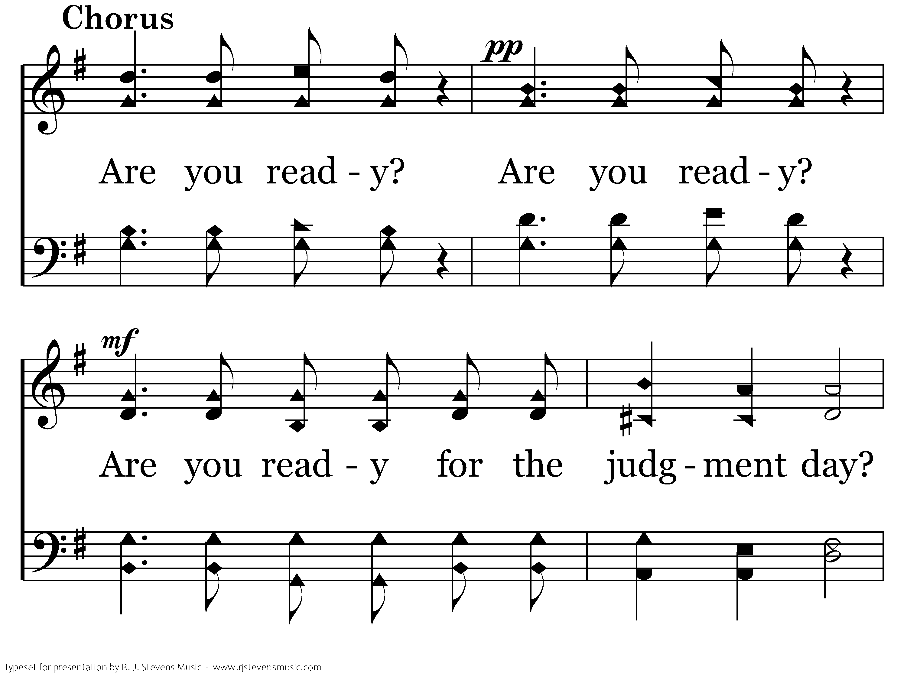
283 - There's A Great Day Coming - C.1

Slide 66
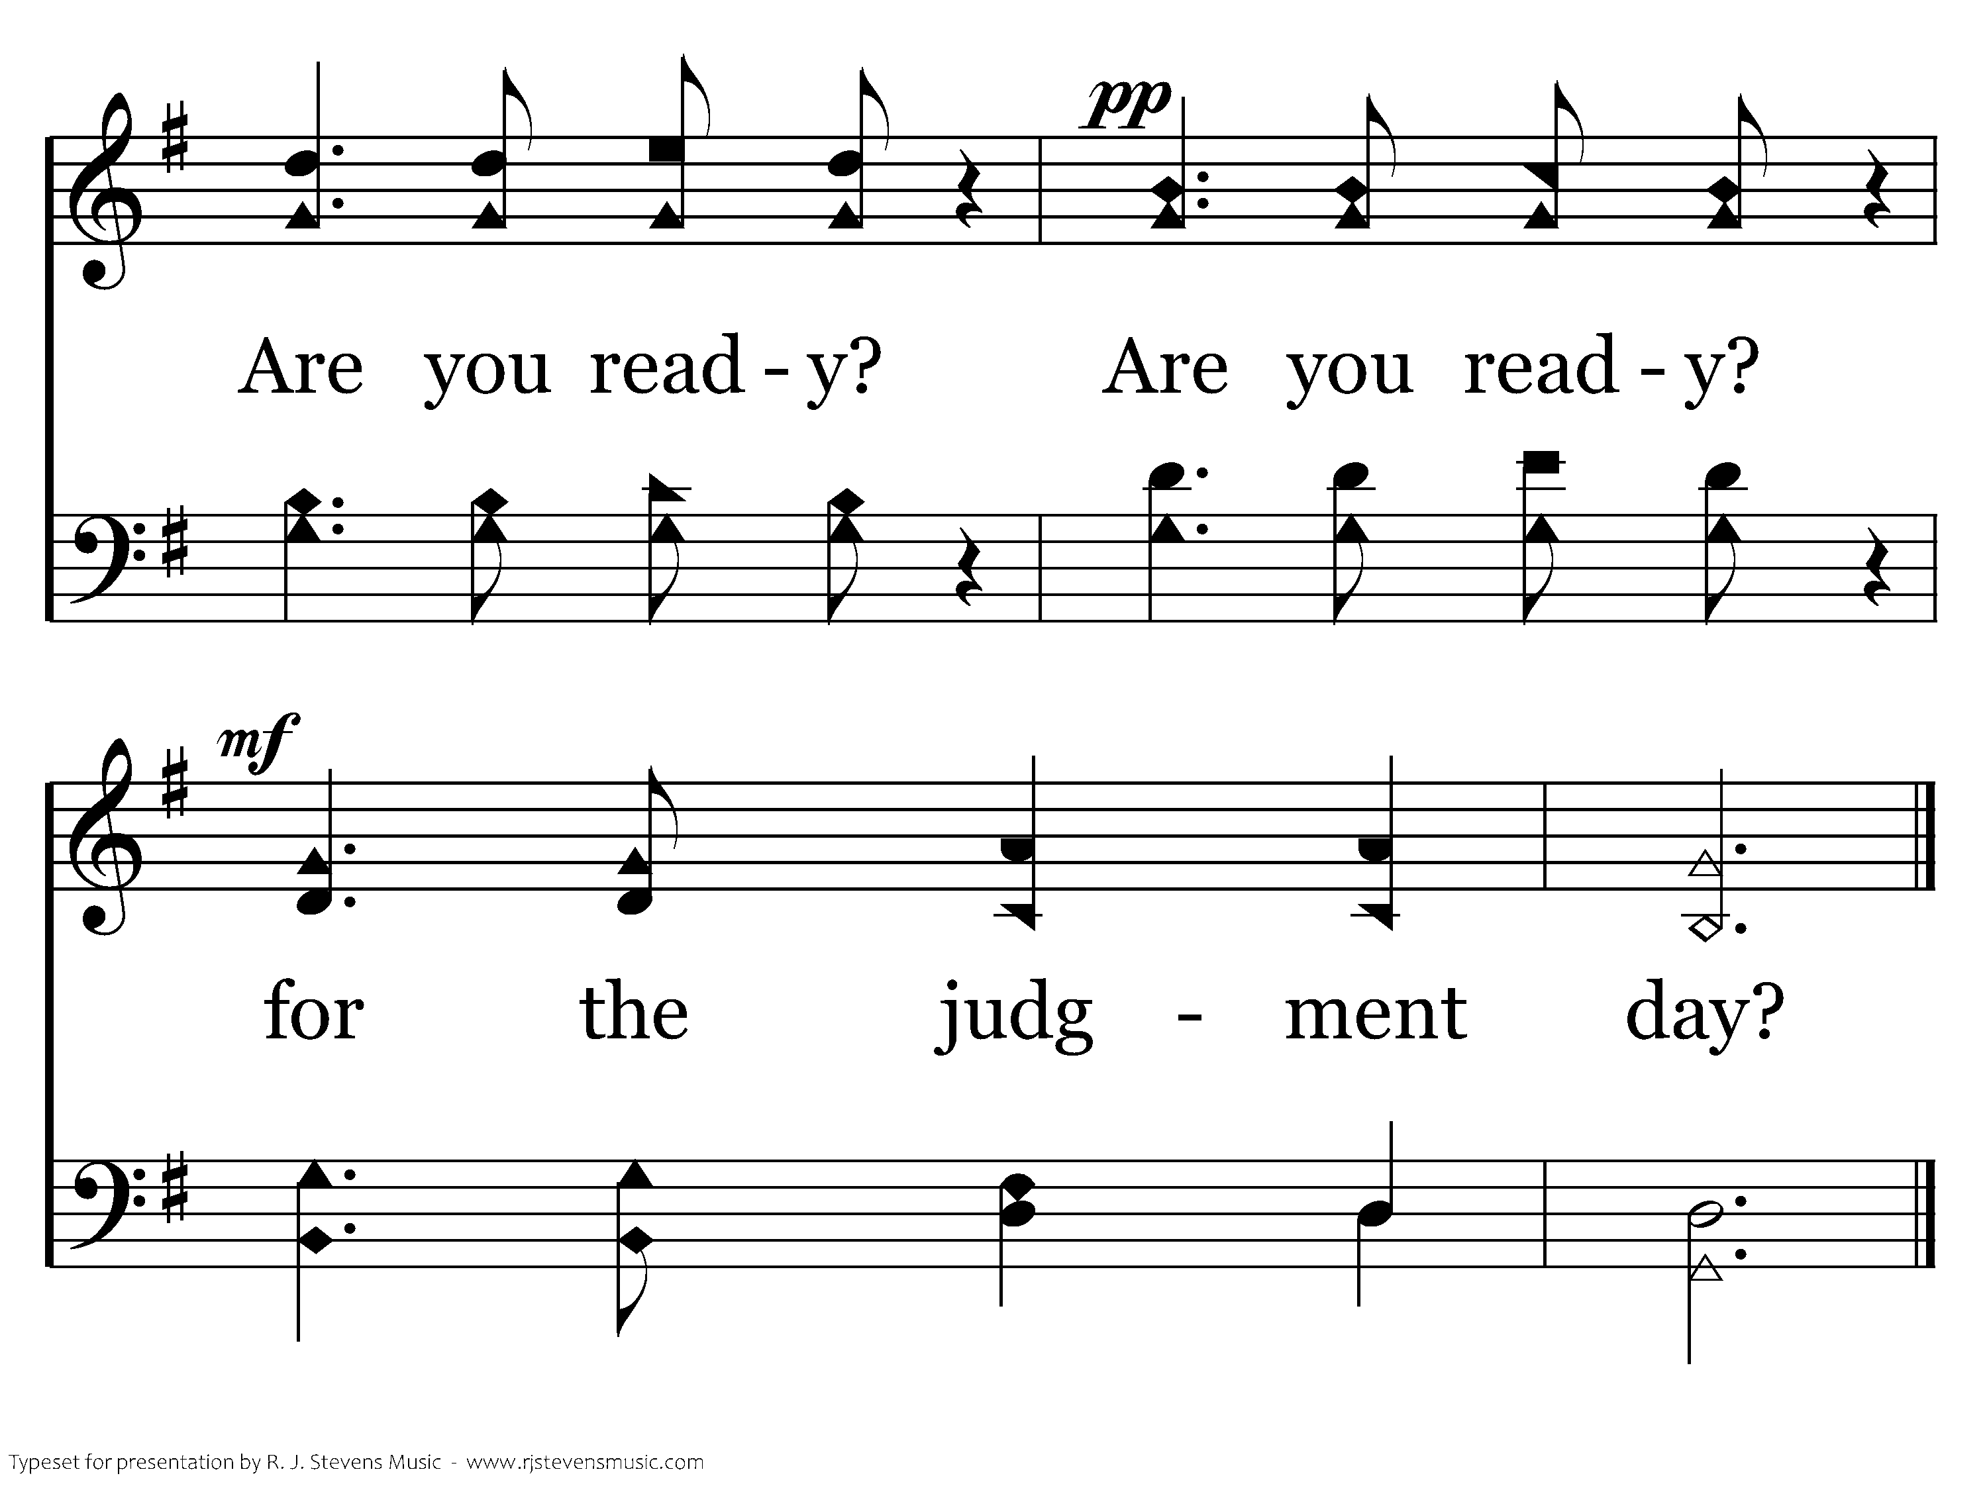
283 - There's A Great Day Coming - C.2
End of Verse 1

Slide 67
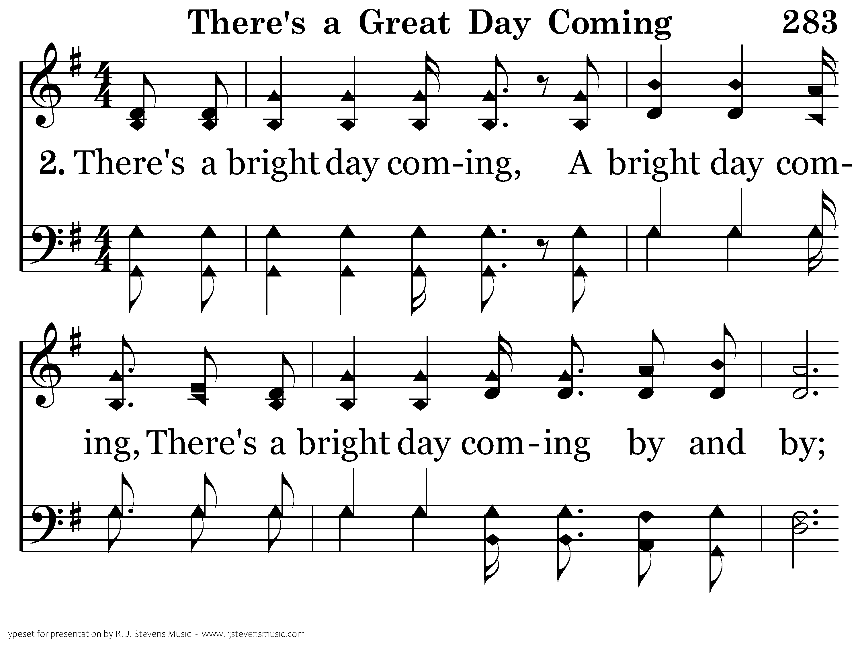
283 - There's A Great Day Coming - 2.1

Slide 68
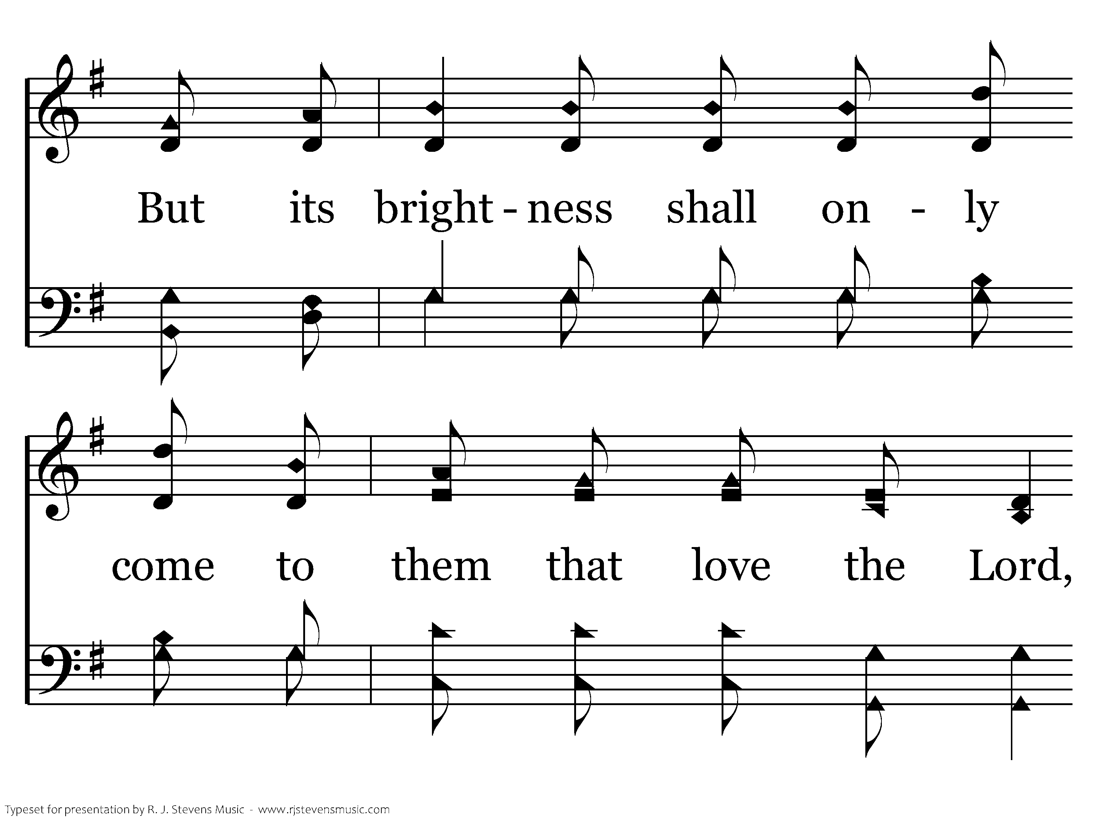
283 - There's A Great Day Coming - 2.2

Slide 69
283 - There's A Great Day Coming - 2.3

Slide 70
283 - There's A Great Day Coming - C.1

Slide 71
283 - There's A Great Day Coming - C.2
End of Verse 2

Slide 72
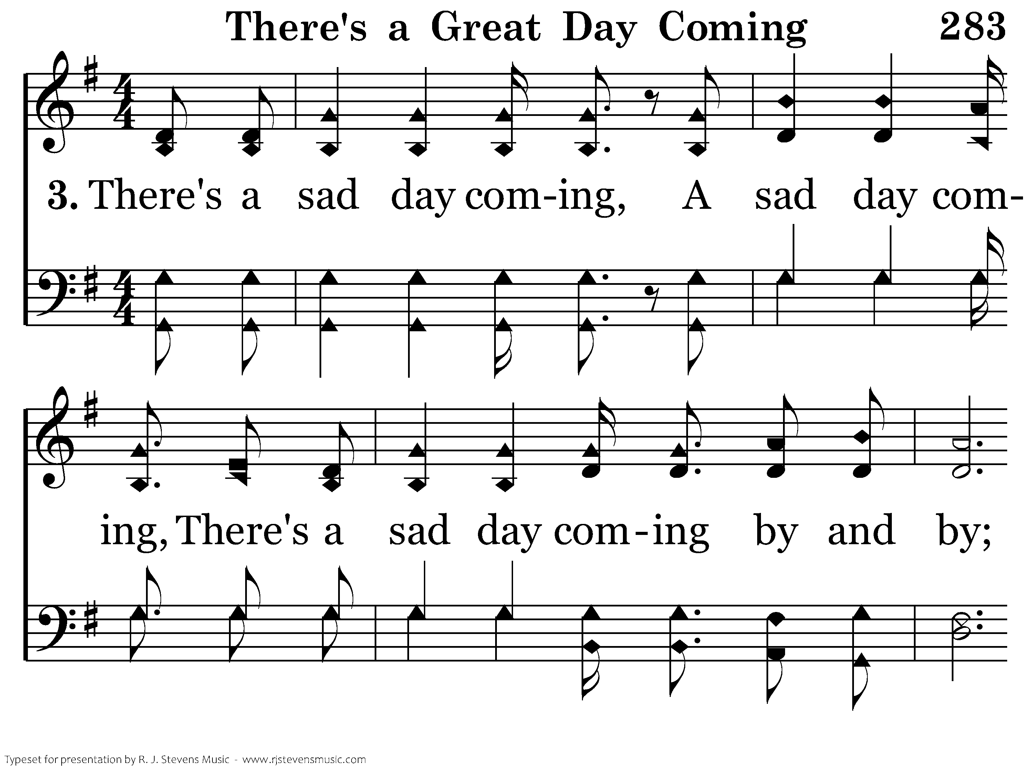
283 - There's A Great Day Coming - 3.1

Slide 73
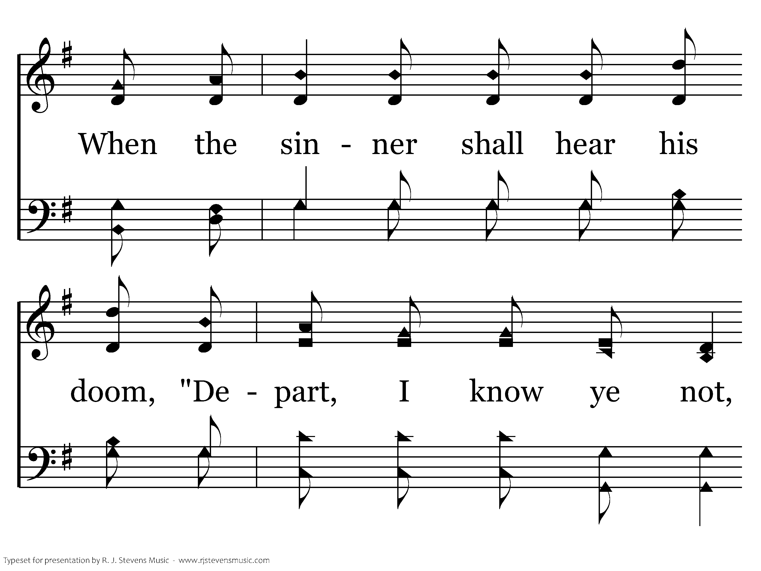
283 - There's A Great Day Coming - 3.2

Slide 74
283 - There's A Great Day Coming - 3.3

Slide 75
283 - There's A Great Day Coming - C.1

Slide 76
283 - There's A Great Day Coming - C.2
End of Song

