Slide 1
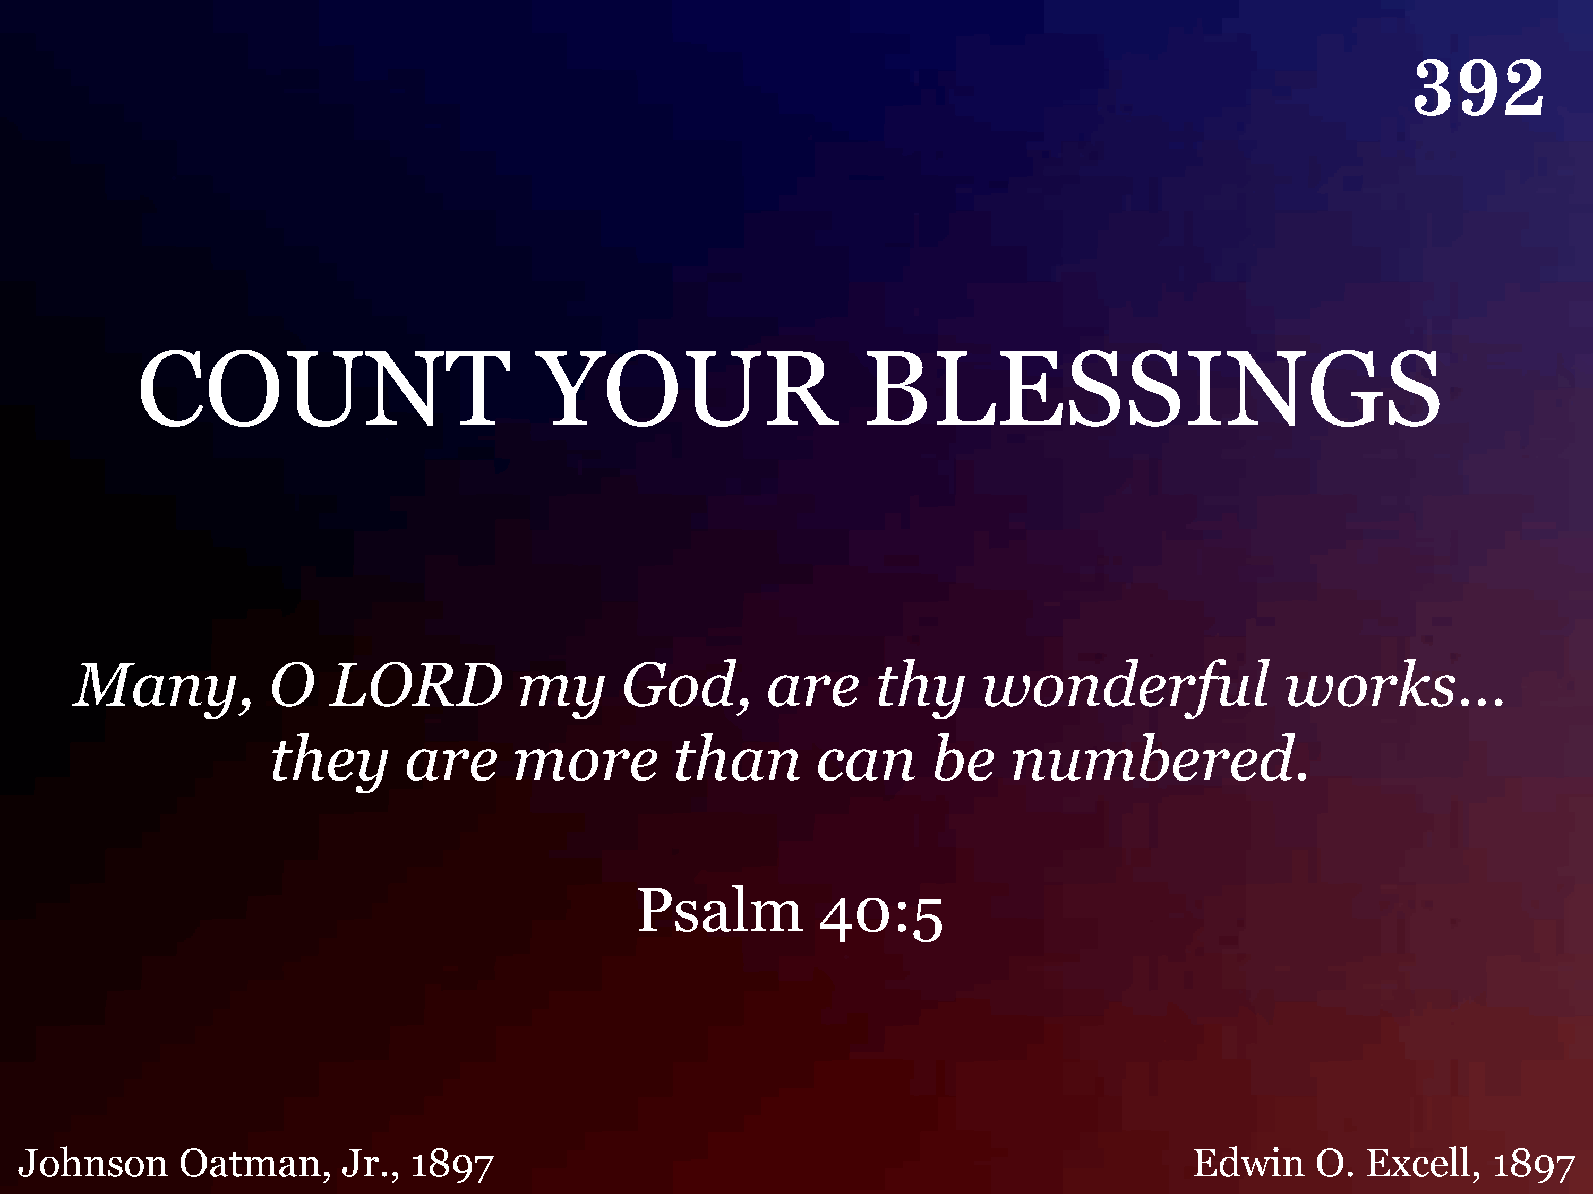
392 - Count Your Blessings - Title

Slide 2
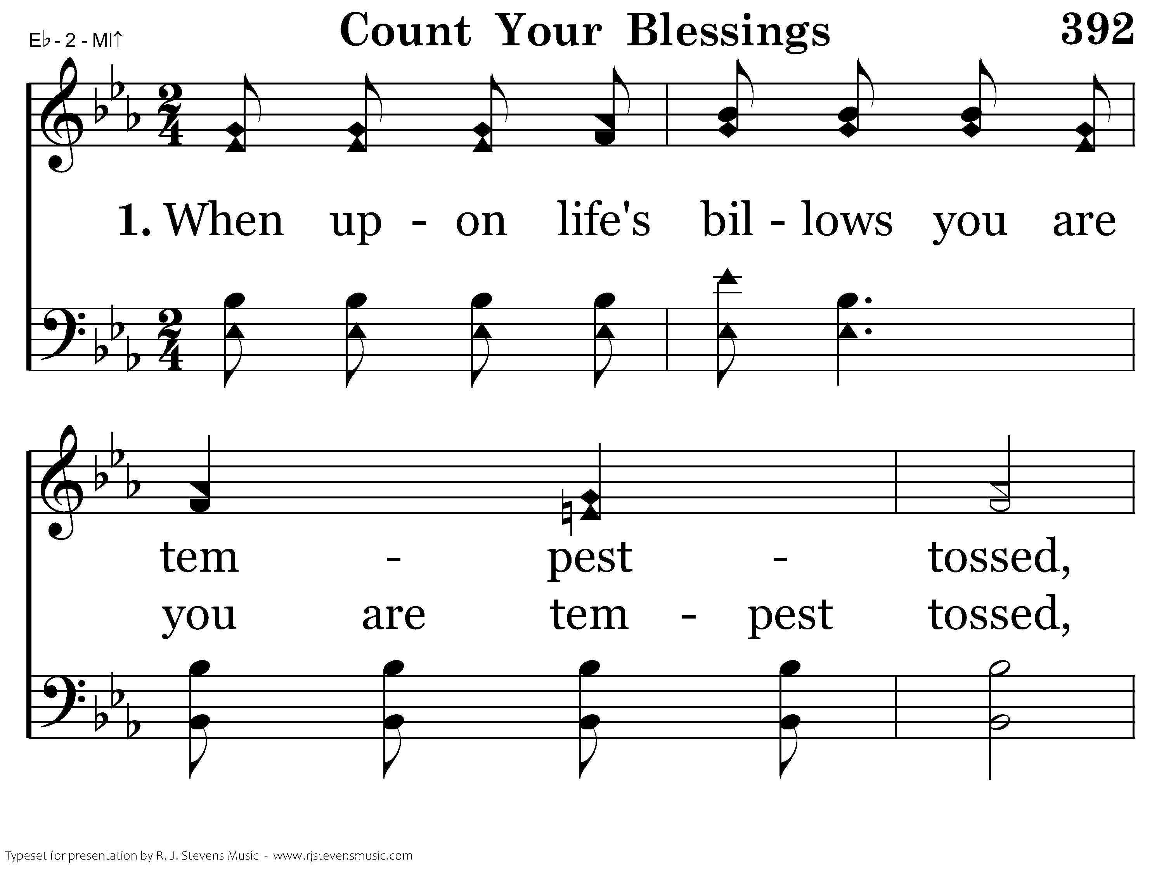
392 - Count Your Blessings - 1.1

Slide 3
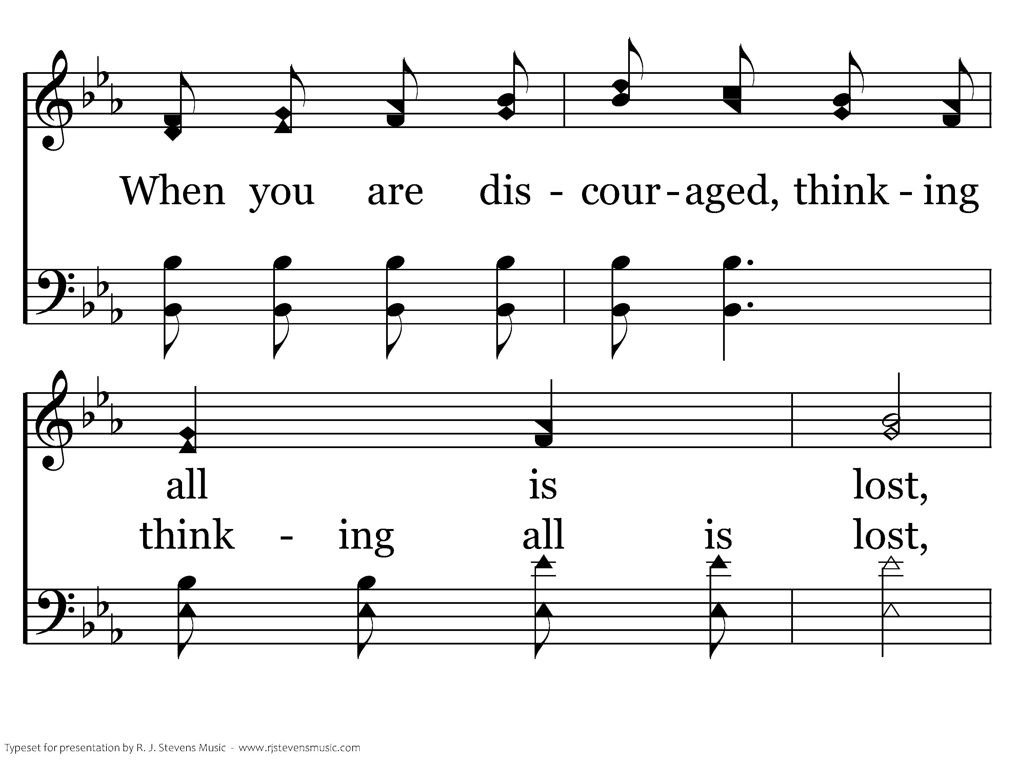
392 - Count Your Blessings - 1.2

Slide 4
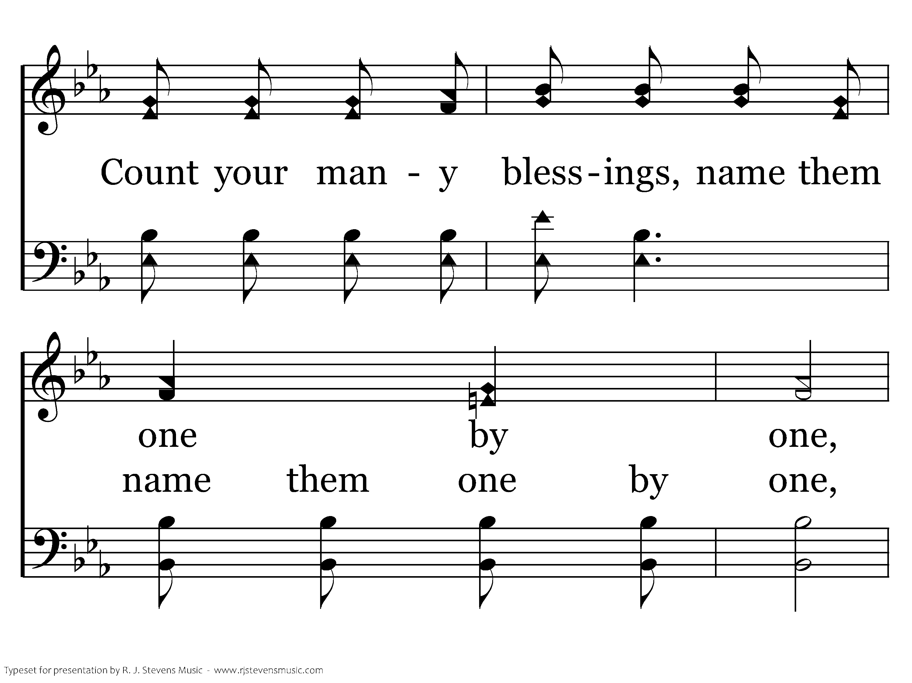
392 - Count Your Blessings - 1.3

Slide 5
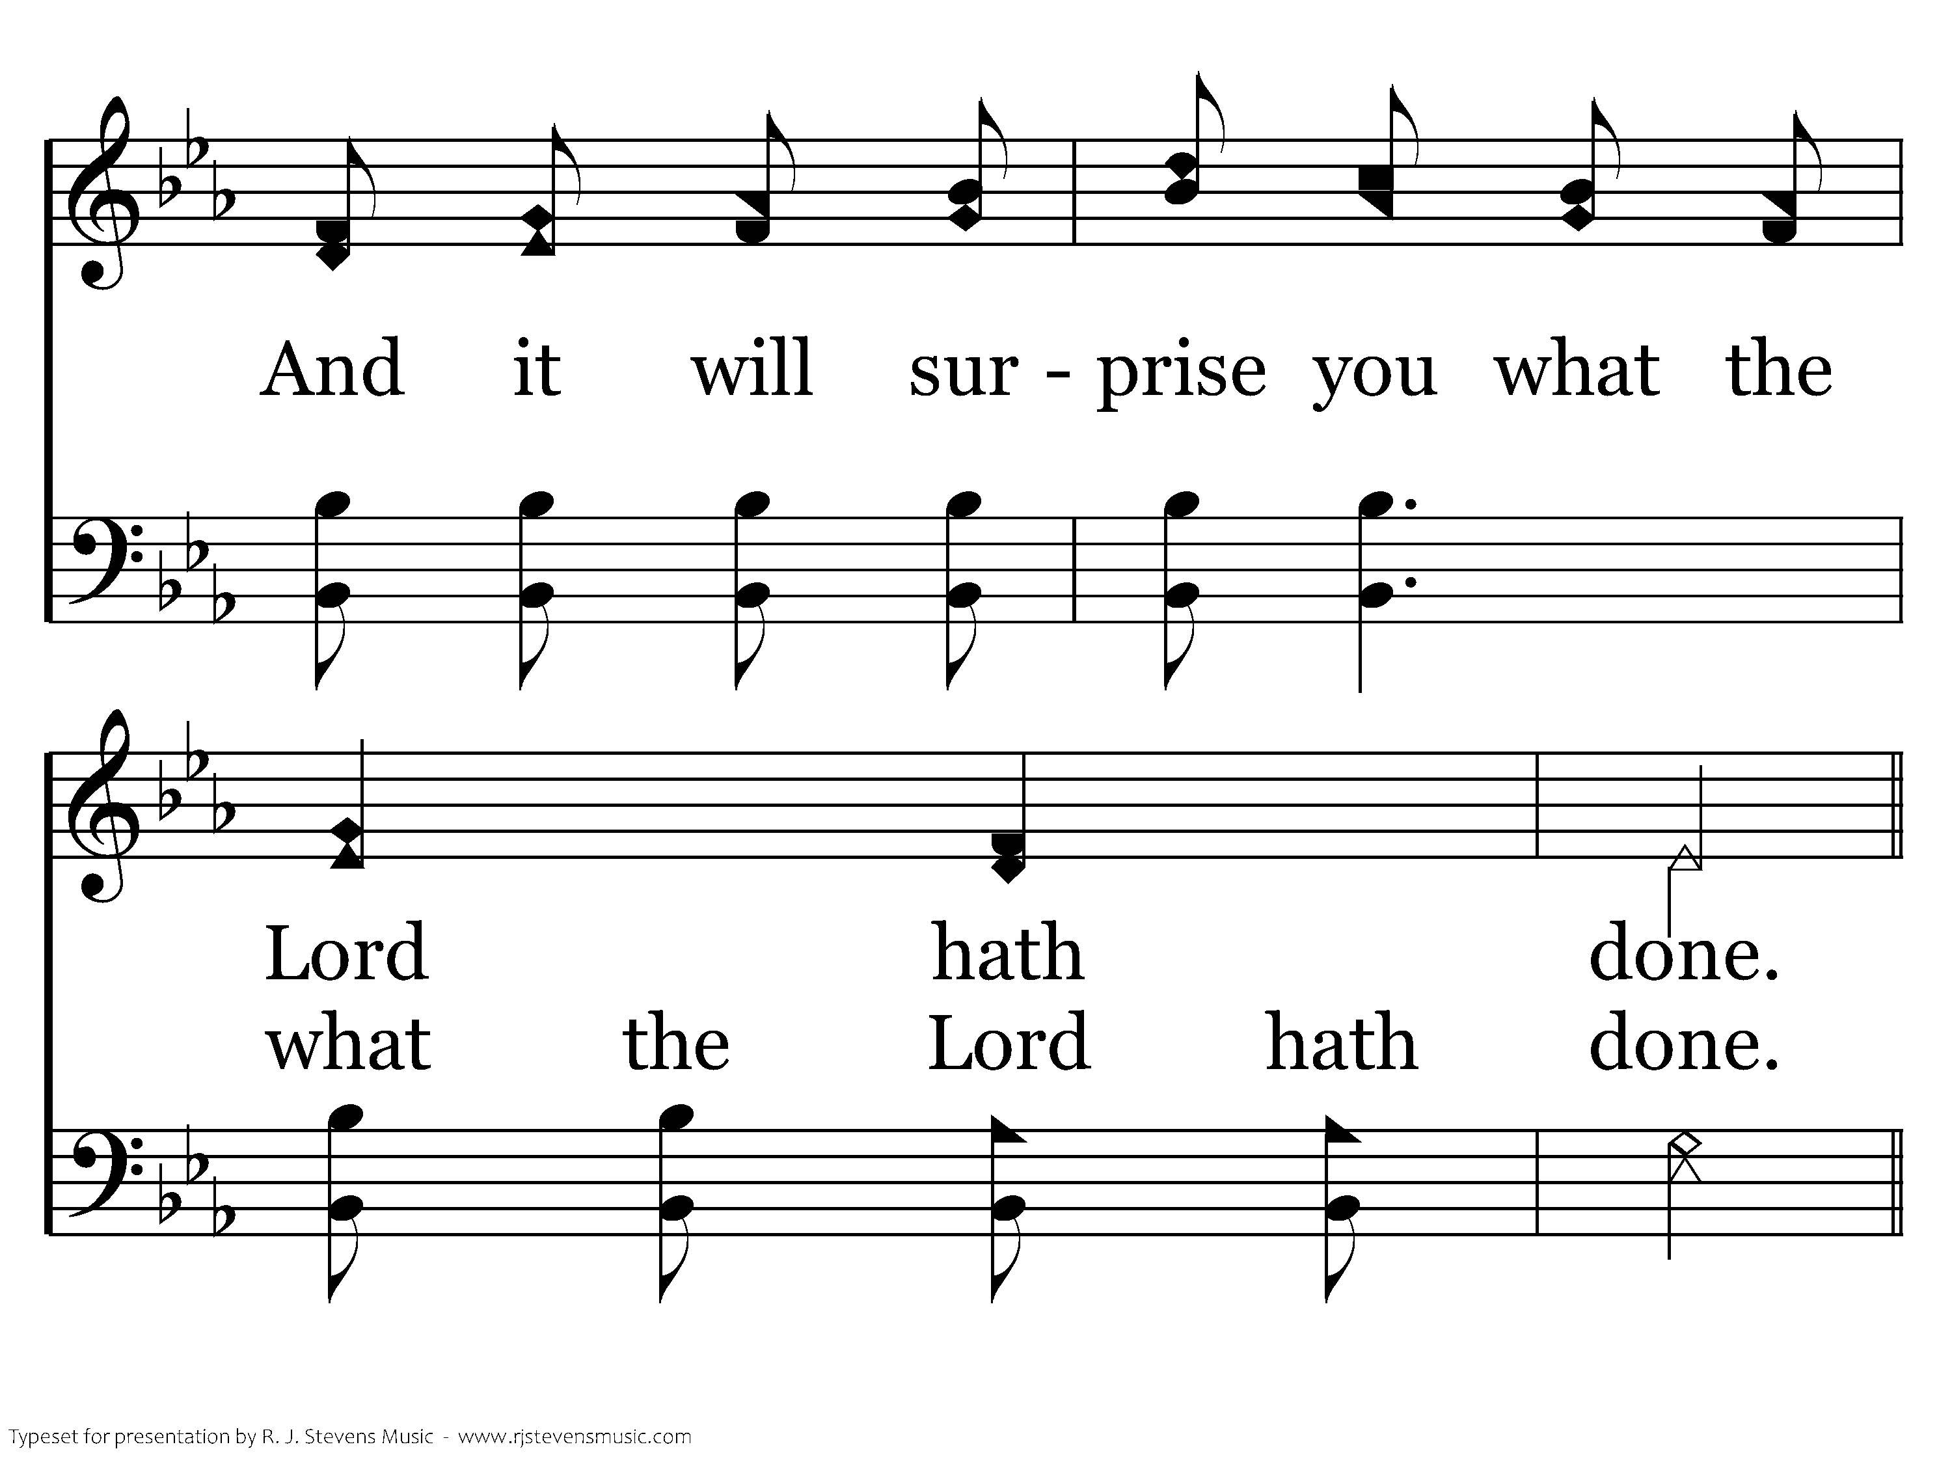
392 - Count Your Blessings - 1.4

Slide 6
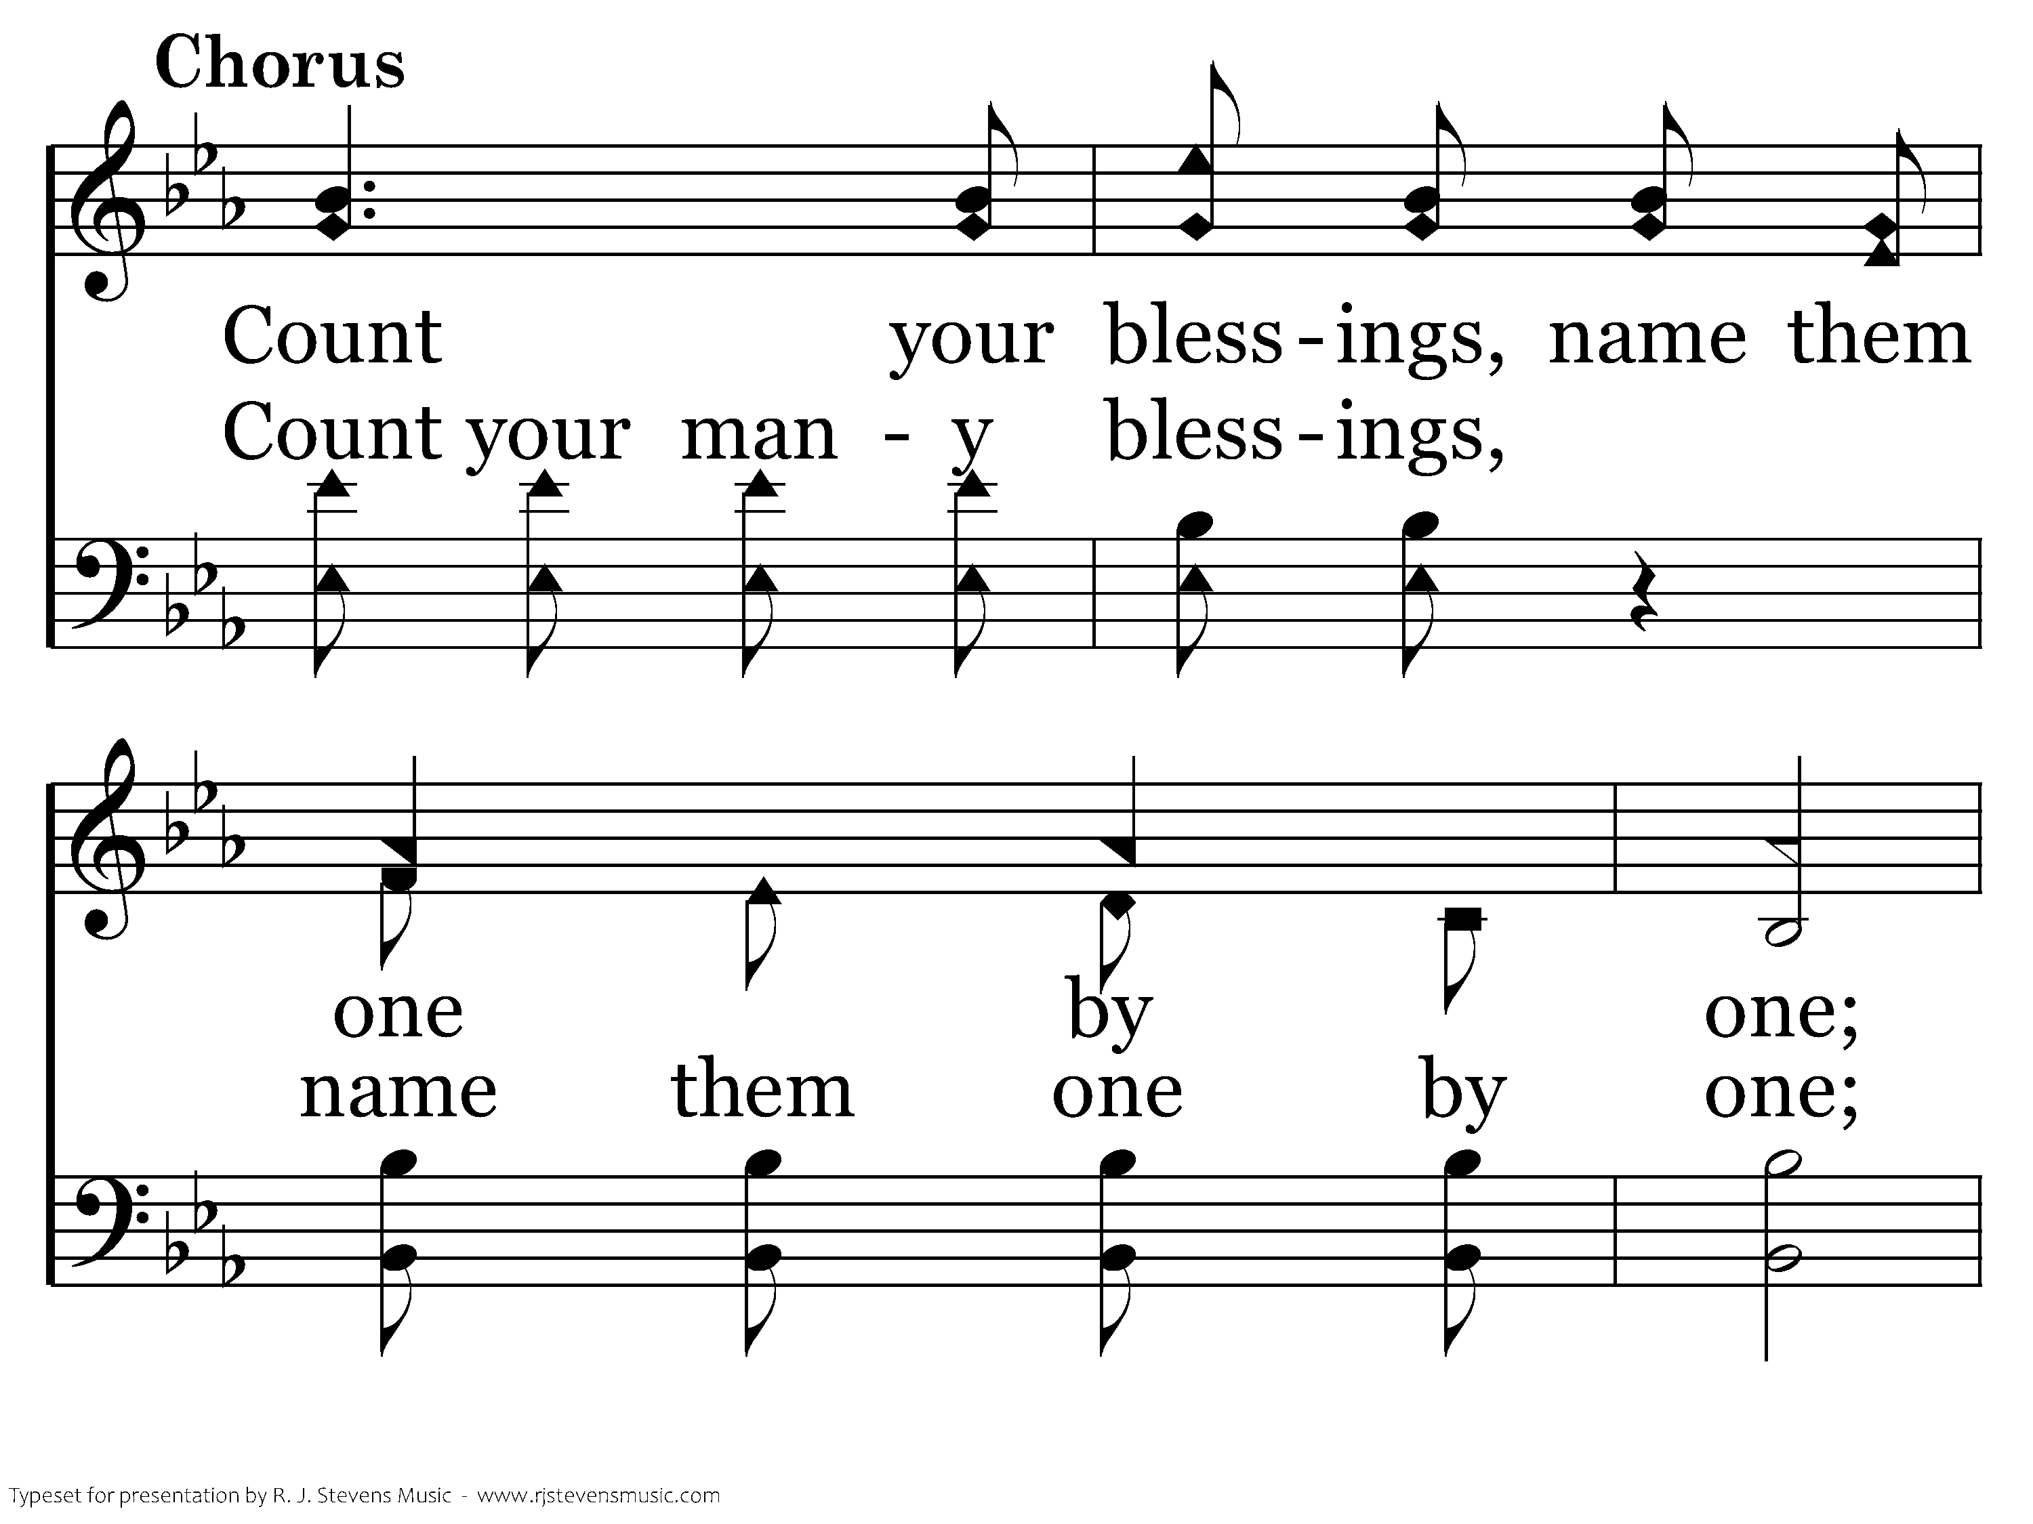
392 - Count Your Blessings - C.1

Slide 7
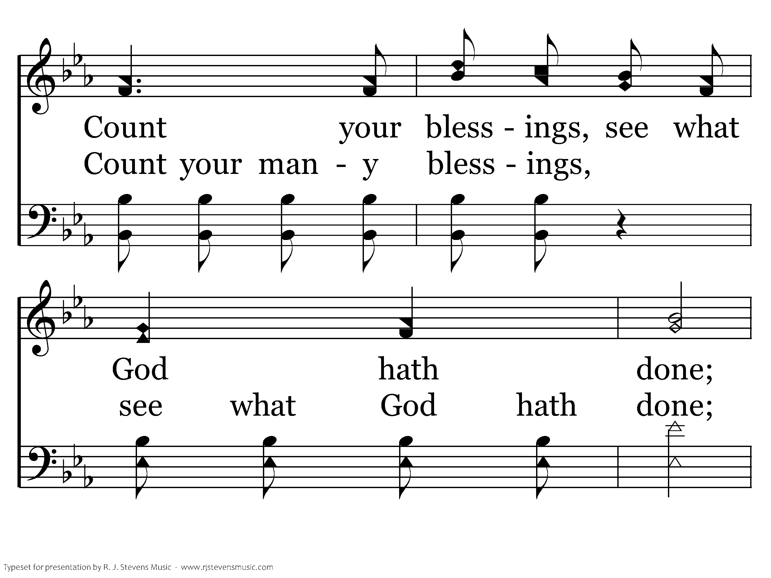
392 - Count Your Blessings - C.2

Slide 8
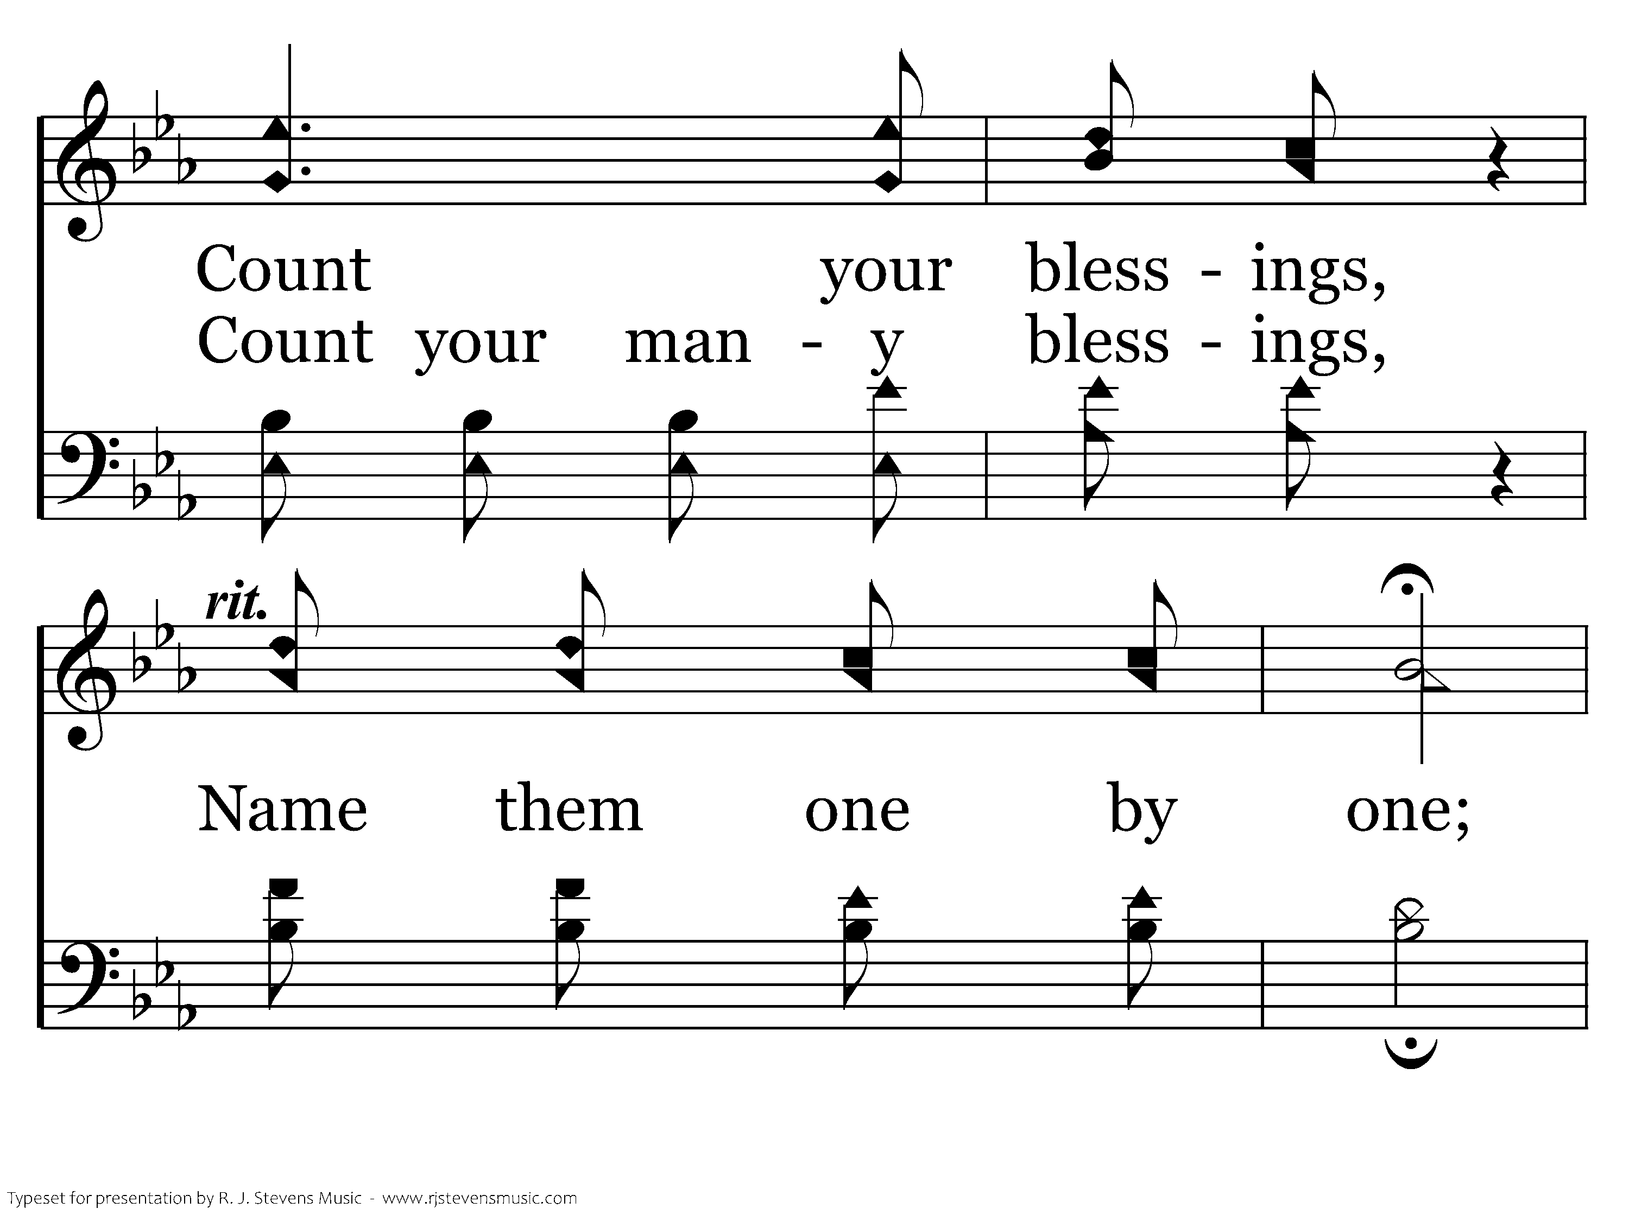
392 - Count Your Blessings - C.3

Slide 9
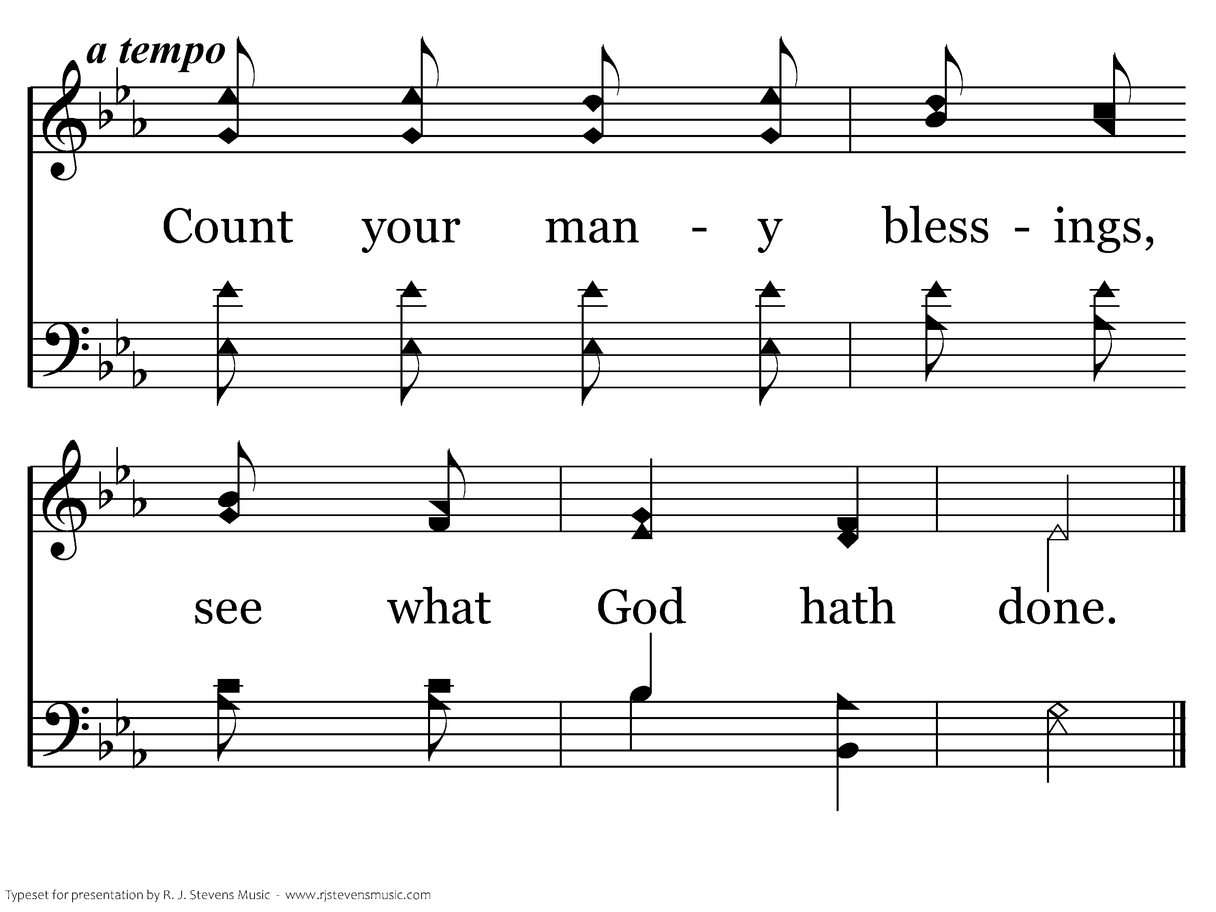
392 - Count Your Blessings - C.4
End of Verse 1

Slide 10
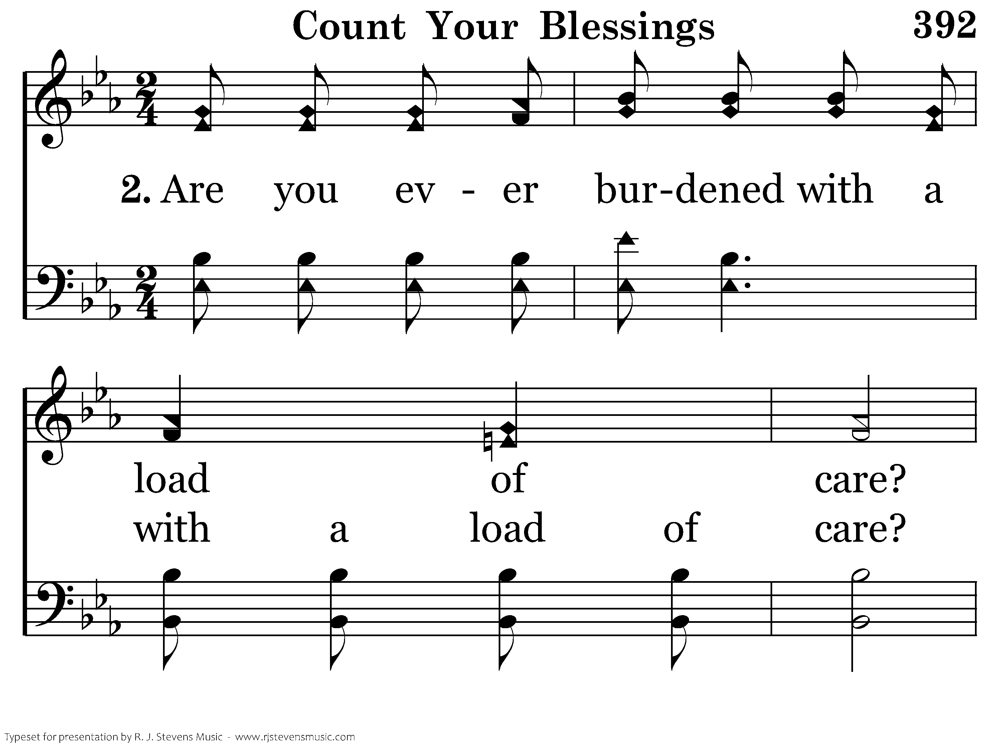
392 - Count Your Blessings - 2.1

Slide 11
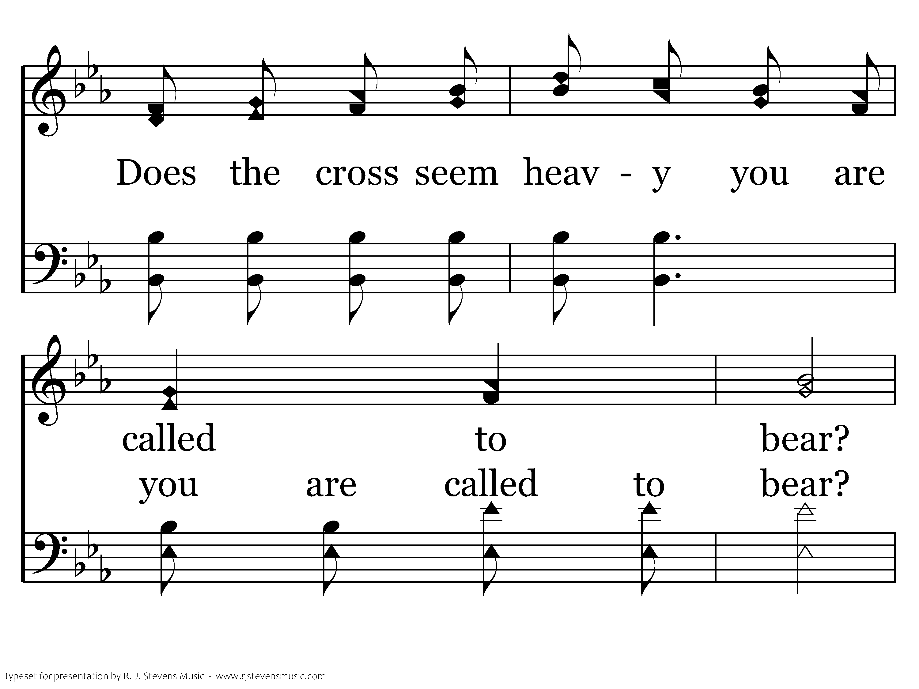
392 - Count Your Blessings - 2.2

Slide 12
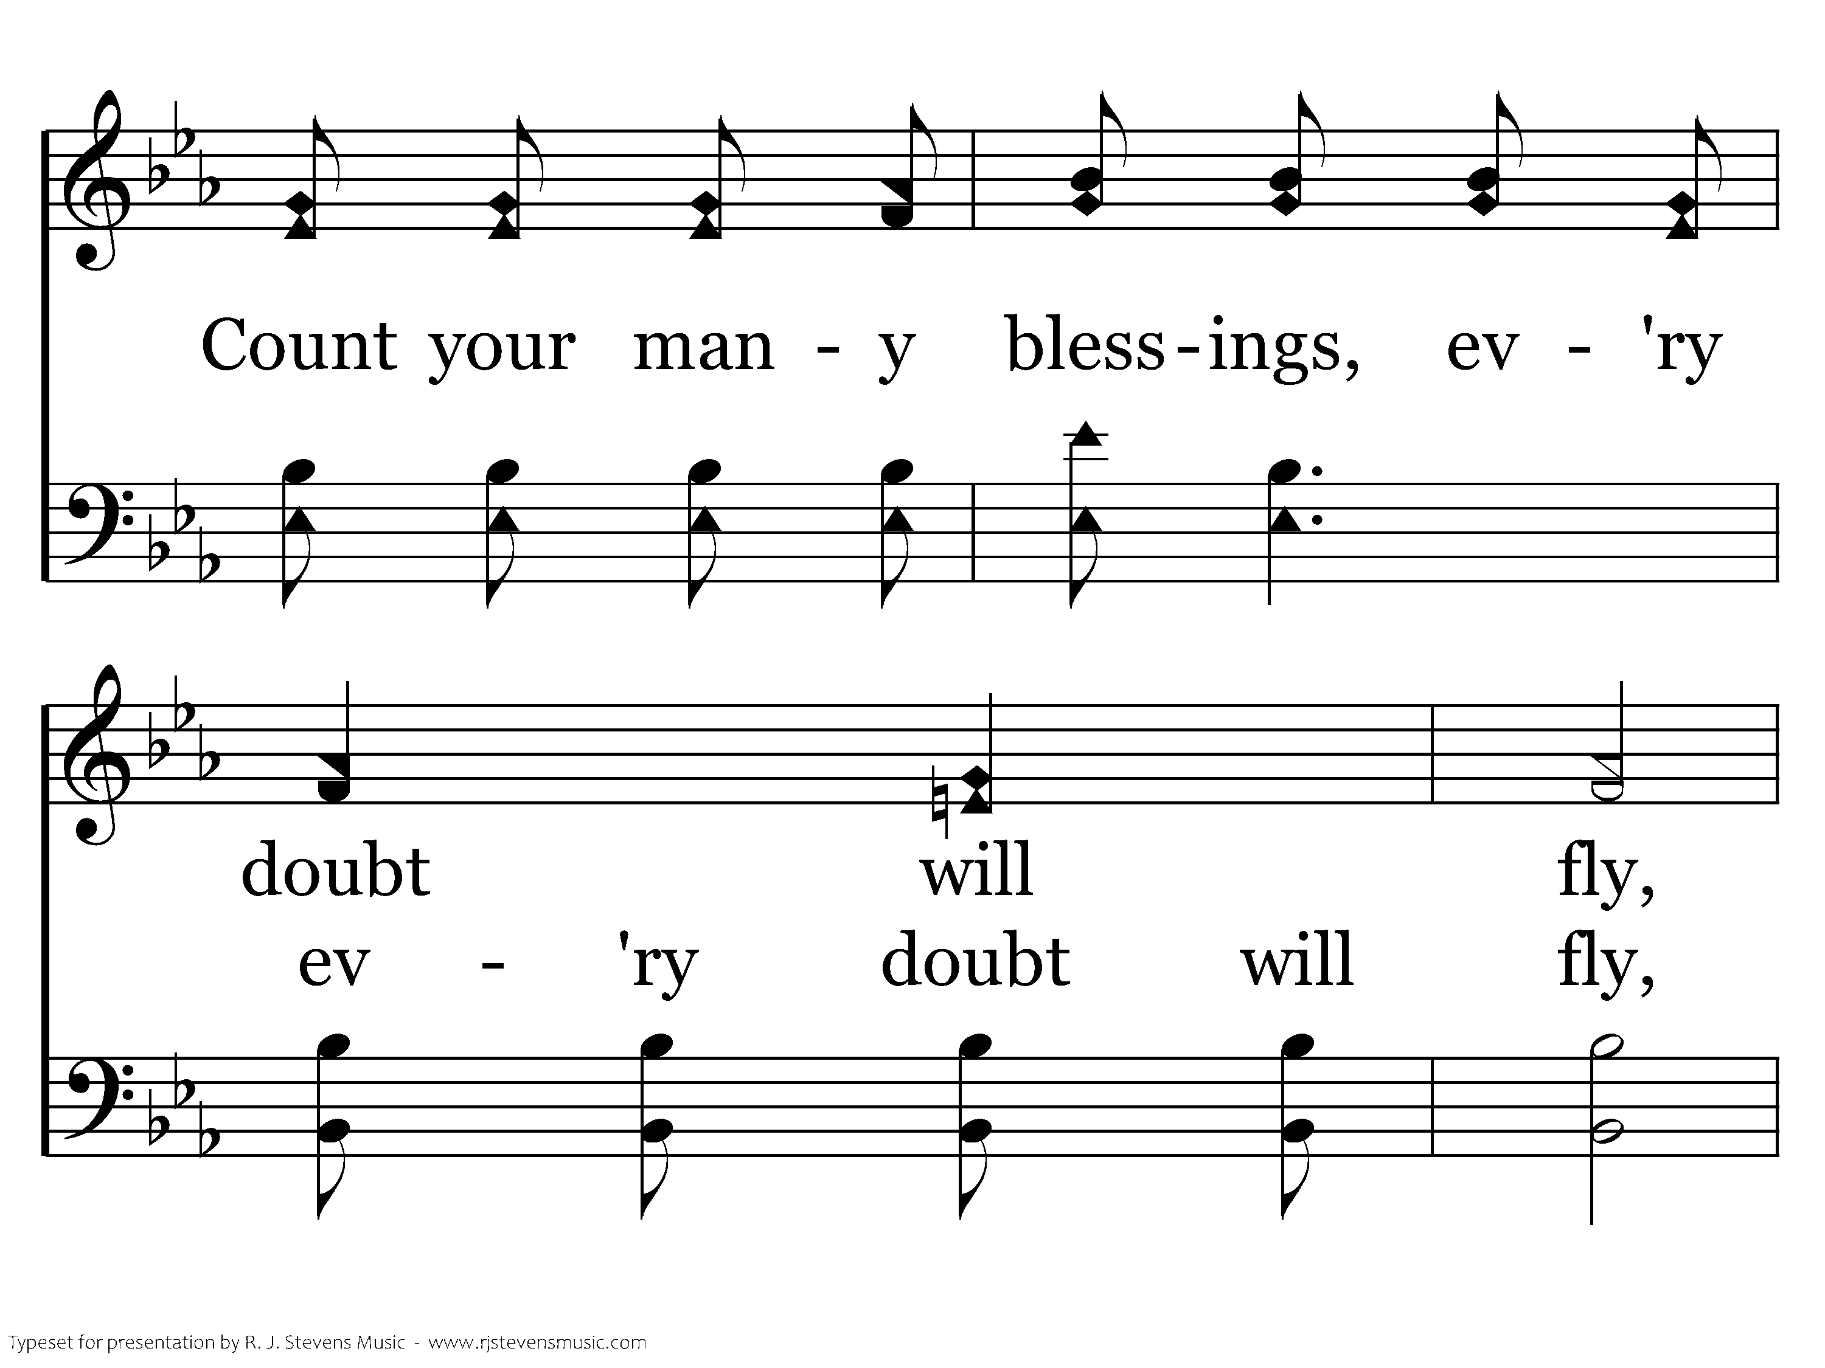
392 - Count Your Blessings - 2.3

Slide 13
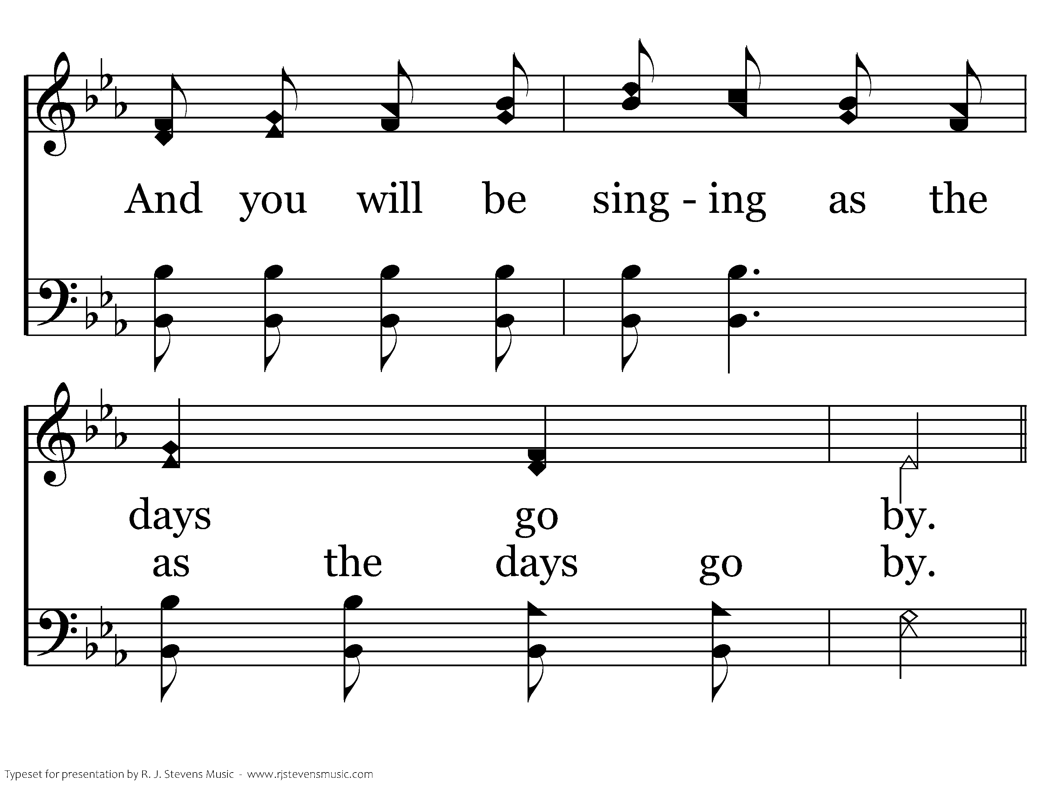
392 - Count Your Blessings - 2.4

Slide 14
392 - Count Your Blessings - C.1

Slide 15
392 - Count Your Blessings - C.2

Slide 16
392 - Count Your Blessings - C.3

Slide 17
392 - Count Your Blessings - C.4
End of Verse 2

Slide 18
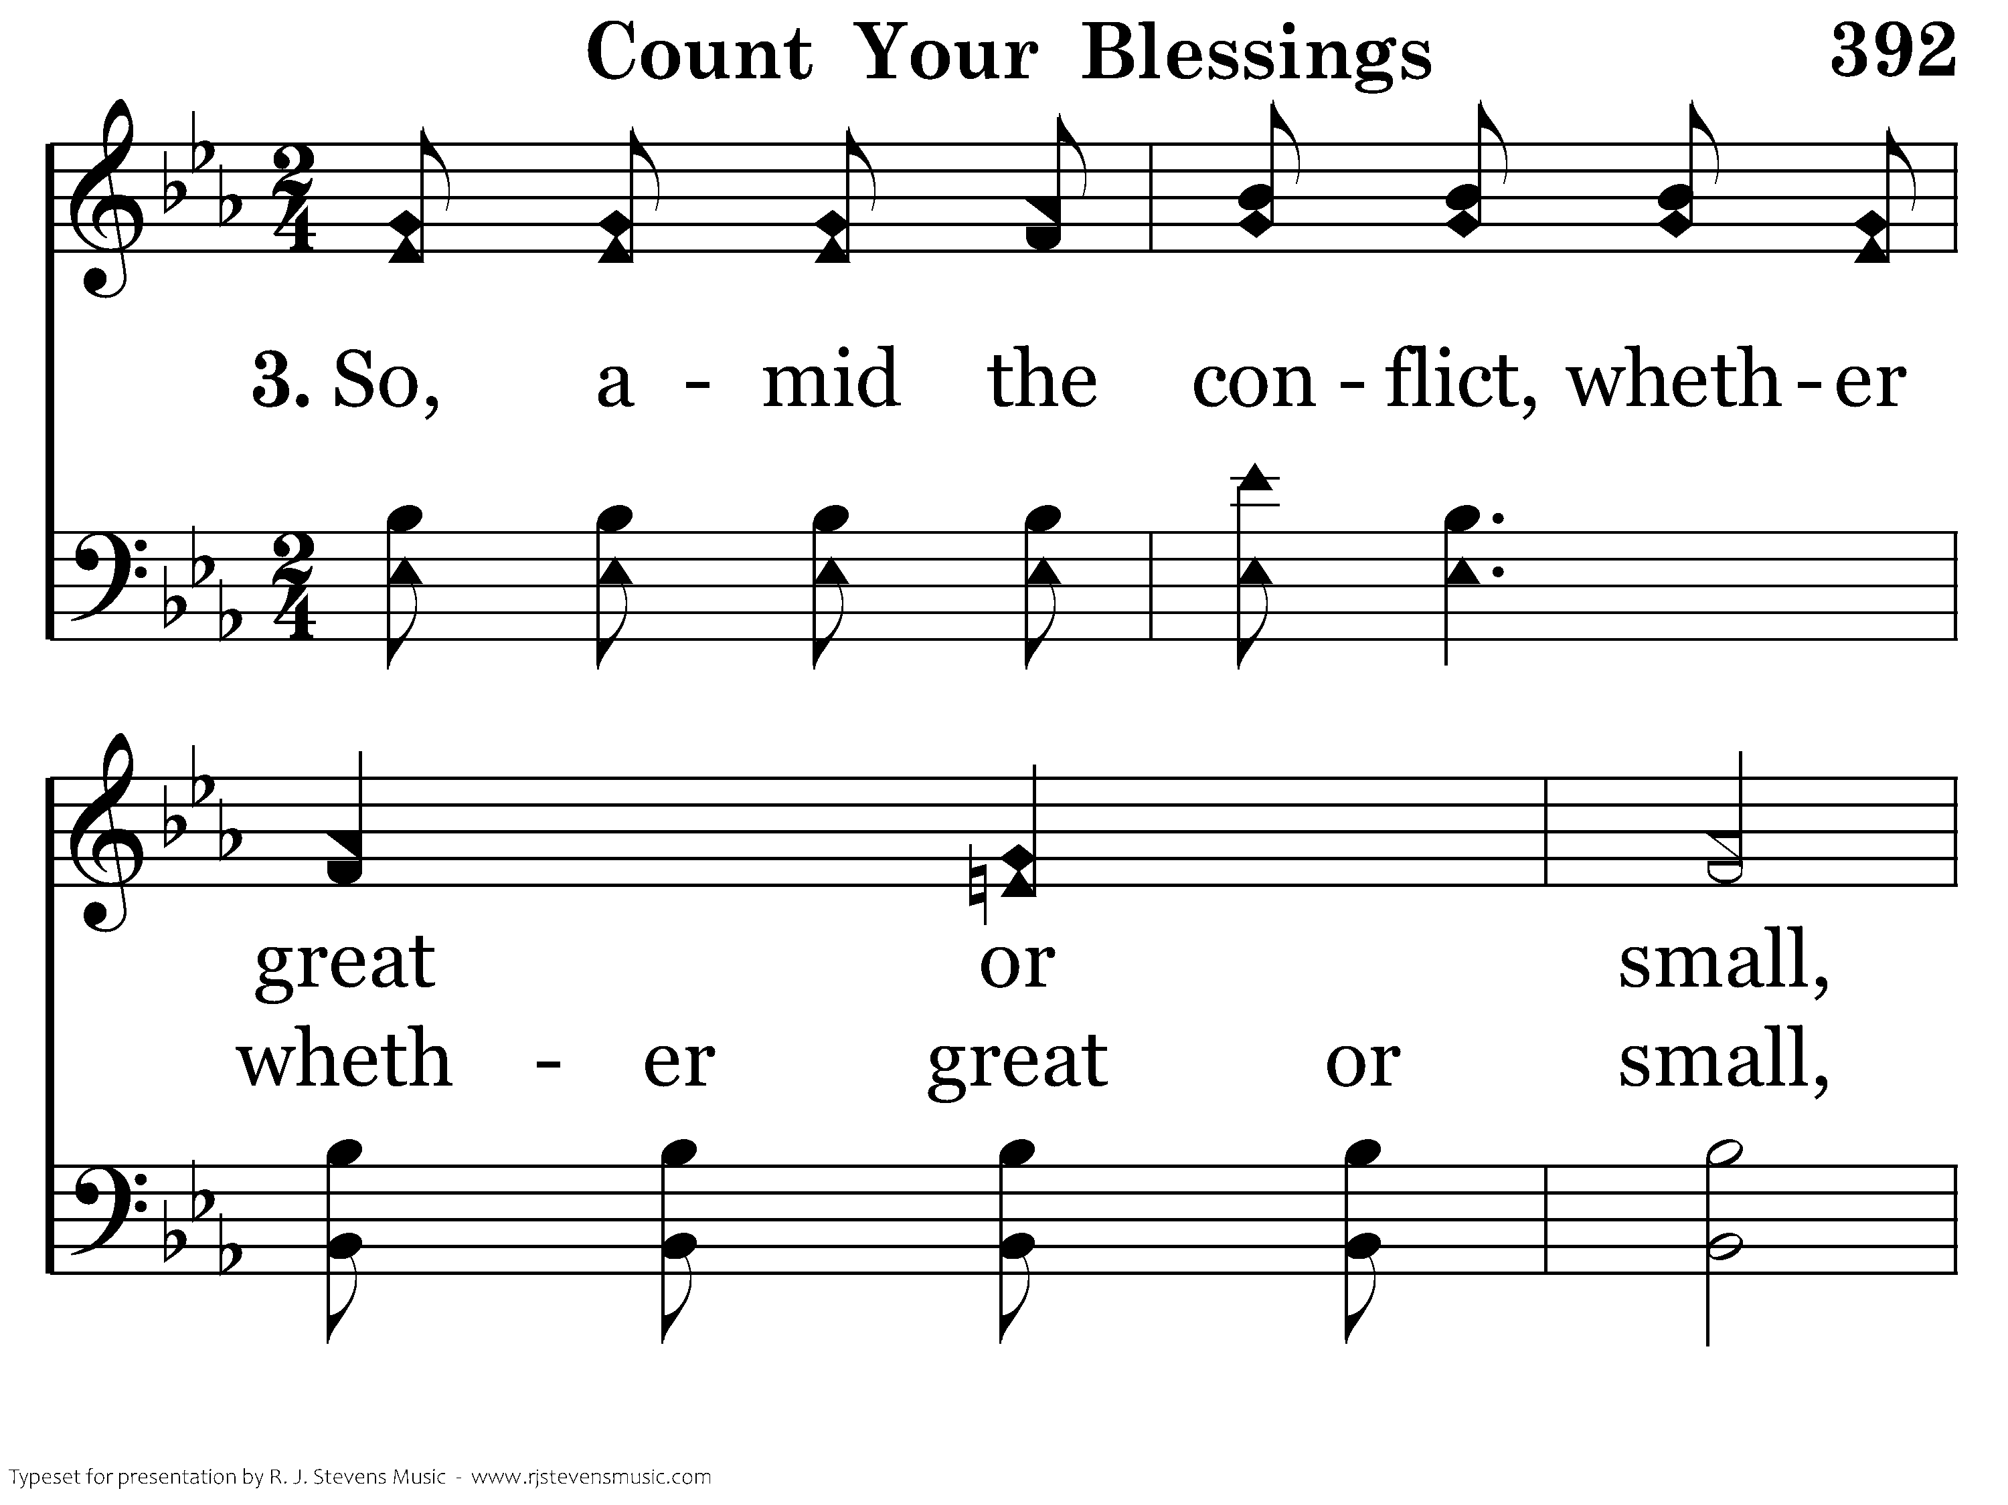
392 - Count Your Blessings - 3.1

Slide 19
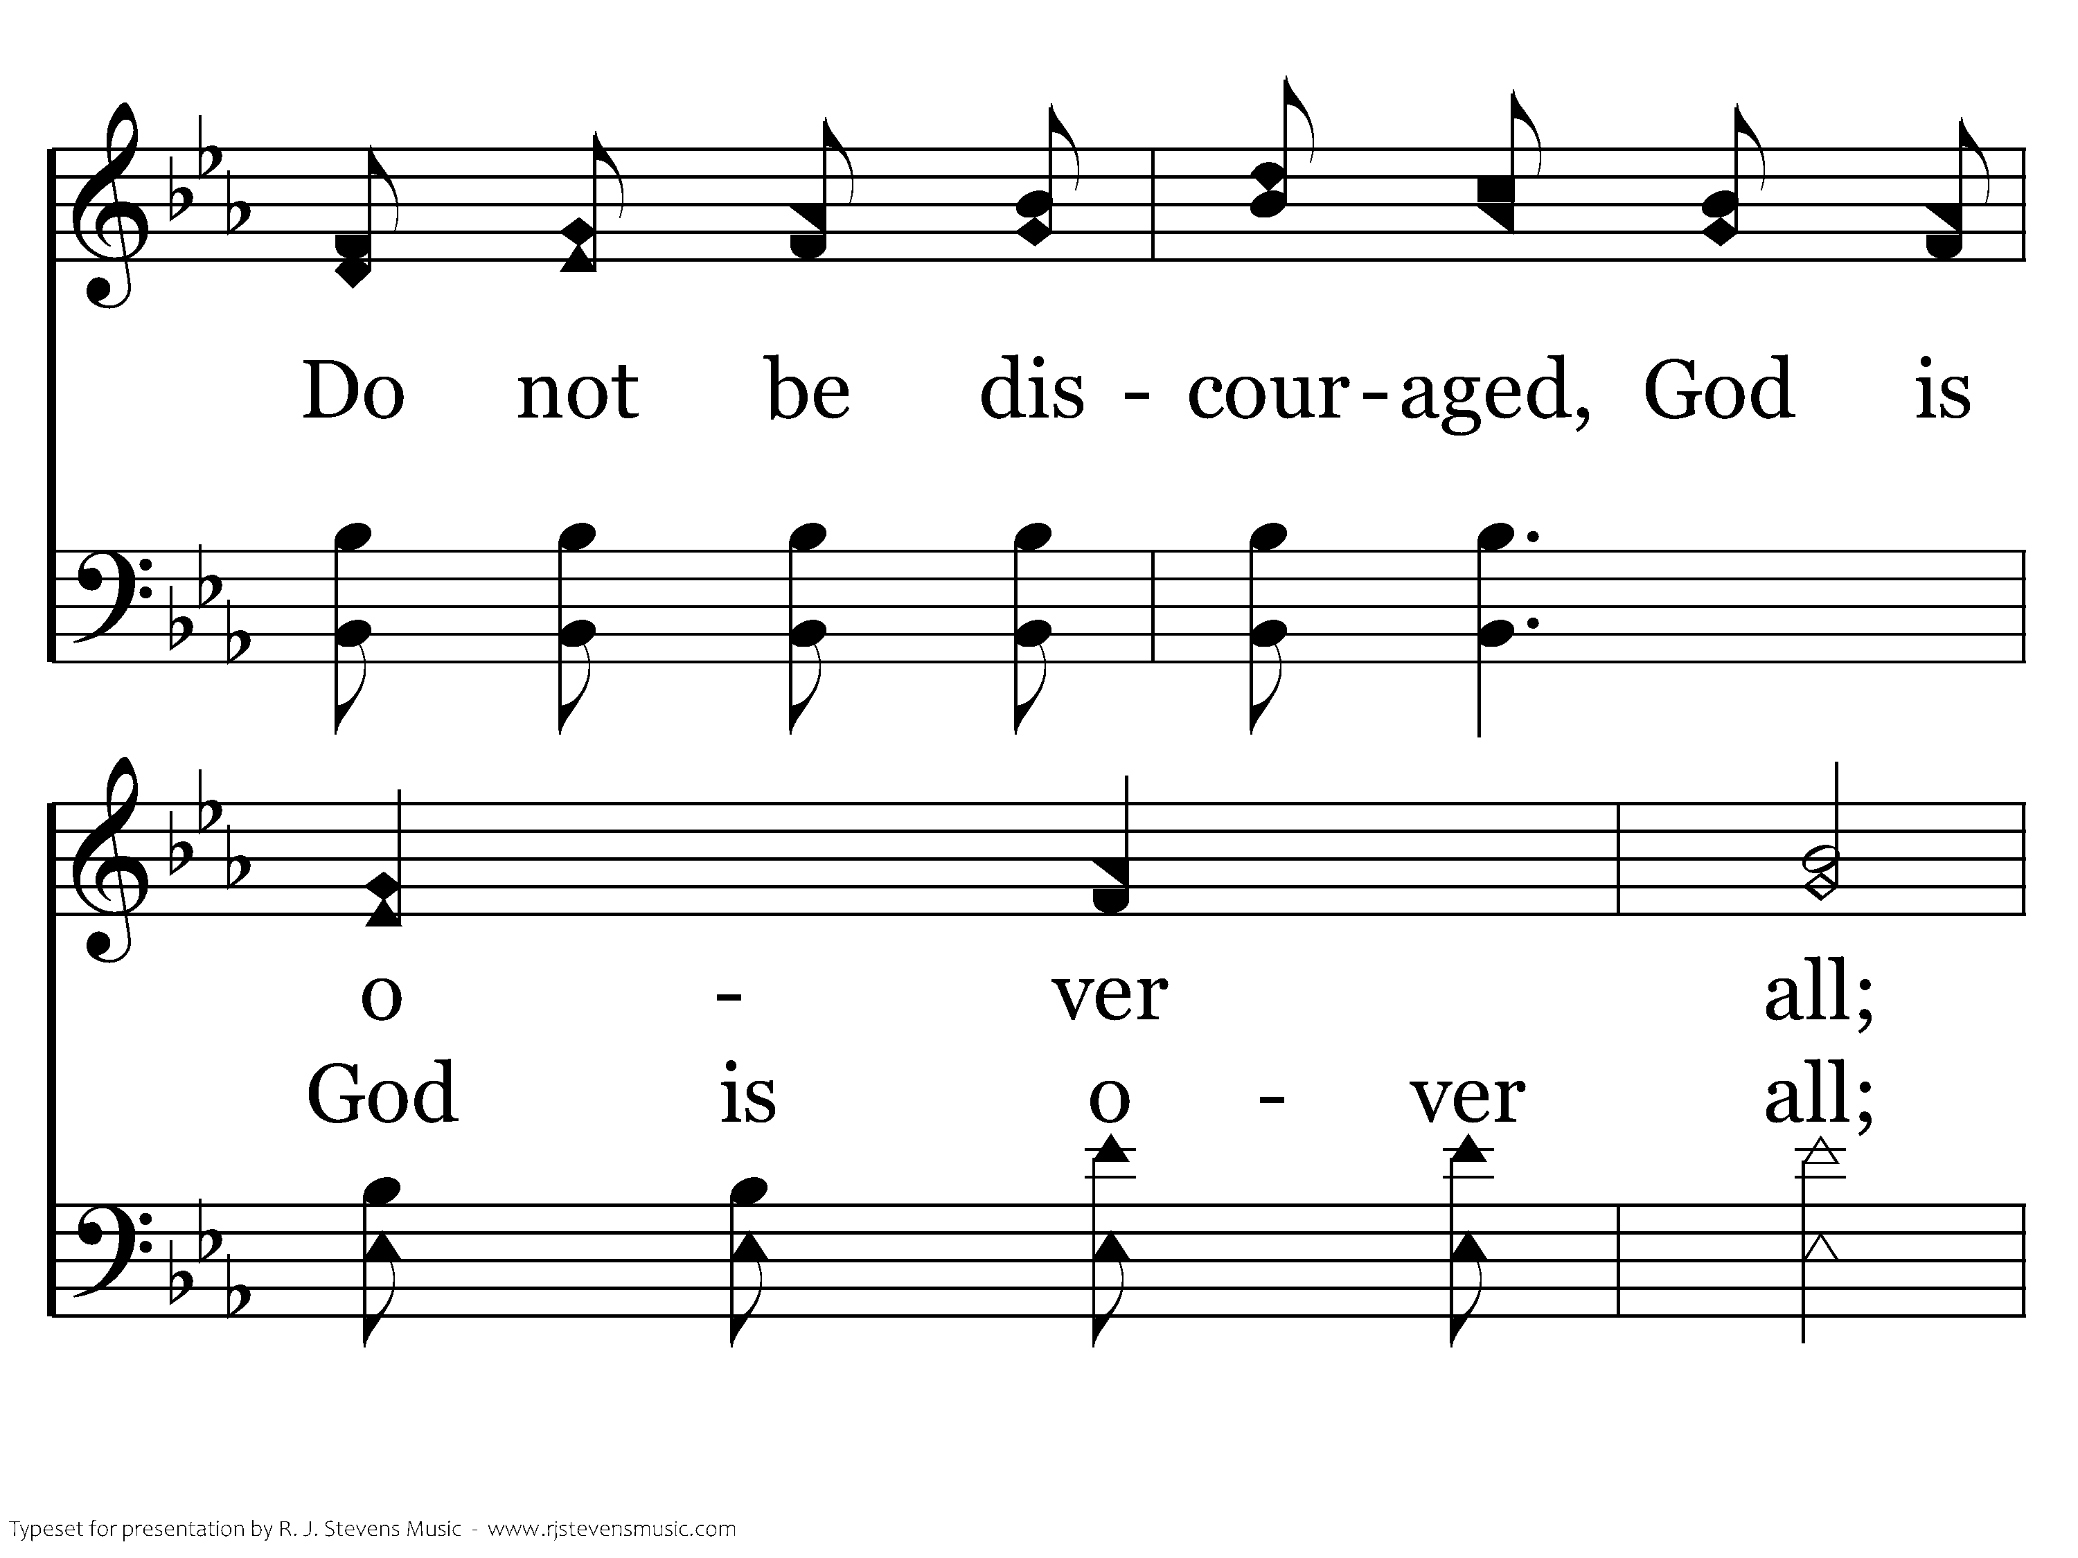
392 - Count Your Blessings - 3.2

Slide 20
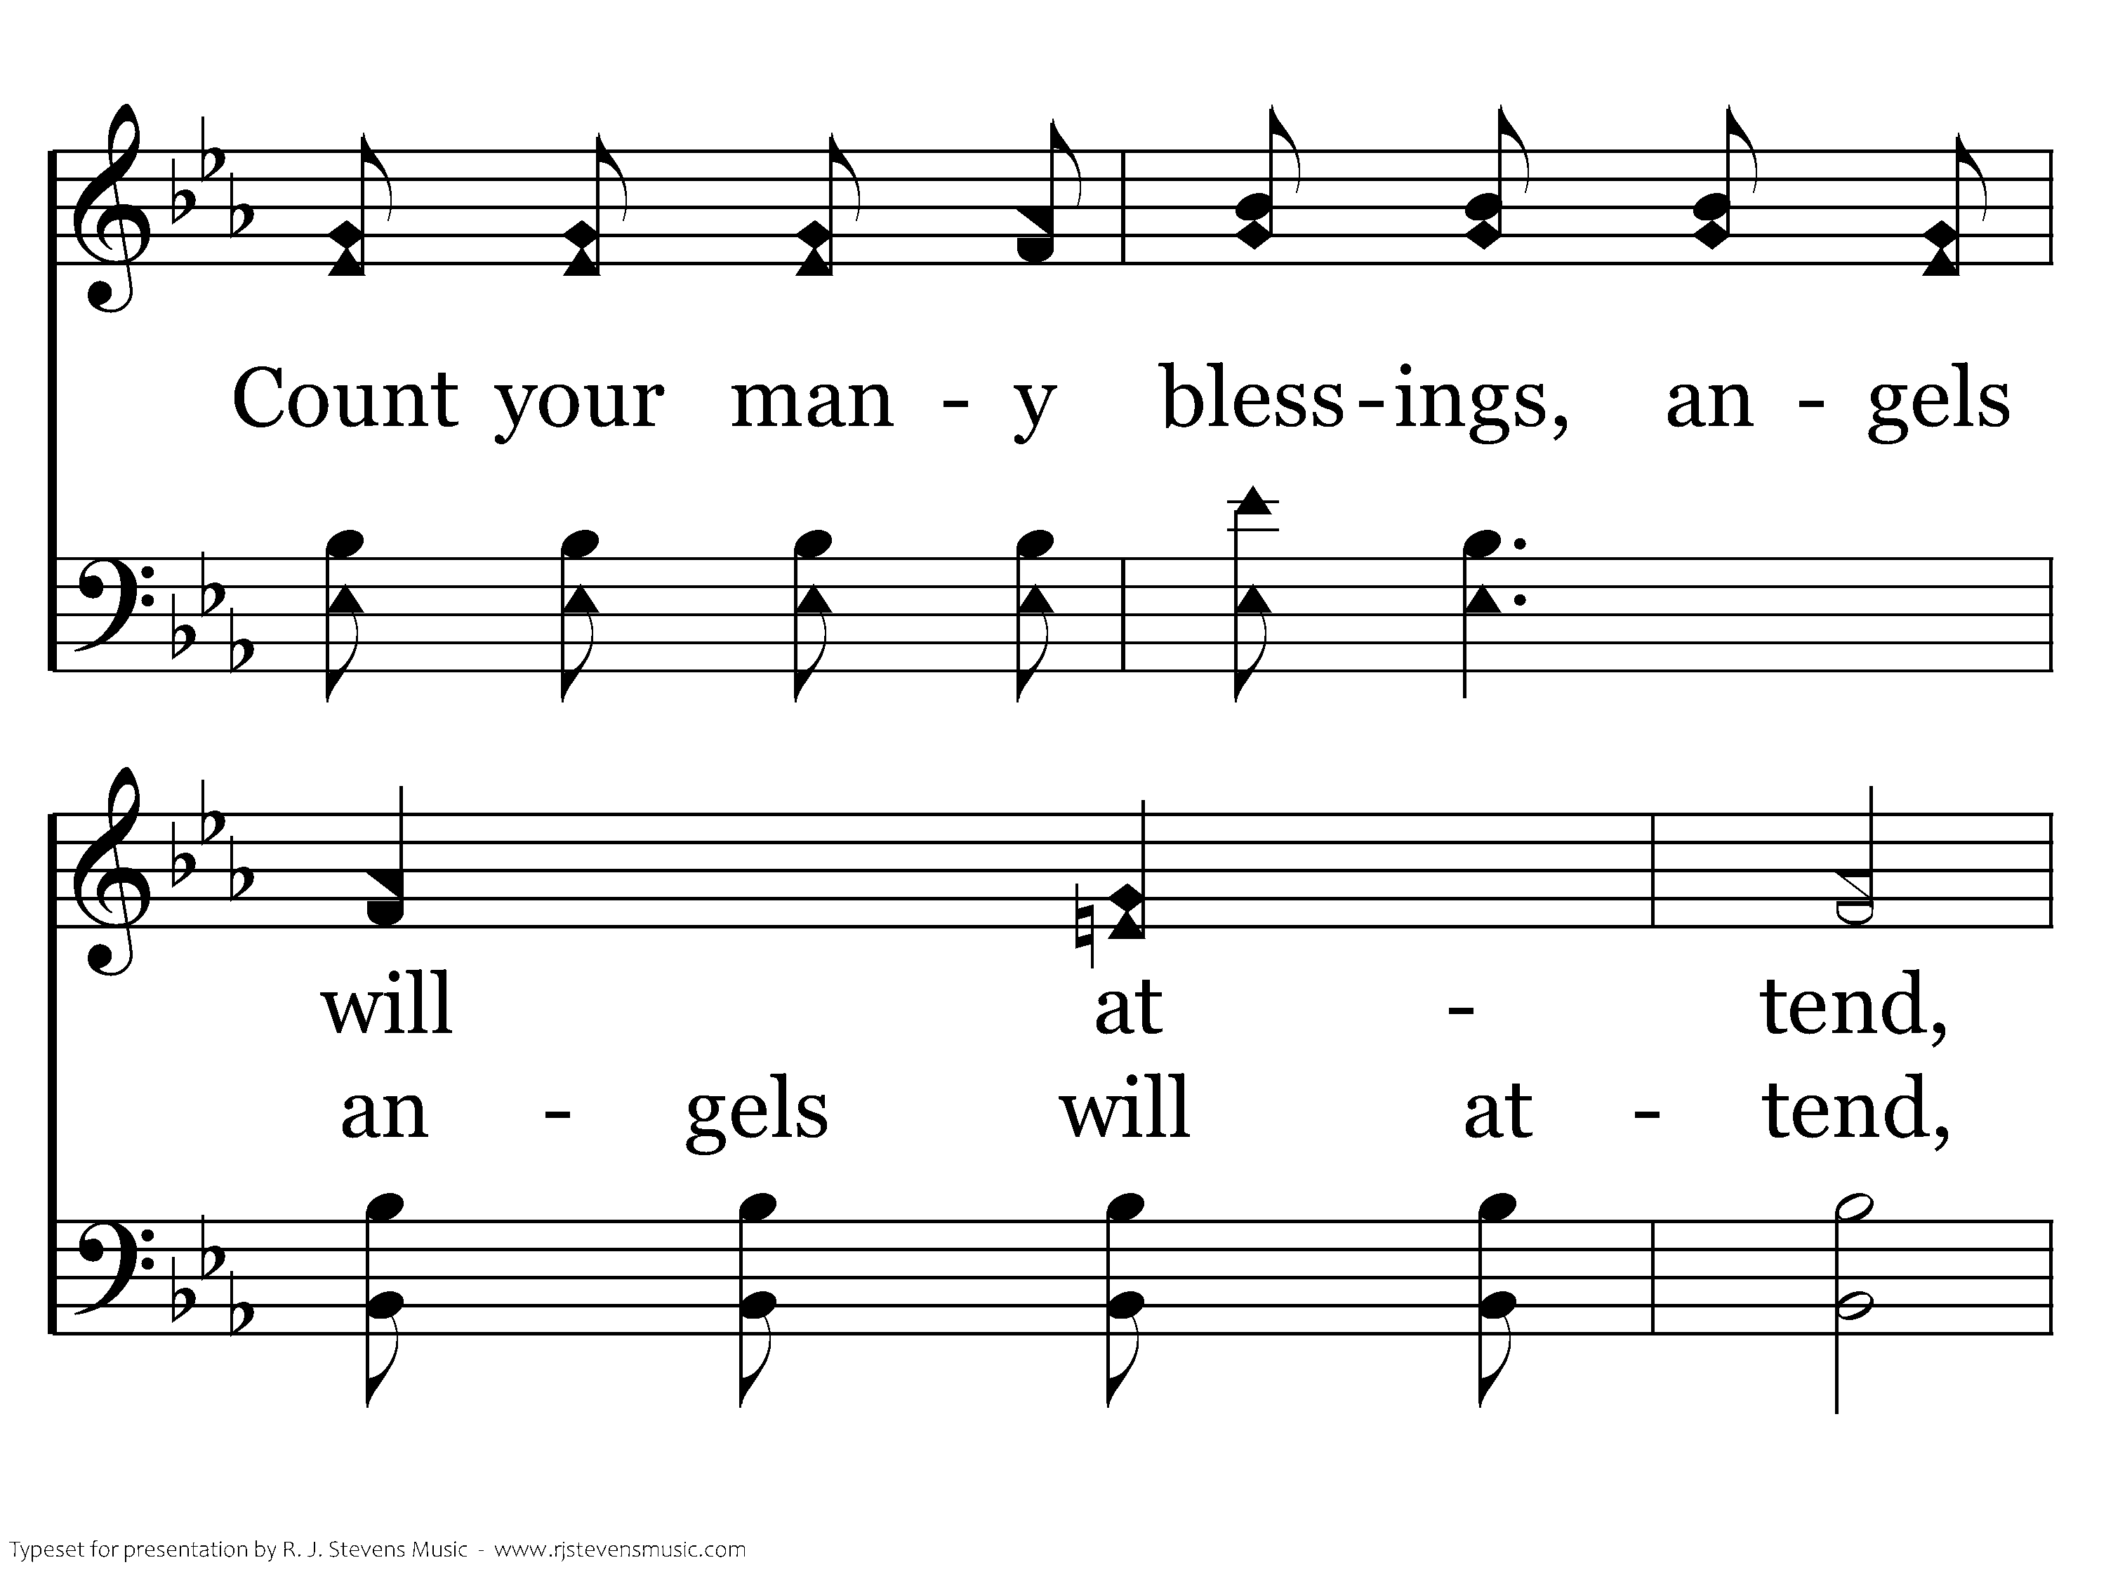
392 - Count Your Blessings - 3.3

Slide 21
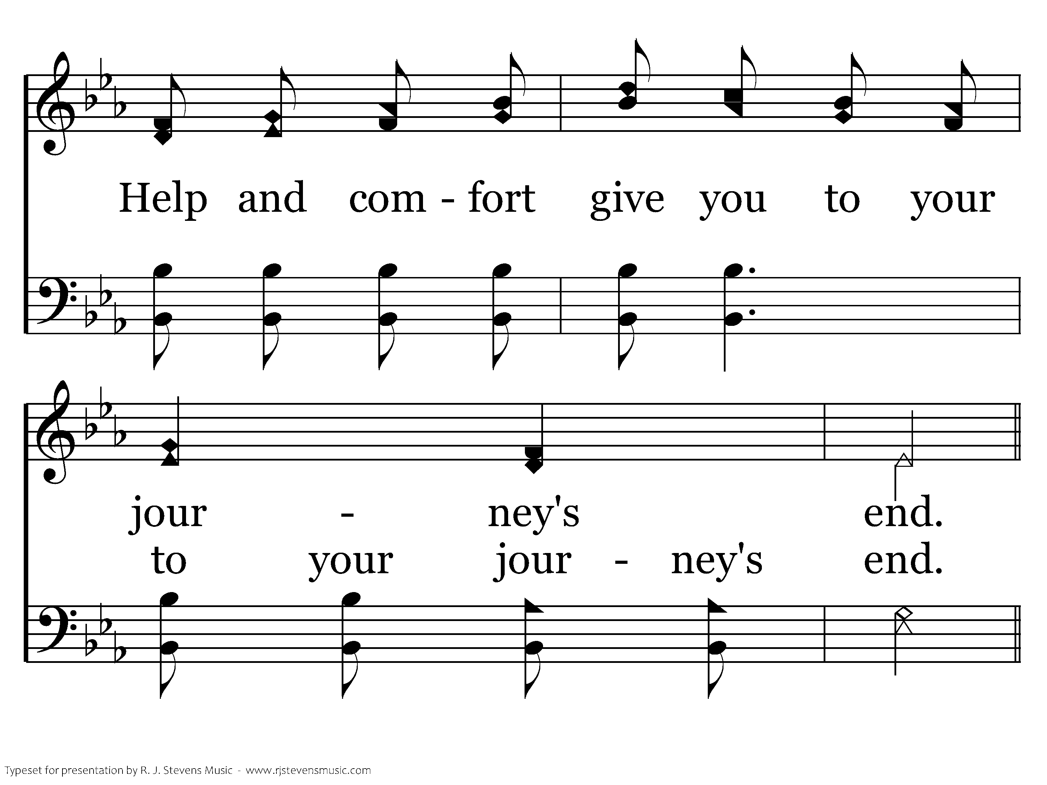
392 - Count Your Blessings - 3.4

Slide 22
392 - Count Your Blessings - C.1

Slide 23
392 - Count Your Blessings - C.2

Slide 24
392 - Count Your Blessings - C.3

Slide 25
392 - Count Your Blessings - C.4
End of Song

Slide 26
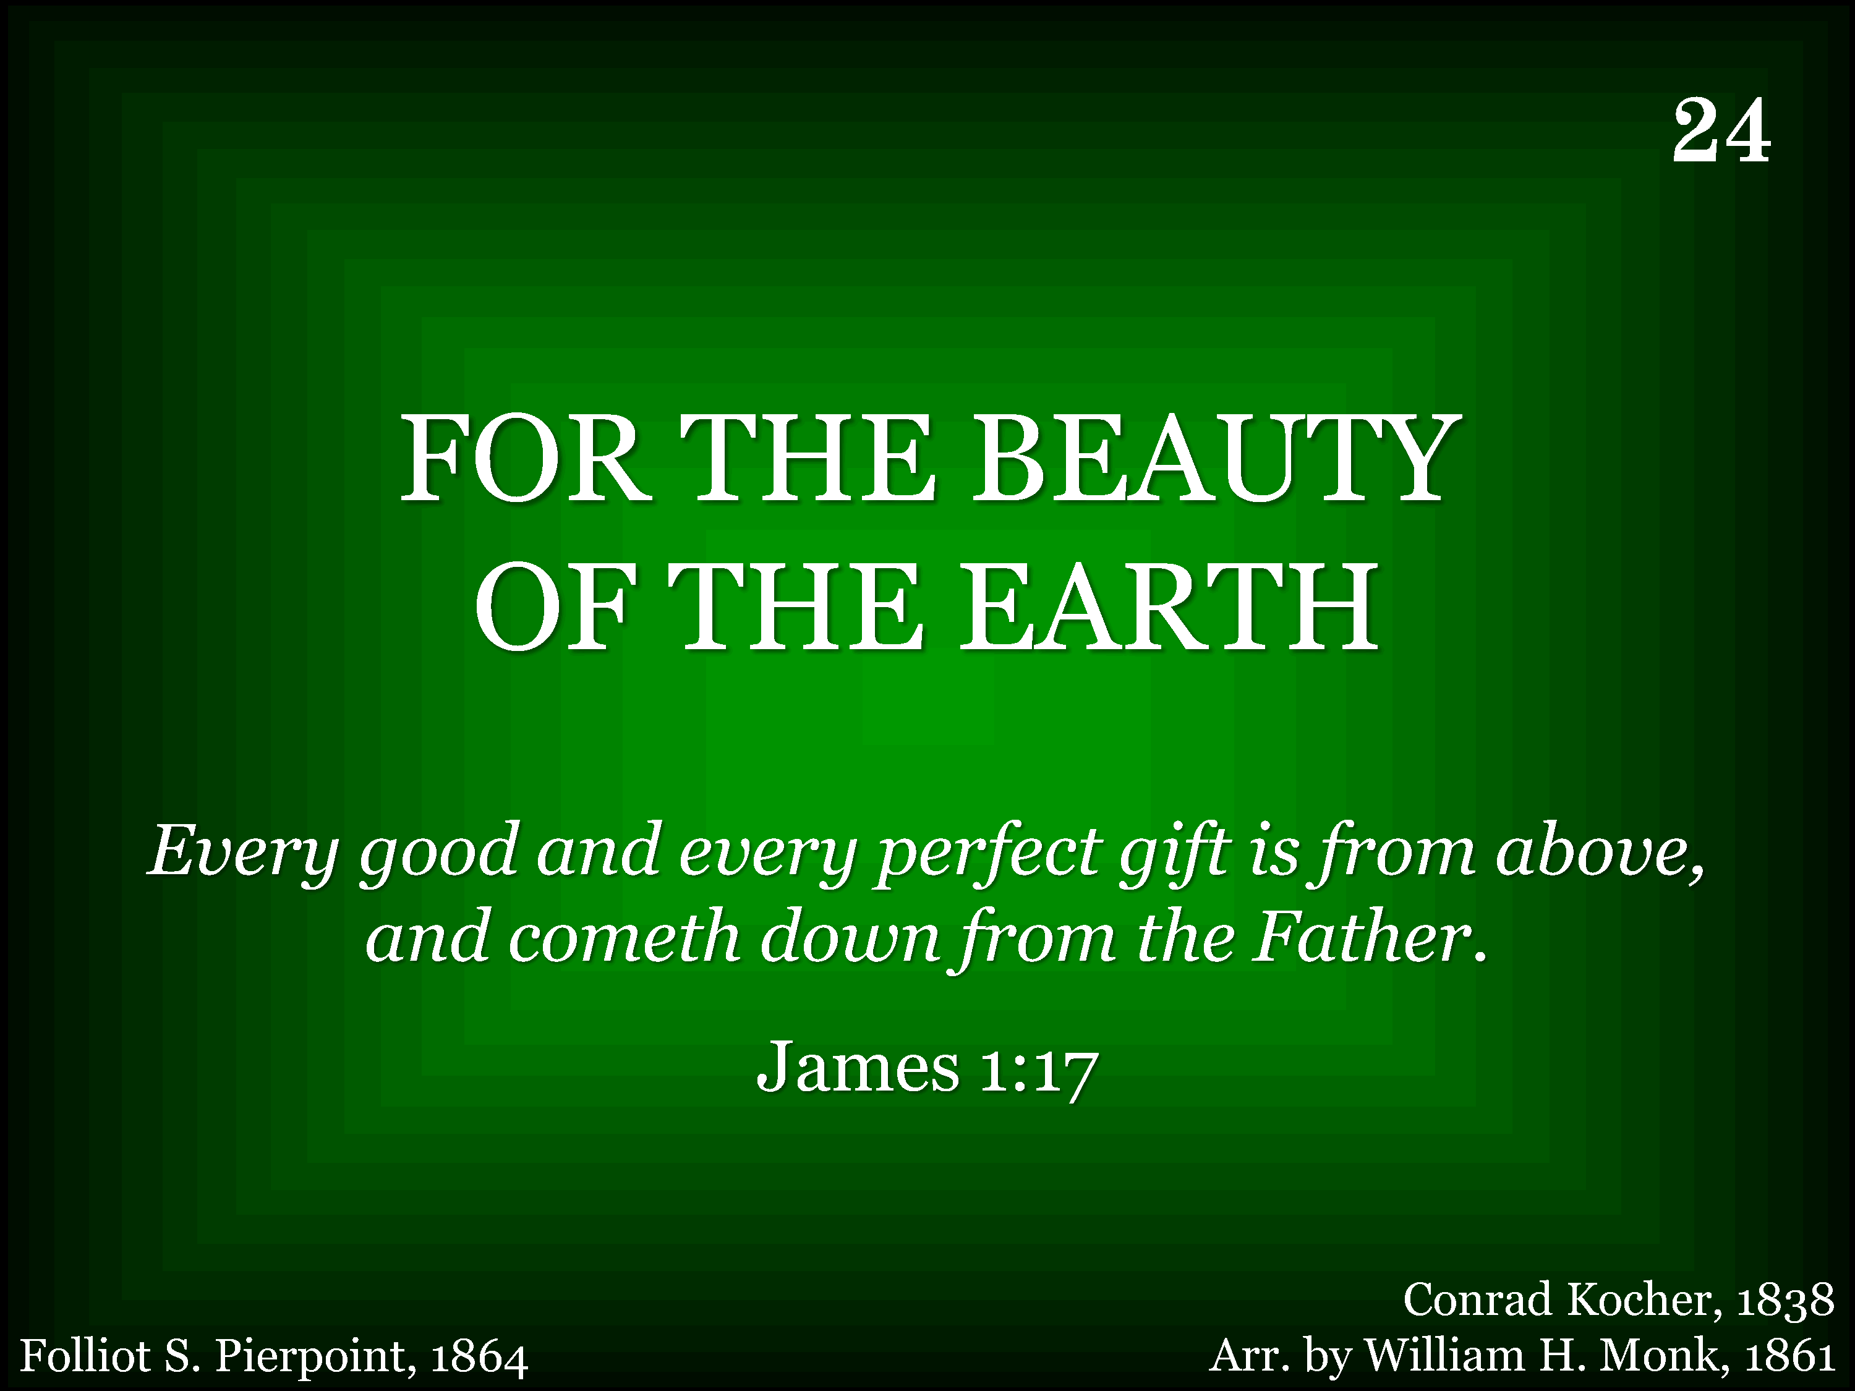
024 - For The Beauty Of The Earth - Title

Slide 27
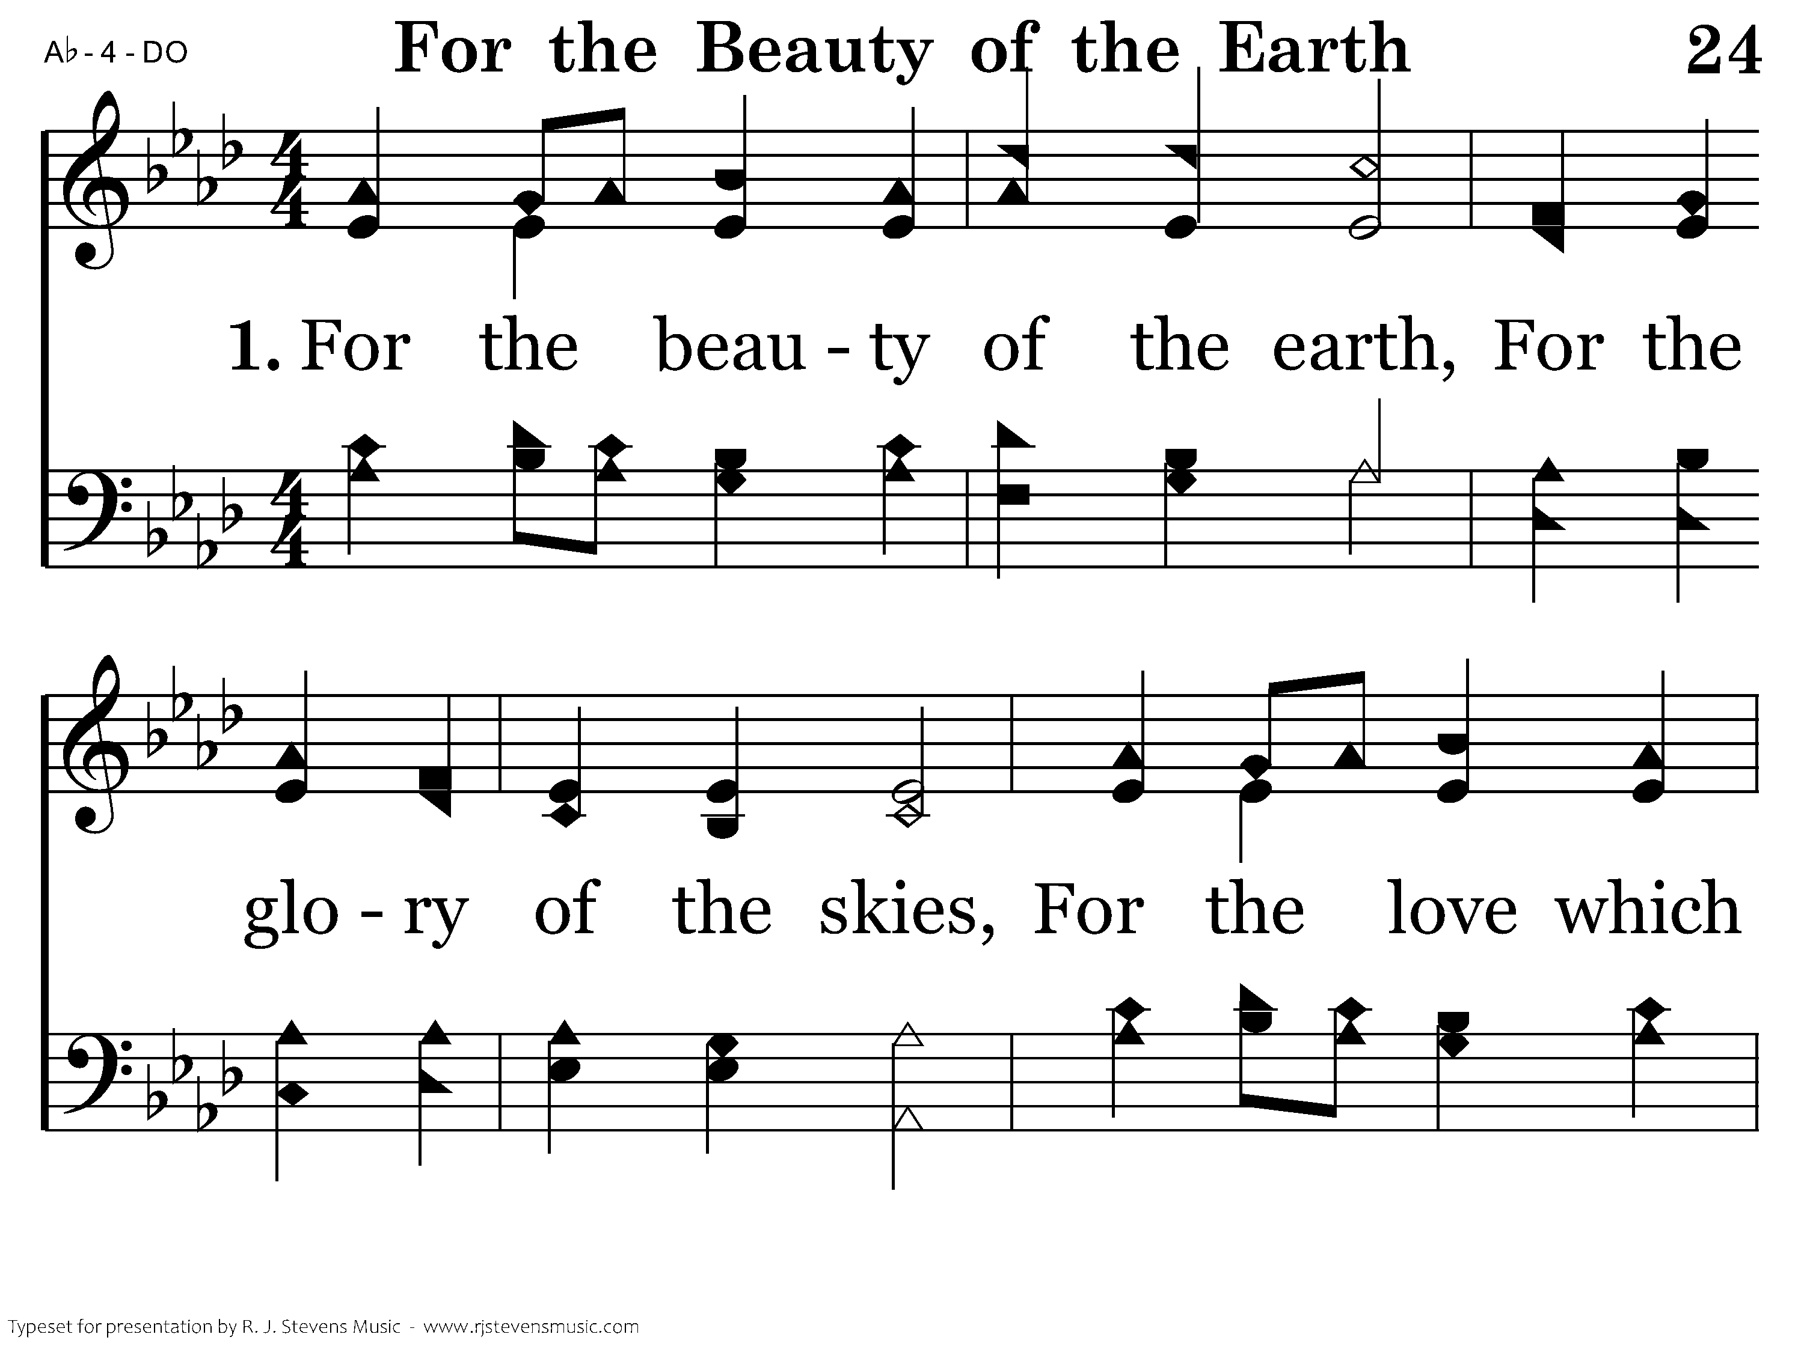
024 - For The Beauty Of The Earth - 1.1

Slide 28
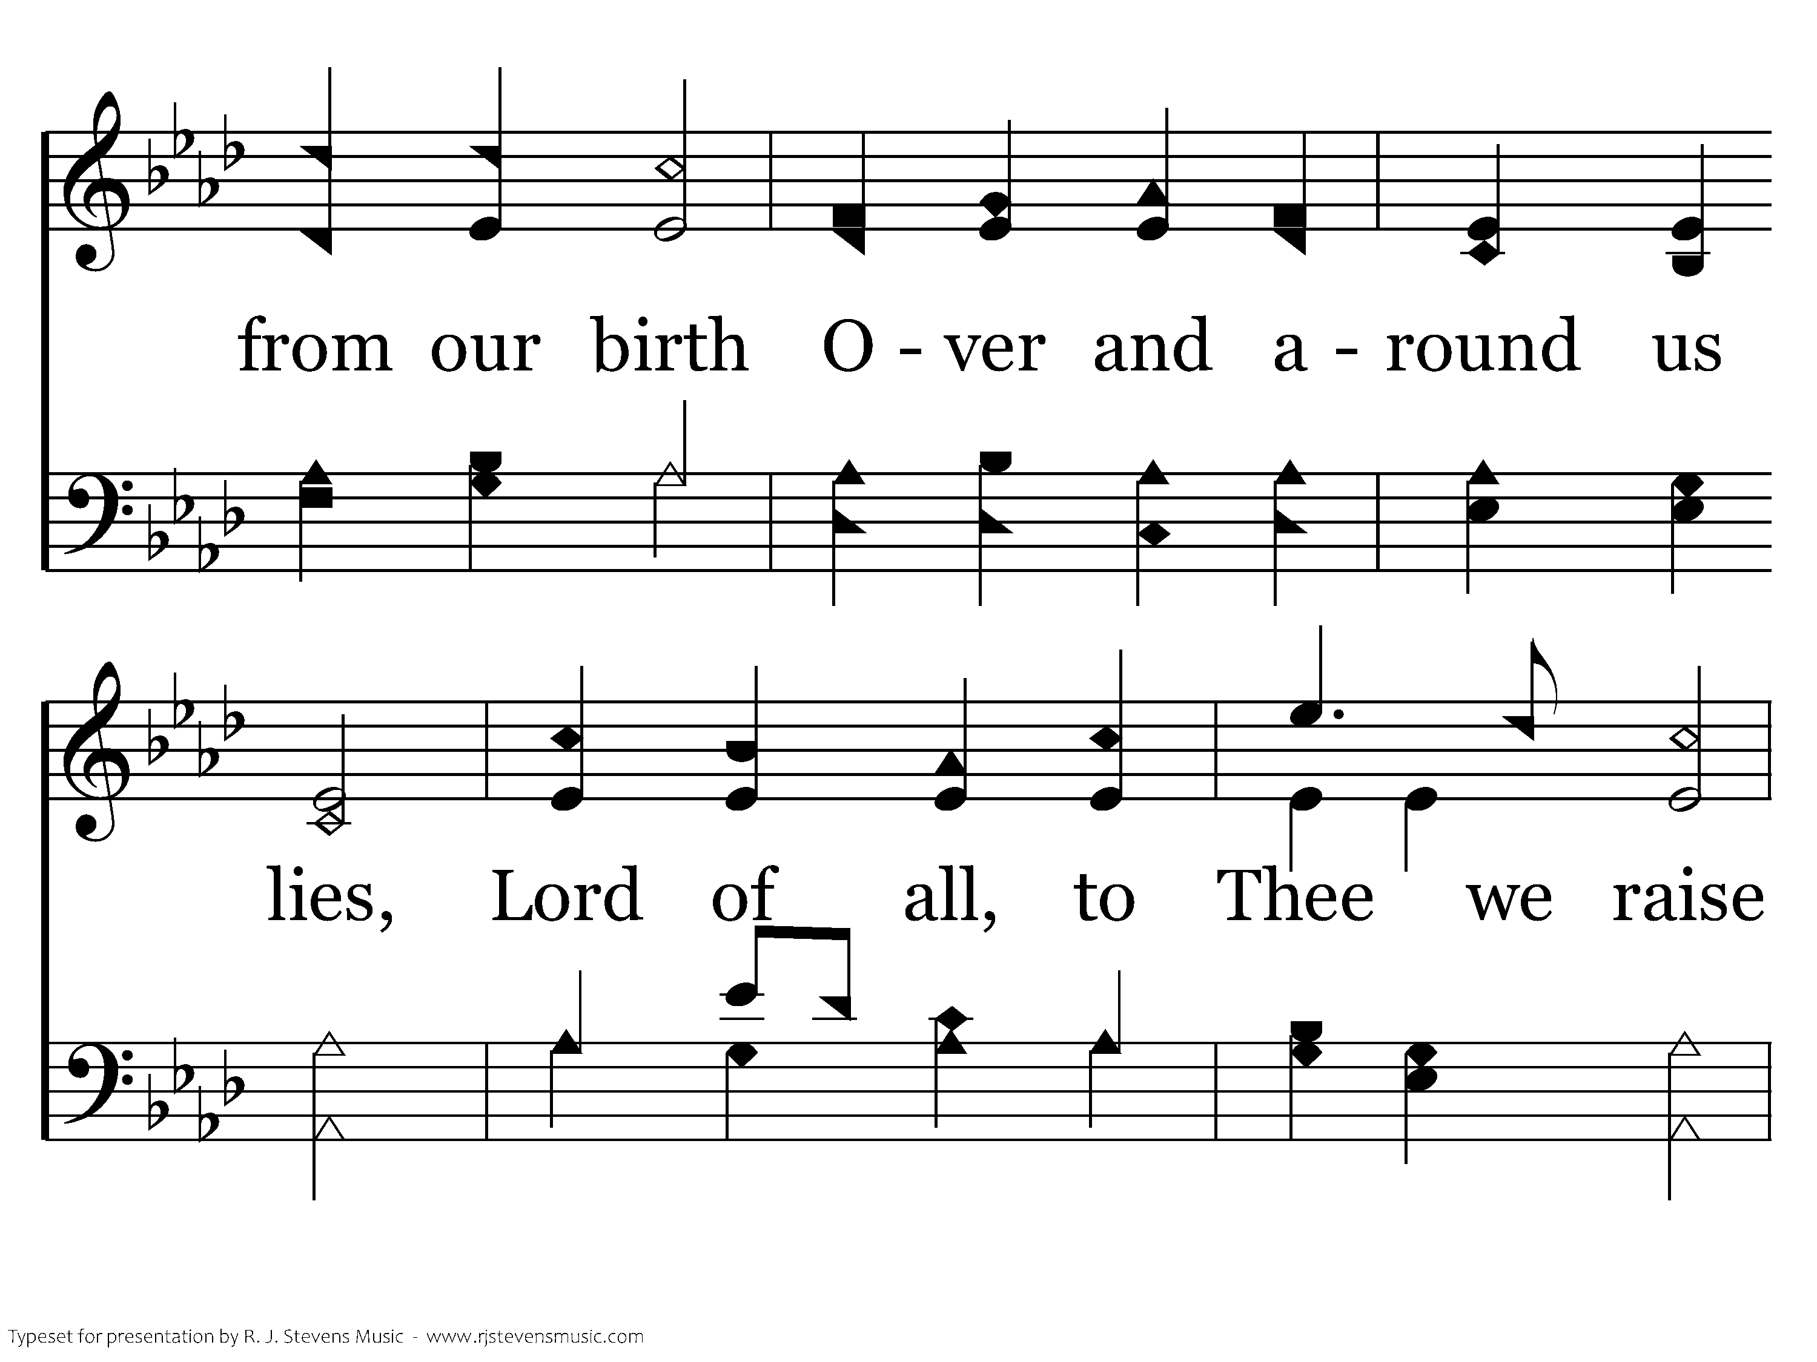
024 - For The Beauty Of The Earth - 1.2

Slide 29
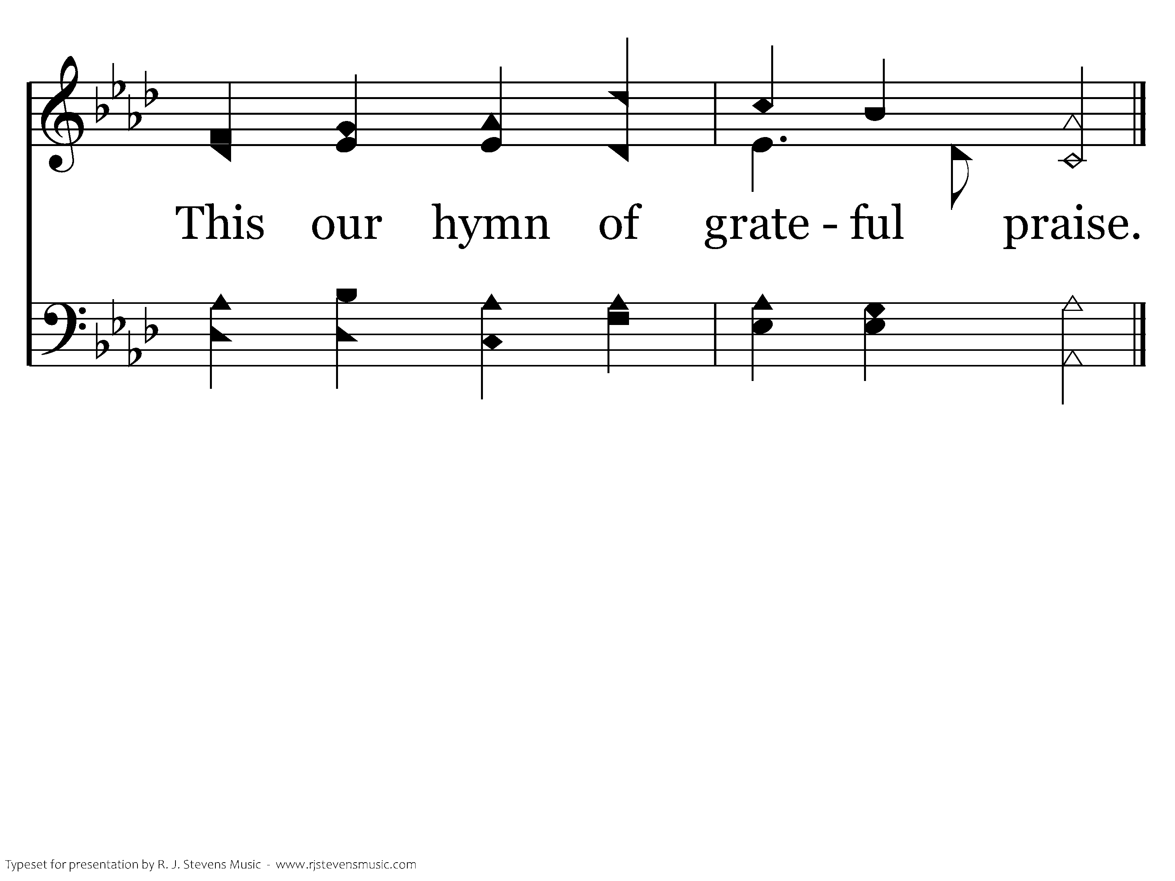
024 - For The Beauty Of The Earth - 1.3
End of Verse 1

Slide 30
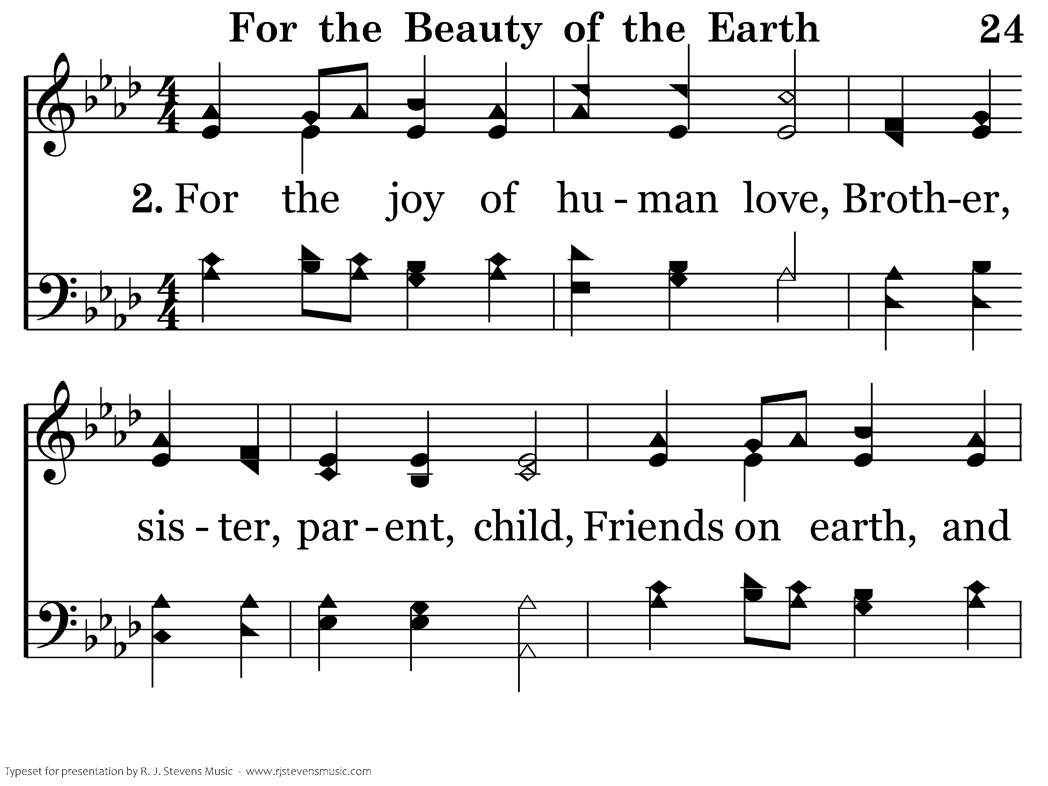
024 - For The Beauty Of The Earth - 2.1

Slide 31
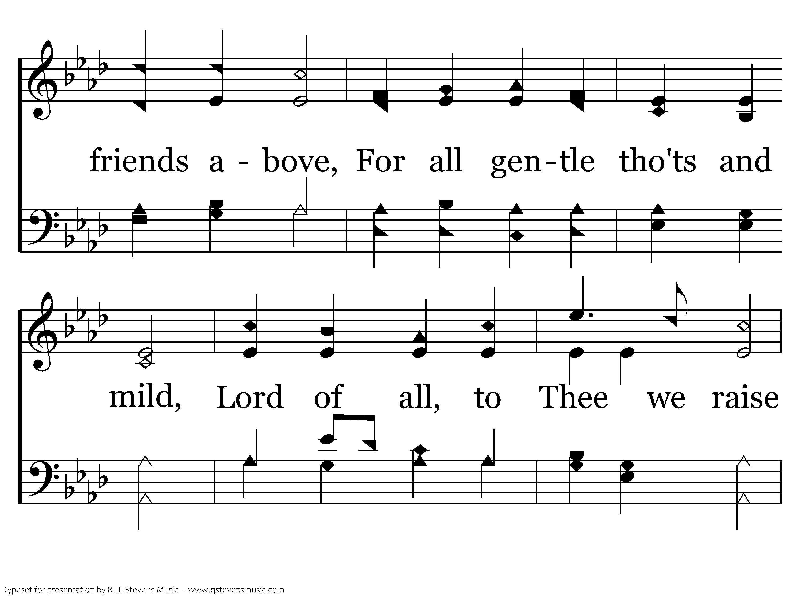
024 - For The Beauty Of The Earth - 2.2

Slide 32
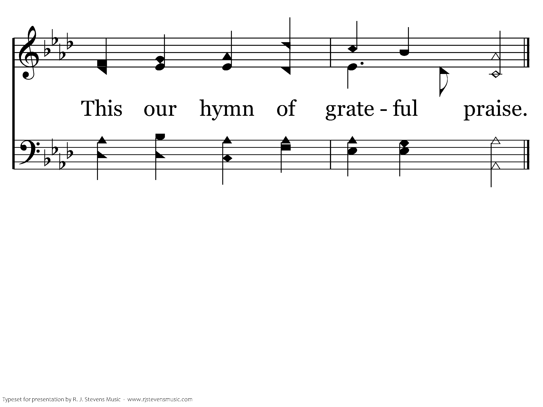
024 - For The Beauty Of The Earth - 2.3
End of Verse 2

Slide 33
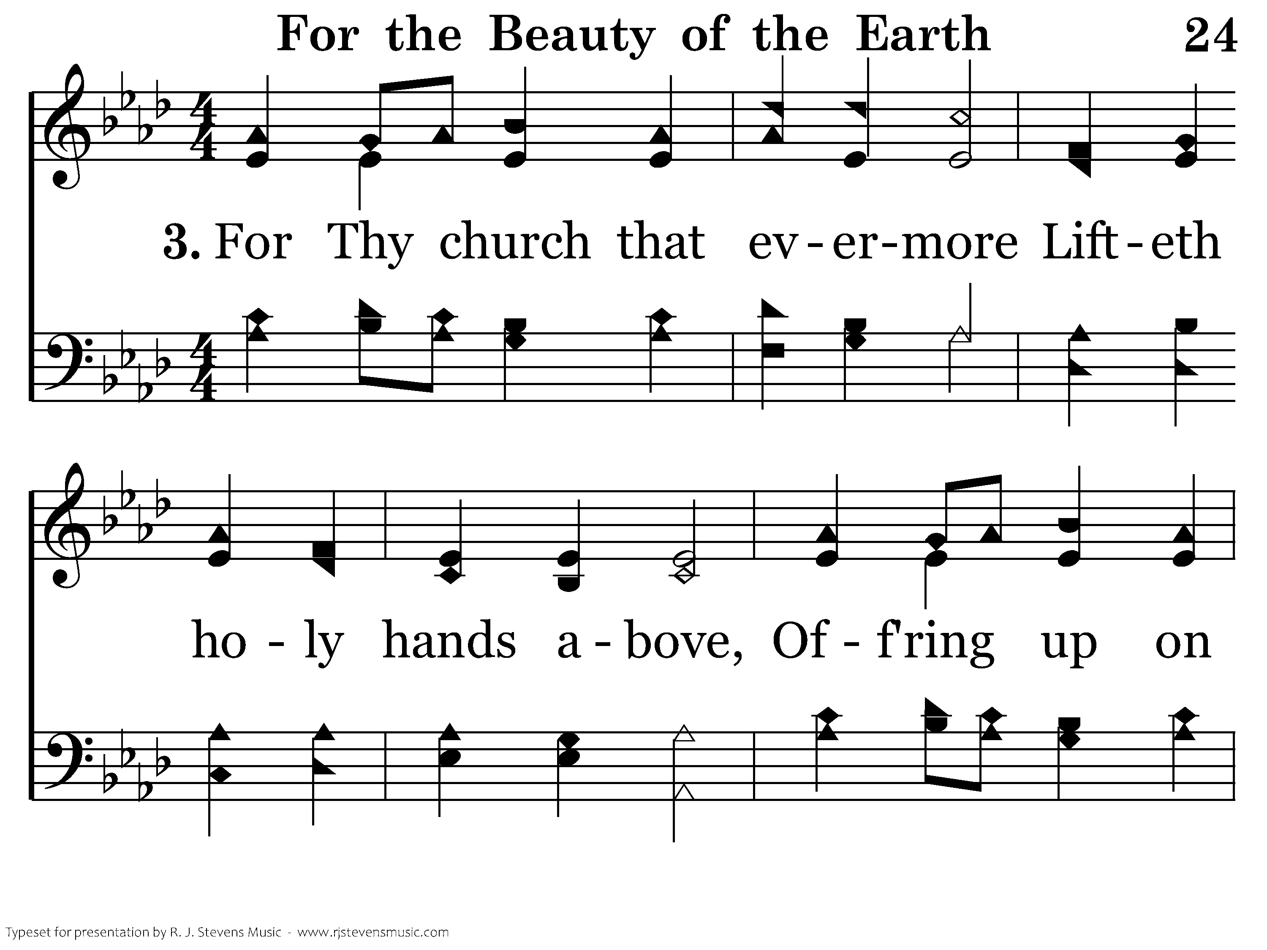
024 - For The Beauty Of The Earth - 3.1

Slide 34
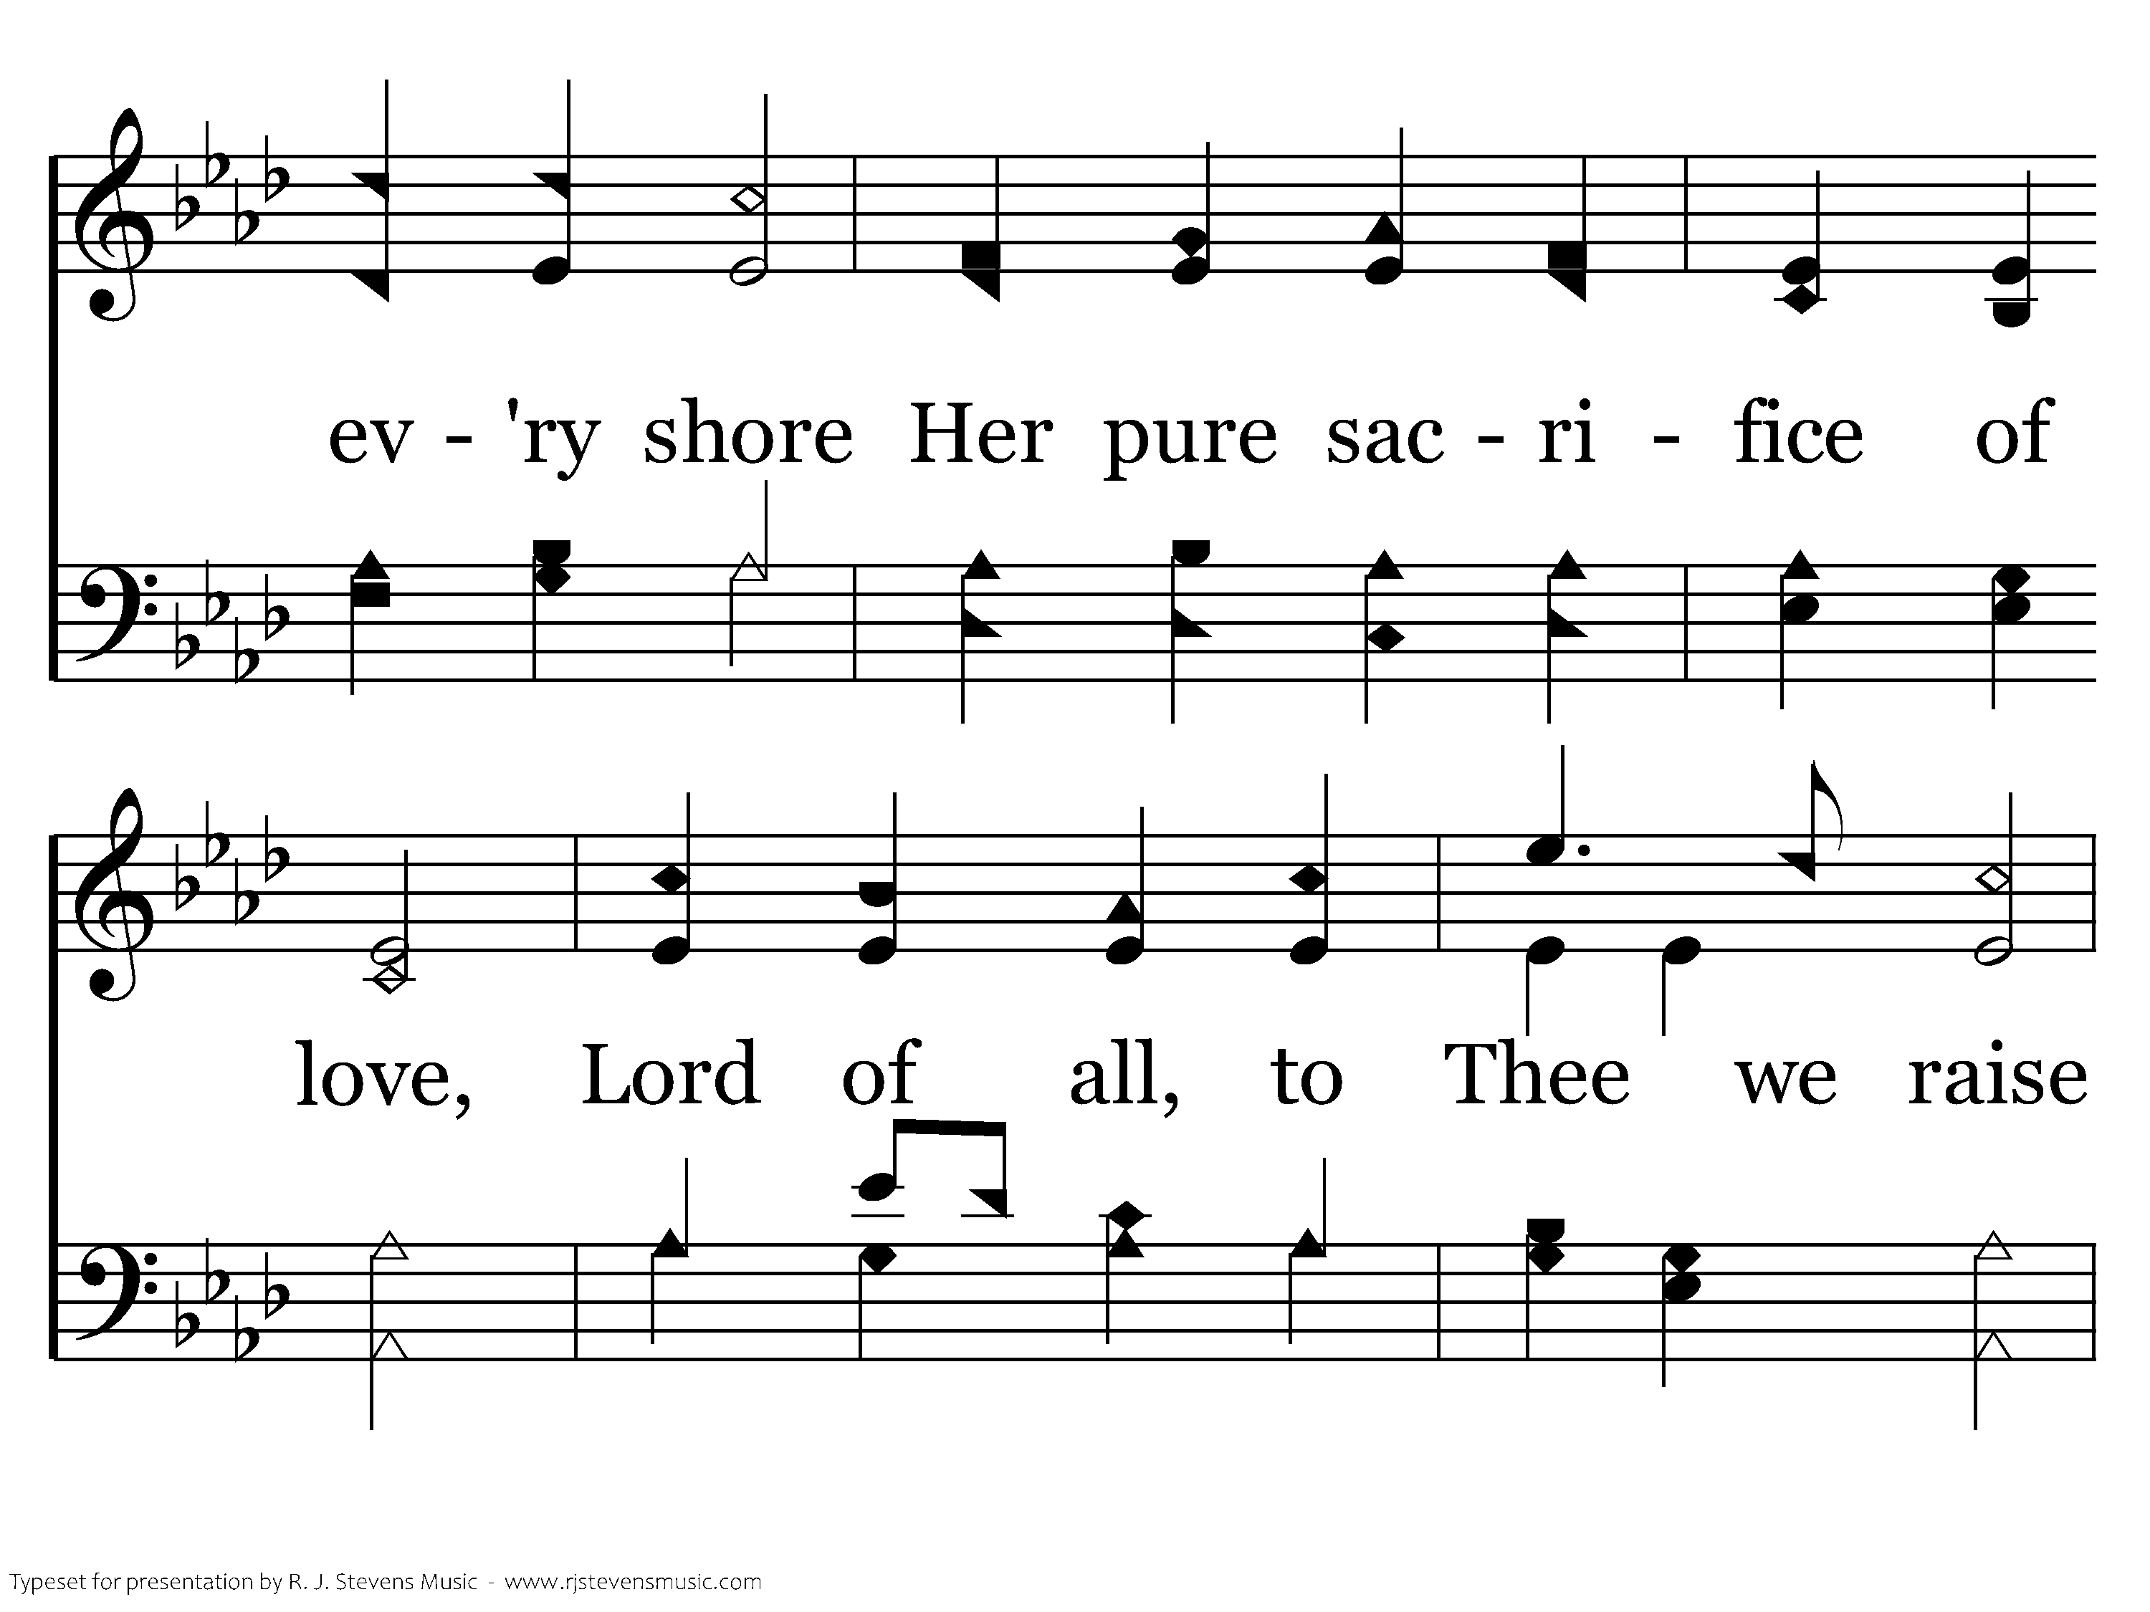
024 - For The Beauty Of The Earth - 3.2

Slide 35
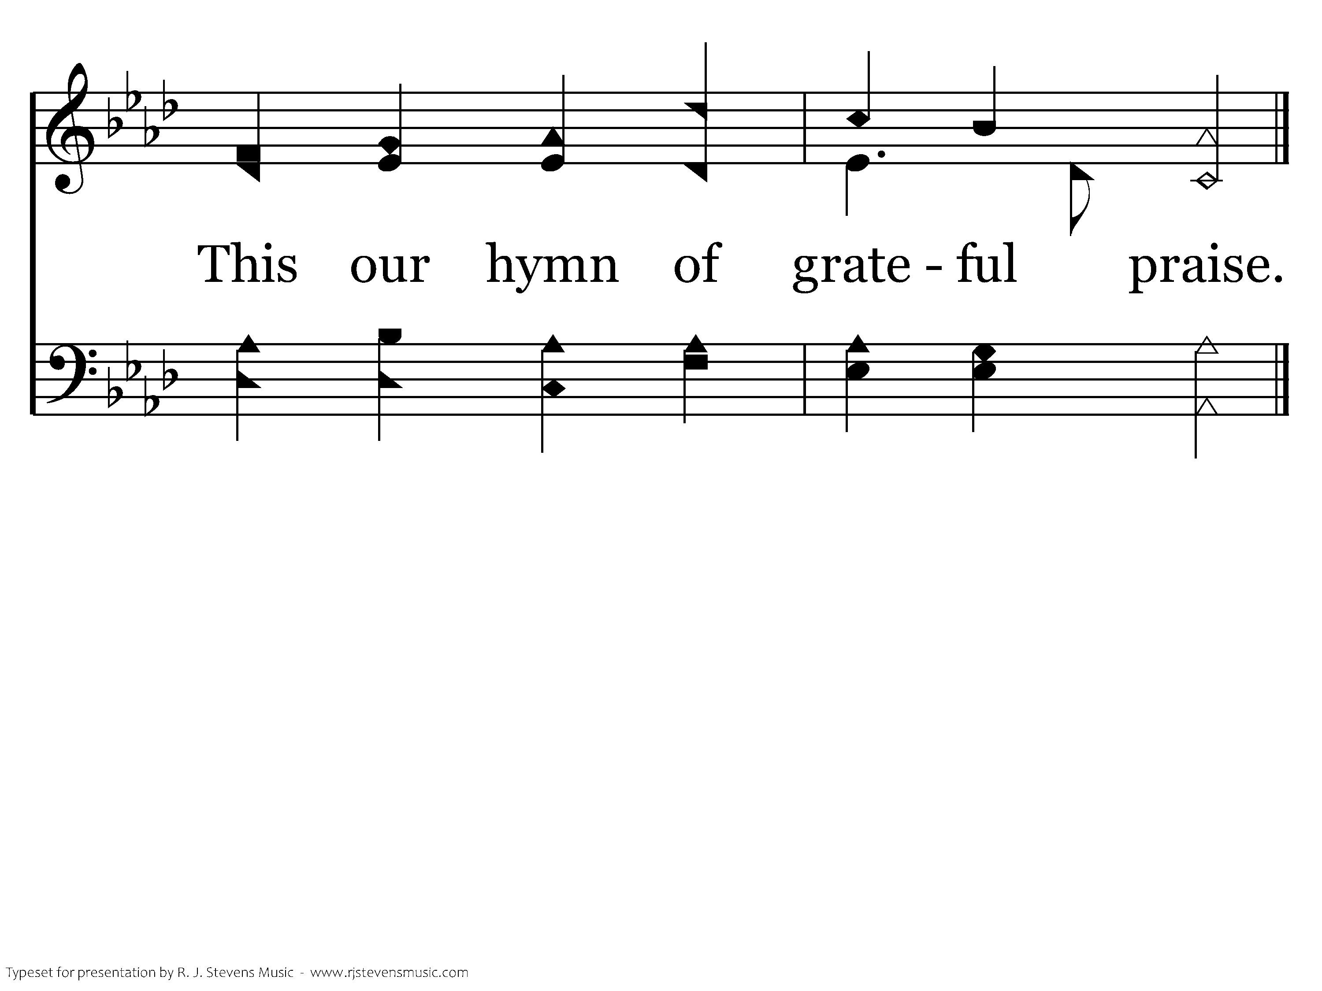
024 - For The Beauty Of The Earth - 3.3
End of Song

Slide 36

1044 - Give Thanks - Title

Slide 37
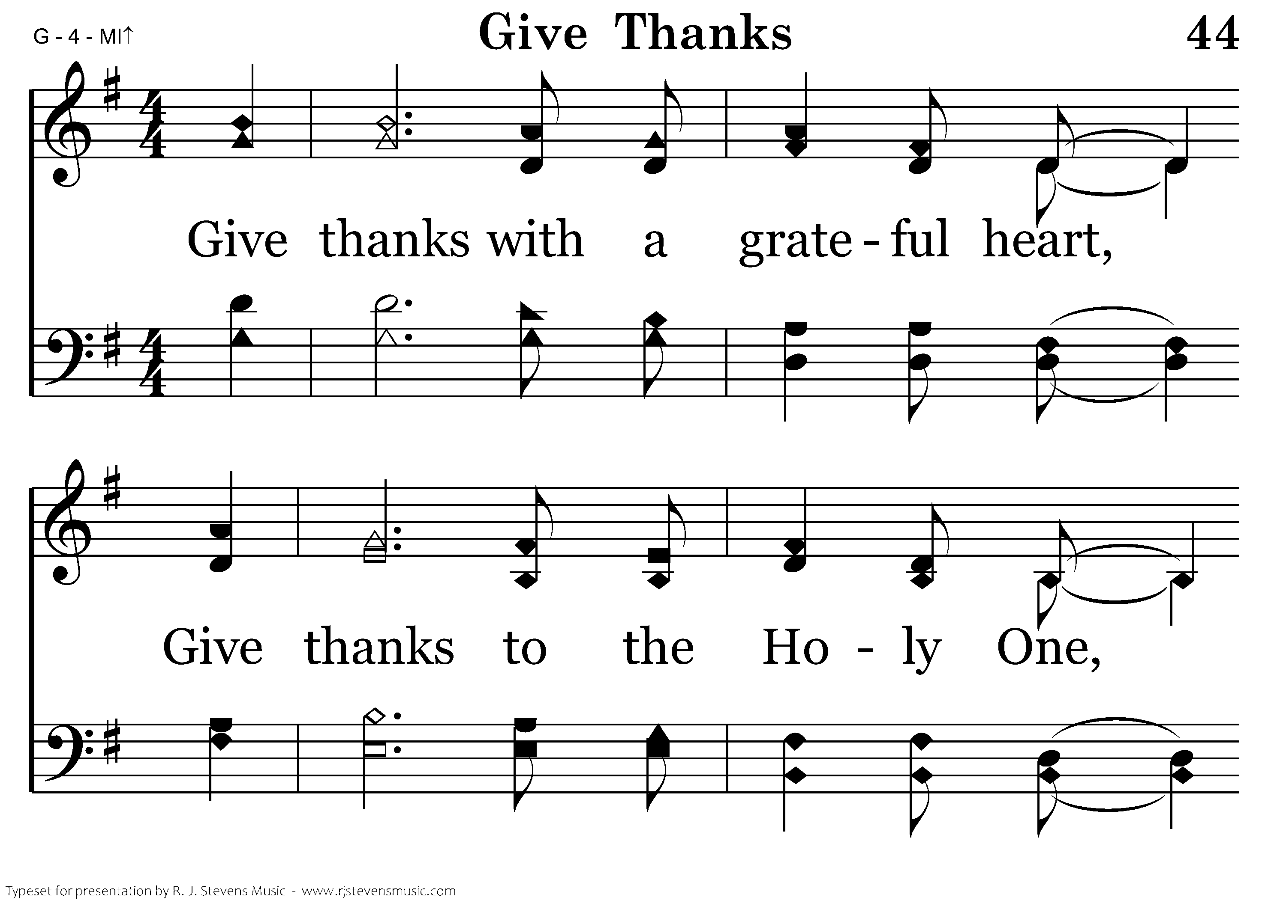
1044 - Give Thanks - 1.1

Slide 38
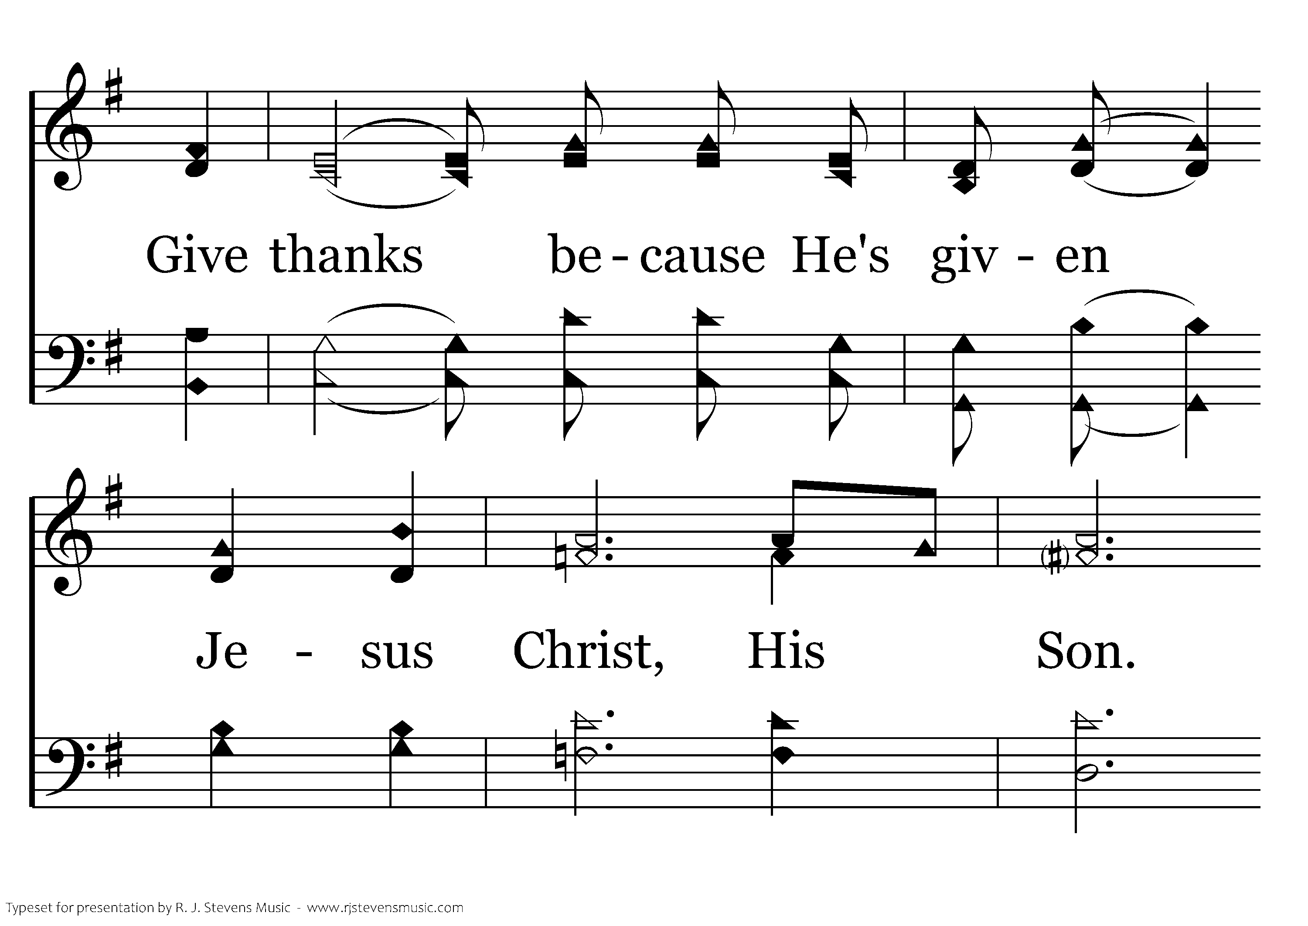
1044 - Give Thanks - 1.2

Slide 39
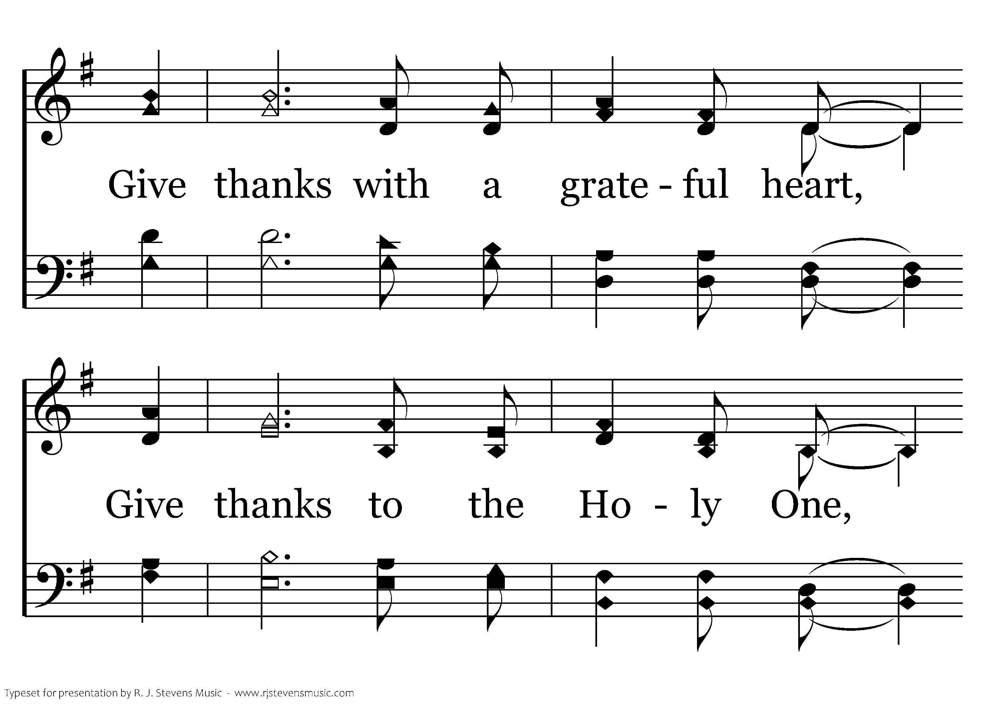
1044 - Give Thanks - 1.3

Slide 40
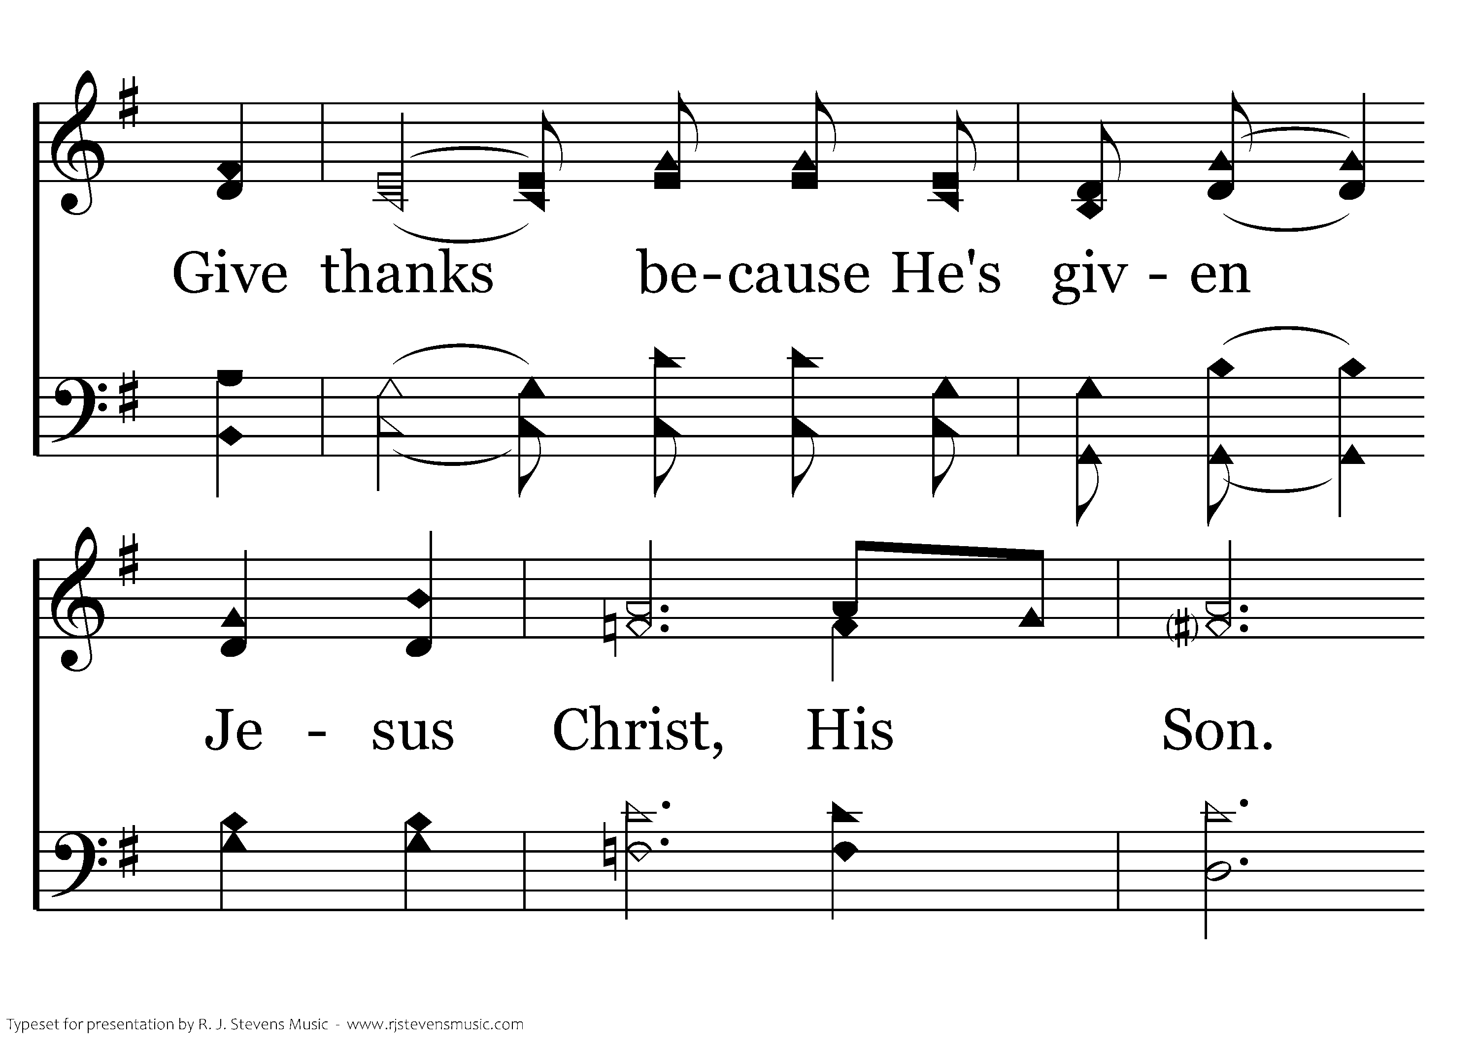
1044 - Give Thanks - 1.4

Slide 41
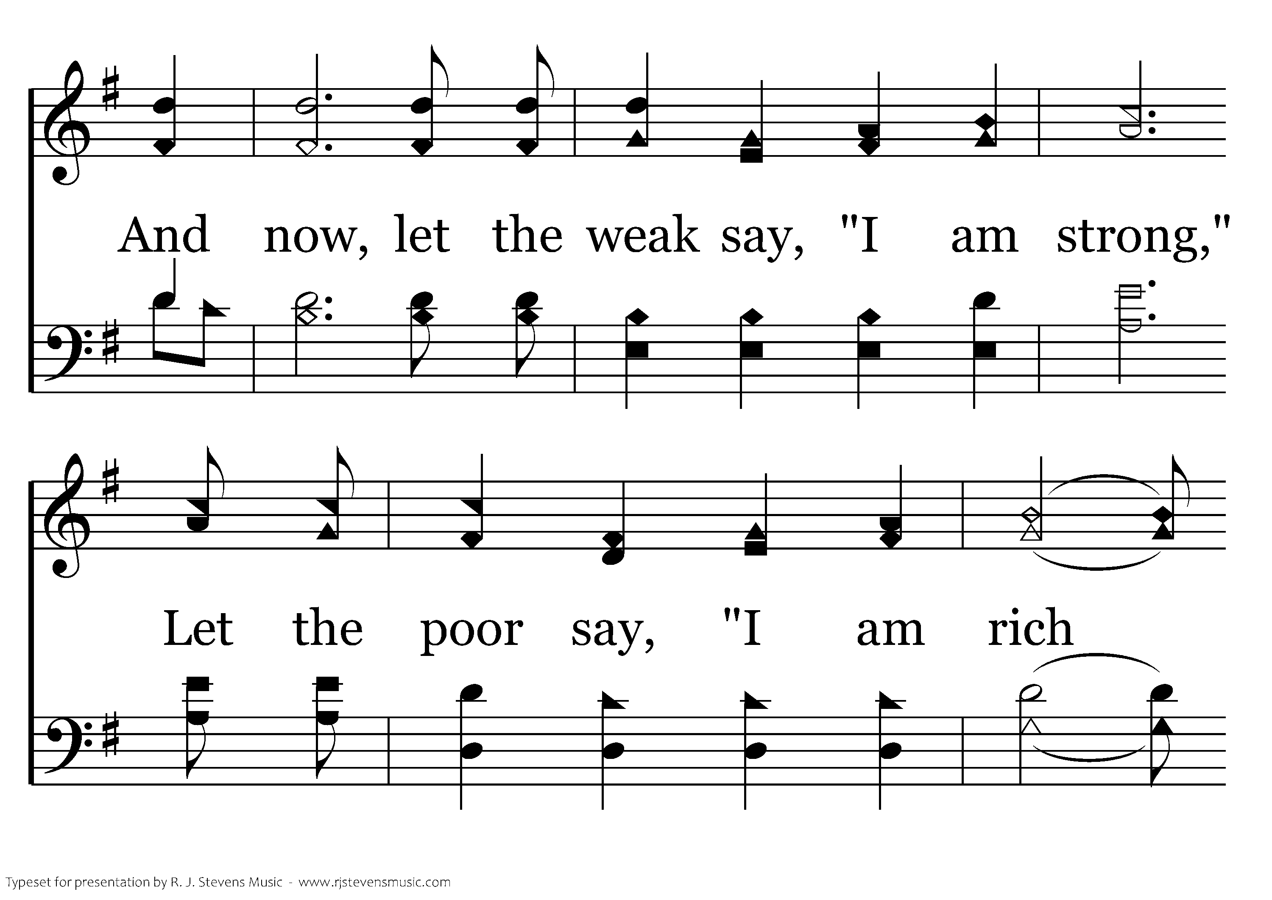
1044 - Give Thanks - 1.5

Slide 42
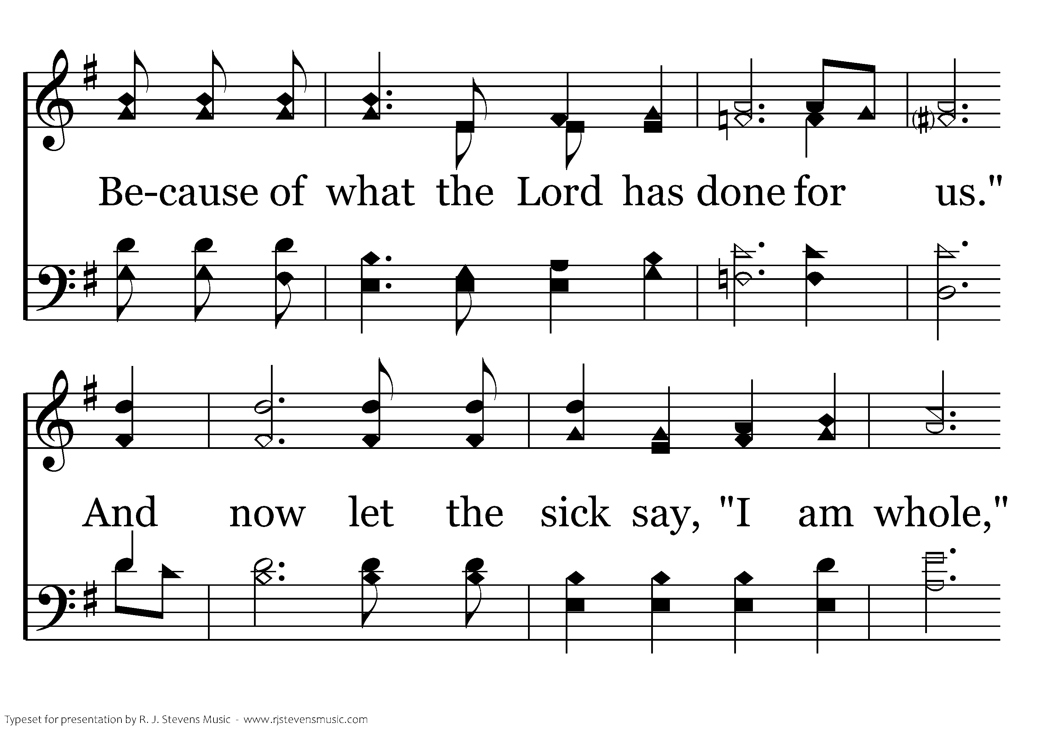
1044 - Give Thanks - 1.6

Slide 43
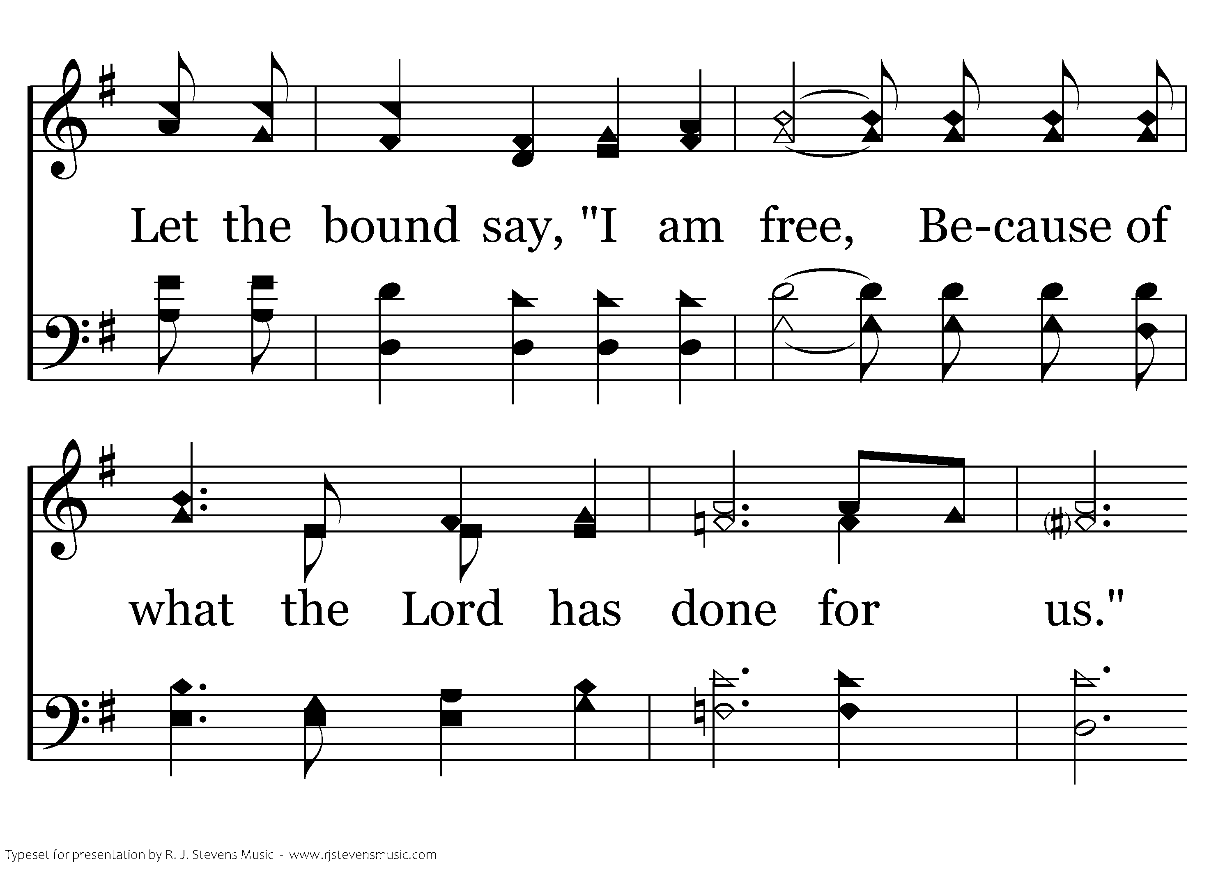
1044 - Give Thanks - 1.7

Slide 44
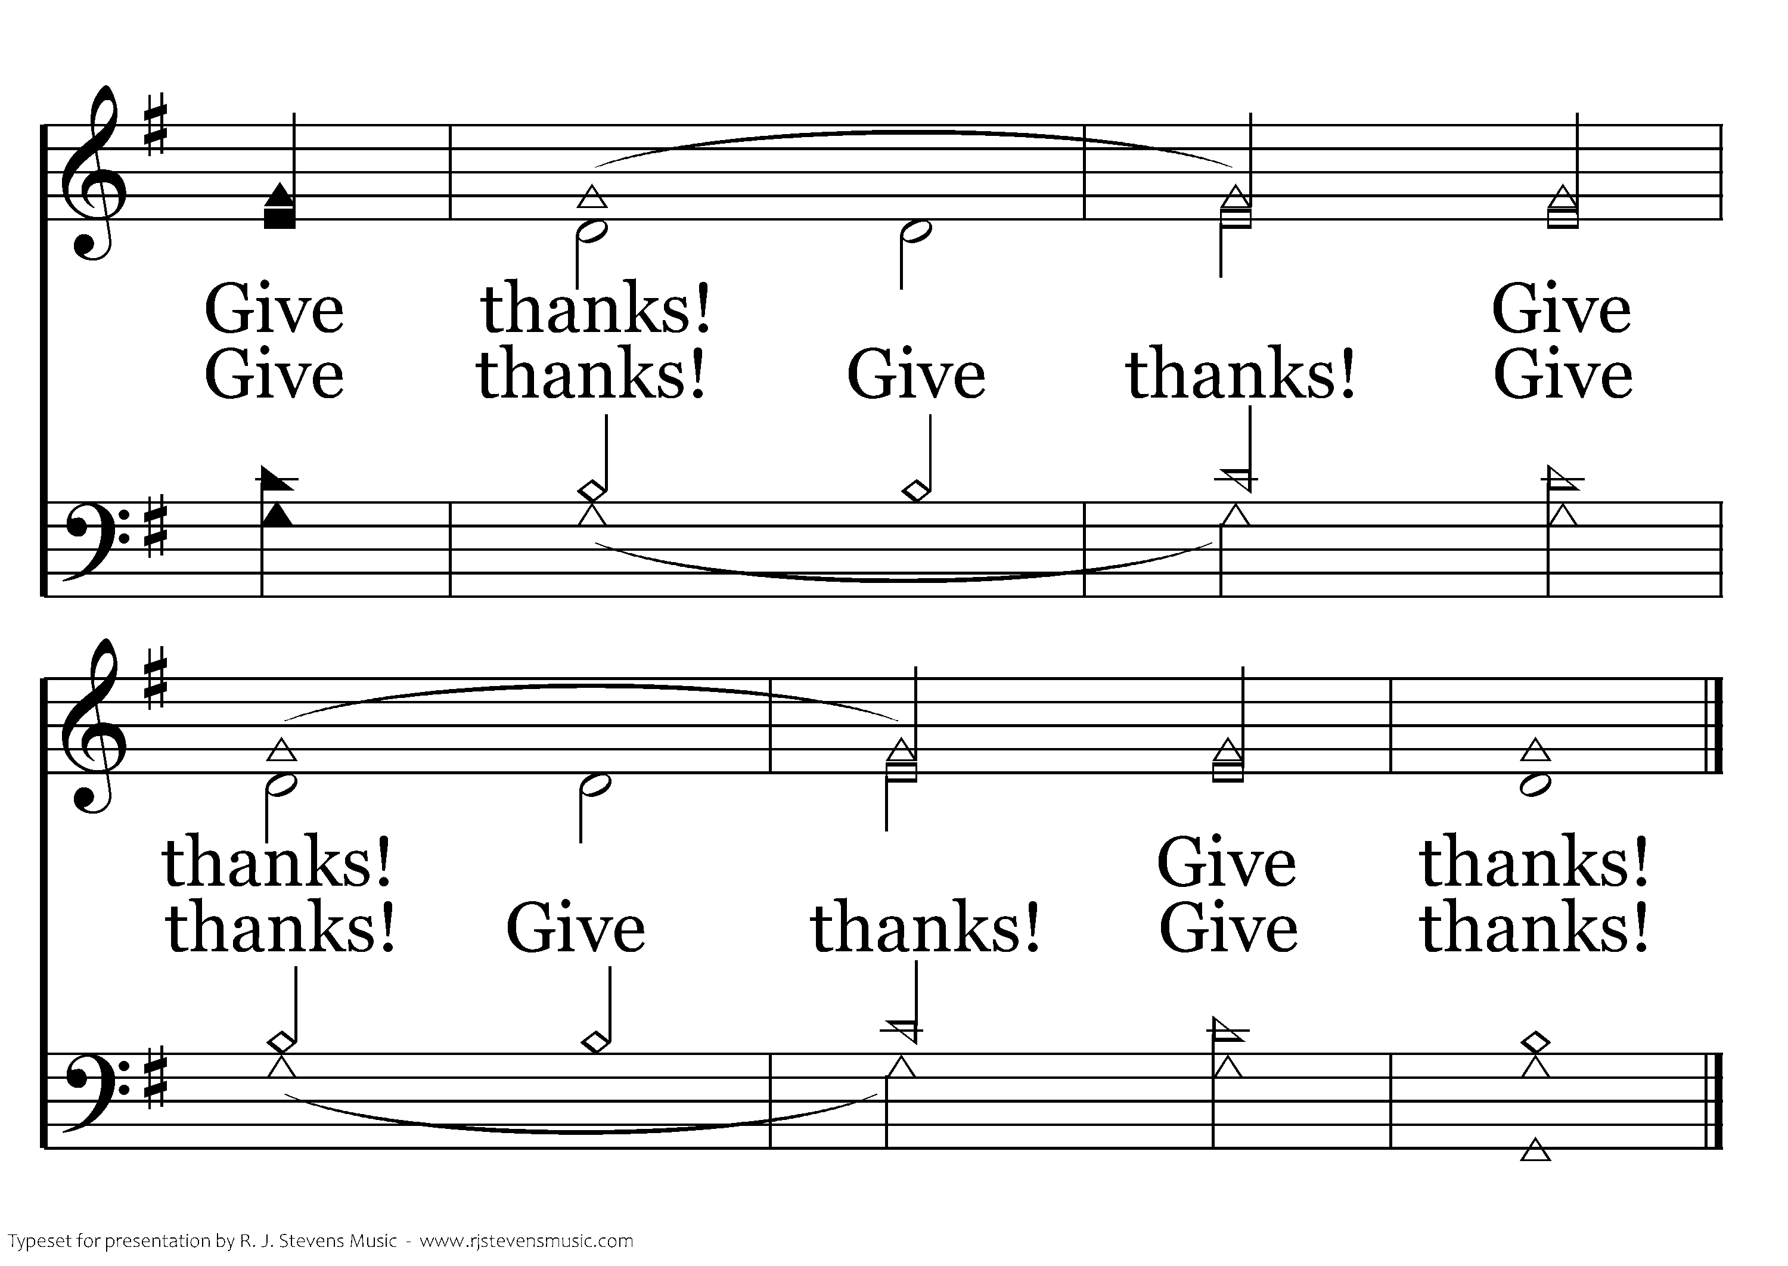
1044 - Give Thanks - 1.8
End of Song

Slide 45

1043 - Thank You, Lord! - Title

Slide 46
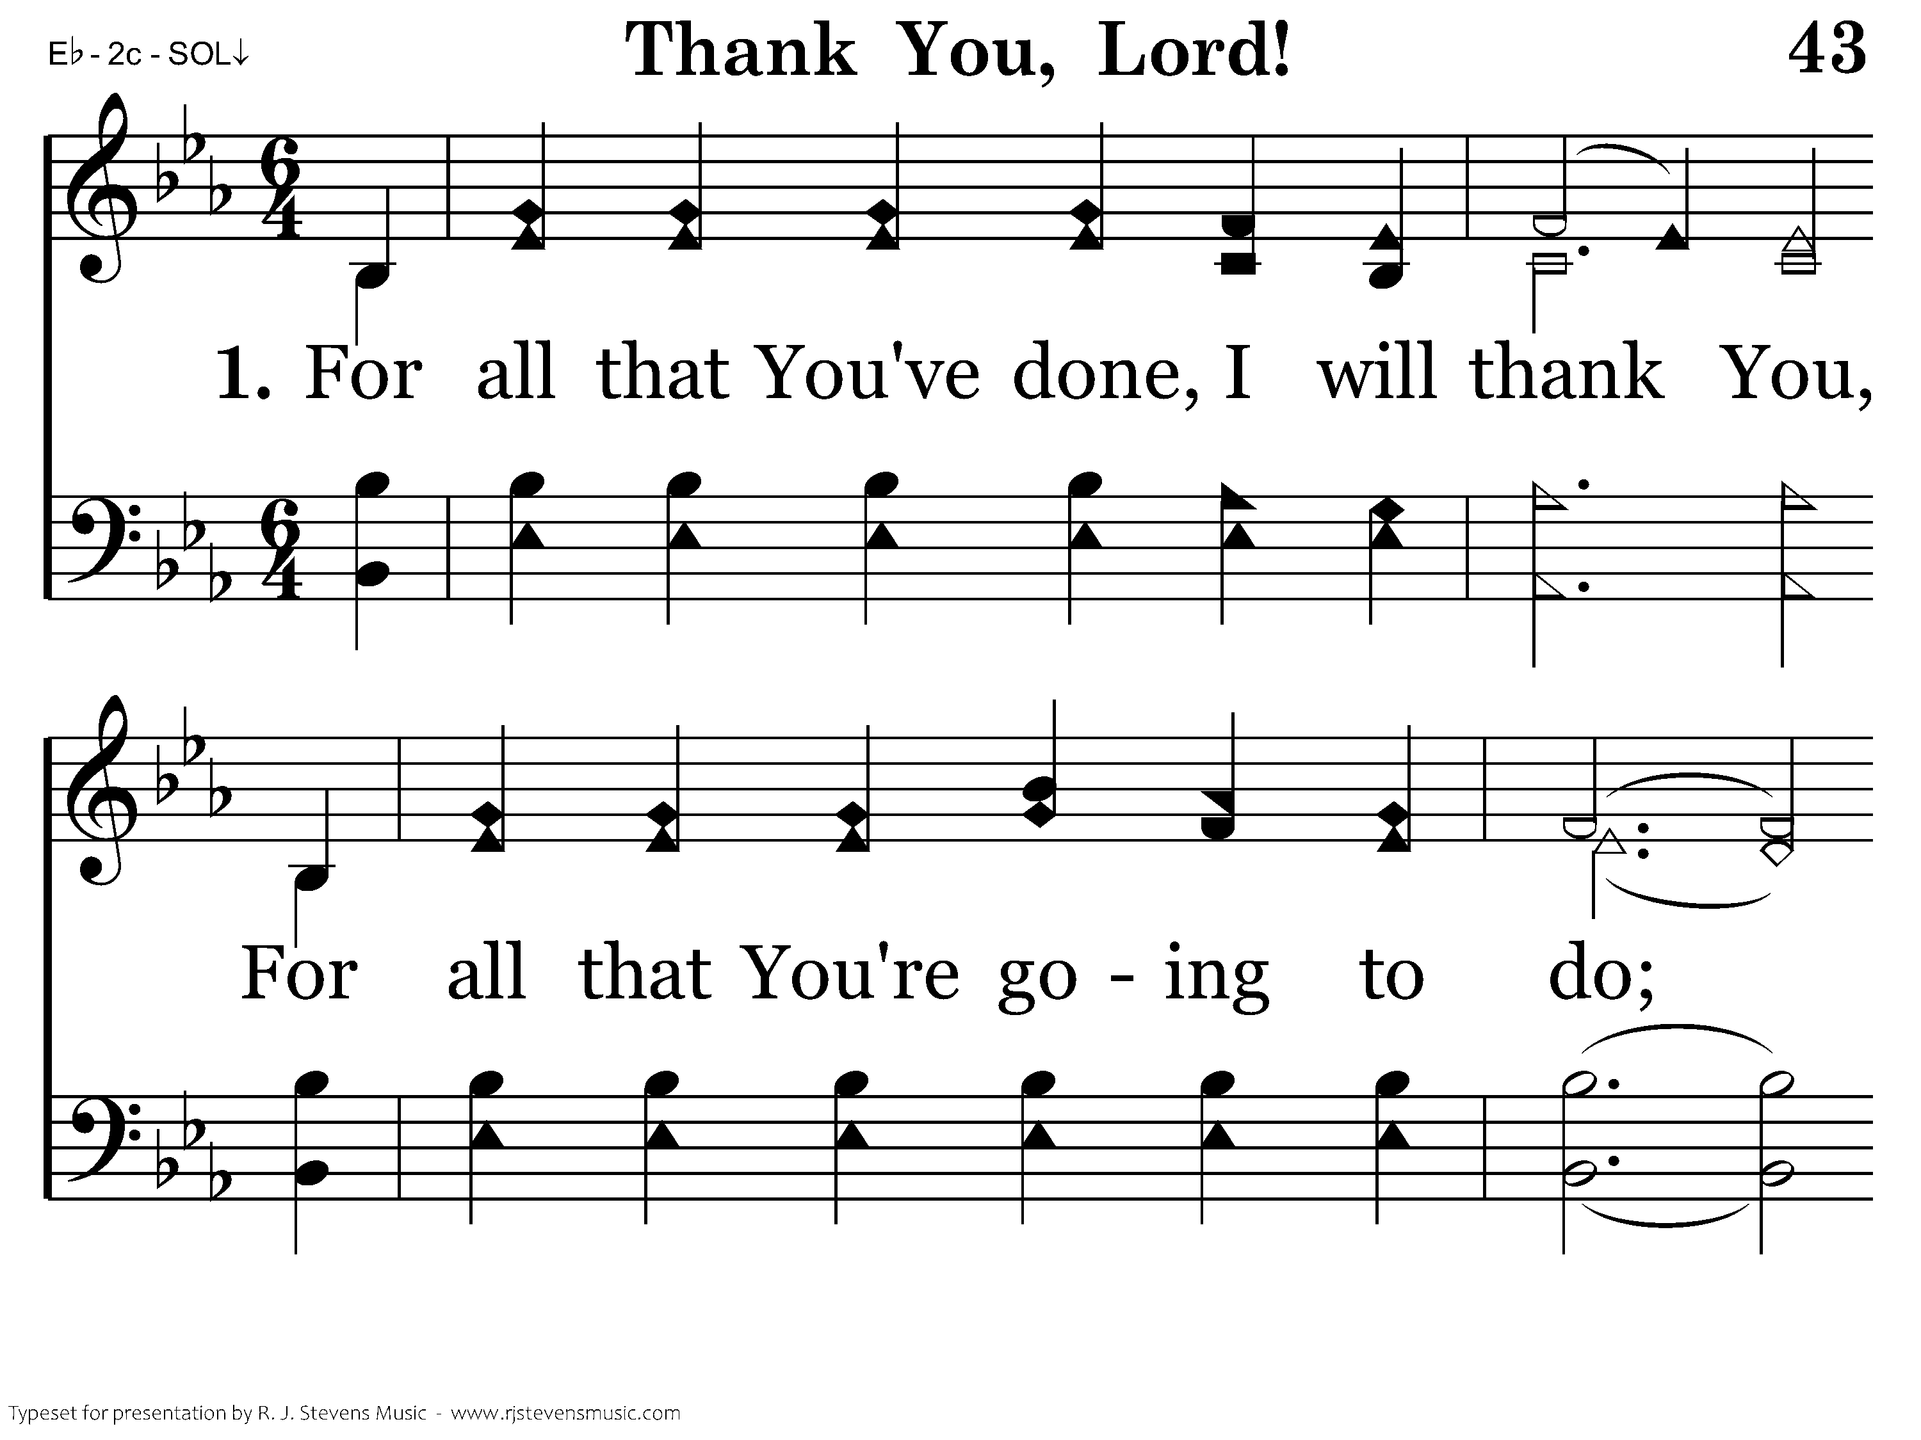
1043 - Thank You, Lord! - 1.1

Slide 47
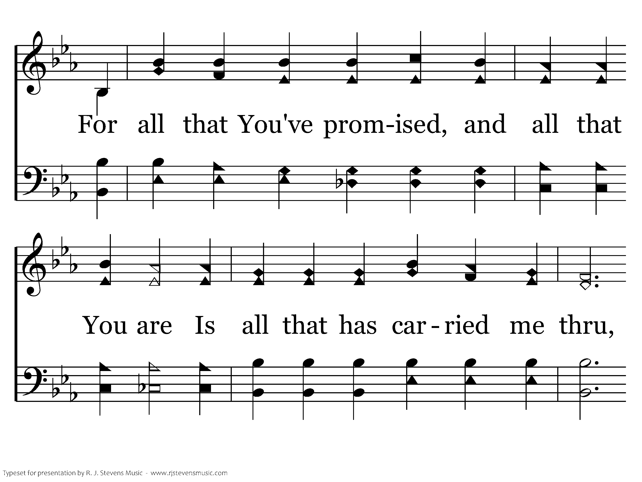
1043 - Thank You, Lord! - 1.2

Slide 48
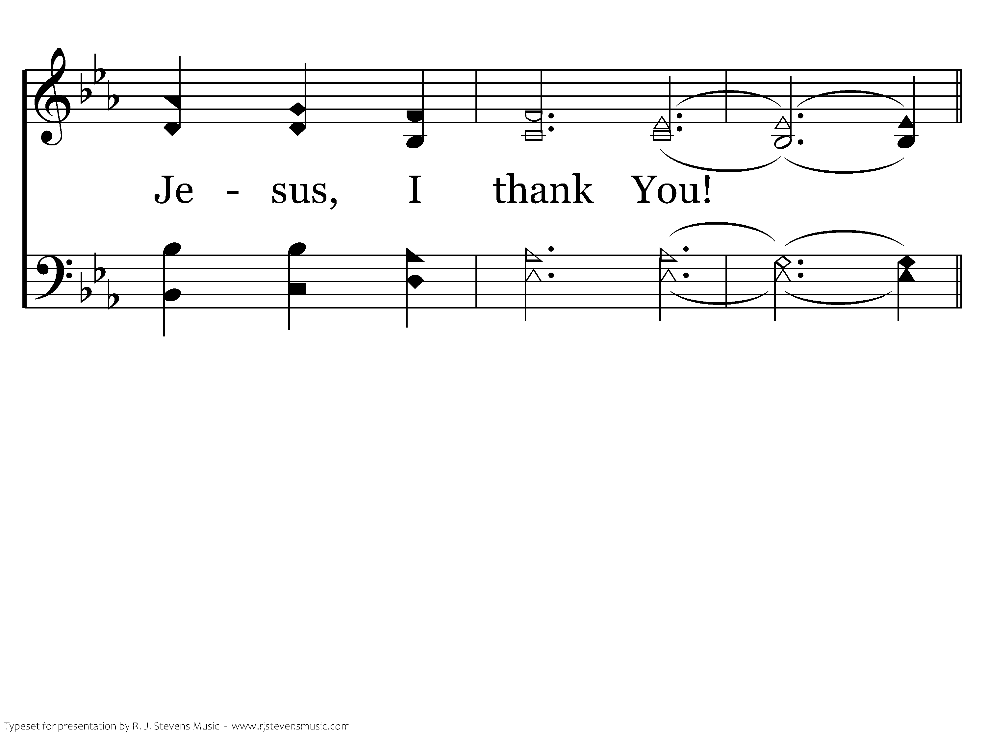
1043 - Thank You, Lord! - 1.3

Slide 49
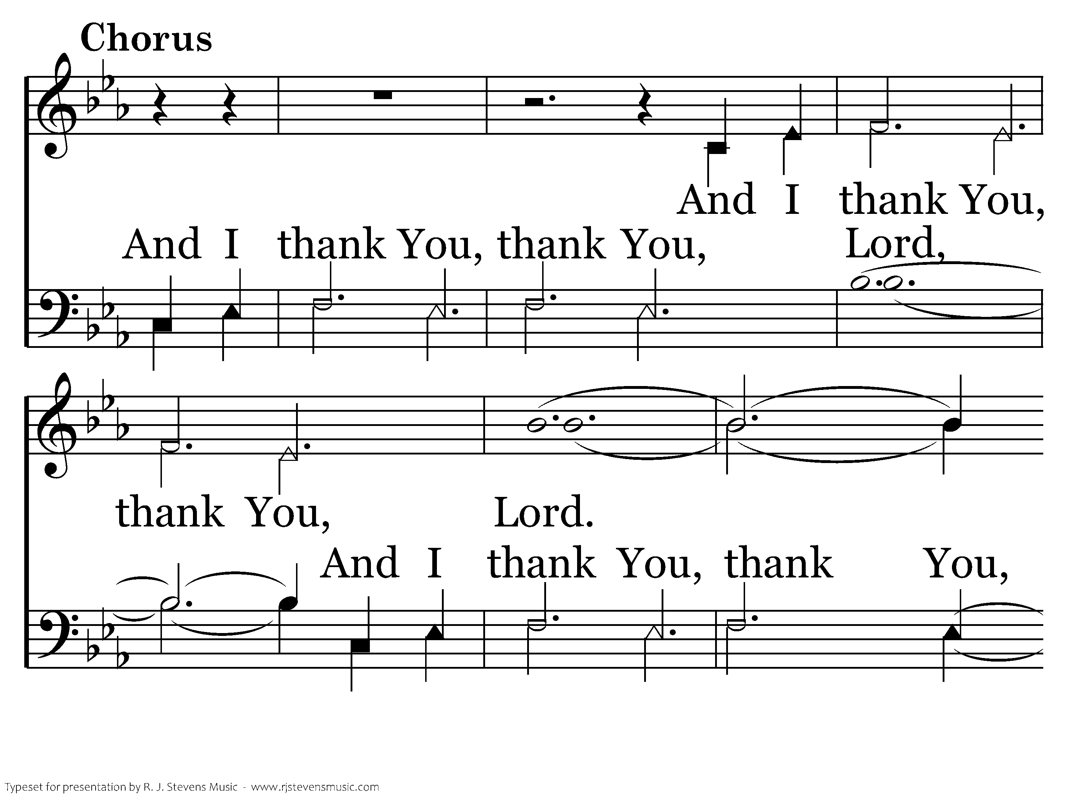
1043 - Thank You, Lord! - C.1

Slide 50
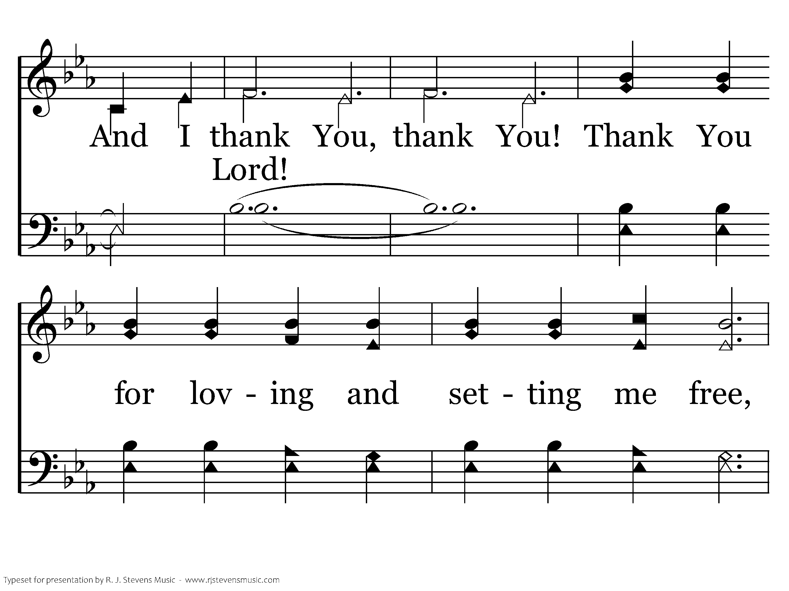
1043 - Thank You, Lord! - C.2

Slide 51
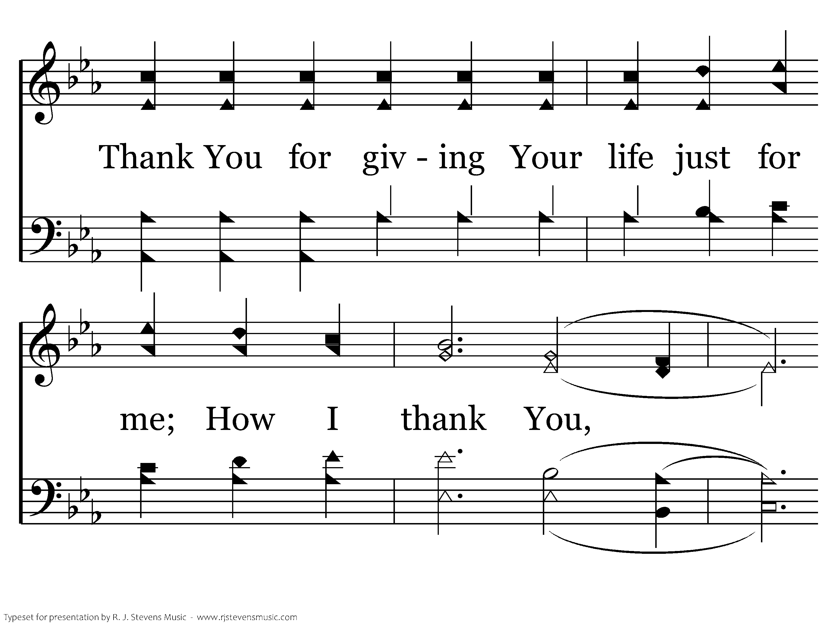
1043 - Thank You, Lord! - C.3

Slide 52
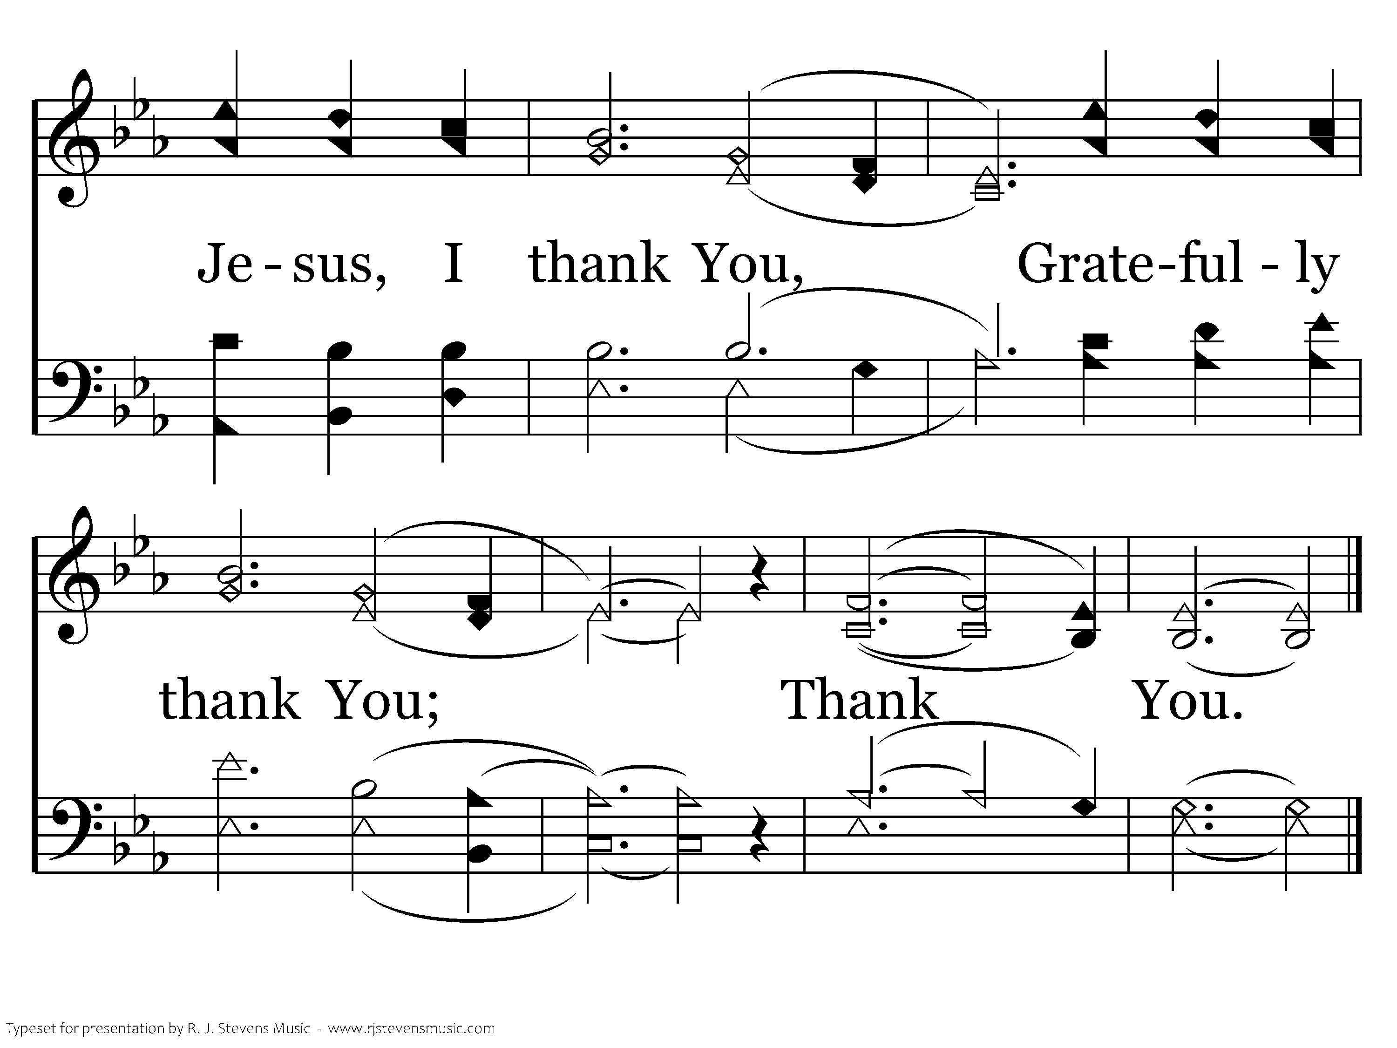
1043 - Thank You, Lord! - C.4
End of Verse 1

Slide 53
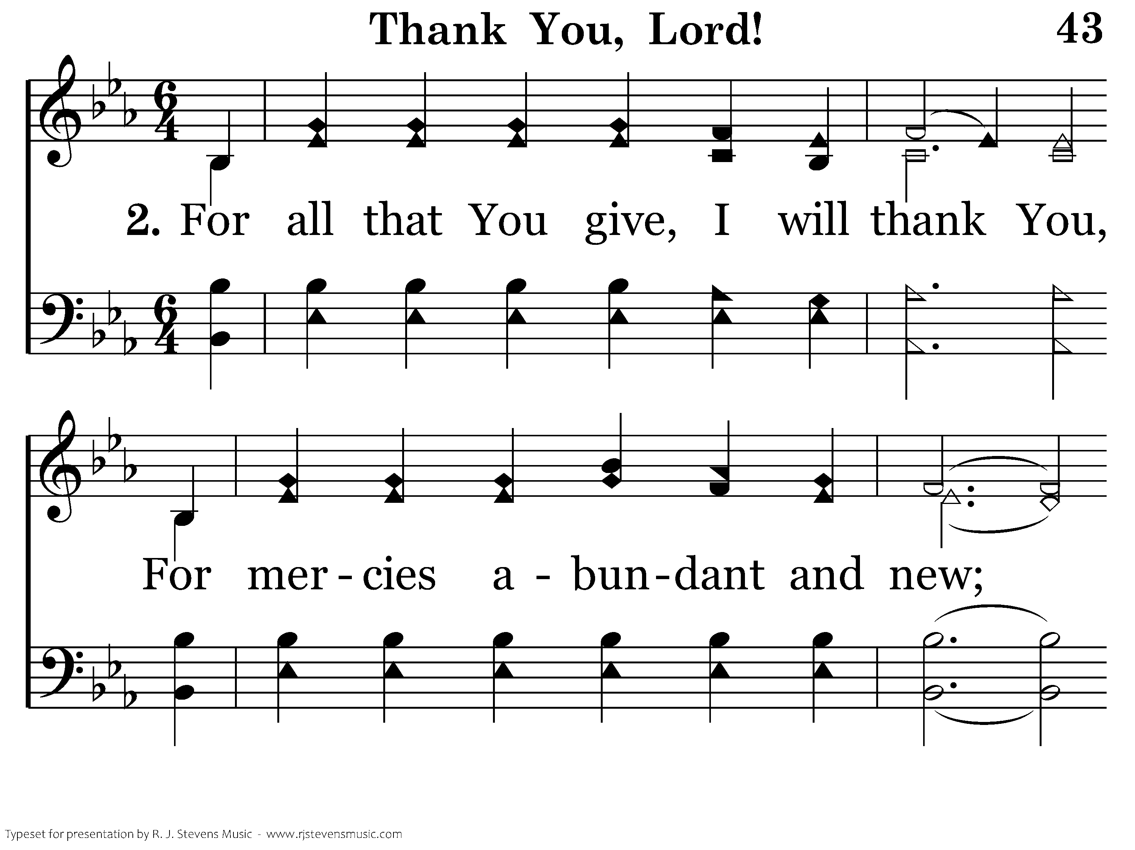
1043 - Thank You, Lord! - 2.1

Slide 54
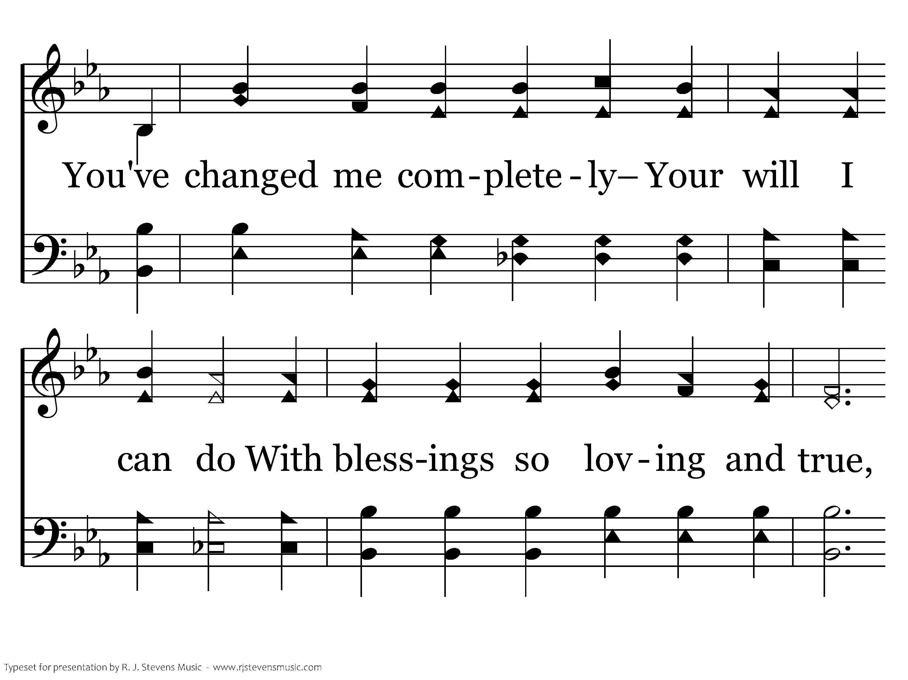
1043 - Thank You, Lord! - 2.2

Slide 55
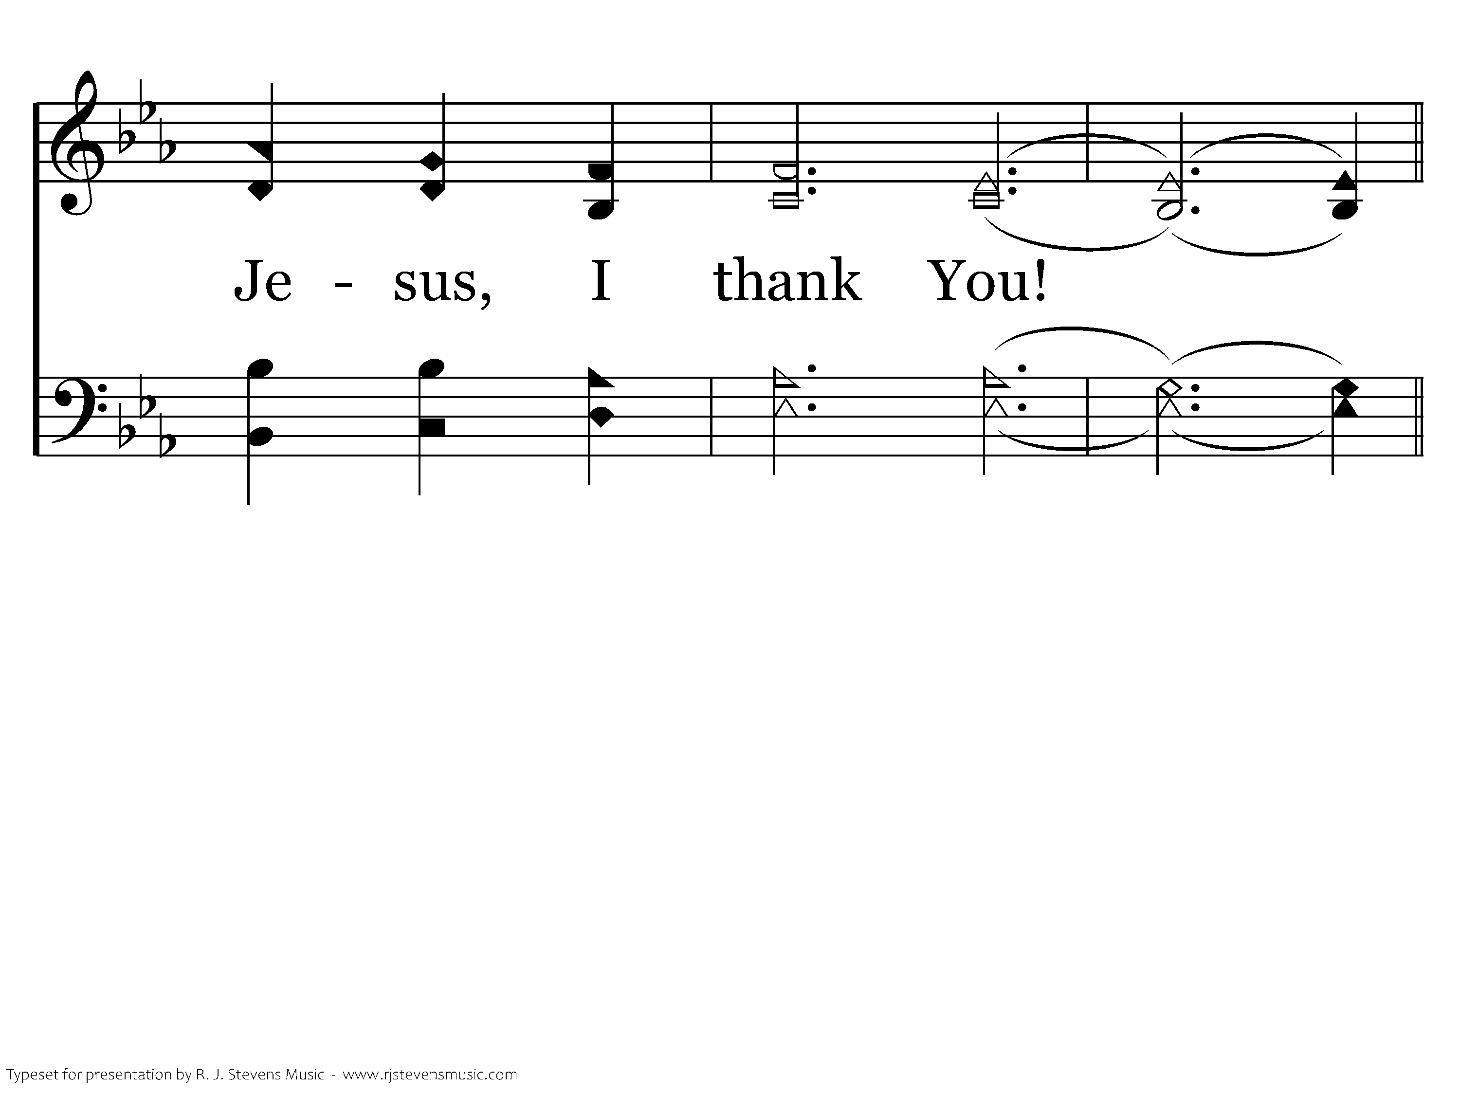
1043 - Thank You, Lord! - 2.3

Slide 56
1043 - Thank You, Lord! - C.1

Slide 57
1043 - Thank You, Lord! - C.2

Slide 58
1043 - Thank You, Lord! - C.3

Slide 59
1043 - Thank You, Lord! - C.4
End of Song

Slide 61
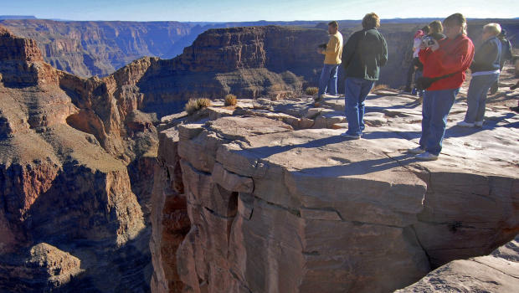

Slide 62

Living in the Danger Zone!
Never damp the fire of the Spirit, and never despise what is spoken in the name of the Lord. By all means use your judgement, and hold on to whatever is really good, Steer clear of evil in any form. (1 Thess. 5:19-22; Phillips NT)
1 Thessalonians 5:21,22

Slide 63

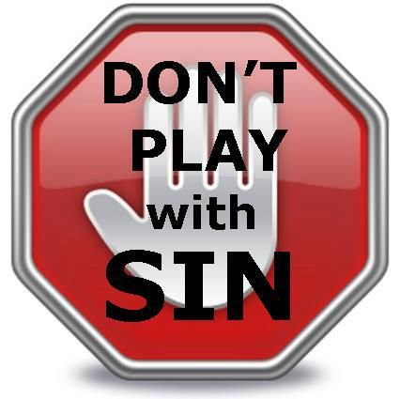
Evil Companions (1 Cor. 15:33)
Media Indulgence (Col. 3:1-3; Phil. 4:8)
Immodesty (1 Tim. 2:9,10; 1 Peter 1:14-16)
“And things like these…” (Gal. 5:19-21)

Slide 64



Slide 65




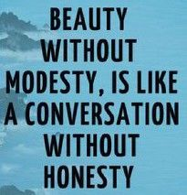

Slide 66
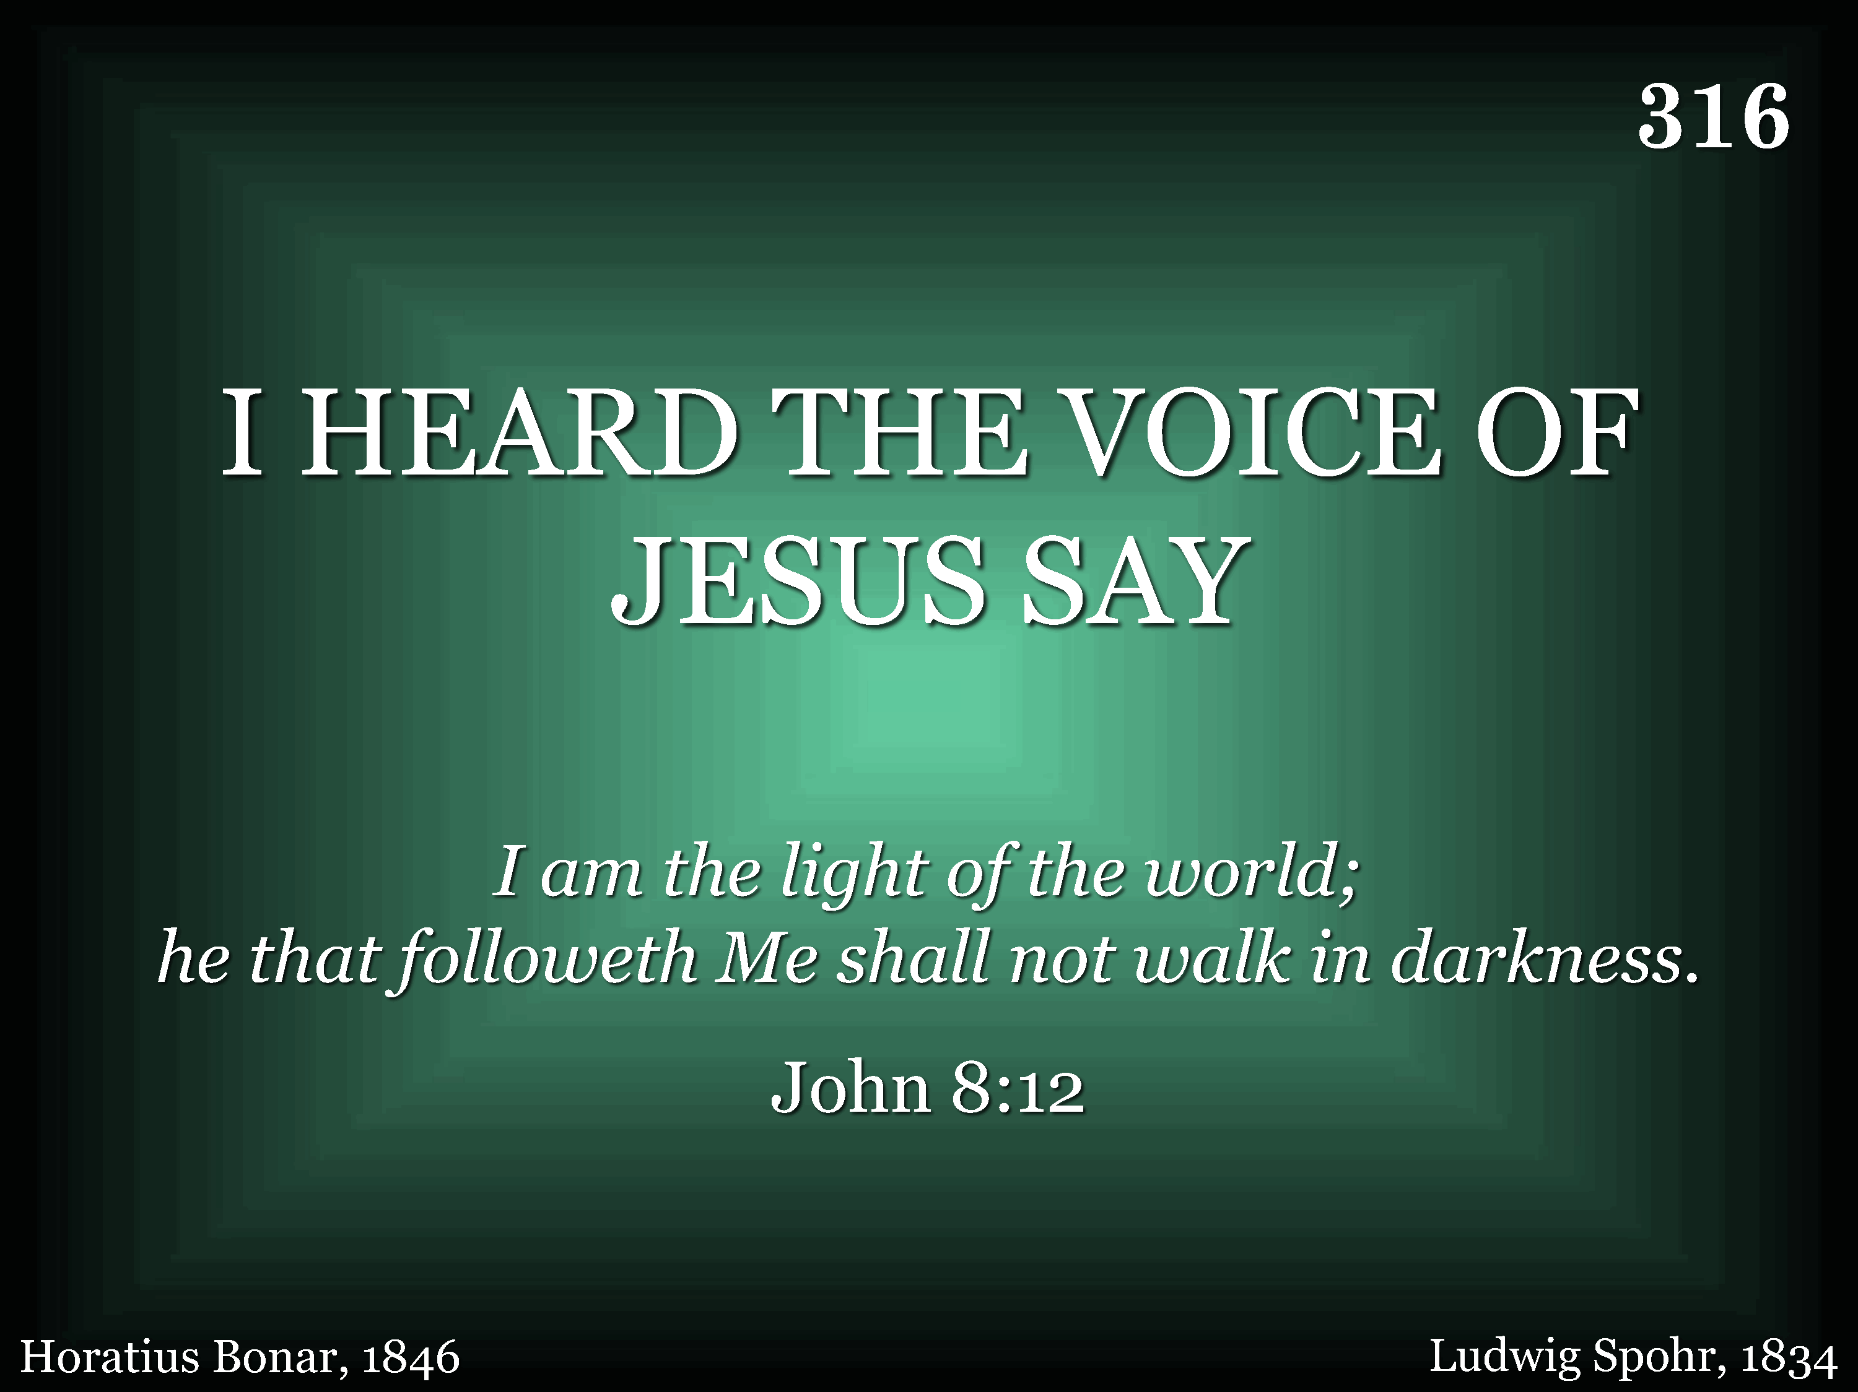
316 - I Heard The Voice Of Jesus Say - Title

Slide 67
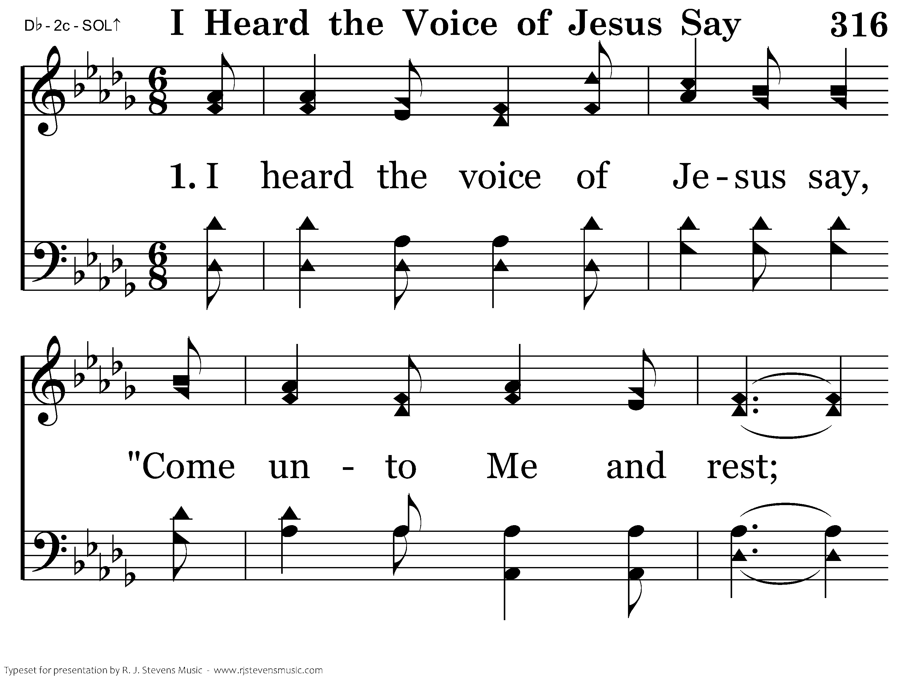
316 - I Heard The Voice Of Jesus Say - 1.1

Slide 68

316 - I Heard The Voice Of Jesus Say - 1.2

Slide 69

316 - I Heard The Voice Of Jesus Say - 1.3

Slide 70

316 - I Heard The Voice Of Jesus Say - 1.4
End of Verse 1

Slide 71

316 - I Heard The Voice Of Jesus Say - 2.1

Slide 72

316 - I Heard The Voice Of Jesus Say - 2.2

Slide 73

316 - I Heard The Voice Of Jesus Say - 2.3

Slide 74

316 - I Heard The Voice Of Jesus Say - 2.4
End of Verse 2

Slide 75

316 - I Heard The Voice Of Jesus Say - 3.1

Slide 76

316 - I Heard The Voice Of Jesus Say - 3.2

Slide 77

316 - I Heard The Voice Of Jesus Say - 3.3

Slide 78

316 - I Heard The Voice Of Jesus Say - 3.4
End of Song

