Slide 3
What the Church Should Be For YOU!
A “REFUGE”.

Slide 4
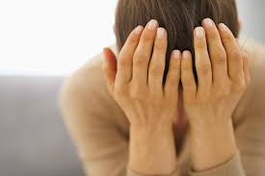
Sometimes the very ones that are to be your help, comfort and support let you down!

Slide 5
God’s care & concern
God has always understood mankind’s need for a “place” to turn to.
A “place” where you feel safe, protected and nurtured.
The concept of a “refuge” is throughout the entire Bible.

Slide 6
A Refuge
A place or something that provides shelter, help, comfort, safe treat, to escape trouble and difficulty.
A safe retreat to find rest and spiritual recovery.

Slide 7
Do we truly understand what the local Church is meant to be???
A “RELATIONSHIP” YOU DO NOT WANT TO LEAVE.

Slide 8
God’s intention for His children.
God wants you to be in His family-be a part!
God knows His family needs to have help, compassion and support.

Slide 9
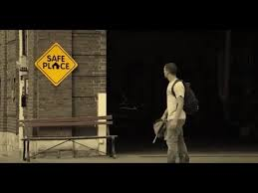
A “RELATIONSHIP” that gives safety, stability, comfort and joy.

Slide 10
Scripture
Numbers 35:6 & 12
Deuteronomy 33:27-29
2 Samuel 22:3

Slide 11
Psalm 9:9 “The Lord also will be a refuge for the oppressed, a refuge in times of trouble. And those who know Your name will put their trust in You for You Lord, have not forsaken those who seek You.”

Slide 12
Psalm 46:1-2 “God is our refuge and strength, a very present help in trouble, therefore you will not fear even though the earth be removed and the mountains carried in the midst of the sea…”

Slide 13
Hebrews 6:18 “That by two immutable things, in which it is impossible for God to lie, we might have strong consolation, who have fled for refuge to lay hold of the hope set before us.”

Slide 14
The Church as God designed:
A source of edification.
A source of exhortation.
A source of love, compassion and comfort.
A source of patience, longsuffering, forbearance and forgiveness.

Slide 15
The Church – family of God.
Ephesians 2:19 Household of God.
1 Timothy 3:15 House of God, church of the living God.

Slide 16
Edification, Exhortation, Compassion

Slide 17
Genuine goodness & care for each other.
How concerned are YOU about others?

Slide 18
GALATIANS 6:1-2 “Brethren, if a man is overtaken in any trespass, you who are spiritual restore such a one in the spirit of gentleness, considering yourself lest you also be tempted. Bear one another’s burdens and so fulfill the law of Christ.”

Slide 19
Ephesians 4:2 “…walk worthy of the calling…with all lowliness and gentleness with longsuffering, bearing with one another in love, endeavoring to keep the unity of the spirit in the bond of peace.”

Slide 20
Ephesians 4:31-32 “Let all bitterness, wrath, anger, clamor and evil speaking be put away from you, with all malice. And be kind to one another, tenderhearted, forgiving one another, even as God as Christ forgave you.”

Slide 21
Colossians 3:12-13 “Therefore as elect of God, holy and beloved put on tender mercies, kindness, humility, meekness, longsuffering, bearing with one another and forgiving one another, even as God in Christ forgave you.”

Slide 22
Matthew 6:12, 14-15 “And forgive us our debts as we forgive our debtors. For if you forgive men their trespasses, your heavenly Father will also forgive you.”

Slide 23
Luke 17:3-4 “Take heed to yourselves. If your brother sins against you, rebuke him and if he repents, forgive him. And if he sins against you seven times in a day, and seven times in a day return to you saying, I repent, you shall forgive him.”

Slide 24
James 5:16 “Confess your trespasses to one another, and pray for one another, that you may be healed. The effective fervent prayer of a righteous man avails much.”

Slide 25
WHAT ARE YOU DOING IN THIS FAMILY?
Are you being a person that becomes a “refuge” for your brothers and your sisters?

Slide 26
Members one of another.
Indicates a connection, commitment and interaction.
We all have a duty and an obligation towards each other.
So what are YOU doing for the welfare, development of the whole body?

Slide 27
What are YOU doing in being:
Being a source of edification.
Being a source of exhortation.
Showing love, compassion and comfort.
In being patient, longsuffering, forbearing and forgiving of others.

Slide 28
Consider God’s description of His people & How God expects us to interact, care, provide and treat one another!
Let us do things God’s way!

Slide 29
Open your Bibles to: Romans 12:1-21

Slide 30
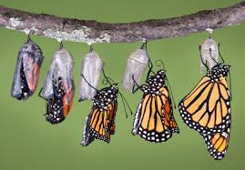
A Christian is all about transformation.

Slide 31
CHURCH INTERACTION & TREATMENT
KIND
LOVE
PREFER
DILIGENT
FERVENT
SERVING
REJOICE
PATIENT
PRAY
NEEDS
HOSPITABLE
BLESS
REJOICE
WEEP
SAME MIND
HUMBLE
NOT WISE
PEACEABLE
REGARD FOR GOOD THINGS, DO NOT REPAY

Slide 32
Open your Bibles to 1 Corinthians 12:11-31

Slide 33
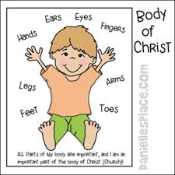

Slide 34
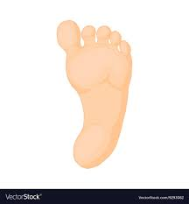

Slide 35
“…those members of the body which seem to be weaker at necessary.” “God composed the body having given greater honor to that part which lacks it.” 1 Corinthians 12:22 & 24

Slide 36
CONCLUSION
Each and every member of this Church has an obligation to be what God tells us to be!
Are we willing to be a “refuge” for others?

Slide 37
Is THIS Church one?

Slide 39
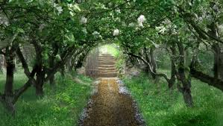

Slide 42
The Church of Christ
Thank you for worshipping with us today.!

Slide 45
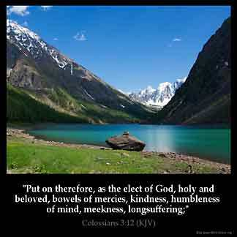

Slide 47
