Slide 1
To have a happy home!
Unless the LORD builds the house, They labor in vain who build it; Unless the LORD guards the city, The watchman keeps awake in vain. (Psalm 127:1, NASB)

Slide 2

Five ways to make a home happy…
Make God a part of it. (Gen. 2:18-24; Psalm 127:1; Matt. 19:1-9)
Love Your Mate. (Eph. 5:21-33)
Listen To Each Other. (Eph. 6:1-4; Prov. 4:1-12)
Plan at least 1 meal each day with the whole family present. (Deut. 6:4-9)
The beauty of a house is harmony,
The security of a house is loyalty,
The joy of a house is love,
The plenty of a house is children,
The rule of a house is service,
The comfort of a house is God Himself.
- Dr. Frank Crane

Slide 3
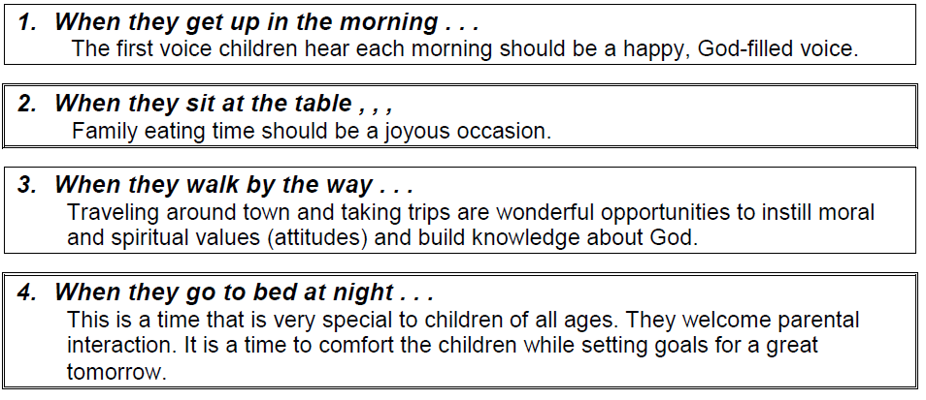
Take Advantage of Every Opportunity…
and you shall teach them diligently to your children, and shall talk of them when you sit in your house, and when you walk by the way, and when you lie down, and when you rise. And you shall bind them as a sign upon your hand, and they shall be as frontlets between your eyes. And you shall write them on the doorposts of your house and on your gates. (Deuteronomy 6:7-9 RSV)

Slide 4
Five ways to make a home happy…
Make God a part of it. (Gen. 2:18-24; Psalm 127:1; Matt. 19:1-9)
Love Your Mate. (Eph. 5:21-33)
Listen To Your Children. (Eph. 6:1-4; Prov. 4:1-12)
Plan at least 1 meal each day with the whole family present. (Deut. 6:4-9)
Make every day count. (James 4:13-17; Psalm 102:3)
The beauty of a house is harmony,
The security of a house is loyalty,
The joy of a house is love,
The plenty of a house is children,
The rule of a house is service,
The comfort of a house is God Himself.
- Dr. Frank Crane

Slide 5

472 - God, Give Us Christian Homes - Title

Slide 6
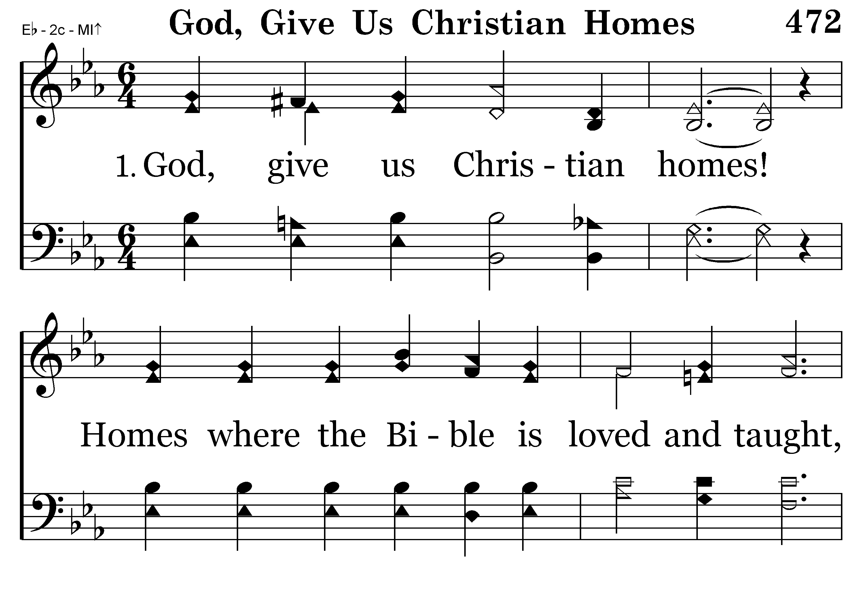
472 - God, Give Us Christian Homes - 1.1

Slide 7
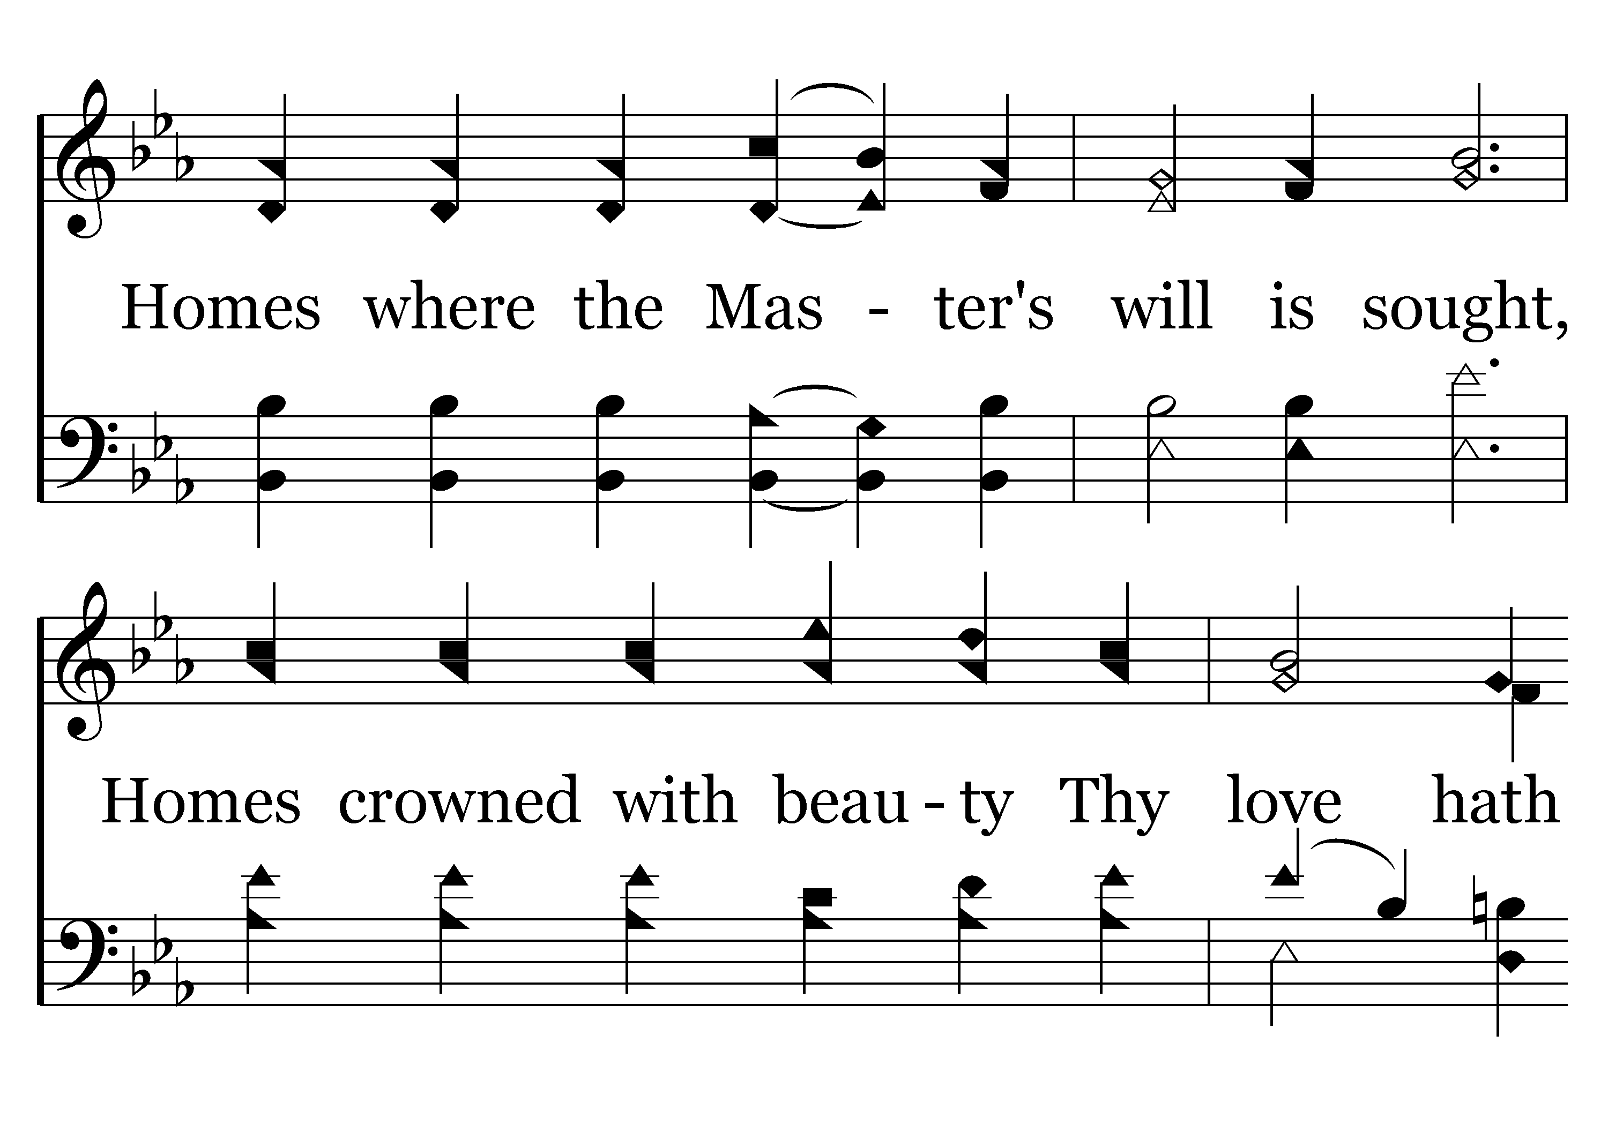
472 - God, Give Us Christian Homes - 1.2

Slide 8
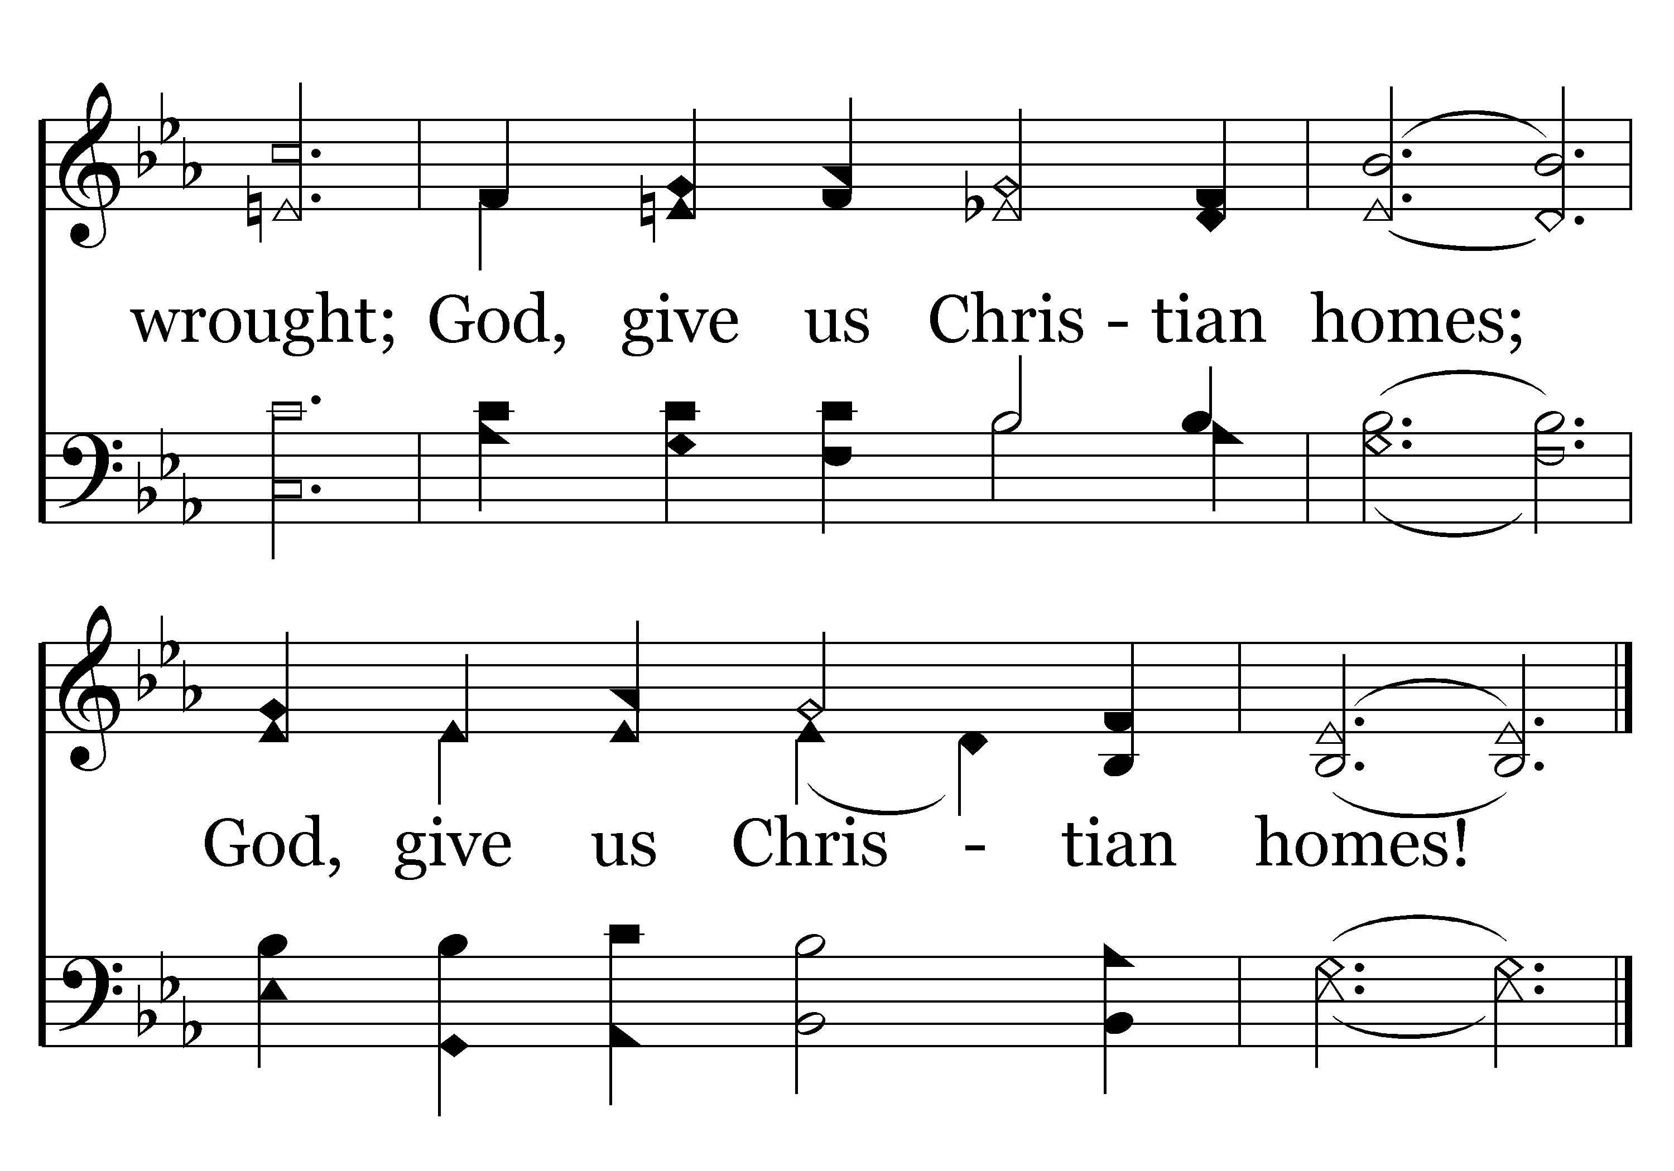
472 - God, Give Us Christian Homes - 1.3
End of Verse 1

Slide 9

472 - God, Give Us Christian Homes - 2.1

Slide 10
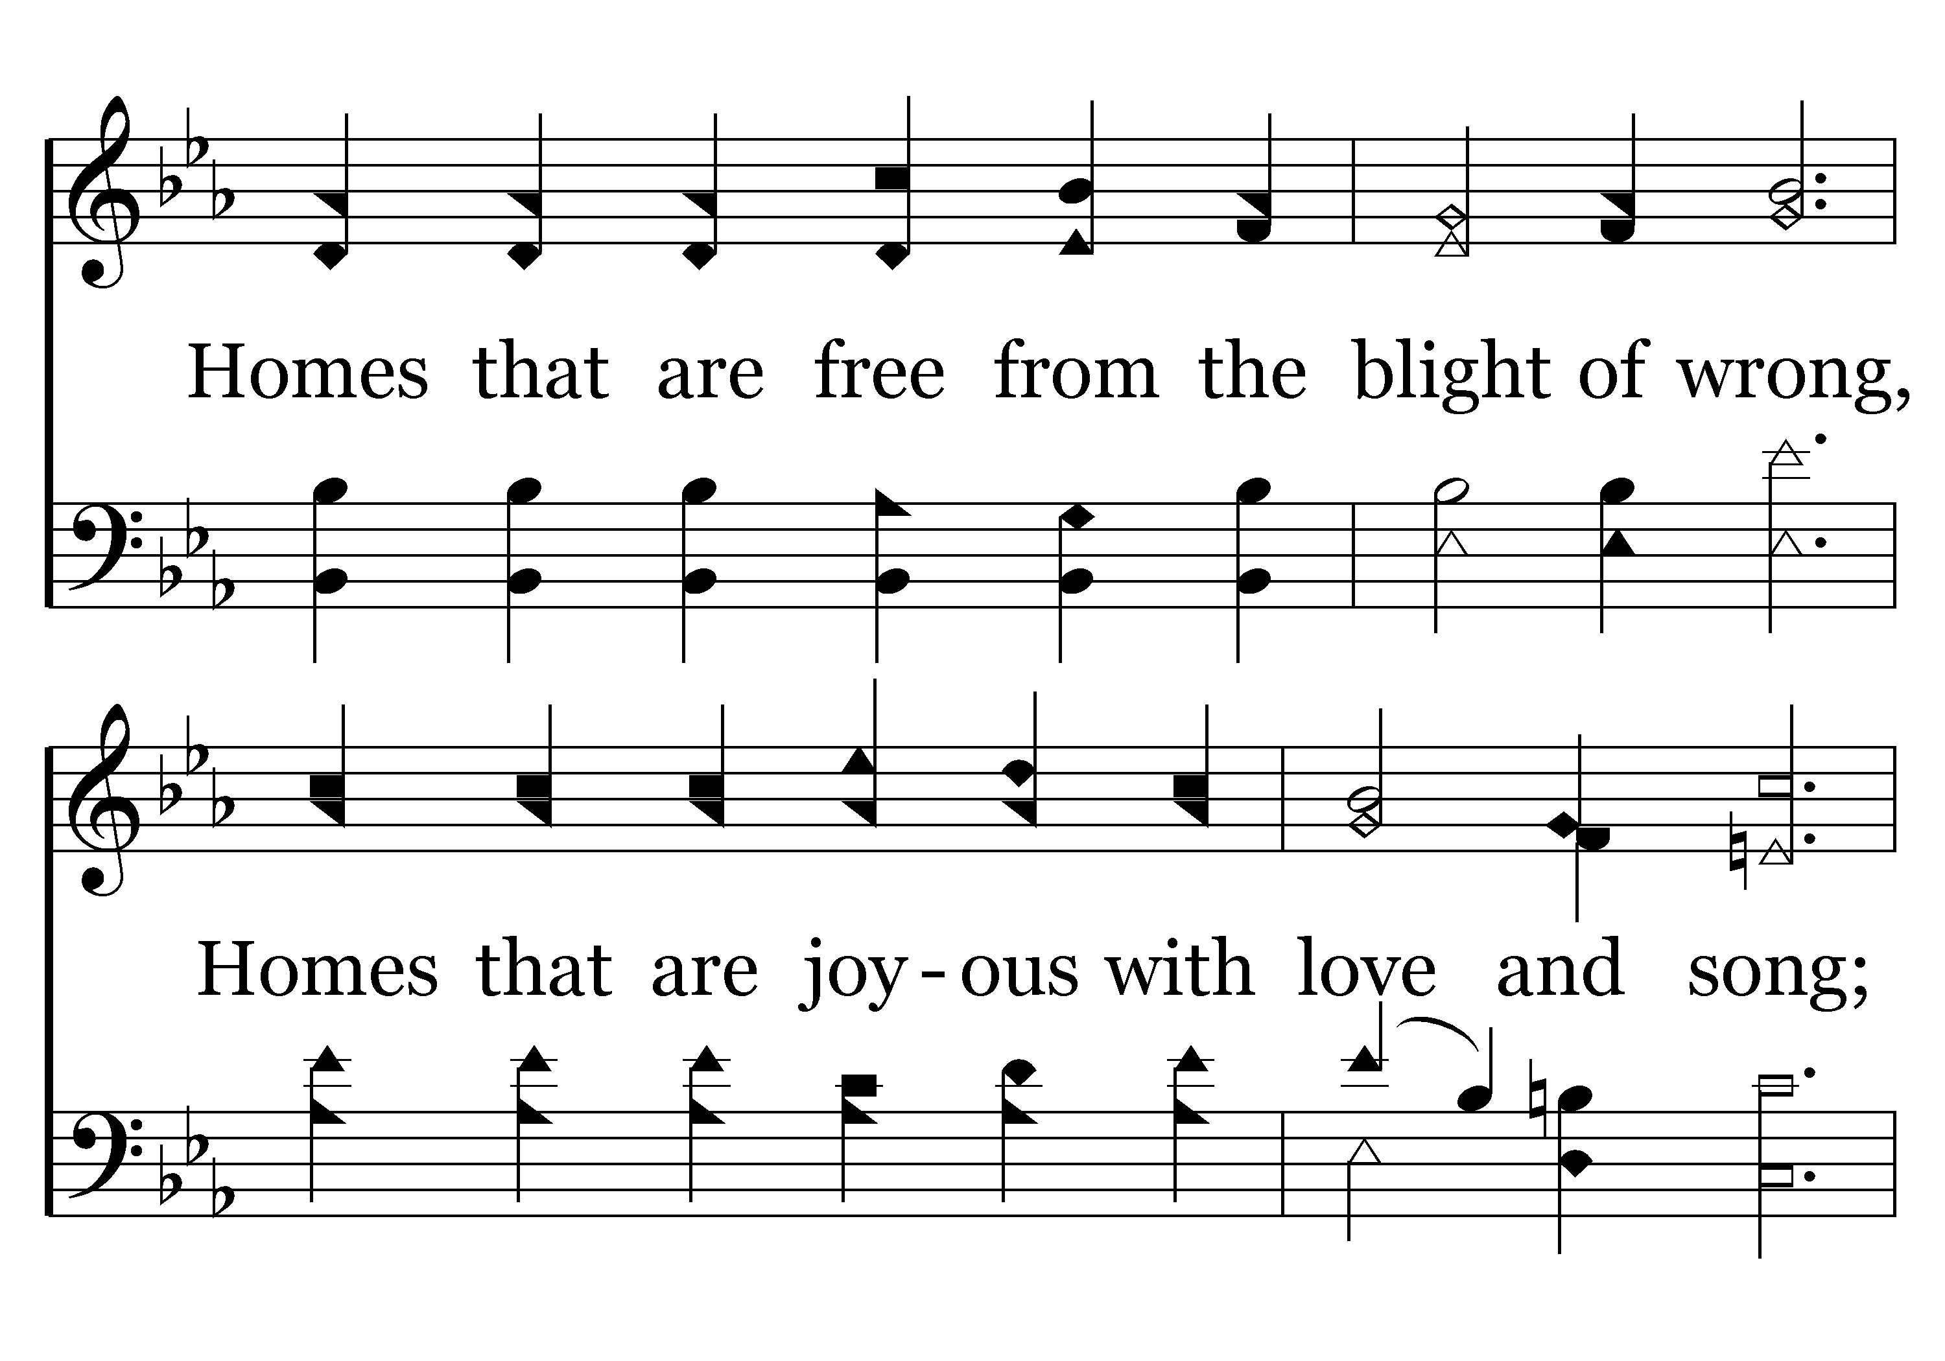
472 - God, Give Us Christian Homes - 2.2

Slide 11
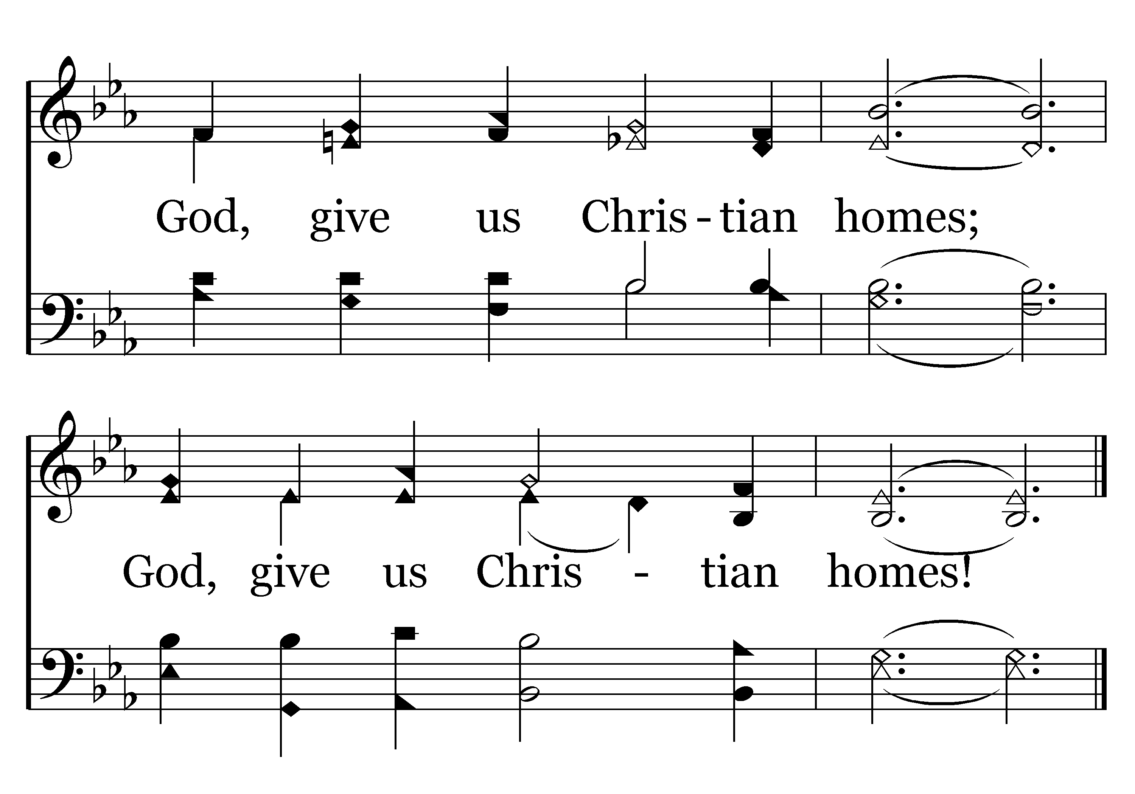
472 - God, Give Us Christian Homes - 2.3
End of Verse 2

Slide 12
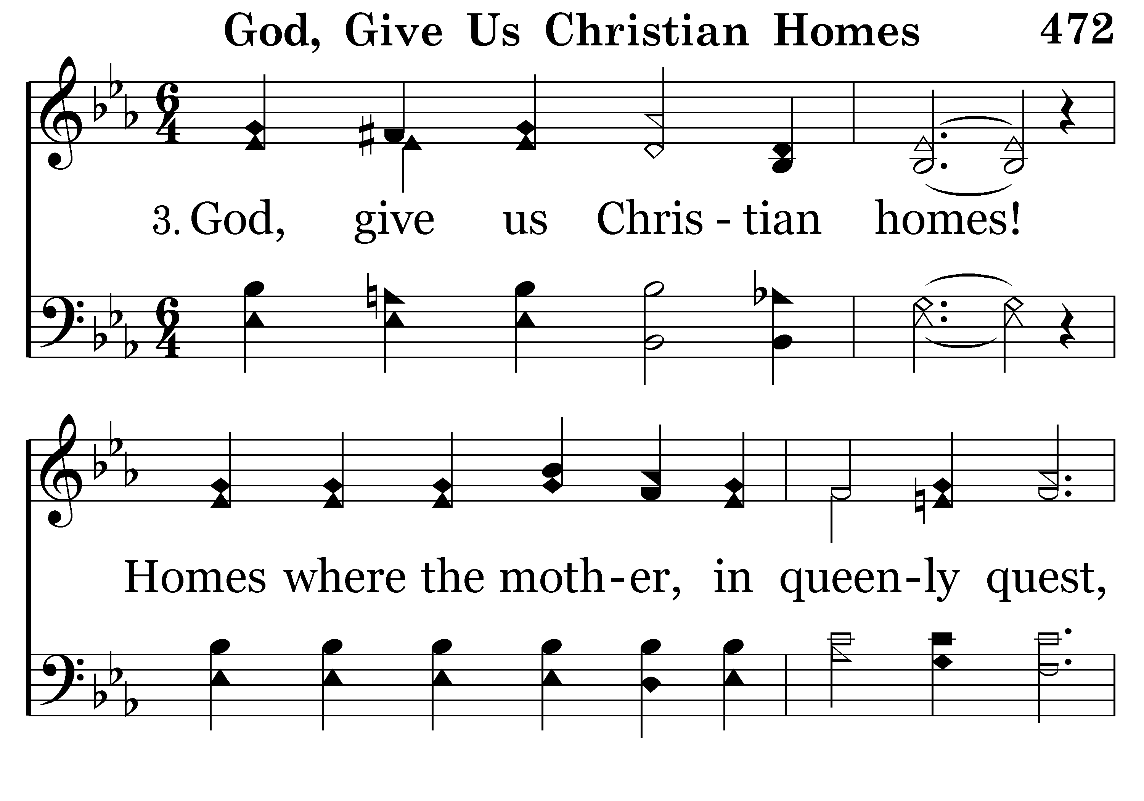
472 - God, Give Us Christian Homes - 3.1

Slide 13
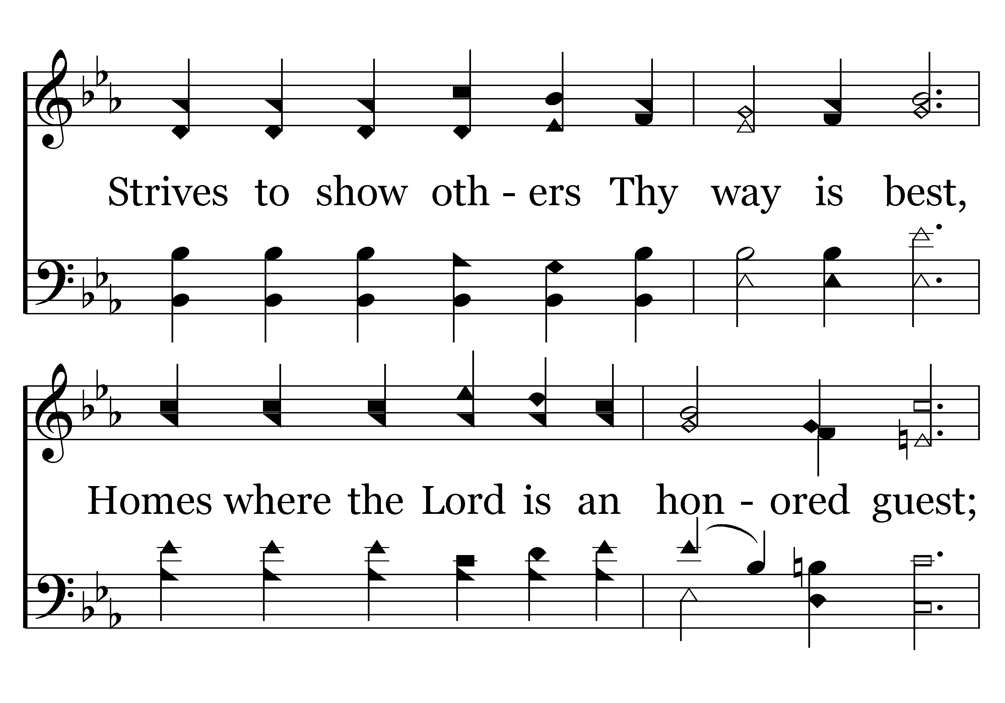
472 - God, Give Us Christian Homes - 3.2

Slide 14
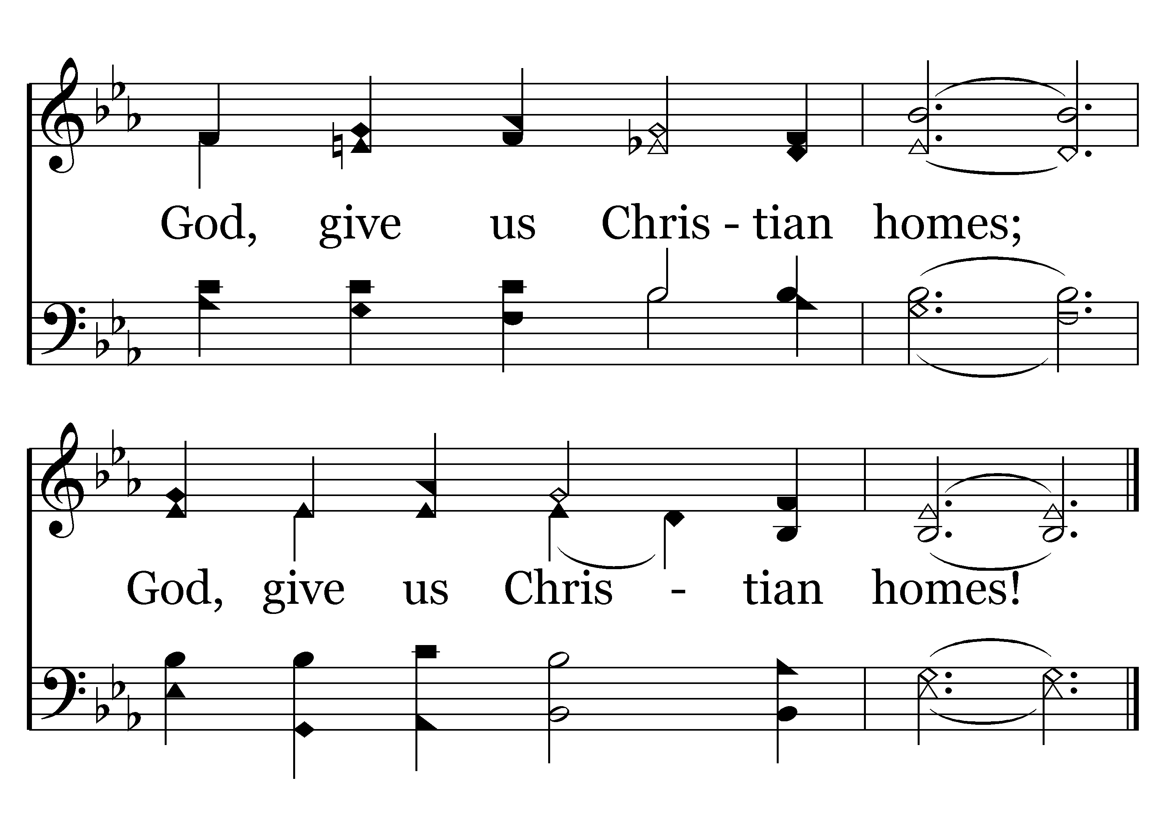
472 - God, Give Us Christian Homes - 3.3
End of Verse 3

Slide 15
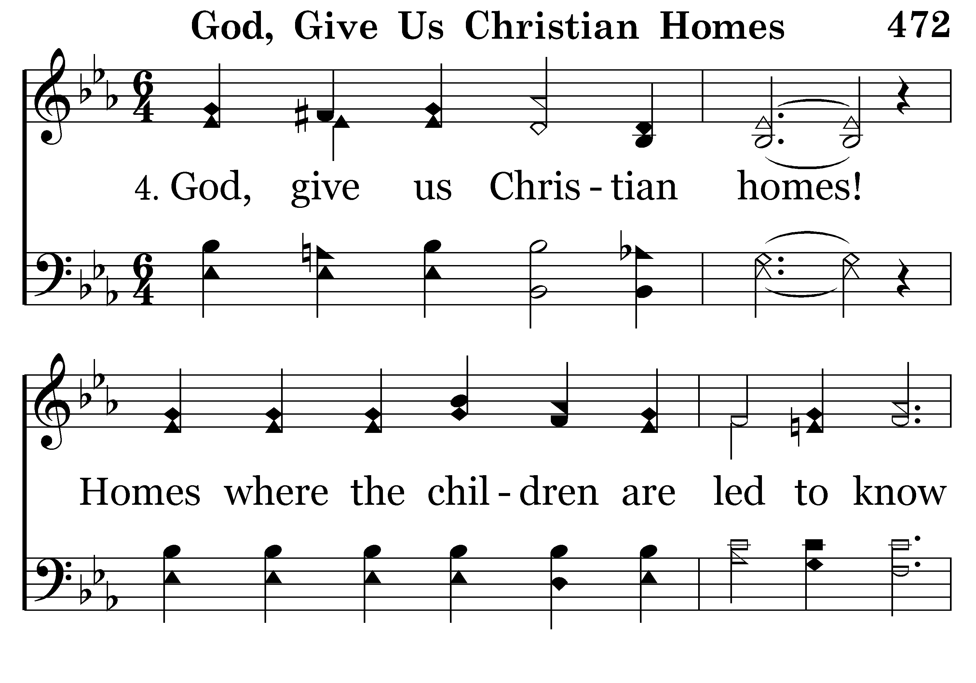
472 - God, Give Us Christian Homes - 4.1

Slide 16
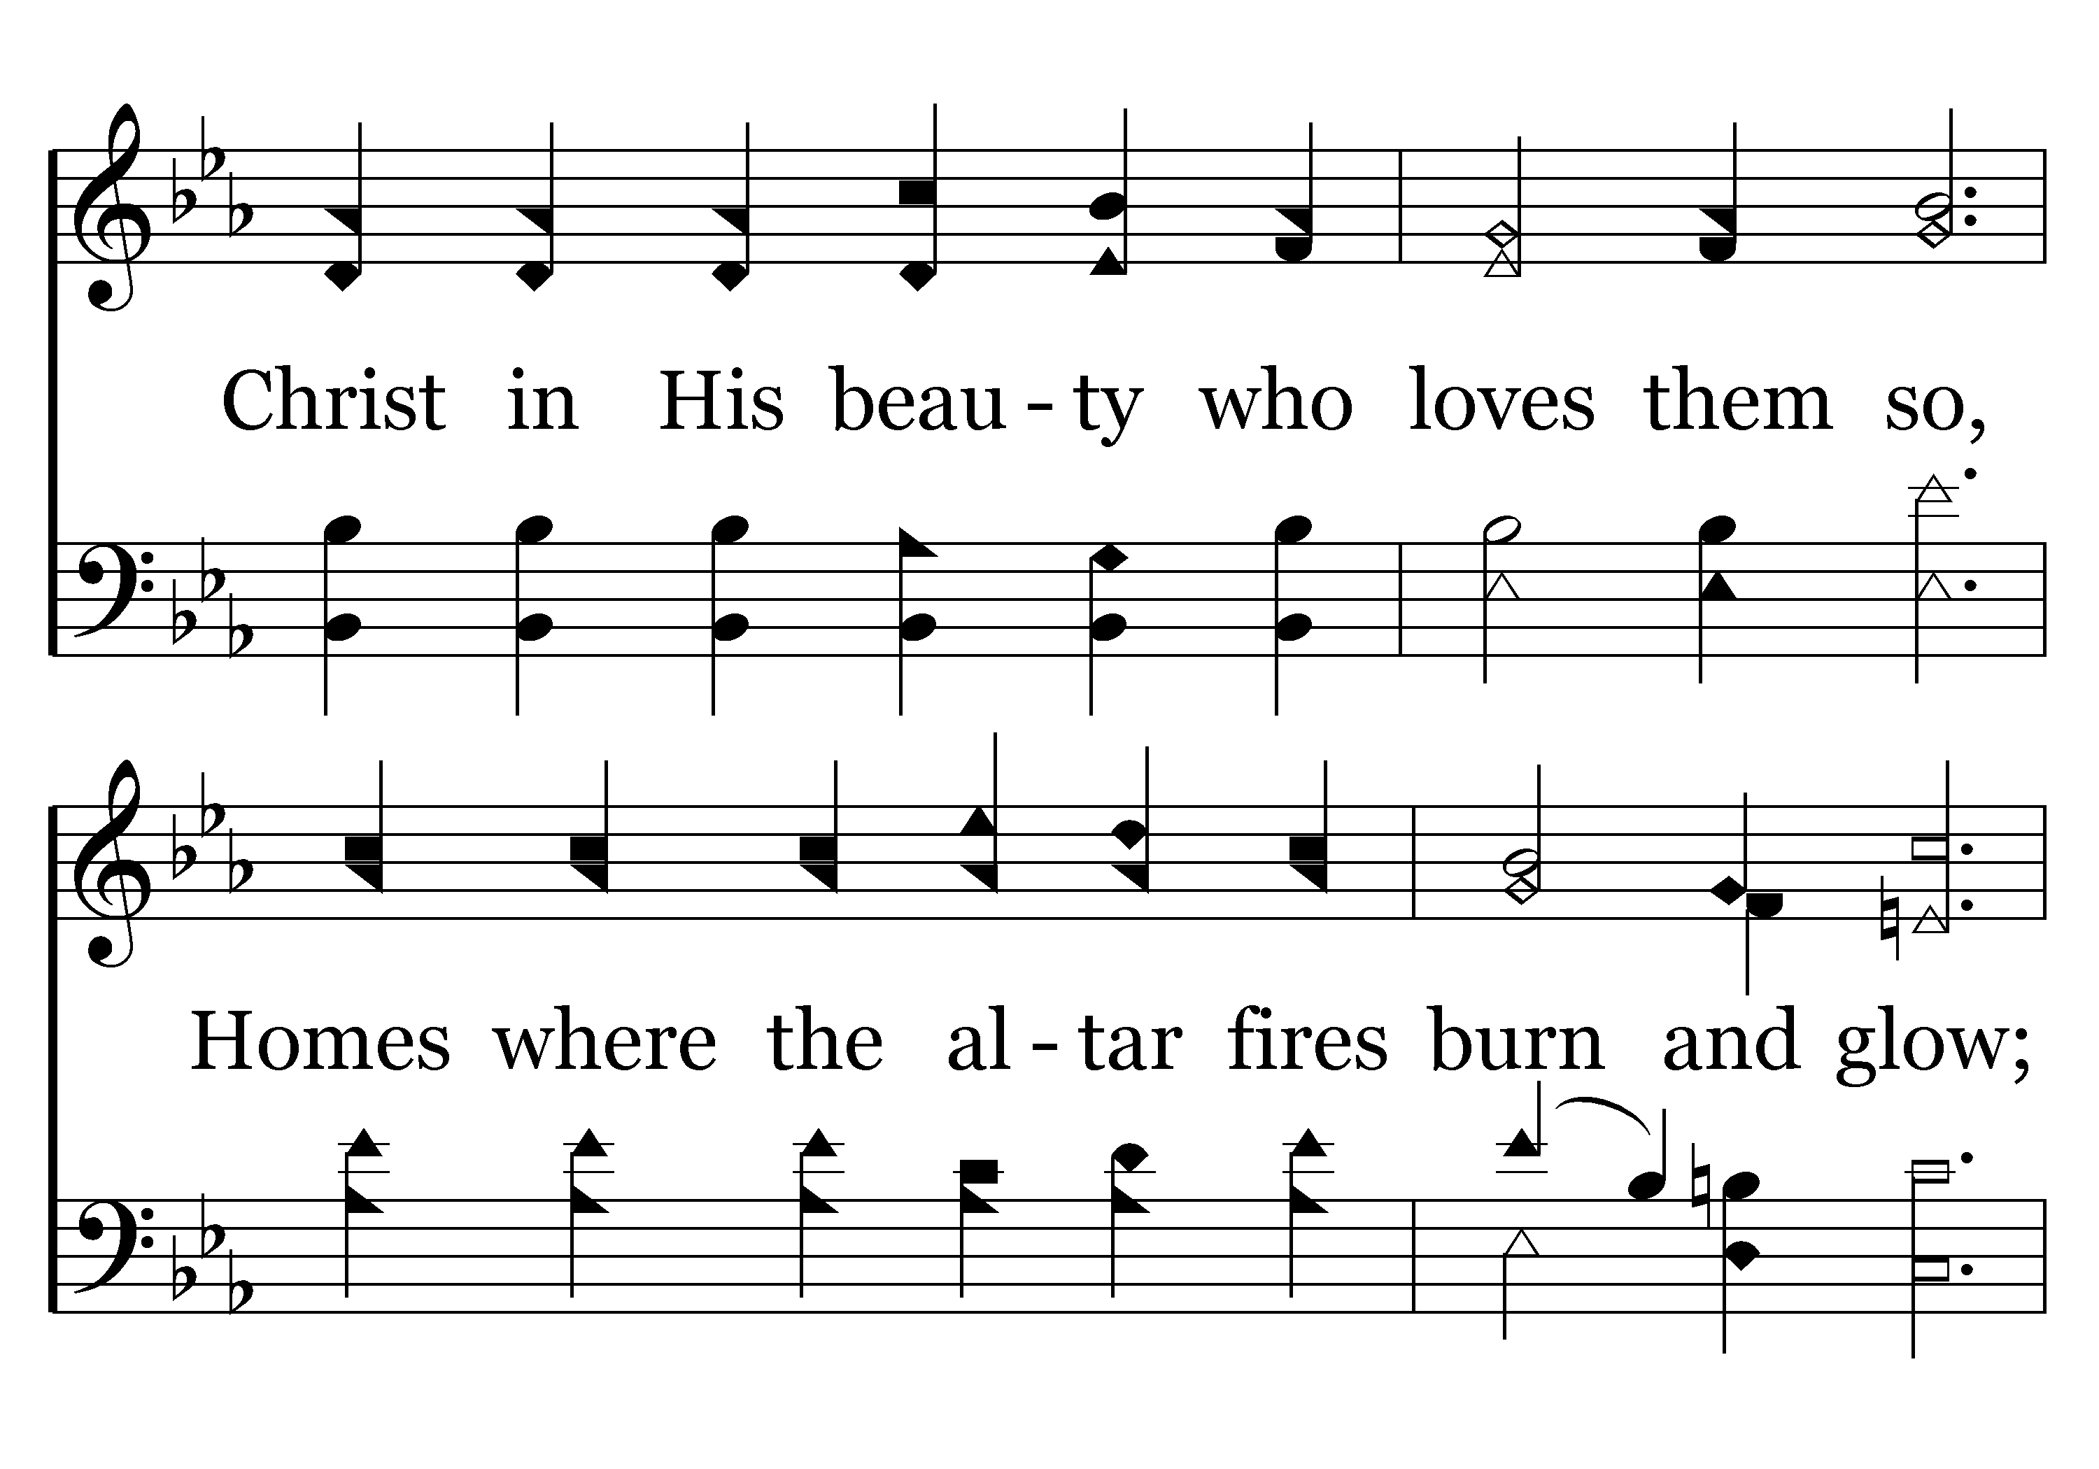
472 - God, Give Us Christian Homes - 4.2

Slide 17
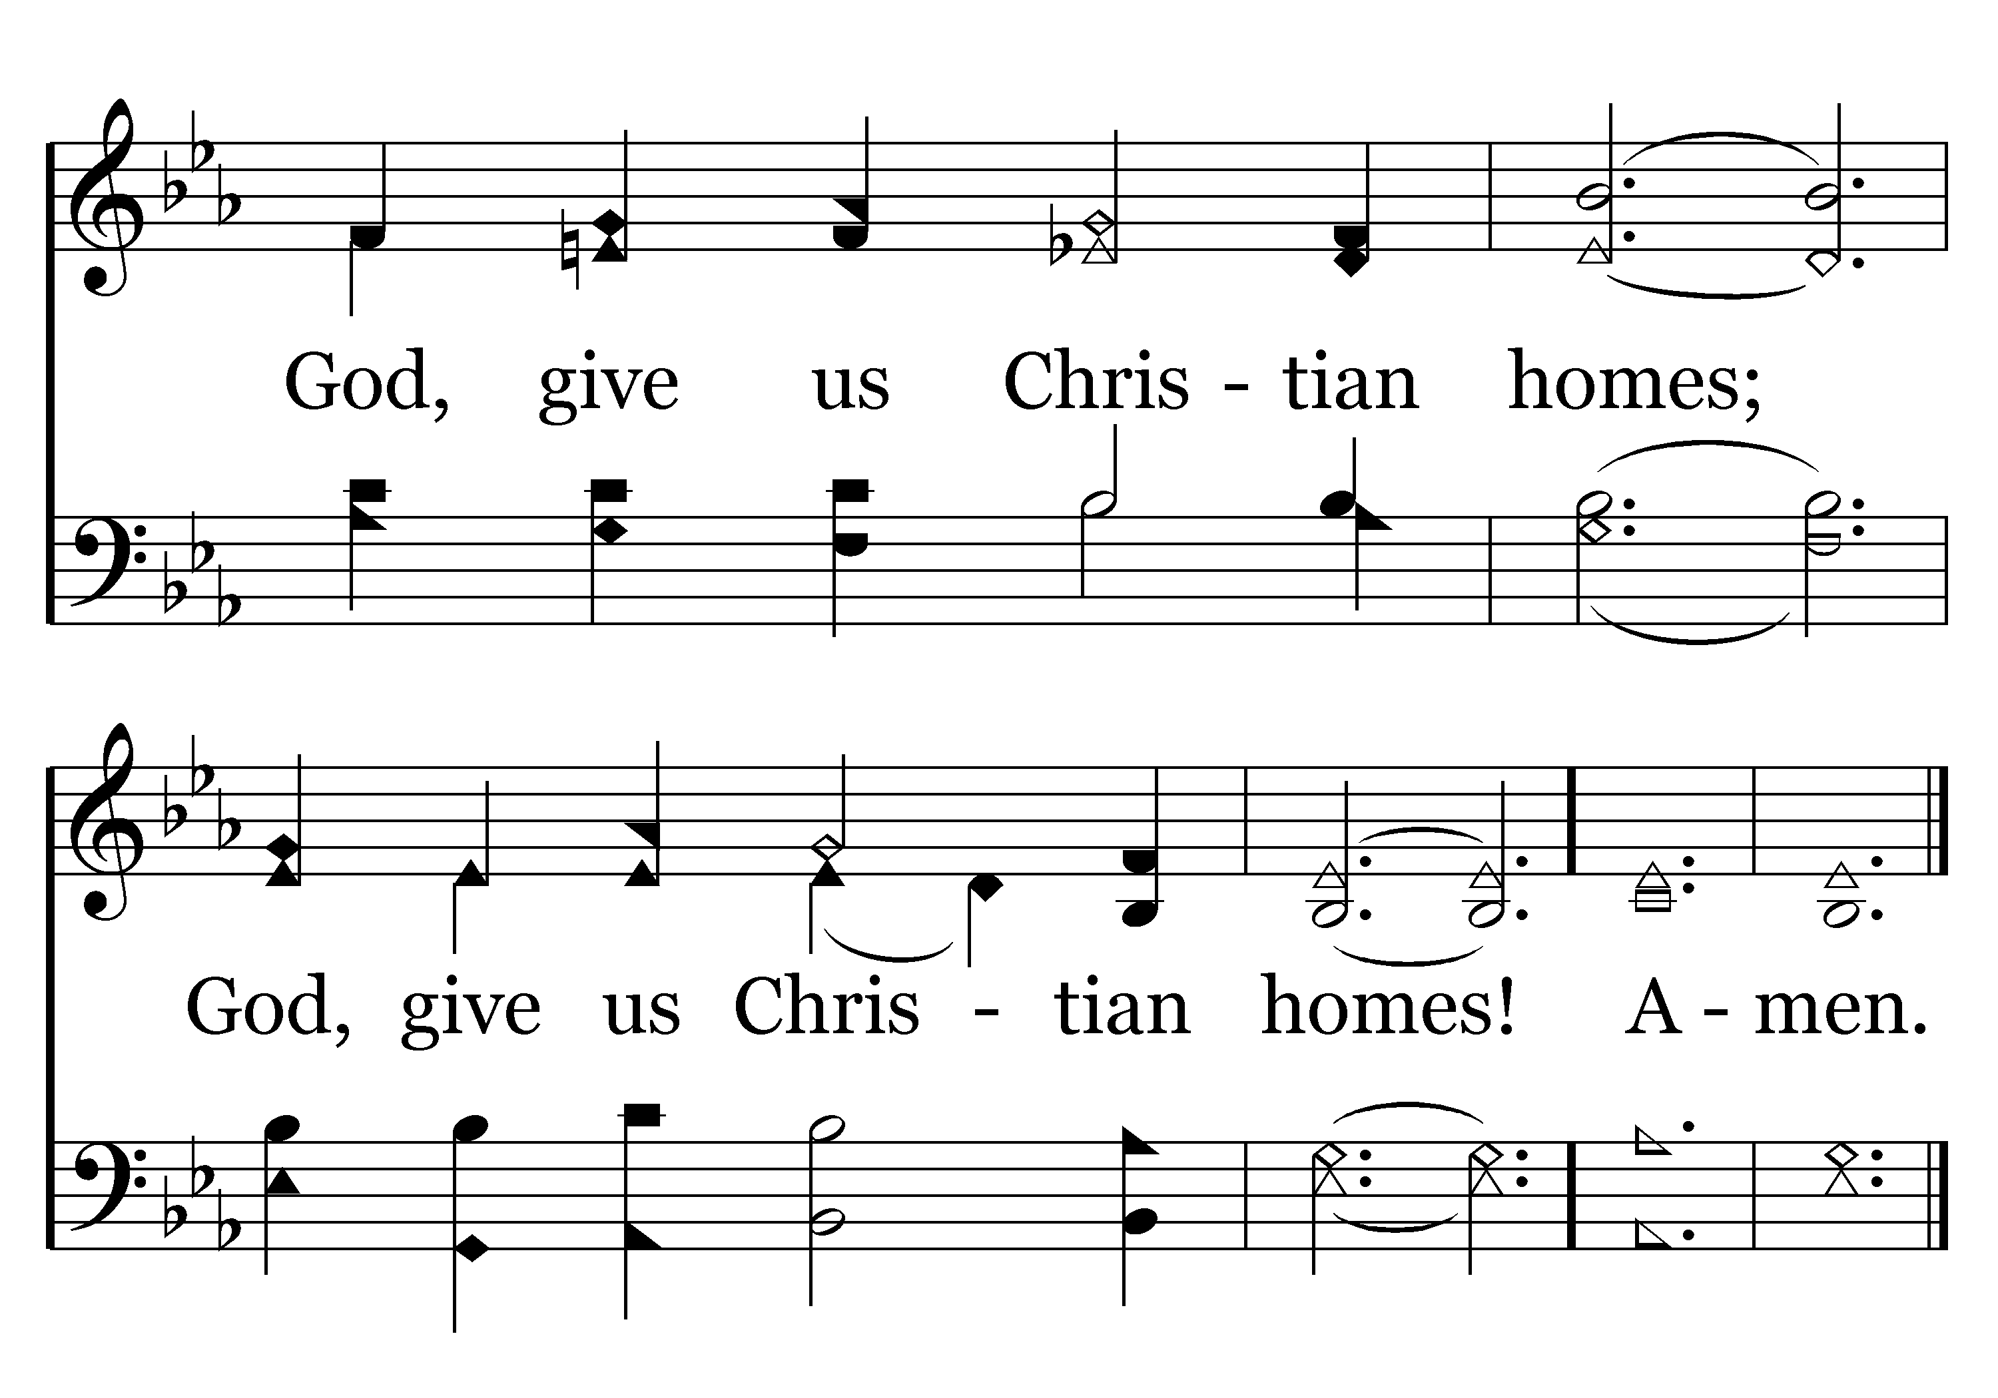
472 - God, Give Us Christian Homes - 4.3
End of Song

Slide 18
Psalm 127
Prosperity Comes from the LORD. A Song of Ascents, of Solomon.
¹Unless the LORD builds the house, They labor in vain who build it; Unless the LORD guards the city, The watchman keeps awake in vain.
²It is vain for you to rise up early, To retire late, To eat the bread of painful labors; For He gives to His beloved even in his sleep.
³Behold, children are a gift of the LORD, The fruit of the womb is a reward.
⁴Like arrows in the hand of a warrior, So are the children of one's youth.
⁵How blessed is the man whose quiver is full of them; They will not be ashamed When they speak with their enemies in the gate.

Slide 19
Sources
Adapted from article excerpt from “That’s Life” – Book by Dee Bowman
New Life Behavior – Anger Management Lesson 6

