Slide 1
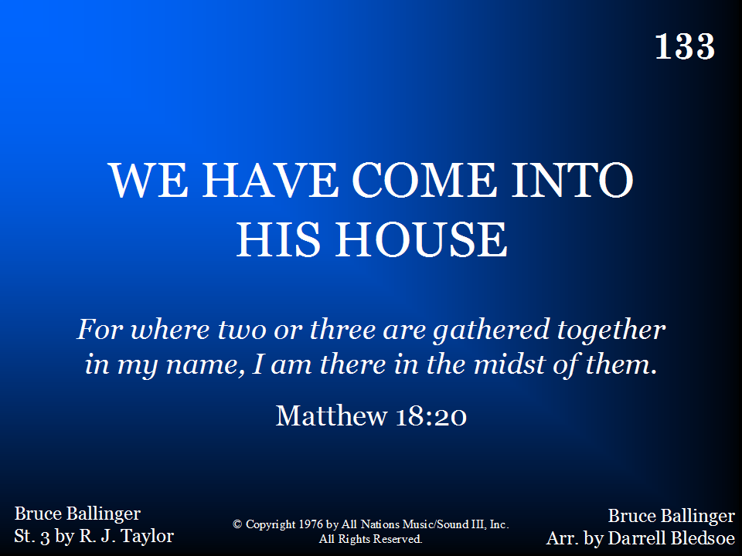
133 - We Have Come Into His House - Title

Slide 2
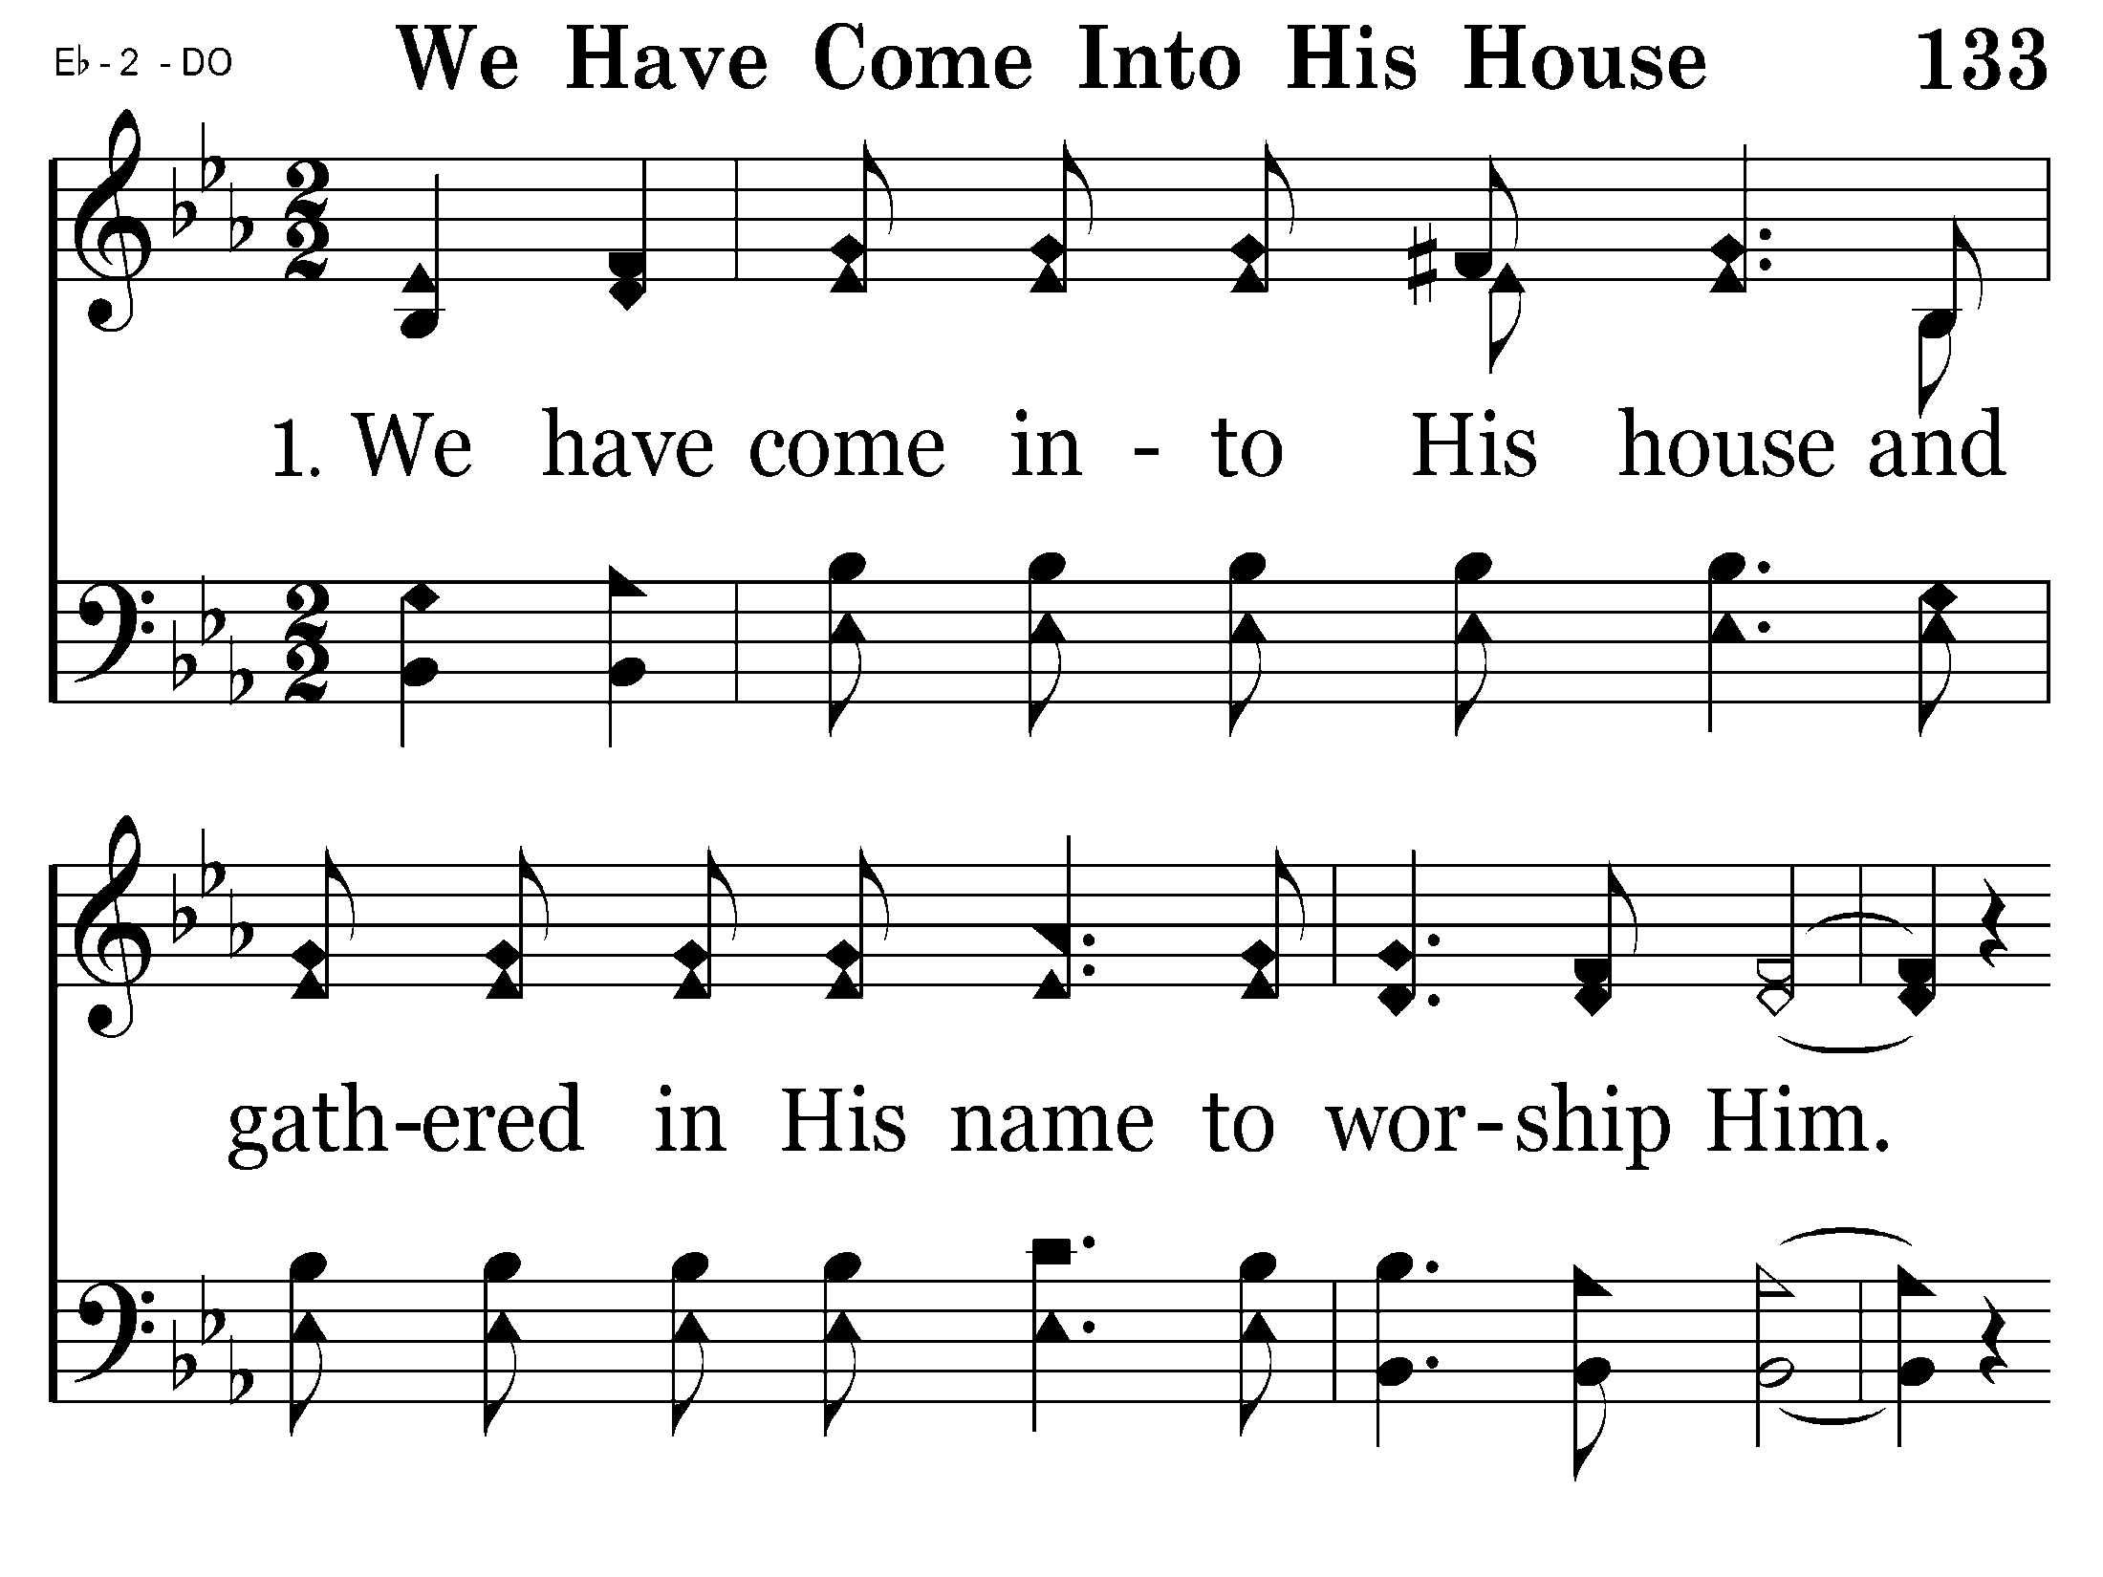
133 - We Have Come Into His House - 1.1

Slide 3
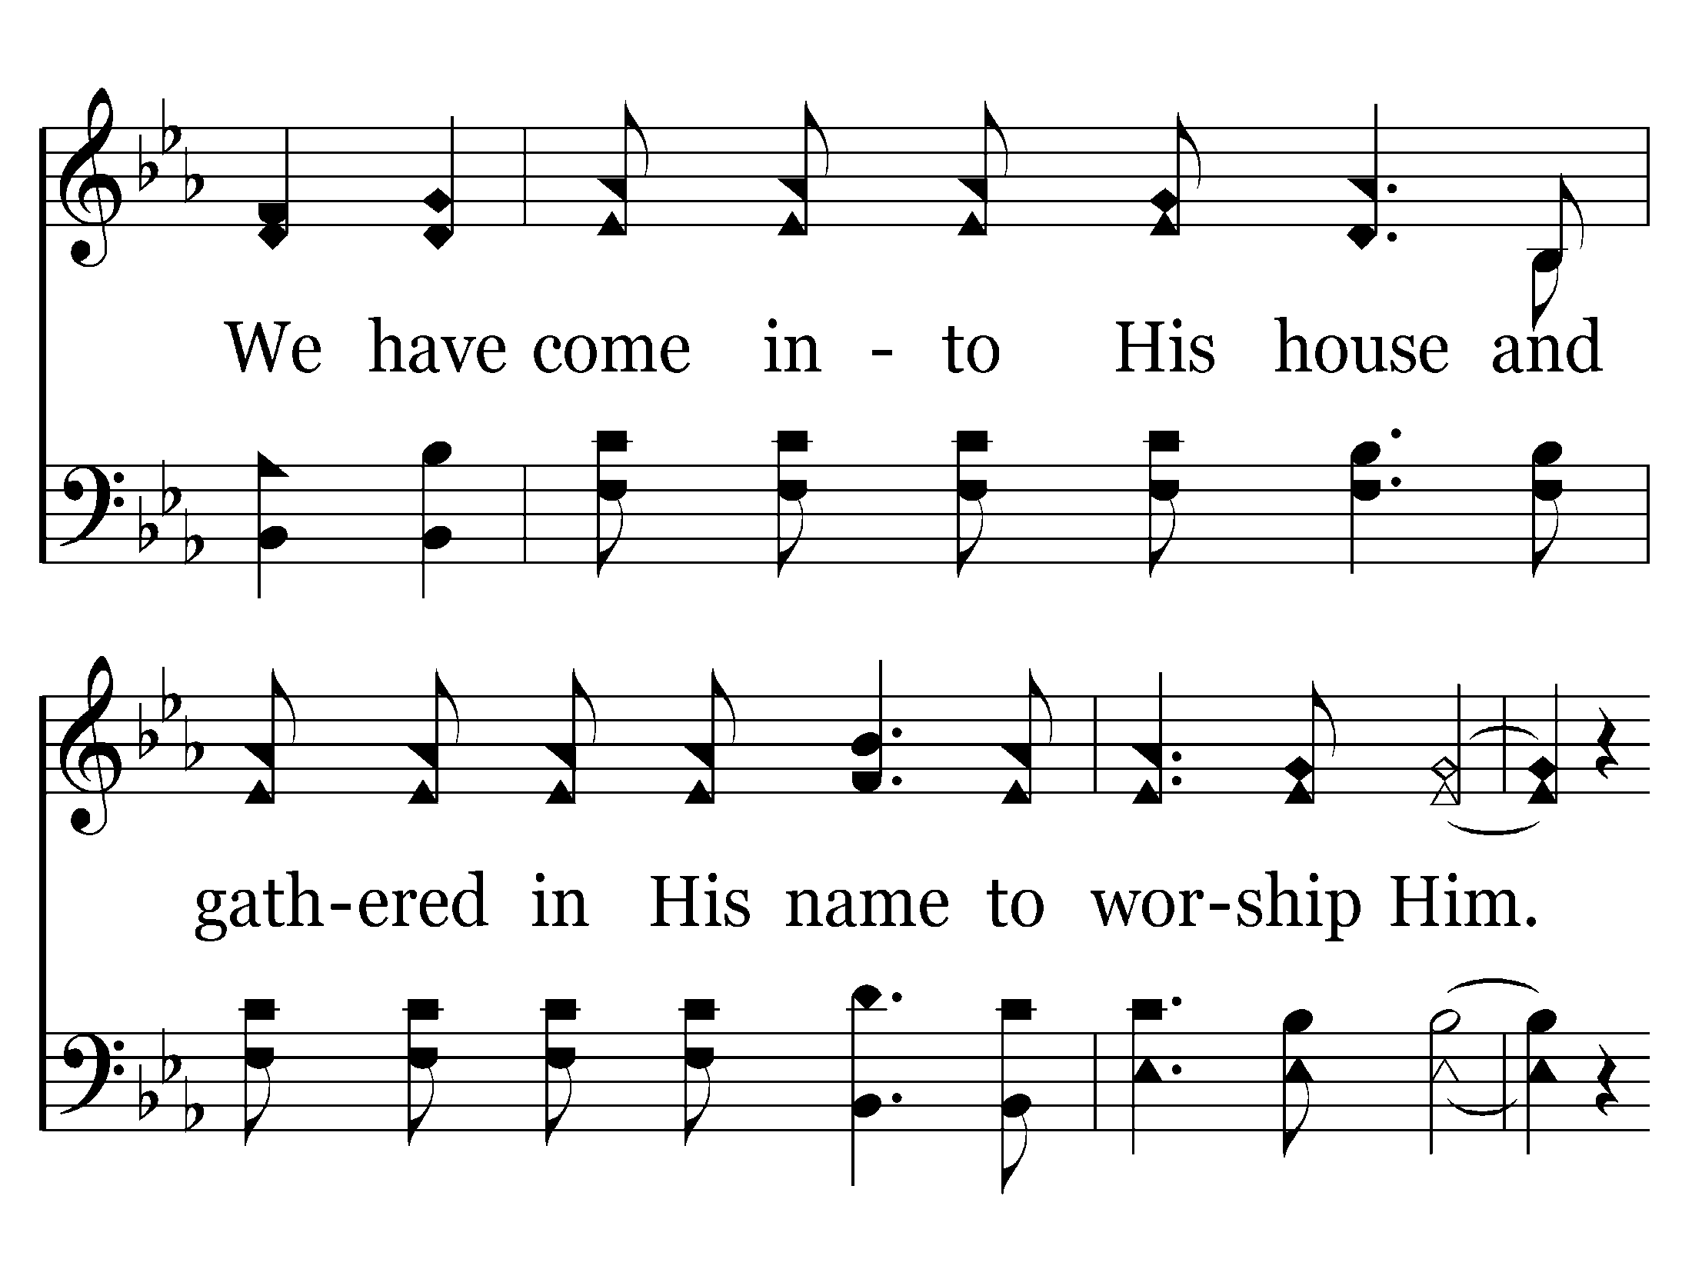
133 - We Have Come Into His House - 1.2

Slide 4
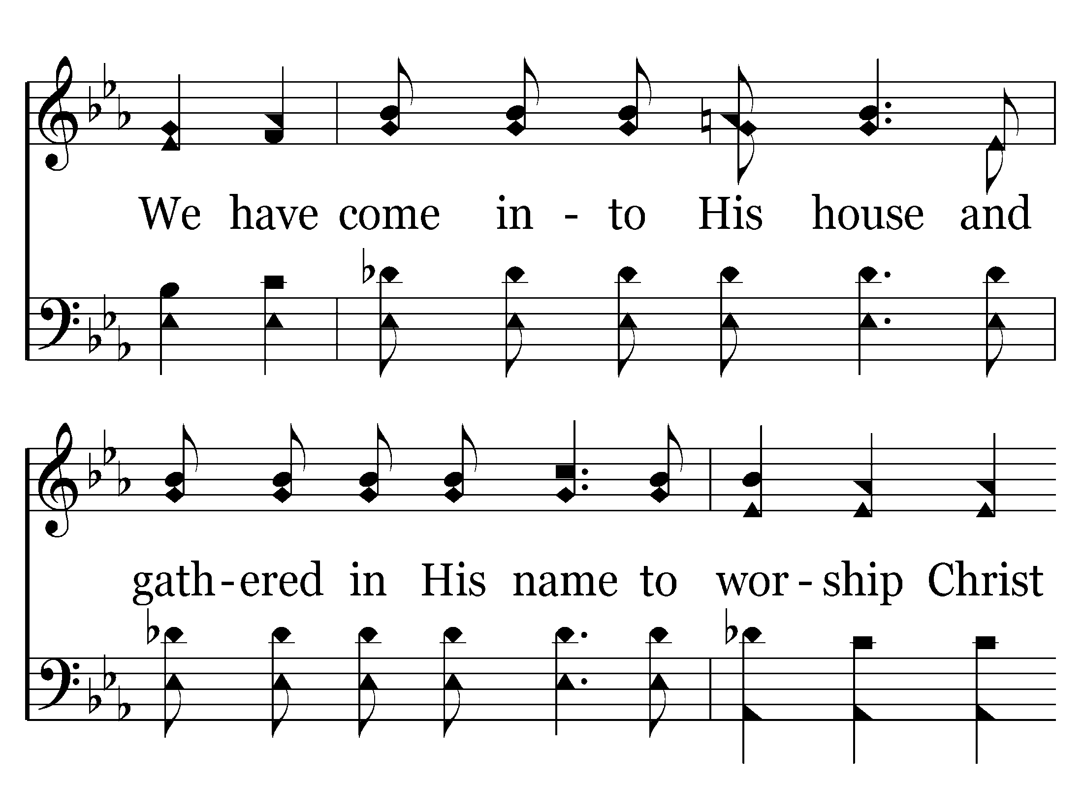
133 - We Have Come Into His House - 1.3

Slide 5
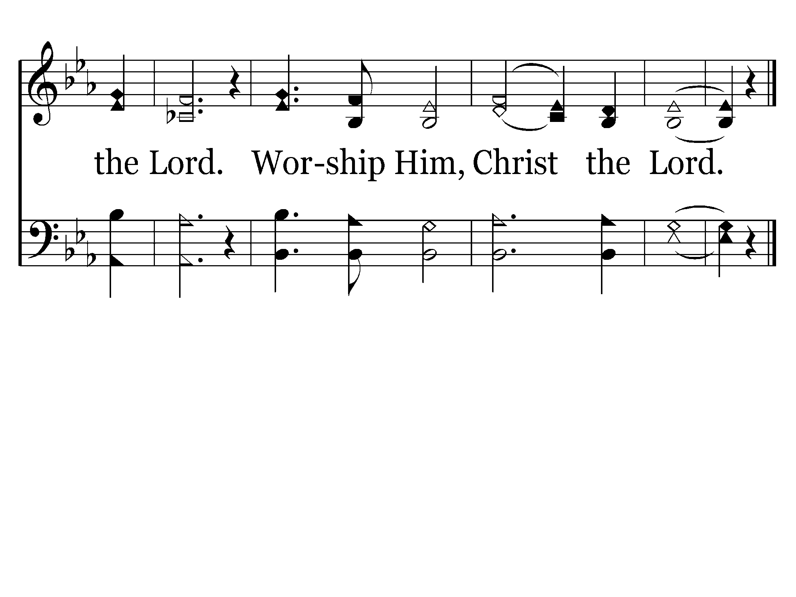
133 - We Have Come Into His House - 1.4
End of Verse 1

Slide 6
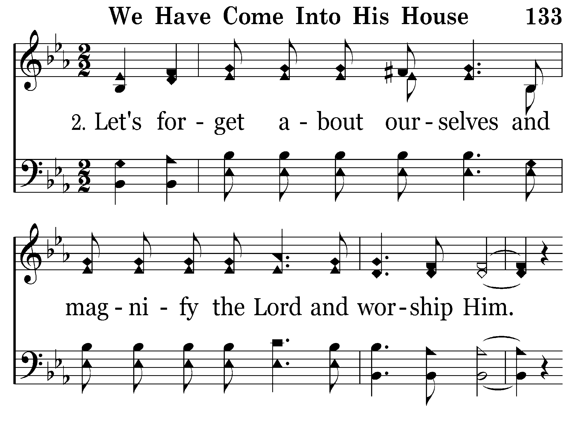
133 - We Have Come Into His House - 2.1

Slide 7
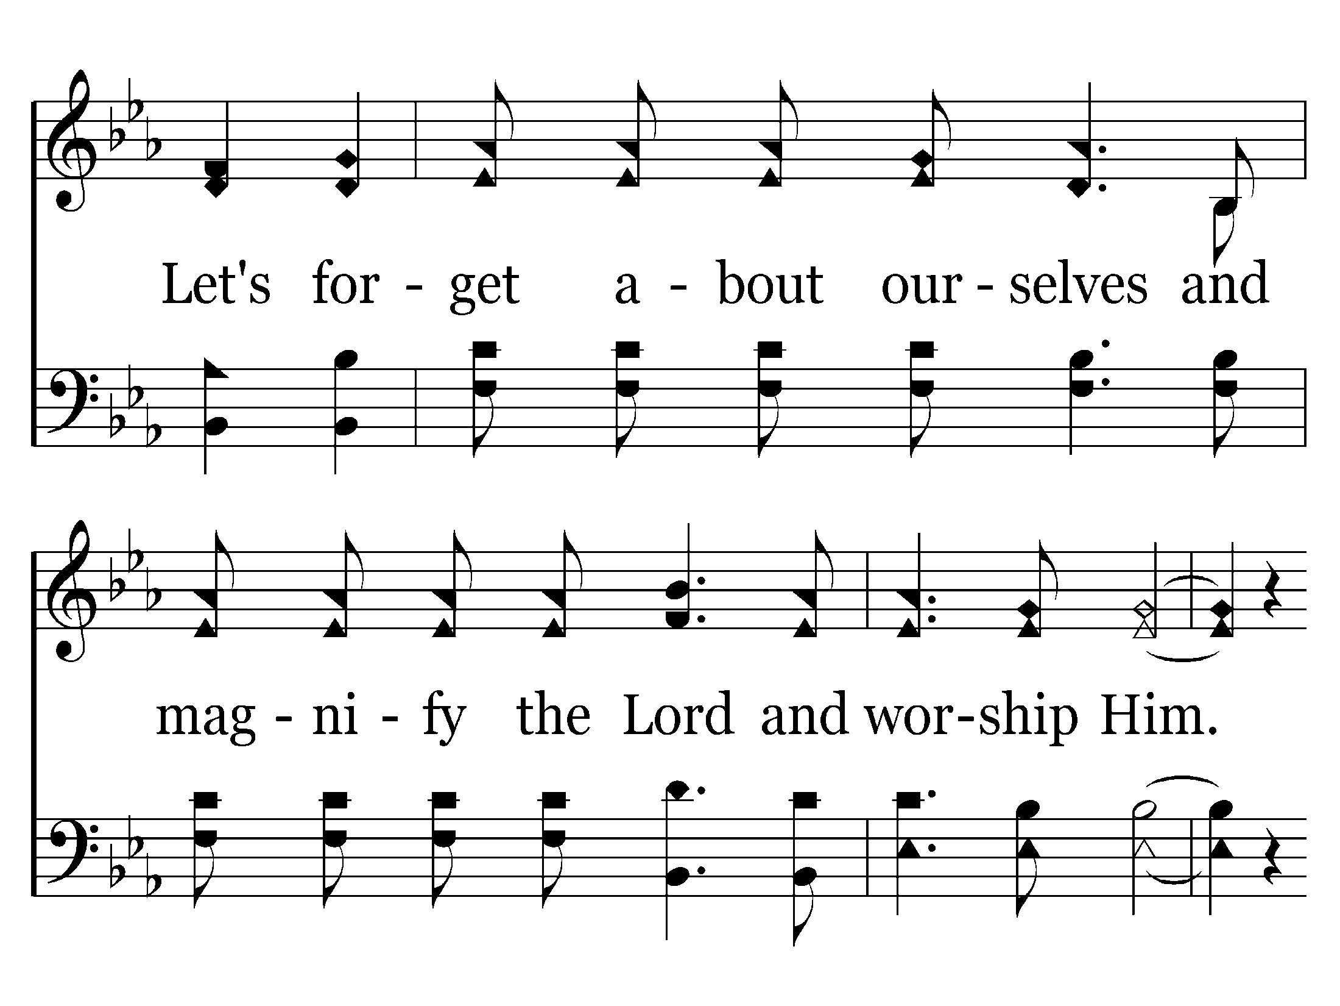
133 - We Have Come Into His House - 2.2

Slide 8
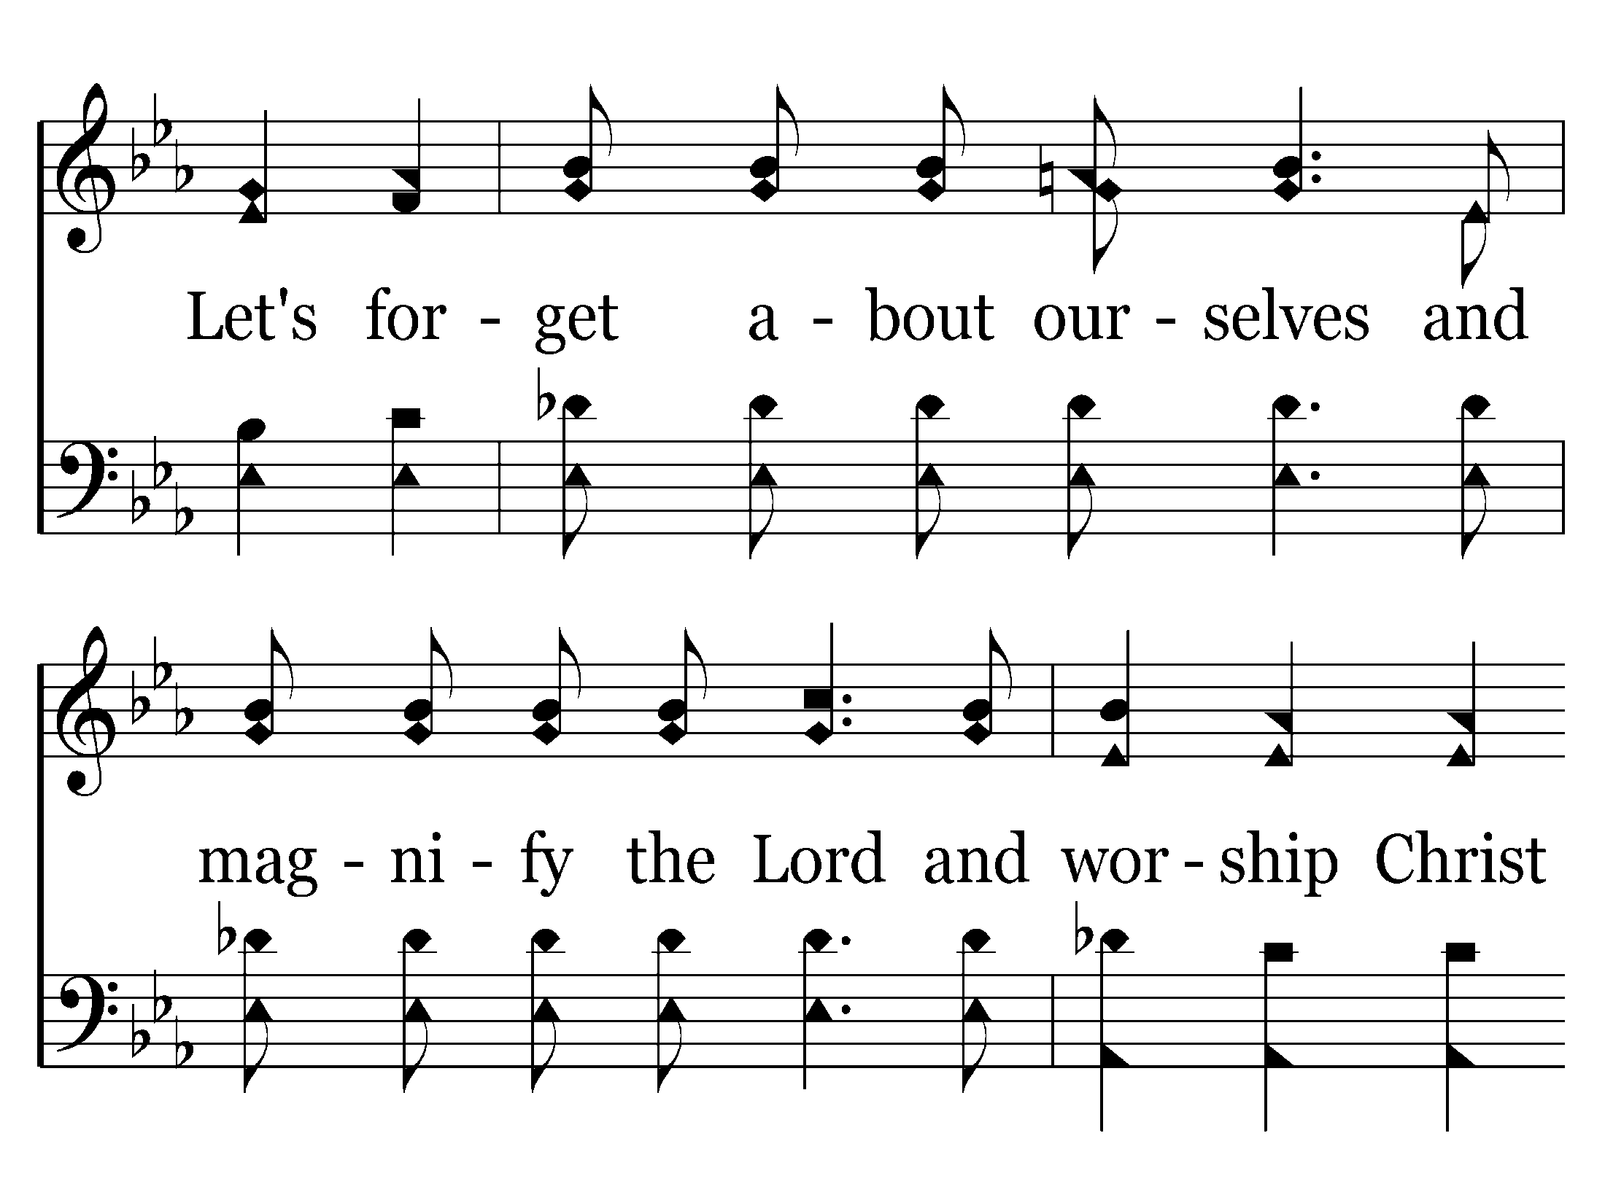
133 - We Have Come Into His House - 2.3

Slide 9

133 - We Have Come Into His House - 2.4
End of Verse 2

Slide 10
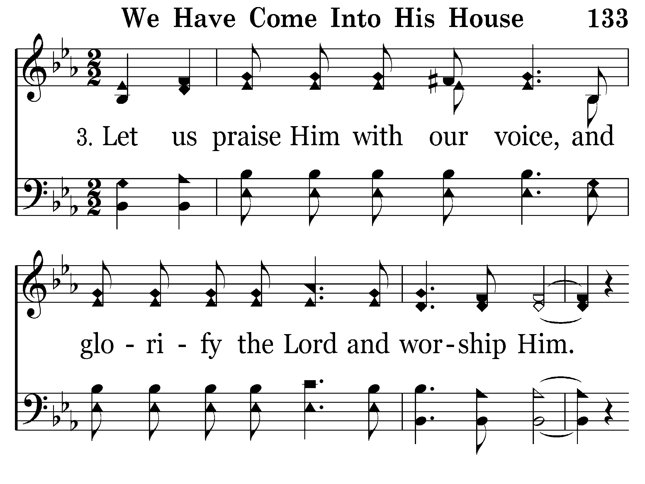
133 - We Have Come Into His House - 3.1

Slide 11
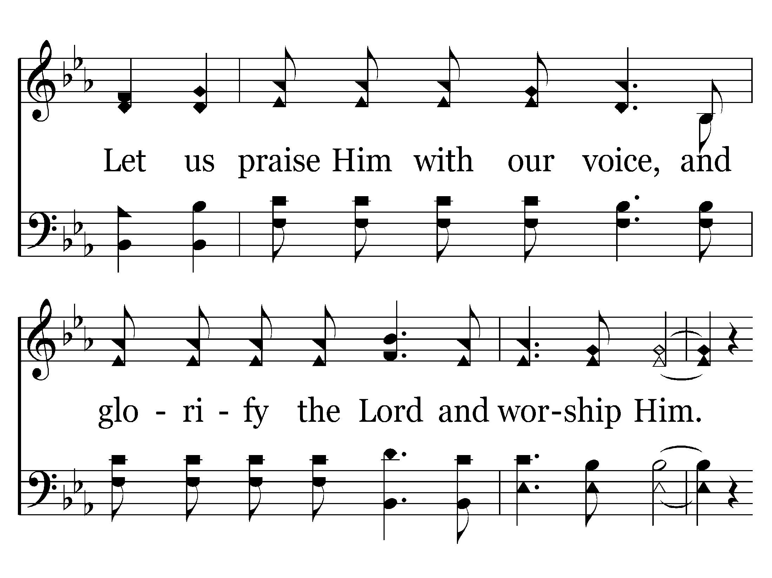
133 - We Have Come Into His House - 3.2

Slide 12
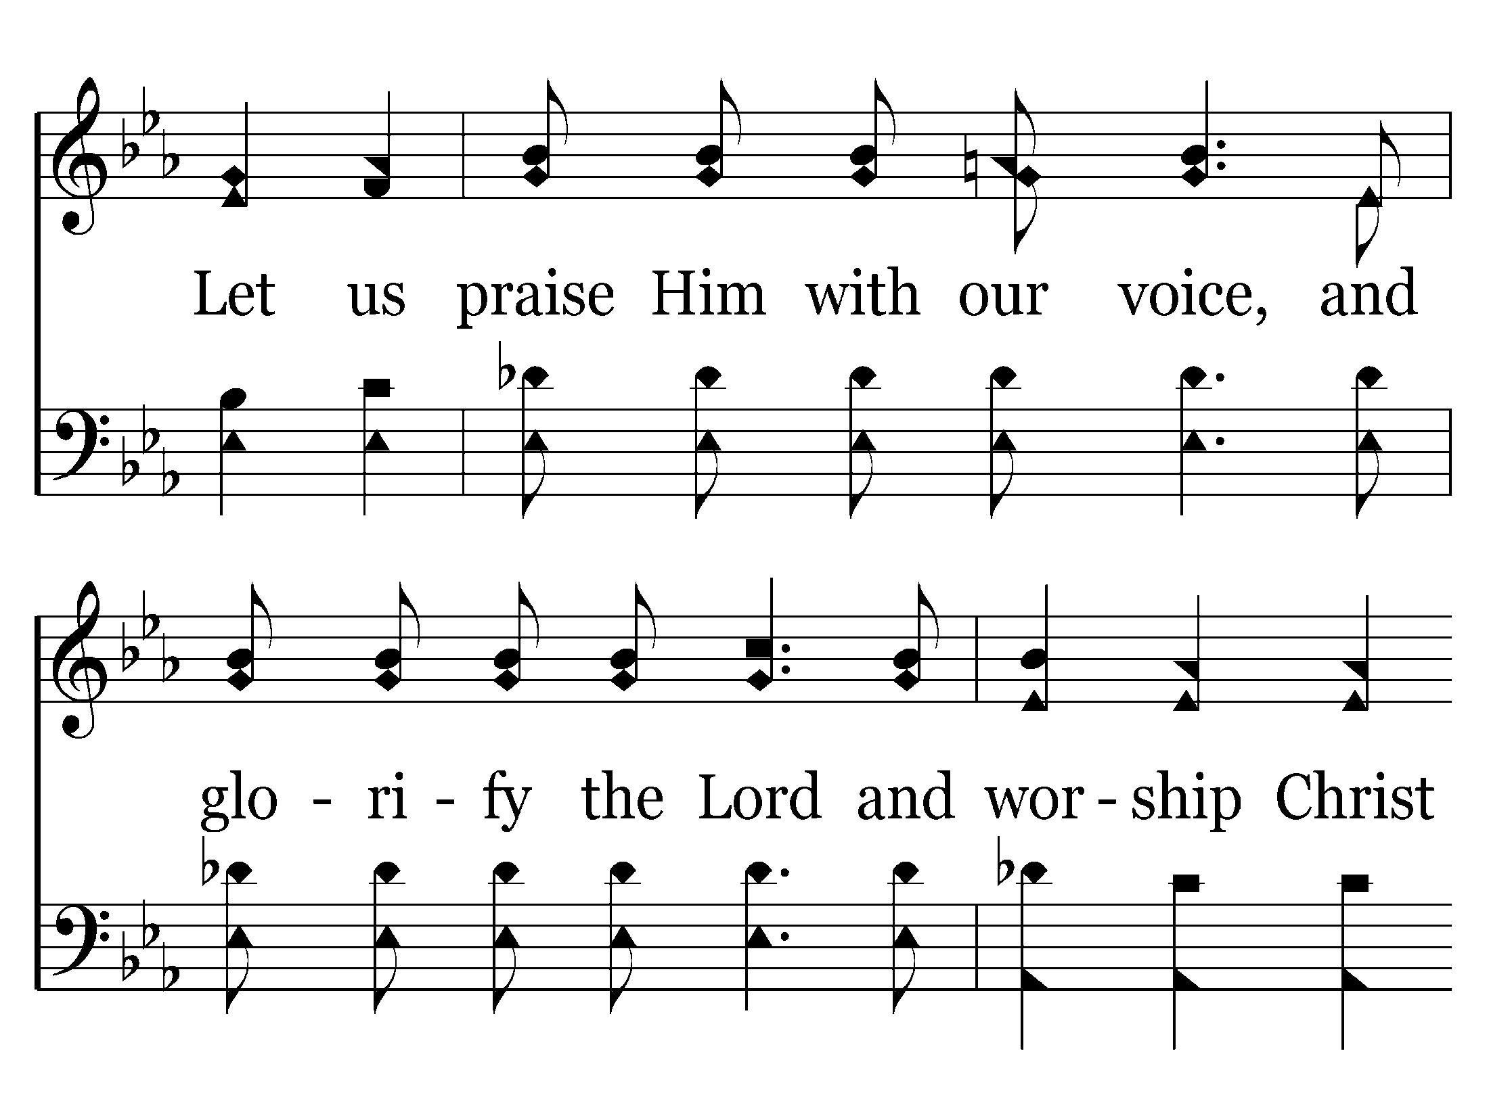
133 - We Have Come Into His House - 3.3

Slide 13
133 - We Have Come Into His House - 3.4
End of Song

Slide 14
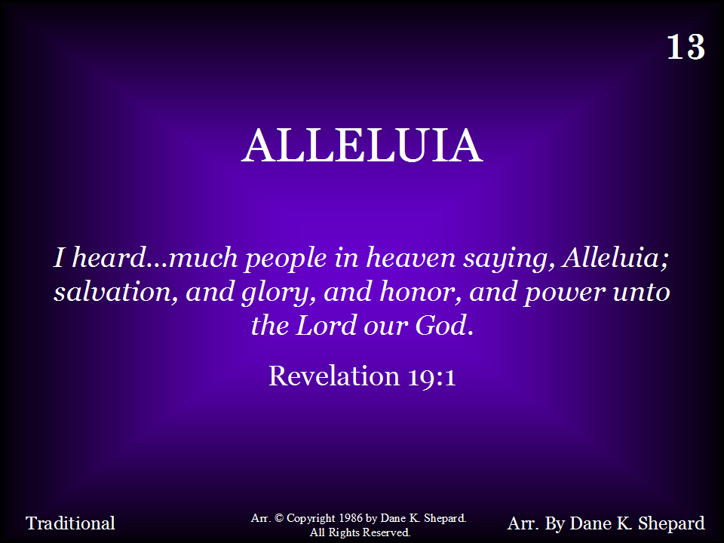
013 - Alleluia - Title

Slide 15
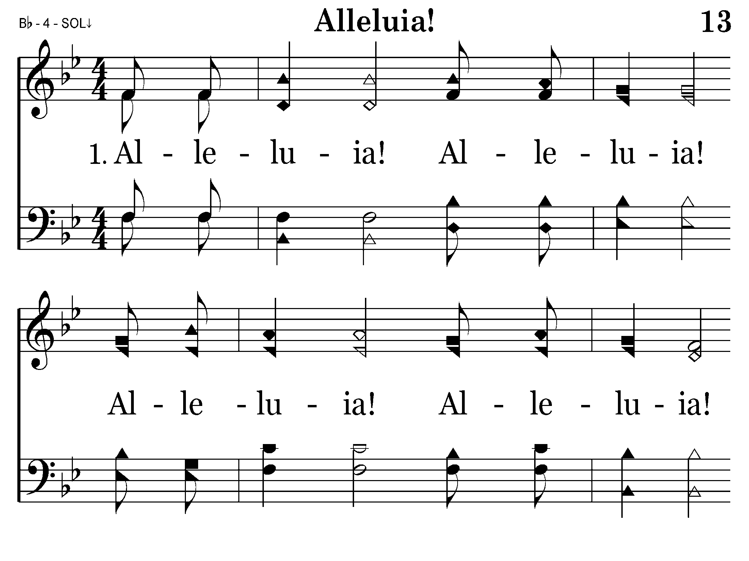
013 - Alleluia - 1.1

Slide 16
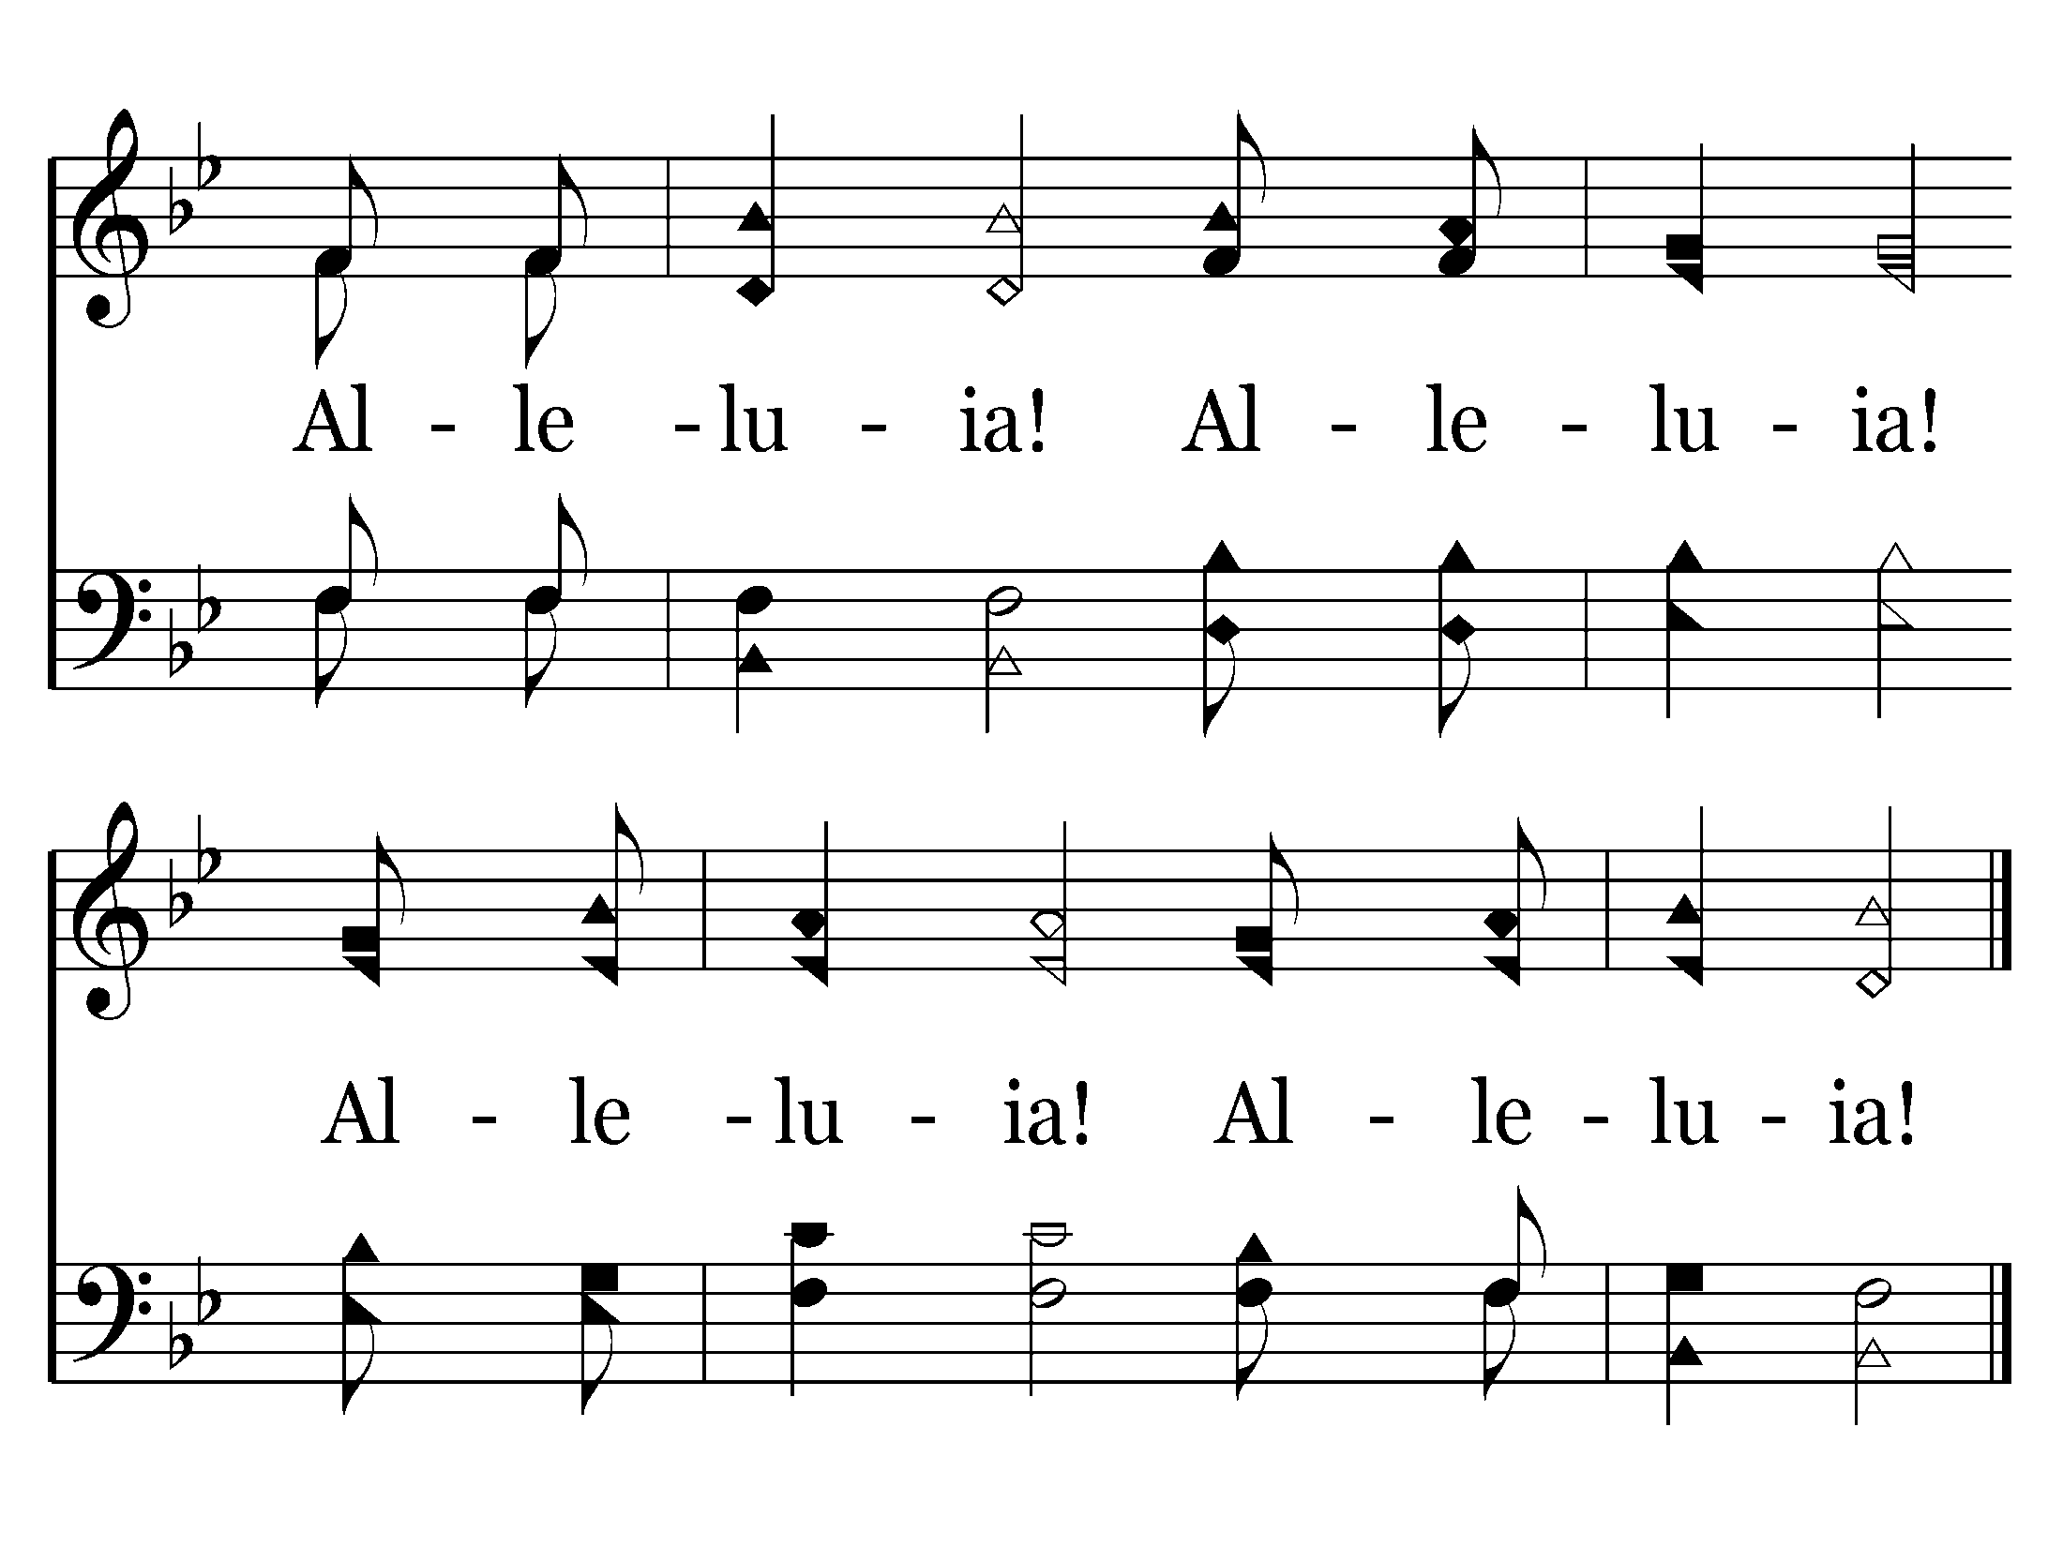
013 - Alleluia - 1.2
End of Verse 1

Slide 17
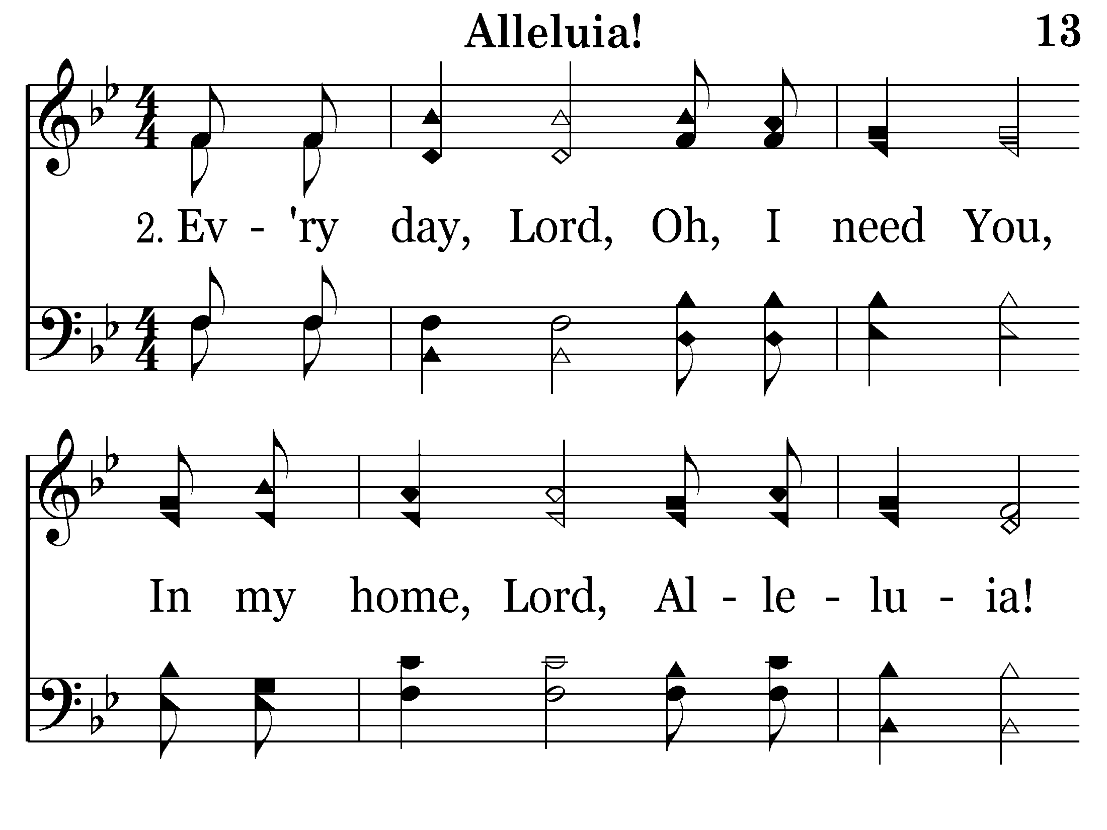
013 - Alleluia - 2.1

Slide 18
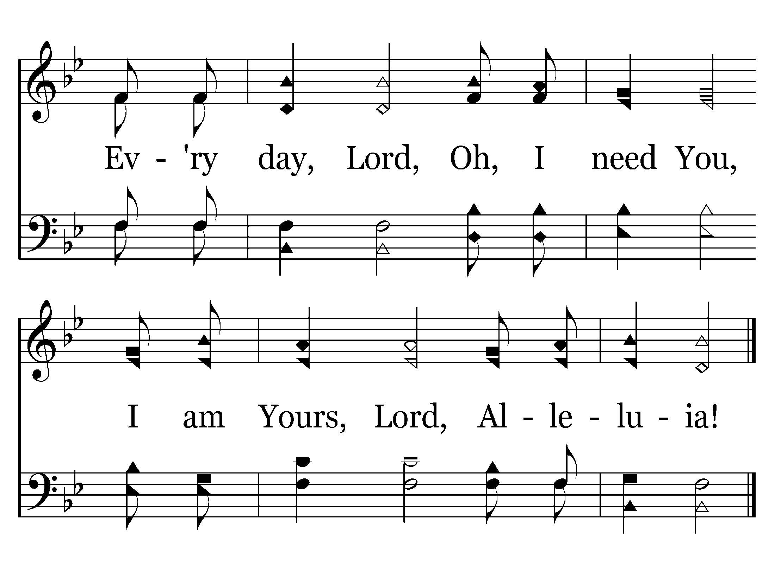
013 - Alleluia - 2.2
End of Verse 2

Slide 19
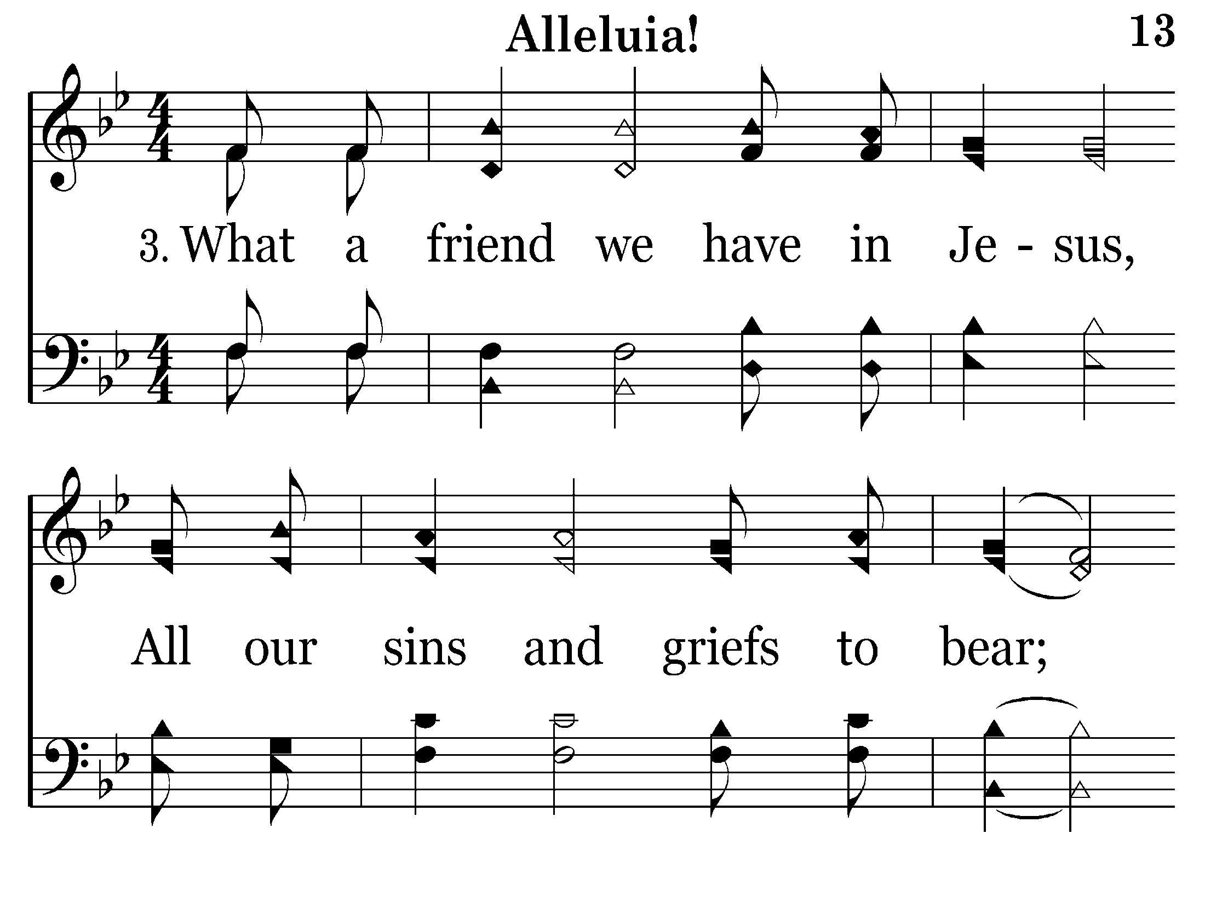
013 - Alleluia - 3.1

Slide 20
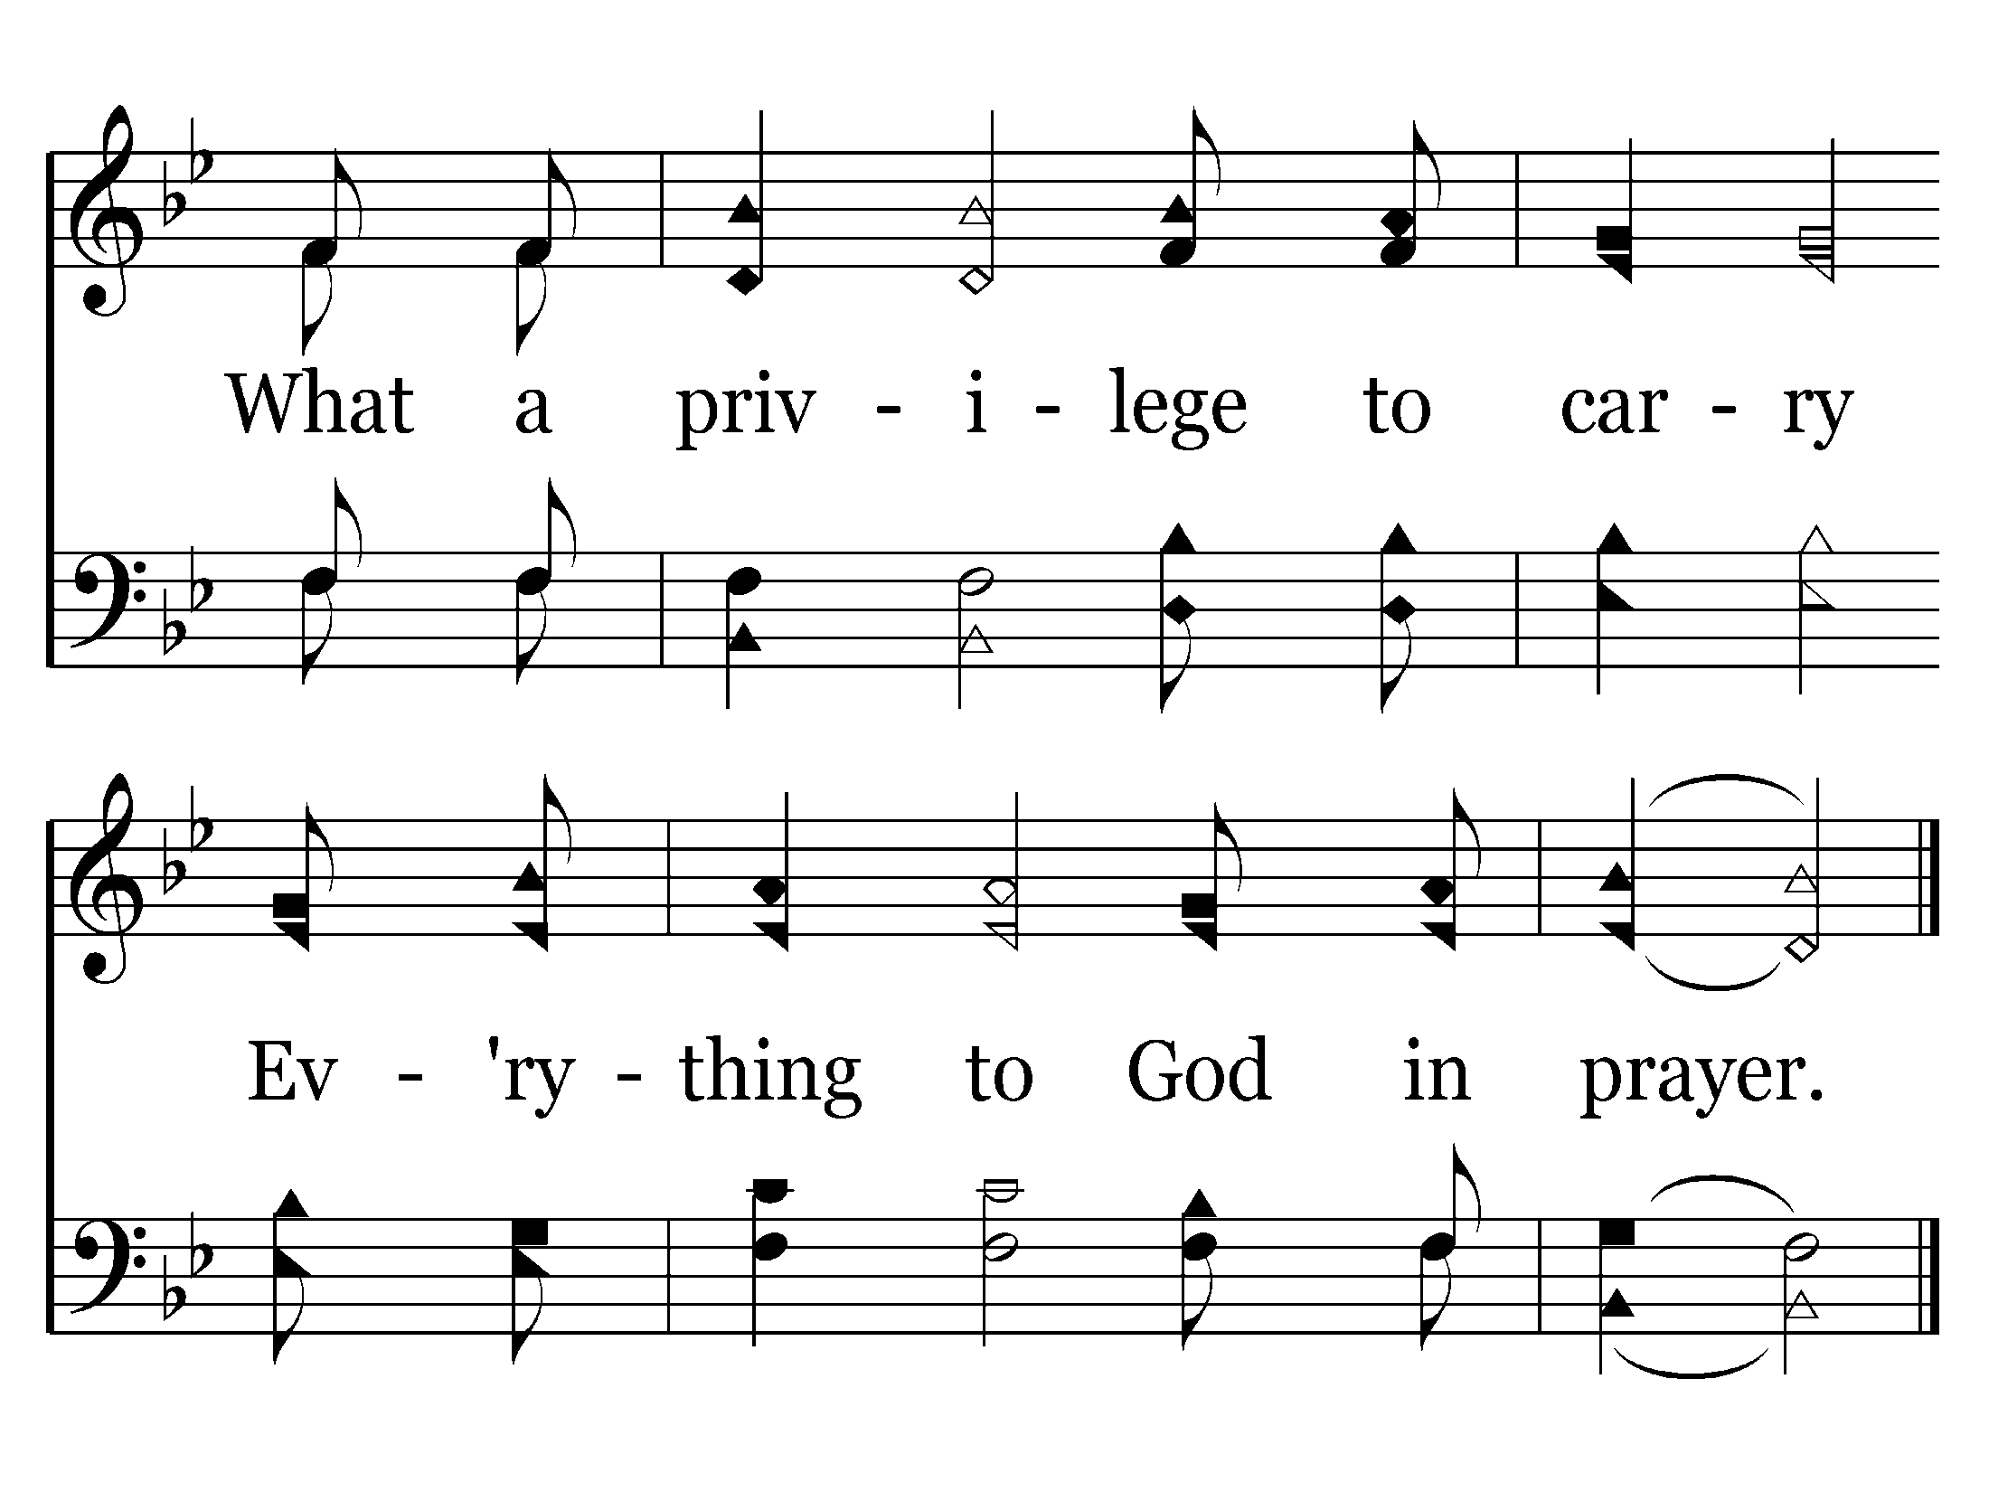
013 - Alleluia - 3.2
End of Verse 3

Slide 21
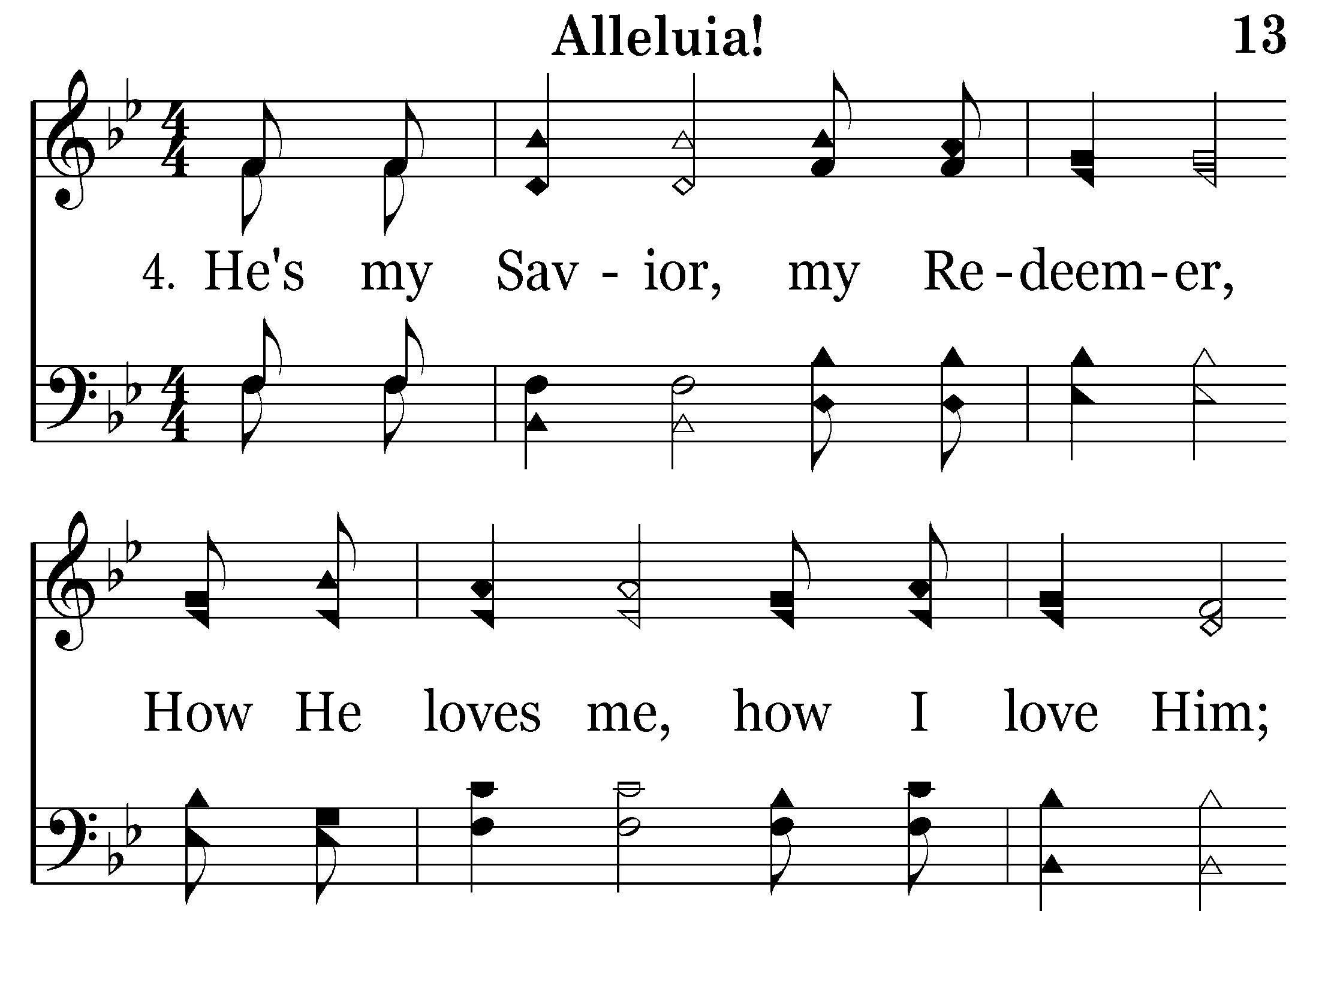
013 - Alleluia - 4.1

Slide 22
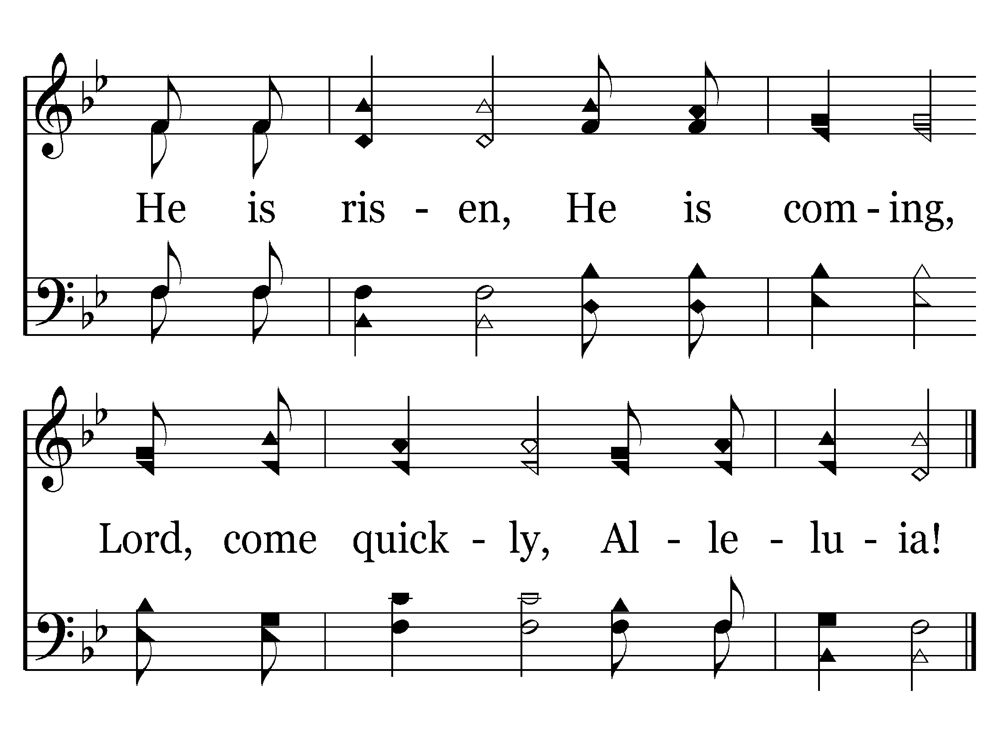
013 - Alleluia - 4.2
End of Song

Slide 23


Slide 24
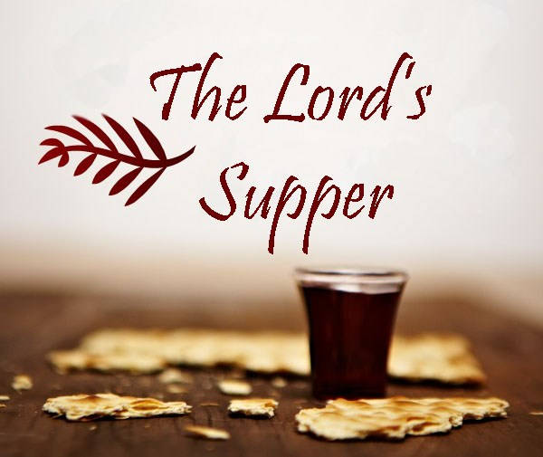
What, When & How Often?

Slide 25
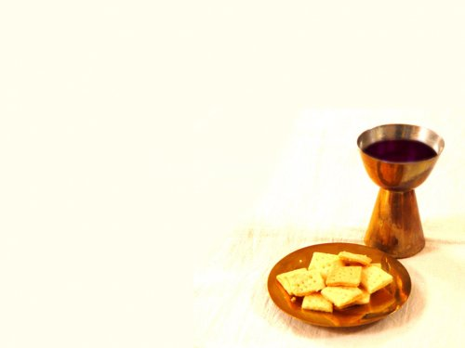
Introduction
Jesus said,
“You worship what you do not know; we know what we worship, for salvation is of the Jews. But the hour is coming, and now is, when the true worshipers will worship the Father in spirit and truth; for the Father is seeking such to worship Him. God is Spirit, and those who worship Him must worship in spirit and truth” (John 4:22-24).
What does it mean to “worship in spirit and truth”?

Slide 26
Surely, it means to worship with sincerity of heart and in strict accordance with the revealed will of God.
Joshua had said,“Now therefore, fear the Lord, serve Him in sincerity and in truth, and put away the gods which your fathers served on the other side of the River and in Egypt. Serve the Lord!” (Josh. 24:14).

Slide 27
Introduction
Jesus had condemned the Pharisees on both counts.
"Hypocrites! Well did Isaiah prophesy about you, saying: 'These people draw near to Me with their mouth, And honor Me with their lips, But their heart is far from Me. And in vain they worship Me, Teaching as doctrines the commandments of men.‘” (Matt. 15:7-9)
They were not worshiping in either spirit or truth!

Slide 28
Introduction
In view of this twofold condemnation and the explicit statement by Jesus, can anyone living today afford to be wrong in this matter?
Surely no one can!

Slide 29
An examination of worship
The apostles and other early Christians engaged in five acts of collective worship:
(1) Studying God’s word
(2) Eating the Lord’s Supper
(3) Praying to God
(4) Singing
(5) Giving
Let us examine the second one in this lesson.

Slide 30
What are the proper elements?
According to Matthew, Mark & Luke, Jesus instituted the Lord‘s Supper on “the first day of the Feast of Unleavened Bread,” “when they killed the Passover lamb.”

Slide 31
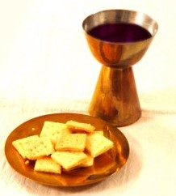
What are the proper elements?
On this day, after eating the Passover, Jesus “took bread, gave thanks and broke it, and gave it to them, saying, ‘This is My body which is given for you; do this in remembrance of Me."
(Luke 22:19)

Slide 32
What are the proper elements?
Afterward, Jesus took the cup, and gave thanks, and gave it to them, saying, "Drink from it, all of you. For this is My blood of the new covenant, which is shed for many for the remission of sins. But I say to you, I will not drink of this fruit of the vine from now on until that day when I drink it new with you in My Father’s kingdom." (Matt. 26:27-29)

Slide 33
What are the proper elements?
Thayer says the word for “bread” refers to “food composed of flour mixed with water and baked; the Israelites made it in a form of an oblong or round cake, as thick as one’s thumb, and as large as a plate or platter … hence it was not cut, but broken.”
When used in the plural form, the word is translated “loaves.”

Slide 34
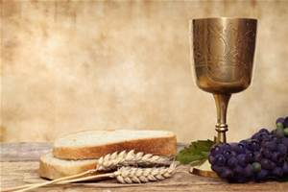
While we cannot tell from the word itself whether the bread contained leaven, which would cause the dough to rise, the Law of Moses prohibited the very presence of leaven in the homes of the Jews during this time.

Slide 35
"You shall eat no leavened bread with it; seven days you shall eat unleavened bread with it, that is, the bread of affliction (for you came out of the land of Egypt in haste), that you may remember the day in which you came out of the land of Egypt all the days of your life. And no leaven shall be seen among you in all your territory for seven days…“ (Deuteronomy 16:3-4)

Slide 36

Exodus 12:11-20
"And thus you shall eat it: with a belt on your waist, your sandals on your feet, and your staff in your hand. So you shall eat it in haste. It is the Lord's Passover. For I will pass through the land of Egypt on that night, and will strike all the firstborn in the land of Egypt, both man and beast; and against all the gods of Egypt I will execute judgment: I am the Lord.

Slide 37
"Now the blood shall be a sign for you on the houses where you are. And when I see the blood, I will pass over you; and the plague shall not be on you to destroy you when I strike the land of Egypt. So this day shall be to you a memorial; and you shall keep it as a feast to the Lord throughout your generations. You shall keep it as a feast by an everlasting ordinance.

Slide 38
“Seven days you shall eat unleavened bread. On the first day you shall remove leaven from your houses. For whoever eats leavened bread from the first day until the seventh day, that person shall be cut off from Israel. On the first day there shall be a holy convocation, and on the seventh day there shall be a holy convocation for you. … So you shall observe the Feast of Unleavened Bread, for on this same day I will have brought your armies out of the land of Egypt.

Slide 39
“Therefore you shall observe this day throughout your generations as an everlasting ordinance. In the first month, on the fourteenth day of the month at evening, you shall eat unleavened bread, until the twenty-first day of the month at evening.

Slide 40
“For seven days no leaven shall be found in your houses, since whoever eats what is leavened, that same person shall be cut off from the congregation of Israel, whether he is a stranger or a native of the land. You shall eat nothing leavened; in all your dwellings you shall eat unleavened bread."

Slide 41
What are the proper elements?
And, since Jesus never sinned, He undoubtedly used unleavened bread, when He instituted the Lord’s Supper.
We cannot be wrong in using what He used.
Those who contend that we may use leavened bread bear the burden of proof.
That is, I don’t have to prove they are wrong. They have to prove they are right.

Slide 42
What are the proper elements?
The word, “cup,” refers to “the contents of the cup, what is offered to be drunk,” hence, “the fruit of the vine” or the liquid product of the grape vine.
While the word, “wine,” is often, though not always, used with reference to an intoxicating beverage, it is never used in connection with the Lord’s Supper.
As with leavened bread, those who contend that intoxicating wine may be used in the Lord’s Supper bear the burden of proof.

Slide 43
What are the proper elements?
These are the only elements the Lord has authorized for the Lord’s Supper.
Though condiments (such as margarine, jelly or peanut butter) might give the unleavened bread a better taste, they are unauthorized and would constitute additions.
Any additions or substitutions would result in vain, or empty worship.

Slide 44
When and how often?
Although there is no indication that Jesus - when instituting the Lord’s Supper - told the apostles when, or with what frequency they were to partake, He did imply that it would be done with some degree of frequency.

Slide 45
Matthew 26:29
"But I say to you, I will not drink of this fruit of the vine from now on until that day when I drink it new with you in My Father's kingdom."
The first instance of the word "drink" above means "to drink one time" but the second instance means "to go on drinking" implying repetition.
How often this would be repeated is unstated.
It would, however, recur on a certain "day."

Slide 46
When and how often?
Jesus also told the apostles that the Holy Spirit would guide them into all truth.

Slide 47
John 16:12-13
"I still have many things to say to you, but you cannot bear them now. However, when He, the Spirit of truth, has come, He will guide you into all truth; for He will not speak on His own authority, but whatever He hears He will speak; and He will tell you things to come."

Slide 48
Acts 20:6-7
“These men, going ahead, waited for us at Troas. But we sailed away from Philippi after the Days of Unleavened Bread, and in five days joined them at Troas, where we stayed seven days. Now on the first day of the week, when the disciples came together to break bread, Paul, ready to depart the next day, spoke to them and continued his message until midnight.”
Here we learn by approved apostolic example the "day" on which Jesus drinks the cup with His disciples in His Father’s kingdom.

Slide 49
Why “the first day of the week”?
“Now when He rose early on the first day of the week, He appeared first to Mary Magdalene, out of whom He had cast seven demons.” (Mark 16:9)
It was the day on which He rose from the dead.

Slide 50
Why “the first day of the week”?
“Paul, a bondservant of Jesus Christ, called to be an apostle, separated to the gospel of God which He promised before through His prophets in the Holy Scriptures, concerning His Son Jesus Christ our Lord, who was born of the seed of David according to the flesh, and declared to be the Son of God with power according to the Spirit of holiness, by the resurrection from the dead.” (Romans 1:4)

Slide 51
Why “the first day of the week”?
"And you shall count for yourselves from the day after the Sabbath, from the day that you brought the sheaf of the wave offering: seven Sabbaths shall be completed. Count fifty days to the day after the seventh Sabbath; then you shall offer a new grain offering to the Lord." (Lev. 23:15-16)
This would always be "the first day of the week."

Slide 52
Why “the first day of the week”?
Of those who obeyed the gospel on the first day of Pentecost following the death, burial, resurrection & ascension of Jesus Christ, it is said:
“And they continued steadfastly in the apostles’ doctrine and fellowship, in the breaking of bread, and in prayers.” (Acts 2:42)

Slide 53
When & how often?
To "continue steadfastly" means, “to endure in … persevere in … give unremitting care to” something; this implies frequency of recurrence.
If no particular frequency were ever given in Scripture, we would have generic authority for any frequency we might choose.

Slide 54
When & how often?
If a particular frequency has been given, however, whether by command or approved example, we have no choice in the matter.
When God told the Jews, “Remember the Sabbath day, to keep it holy” (Ex. 20:8) --
They understood that they were to remember it every time it rolled around, which was once a week.

Slide 55
When & how often?
Since the first day of the week is the only day authorized for eating the Lord’s Supper, a weekly frequency is authorized in the example of the disciples at Troas.
There is no reason to suppose the disciples at Troas would continue any more steadfastly in the breaking of bread than the disciples at Jerusalem.
Neither is there any reason to assume the disciples at Jerusalem would continue any more or less steadfastly in the breaking of bread than the disciples at Troas.

Slide 56
When & how often?
Supposition and assumption do not authorize.
Therefore, no greater or lesser frequency of partaking is authorized anywhere.
Thus, those who partake monthly, quarterly or semi-annually do so without divine authority.

Slide 57
To Summarize---
What?
When?
How Often?
Unleavened Bread & Grape Juice
First day of the week
Every Sunday

Slide 58
What, When & How Often?

