Slide 1
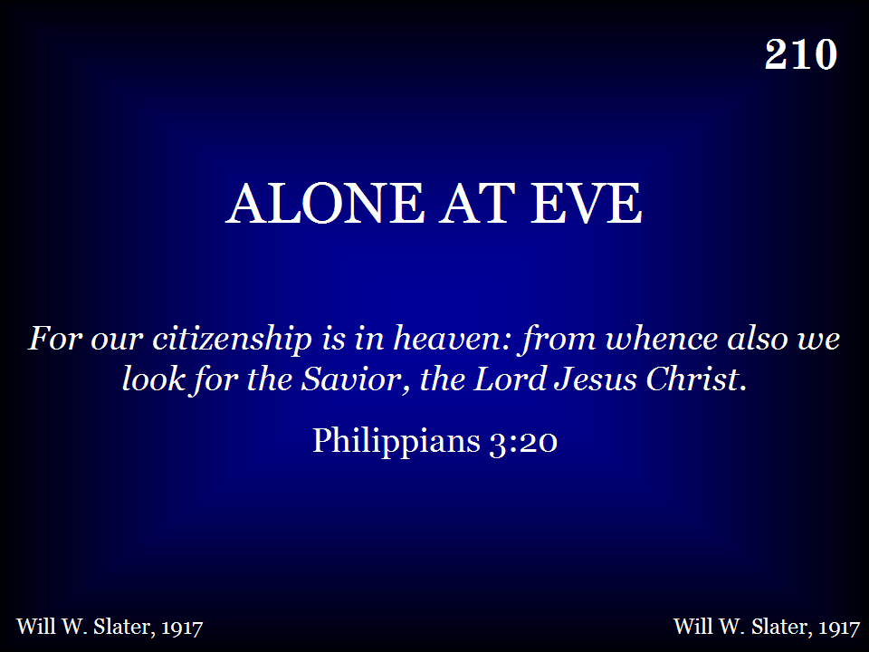
210 - Alone At Eve - Title

Slide 2
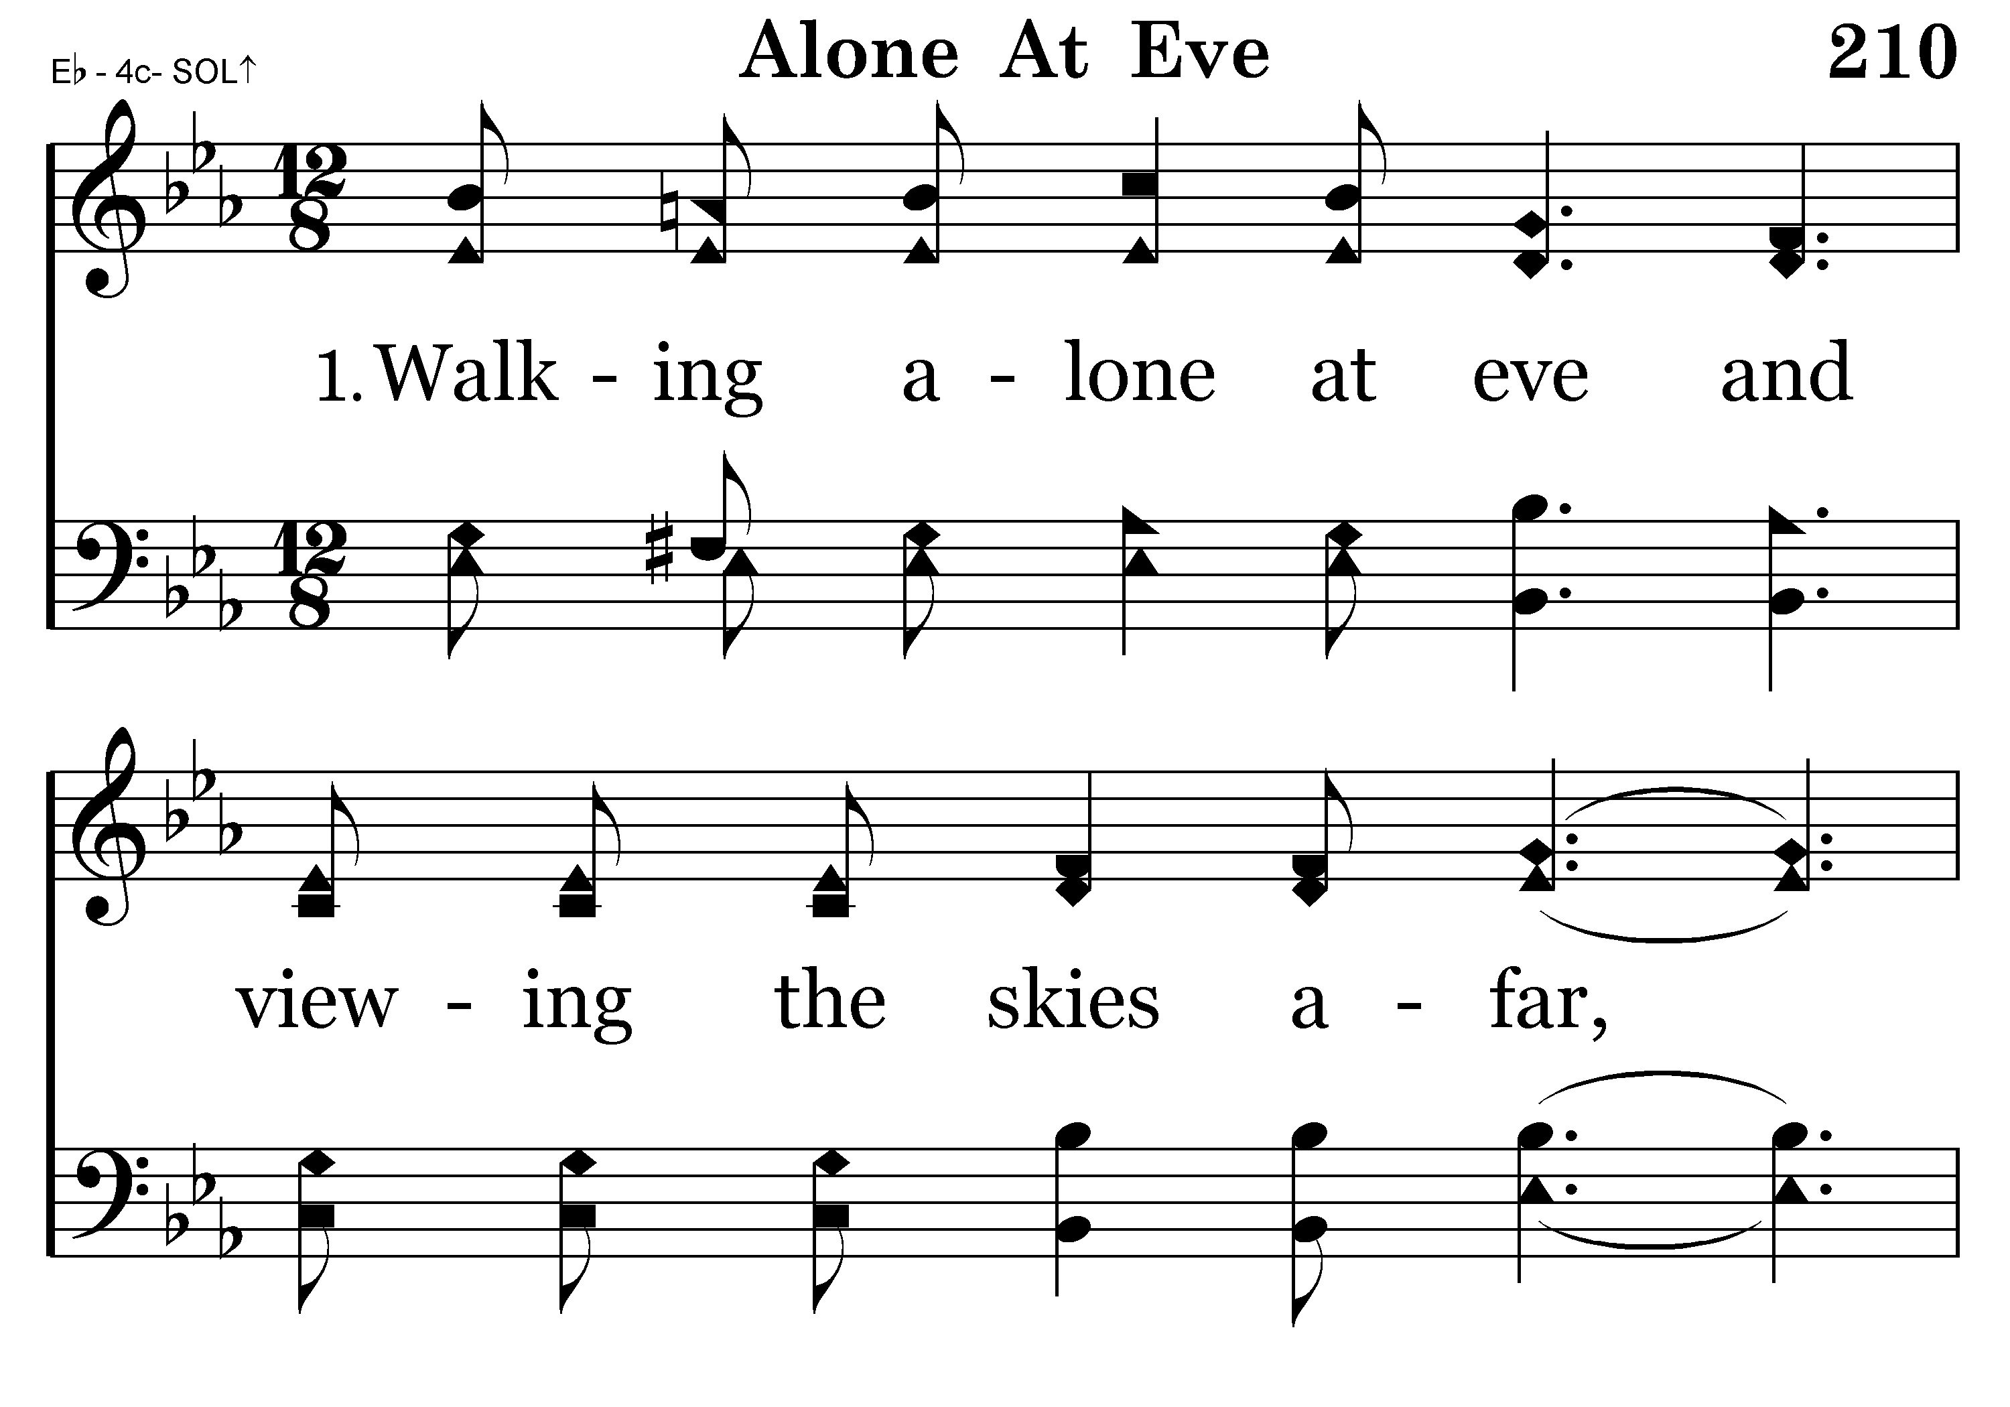
210 - Alone At Eve - 1.1

Slide 3
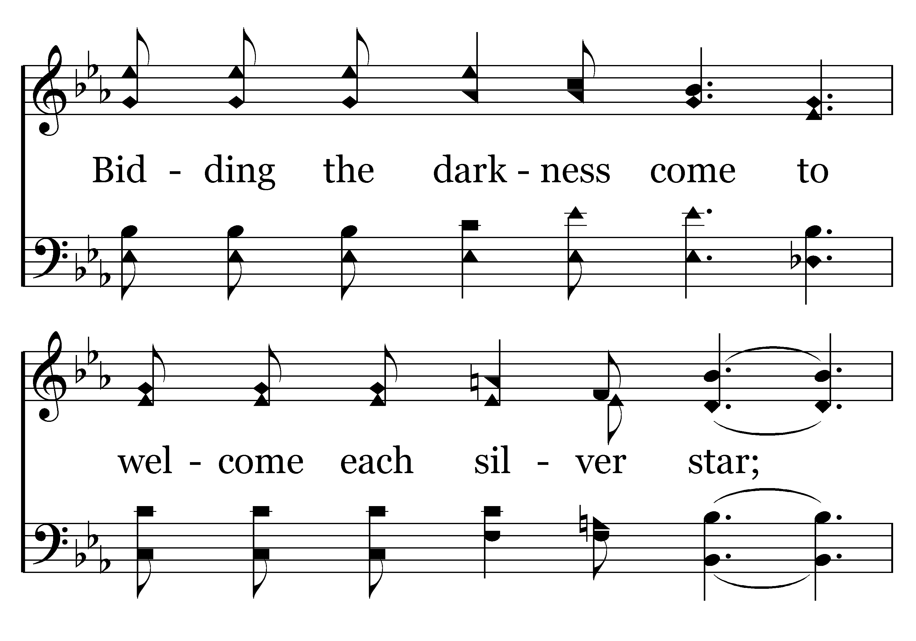
210 - Alone At Eve - 1.2

Slide 4
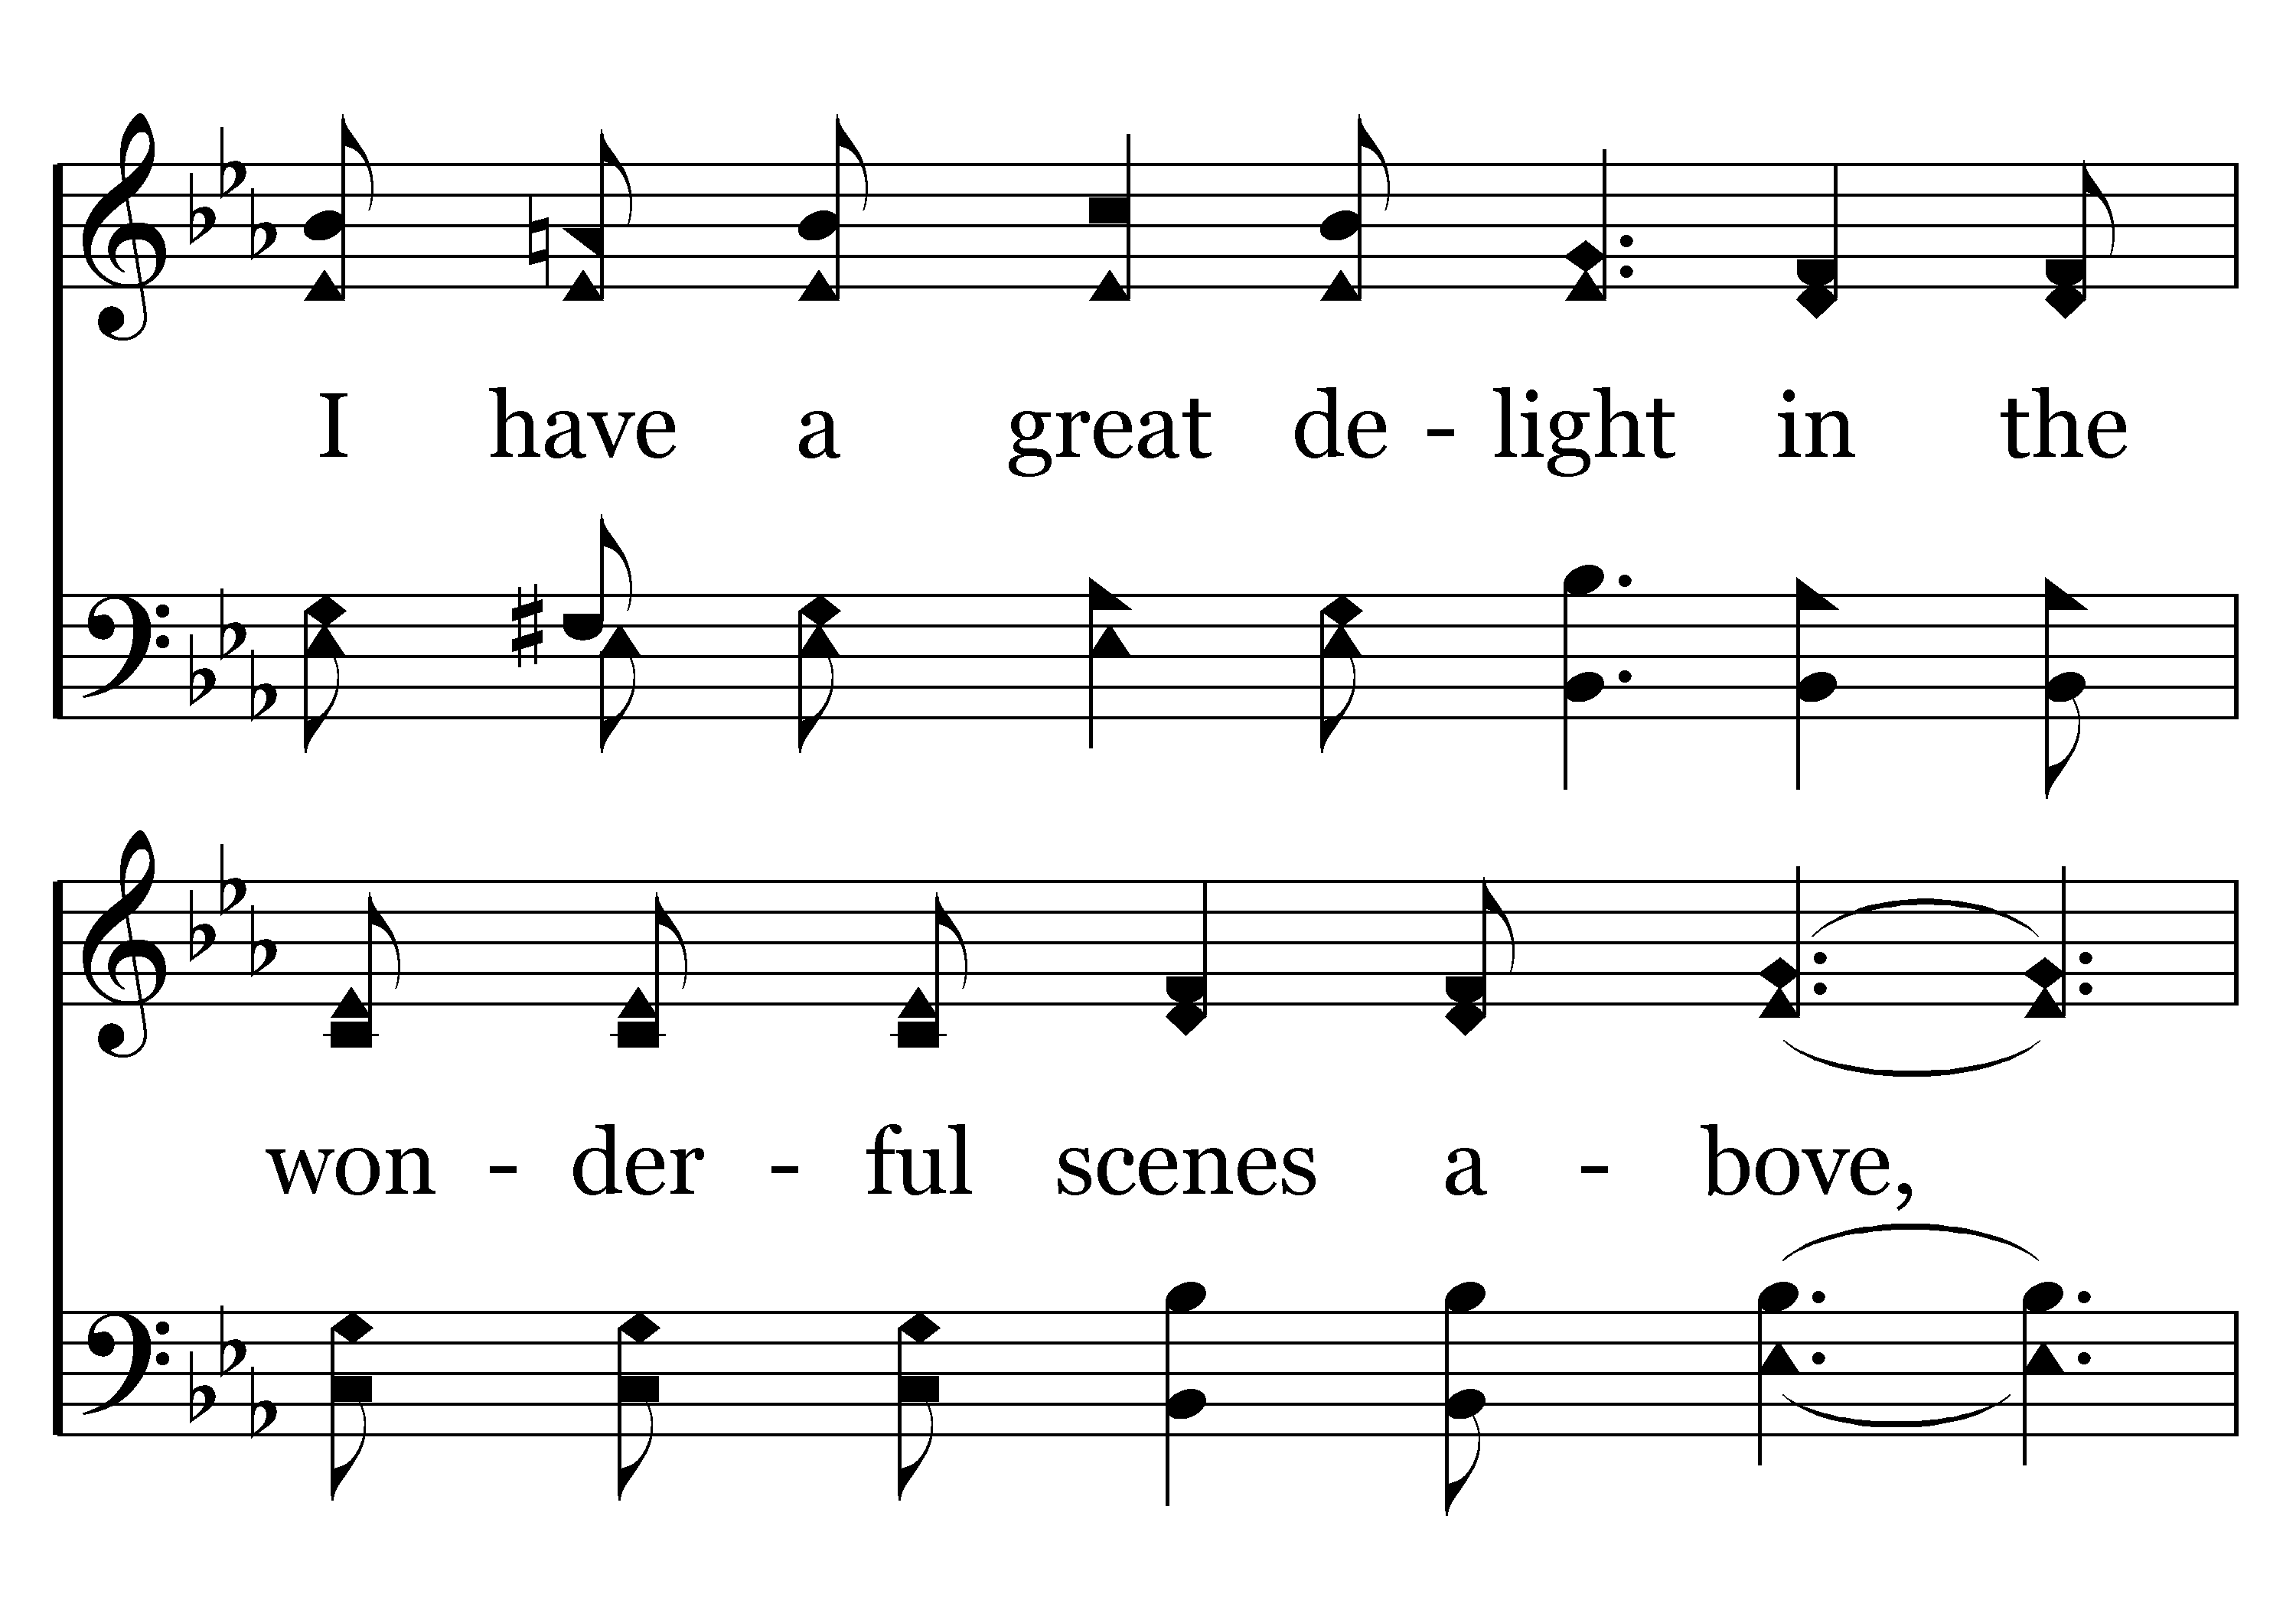
210 - Alone At Eve - 1.3

Slide 5
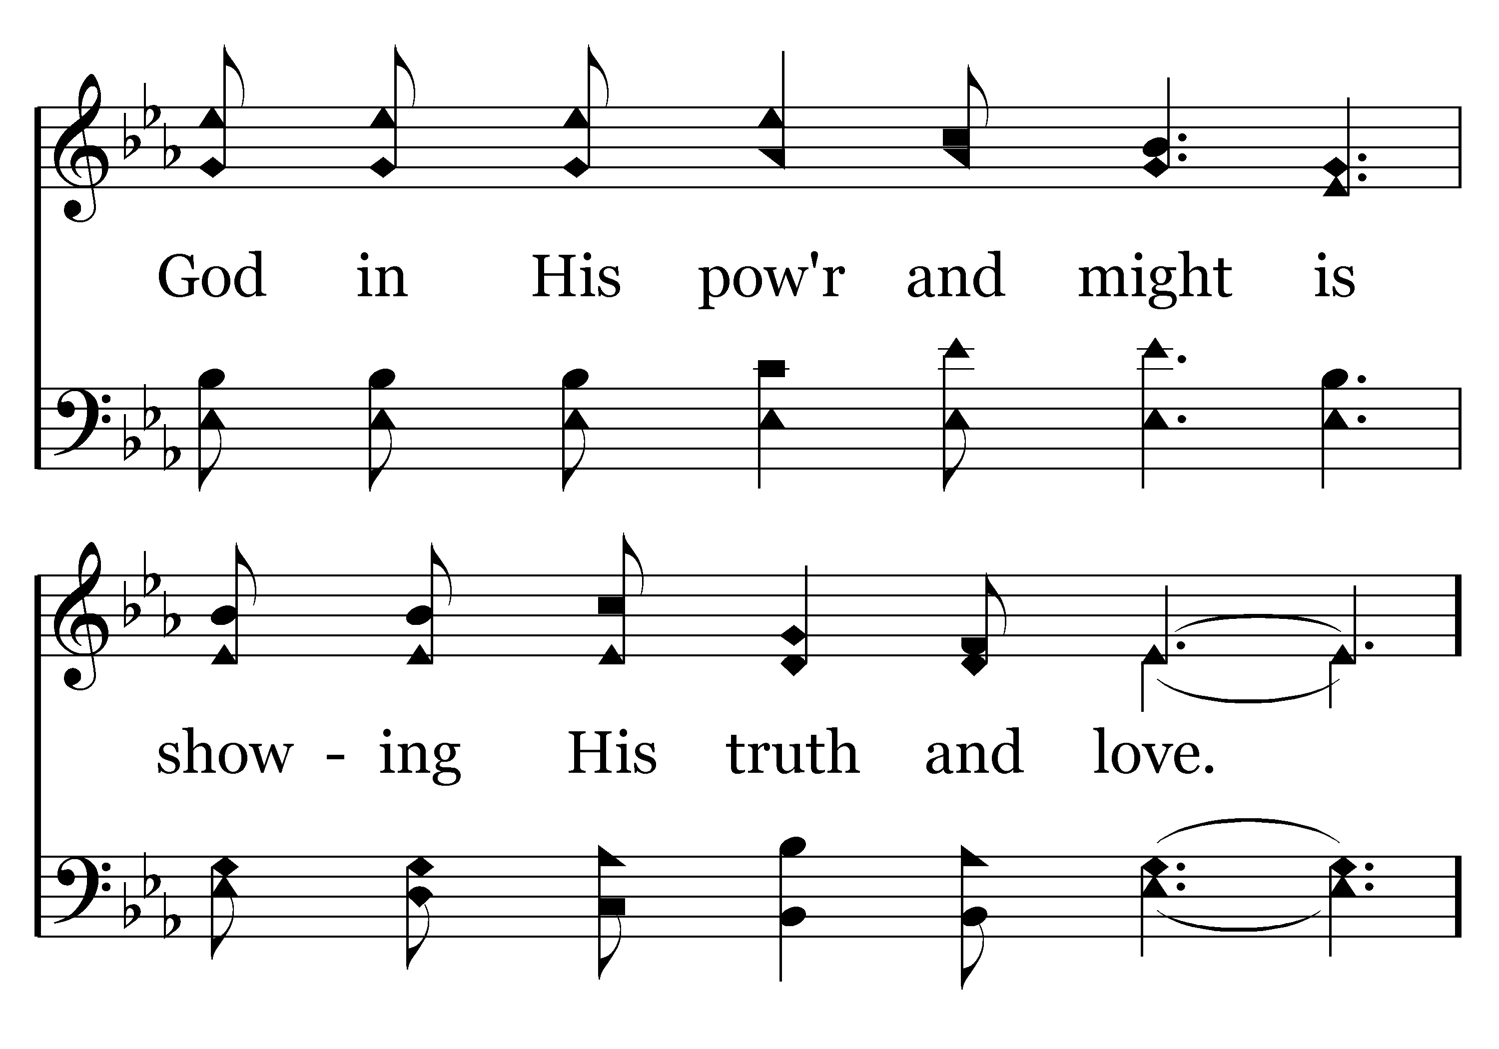
210 - Alone At Eve - 1.4

Slide 6
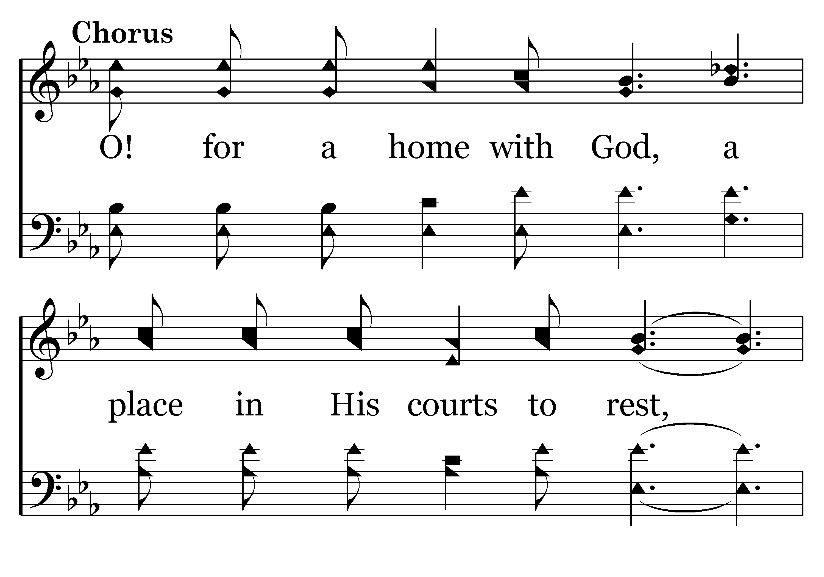
210 - Alone At Eve - C.1

Slide 7
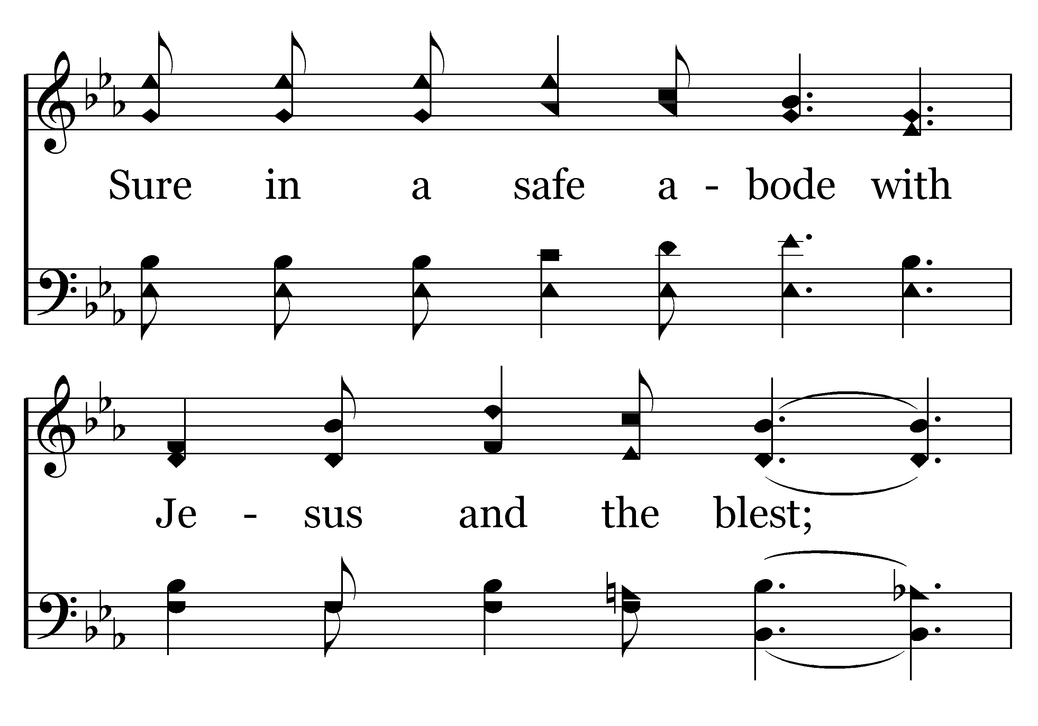
210 - Alone At Eve - C.2

Slide 8
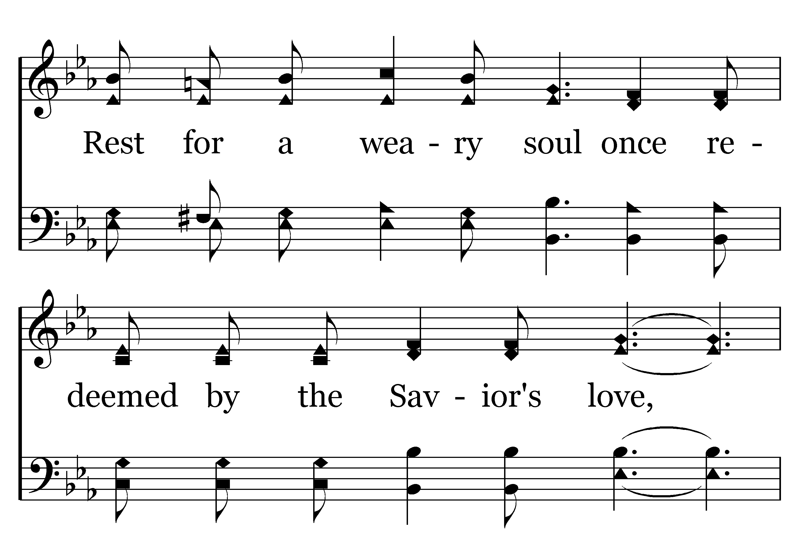
210 - Alone At Eve - C.3

Slide 9
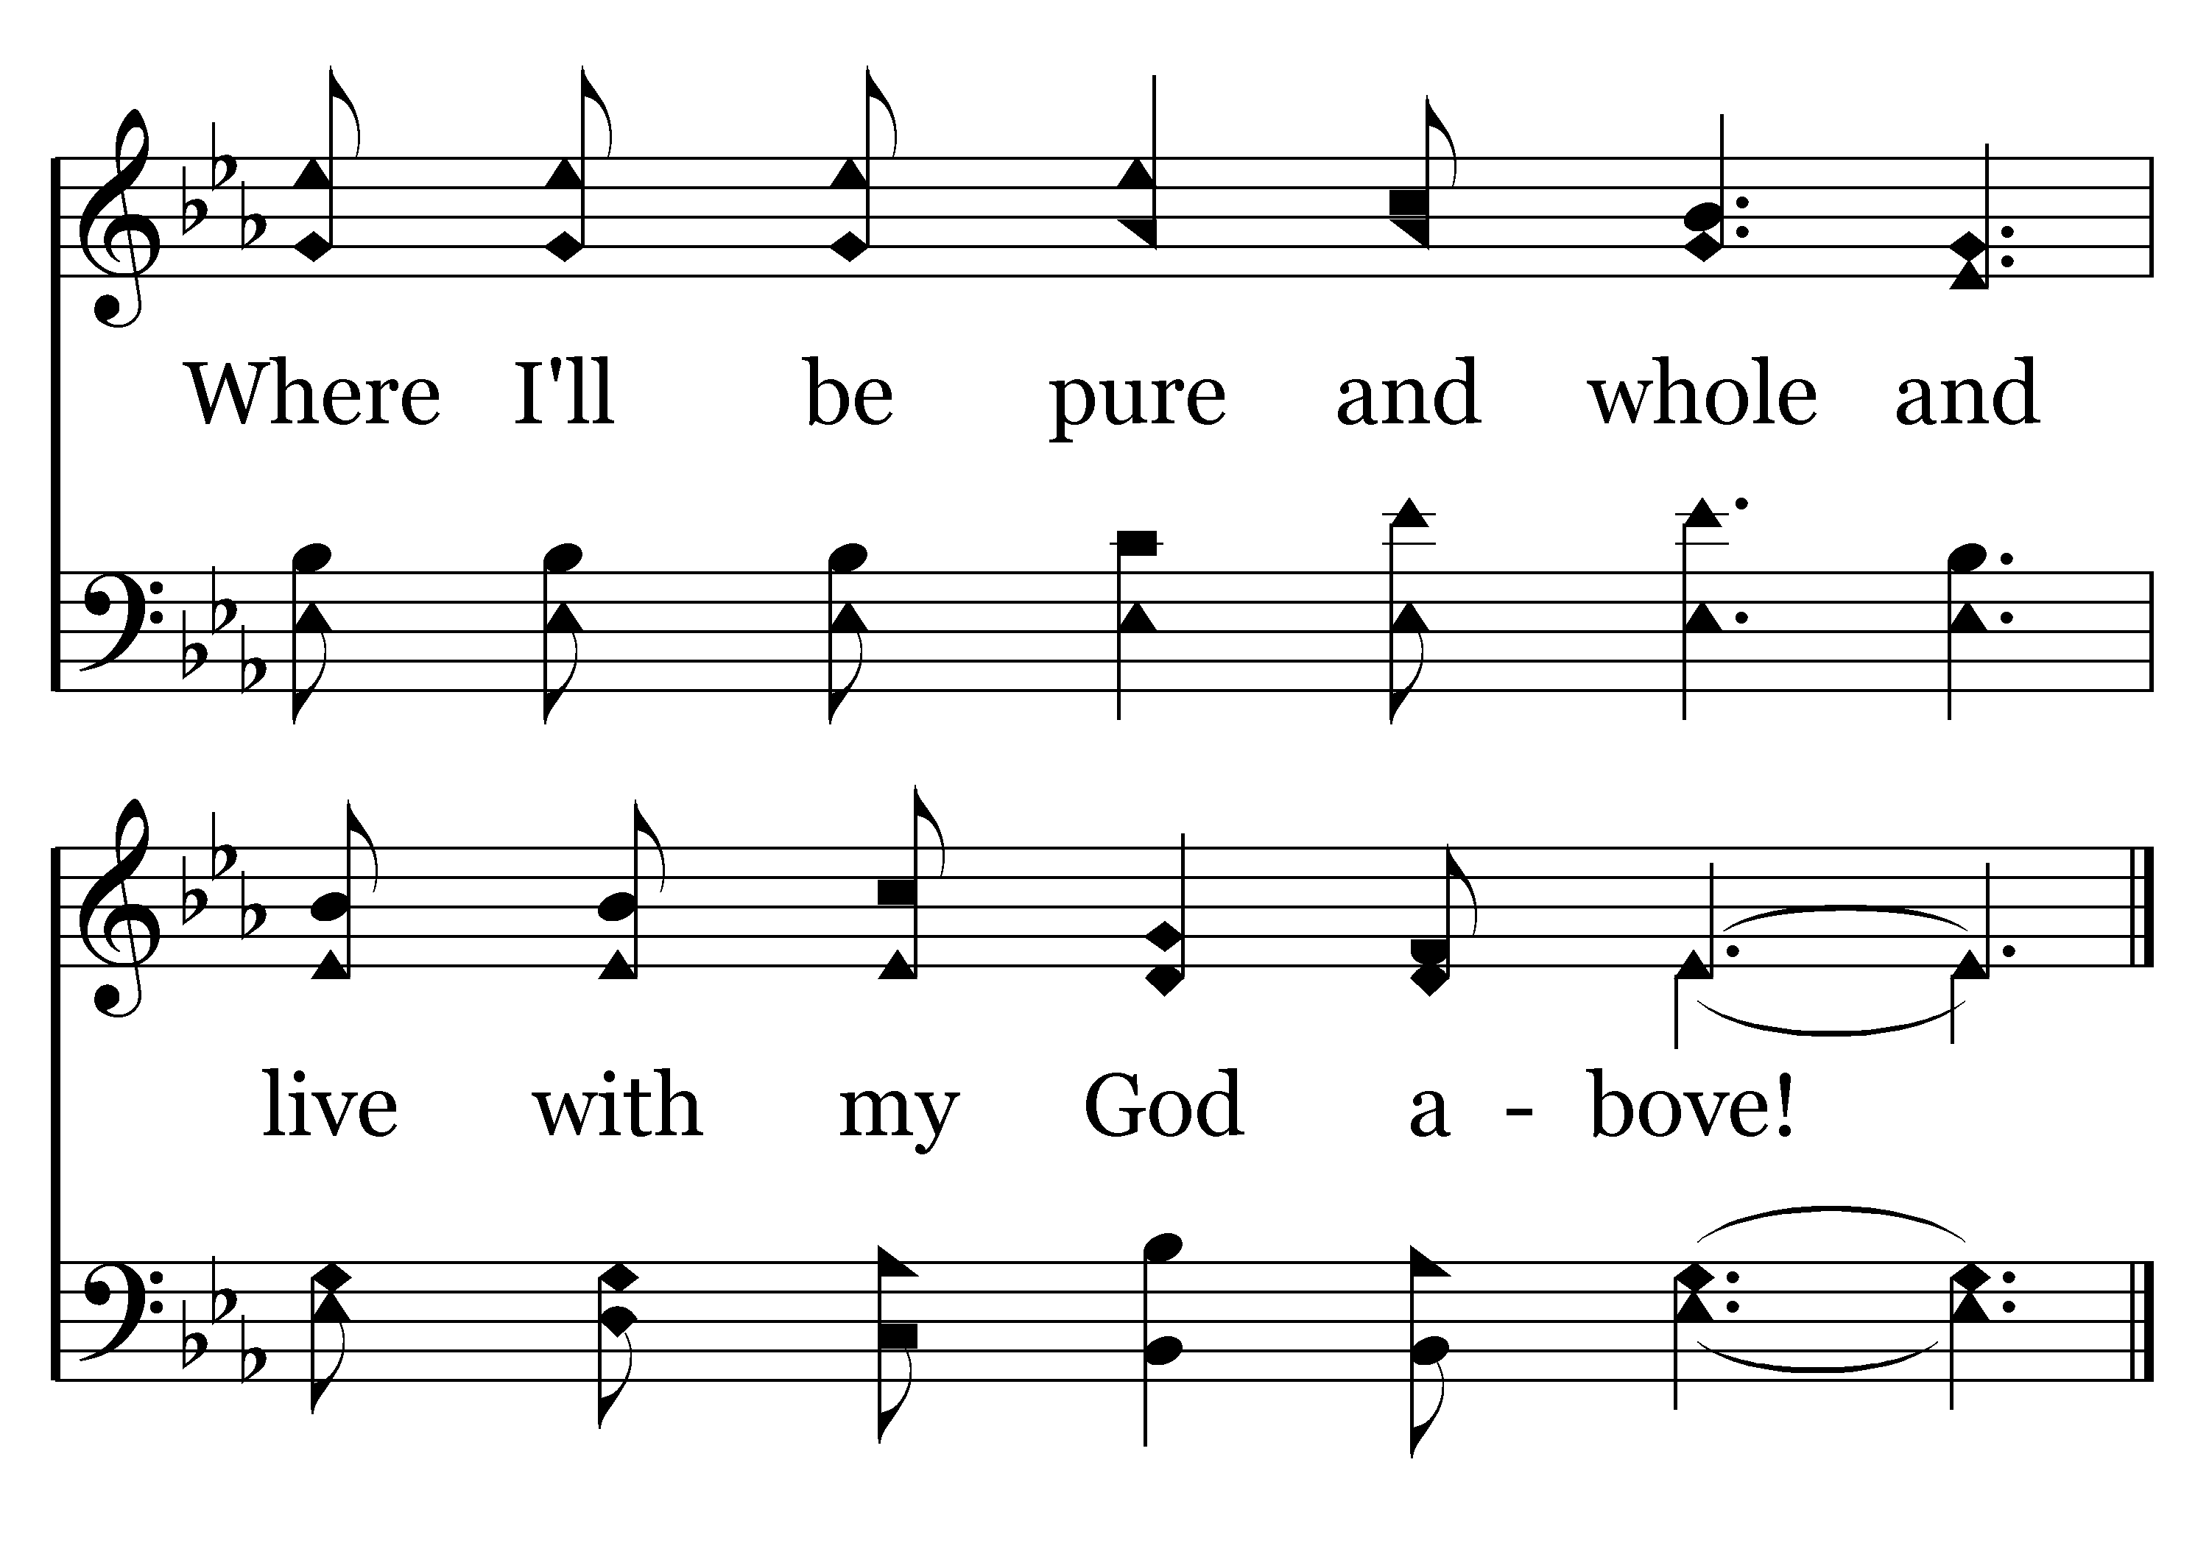
210 - Alone At Eve - C.4
End of Verse 1

Slide 10
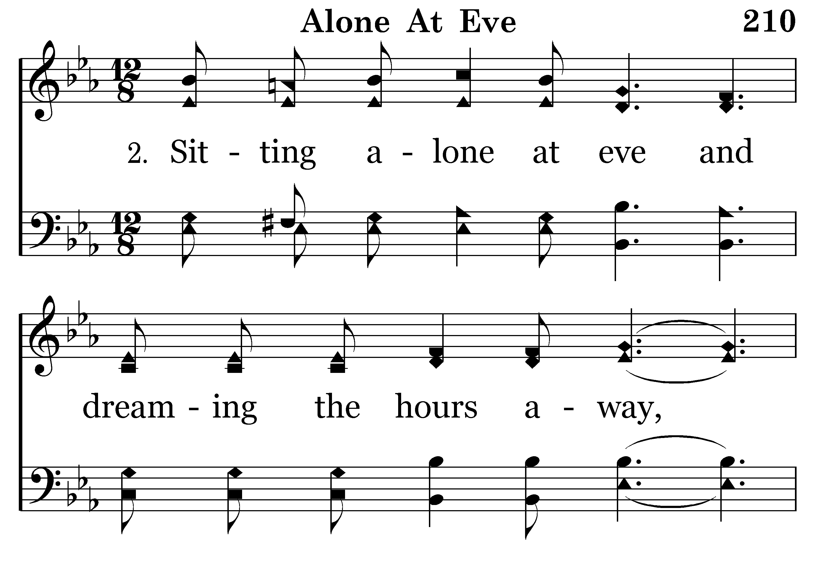
210 - Alone At Eve - 2.1

Slide 11
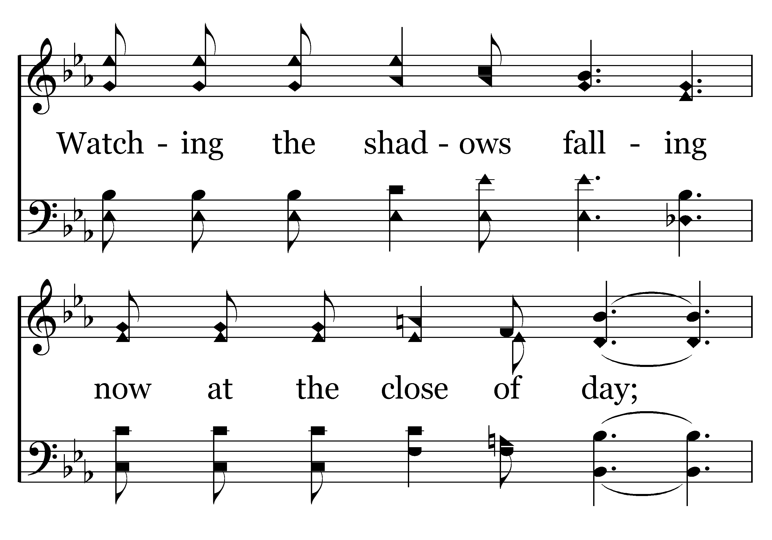
210 - Alone At Eve - 2.2

Slide 12
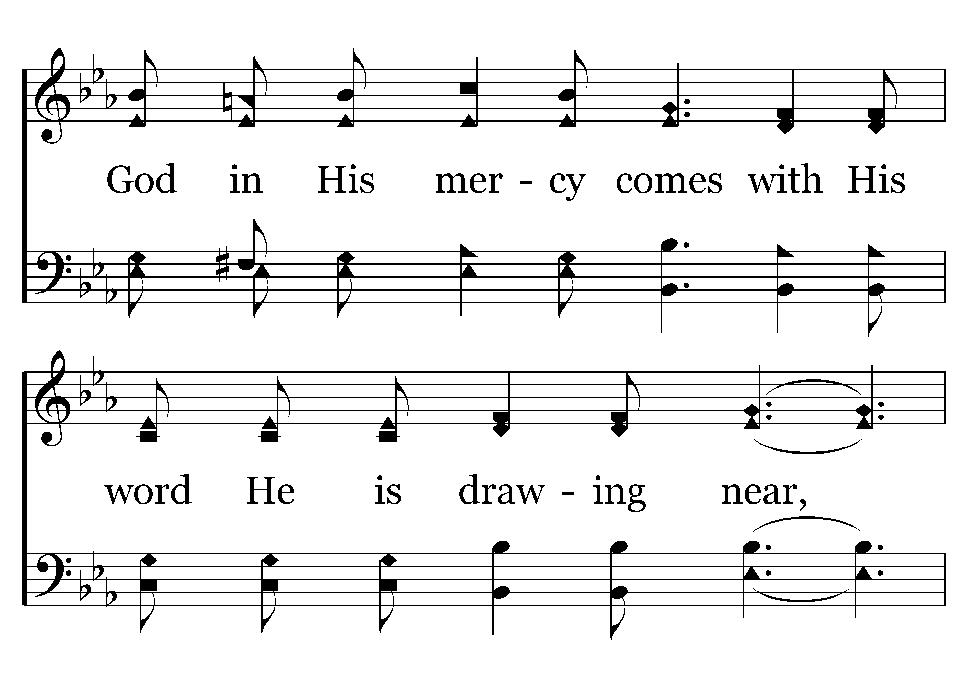
210 - Alone At Eve - 2.3

Slide 13
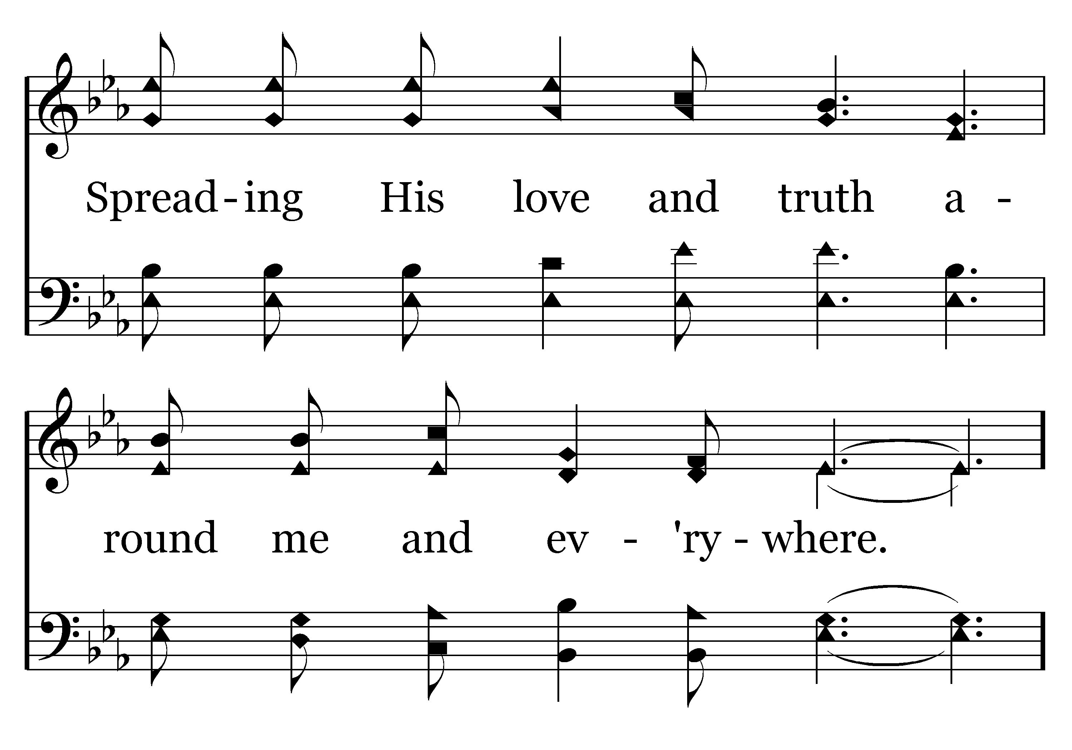
210 - Alone At Eve - 2.4

Slide 14
210 - Alone At Eve - C.1

Slide 15
210 - Alone At Eve - C.2

Slide 16
210 - Alone At Eve - C.3

Slide 17
210 - Alone At Eve - C.4
End of Verse 2

Slide 18
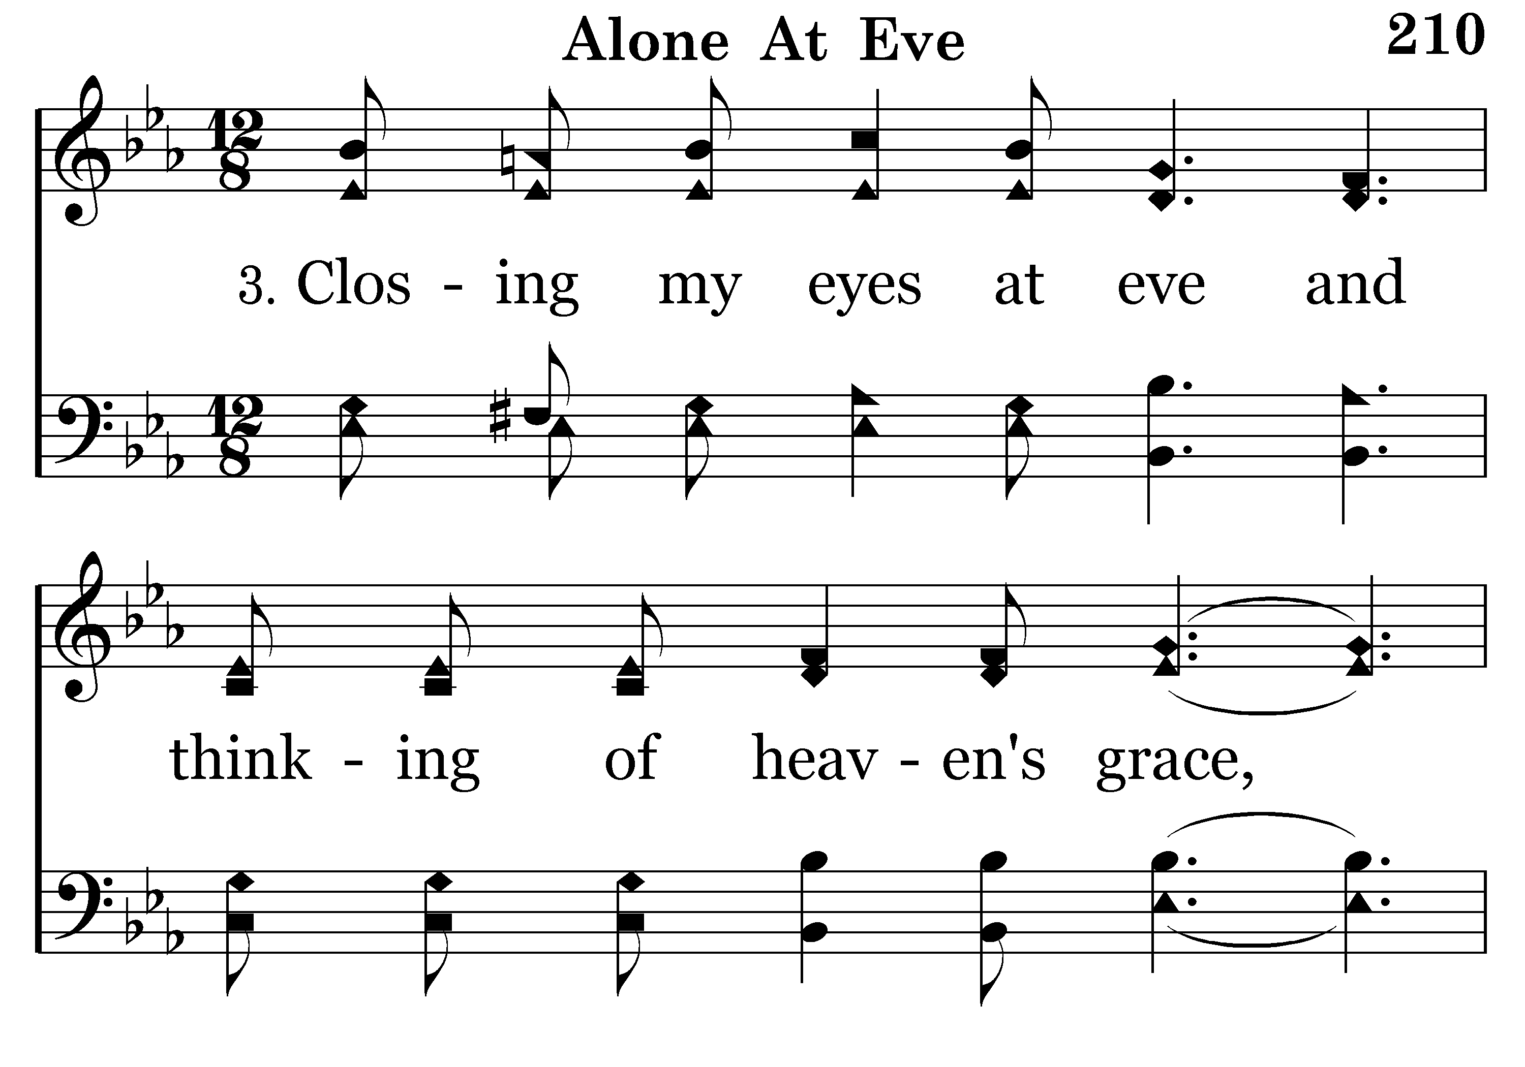
210 - Alone At Eve - 3.1

Slide 19
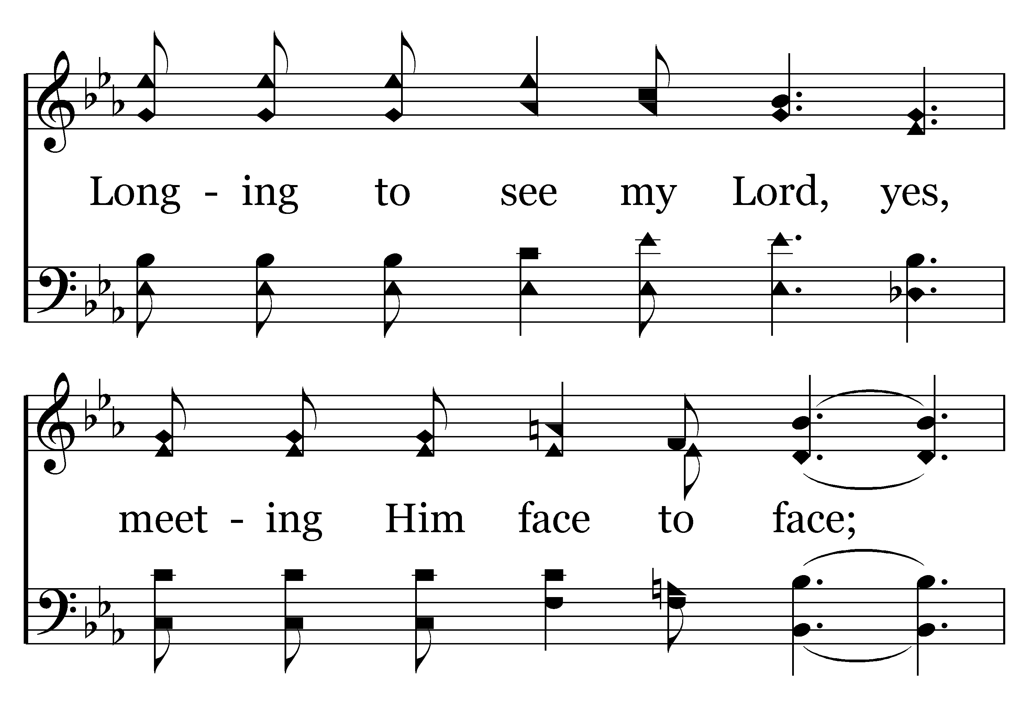
210 - Alone At Eve - 3.2

Slide 20
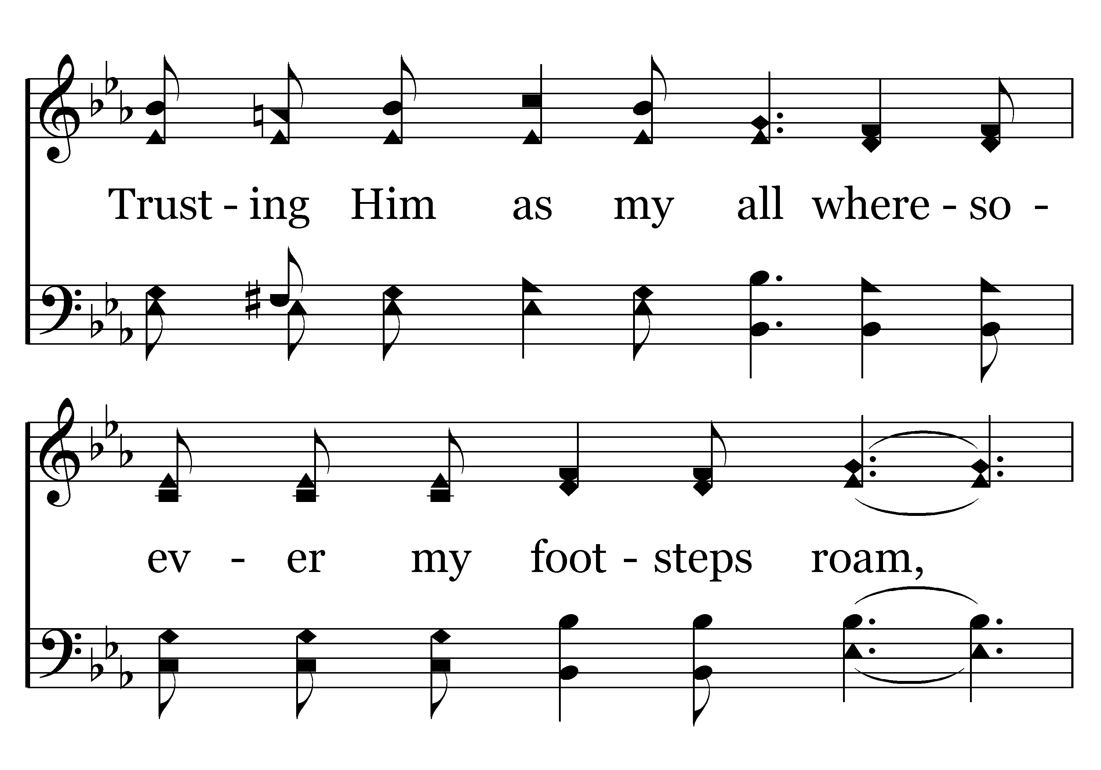
210 - Alone At Eve - 3.3

Slide 21
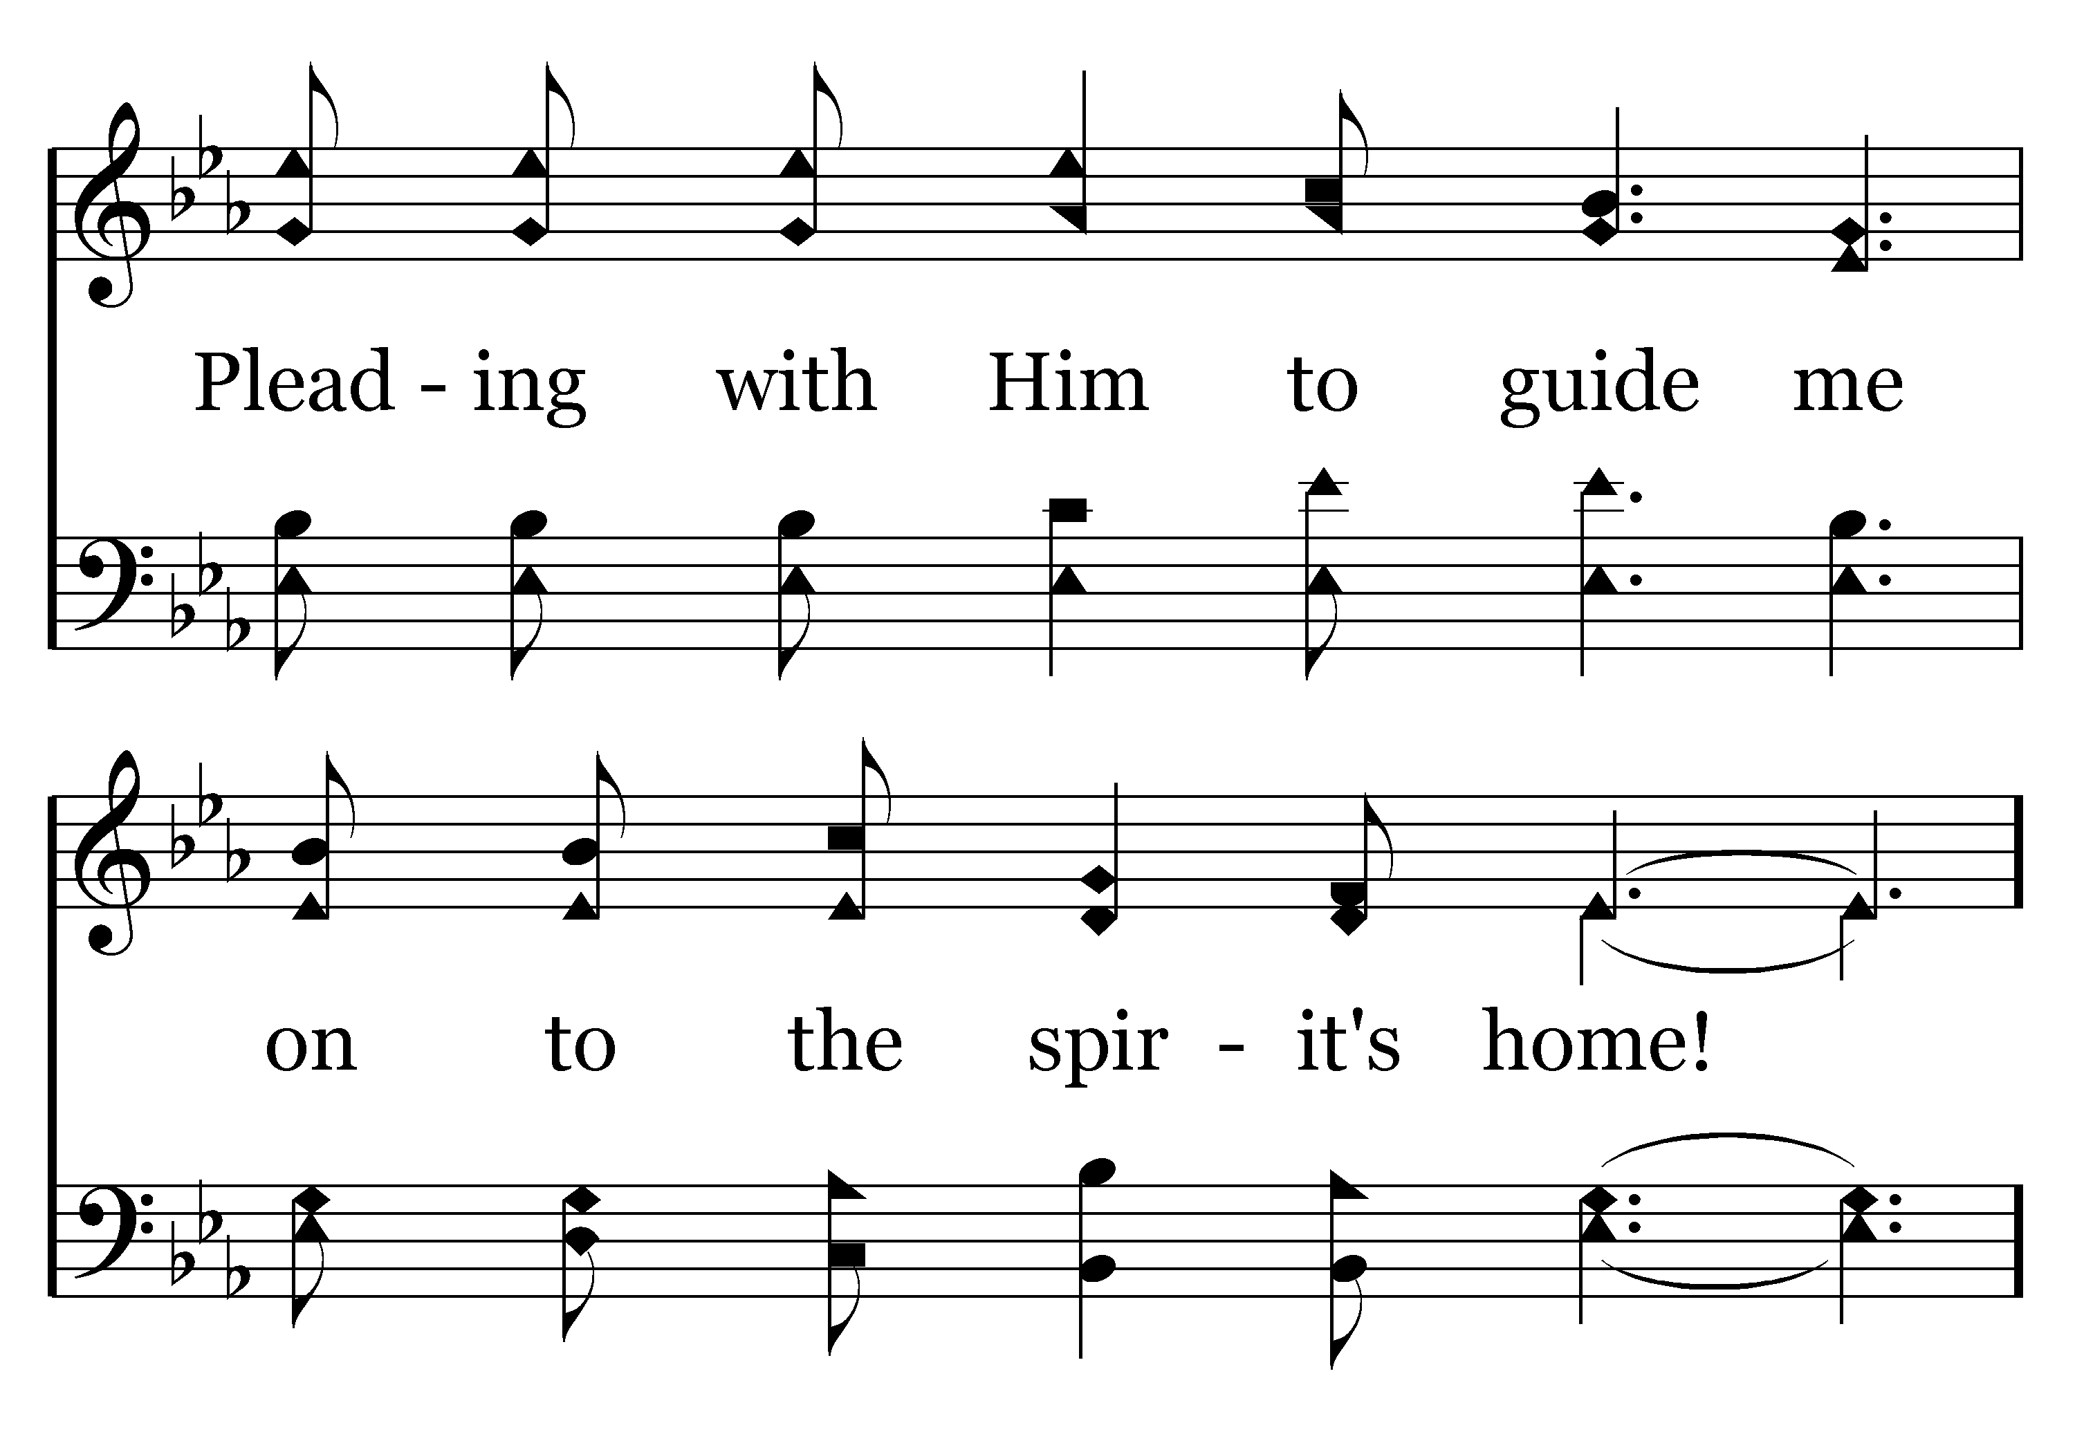
210 - Alone At Eve - 3.4

Slide 22
210 - Alone At Eve - C.1

Slide 23
210 - Alone At Eve - C.2

Slide 24
210 - Alone At Eve - C.3

Slide 25
210 - Alone At Eve - C.4
End of Song

Slide 26

109 - O Fill My Cup - Title

Slide 27
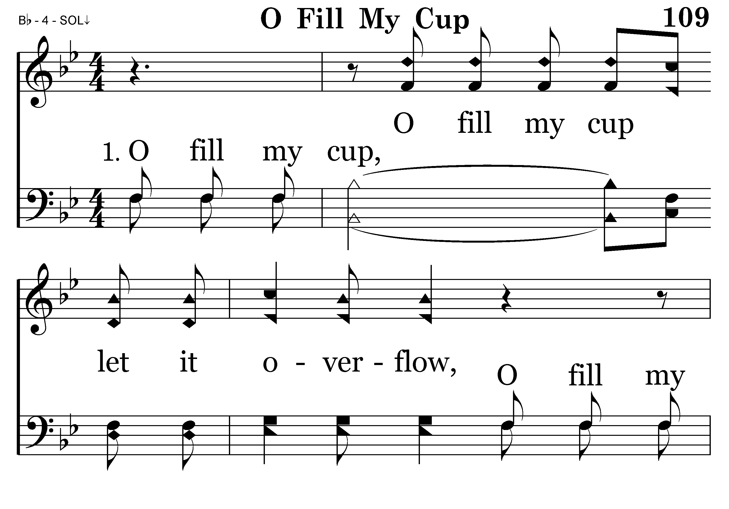
109 - O Fill My Cup - 1.1

Slide 28
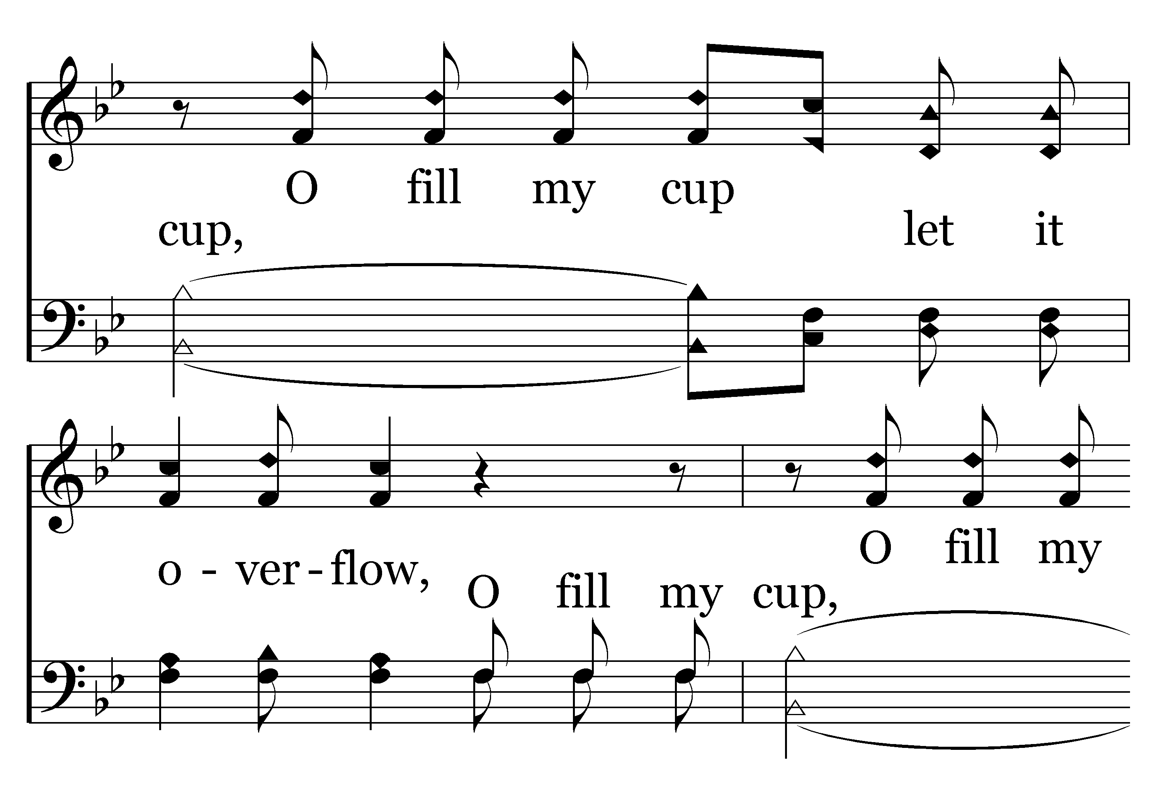
109 - O Fill My Cup - 1.2

Slide 29
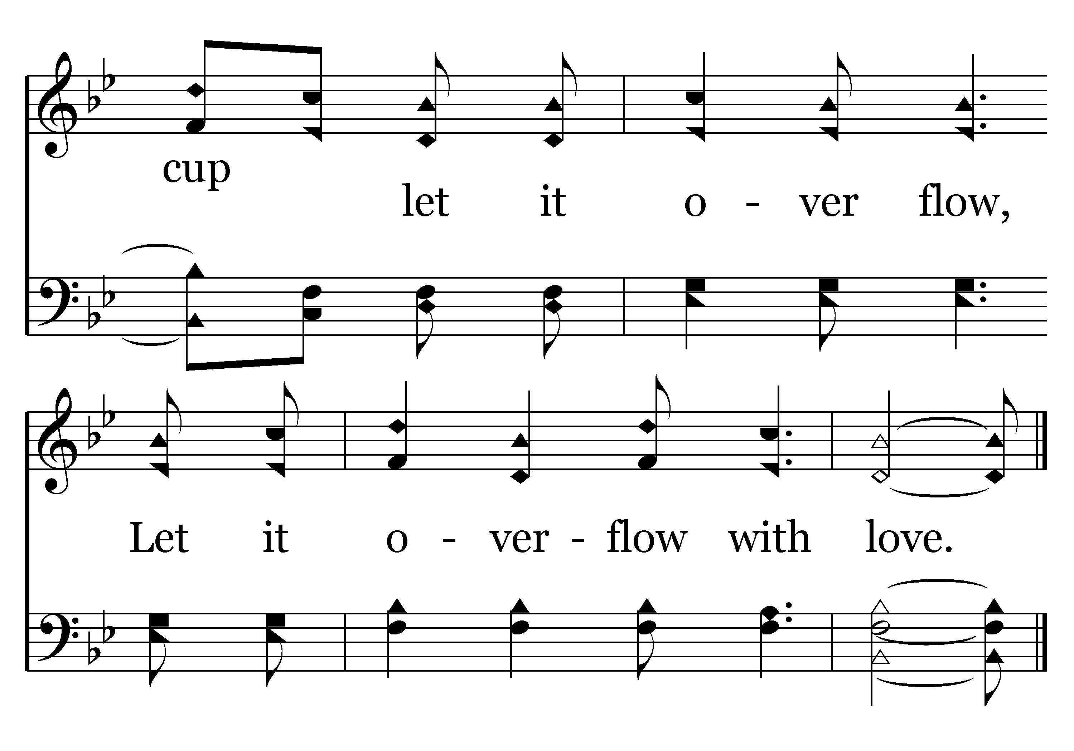
109 - O Fill My Cup - 1.3
End of Verse 1

Slide 30
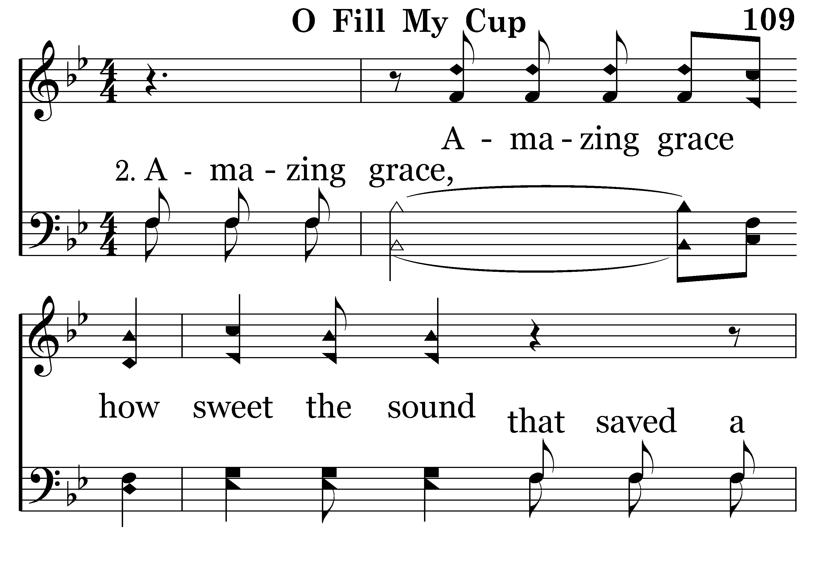
109 - O Fill My Cup - 2.1

Slide 31
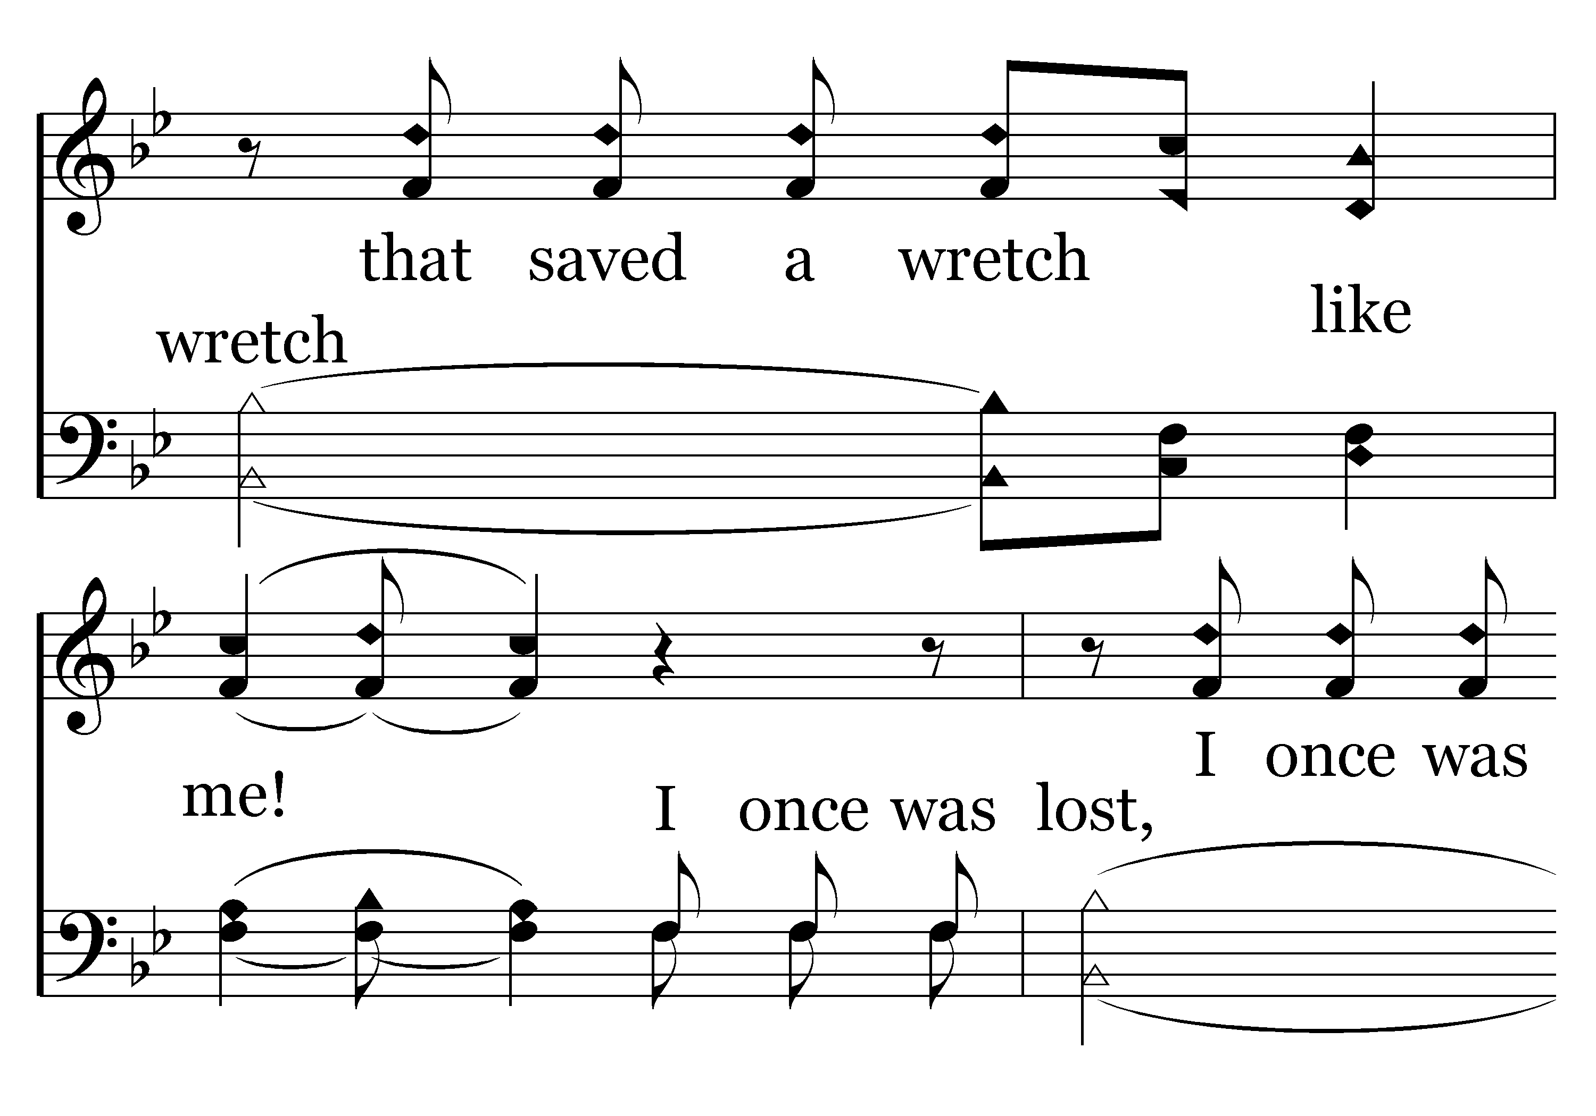
109 - O Fill My Cup - 2.2

Slide 32
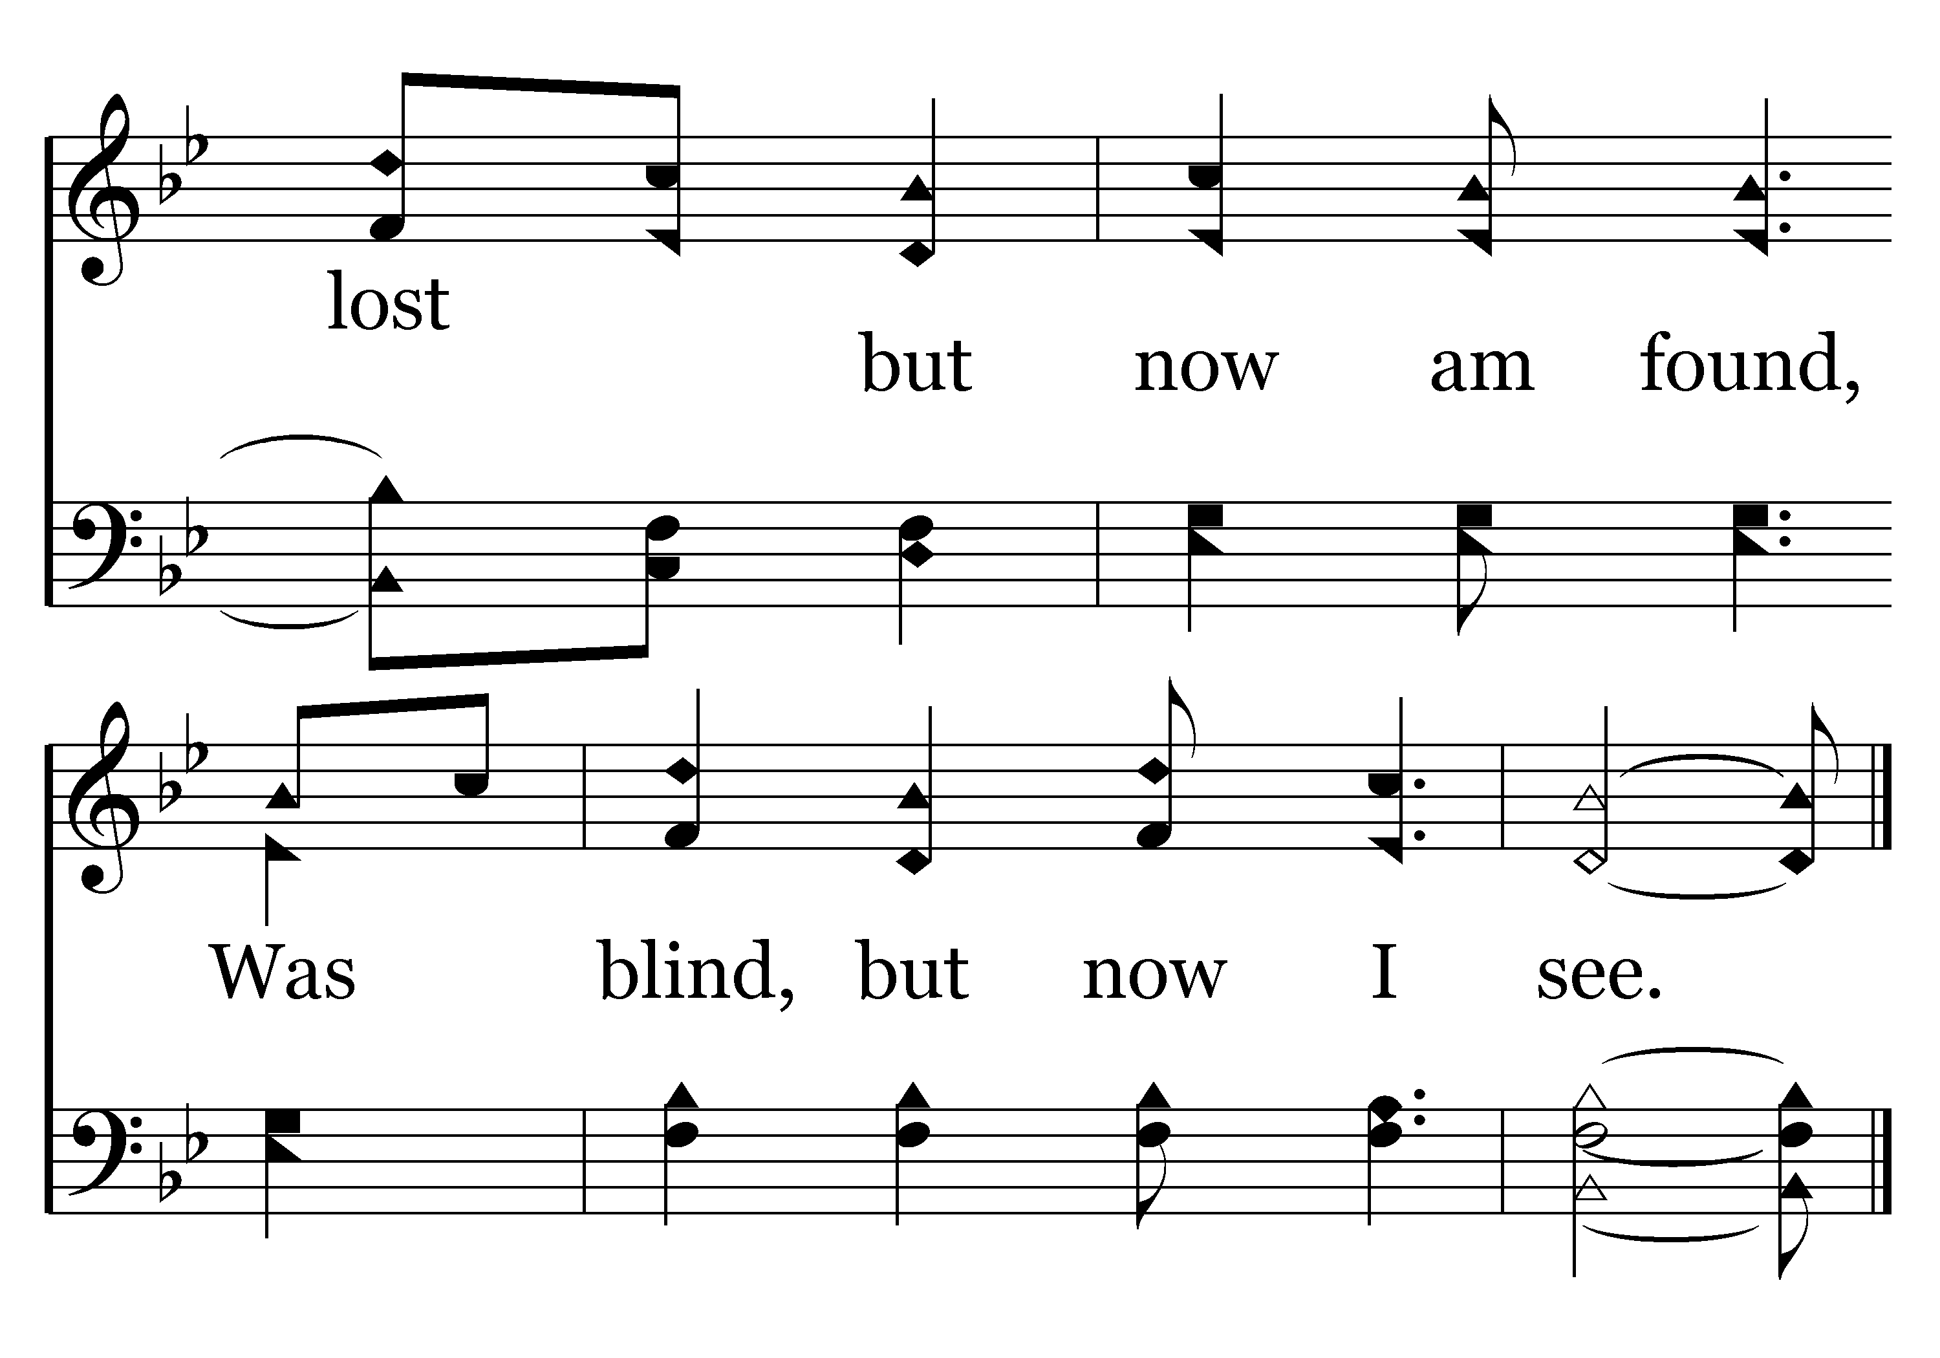
109 - O Fill My Cup - 2.3
End of Verse 2

Slide 33
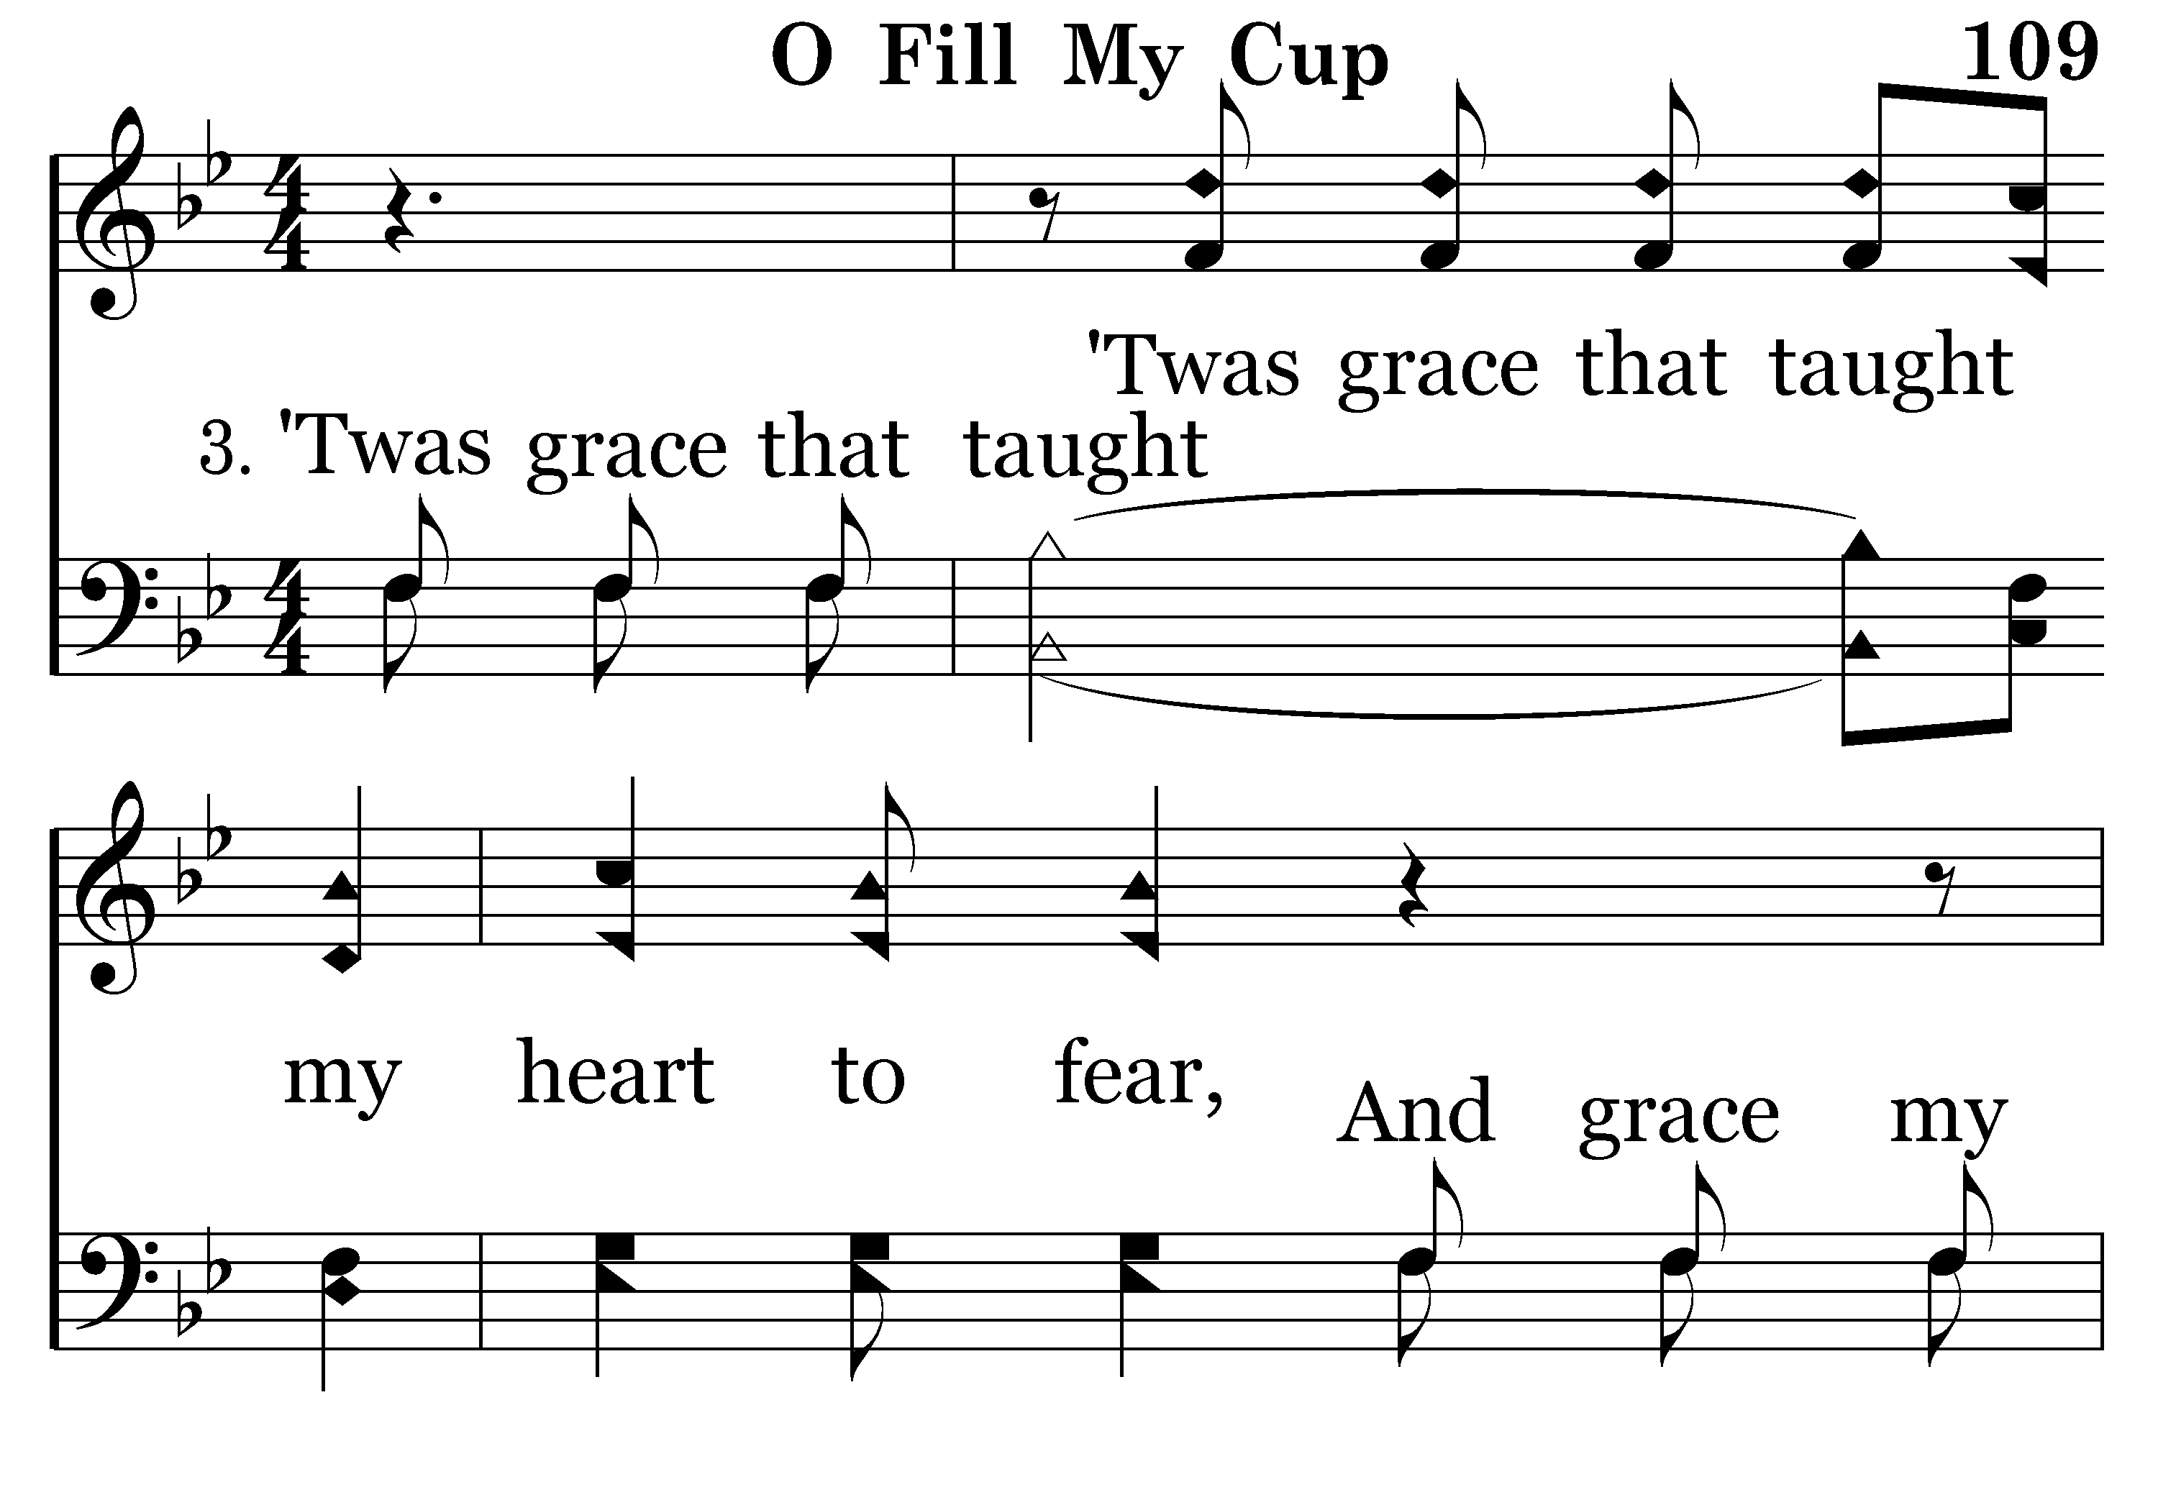
109 - O Fill My Cup - 3.1

Slide 34
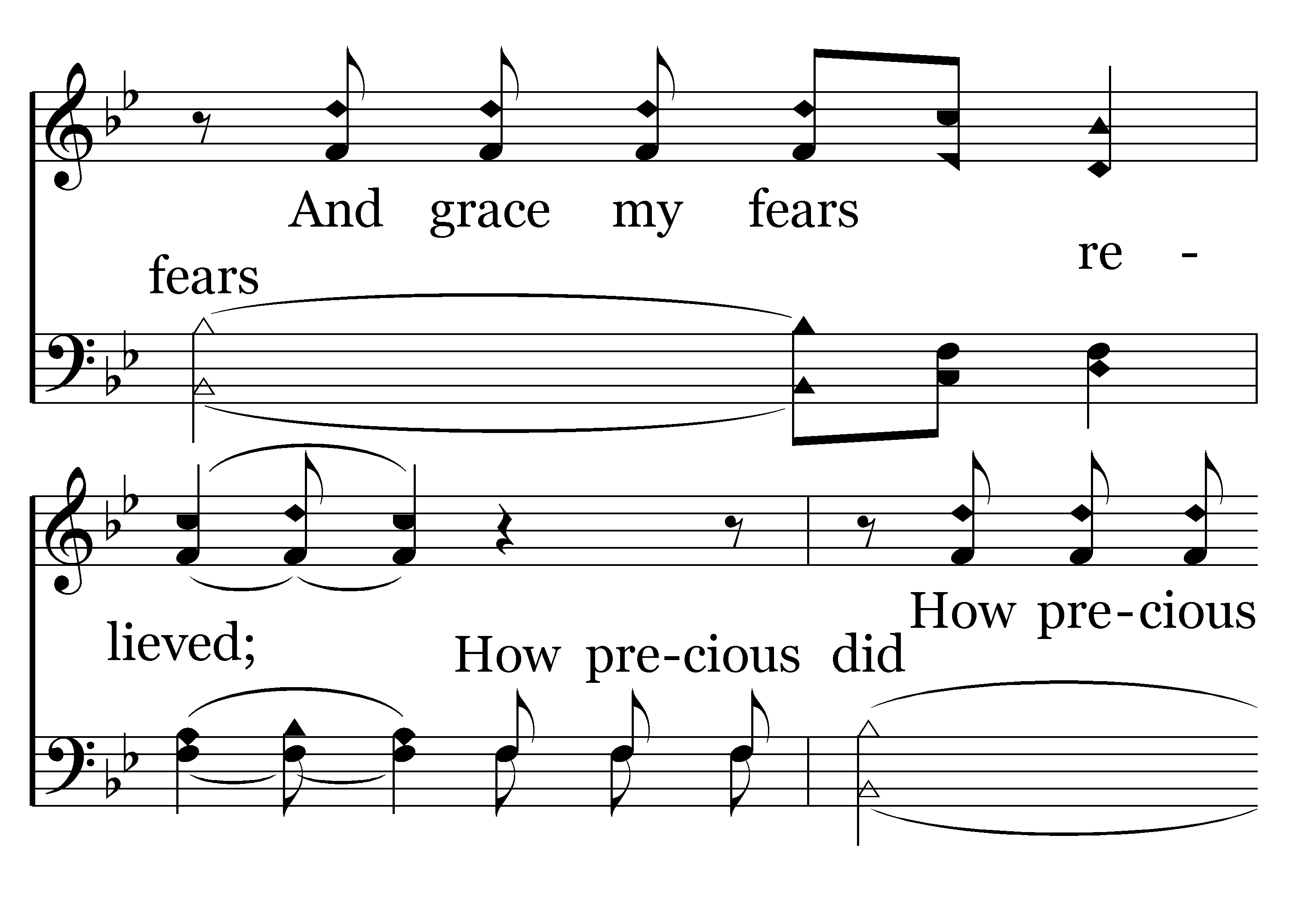
109 - O Fill My Cup - 3.2

Slide 35
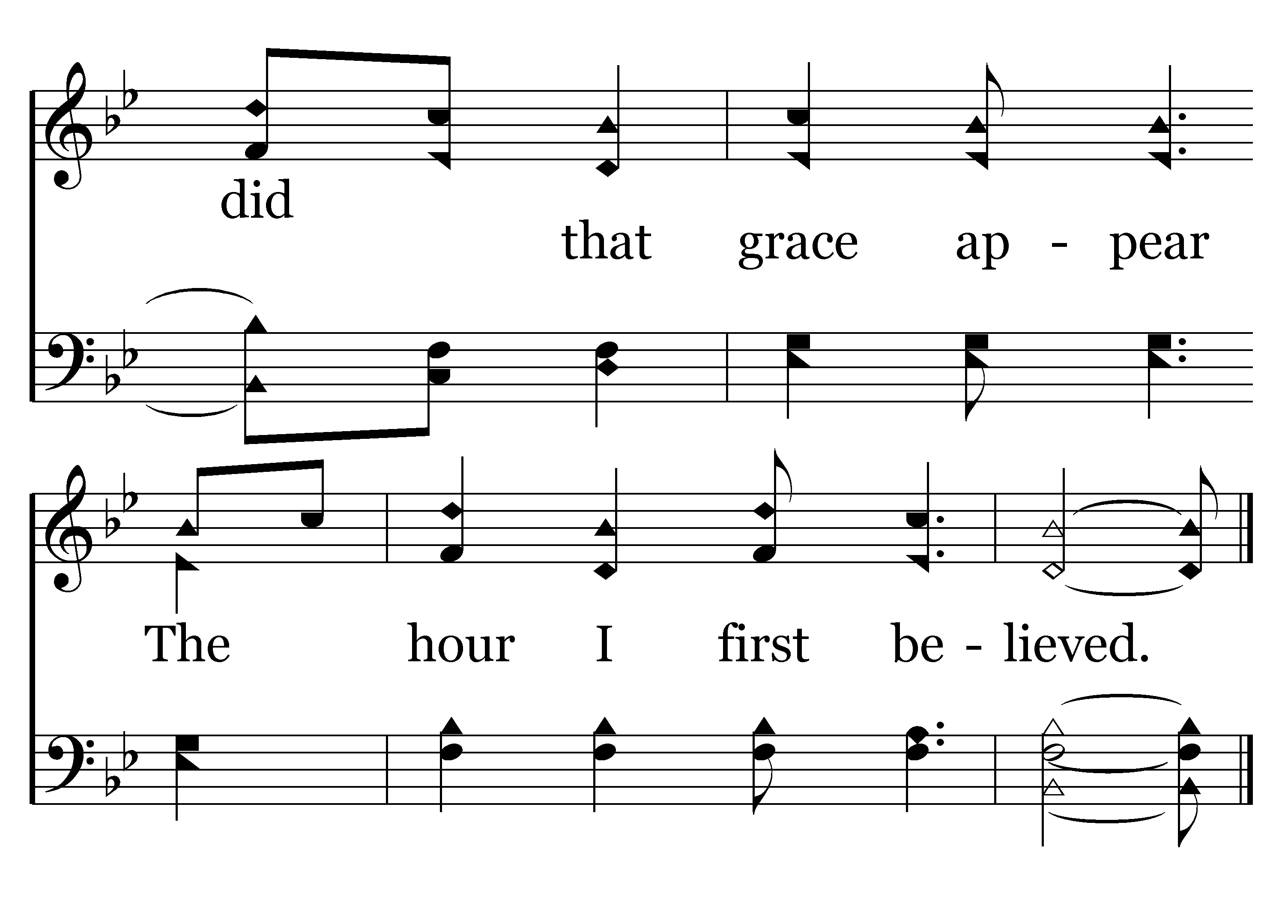
109 - O Fill My Cup - 3.3
End of Verse 3

Slide 36
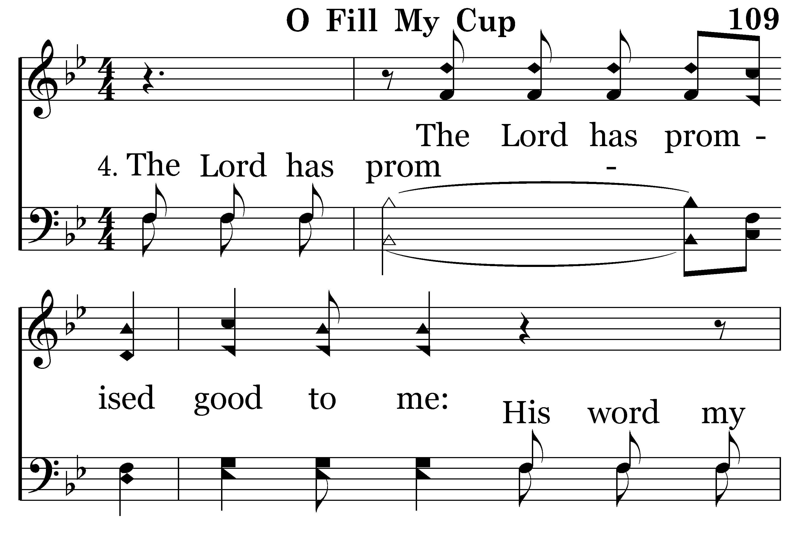
109 - O Fill My Cup - 4.1

Slide 37
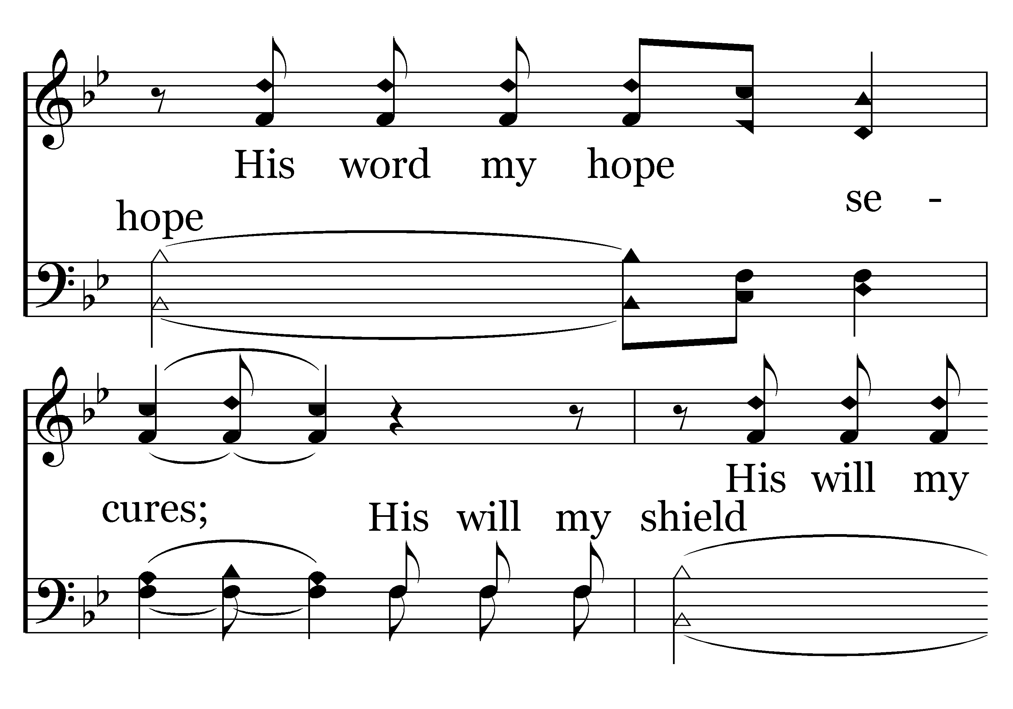
109 - O Fill My Cup - 4.2

Slide 38
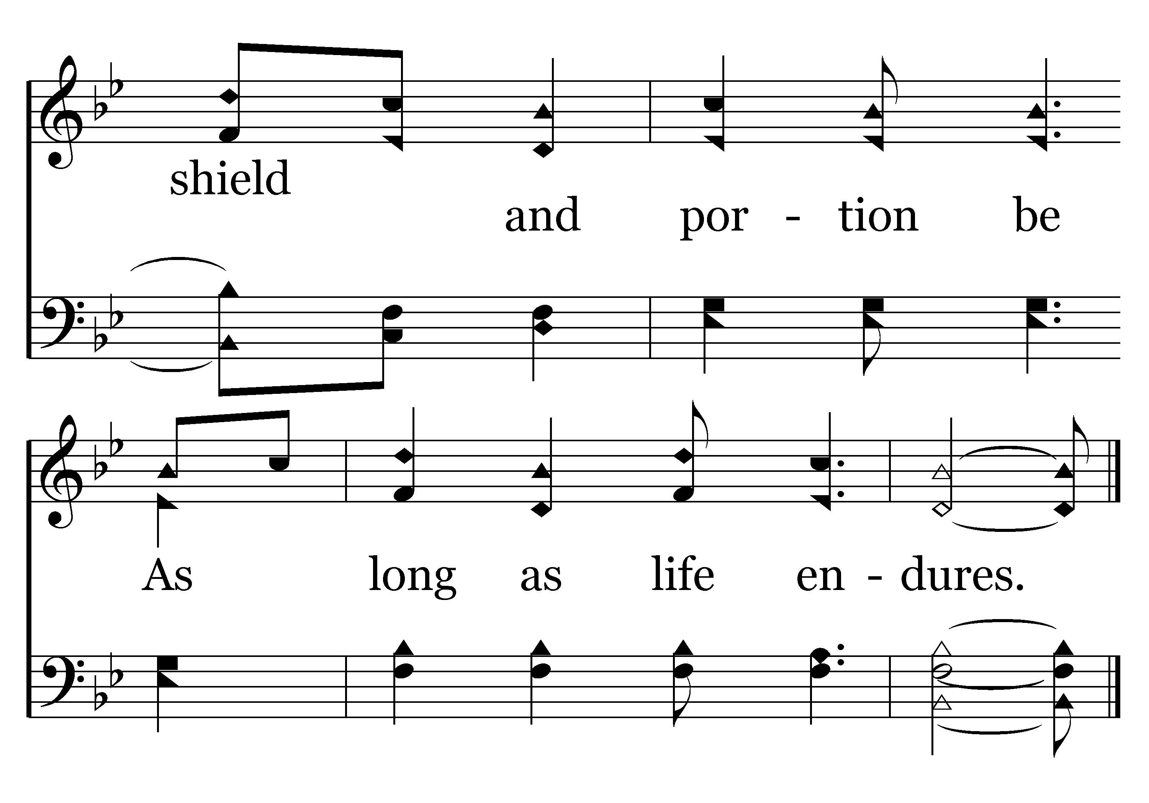
109 - O Fill My Cup - 4.3
End of Verse 4

Slide 39
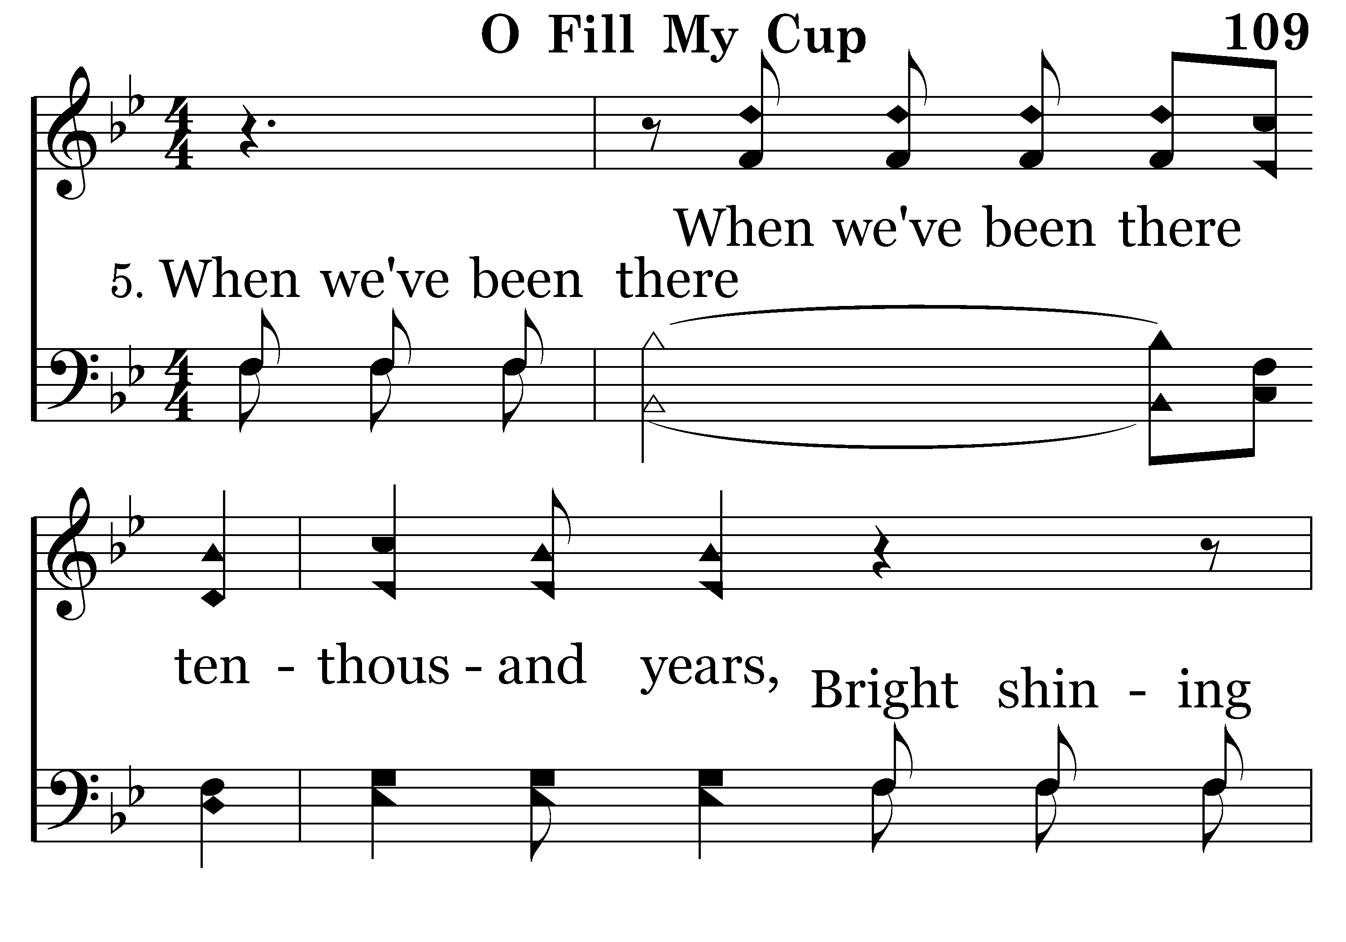
109 - O Fill My Cup - 5.1

Slide 40

109 - O Fill My Cup - 5.2

Slide 41
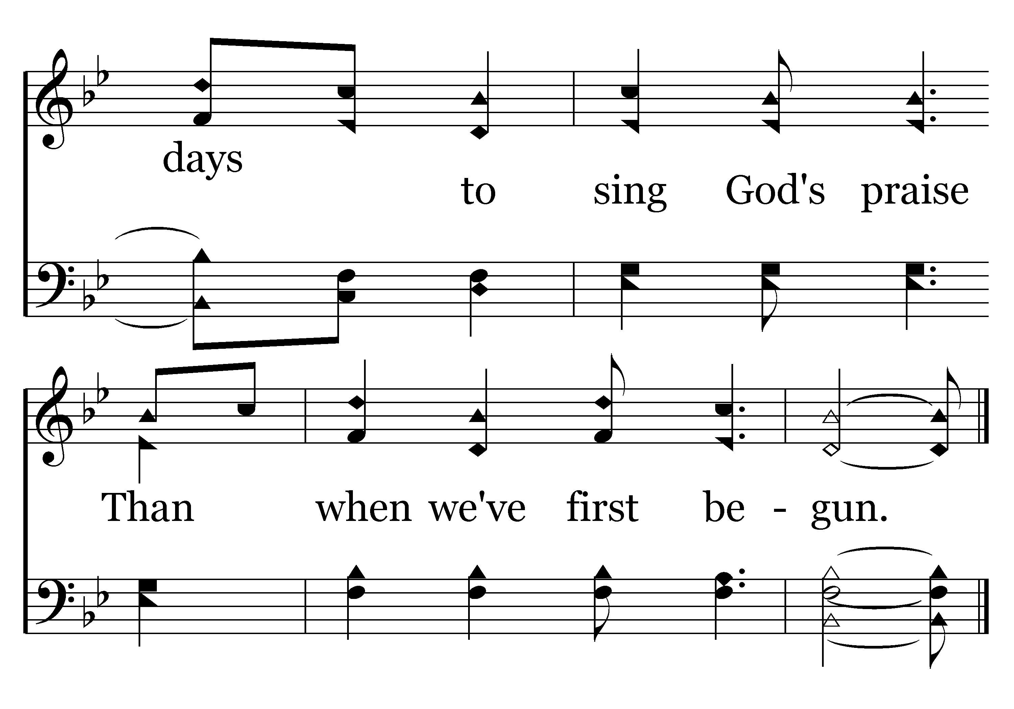
109 - O Fill My Cup - 5.3
End of Verse 5

Slide 42
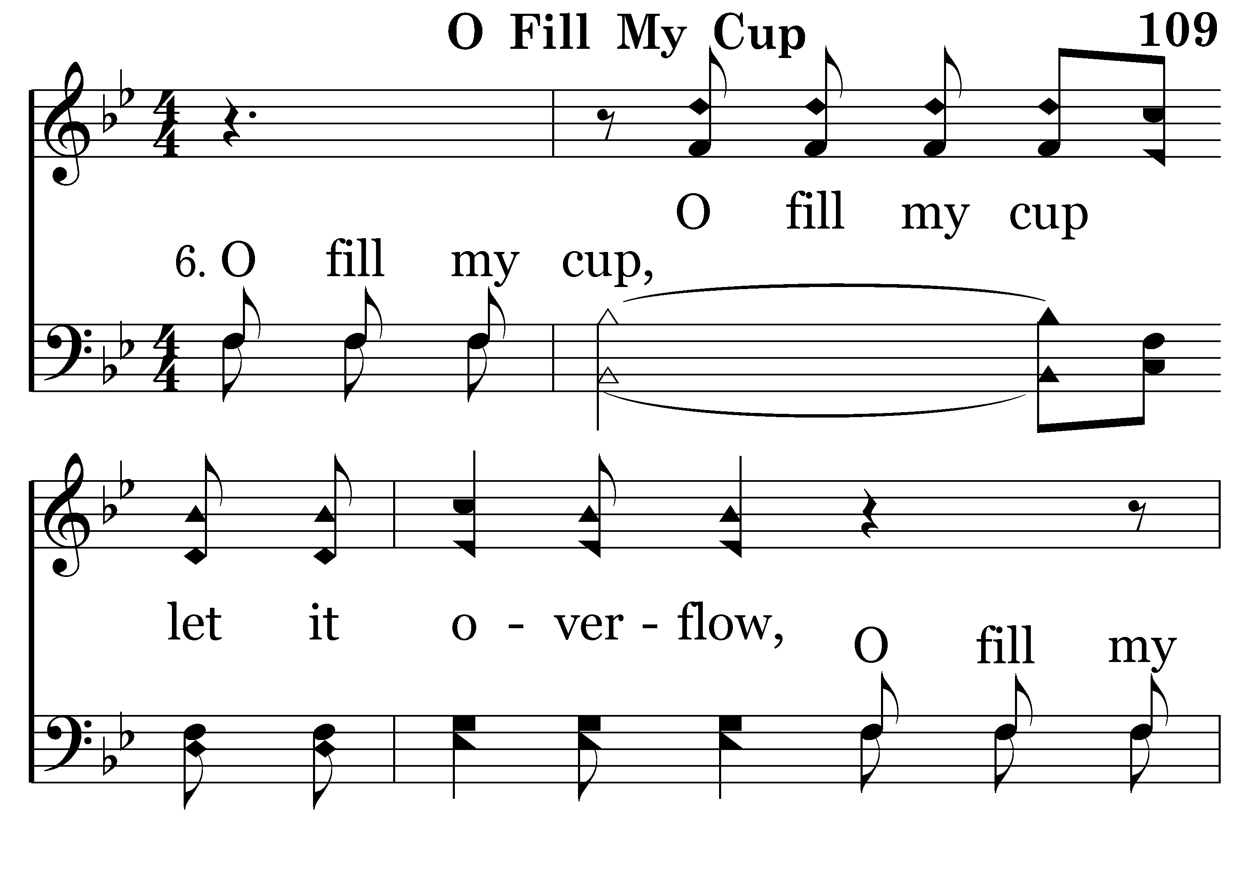
109 - O Fill My Cup - 6.1

Slide 43
109 - O Fill My Cup - 6.2

Slide 44

109 - O Fill My Cup - 6.3
End of Song

Slide 45
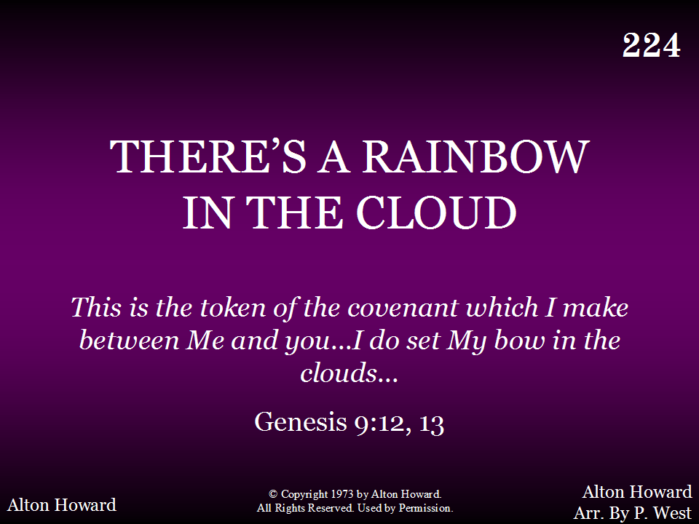
224 - There's A Rainbow In The Cloud - Title

Slide 46
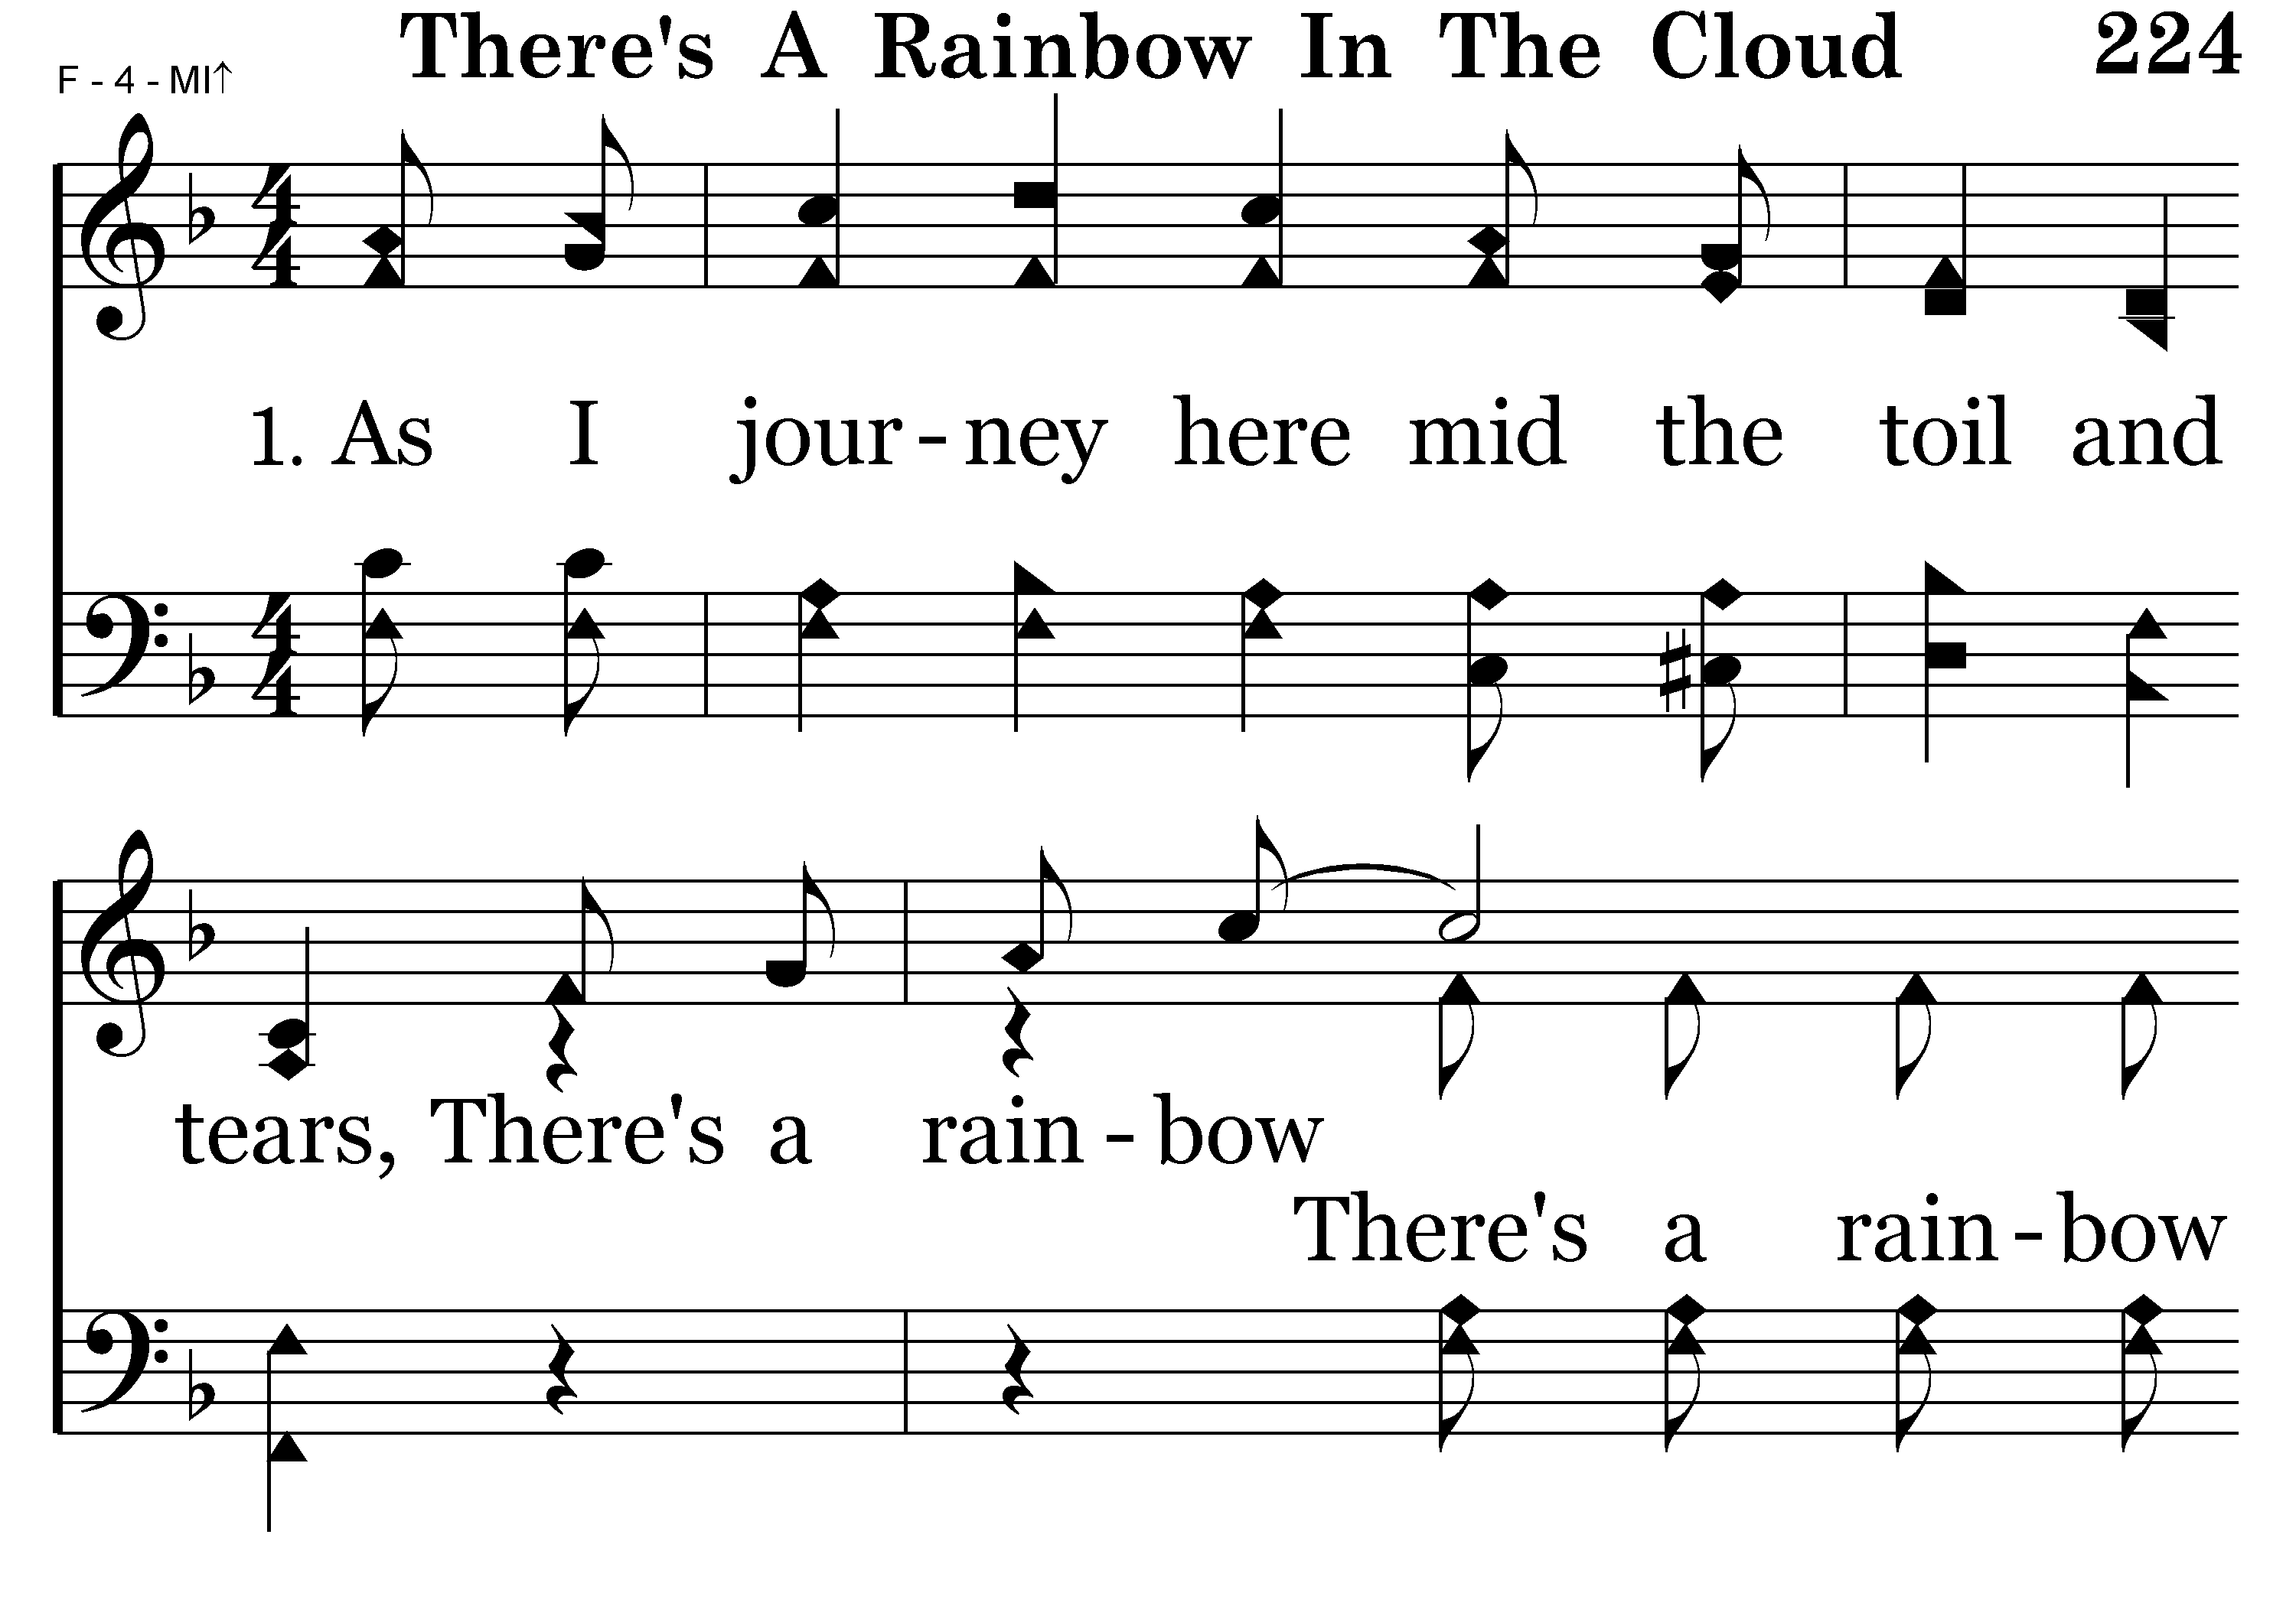
224 - There's A Rainbow In The Cloud - 1.1

Slide 47
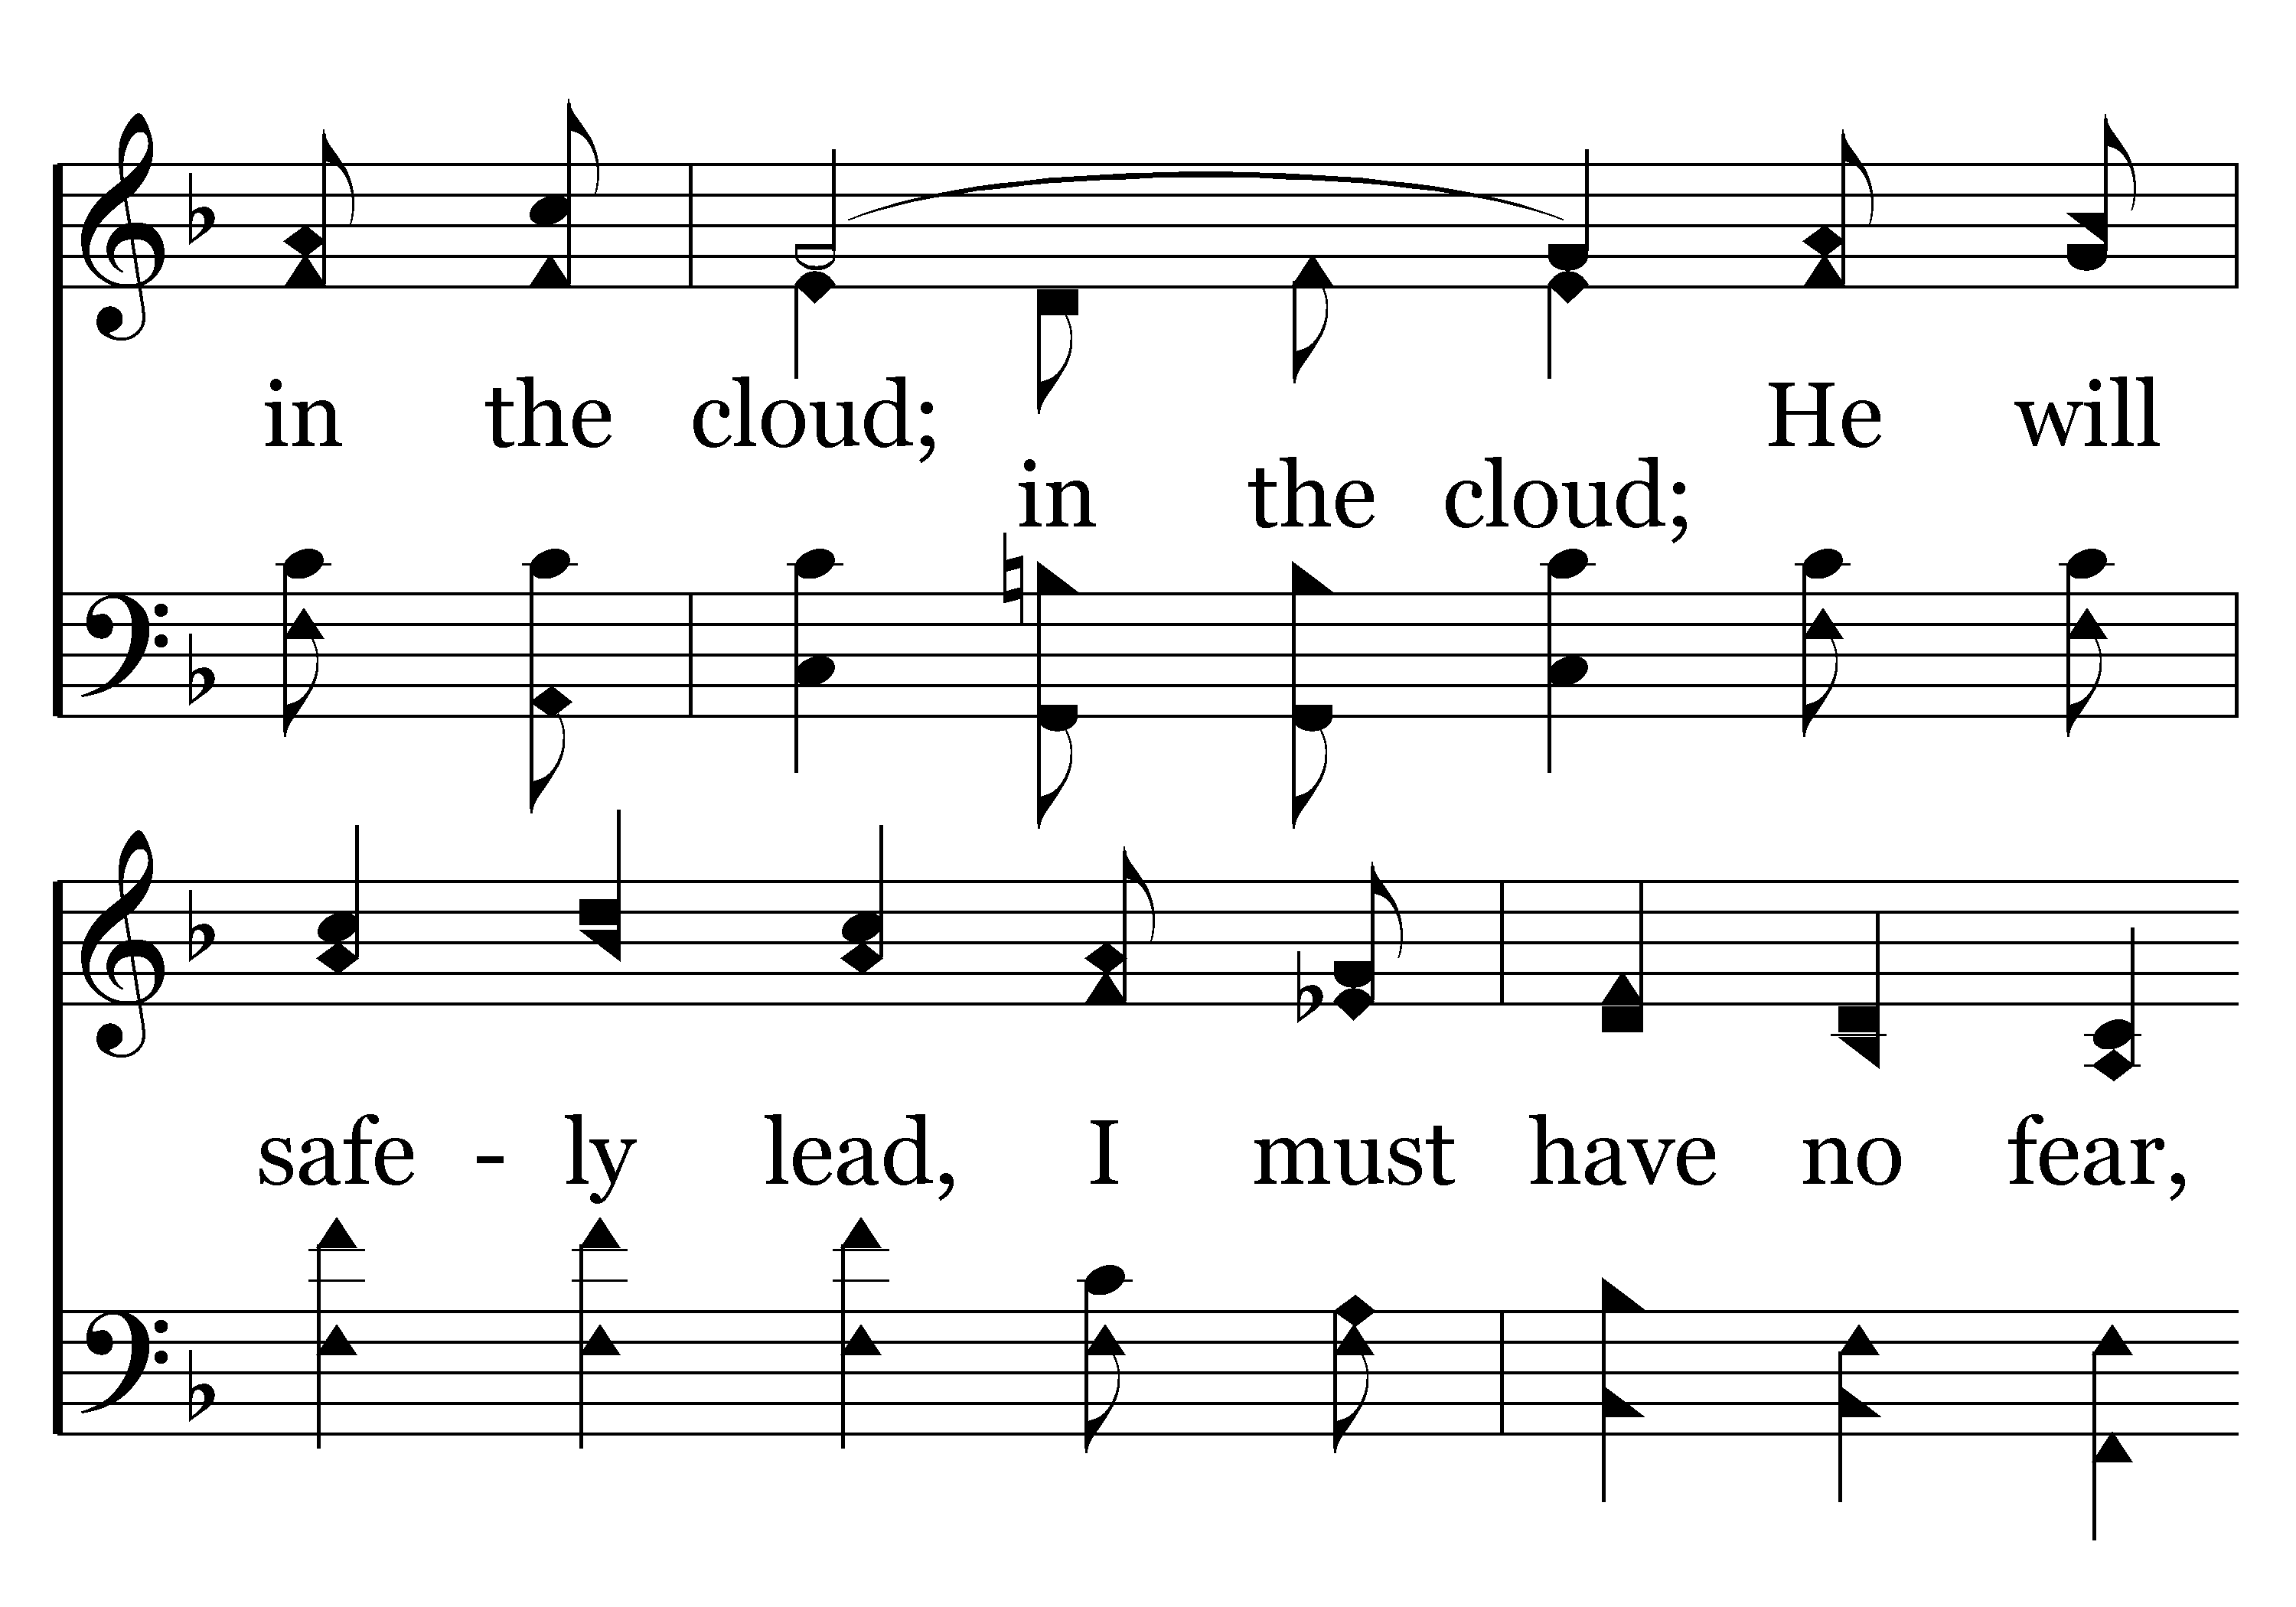
224 - There's A Rainbow In The Cloud - 1.2

Slide 48
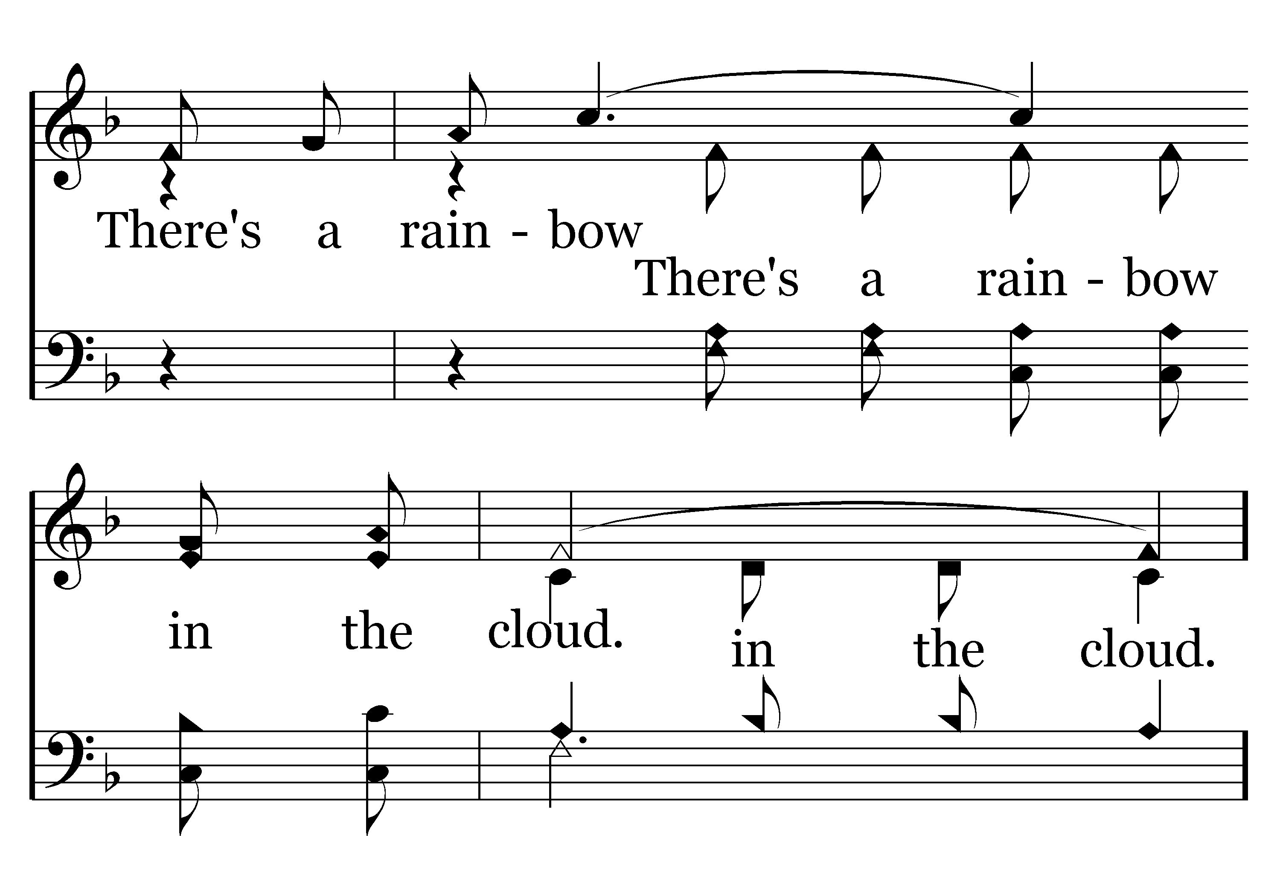
224 - There's A Rainbow In The Cloud - 1.3

Slide 49
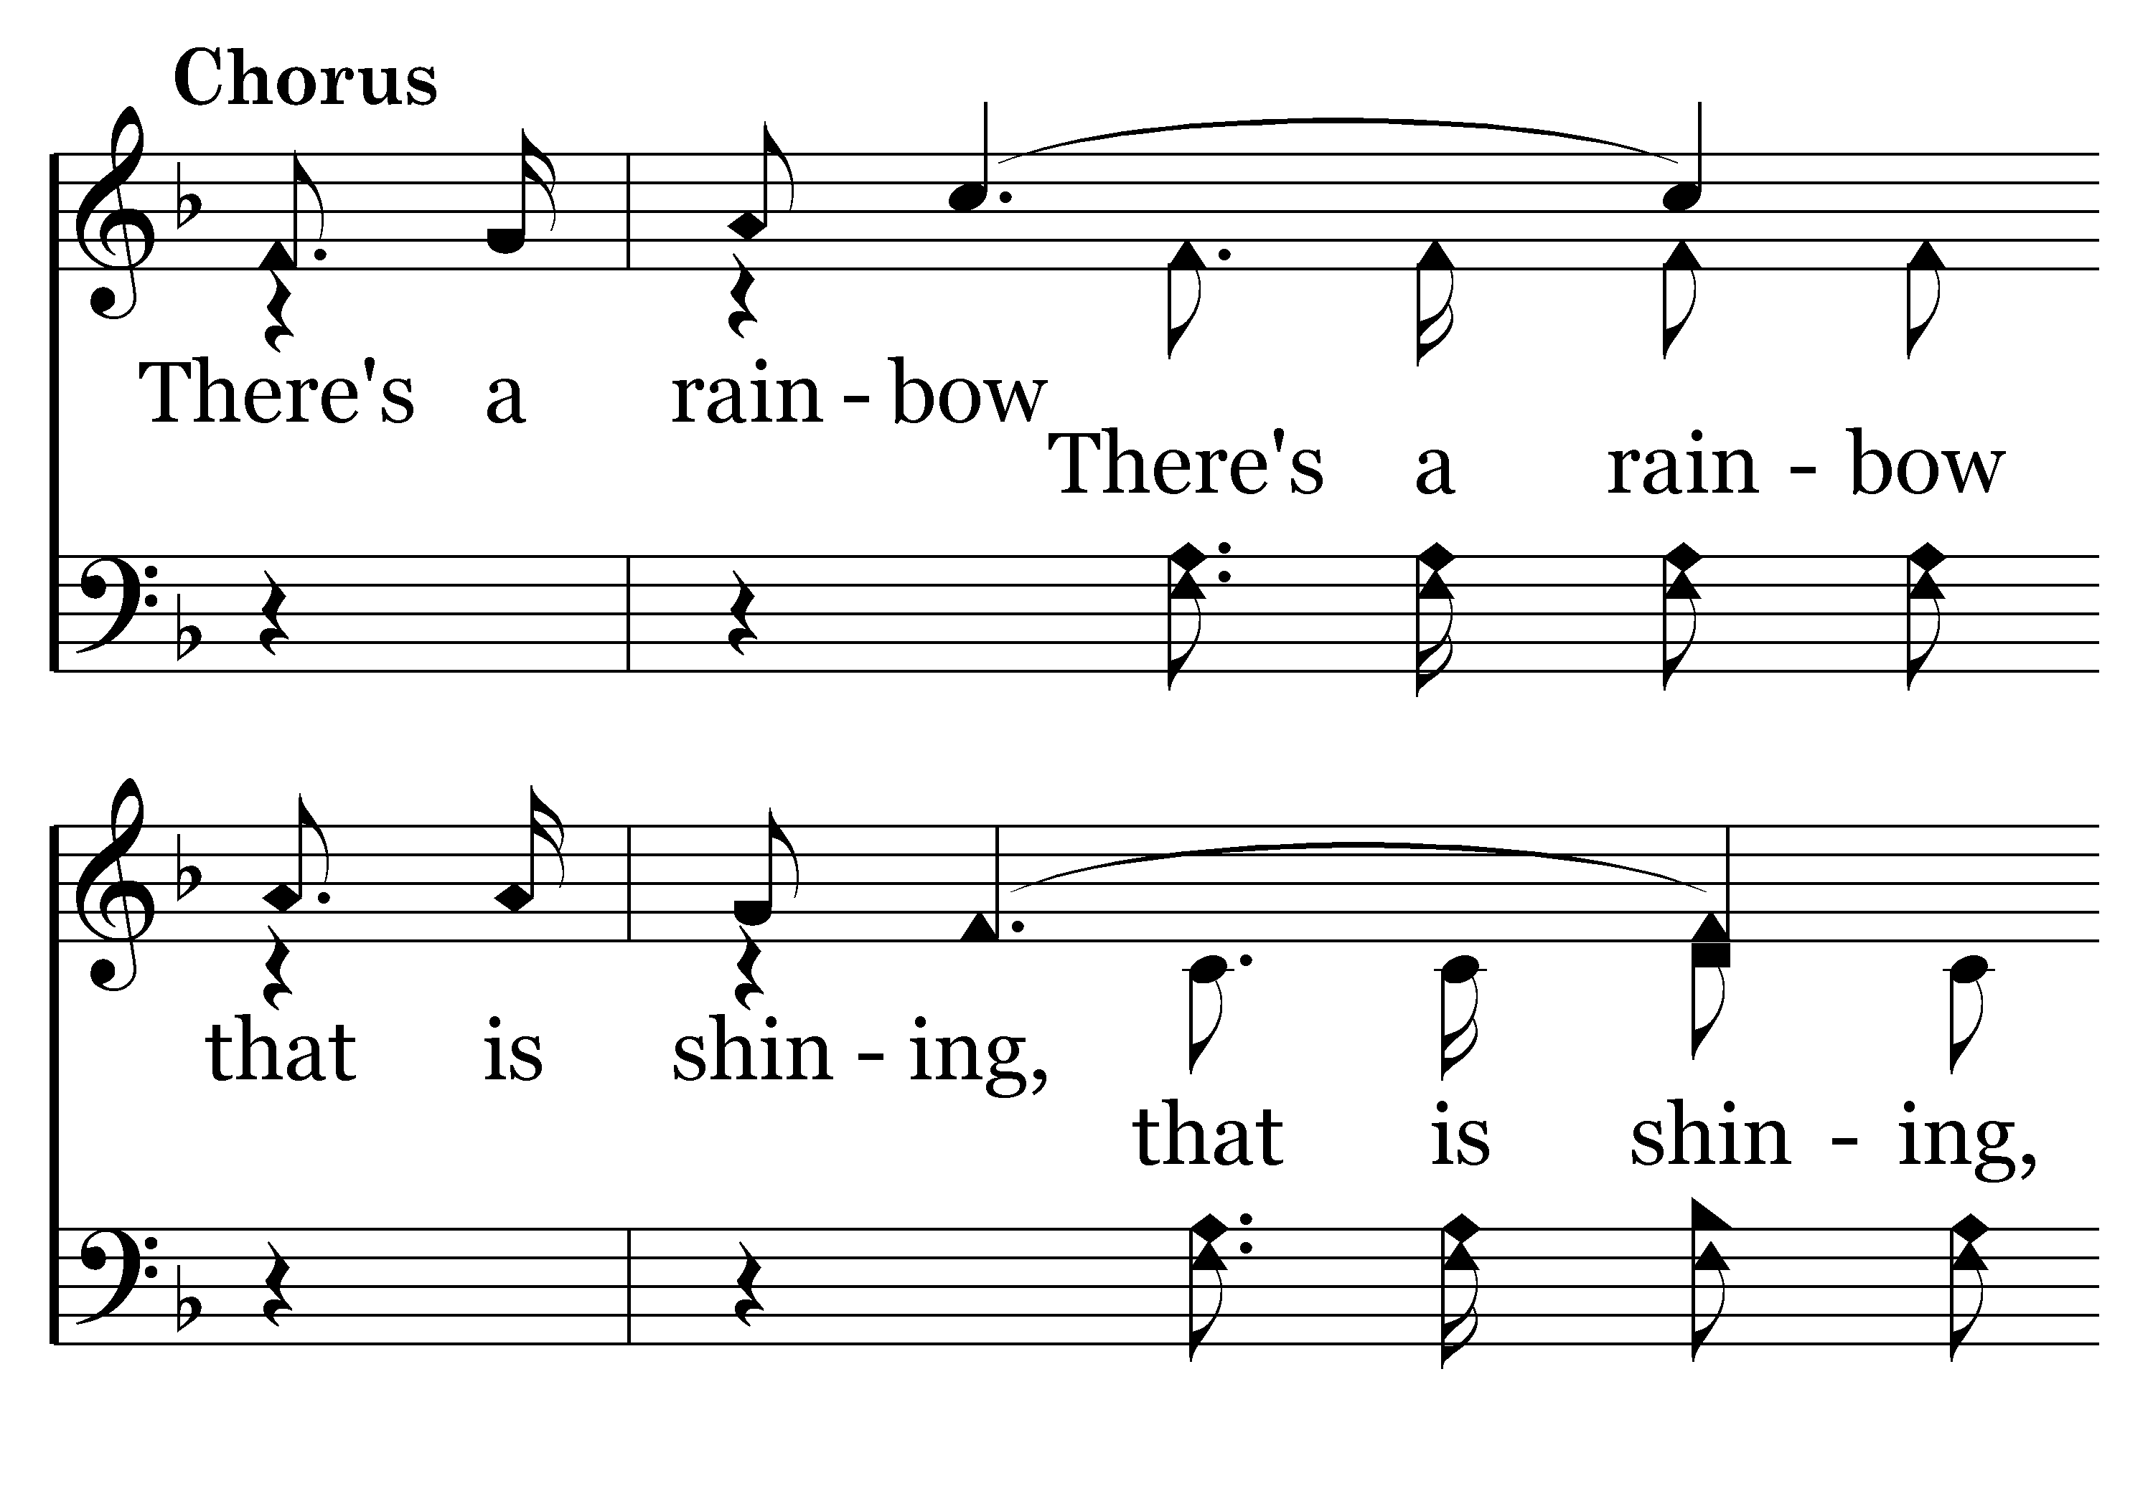
224 - There's A Rainbow In The Cloud - C.1

Slide 50
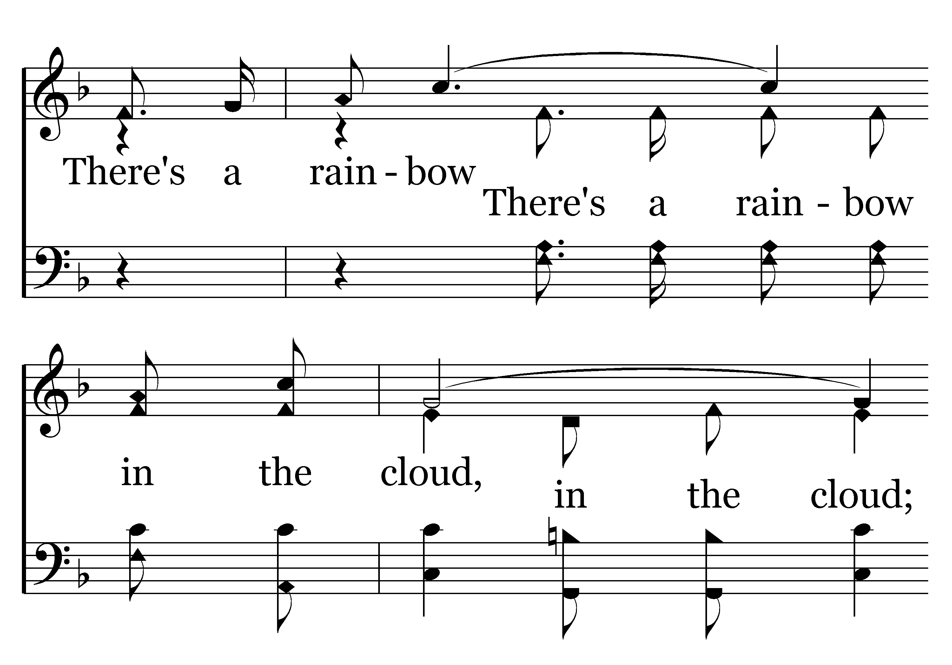
224 - There's A Rainbow In The Cloud - C.2

Slide 51
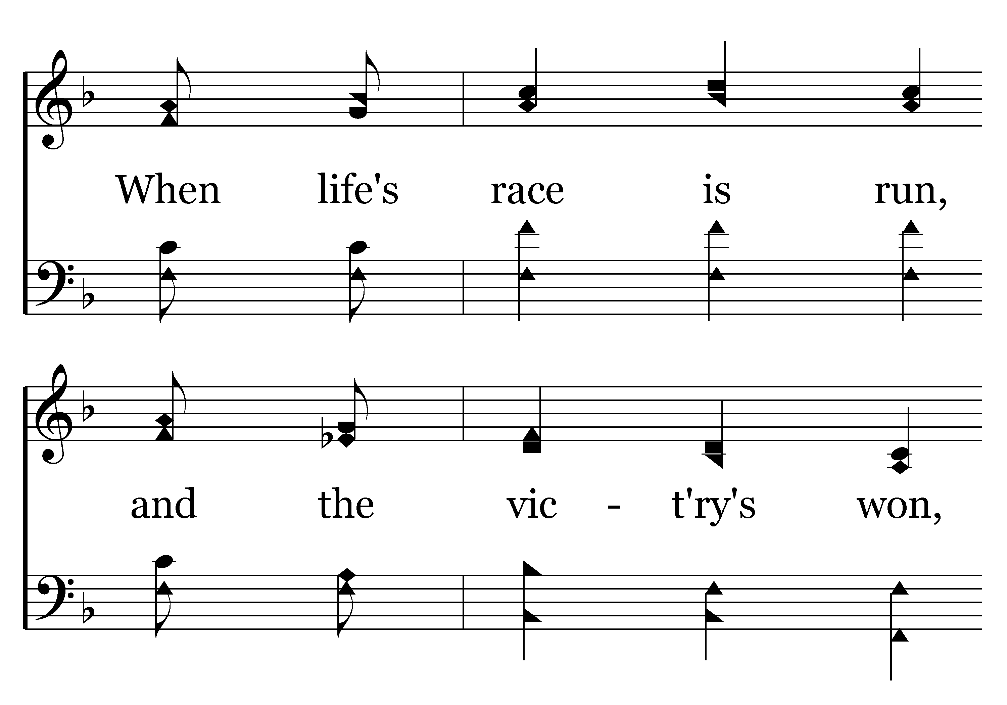
224 - There's A Rainbow In The Cloud - C.3

Slide 52
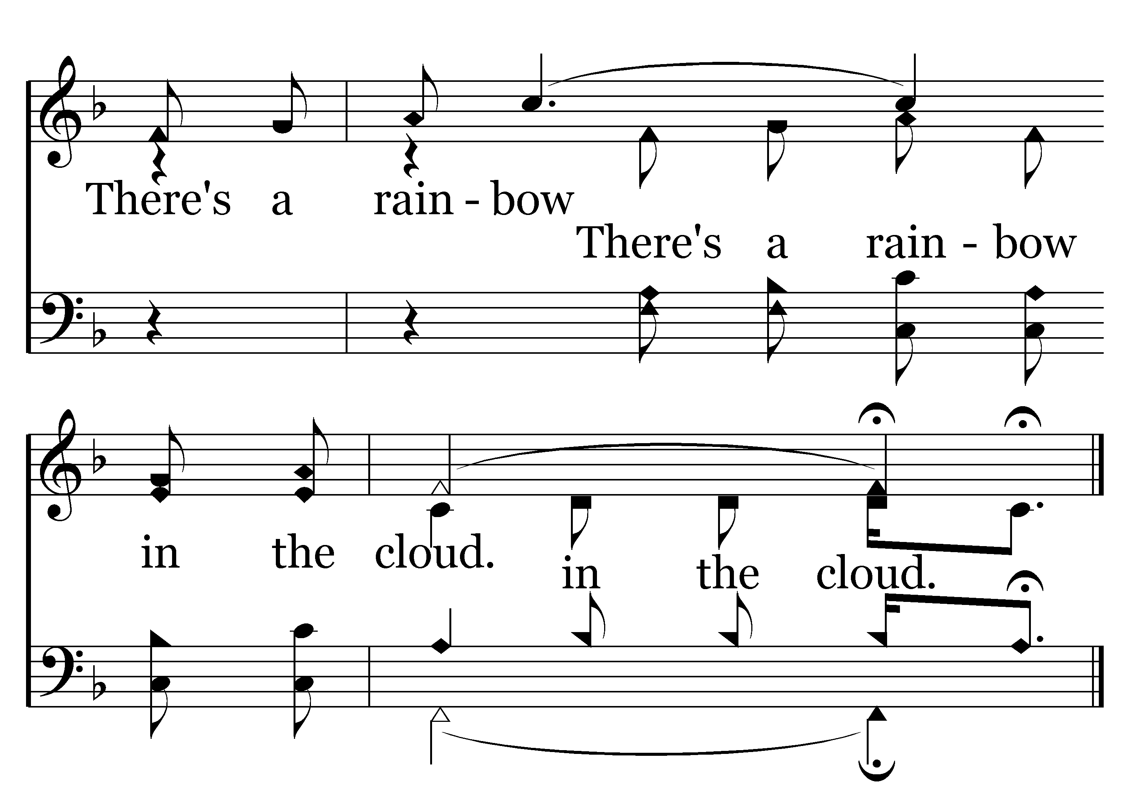
224 - There's A Rainbow In The Cloud - C.4
End of Verse 1

Slide 53
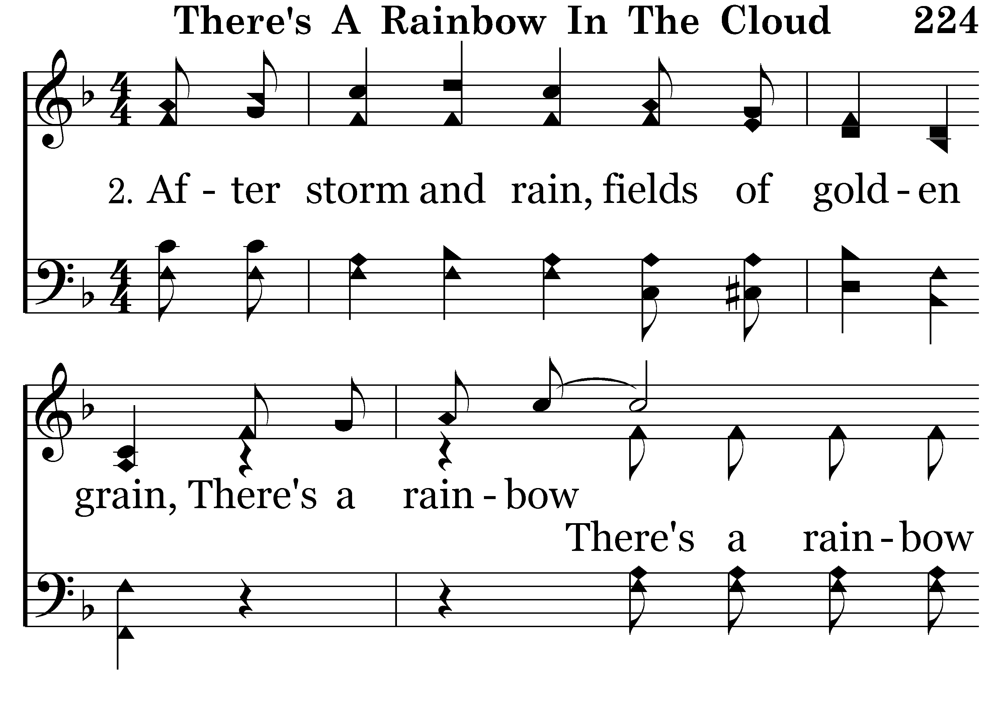
224 - There's A Rainbow In The Cloud - 2.1

Slide 54
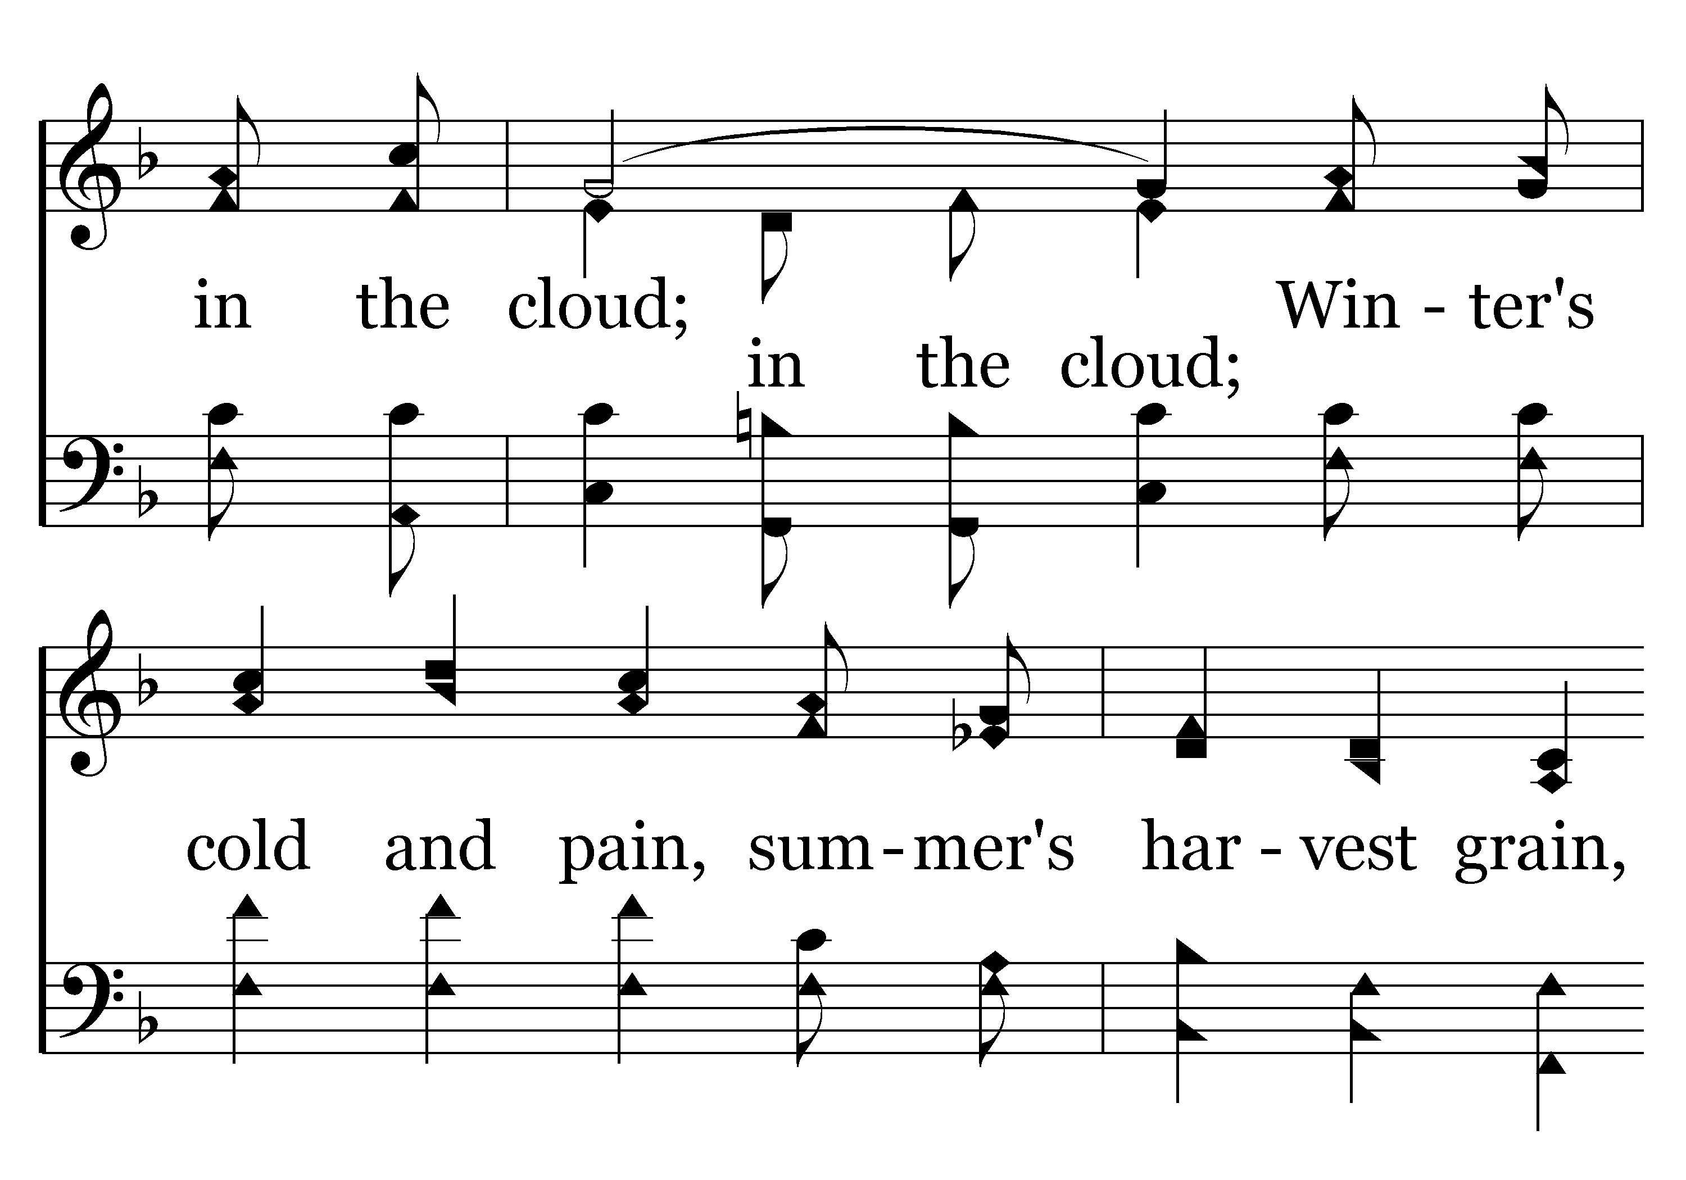
224 - There's A Rainbow In The Cloud - 2.2

Slide 55
224 - There's A Rainbow In The Cloud - 2.3

Slide 56
224 - There's A Rainbow In The Cloud - C.1

Slide 57
224 - There's A Rainbow In The Cloud - C.2

Slide 58
224 - There's A Rainbow In The Cloud - C.3

Slide 59
224 - There's A Rainbow In The Cloud - C.4
End of Verse 2

Slide 60
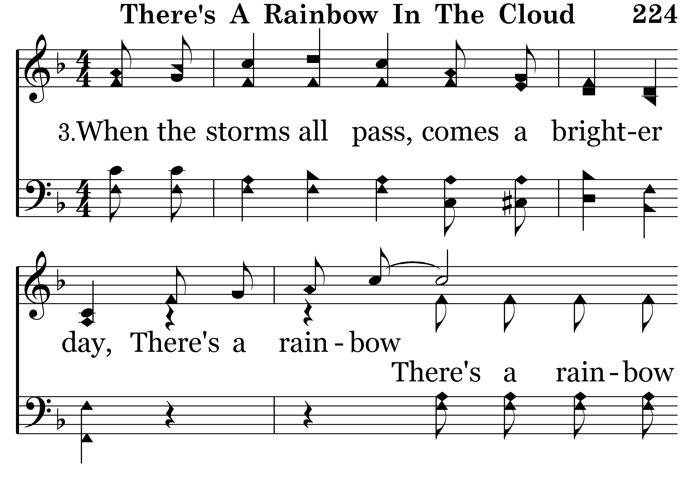
224 - There's A Rainbow In The Cloud - 3.1

Slide 61
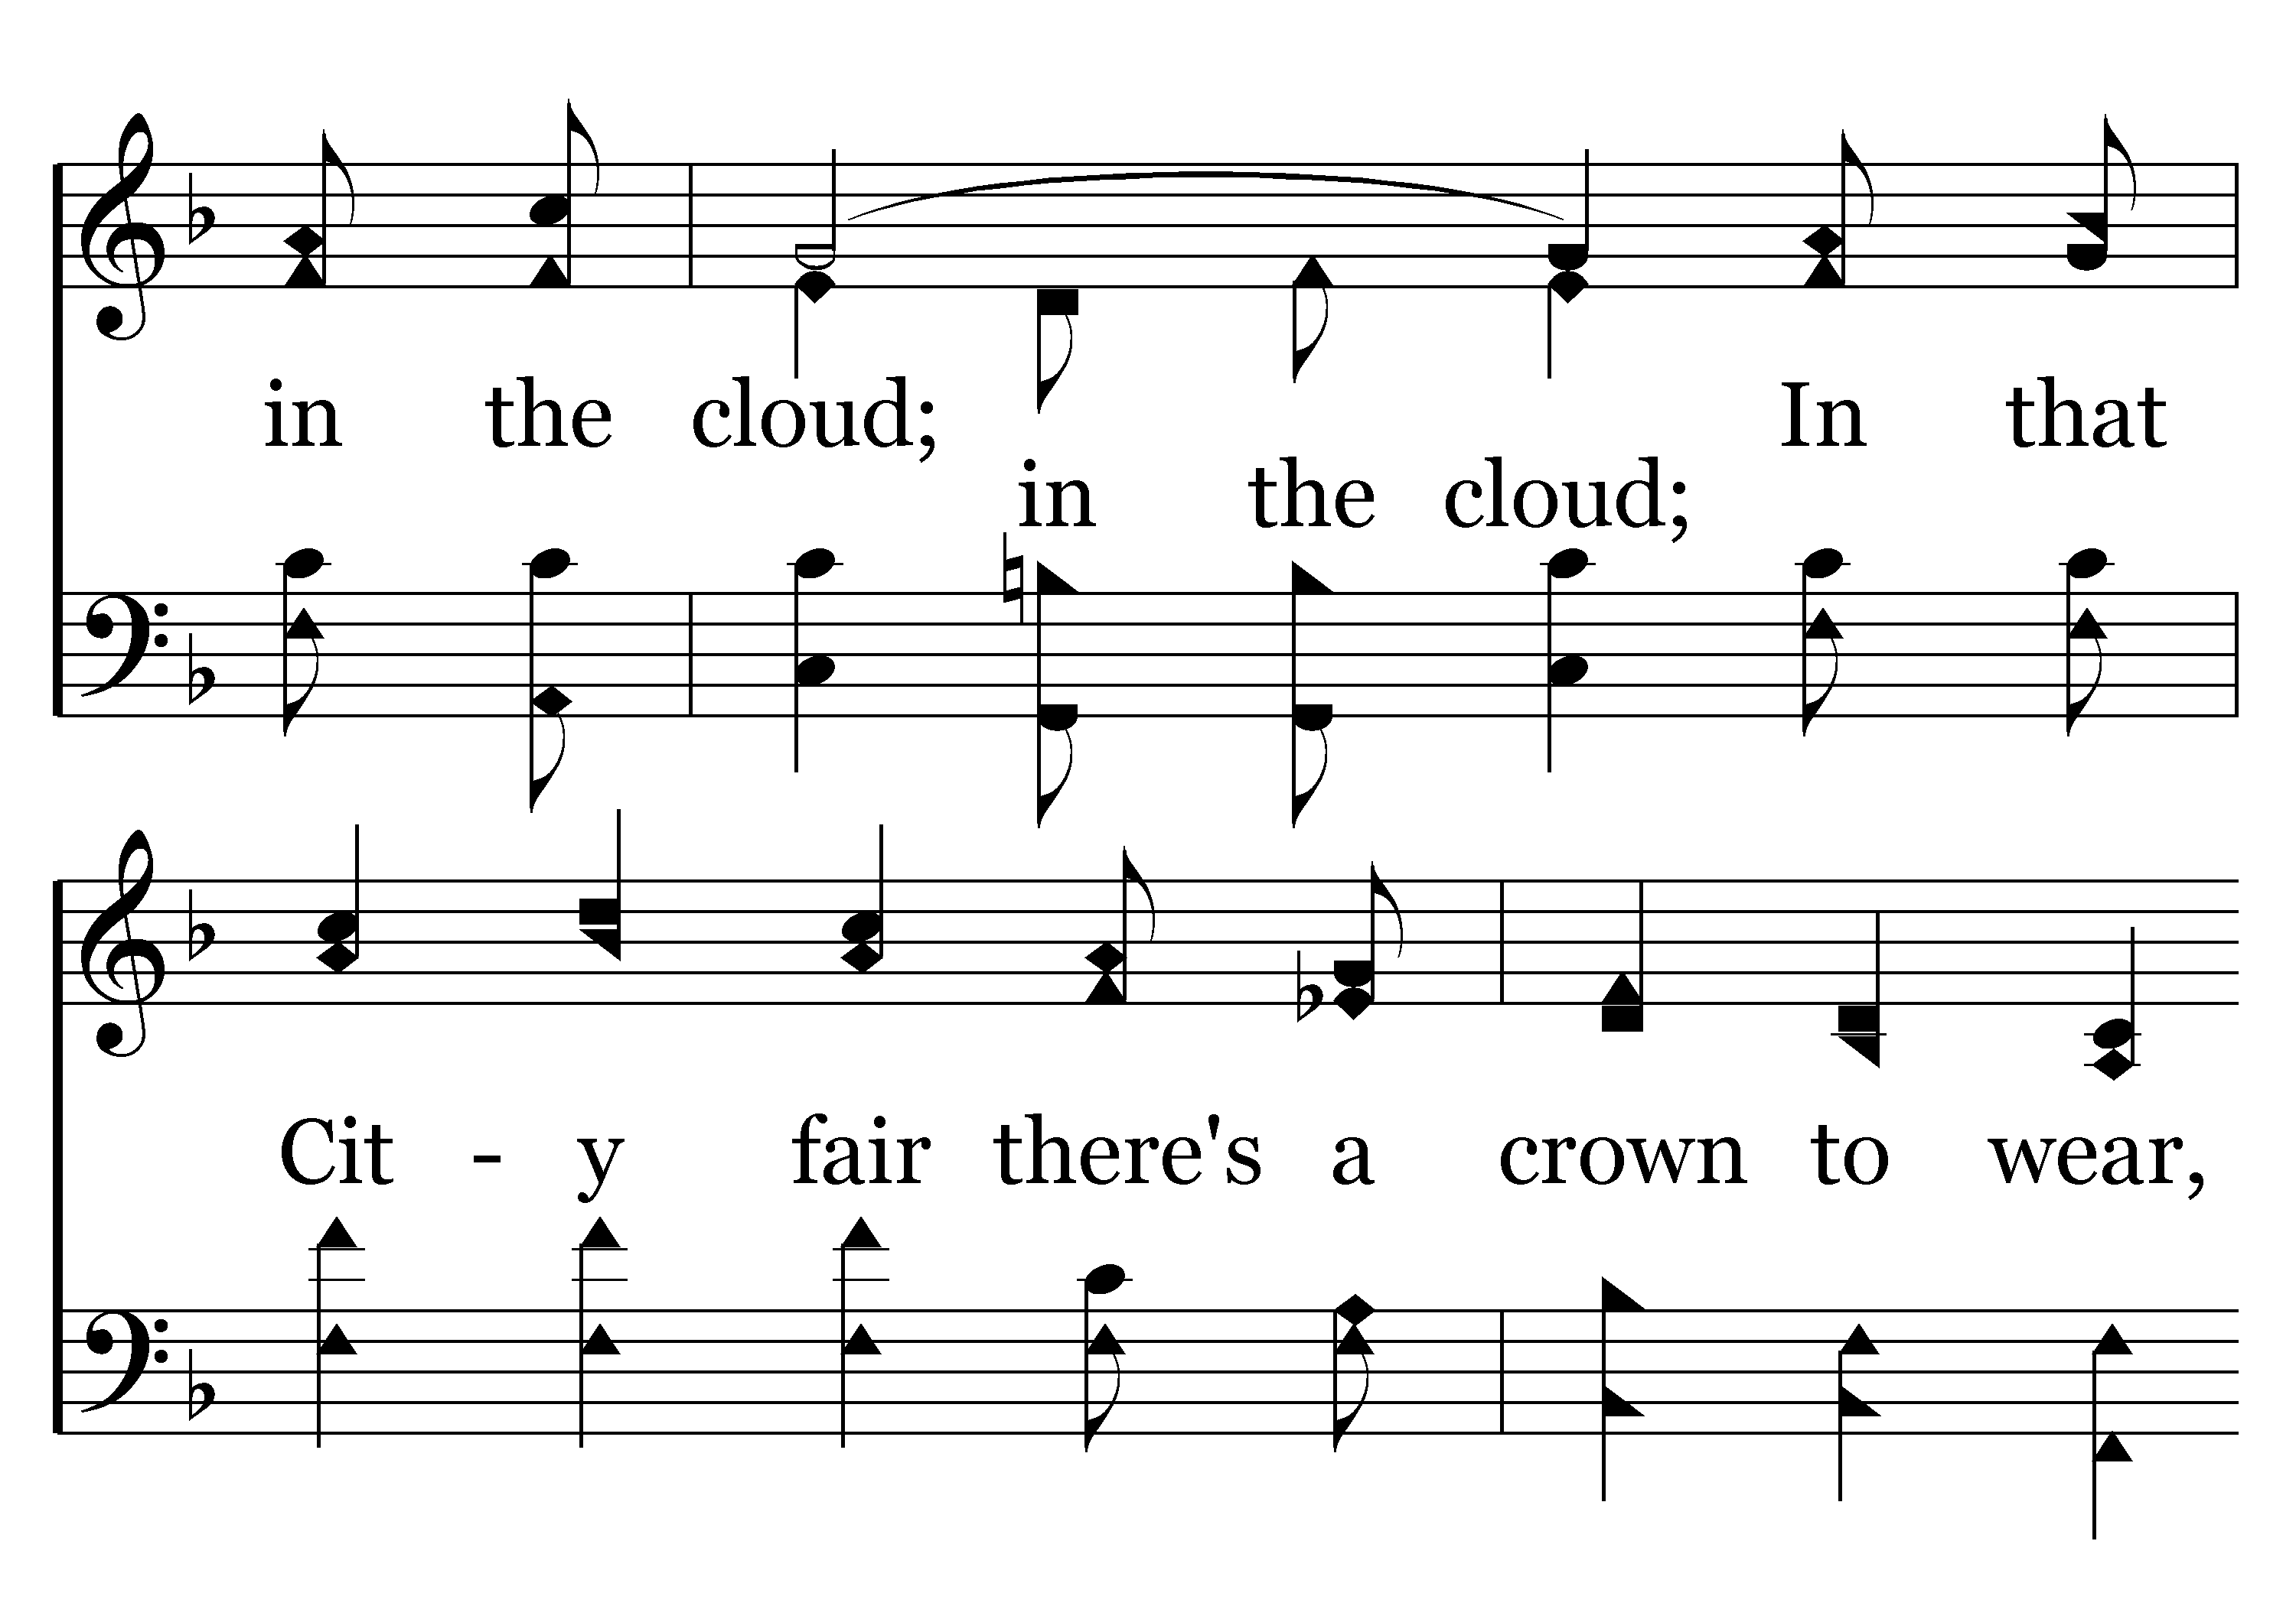
224 - There's A Rainbow In The Cloud - 3.2

Slide 62
224 - There's A Rainbow In The Cloud - 3.3

Slide 63
224 - There's A Rainbow In The Cloud - C.1

Slide 64
224 - There's A Rainbow In The Cloud - C.2

Slide 65
224 - There's A Rainbow In The Cloud - C.3

Slide 66
224 - There's A Rainbow In The Cloud - C.4
End of Song

Slide 67


Slide 68

In A Divisive World
Ephesians 4:1-16

Slide 69

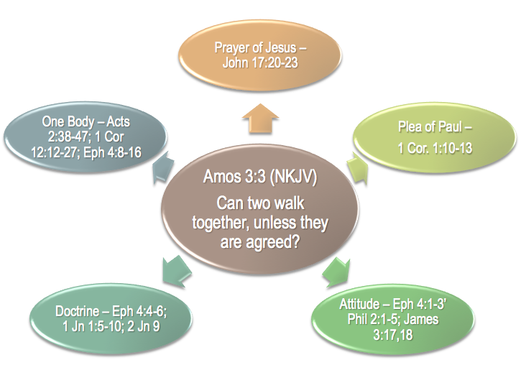

Amos 3:3 (NKJV)
“Can two walk together, unless they are agreed?”

Slide 70

Early Disciples / Judaizers - Acts 15
The church in Corinth - 1 Cor. 1:10-13
Walking In Truth / Gnostics - 1 John
Faithful / Unfaithful - Rev 2-3
Strong / Weak - Romans 14
Denominations / Ecumenical / One Church

Slide 71


Many In The Religious WORLD Attempt To Solve The Problem By Doing Away With ALL ABSOLUTES!
Unscriptural Teaching, Work & Worship
Scriptural & Authorized
Teaching, Work & Worship

Slide 72

Unity in Christ is dependent upon two primary things –
  Our submission to the authority of Jesus the Christ in doctrine & practice.
  The application of the attitudes commanded by Jesus that we are to have toward one another.

Slide 73
United By Walking According To The Same Calling
Ephesians 4:1 (NKJV)
“I, therefore, the prisoner of the Lord, beseech you to walk worthy of the calling with which you were called.”

Slide 74
United By Walking According To The Same Calling
Our walk should correspond to our calling
The same holy calling of God in Christ Jesus – 2 Tim. 1:9
Called by means of the same gospel/faith– 2 Thess. 2:12-13; Gal 1:6-9; Jude 1:3
Out of darkness into God’s light – 1 Pet. 2:9; 1 John 1:5-8
Unto God’s kingdom & glory – 1 Thess. 2:12; Col. 1:13

Slide 75
United By Possessing The Same Attitudes
Ephesians 4:2-3 (NKJV)
“with all lowliness and gentleness, with longsuffering, bearing with one another in love, ³endeavoring to keep the unity of the Spirit in the bond of peace.”

Slide 76
United By Possessing The Same Attitudes
Lowliness – putting others above self – Phil. 2:1-5; James 3:15-18
Gentleness – strength under God’s control – Matt. 5:5; Gal. 6:1
With longsuffering, - Self-restraint which does not hastily retaliate a wrong —Gal. 5:22
Bearing with one another in love – Patient with others foibles, faults, and infirmities - 1 Cor. 13:4
These virtues do not come naturally or easily – it requires much effort – Eph. 4:3
2 Pet 1:5-10

Slide 77
United By Possessing The Same Attitudes
These virtues do not come naturally or easily – it requires much effort – Eph. 4:3
2 Pet 1:5-10
Colossians 3:12–15 (NKJV)
tender mercies,
kindness, humility,
meekness,
longsuffering;
bearing with one another,
forgiving one another,
love

Slide 78
United By Possessing The Same Attitudes
These virtues do not come naturally or easily – it requires much effort – Eph. 4:3
2 Pet 1:5-10
Philippians 2:1–5 (NKJV)
Being like-minded,
Having the same love,
Being of one accord,
Of one mind.
In lowliness esteeming others better than himself.

Slide 79
United By Possessing The Same Attitudes
These virtues do not come naturally or easily – it requires much effort – Eph. 4:3
2 Pet 1:5-10
Rom 14:1-15:6 / 1 Cor 8-14
Respecting the conscience of others – Rom.14:12-13,19-23; 1 Cor. 8:8-13
Being patient while we learn & grow – Rom. 15:1-6
Do things that will lead to edification – Rom 14:19; 1 Cor. 14:26
Walk in love – Rom 14:15; 1 Cor. 13

Slide 80
United By Believing & Following The Truth
One body – one church / the saved – Acts 2:47; Eph. 1:22-23; 5:23
One Spirit – one source of truth – John 16:13; Eph. 3:3-5
One hope – one way to salvation & heaven – 1 Thess. 5:8; Acts 23:6; Col. 1:5
One Lord, - one master – Acts 10:36; 1 Cor. 1:2,13
One faith – one body of truth to be believed, taught & defended – 2 Tim. 1:13; Rom. 10:8; Jude 3
Our unity is dependent on our conformity to Divine truth

Slide 81
United By Believing & Following The Truth
One baptism – Commanded by Jesus & the apostles – the means of entrance into the body of Christ – Matt. 28:19; Mark 16:16; Acts 2:38; 10:48; Rom 6:3,4; 1 Pet. 3:21
One God and Father - the Father “of” all who believe; they are His children (John 1:12; Gal. 3:26). And He is “over” all them as their Sovereign. He lives “through” them and manifests Himself “in” them.
Our unity is dependent on our conformity to Divine truth

Slide 82
United In The Body of Christ
The Source Of These Gifts … 7-10 Jesus Christ – from the bounty of His grace (7) – as prophesied (8, cf Ps 68:18) – as resurrected Lord – (9-10)
The Nature Of These Gifts ... (11) – Providing the church with the necessary functions (apostles, prophets, evangelist, pastors, teachers)
The Purpose Of These Gifts ... (12-15) – for development stability and unity - To prepare members of the body for service
Our unity is dependent on our working together in love – (16)

Slide 83
There Is Great Power In UNITY
Division Brings Weakness
We Must Use The Same Standard
Unity by believing only what the scriptures teach!
(John 17:20-21; Eph. 4:4-6,
1 Cor. 1:10; 2 Tim. 3:16)

Slide 84
There Is Great Power In UNITY
Division Brings Weakness
We Must Use The Same Standard
Unity by preaching and teaching ONLY things authorized by the scriptures (1 Peter 4:11; 2 Tim. 4:2)

Slide 85
There Is Great Power In UNITY
Division Brings Weakness
We Must Use The Same Standard
Unity by staying within the boundaries established by the scriptures
(Col. 3:17; 2 Cor. 5:7; Rom. 10:17; 2 John 1:9)

Slide 86
There Is Great Power In UNITY
Division Brings Weakness
We Must Use The Same Standard
Unity by developing the attitude of Christ
(Eph. 4:1-3; Col. 3:12-15; Phil. 2:1-5; Rom 14-15:6)

Slide 87
There Is Great Power In UNITY
Division Brings Weakness
Is your desire to know and follow the TRUTH? Matt. 26:39
Are you willing to lay aside, or at least NOT bind your opinions upon others for the sake of unity?
Superficial approaches to division will never solve the problem. ONLY by truly conforming our hearts to the Lord’s teaching will we ever truly achieve unity!!!!

Slide 88
In A Divisive World
Ephesians 4:1-16

