Slide 1
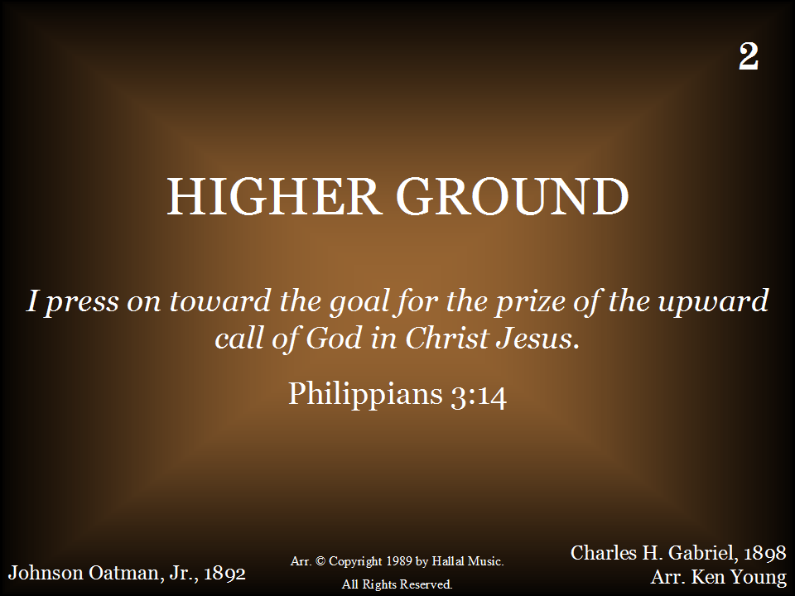
002 - Higher Ground - Title

Slide 2
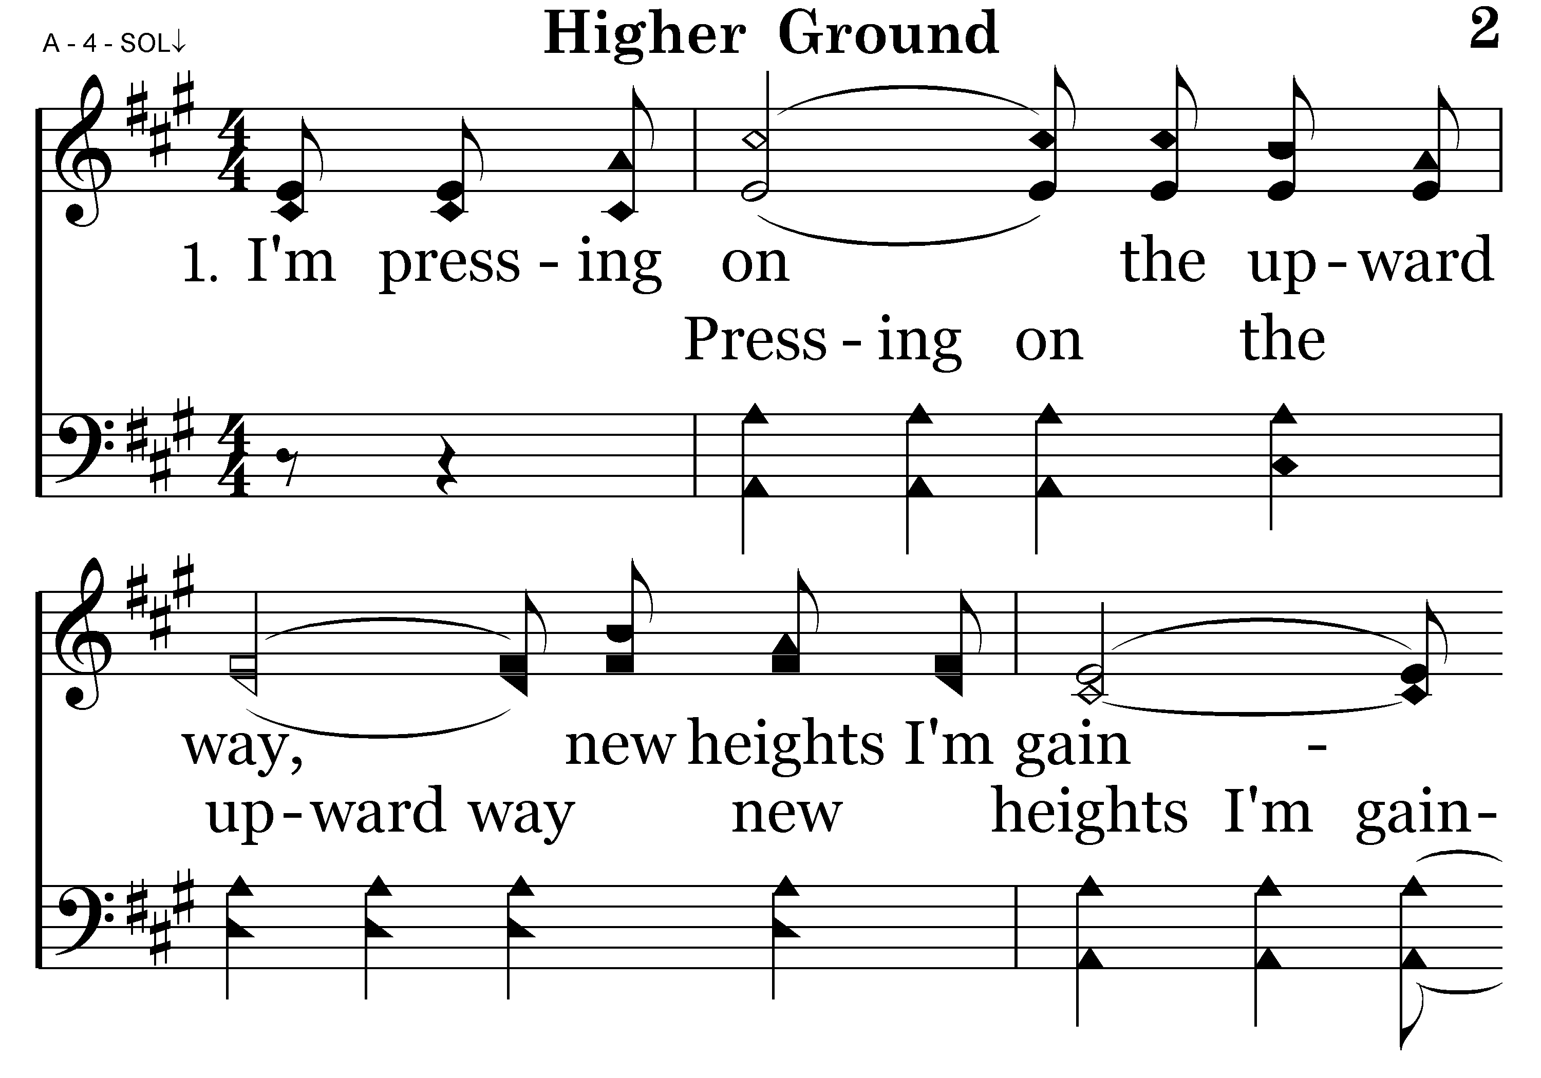
002 - Higher Ground - 1.1

Slide 3
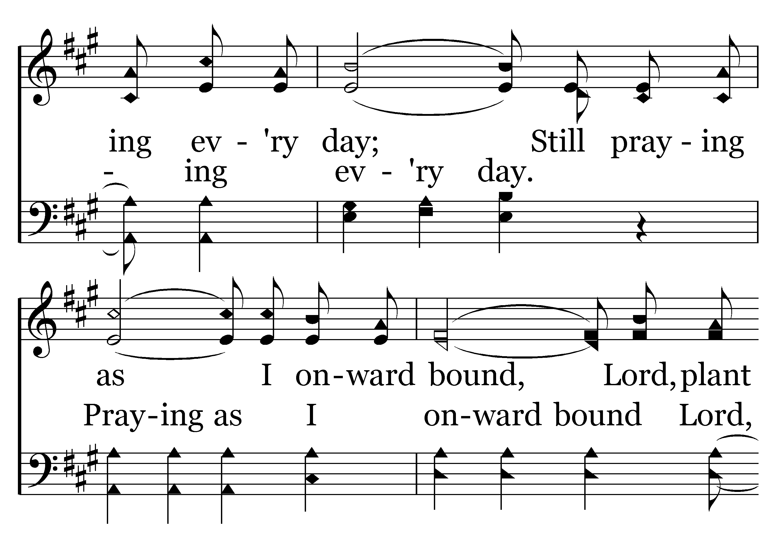
002 - Higher Ground - 1.2

Slide 4
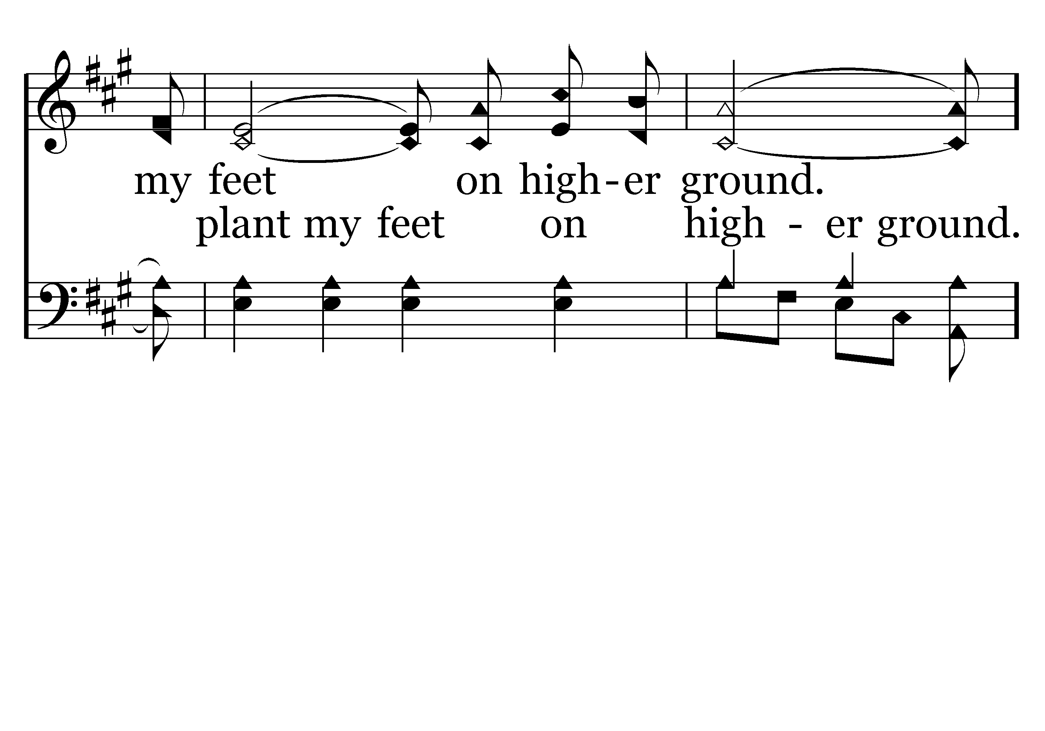
002 - Higher Ground - 1.3

Slide 5
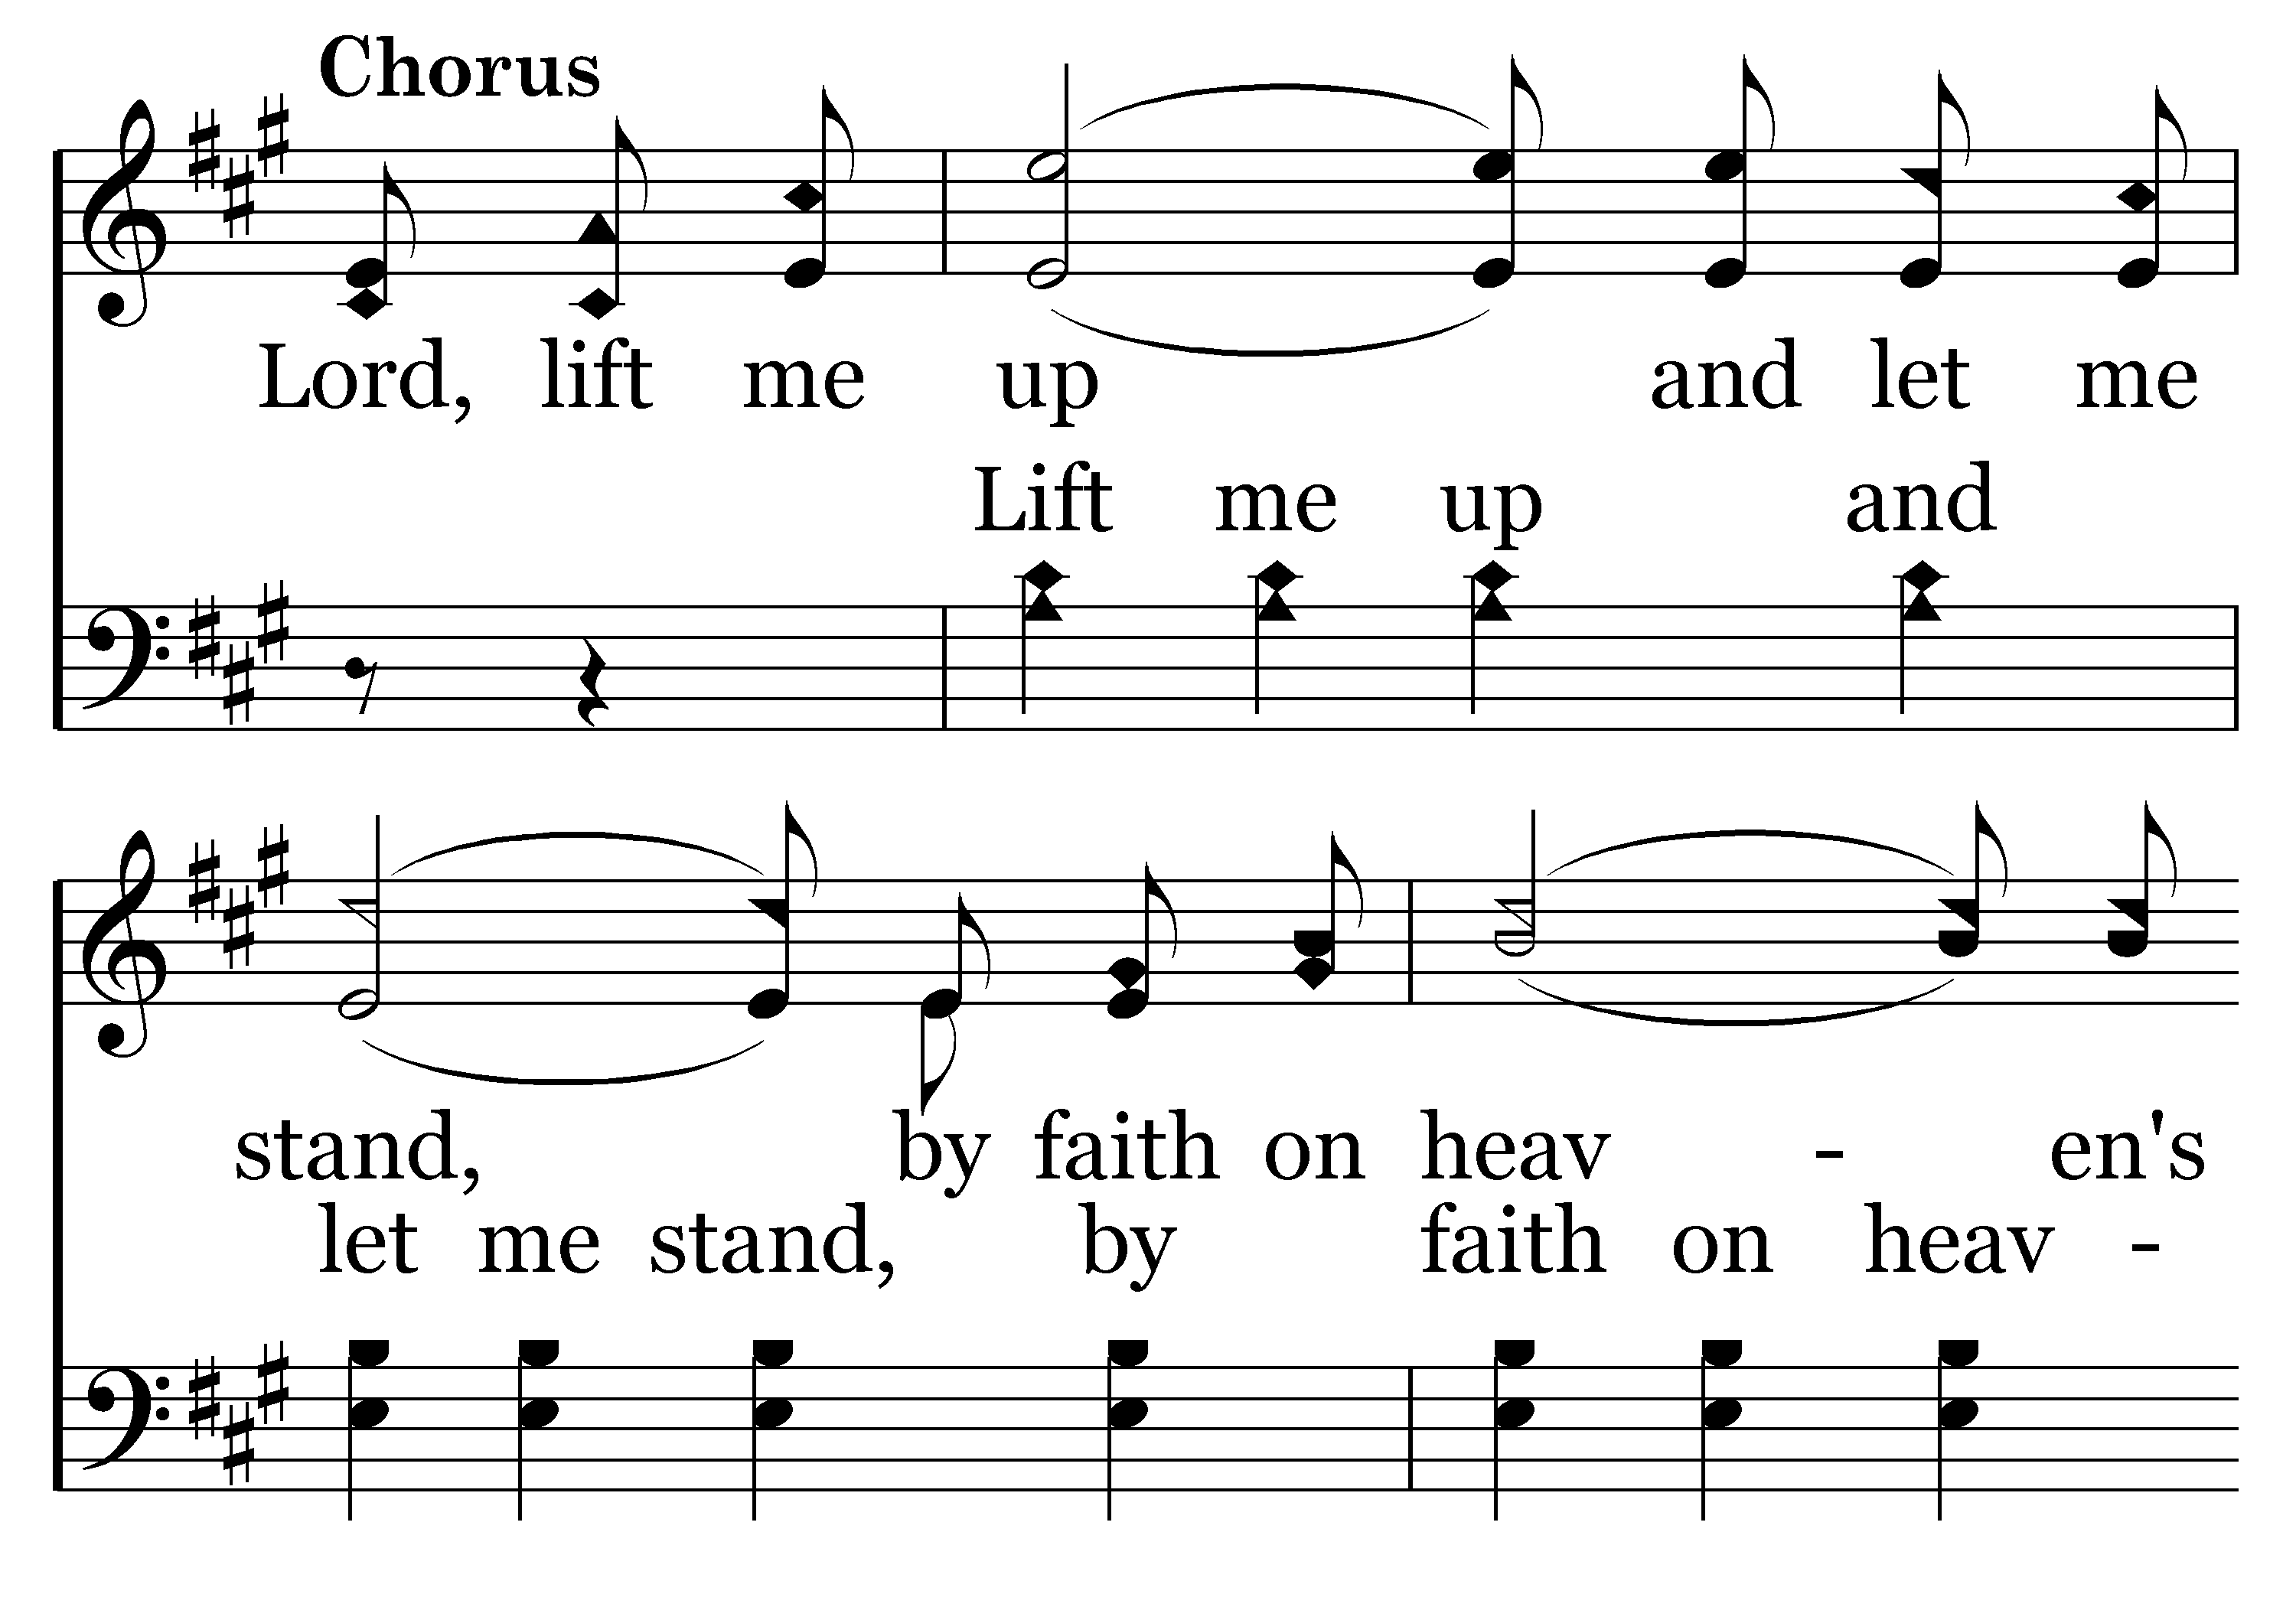
002 - Higher Ground - C.1

Slide 6
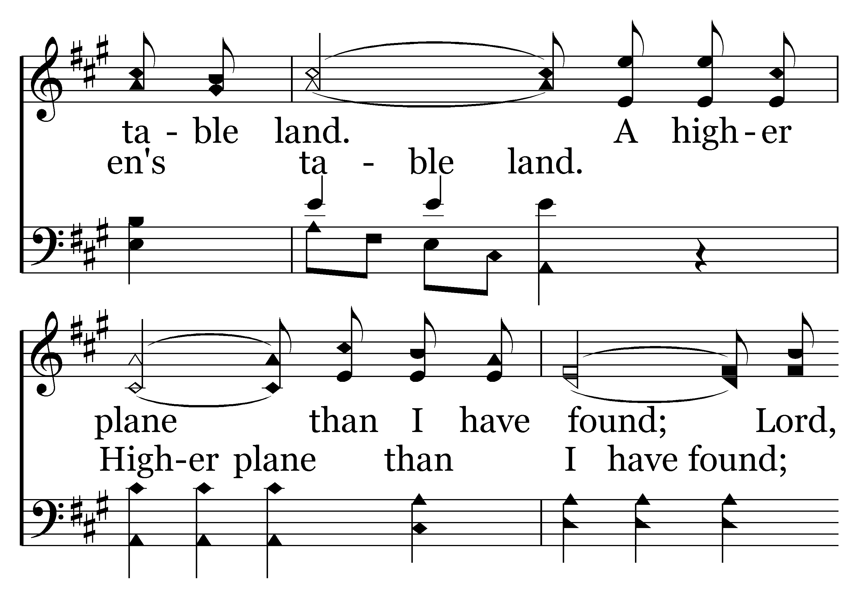
002 - Higher Ground - C.2

Slide 7
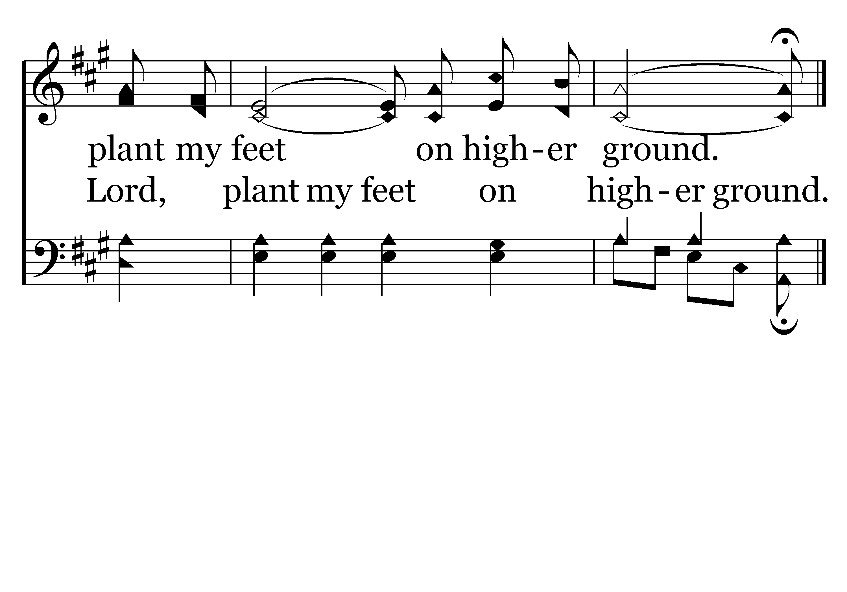
002 - Higher Ground - C.3
End of Verse 1

Slide 8
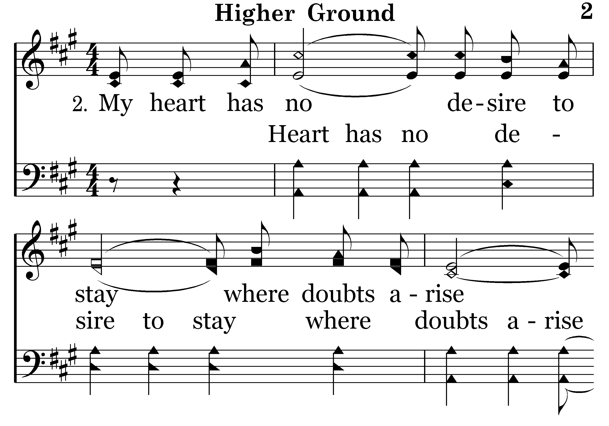
002 - Higher Ground - 2.1

Slide 9
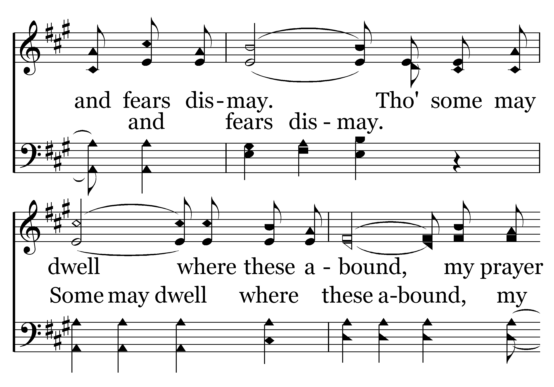
002 - Higher Ground - 2.2

Slide 10
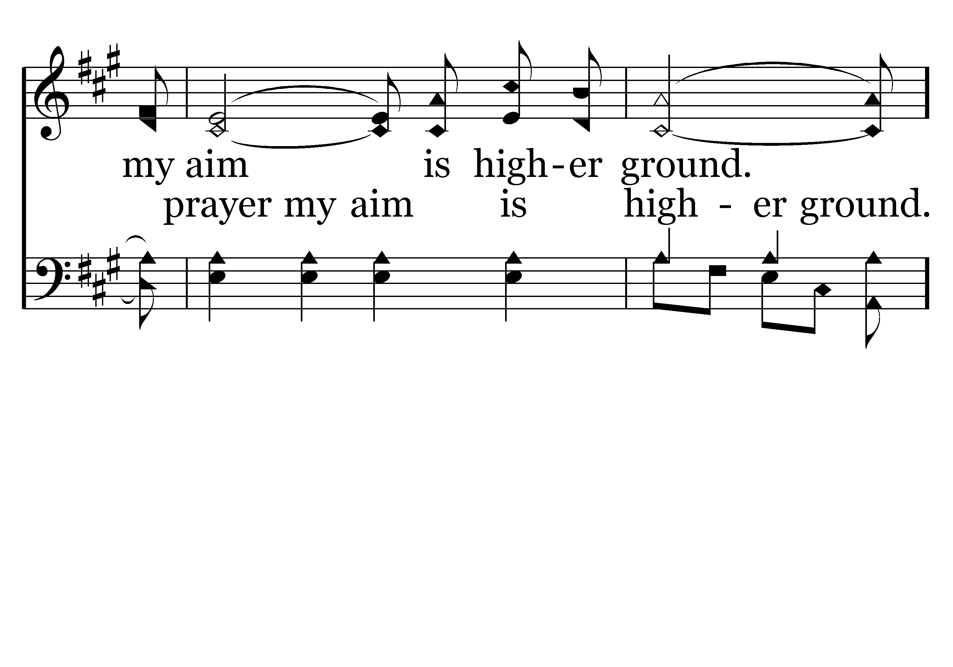
002 - Higher Ground - 2.3

Slide 11
002 - Higher Ground - C.1

Slide 12
002 - Higher Ground - C.2

Slide 13
002 - Higher Ground - C.3
End of Verse 2

Slide 14
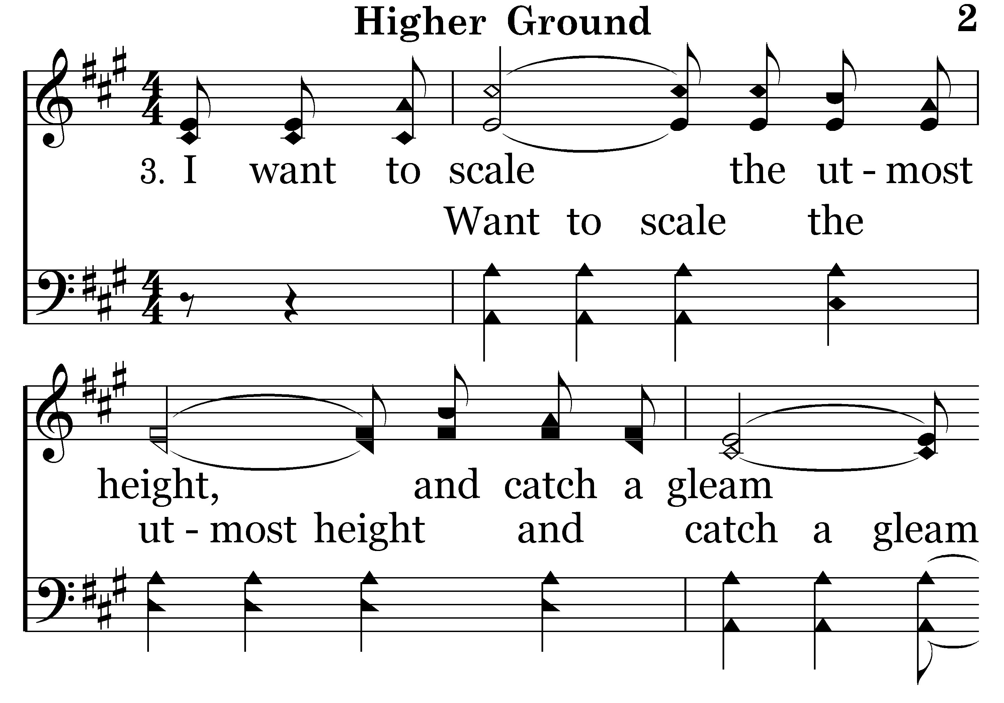
002 - Higher Ground - 3.1

Slide 15
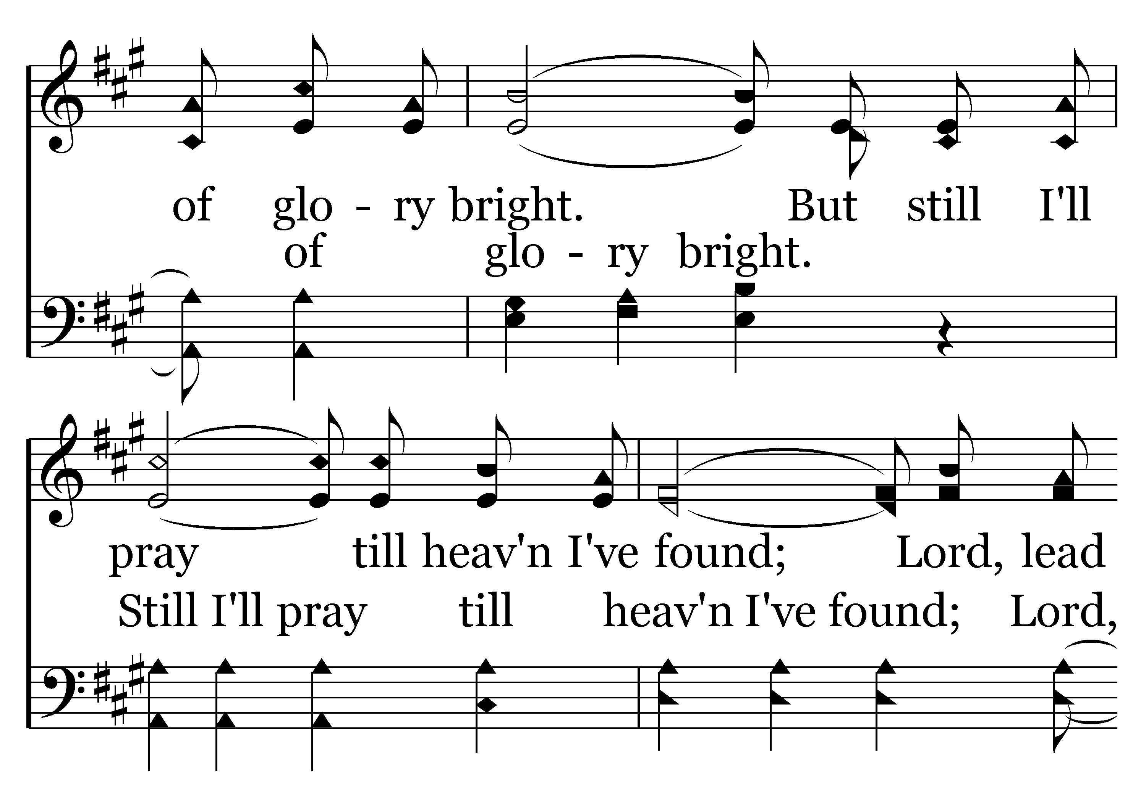
002 - Higher Ground - 3.2

Slide 16
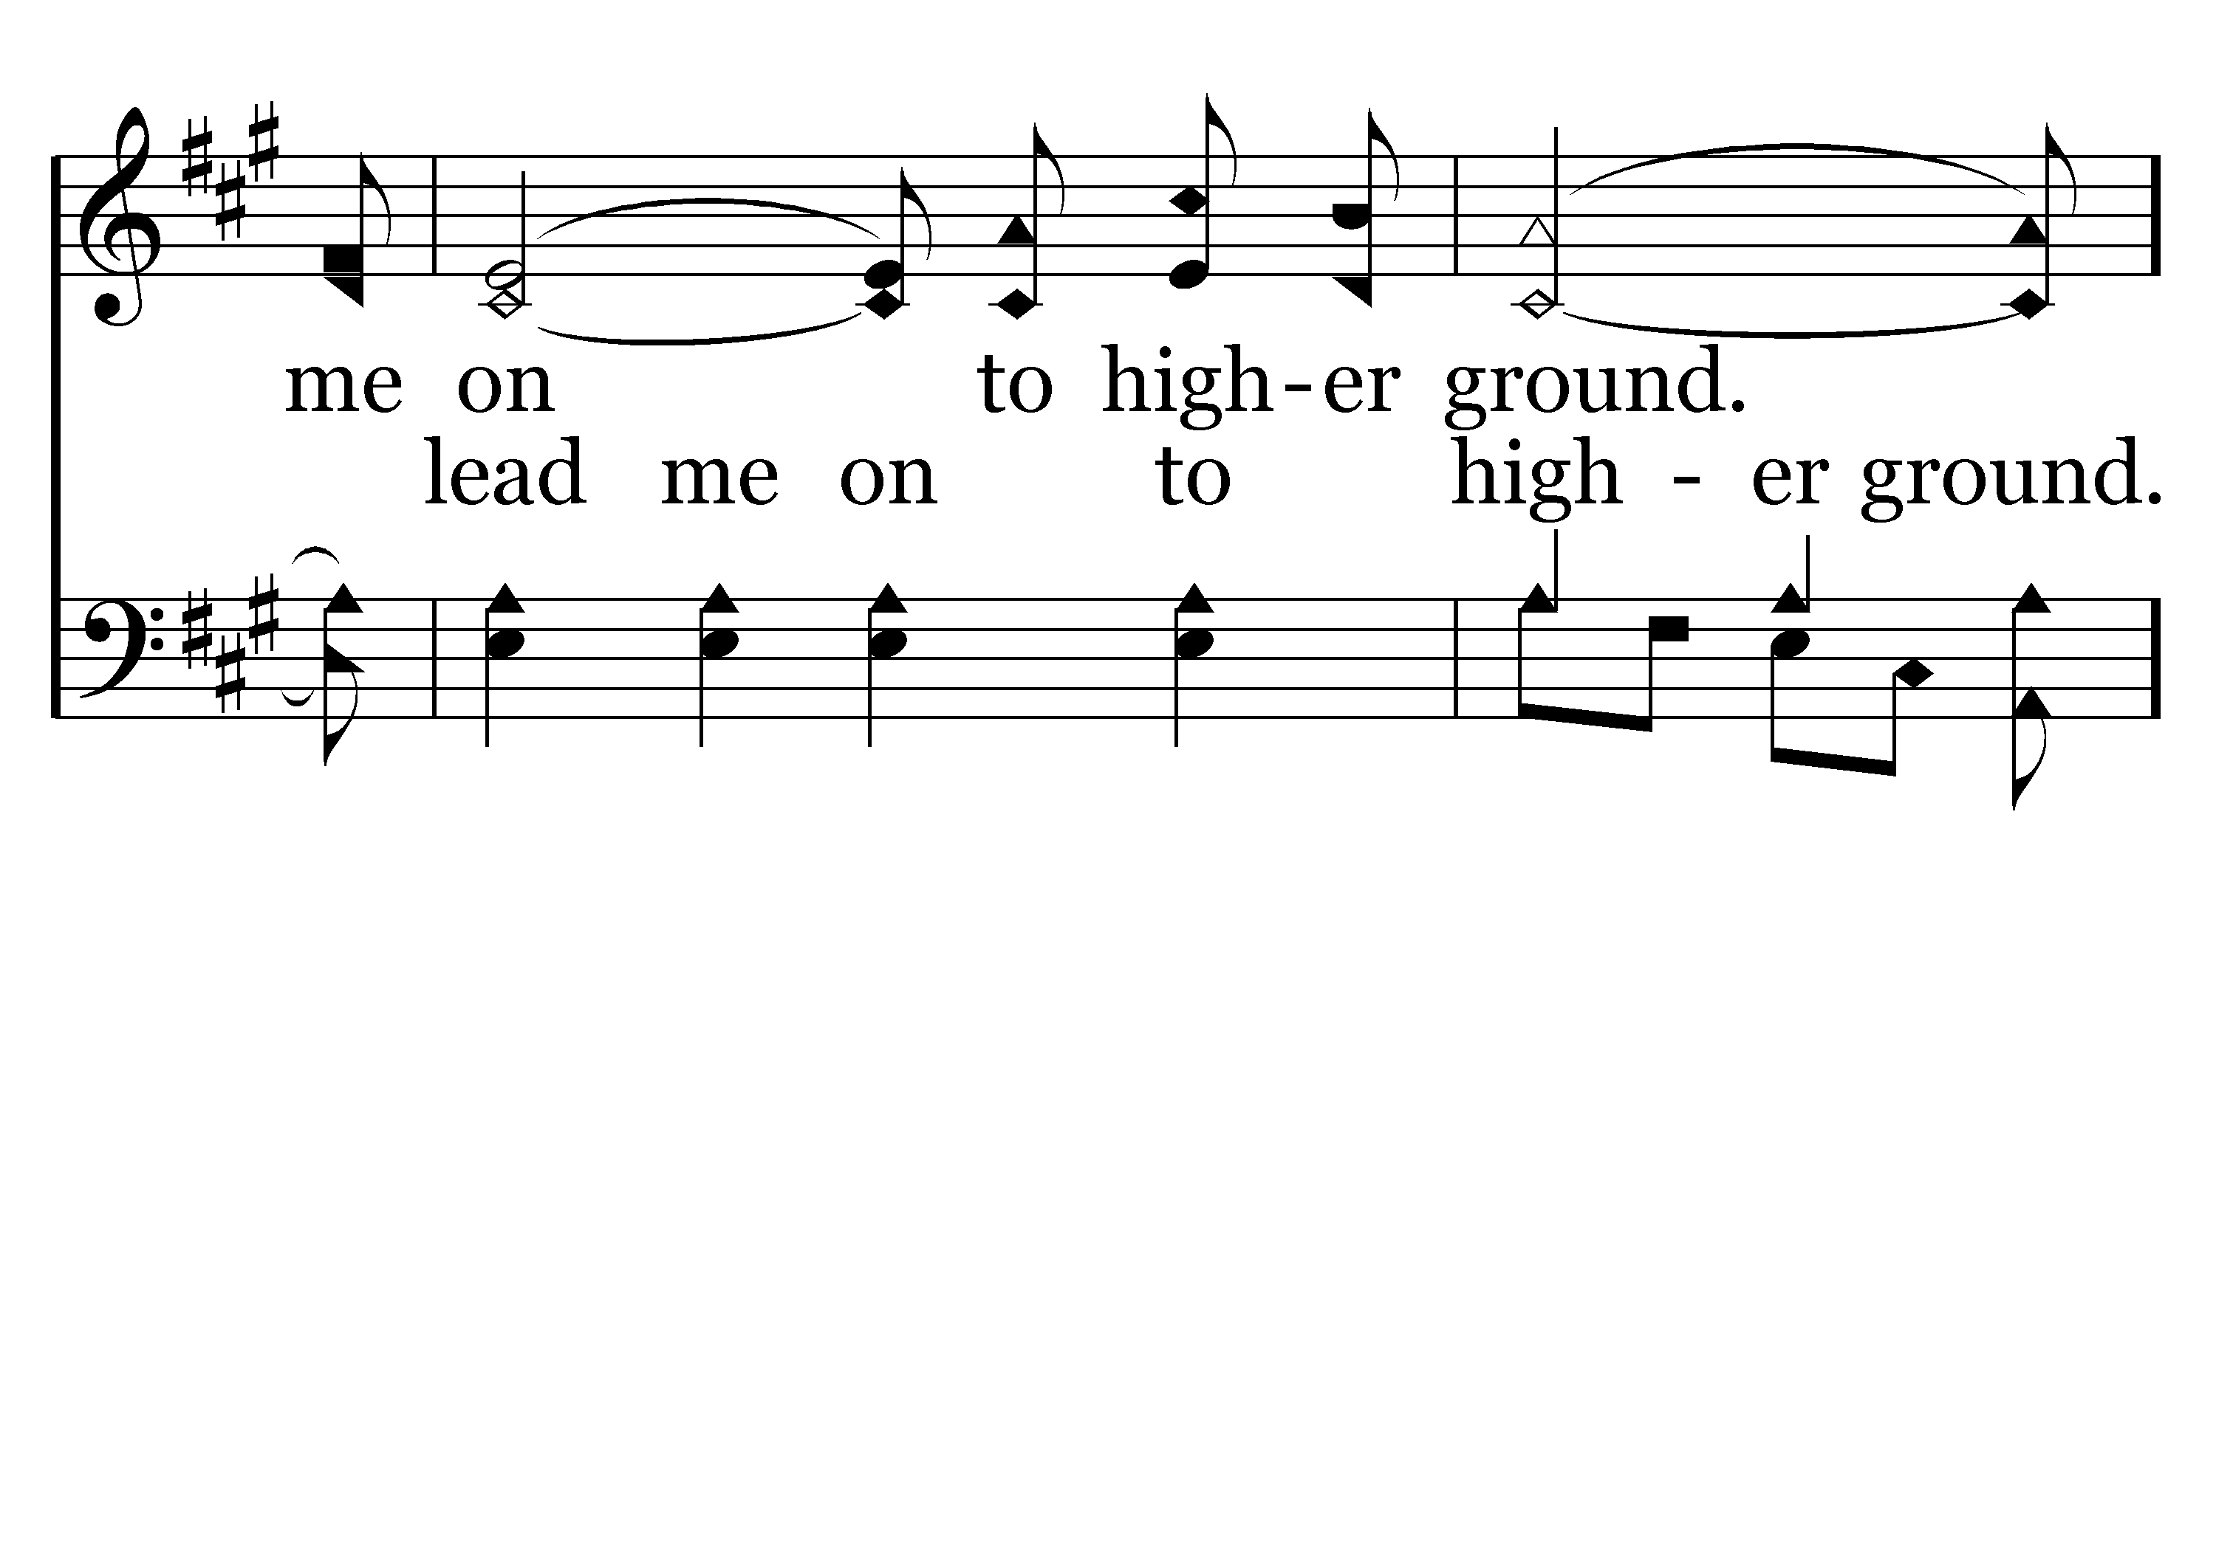
002 - Higher Ground - 3.3

Slide 17
002 - Higher Ground - C.1

Slide 18
002 - Higher Ground - C.2

Slide 19
002 - Higher Ground - C.3
End of Song

Slide 20
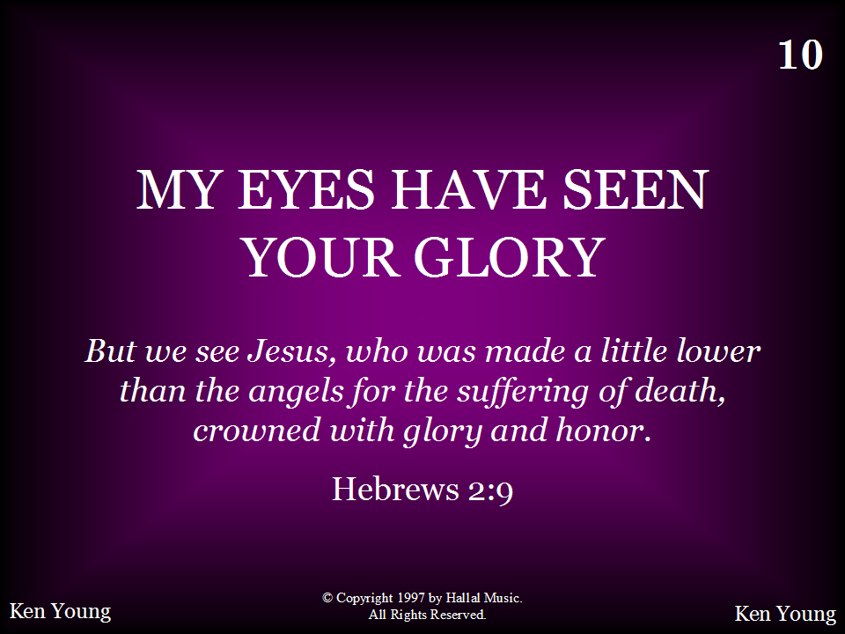
010 - My Eyes Have Seen Your Glory - Title

Slide 21
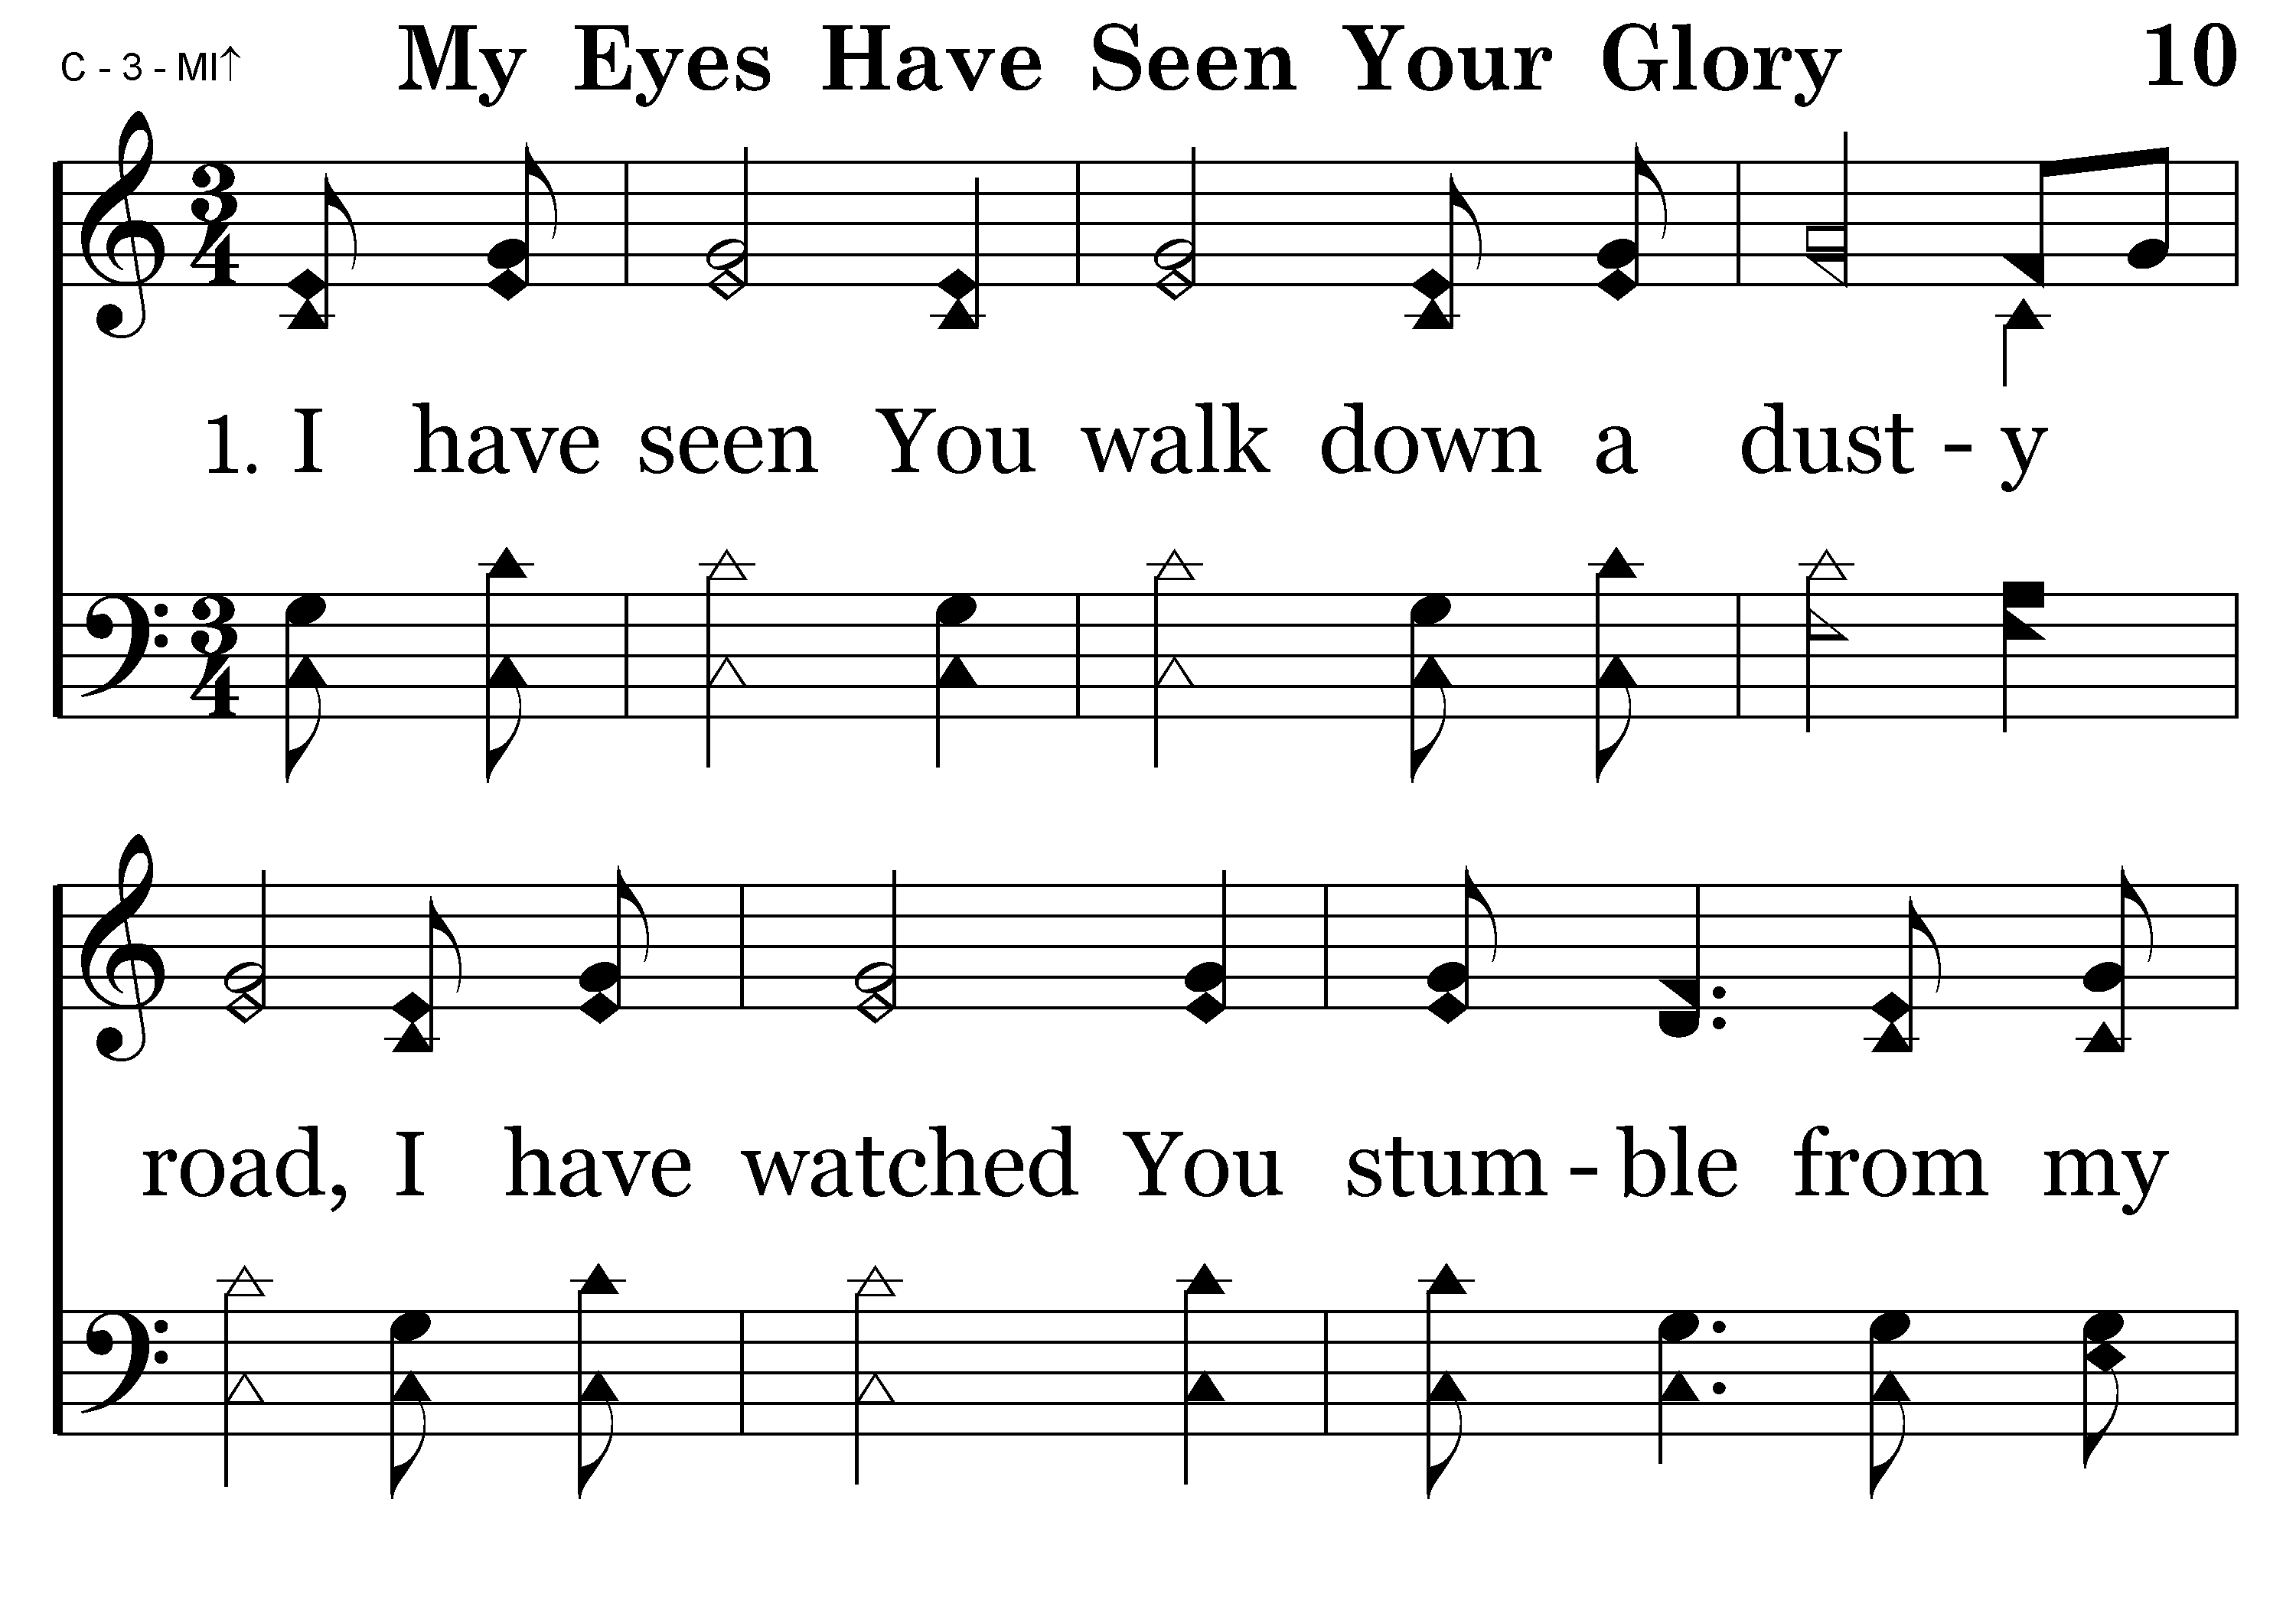
010 - My Eyes Have Seen Your Glory - 1.1

Slide 22
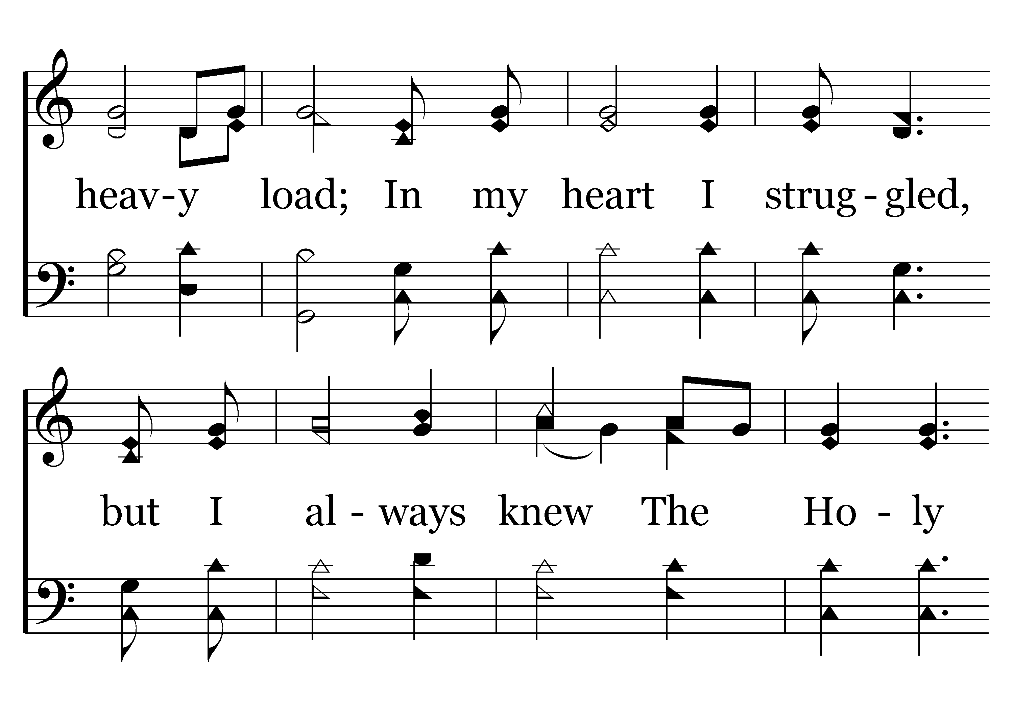
010 - My Eyes Have Seen Your Glory - 1.2

Slide 23
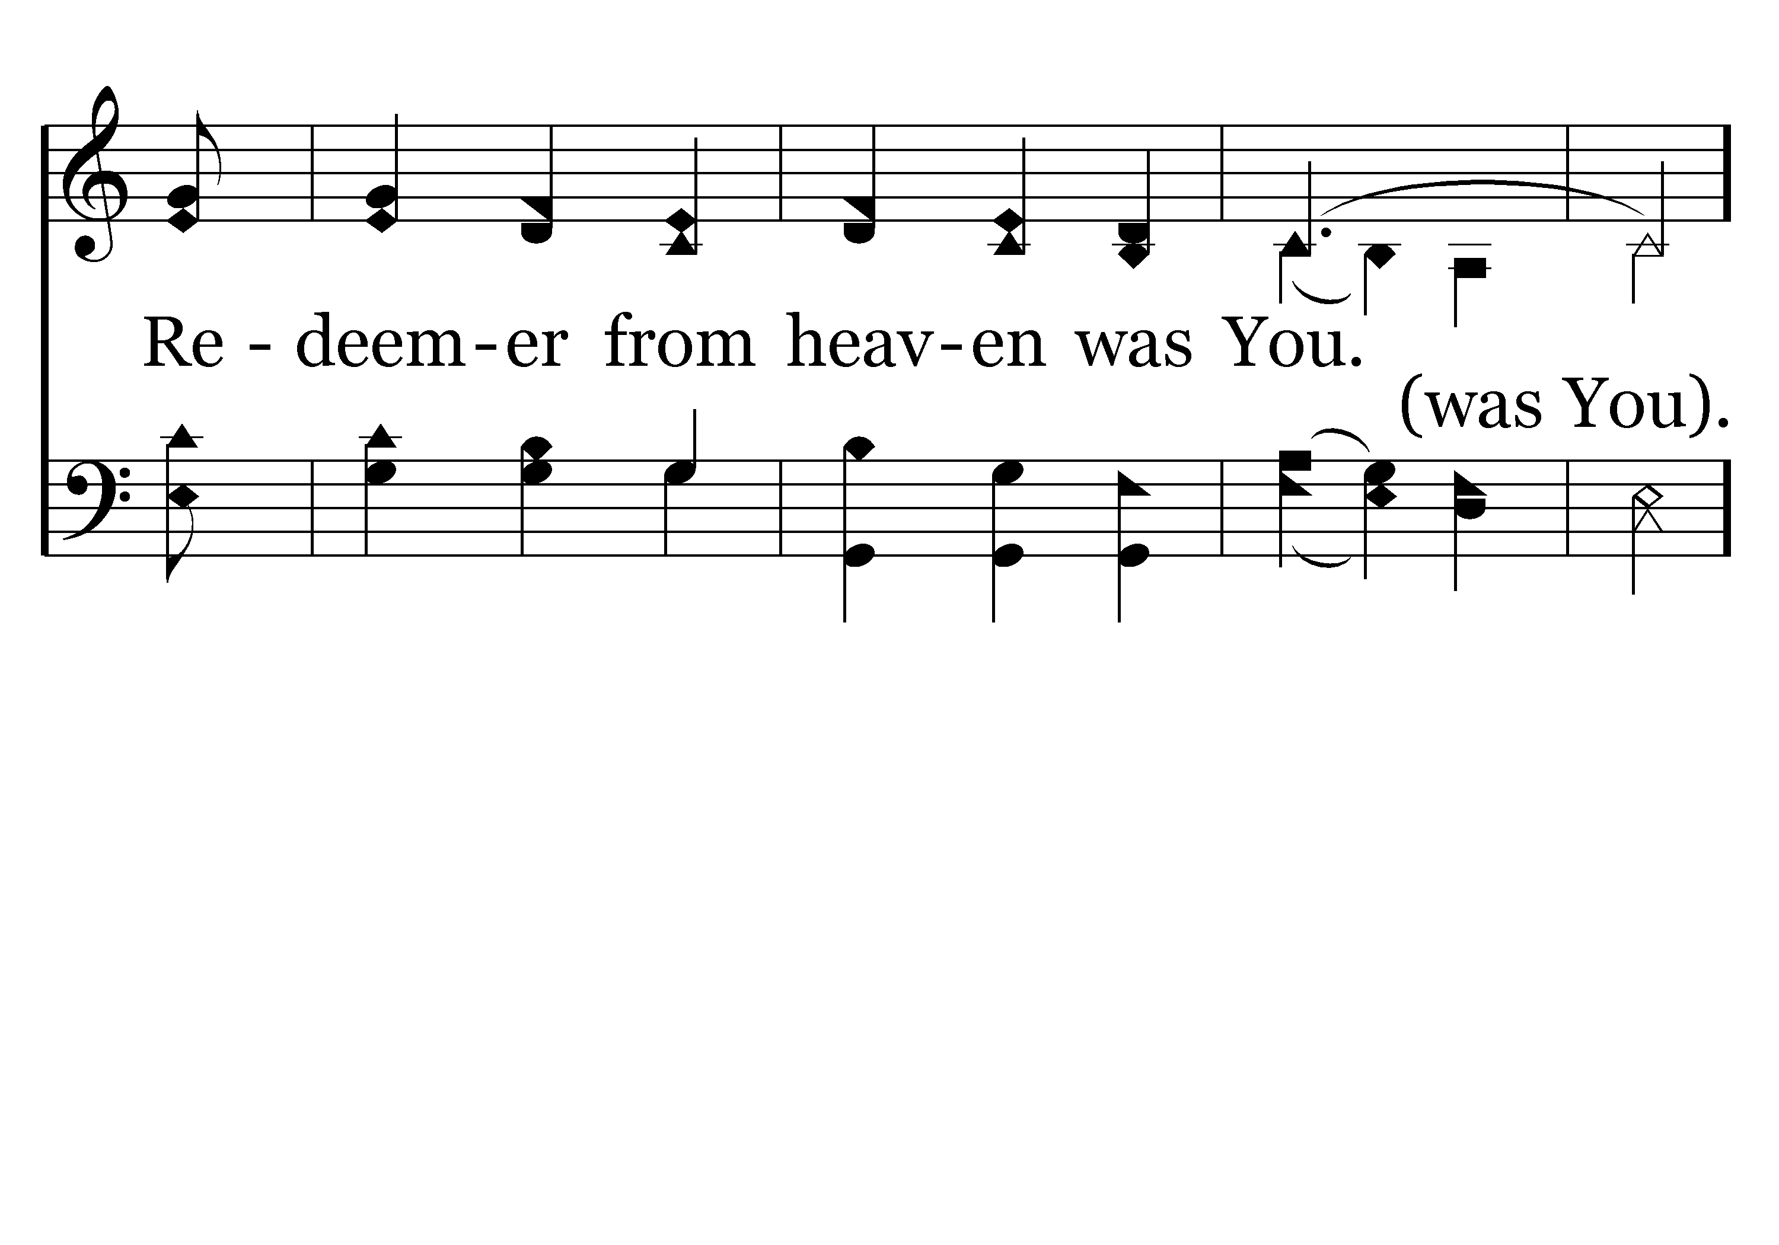
010 - My Eyes Have Seen Your Glory - 1.3

Slide 24
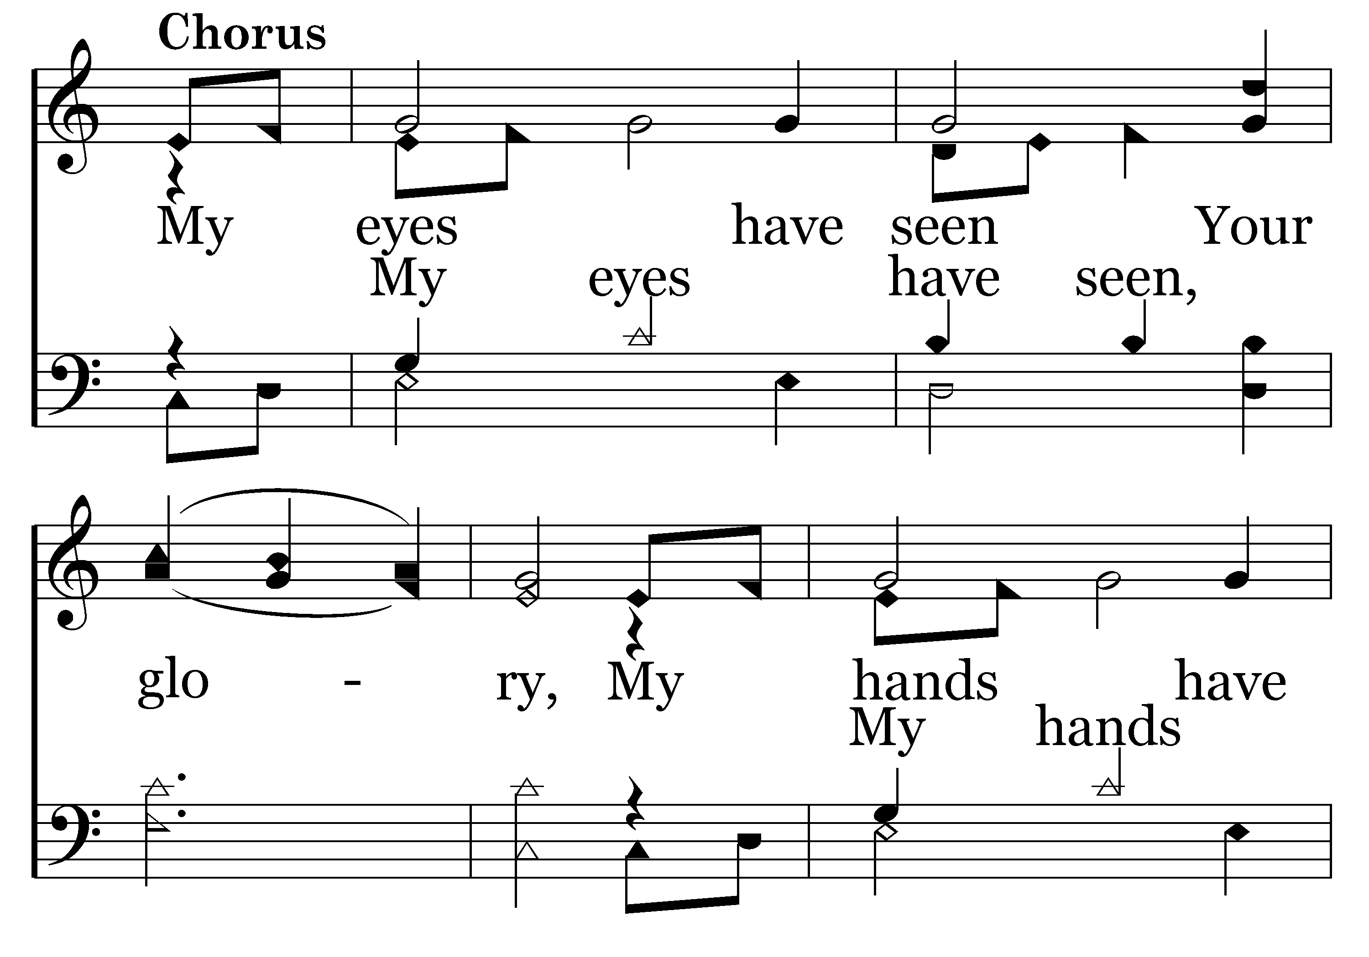
010 - My Eyes Have Seen Your Glory - C.1

Slide 25
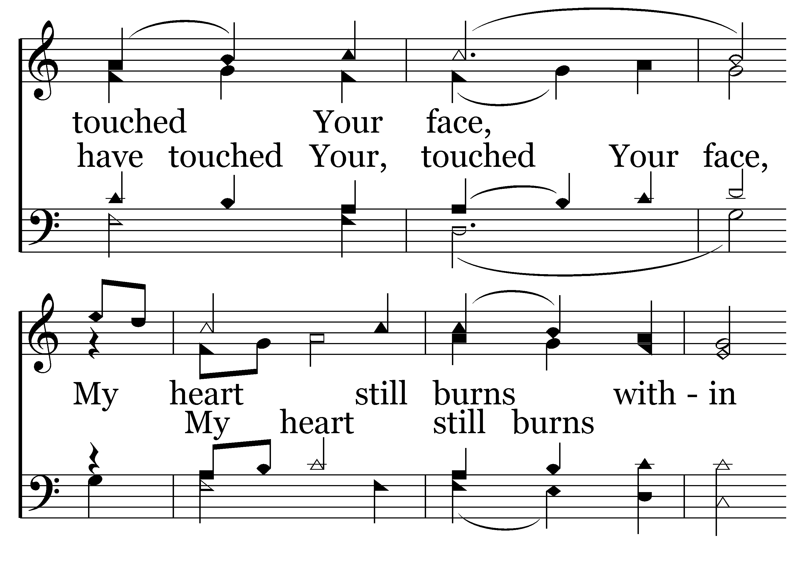
010 - My Eyes Have Seen Your Glory - C.2

Slide 26
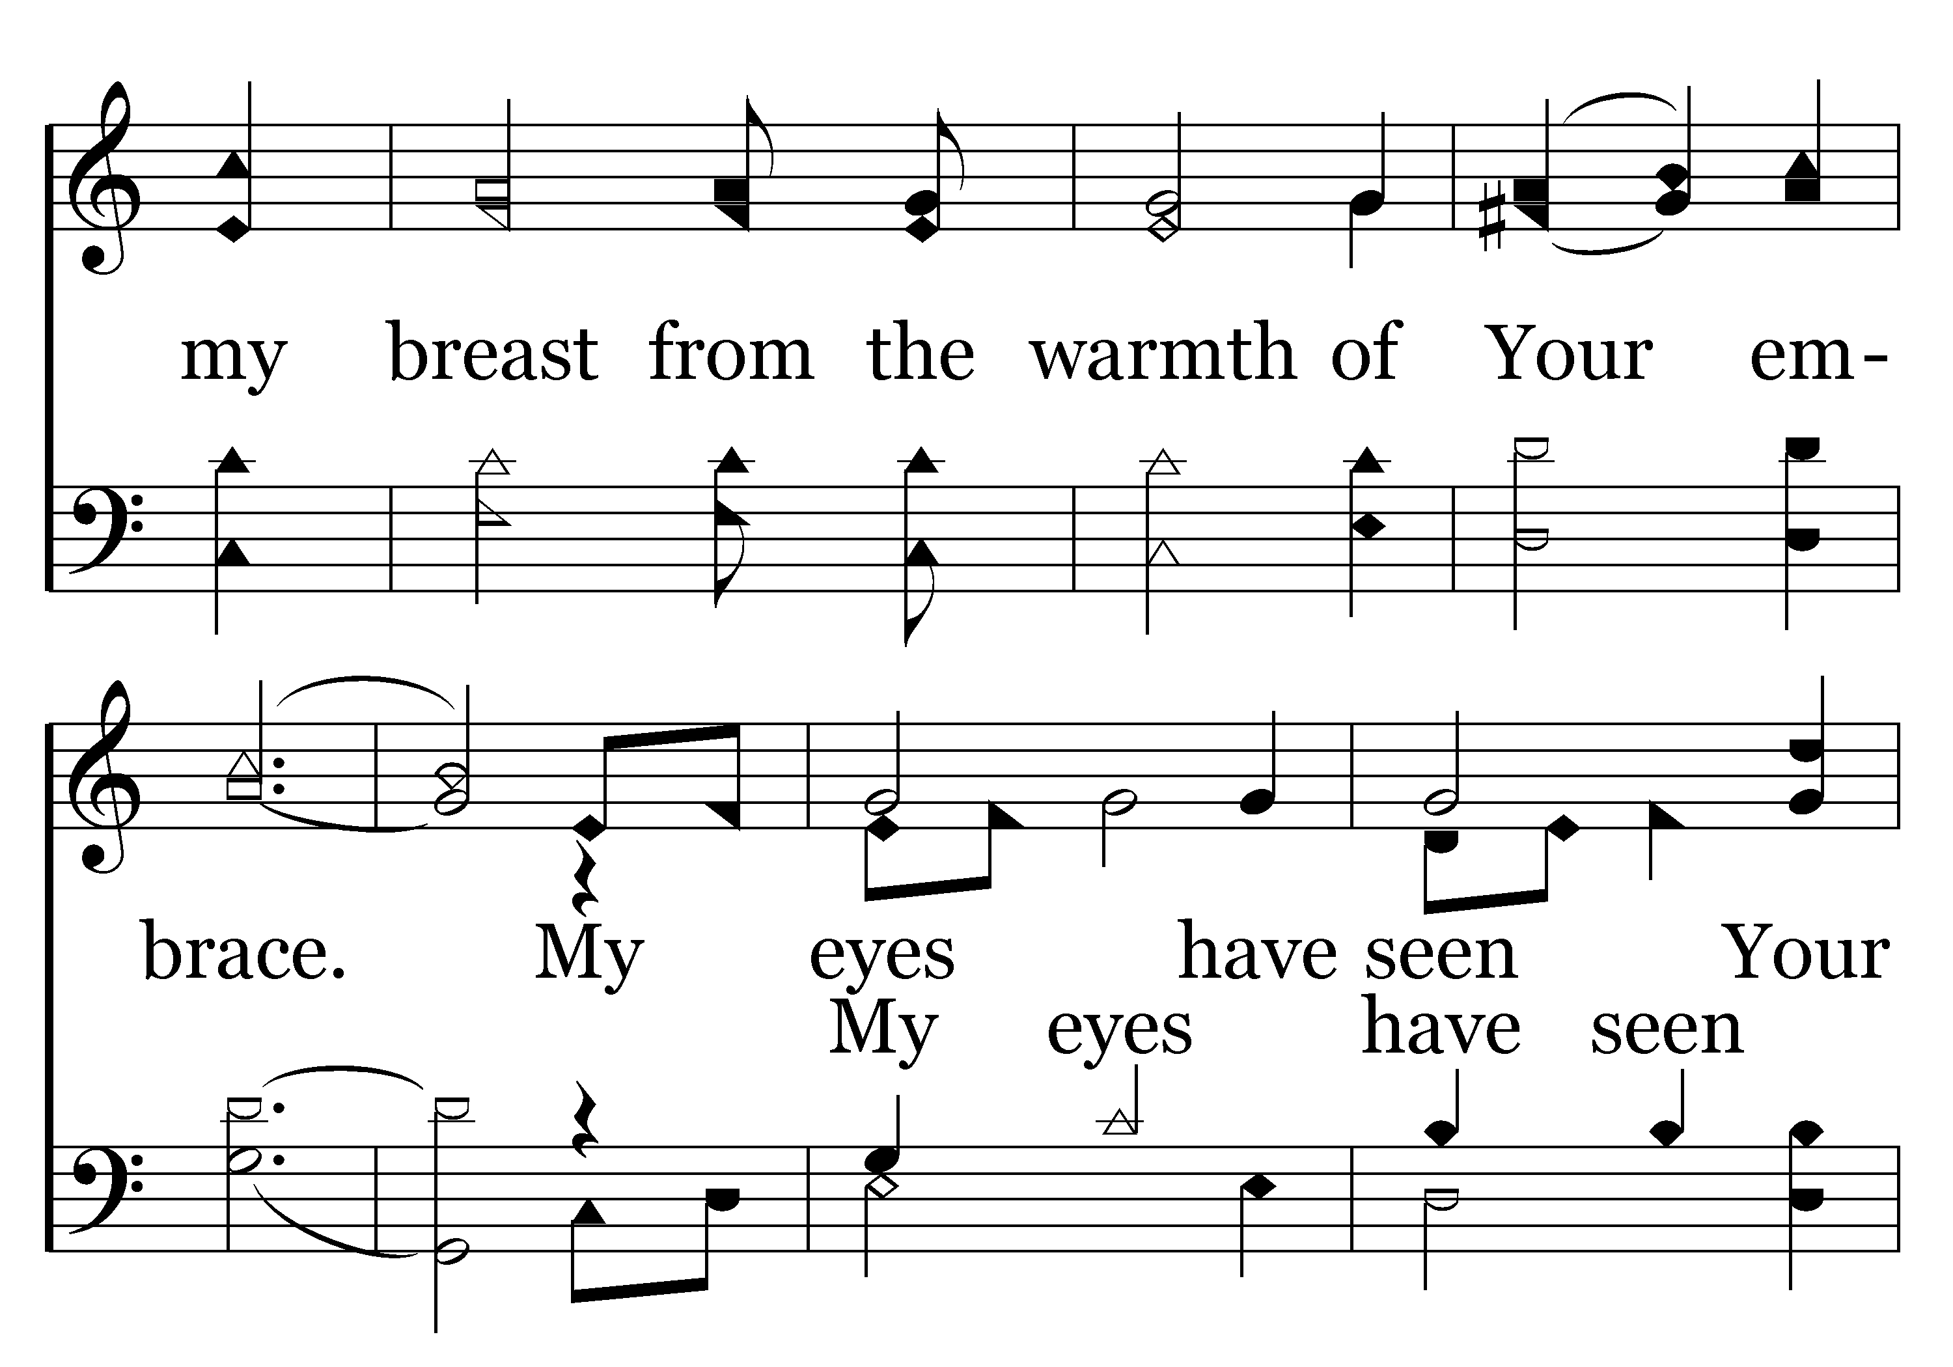
010 - My Eyes Have Seen Your Glory - C.3

Slide 27
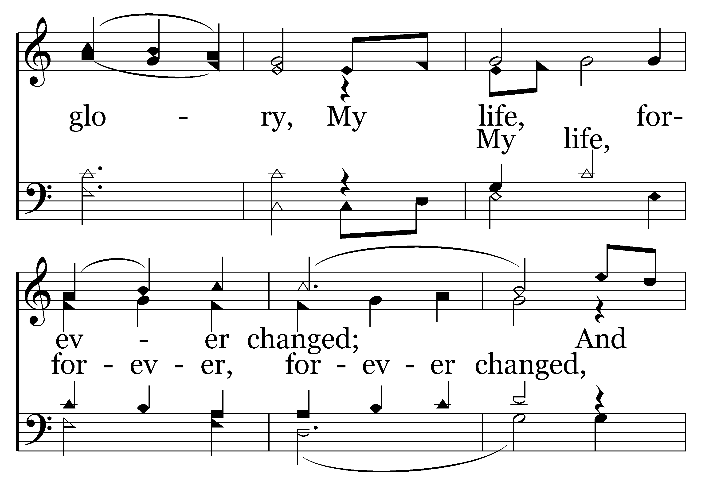
010 - My Eyes Have Seen Your Glory - C.4

Slide 28
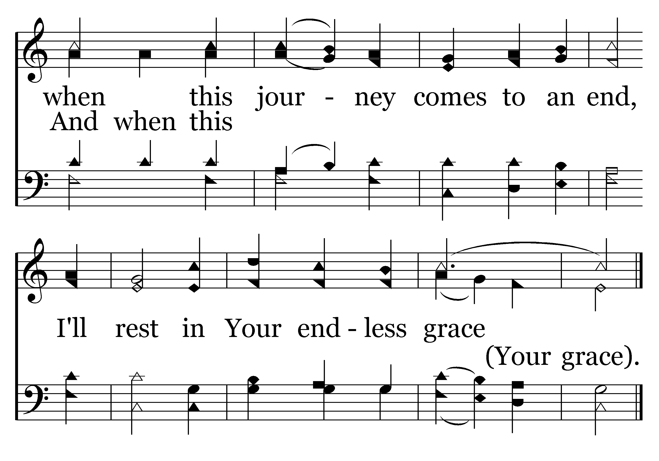
010 - My Eyes Have Seen Your Glory - C.5
End of Verse 1

Slide 29
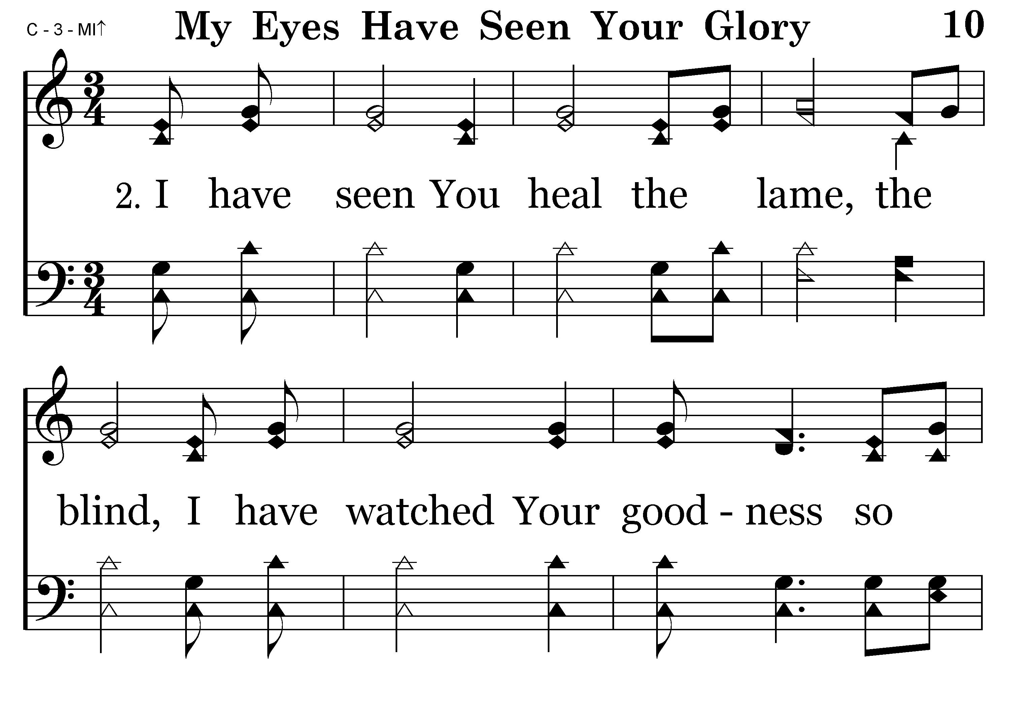
010 - My Eyes Have Seen Your Glory - 2.1

Slide 30
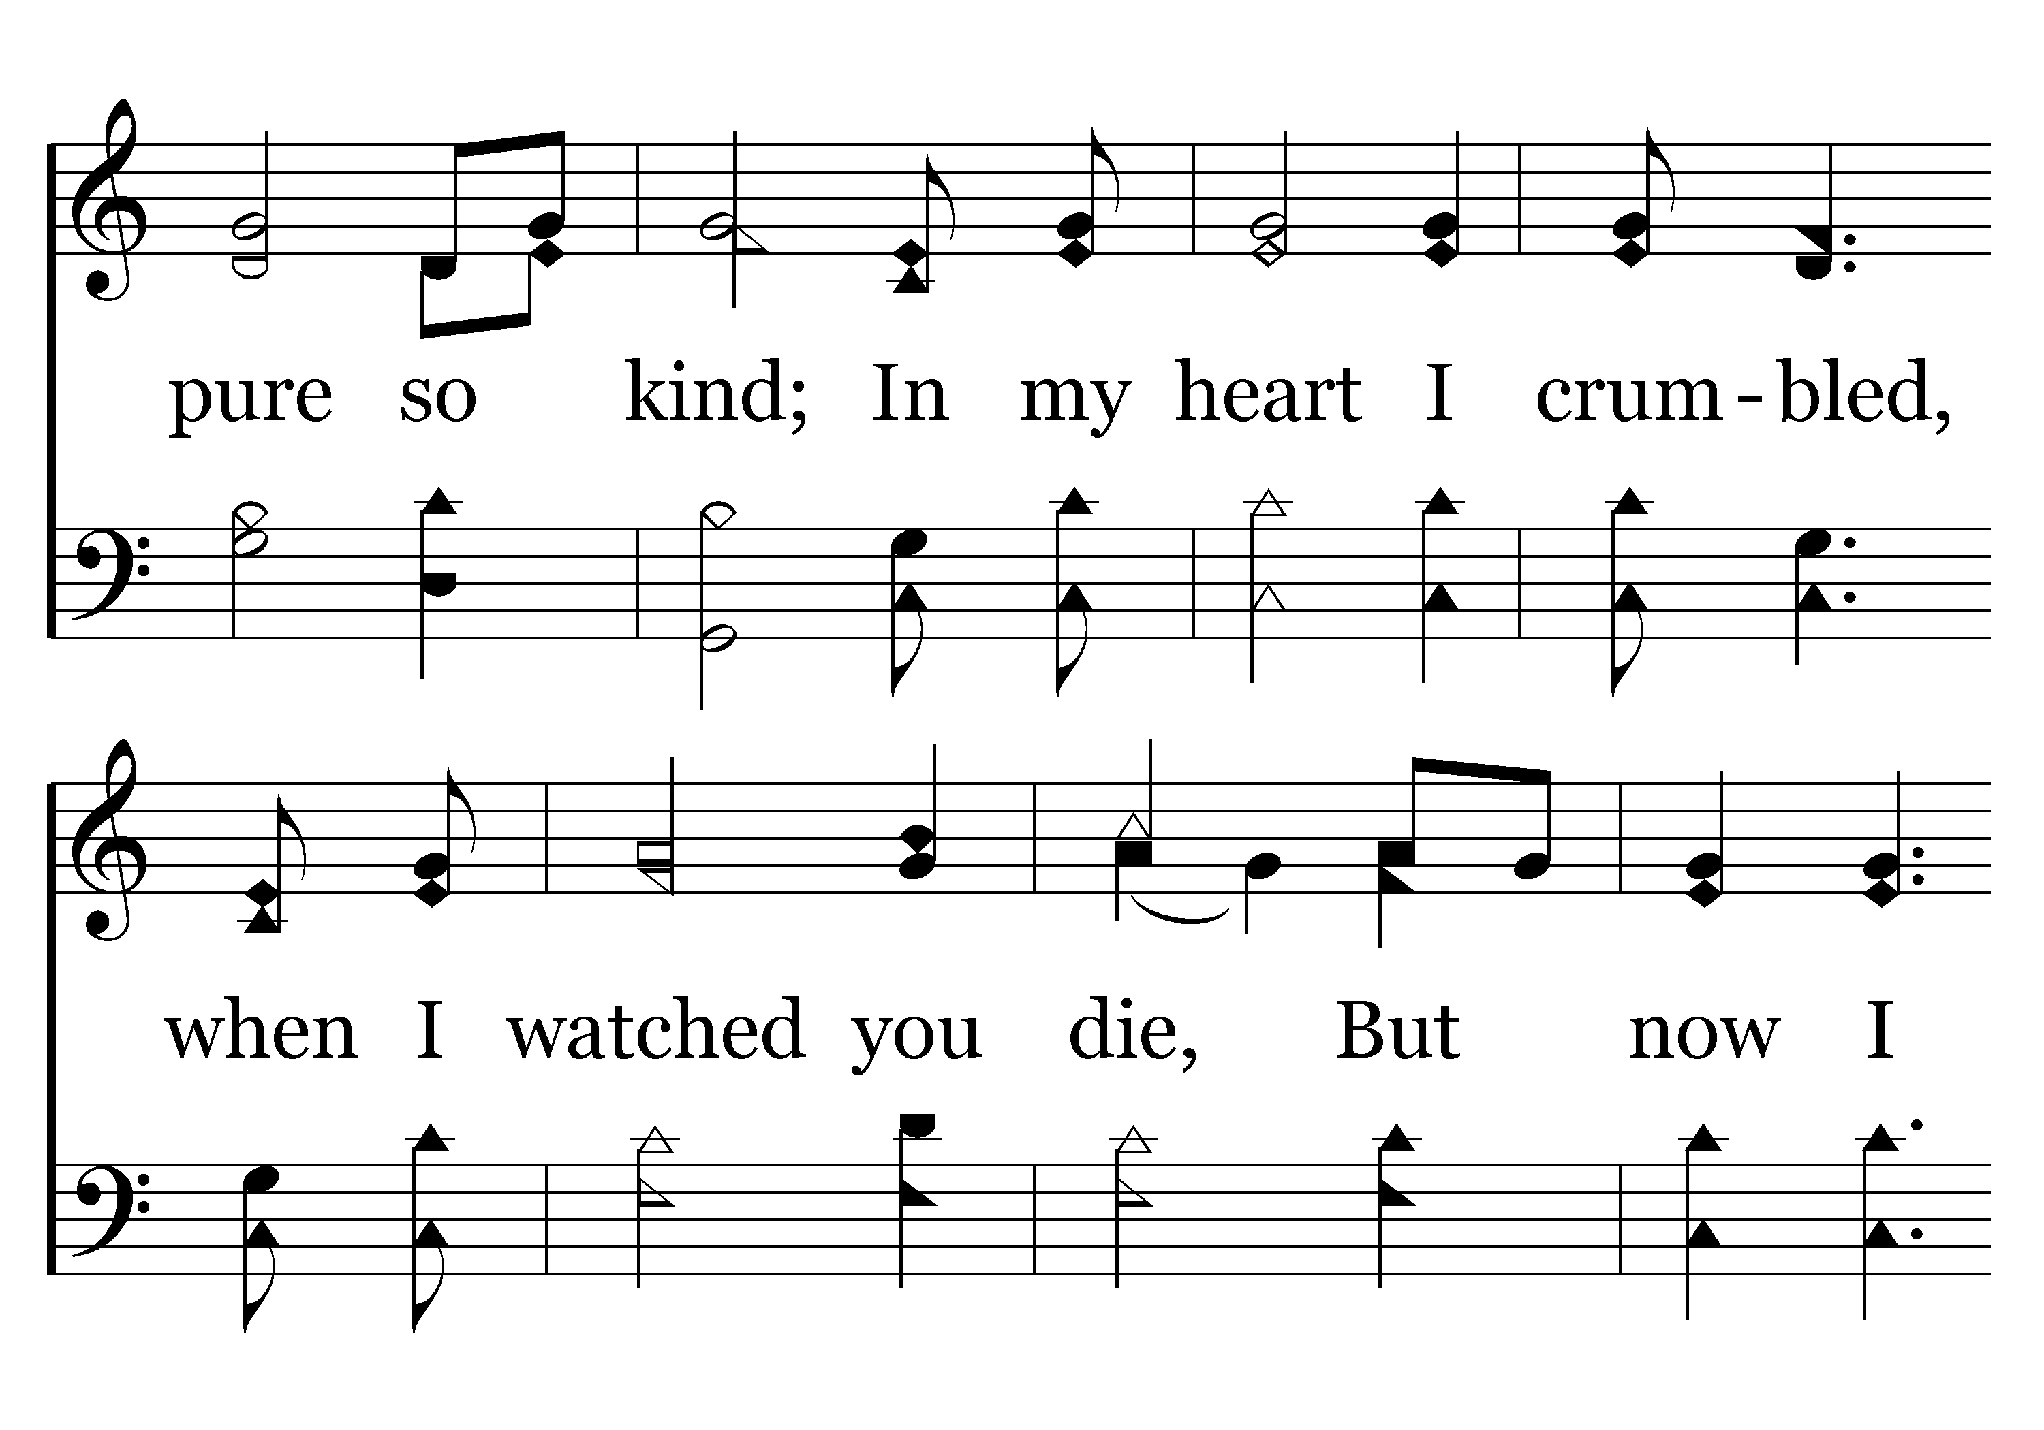
010 - My Eyes Have Seen Your Glory - 2.2

Slide 31
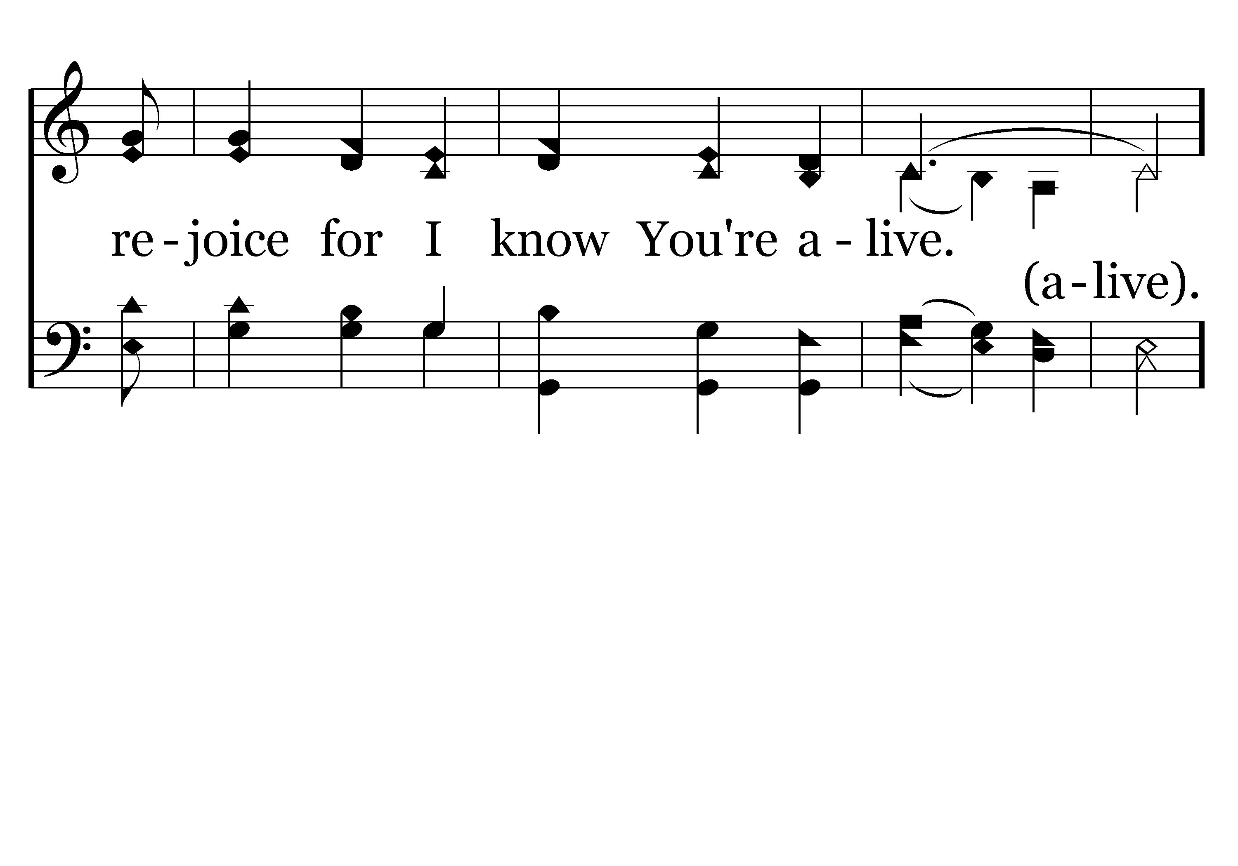
010 - My Eyes Have Seen Your Glory - 2.3

Slide 32
010 - My Eyes Have Seen Your Glory - C.1

Slide 33
010 - My Eyes Have Seen Your Glory - C.2

Slide 34
010 - My Eyes Have Seen Your Glory - C.3

Slide 35
010 - My Eyes Have Seen Your Glory - C.4

Slide 36
010 - My Eyes Have Seen Your Glory - C.5
End of Song

Slide 37
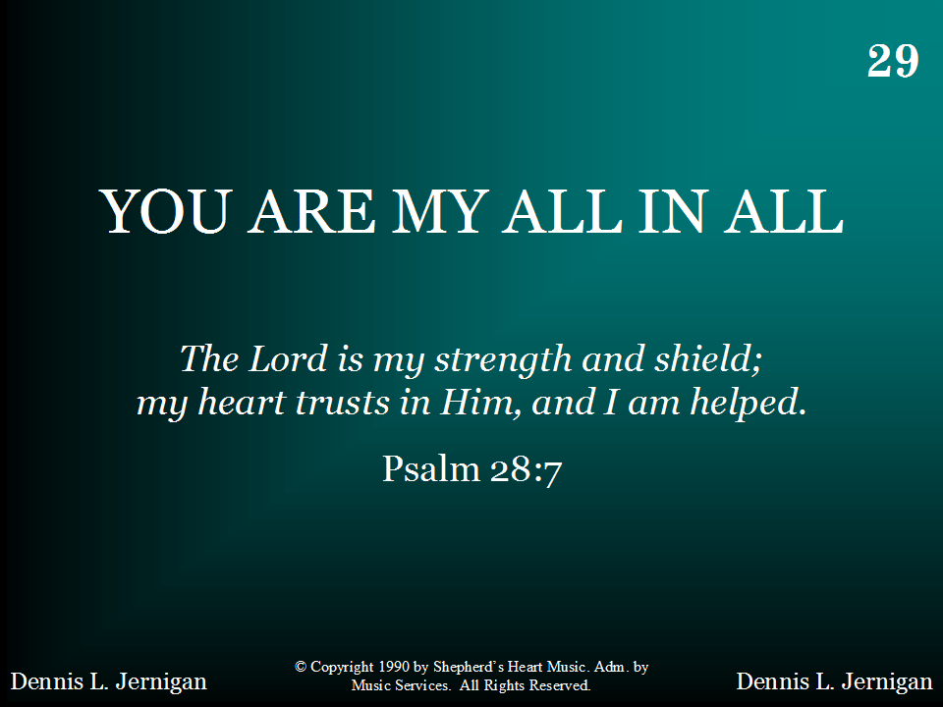
029 - You Are My All In All - Title

Slide 38
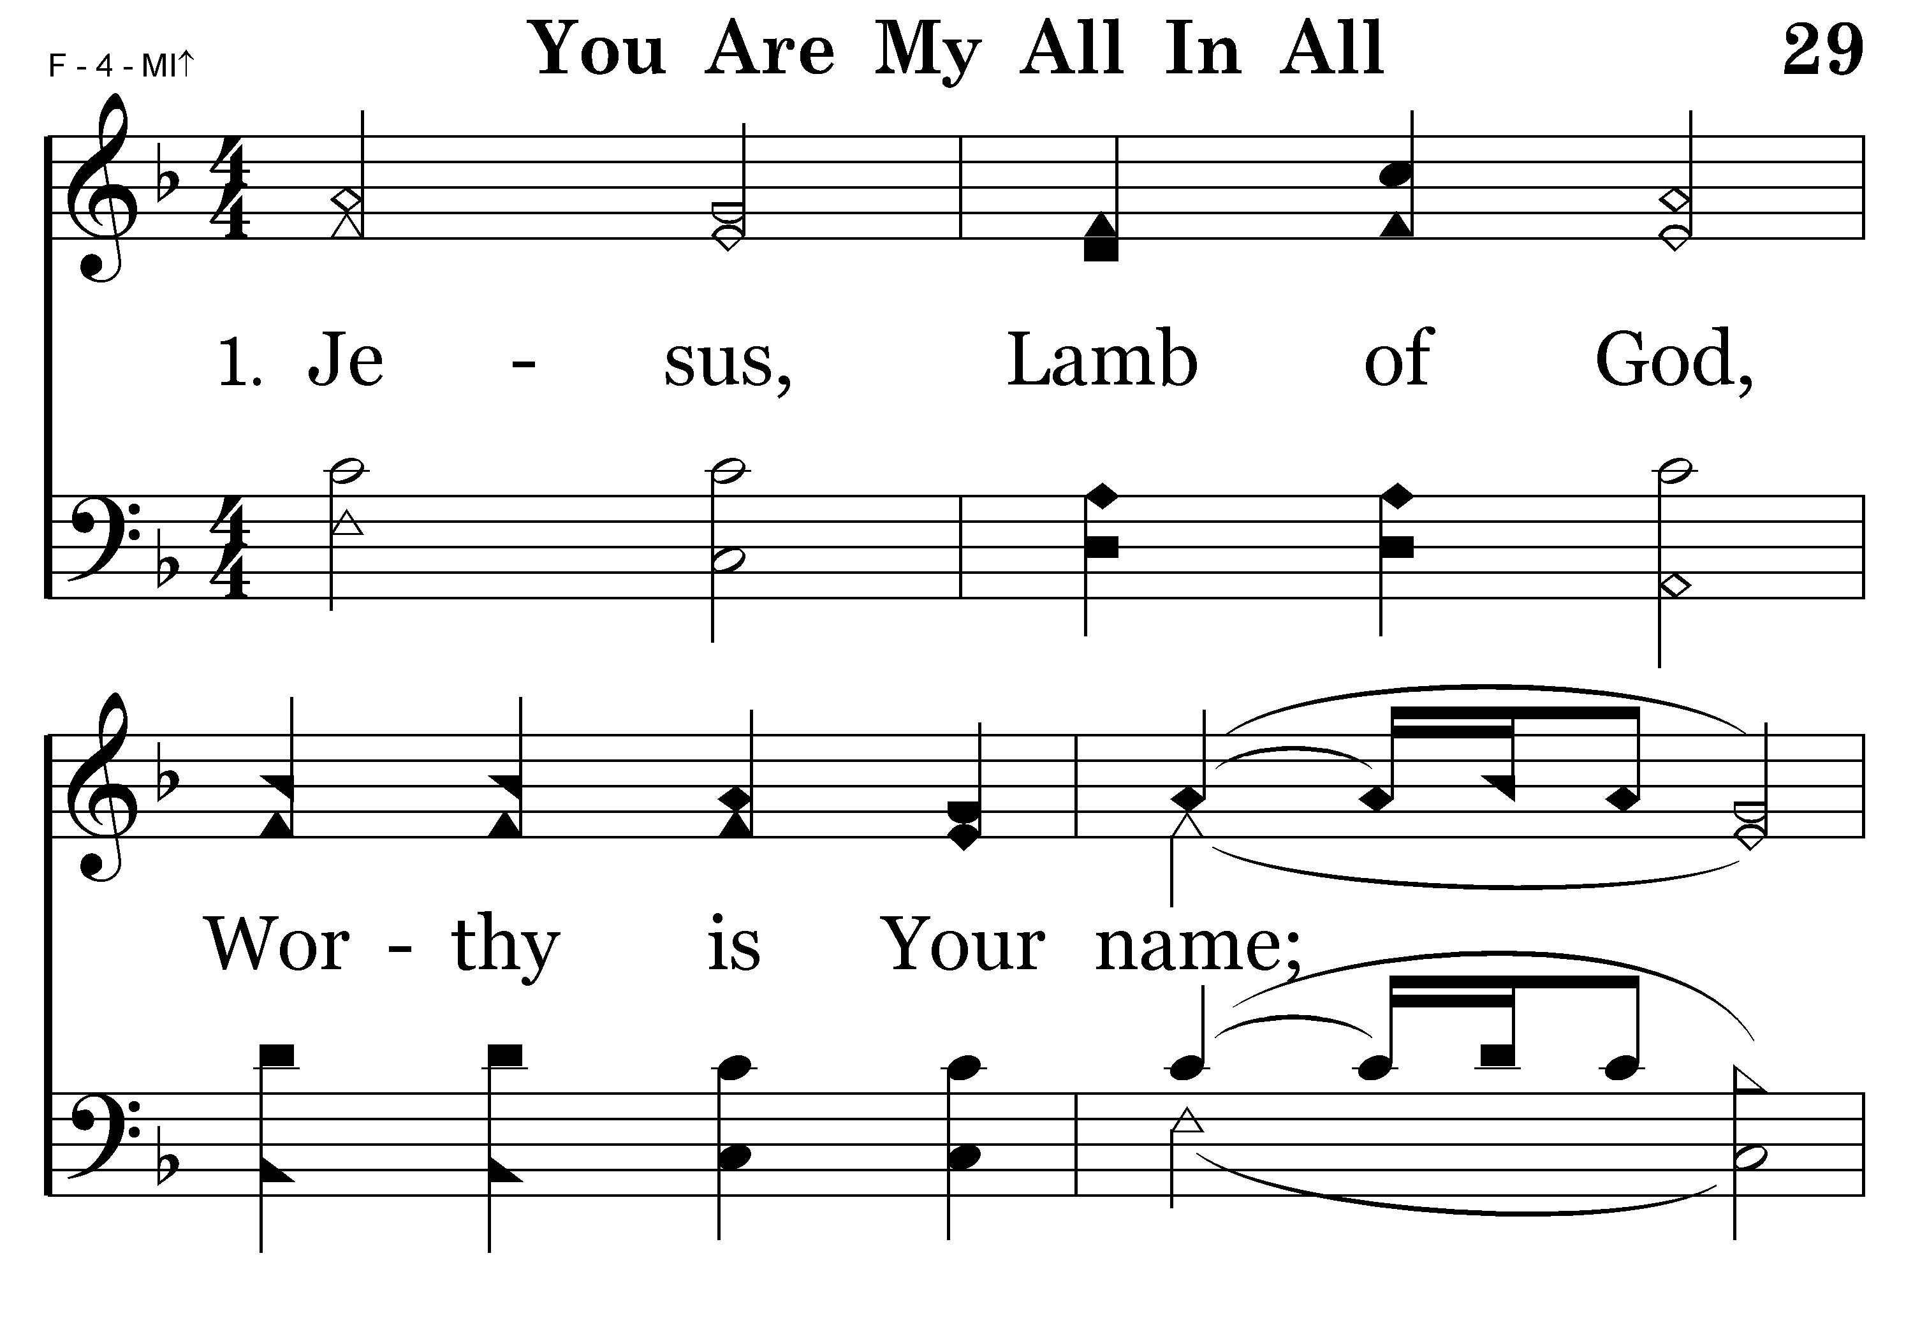
029 - You Are My All In All - 1.1

Slide 39
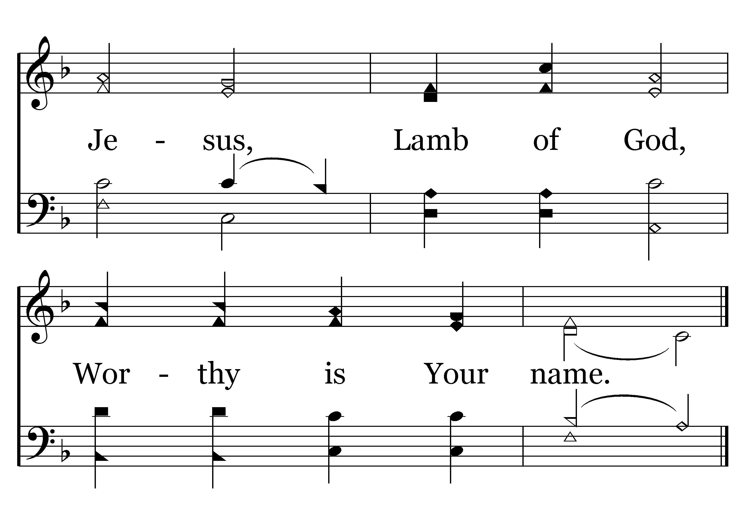
029 - You Are My All In All - 1.2
End of Verse 1

Slide 40
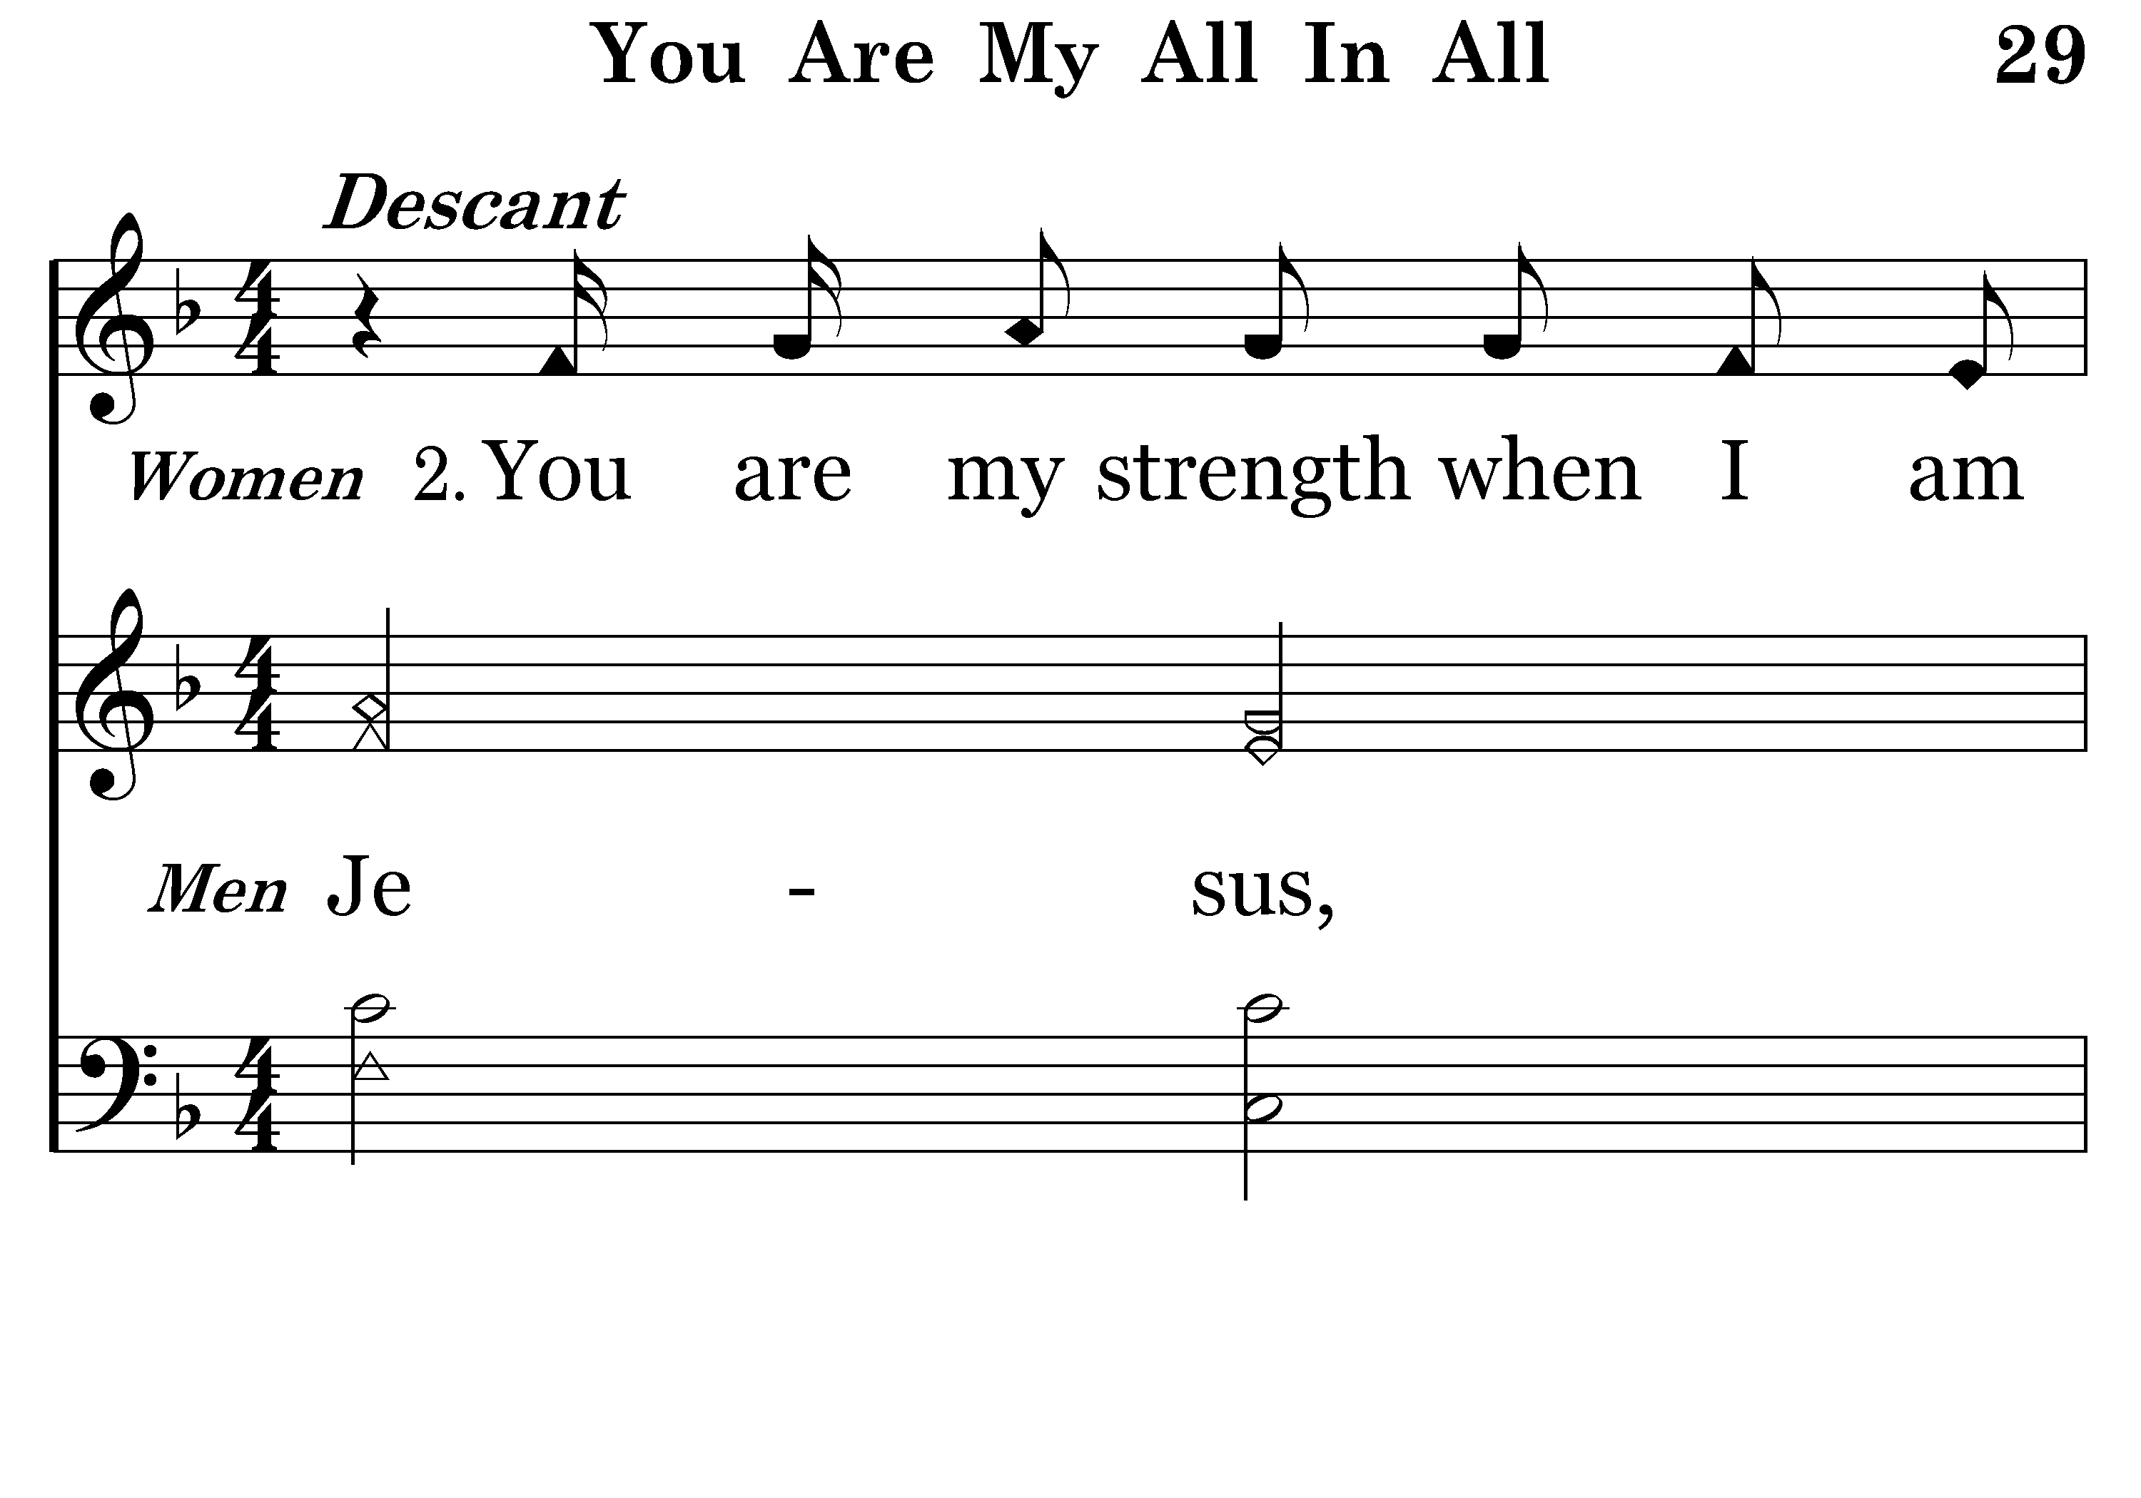
029 - You Are My All In All - 2.1

Slide 41
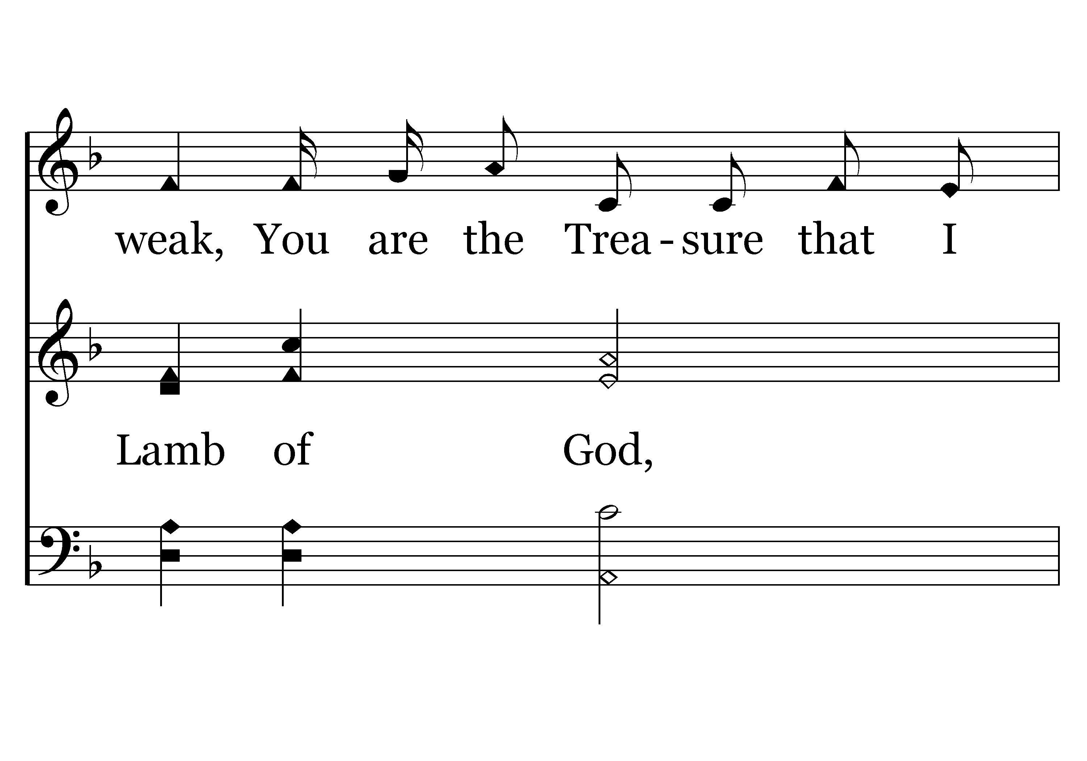
029 - You Are My All In All - 2.2

Slide 42
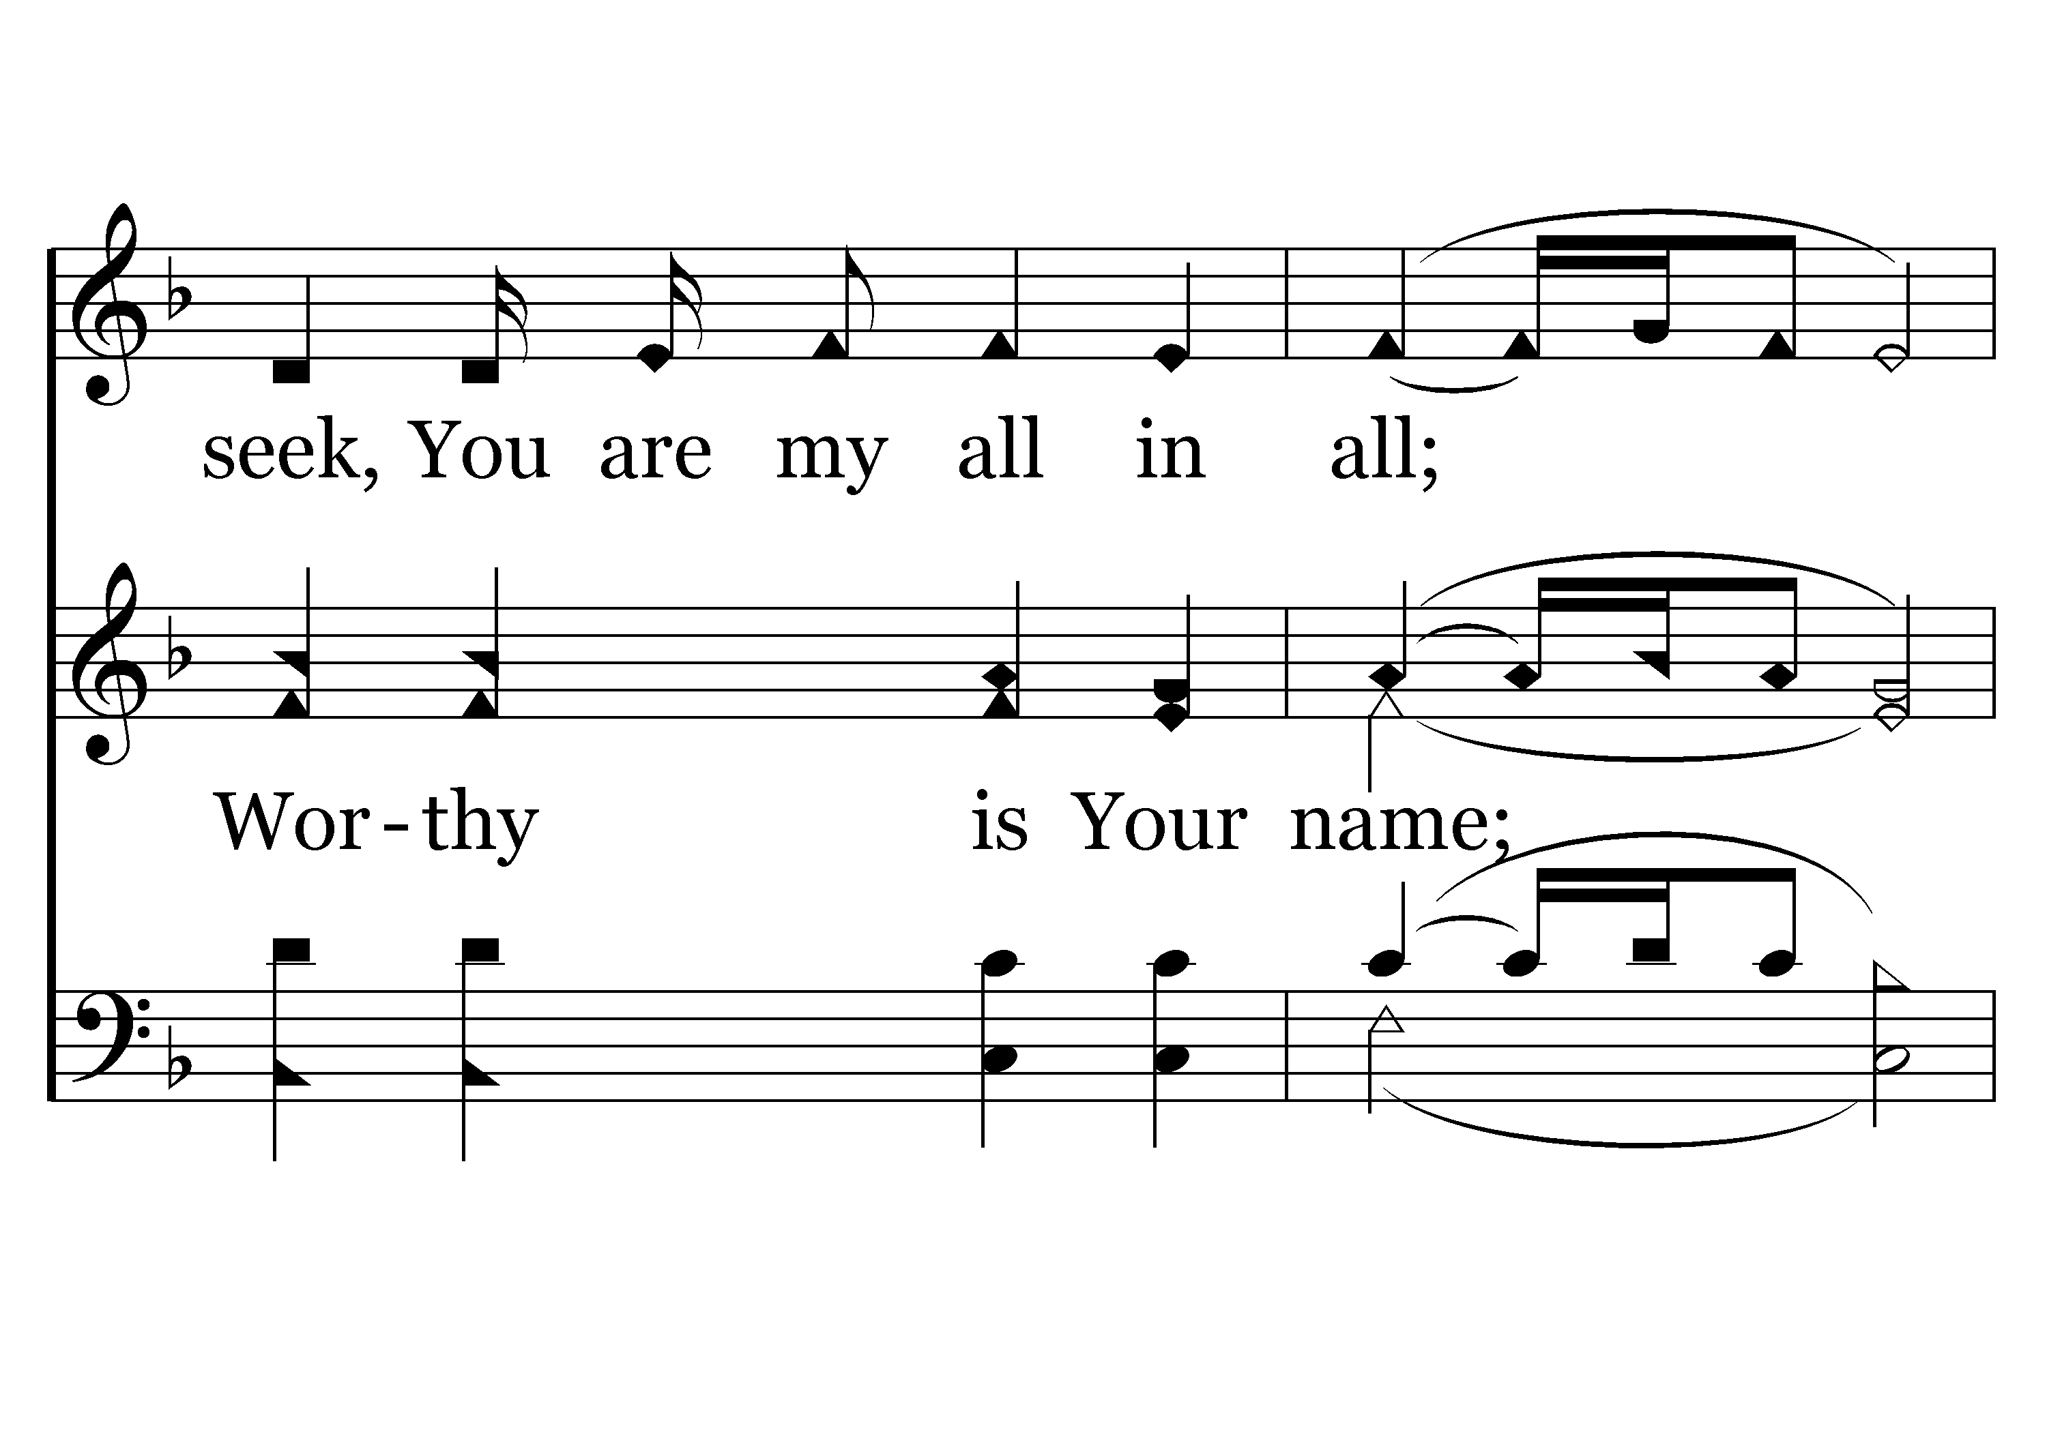
029 - You Are My All In All - 2.3

Slide 43
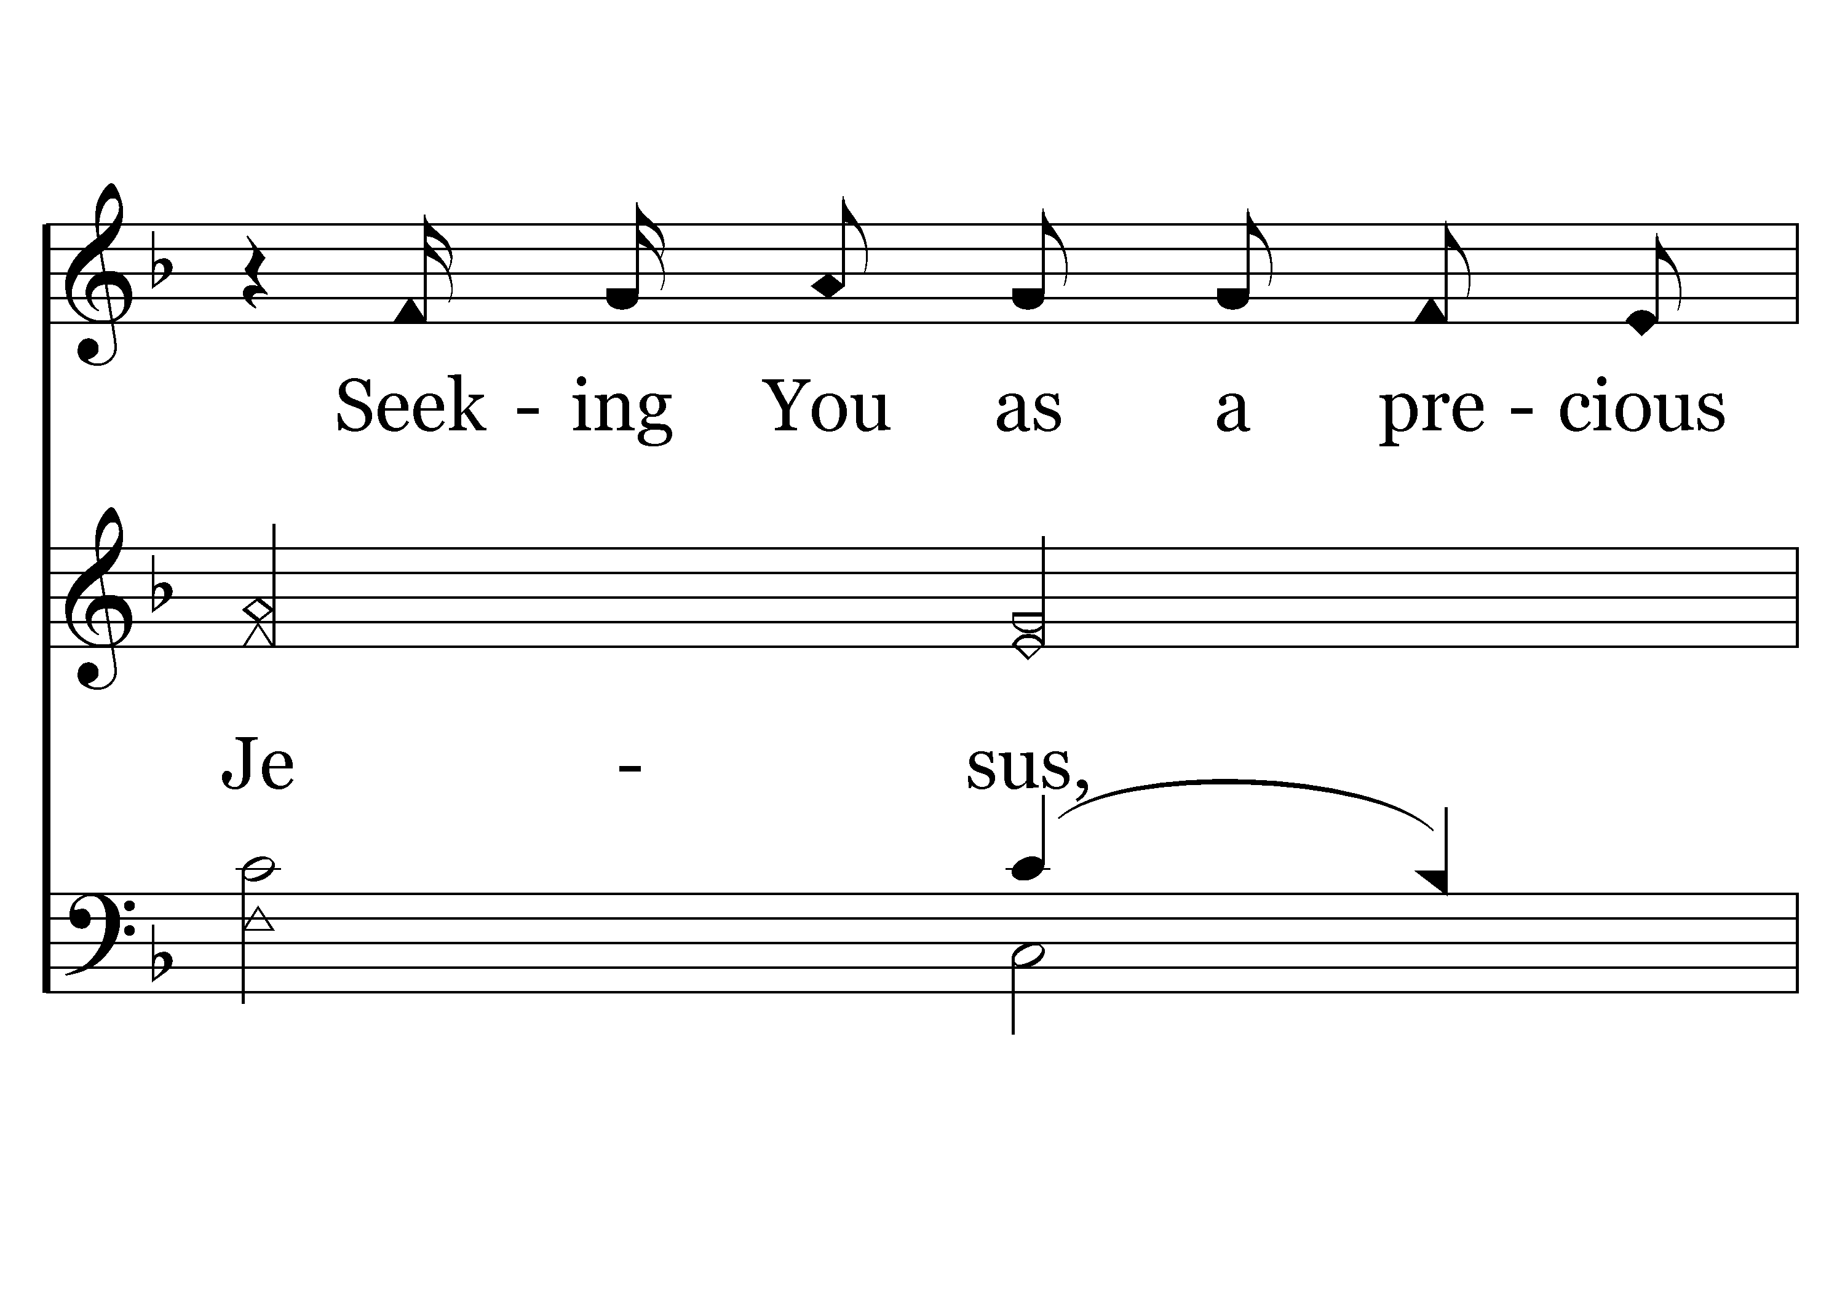
029 - You Are My All In All - 2.4

Slide 44
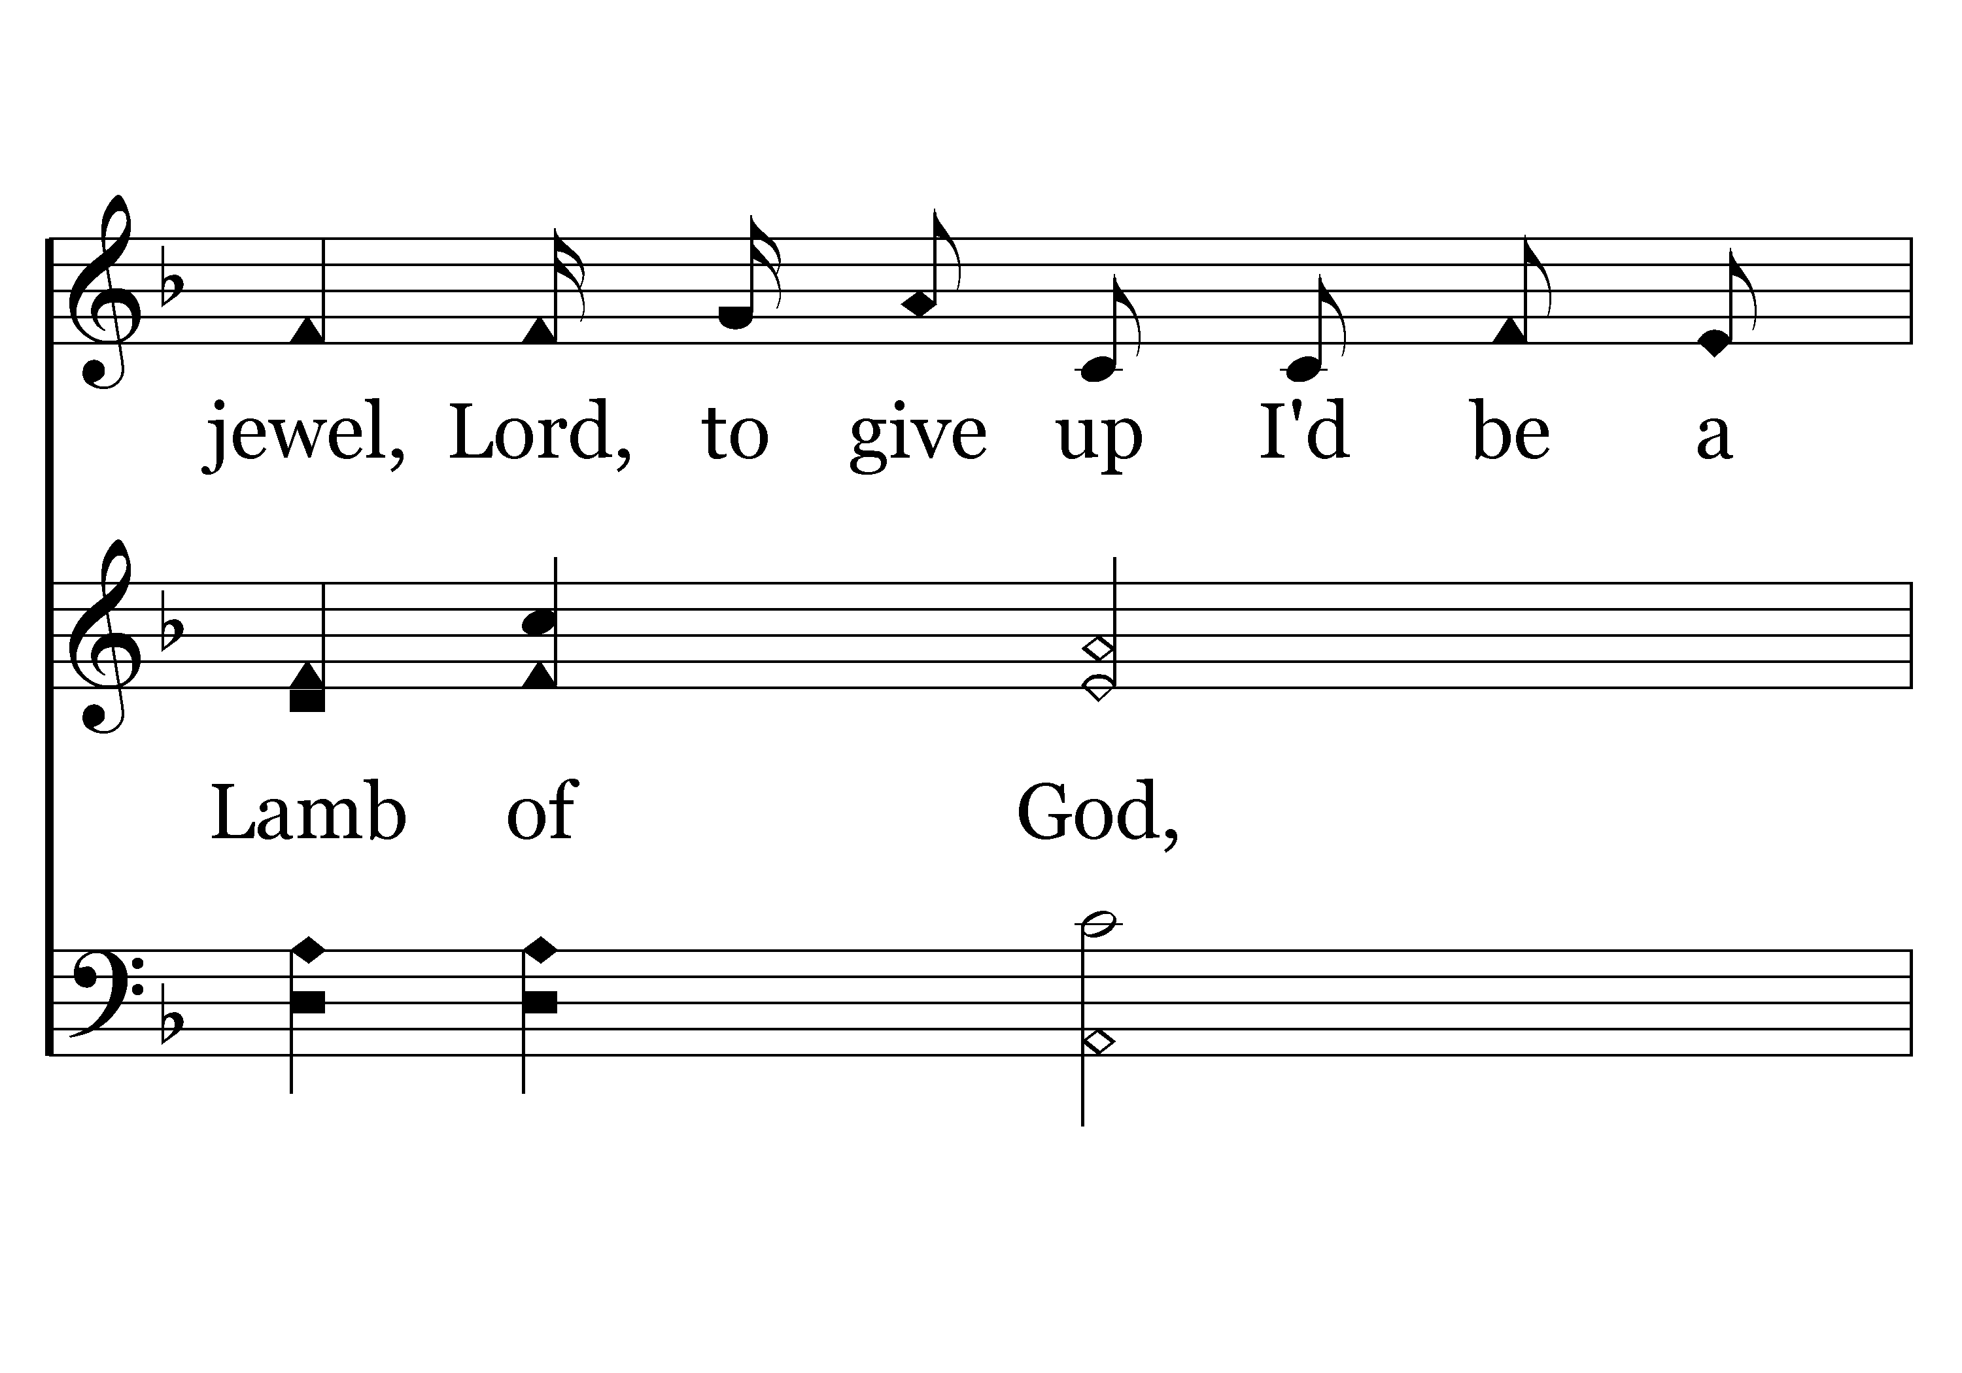
029 - You Are My All In All - 2.5

Slide 45
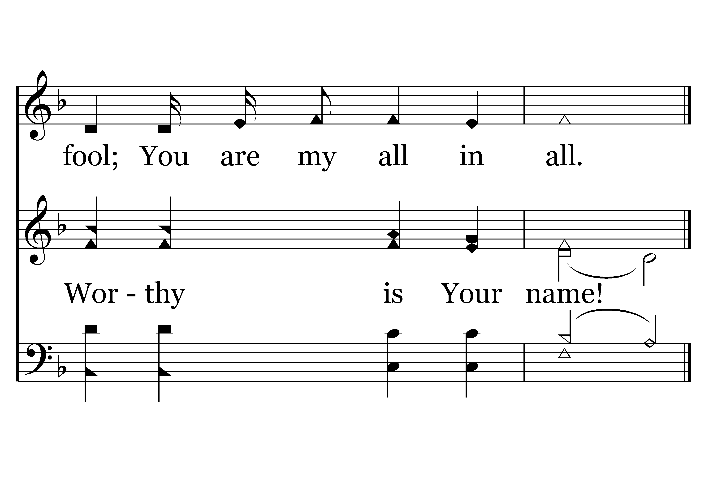
029 - You Are My All In All - 2.6
End of Verse 2

Slide 46
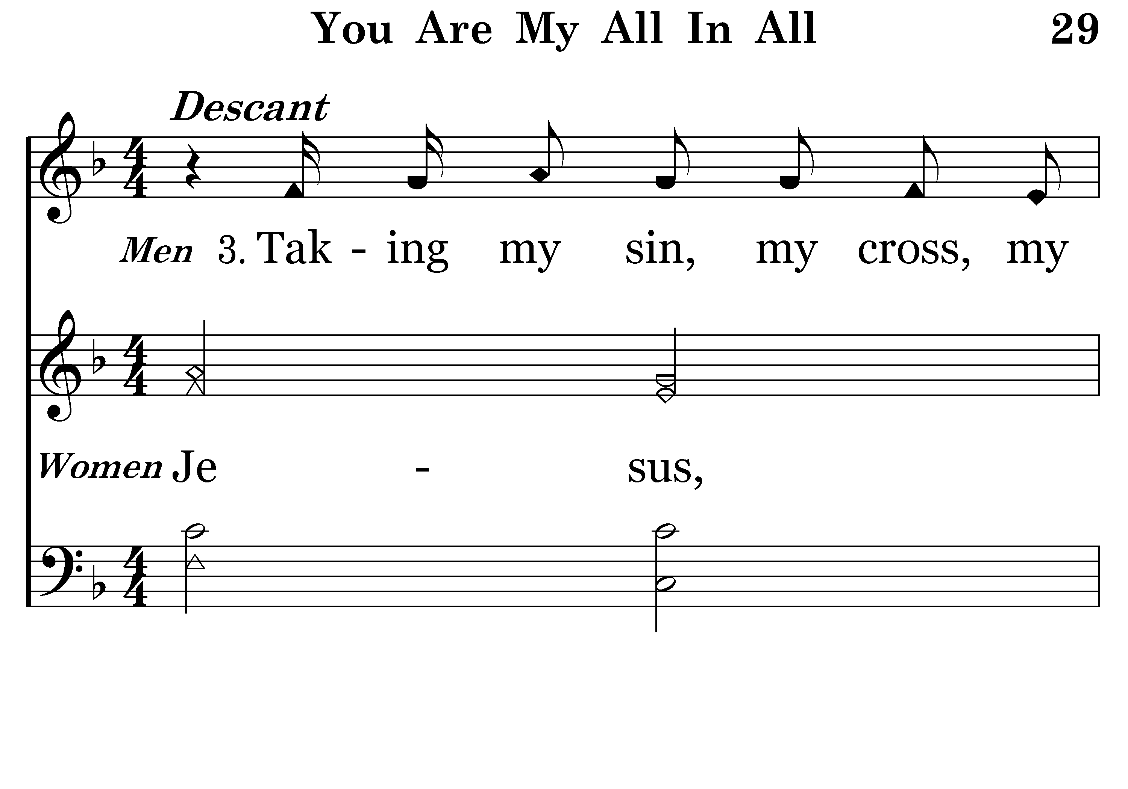
029 - You Are My All In All - 3.1

Slide 47
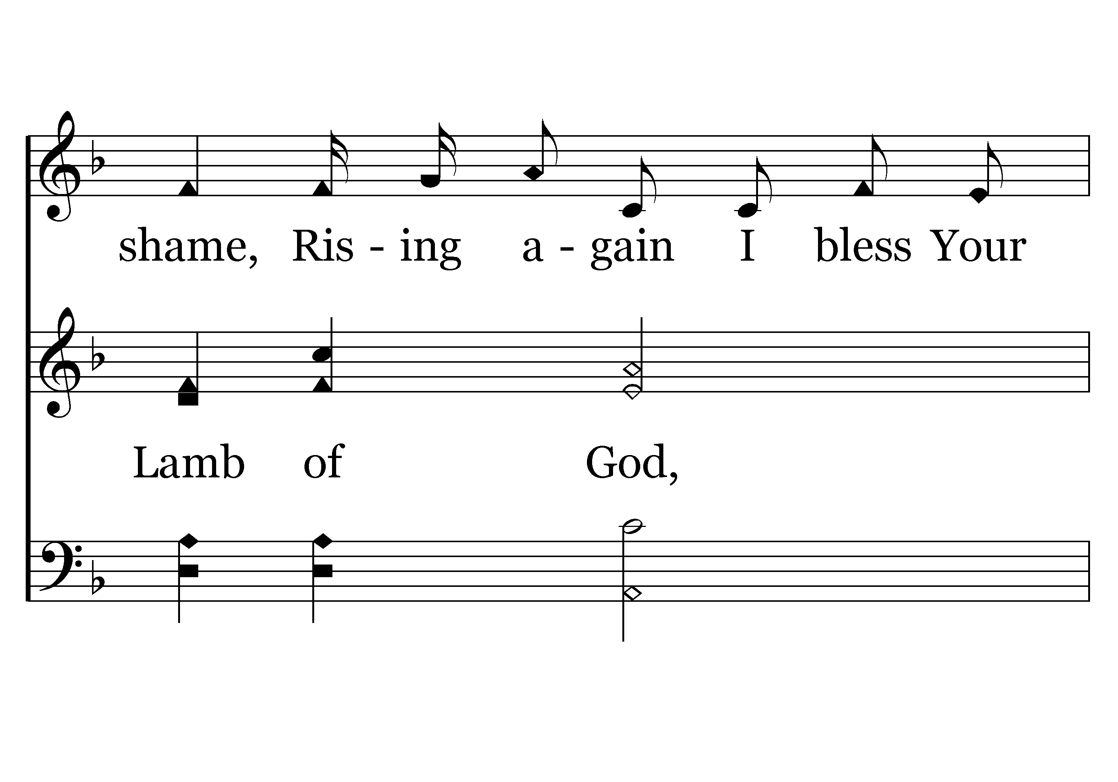
029 - You Are My All In All - 3.2

Slide 48
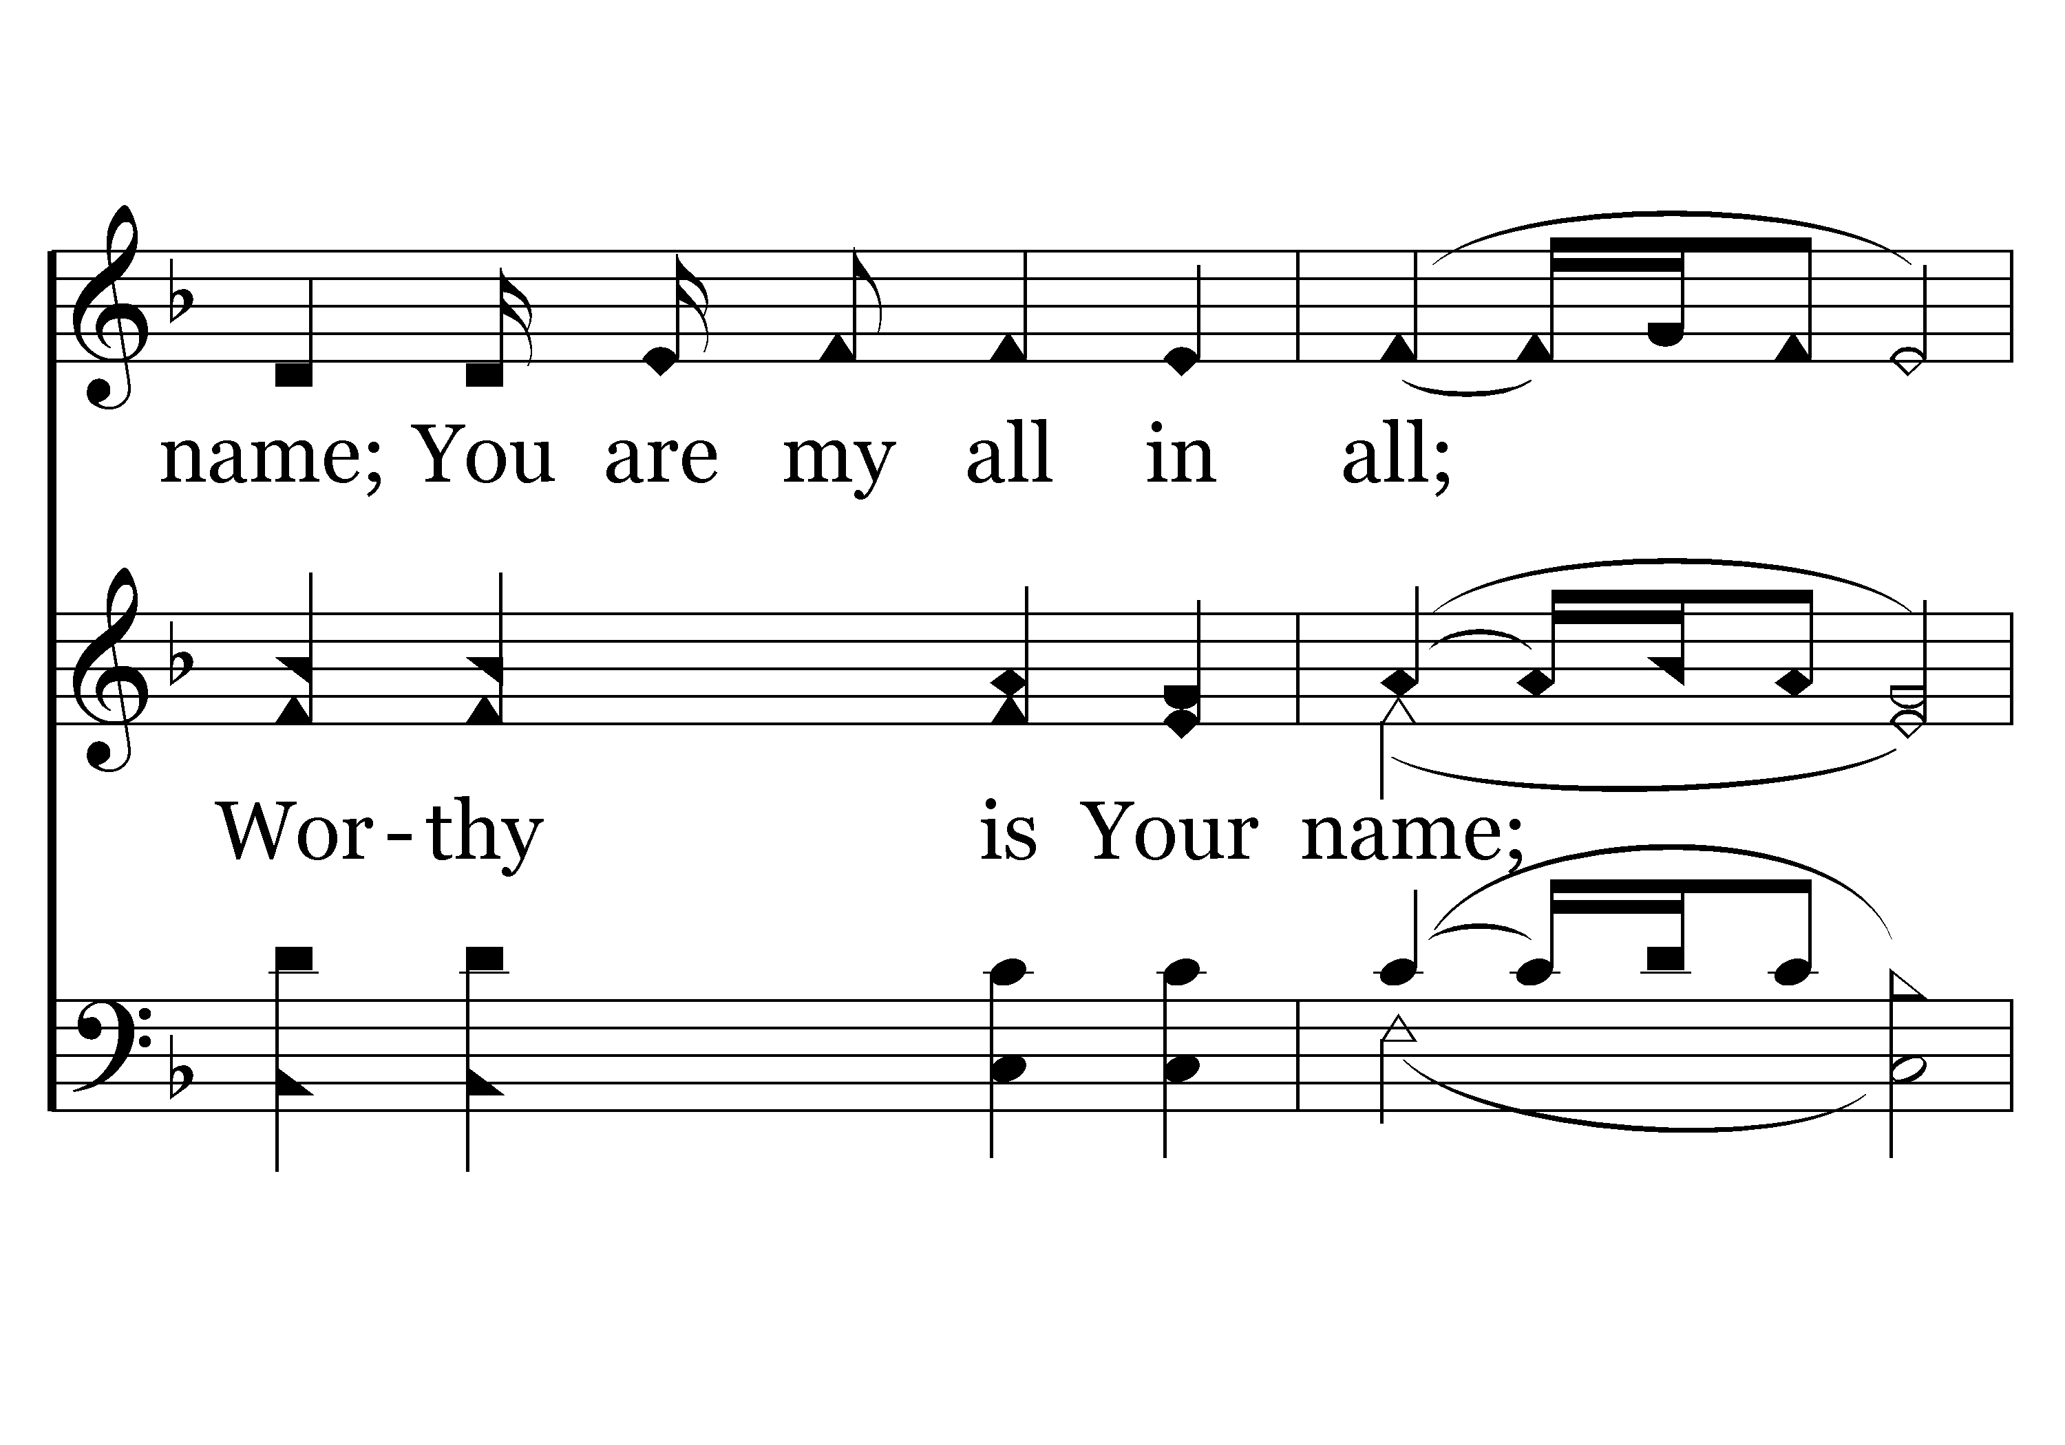
029 - You Are My All In All - 3.3

Slide 49
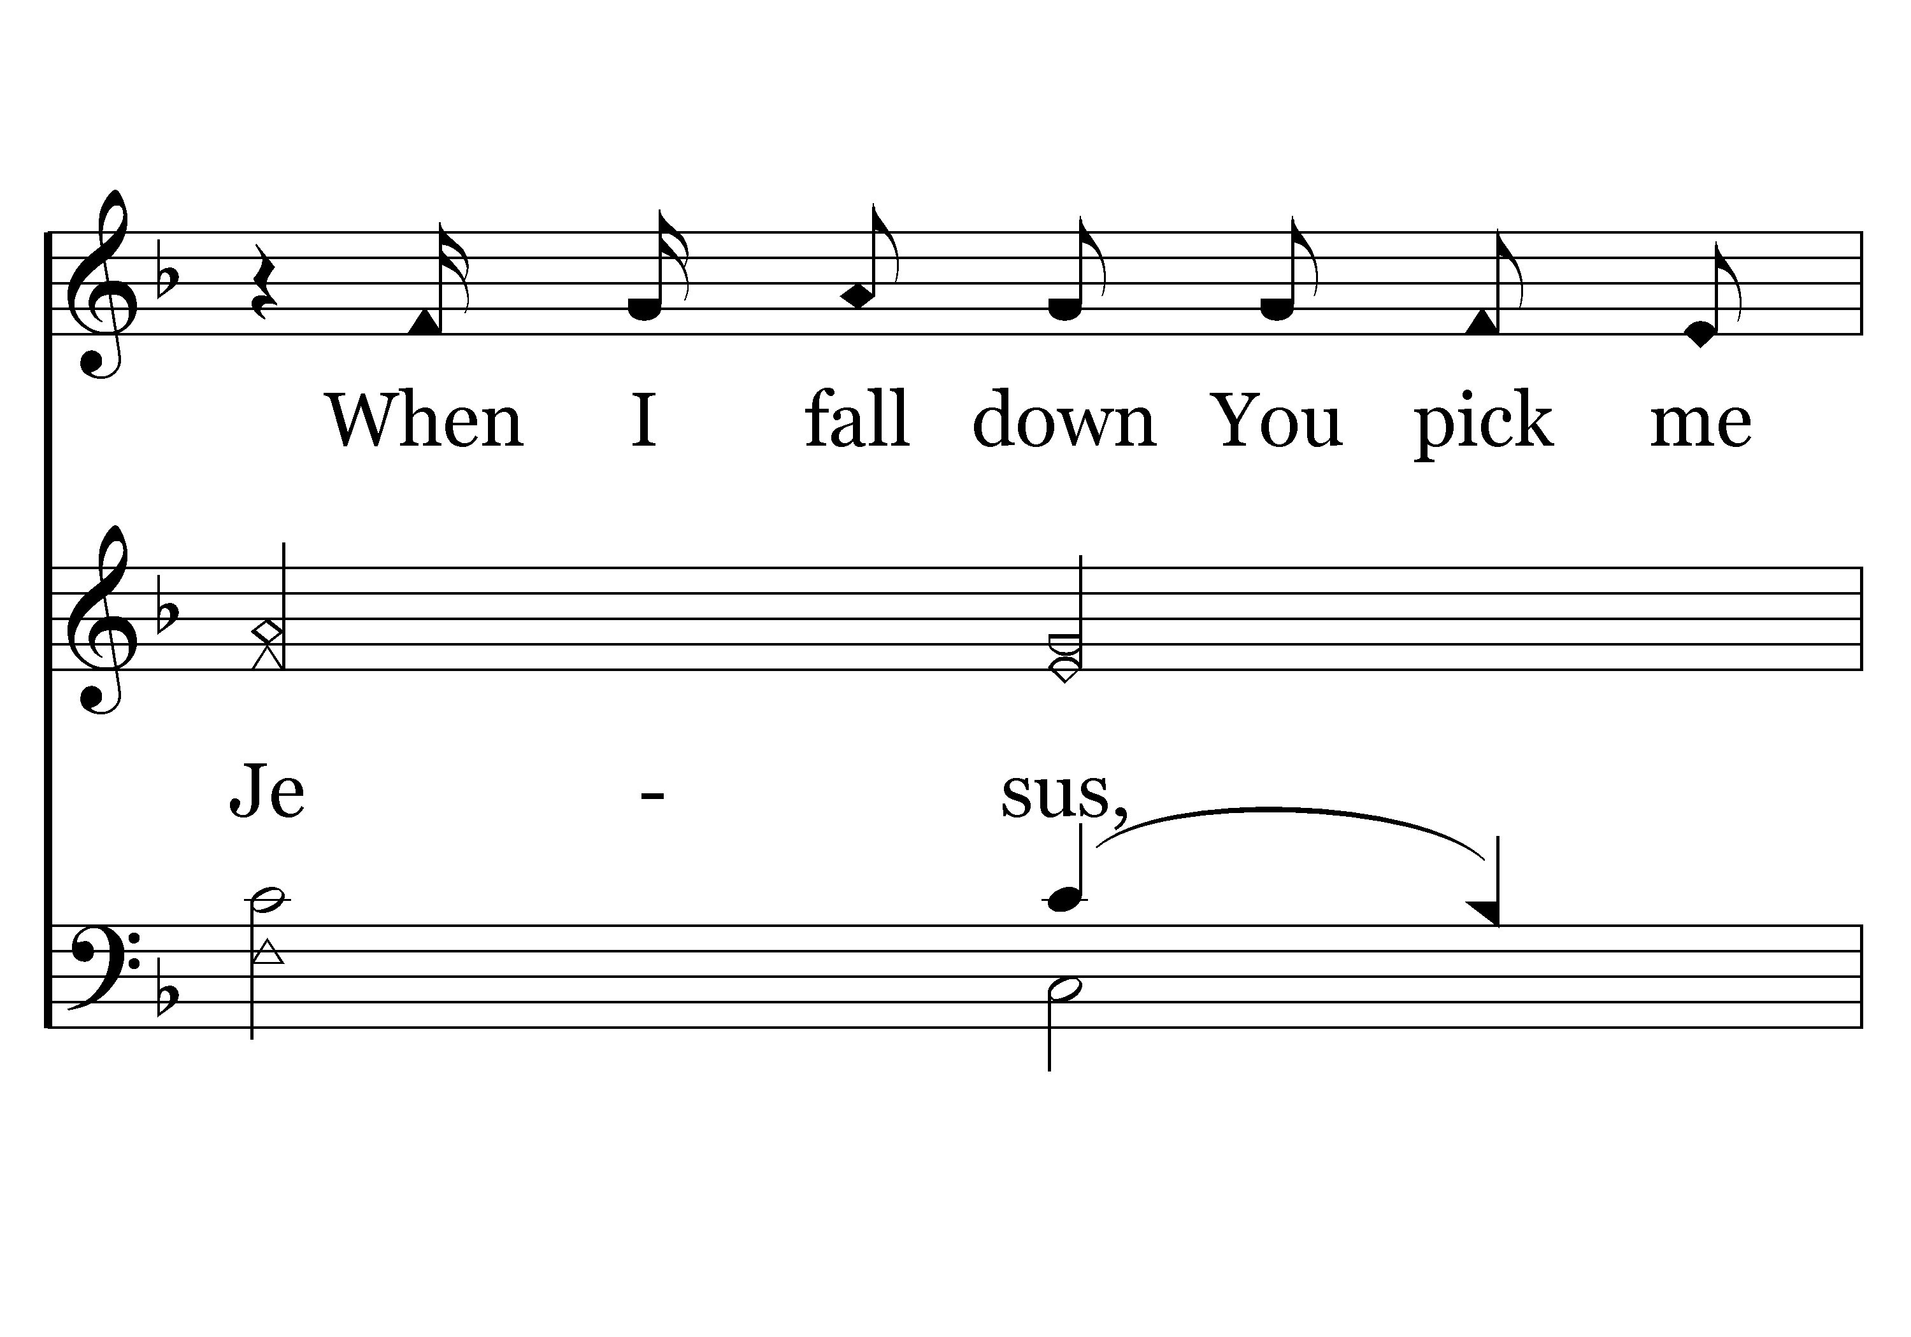
029 - You Are My All In All - 3.4

Slide 50
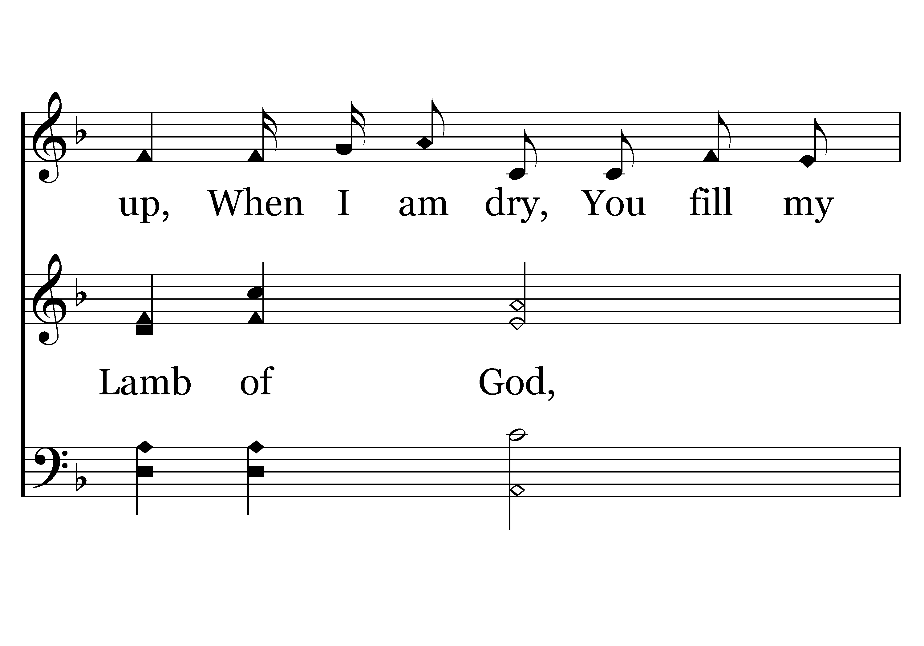
029 - You Are My All In All - 3.5

Slide 51

029 - You Are My All In All - 3.6
End of Verse 3

Slide 52
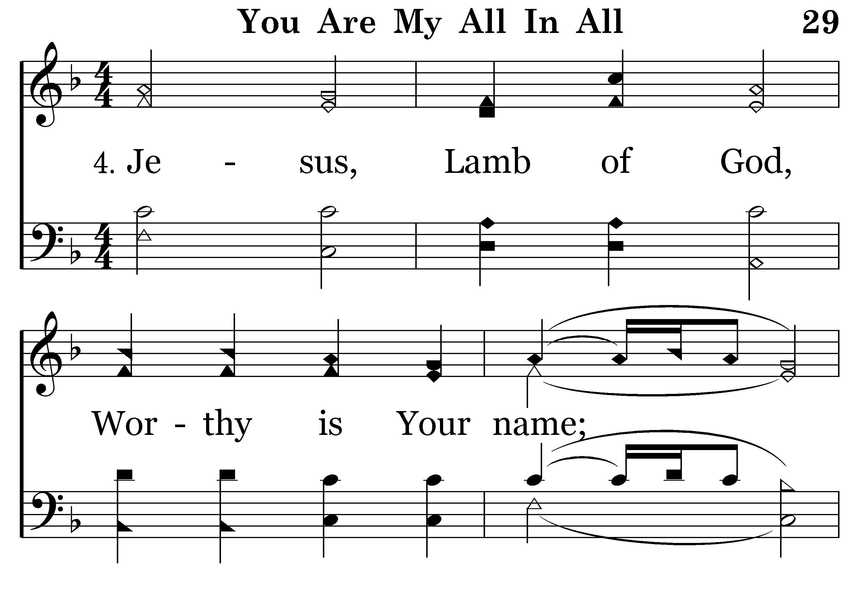
029 - You Are My All In All - 4.1

Slide 53
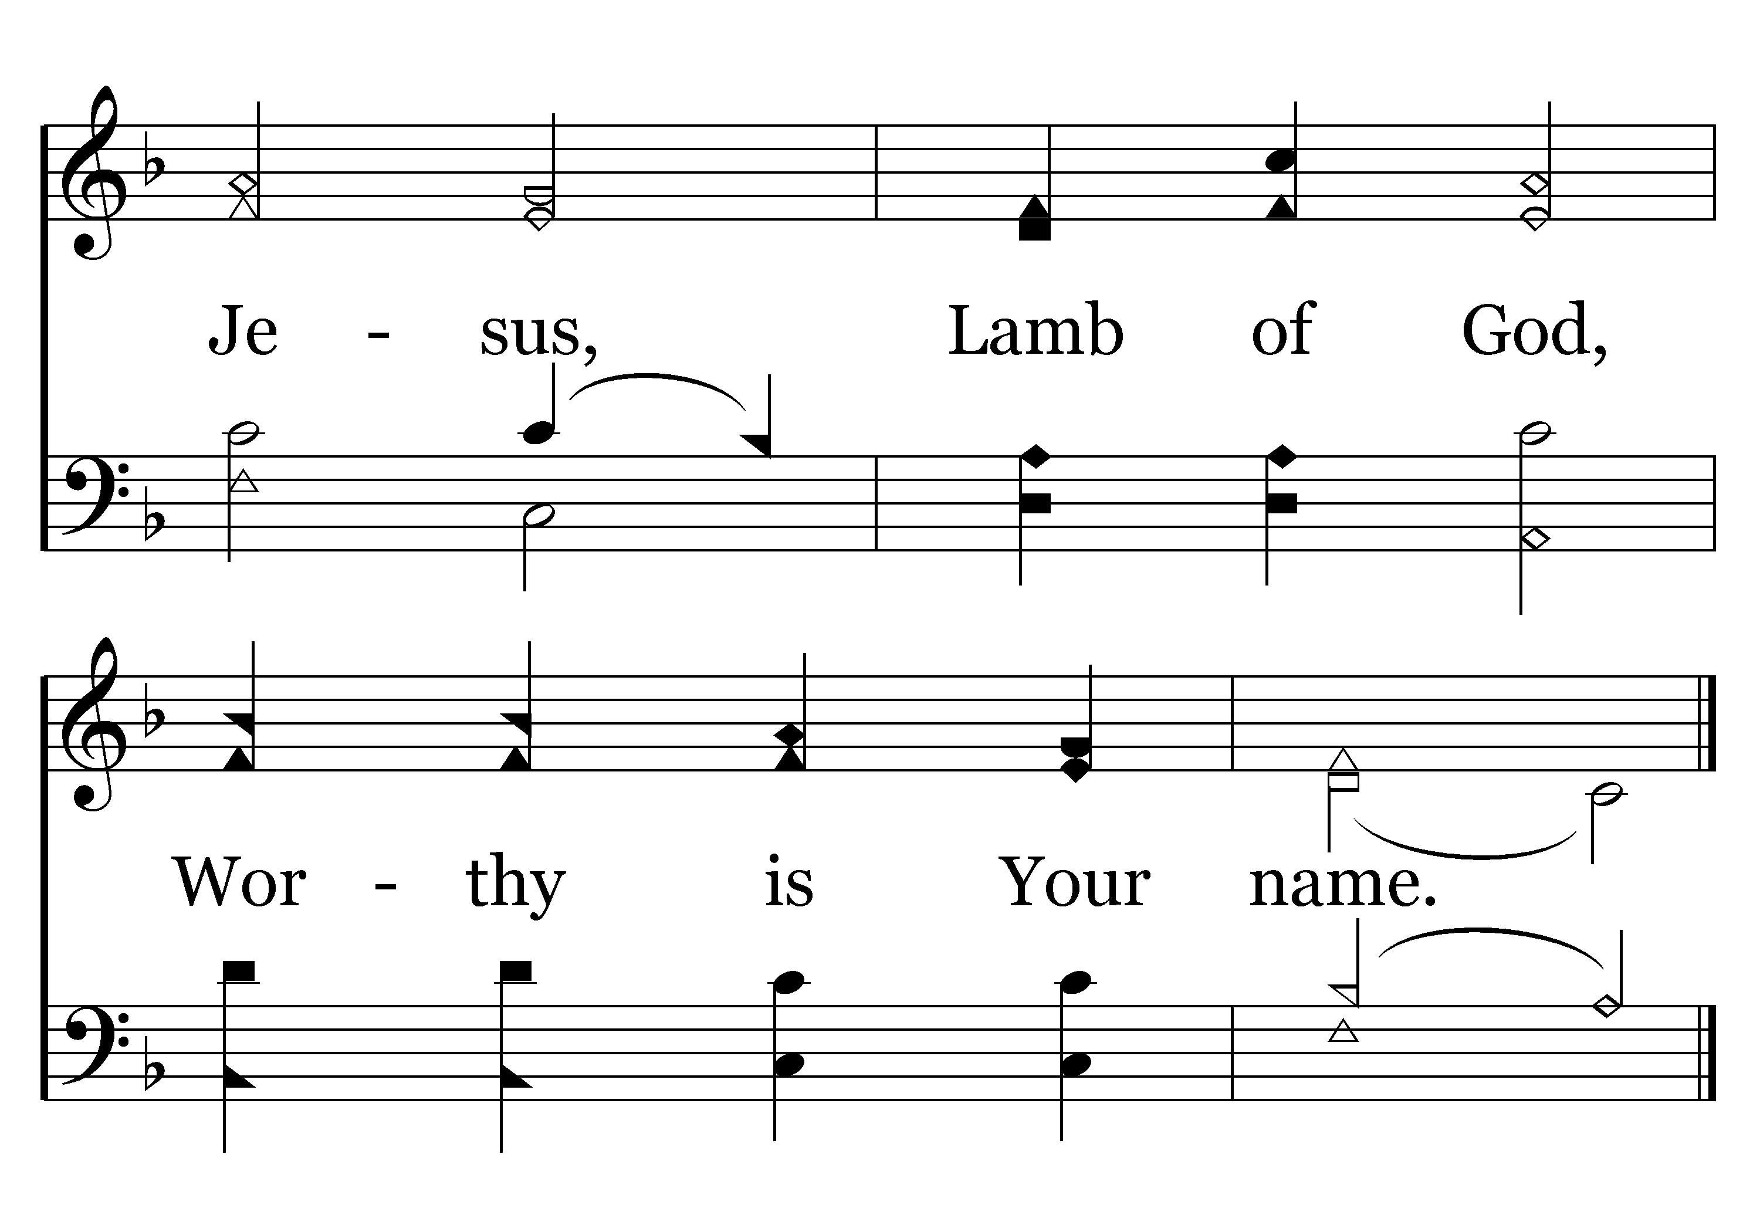
029 - You Are My All In All - 4.2
End of Song

Slide 54


Slide 55

Acts 17:1–6
Isaiah 5:20-23
Luke 16:15

Slide 56
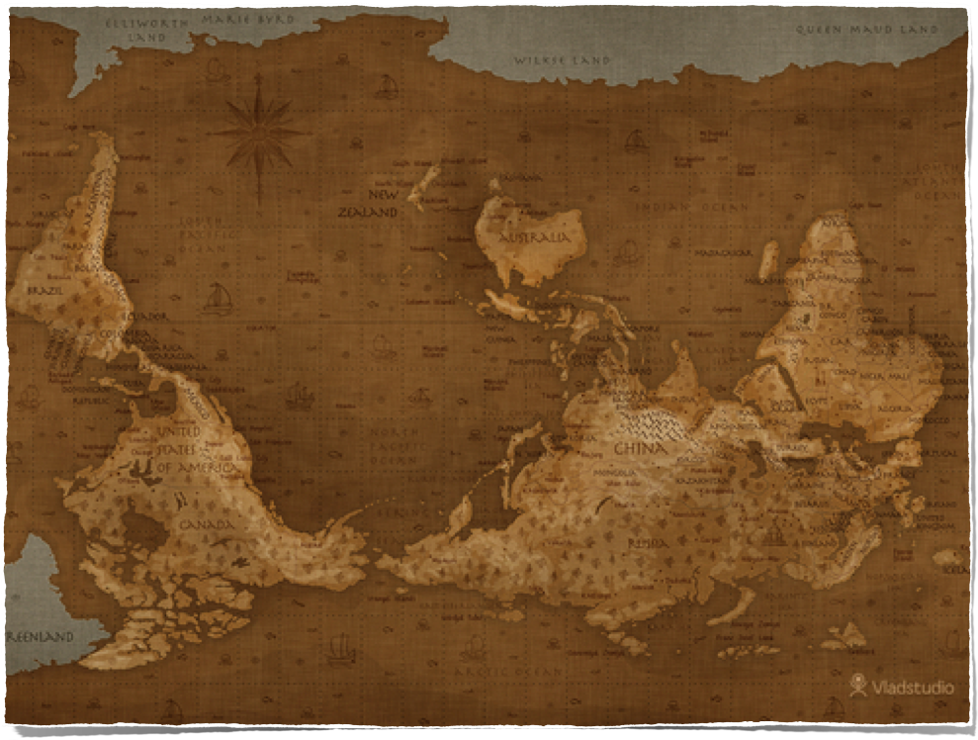
Living Upright
In An Upside Down World
The world was turned upside down in Genesis 3
    (Genesis 3:16-19; Rom. 3:9-18, 23; 5:12)
In Genesis 6, Noah & his family, (eight souls), were the only ones living upright in an upside down world
  (Gen. 6:5-12; Heb. 11:7; 1 Peter 3:20)
The majority has always been in the wrong
    (Exodus 23:2; Matt. 7:13,14; 1 John 5:19)
xx

Slide 57


Living Upright
In An Upside Down World
Acts 17:1–6 (NKJV)
¹ Now when they had passed through Amphipolis and Apollonia, they came to Thessalonica, where there was a synagogue of the Jews. ² Then Paul, as his custom was, went in to them, and for three Sabbaths reasoned with them from the Scriptures, ³ explaining and demonstrating that the Christ had to suffer and rise again from the dead, and saying, “This Jesus whom I preach to you is the Christ.” ⁴ And some of them were persuaded; and a great multitude of the devout Greeks, and not a few of the leading women, joined Paul and Silas.
The WORLDLY Simply View God’s Way & His People As Being Upside Down!

Slide 58
Living Upright
In An Upside Down World
Acts 17:1–6 (NKJV)
⁵ But the Jews who were not persuaded, becoming envious, took some of the evil men from the marketplace, and gathering a mob, set all the city in an uproar and attacked the house of Jason, and sought to bring them out to the people. ⁶ But when they did not find them, they dragged Jason and some brethren to the rulers of the city, crying out, “These who have turned the world upside down have come here too.”
The WORLDLY Simply View God’s Way & His People As Being Upside Down!

Slide 59
Living Upright
In An Upside Down World
Isaiah 5:20–23 (NKJV)
²⁰ Woe to those who call evil good, and good evil; Who put darkness for light, and light for darkness; Who put bitter for sweet, and sweet for bitter! ²¹Woe to those who are wise in their own eyes, And prudent in their own sight! ²²Woe to men mighty at drinking wine, Woe to men valiant for mixing intoxicating drink, ²³Who justify the wicked for a bribe, And take away justice from the righteous man!

Slide 60
Living Upright
In An Upside Down World
Luke 16:15 (NKJV)
¹⁵And He said to them, “You are those who justify yourselves before men, but God knows your hearts. For what is highly esteemed among men is an abomination in the sight of God.

Slide 61

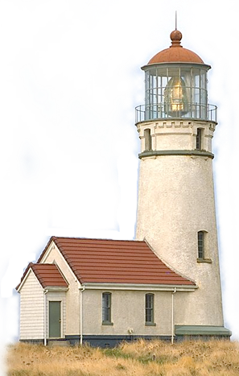
Living Upright
In An Upside Down World
¹³ “You are the salt of the earth; but if the salt loses its flavor, how shall it be seasoned? It is then good for nothing but to be thrown out and trampled underfoot by men.
¹⁴ “You are the light of the world. A city that is set on a hill cannot be hidden. ¹⁵ Nor do they light a lamp and put it under a basket, but on a lampstand, and it gives light to all who are in the house. ¹⁶ Let your light so shine before men, that they may see your good works and glorify your Father in heaven.

Slide 62
Living Upright
In An Upside Down World
We will not please God OR be a positive influence on the world if we are like the world.
      Come out & be separate - 2 Cor. 6:14-7:1
      Shine in a crooked world holding forth the word of life – Phil. 2:14-16
      Share faith by letting Jesus be seen in you – Philemon 1:6
      Believing & understanding the truth changes our perspective – Eph. 5:17; Col. 1:9; 1 Pet. 1:14

Slide 63

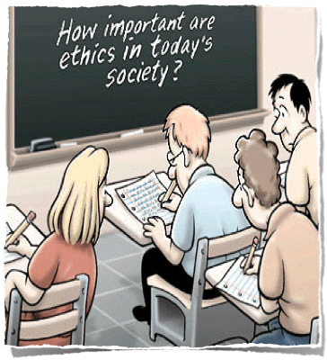
Living Upright
In An Upside Down World
We are to be morally pure – (Eph. 5:3; 1 Cor. 6:9-11; Gal. 5:19-21; 1 Pet. 1:13-16)
“⁷Do not be partakers with them . . . ¹¹have no fellowship . . . expose them” - (Eph. 5:3-18)

Slide 64


Living Upright
In An Upside Down World
Neither filthiness, nor foolish talking, nor coarse jesting – (Eph. 5:4)
Sound speech that cannot be condemned . . . – (Titus 2:8 )
“Let your speech always be with grace, seasoned with salt, that you may know how you ought to answer each one” - (Col. 4:6)
Pure – Truthful - Loving – Helpful –Instructive

Slide 65


Living Upright
In An Upside Down World
Modest clothing professing godliness – (1 Tim. 2:9,-10; 1 Peter 3:3)
  Not revealing -
  Not caught up in worldly fashions –

Slide 66

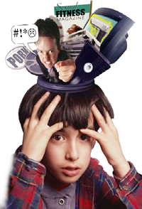
Living Upright
In An Upside Down World
We are to think on things that are good and wholesome - (Phil. 4:8)
What about the TV programs and movies we watch? The music we listen to? The places we go? The books we read?
Our mind is easily contaminated by garbage!

Slide 67


Living Upright
In An Upside Down World
The Beatitudes, [humility, hate sin, meekness, hunger for God, merciful, pure, peacemakers, faithful] - (Matt. 5:3-12)
A supreme love for God and a sincere love for our fellowman – (Mark 12:29-31)
Faith & hope – (Phil. 4:12-13)
Complaining?
Nagging?
Negative?
Hateful?
Unhappy?
etc.

Slide 68

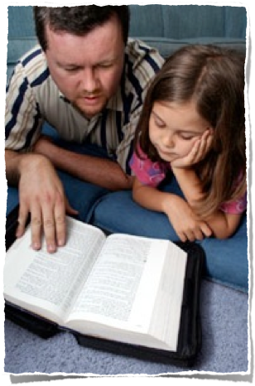
Living Upright
In An Upside Down World
Attendance? – (Heb. 10:25)
Worship? – (John 4:24)
Fruit – (Gal. 5:22,23)
Caring for one another? – (1 John 3:17)
Our public practice - (Rom. 1:16) - (Praying in public? Reading the Bible? Talking about spiritual things with others, godly living)

Slide 69
Living Upright
In An Upside Down World
Romans 12:1–2 (NKJV)
¹ I beseech you therefore, brethren, by the mercies of God, that you present your bodies a living sacrifice, holy, acceptable to God, which is your reasonable service. ² And do not be conformed to this world, but be transformed by the renewing of your mind, that you may prove what is that good and acceptable and perfect will of God.

Slide 70
Isaiah 29:9–16 (NKJV)
⁹ Pause and wonder! Blind yourselves and be blind! They are drunk, but not with wine; They stagger, but not with intoxicating drink. ¹⁰ For the Lord has poured out on you The spirit of deep sleep, And has closed your eyes, namely, the prophets; And He has covered your heads, namely, the seers. ¹¹ The whole vision has become to you like the words of a book that is sealed, which men deliver to one who is literate, saying, “Read this, please.” And he says, “I cannot, for it is sealed.”

Slide 71
Isaiah 29:9–16 (NKJV)
¹² Then the book is delivered to one who is illiterate, saying, “Read this, please.” And he says, “I am not literate.” ¹³ Therefore the Lord said: “Inasmuch as these people draw near with their mouths And honor Me with their lips, But have removed their hearts far from Me, And their fear toward Me is taught by the commandment of men,¹⁴ Therefore, behold, I will again do a marvelous work Among this people, A marvelous work and a wonder; For the wisdom of their wise men shall perish, And the understanding of their prudent men shall be hidden.”

Slide 72
Isaiah 29:9–16 (NKJV)
¹⁵ Woe to those who seek deep to hide their counsel far from the Lord, And their works are in the dark; They say, “Who sees us?” and, “Who knows us?” ¹⁶Surely you have things turned around! Shall the potter be esteemed as the clay; For shall the thing made say of him who made it,“He did not make me”? Or shall the thing formed say of him who formed it, “He has no understanding”?

Slide 73

Living Upright
In An Upside Down World
Our Morality?
Our Language?
Our Clothing?
Our Entertainment?
Our Attitude?
Our Spirituality?

