Slide 2
(John 4:19-26)

Slide 3
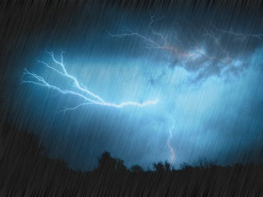
John 4:19-26 (NKJV)
¹⁹The woman said to Him, "Sir, I perceive that You are a prophet. ²⁰Our fathers worshiped on this mountain, and you Jews say that in Jerusalem is the place where one ought to worship." ²¹Jesus said to her, "Woman, believe Me, the hour is coming when you will neither on this mountain, nor in Jerusalem, worship the Father.

Slide 4
John 4:19-26 (NKJV)
²²You worship what you do not know; we know what we worship, for salvation is of the Jews. ²³But the hour is coming, and now is, when the true worshipers will worship the Father in spirit and truth; for the Father is seeking such to worship Him. ²⁴God is Spirit, and those who worship Him must worship in spirit and truth."

Slide 5
John 4:19-26 (NKJV)
²⁵The woman said to Him, "I know that Messiah is coming" (who is called Christ). "When He comes, He will tell us all things." ²⁶Jesus said to her, "I who speak to you am He."

Slide 6
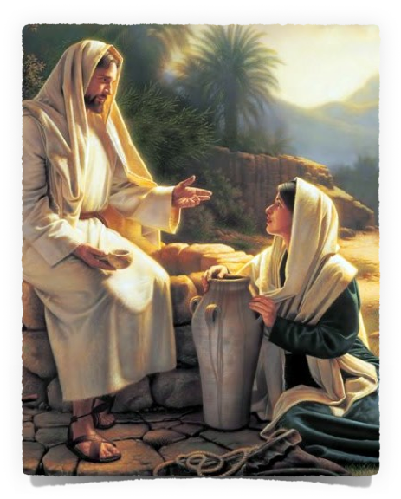
“Worshipping God In Spirit & In Truth”
The Samaritans & Jews disagreed over where God should be worshipped - (John 4:20)
The Samaritans were wrong & the Jews were right - (4:22; 2 Kings 17:26-33; Deut. 12:5-11; 2 Chron. 6:6)
John 4:20 (NKJV) ²⁰ Our fathers worshiped on this mountain, and you Jews say that in Jerusalem is the place where one ought to worship."

Slide 7
“Worshipping God In Spirit & In Truth”
People continue to disagree over the where, when & how one ought to worship God.
Saturday or Sunday?
The Lord’s supper?
The collection?
Music?
John 4:20 (NKJV) ²⁰ Our fathers worshiped on this mountain, and you Jews say that in Jerusalem is the place where one ought to worship."

Slide 8
“Worshipping God In Spirit & In Truth”
There would soon be a change in how men worship the Father. (4:21; 14:6; Eph. 2:18; 3:14)
As prophesied - (Mal. 1:11)
Jesus would inaugurate this change after His death & resurrection - (Acts 2; 6:14)
The shadows under the OT would soon be replaced by the “spiritual realities” to which they pointed.
John 4:21 (NKJV)
²¹Jesus said to her, "Woman, believe Me, the hour is coming when you will neither on this mountain, nor in Jerusalem, worship the Father.

Slide 9
“Worshipping God In Spirit & In Truth”
Jesus took the focus off what her ancestors had done and focused on The Father’s demands.
The Jews had a similar problem - (8:33,39,53, 41-47; Matt. 15:1-6; Mk. 7:3-13)
This is still a problem...
John 4:21 (NKJV)
²¹Jesus said to her, "Woman, believe Me, the hour is coming when you will neither on this mountain, nor in Jerusalem, worship the Father.

Slide 10
“Worshipping God In Spirit & In Truth”
The Samaritans accepted the Law but rejected the prophets - (4:22; 2 Kings 17:27-46; Ezra 4:2)
Thus their knowledge of God & His instructions on how to worship Him was incomplete - (Hos. 4:6)
Some aspects of their worship were manmade.
John 4:22 (NKJV)
²²You worship what you do not know; we know what we worship, for salvation is of the Jews.

Slide 11
“Worshipping God In Spirit & In Truth”
Salvation is of the Jews -
They had the Law and the proper form of worship - (Rom 3:1-2)
The Messiah, who will bring salvation, is to proceed from them - (Luke 2:30, 3:6; Romans 9:4-5)
John 4:22 (NKJV)
²² You worship what you do not know; we know what we worship, for salvation is of the Jews.

Slide 12
“Worshipping God In Spirit & In Truth”
We cannot worship God without knowing God & His will - (4:22; Acts 17:23-30; Rom. 10:1-3)
Worship is NOT about us - but about God! - (Mal. 1:6-14; 3:8-10)
Sincerity is NOT enough! – (Acts 23:1; Acts 26:9)
John 4:22 (NKJV)
²² You worship what you do not know; we know what we worship, for salvation is of the Jews.

Slide 13
“Worshipping God In Spirit & In Truth”
“There are two ways to commit idolatry – worship something other than the one true God, or worship the one true God in the wrong way”

Slide 14
“Worshipping God In Spirit & In Truth”
True worshippers
Those who are actually worshipping the one true God.
God has always only accepted worship from those who offered it from their heart and in accordance with His Law.
John 4:24 (NKJV)
²⁴ God is Spirit, and those who worship Him must worship in spirit and truth."

Slide 15
“Worshipping God In Spirit & In Truth”
Leviticus 10:1-3 (NKJV)
¹Then Nadab and Abihu, the sons of Aaron, each took his censer and put fire in it, put incense on it, and offered profane fire before the LORD, which He had not commanded them. ²So fire went out from the LORD and devoured them, and they died before the LORD. ³And Moses said to Aaron, "This is what the LORD spoke, saying: 'By those who come near Me I must be regarded as holy; And before all the people I must be glorified.' " So Aaron held his peace.

Slide 16
“Worshipping God In Spirit & In Truth”
Matthew 15:7-9 (NKJV)
⁷Hypocrites! Well did Isaiah prophesy about you, saying: ⁸'These people draw near to Me with their mouth, And honor Me with their lips, But their heart is far from Me. ⁹And in vain they worship Me, Teaching as doctrines the commandments of men.' "
(quote from Isaiah 29:13)

Slide 17
“Worshipping God In Spirit & In Truth”
Spirit & Truth
Spirit - From the heart, with reverence, humility - proper attitude.
Truth - Proper form, according to the revealed pattern.
John 4:24 (NKJV)
²⁴ God is Spirit, and those who worship Him must worship in spirit and truth."

Slide 18
“Worshipping God In Spirit & In Truth”
In spirit, i.e., spiritual
"...men must offer a worship corresponding with the nature and attributes of God." - J. W. McGarvey
"Since he is Spirit, he must receive spiritual worship" - B.W. Johnson
John 4:24 (NKJV)
²⁴ God is Spirit, and those who worship Him must worship in spirit and truth."

Slide 19
“Worshipping God In Spirit & In Truth”
"A pure, a holy, a spiritual worship, therefore, is such as he seeks the offering of the soul rather than the formal offering of the body - the homage of the heart rather than that of the lips." - A. Barnes
John 4:24 (NKJV)
²⁴ God is Spirit, and those who worship Him must worship in spirit and truth."

Slide 20
“Worshipping God In Spirit & In Truth”
In spirit, i.e., spiritual
Physical ordinances of the OT were until "the time of reformation" (He 9:9-10), i.e., the NT.
NT worship is more in keeping with the nature of God & relates more to the spiritual side of man.
John 4:24 (NKJV)
²⁴ God is Spirit, and those who worship Him must worship in spirit and truth."

Slide 21
“Worshipping God In Spirit & In Truth”
In Truth, i.e., real
The Tabernacle was a symbol – Heb. 9:8-9
The Law with its worship was only a shadow of that to come – Heb. 10:1
Christ is now in the true tabernacle (heaven)- Heb. 9:11-12,24
John 4:24 (NKJV)
²⁴ God is Spirit, and those who worship Him must worship in spirit and truth."

Slide 22
“Worshipping God In Spirit & In Truth”
In Truth, i.e., real
We should expect the worship in this age, to which the shadows in the OT pointed, to be governed by the spiritual realities which now exist, and therefore be different from that of the shadow.
John 4:24 (NKJV)
²⁴ God is Spirit, and those who worship Him must worship in spirit and truth."

Slide 23
“Worshipping God In Spirit & In Truth”
Unauthorized acts - Thus not in truth . . .
Focused on what people want rather than what God wants
To emotionally stimulate an audience by entertaining them
An incorrect association between emotionalism and spirituality.
John 4:24 (NKJV)
²⁴ God is Spirit, and those who worship Him must worship in spirit and truth."

Slide 24
Worship In Spirit & Truth
The ABSOLUTE of worship
The object of worship – Him
The attitude of worship – spirit
The standard of worship – truth

Slide 25
Worship In Spirit & Truth
The ACTION of worship
PROSKUNEO 60 times in N.T.
Thayer – “to kiss the hand to (towards) one, in token of reverence; to fall upon the knees and touch the ground with the forehead as an expression of profound reverence”

Slide 26
Worship In Spirit & Truth
The ACTION of worship
SEBOMAI 10 times in N.T.
“To stand in awe; to venerate, to reverence, to worship, to adore”
LATREUO 21 times in N.T.
Most times translated service, occasionally as worship
“To render religious service of homage”

Slide 27
Worship In Spirit & Truth
The ACTION of worship
PROSKUNEO 60 times in N.T.
SEBOMAI 10 times in N.T.
LATREUO 21 times in N.T.
From these words it is clear that true worship entails participation – we are not to be spectators!

Slide 28
Worship In Spirit & Truth
The AIM of worship
God is to be the sole object of our worship Exodus 20:1-5; Matthew 4:9-10
This would exclude all else as an object of worship

Slide 29
Worship In Spirit & Truth
The ATTITUDE of worship
New Testament worship is spiritual
1 Peter 2:5; Heb. 10:22; Col. 3:17; Eph. 5:19
New Testament worship must come from the heart
Eph. 5:19; Col. 3:16; Heb. 12:28; Matt. 15:7-9

Slide 30
Worship In Spirit & Truth
The ATTITUDE of worship, in “spirit”
How do we do this?
Prepare your heart – prayer, proper mind-set, rest;
Maintain a worshipful atmosphere;
Cultivate a deep awareness of God;
Don’t let things become commonplace;
Put your heart into it;
Study Bible examples of worship.

Slide 31
“Worshipping God In Spirit & In Truth”
John 4:23-24 (NKJV)
²³But the hour is coming, and now is, when the true worshipers will worship the Father in spirit and truth; for the Father is seeking such to worship Him. ²⁴God is Spirit, and those who worship Him must worship in spirit and truth."

Slide 32
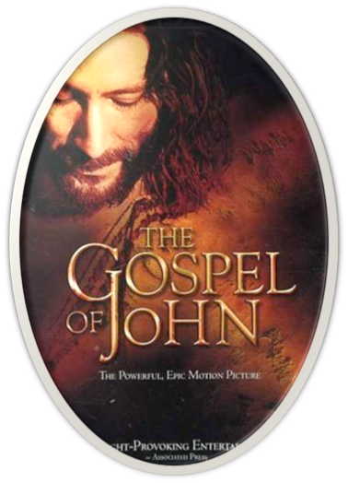
“Worshipping God In Spirit & In Truth”
John 20:30-31 (NKJV) ³⁰ And truly Jesus did many other signs in the presence of His disciples, which are not written in this book; ³¹ but these are written that you may believe that Jesus is the Christ, the Son of God, and that believing you may have life in His name.

